Slide 1
Introduction to Business
Chapter 3 COMPETING IN THE GLOBAL MARKETPLACE

Slide 2
Learning Outcomes
Why is global trade important to the United States, and how is it measured?
Why do nations trade?
What are the barriers to international trade?
How do governments and institutions foster world trade?
What are international economic communities?
How do companies enter the global marketplace?
What threats and opportunities exist in the global marketplace?
What are the advantages of multinational corporations?
What are the trends in the global marketplace?

Slide 3
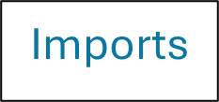

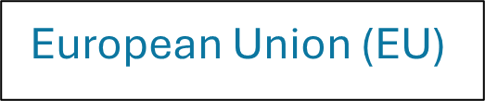



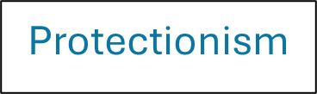
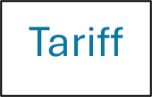


A few Key Concepts to start with

Slide 4
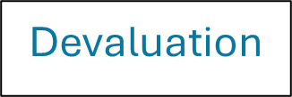
These are good questions/exercises to practice your understanding of the concepts
CONCEPT CHECK
What is global vision, and why is it important?
What impact does international trade have on the U.S. economy?
Explain the impact of a currency devaluation.

Slide 5
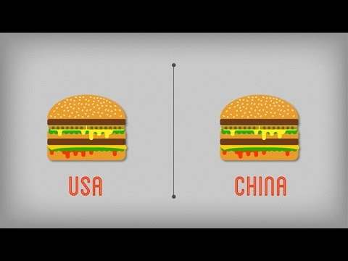
The Big Mac Index
Can the price of a Big Mac around the world help compare and even predict the relative purchasing power of each currency? As stated by Travelex, the creator of this video: “Twice a year The Economist publishes the Big Mac index. It is a fun guide to the world's currencies that attempts to adjust them all to an equitable level through the great equalizer known as the Big Mac.” Since the Big Mac can be purchased in essentially the same form in over 120 countries, it’s a good way to compare prices around the world, which helps to also estimate the relative “purchasing power” of each currency.

Slide 6
The Big Mac Index
Check out the most recent chart referenced above, and then decide whether as a resident of the USA you would find products from which Scandinavian nation more affordable to purchase with your dollars, products from Norway or Sweden? (Hint: Norway’s Krone is overvalued by 5.3% and Sweden’s Krona is undervalued by 4.0%).

Slide 7

These are good questions/exercises to practice your understanding of the concepts
CONCEPT CHECK
Describe the policy of free trade and its relationship to comparative advantage.
Why do people fear globalization?
What are the benefits of globalization?

Slide 8


Why Nations Trade
The concepts of absolute and comparative advantage help explain the benefits of global trade. Watch this video from Khan Academy which explains in more detail two different kinds of trade advantages discussed in Section 3.2 that a nation might have in the production of certain goods or services: Comparative and Absolute.

Slide 9

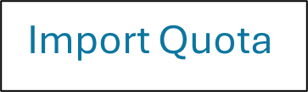
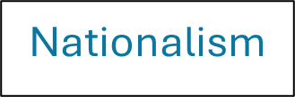
These are good questions/exercises to practice your understanding of the concepts
CONCEPT CHECK
What are “barriers to trade?”
Discuss the concept of natural trade barriers.
What is the difference between absolute and comparative advantage?
Describe several tariff and nontariff barriers to trade.

Slide 10
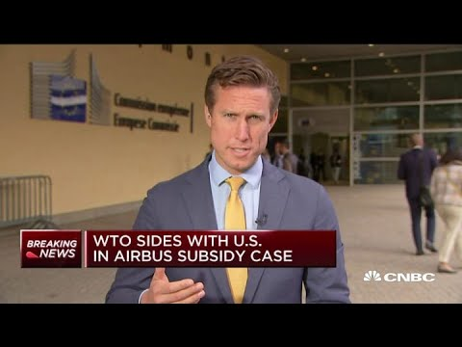
Fostering Global Trade
What is unfair competition between nations, and what can organizations like the WTO do to regulate global trade so it is more fair? As explained in Section 3.4, the United States has had mixed results in bringing disputes before the WTO, having won less than half of these cases. The U.S. has also won about one-third of the cases brought against it by other countries.
The October 2019 video from CNBC reports a news story about the WTO taking the side of the U.S. airplane maker Boeing against European competitor Airbus. The decision permitted the United States to impose tariffs (taxes on imports) of over $7 billion as a consequence of the WTO ruling that illegal subsidies were paid to Airbus. Now subsidies are direct or indirect payments from a government in cash or tax breaks.

Slide 11
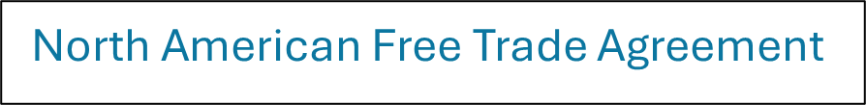
These are good questions/exercises to practice your understanding of the concepts
CONCEPT CHECK
Explain the pros and cons of NAFTA.
What is the European Union? Will it ever be a United States of Europe?

Slide 12
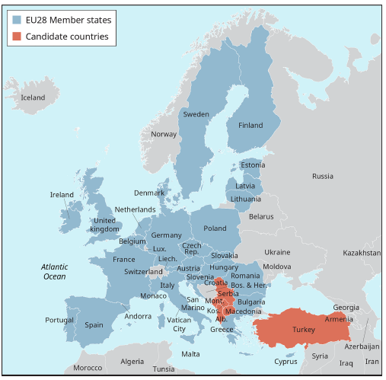

Exhibit 3.1 The European Union

Slide 13




These are good questions/exercises to practice your understanding of the concepts
CONCEPT CHECK
Discuss several ways that a company can enter international trade.
Explain the concept of countertrade.

Slide 14
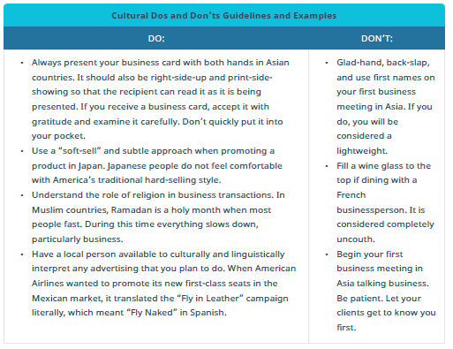
Table 3.1 Cultural Dos and Don’ts Guidelines and Examples

Slide 15
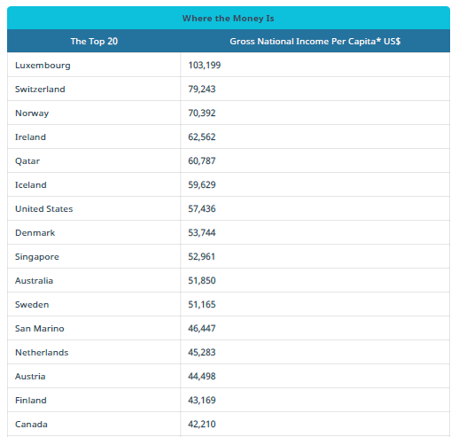
Table 3.2 Where the Money Is

Slide 16

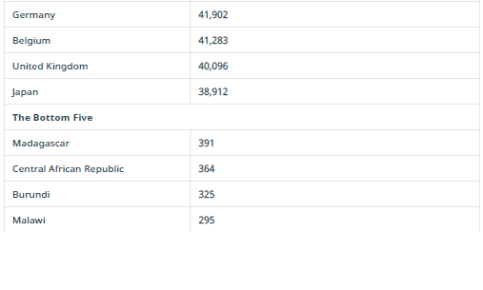
Table 3.2 Where the Money Is, continued

Slide 17
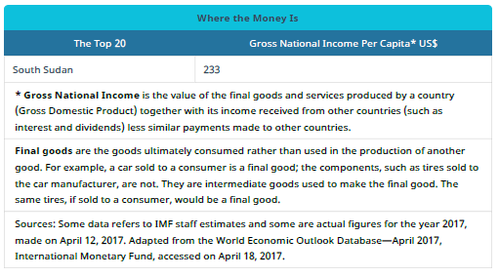
Table 3.2 Where the Money Is, continued

Slide 18

Participating in the Global Marketplace
There are a number of ways to enter global trade, so organizations must carefully select the most appropriate method of entering the world marketplace. As explained in this Section, a company has a variety of ways to enter global trade, including Exporting, Licensing and Franchising, Contract Manufacturing, Joint Ventures, and Direct Foreign Investment. Direct foreign investment is described in Section 3.5 as having at the same time both the greatest potential reward and risk of all the various methods to expand a business beyond the shores of the home country. One example provided of the potential risks in this Section was the failure of Walmart in Germany.
View the video which reports on a similar failure of Target to expand from the USA to Canada. Compared to Walmart, which has over 6,000 stores outside the U.S., Target was new to global expansion since Canada was the first global location attempted. Evaluate the challenges Target faced related to those Walmart had to overcome in Germany that were described in Section 3.5.

Slide 19
These are good questions/exercises to practice your understanding of the concepts
CONCEPT CHECK
Explain how political factors can affect international trade.
Describe several cultural factors that a company involved in international trade should consider.
How can economic conditions affect trade opportunities?

Slide 20
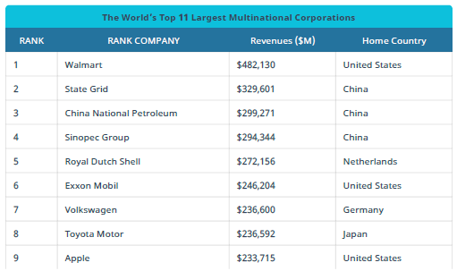

Table 3.3 The World’s Top 11 Largest Multinational Corporations

Slide 21
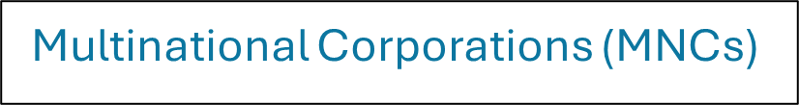
These are good questions/exercises to practice your understanding of the concepts
CONCEPT CHECK
What is a multinational corporation?
What are the advantages of multinationals?

Slide 22
The Impact of Multinational Corporations
Globalization includes the growth of international brands, with technology companies leading the way. A list of The World’s Top 11 Largest Multinational Corporations from Fortune Magazine is displayed in Table 3.3, ranked by revenue, with Walmart topping out at number one. The next three corporations on this list are all from China, and it’s not until number 6 does another U.S. company show up. Compare this to the list from Interbrand, as discussed in the video, and presented in this article.

Slide 23
The Impact of Multinational Corporations
Why do you think Apple is number one on this list (7 years running) and Walmart doesn’t even show up in the top 100?
Certainly, Fortune is using revenue only and Interbrand is valuing the “brand” not only the sales made by the company. Comment on both approaches.

Slide 24
These are good questions/exercises to practice your understanding of the concepts
CONCEPT CHECK
What trends will foster continued growth in world trade?
Describe some of the ways businesses can take advantage of these trends to “go global.”
This OpenStax ancillary resource is © Rice University under a CC-BY 4.0 International license; it may be reproduced or modified but must be attributed to OpenStax, Rice University and any changes must be noted. Any images credited to other sources are similarly available for reproduction, but must be attributed to their sources.

