Slide 1
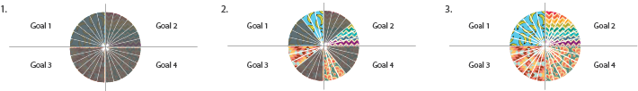
My Wheel of Wellness Goals
Directions
Choose four meaningful things you’d like to do on a daily basis. These four actions should be for your overall well-being, things for others, or outward gestures.
Type them in the boxes titled “goal.”
Use this document on a weekly basis and online only. Each week you can change out the tasks or repeat as desired.
Each day that you complete one of the goals, select a pie piece in the corresponding quadrant and tap Delete to remove the gray filter.
Repeat for each task and repeat daily.
Enjoy the beautiful design your good actions create.
Dare to Hope: A Call to Action for Intentional Self-Care

Slide 2
My Wheel of Wellness Goals 01
Each day that you complete one of the goals, select a pie piece from the corresponding quadrant and tap Delete to remove the gray filter.
Week of ____________________
Reach out to a friend/family member
just to see how
they’re doing.
Smile at a stranger.
Make more eye contact when I’m listening.
Compliment a co-worker on their work.

Slide 3
My Wheel of Wellness Goals 01
Each day that you complete one of the goals, select a pie piece from the corresponding quadrant and tap Delete to remove the gray filter.
Week of ______________
Reach out to a friend/family member
just to see how
they’re doing.
Smile at a stranger.
Make more eye contact when I’m listening.
Compliment a co-worker on their work.

Slide 4
My Wheel of Wellness Goals 01
Each day that you complete one of the goals, select a pie piece from the corresponding quadrant and tap Delete to remove the gray filter.
Week of _______________
Reach out to a friend/family member
just to see how
they’re doing.
Smile at a stranger.
Make more eye contact when I’m listening.
Compliment a co-worker on their work.

Slide 5
My Wheel of Wellness Goals 01
Each day that you complete one of the goals, select a pie piece from the corresponding quadrant and tap Delete to remove the gray filter.
Week of ______________
Reach out to a friend/family member
just to see how
they’re doing.
Smile at a stranger.
Make more eye contact when I’m listening.
Compliment a co-worker on their work.

Slide 6
My Wheel of Wellness Goals 01
Each day that you complete one of the goals, select a pie piece from the corresponding quadrant and tap Delete to remove the gray filter.
Week of ____________
Reach out to a friend/family member
just to see how
they’re doing.
Smile at a stranger.
Make more eye contact when I’m listening.
Compliment a co-worker on their work.

