Slide 1

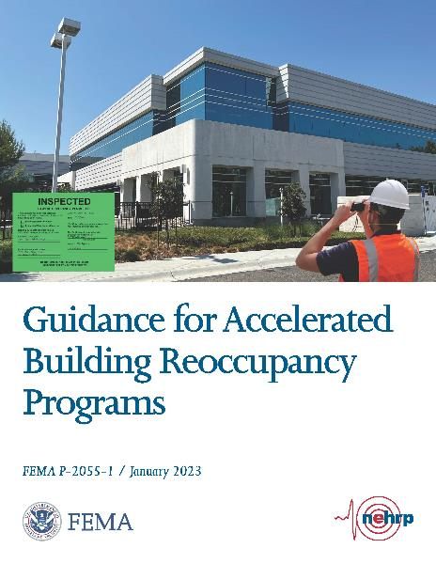

Resilience through Accelerated Building Reoccupancy
WAYNE CHANG, SE
STRUCTURAL FOCUS
Notes:
I WOULD LIKE TO SHAR WITH YOU ALL A FEMA GUILDELINE THAT OUTLINE A PROGRAM TO UTILITIZE THE LOCAL RESOURCES THAT CAN INCREASE RESILIENCE OF COMMUNITY BY SPEEDING UP THE RECOVERY

Slide 2

Imagine – if a 7.8M Earthquake occurs…
First Responders/Research Rescue teams deploys
Local building official, plan checkers, and inspectors are overwhelmed with inspection for City owned facilities as well as resident’s request for assistances.
Request assistances from the technical staff of other departments, Mutual Aid, CalOES SAP, and maybe EMAC.
It could take weeks before all the requests are addressed.
Notes:
Let me set the tone of my presentation. Let me paint the scenario that we hope it will never happen, but we all know that it will happen so or later…
EMAC = Emergency Management Assistance Compact for out the state volunteer assistance.

Slide 3
ABR Program Objective
Accelerated Building Reoccupancy (ABR) after a damaging earthquake will help the community to a speedy recovery.
How?
  Reduce demand on local building departments after a damaging earthquake for faster building evaluations using a pre-trained and well-prepared technical resources.
What?
  Formed by a 3-way agreement between building owners, engineers, and building department on post earthquake responses.
Notes:
The ABR objective is to help communities recover faster!

Slide 4
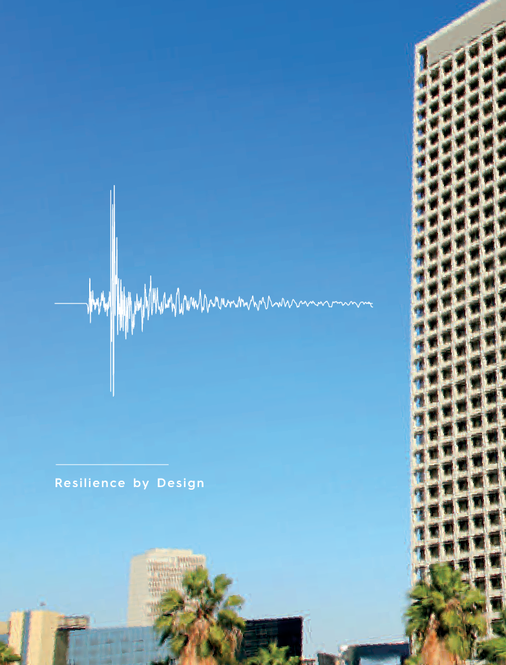
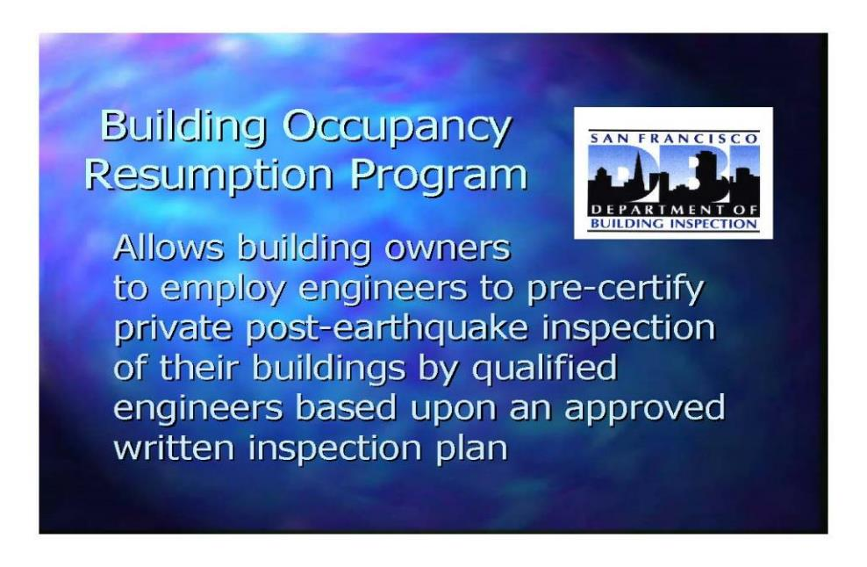
A bit of background…
BORP program started in San Francisco in early 1990’s after the City is overwhelmed after the Loma Prieta Earthquake
LA Resilience by Design recommends a creation of a Back to Business Program (a.k.a. ABR) to rapidly supplement the city’s building inspection forces in the event of a major earthquake
Notes:
After the Loma Prieta earthquake, the San Francisco City and engineering community seem a need to enhance the response after a major earthquake. The same sentiment is shared by the Los Angeles Major taskforce led by Lucy Jone. It is recommended in the Resilience by Design report to Major that a Back to Business program be created to supplement the City’s building inspection force in event for a major earthquake to enhance the resiliency.

Slide 5
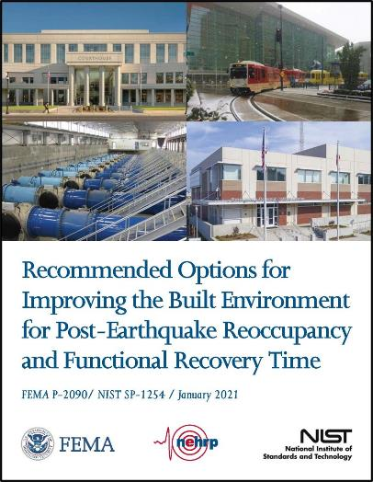
In the report to Congress as related to the Improving the Built Environment for Post-Earthquake Reoccupancy and Functional Recovery Time (FEMA P-2090), one of the FEMA/ATC/NIST recommendation is:
Recommendation 5, Task 5.5: Develop and Implement Building Occupancy Resumption Programs. (a.k.a. ABR)
“In the immediate aftermath of an earthquake, people want to know if it is safe to reenter their buildings. One approach to making this information available and expediting post-earthquake recovery is to encourage the development and implementation of building occupancy resumption programs….”

Slide 6



PROJECT TEAM
^{PROJECT TECHNICAL COMMITTEE}
^{PROJECT REVIEW PANEL}
David Cocke (Project Technical Director)
Laurence Kornfield
Kevin Moore
Ines Pearce
Jonathan C. Siu
Anne Castleton
Amit Kumar
Bret Lizundia
Brent Maxfield
Rachel Minnery
David Ojala
Stuart Tom
Greg Wilken
^{WORKING GROUP MEMBERS}
Logan McDevitt
Maria Mohammed
FEDERAL EMERGENCY MANAGEMENT AGENCY
^{APPLIED TECHNOLOGY COUNCIL}
Jon A. Heintz, Project Executive
Ayse Hortacsu, Project Manager
Michael Mahoney, Project Officer (retired)
Christina Aronson, Task Monitor
Notes:
FEMA P2055-1 captures and refines a concept that several cities across of the country have implemented. San Francisco, Salt Lake City, etc
Some of you may hear of BORP program. The new generic name is ABR.

Slide 7
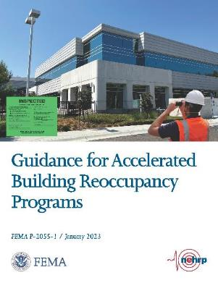
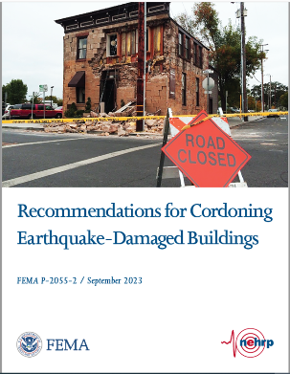


FEMA P-2055-1 is available for FREE download on FEMA website
https://femap2055.atcouncil.org/
provides additional documentation
including editable Word files
New!
CONTACT INFO:
Christina Aronson - christina.aronson@fema.dhs.gov
David Cocke - dcocke@structuralfocus.com

Slide 8

FEMA P-2055-1 Overview
Context of post-earthquake building safety evaluations
^{Benefits of ABR program}
^{Types of programs}
Recommended outreach activities
Key issues for program management, design, and implementation
^{Summary of active programs}
Templates for administrative documents to facilitate ABR programs

Slide 9
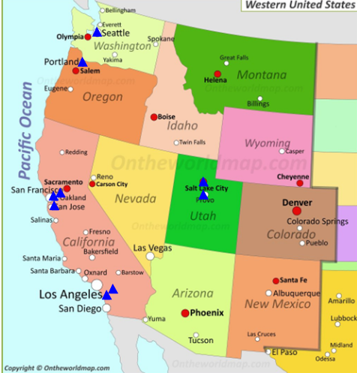
Existing Identified ABR Programs In Place
^{Berkeley (Authorized)}
^{*Culver City (Authorized)}
^{*Glendale (Authorized)}
^{Salt Lake City (Authorized)}
^{San Francisco (Authorized)}
^{San Jose (Authorized)}
^{Portland (Authorized)}
^{Murray City, Utah (Authorized)}
^{Seattle (Advisory)}
* Structural Focus programs with various clients

Slide 10
Key Authorized Program Elements
Owner contracts with qualified Building Safety Evaluators (BSE)
Building Safety Evaluators are licensed professionals and trained in ATC-20 Procedures
Pre-event building-specific evaluation and response plan are required
Following a triggering event, BSE arrives at building site and conducts post-earthquake safety evaluation
BSE posts building as UNSAFE, RESTRICTED USE or INSPECTED and reports results to AHJ
AHJ provides quality assurance and can override posting
Notes:
Guidance for Accelerated Building Reoccupancy Programs (ABR) FEMA P-2055-1 captures and refines a concept that several cities across the country have implemented.
AHJ is the acronym for Agency Having Jurisdiction meaning the building department and/or Building Official. I’m going to use AHJ throughout my presentation.
Official agreements among the AHJ, the building owner, and qualified safety evaluators are established BEFORE the event. The agreements address how the AHJ and building owners share a joint responsibility for conducting building safety evaluations. This expedites the post-earthquake determination of the “red, yellow, or green tag.” Most important: Green tagged buildings covered by the agreement can be reoccupied quickly.

Slide 11
AHJ
Owner
Program is built on TRUST
Evaluator
Notes:
A successful ABR program will rely on commitments from key personnel including:
▪ AHJ representative, e.g., building official
▪ Building owner or agent
▪ Building safety evaluator(s) under contract with the building owner
Establishment of a program would have to be initiated by the AHJ
Looking into potential funding mechanisms - setting up these programs may be eligible for BRIC and FEMA NERHP funding.

Slide 12
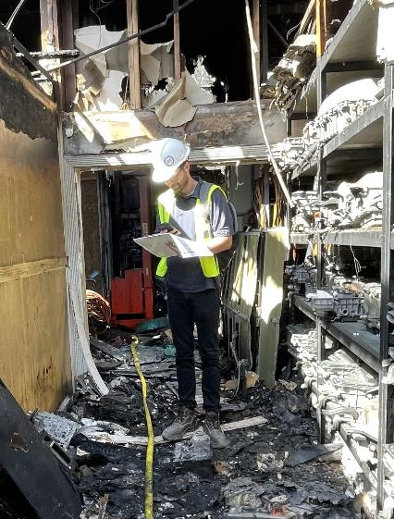
BENEFITS
Building Owners:
Accelerated reoccupancy of the building
More accurate safety evaluation results
Undamaged “green” buildings can be assessed and occupied much faster!
Notes:
These are potential benefits in an ideal situation. Actual results depend on many factors.
Benefits of Program:
In addition to faster recovery of the community,
establishing ABR programs will benefit the AHJ by relieving of some of the burden to conduct immediate safety evaluations in a chaotic post-earthquake environment, freeing personnel for other essential job duties and benefit the building
establishing ABR programs will benefit building owners by providing more accurate safety evaluation results due to required pre-event work that allows the building safety evaluators to familiarize themselves with the building structural and non-structural systems and identify critical areas to evaluate after an event.

Slide 13
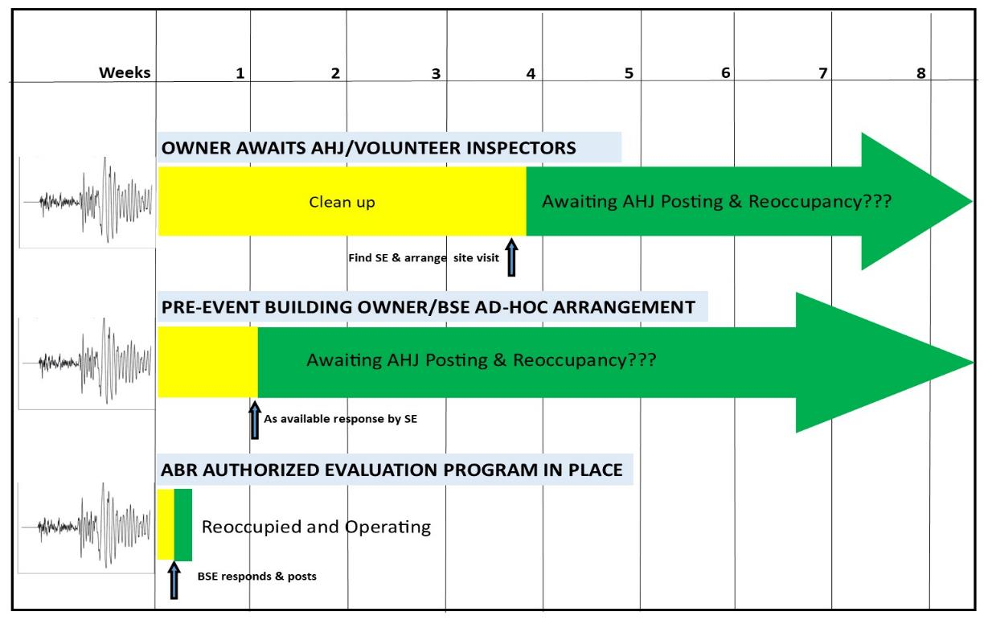
A hypothetical low-rise older wood framed building after experienced strong shaking…
ABR Program reduces recovery time
Notes:
NOTES
This slide shows the reduction in recovery time compared between 3 levels of program.
This is based on a hypothetical scenario where we have a low-rise older wood framed building that has experienced strong earthquake shaking.
The owner observed damage consisting of plaster cracking and some non-structural damage. The owner is pretty confident that their building is safe to occupy but wants an expert to make that determination to reassure him that he can safely reoccupy, while waiting for the AHJ to post an official placard.
In the top timeline, the current practice with no pre-arrangements, the owner has to find their own SE and arrange a site visit which might take a few weeks. In addition, there is no indication of when AHJ Inspector will arrive to post the building. The SE writes a report and “advises” that the building is safe, but they have no formal posting informing owner/tenants/public on the status of the building. The start of the green bar is when the SE has written a report, but still waiting for the AHJ inspector. (Note that “volunteer inspectors,” in this context, are working under the direction of the AHJ. In California, these are the Cal OES SAP volunteers, but there are recognized volunteer programs in other states such as Missouri and Washington.)
In the second timeline, they owner has made pre-arrangements for an SE to arrive as soon as they’re available, but again there is no formal posting informing owner/tenants/public on the status of the building.
When an ABR Program is in place, the BSE arrives right away and has the authority to post the building and they can get back to business after clean up is completed.
We need to point out that the easy green tags need to get up and running ASAP!

Slide 14
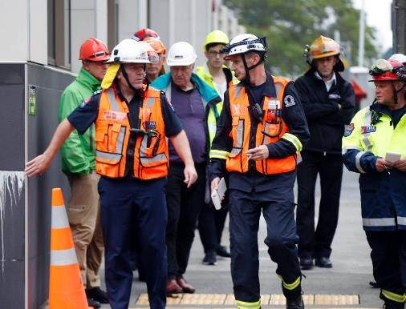
BENEFITS
AHJ (Building Official):
Reduced burden on the staff (inventory to be assessed is reduced)
Damage and potential danger can be clarified. Provides ATC-20 “Detailed Assessment Report” (not just “Rapid Assessment”)
Faster community recovery
Undamaged buildings can be reoccupied
Minor damage can be addressed and put back in operation faster
Notes:
These are potential benefits in an ideal situation. Actual results depend on many factors.
Benefits of Program:
In addition to faster recovery of the community,
establishing ABR programs will benefit the AHJ by relieving of some of the burden to conduct immediate safety evaluations in a chaotic post-earthquake environment, freeing personnel for other essential job duties and benefit the building
establishing ABR programs will benefit building owners by providing more accurate safety evaluation results due to required pre-event work that allows the building safety evaluators to familiarize themselves with the building structural and non-structural systems and identify critical areas to evaluate after an event.

Slide 15












A COMMUNITY’S BUILDING INVENTORY
Notes:
Let’s say we have a relatively small community and here is a graphic representing their inventory of buildings.

Slide 16
A COMMUNITY’S BUILDING INVENTORY
HCAI/OSHPD
Notes:
We do know that the Building Official does not have the responsibility to evaluate the Hospital.

Slide 17
A COMMUNITY’S BUILDING INVENTORY
DSA
Notes:
Or the public schools.

Slide 18
A COMMUNITY’S BUILDING INVENTORY
Notes:
Let’s say with an ABR Program in place, many of the commercial properties can be knocked off of the Building Official’s list to be inspected.

Slide 19

A COMMUNITY’S BUILDING INVENTORY
ABR Programs
Notes:
As well as many of the industrial properties.

Slide 20
A COMMUNITY’S BUILDING INVENTORY
ABR Programs
Notes:
The apartment buildings can also be part of an ABR Program reducing the demand to be inspected by the Building Official.

Slide 21
A COMMUNITY’S BUILDING INVENTORY
ABR Programs
Notes:
As well as the grocery stores and other markets.
So it is obvious that a program can significantly decrease the demand on the building department allowing them to concentrate on the essential services, government buildings and housing.

Slide 22
Authorized vs Advisory
Agreement between AHJ, Owner, and BSE
AHJ grants full authority to BSE to post building
Contract between Owner and BSE
Rigorous documentation between BSE and AHJ
Less formal, less rigorous documentation
BSE posts building with Advisory placard
Only contract is between Owner and BSE
May require more follow-up by AHJ
I am focusing on Authorized programs today because we believe that there are significant advantages over Advisory programs…
Notes:
There are some modified ABR programs out there that are less-formalized than our recommended “authorized” program.

Slide 23
ABR program implementation
1. Identify buildings to be enrolled
2. Assign SPECIFIC Building safety evaluators
3. Collect and review Building documents
4. Conduct site survey
5. Prepare Building Information File (BIF) for each building
6. Complete City’s ABR Application for each building
Notes:
To enroll a building in a ABR Program…

Slide 24
1. Candidate Buildings
Owner and BSE identify buildings based on several considerations:
  Potentially high business interruption costs
  Post-earthquake use
  Occupancy (importance, revenue, etc.)
  Potential for damage
  Functional recovery needs (community)
  Importance for site evacuation (i.e., parking structure)
Notes:
Some obvious building candidates are those that have potential for high business interruption costs or are essential to the recovery of the community.

Slide 25
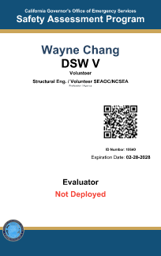
2. Assign Building Safety Evaluator (BSE)
For each building, identifies:
Specific (named), pre-trained, pre-qualified BSE – Primary & Secondary (back-up)
BSE requirements:
ATC-20 Trained (via CalOES SAP, Missouri SAVE, or WAsafe, or similar)
Professional Engineer or Licensed Architect
Primary BSE should have experience with buildings similar to subject building
Trained for specific site and buildings
Notes:
So after the potential candidate buildings are identified, the owner needs to find a qualified Building Safety Evaluator or BSE.

Slide 26

3. Collect and review building information
BSE:
Collects and studies available building information
Performs evaluation to identify specific deficiencies and likely damage
Notes:
The BSE will work to collect and review all of the relevant info about the building.

Slide 27
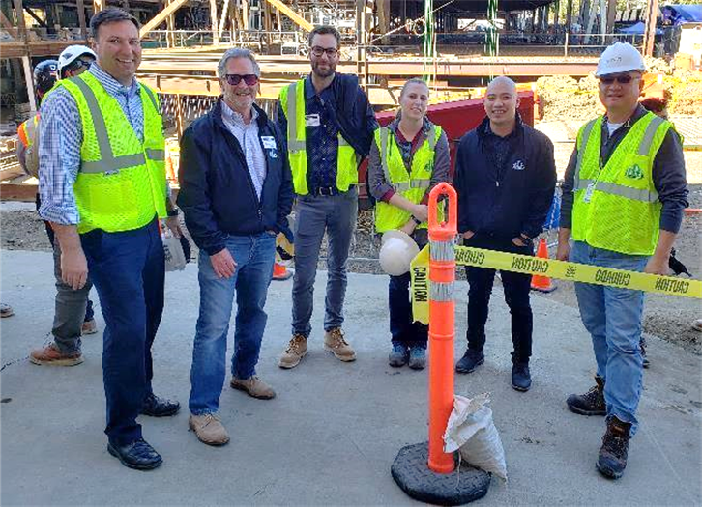
4. Conduct Site Survey
BSE:
Visits site to confirm building information
Meets on-site staff
Sets protocols for post-earthquake
access and communications
Notes:
The BSE team needs to complete a site survey to confirm the building info, meet with the owner’s onsite team and set protocols for post-EQ actions.

Slide 28
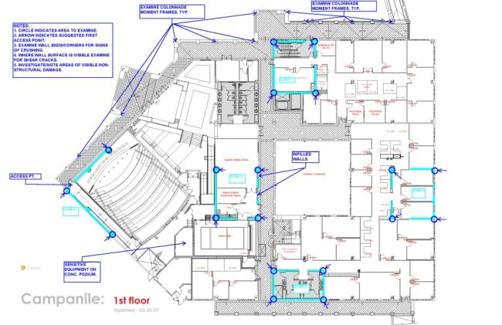
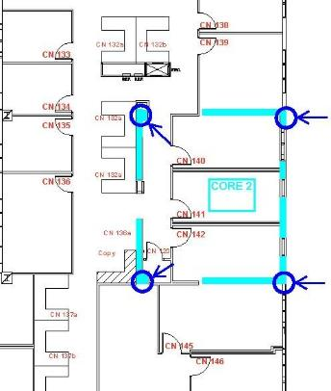
5. Prepare Building Information File (BIF)
BSE prepares:
Part A: List of building’s emergency contacts.
Part B: Building description, key plan and other information
Part C: Emergency response protocols including trigger and access
Part D: Procedures for safety evaluation, reporting instructions and checklists
Notes:
The BSE then will complete a Building Information File (BIF) for each building. A template is included in the Guide

Slide 29
6. Complete and submit City docs to AHJ
Owner and BSE provide to AHJ:
Building Information File
Building Safety Evaluator (BSE) qualifications for BSE authorization
Agreement for Owner/BSE/AHJ to sign
Emergency contacts info
Annual ABR Program Renewal
Notes:
Finally the owner and BSE will provide their documents to the AHJ for review and acceptance. The is all formalized by the signatures in a 3-way “Agreement between Owner/BSE/AHJ”.

Slide 30
Legal Considerations
Does an ABR Program increase
the liability for any of the 3 parties?
Owner
No change in liability – will have to hire a licensed professional with or without an ABR program in place
Notes:
One of the reasons we have observed that more programs have not been adopted is the AHJ’s mistaken perception that their liability is actually increased if a program is established. We wanted to address that misconception head-on for all 3 parties involved.

Slide 31
Legal Considerations
Does an ABR Program increase
the liability for any of the 3 parties?
Building Safety Evaluators
BSE is a licensed professional and is subject to state licensing laws
BSE is not a volunteer – has a contract with the building owner
  Because BSE is not a volunteer, they are likely to be professionally liable for their work even in states with Good Samaritan laws
Notes:
As for the BSE, they will have a contract with the owner even if a program is not in place, so their professional liability does not change. They also need to be clear that since they are under contract and are getting paid, they are not protected by the good Samaritan laws or have the same protection as provided by the state to SAP Mutual Aid volunteers.

Slide 32
Legal Considerations
Does an ABR Program increase
the liability for any of the 3 parties?
Authority Having Jurisdiction
AHJ is generally immune from liability in accordance with “sovereign immunity” or other state laws
Can delegate their authority to BSE under state laws
2021 IBC allows delegation of authority to BSE: “..the officer or other designated authority charged with the administration and enforcement of this code, or a duly authorized representative."
Notes:
Finally, the AHJ’s liability does NOT increase. State law allows an AHJ to delegate their authority. In addition, the AHJ should remember that the BSE is designated in advance and is already very familiar with the particular building, as opposed to a building inspector or a mutual aid inspector that likely has no familiarity with that particular building.

Slide 33
Legal Considerations
A Sample Statement of Liability based on Salt Lake City Program:
As a governmental entity the AHJ is immune from suit for any injuries or damages arising under or in connection with policies, practices, or actions relating to the [Accelerated Building Reoccupancy] Program. The AHJ expressly refuses to waive any immunity it possesses pursuant to state law, and any responsibility or liability associated with ABR Program shall be attributed solely to the owner and their contracted inspectors. The extent of any responsibility and liability is governed by the agreement between the owner and their respective inspectors.
Notes:
Finally, the AHJ’s liability does NOT increase. State law allows an AHJ to delegate their authority. In addition, the AHJ should remember that the BSE is designated in advance and is already very familiar with the particular building, as opposed to a building inspector or a mutual aid inspector that likely has no familiarity with that particular building.

Slide 34
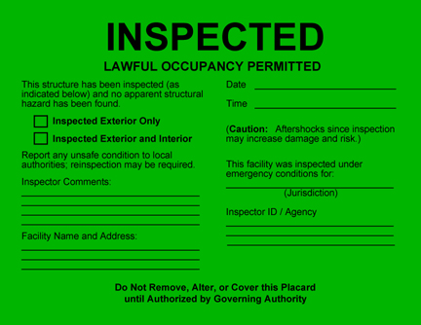
Other Key Issues Discuss in Guide
Program Design and Management
  Structural Safety
  Habitability Evaluations
  BSE/AHJ Staffing and Fees
  Training
Program Implementation
  Triggering Event
  Required Time to Respond
  Prioritization for Multiple Buildings
  Placards
  Emergency Shoring and Repairs
  Access to Site
  Communicating with AHJ
Notes:
The Guidelines also address several other key issues.

Slide 35
Program Costs
In general, the building owner pays for implementation and maintenance of the program
  Consultant fees paid to the BSE (usually a retainer)
  AHJ’s application fees for staff to review. (Fees should be reasonable to help promote the program)
  Consultant fees for post EQ assessments
Other potential funding:
  A grant from FEMA’s Building Resilient Infrastructure and Communities Program (BRIC) might be available for establishment of an ABR program

Slide 36
Recap
An Accelerated Building Reoccupancy (ABR) program provides:
Faster recovery of the communities/building owners.
Reduced burden on the local building department.
More accurate safety evaluation results.
Notes:
In summary,
- a well planned ABR Program can be very valuable to building owners
- an ABR Program can definitely help the Building Official to reduce the number of buildings to be inspected and speed up community recovery!
- We now have a published Guide that can be useful to establish a new ABR Program!

Slide 37
FEMA P-2055-1 is available for FREE download on FEMA website
https://femap2055.atcouncil.org/
provides additional documentation
including editable Word files
New!
CONTACT INFO:
Christina Aronson - christina.aronson@fema.dhs.gov
David Cocke - dcocke@structuralfocus.com

