Slide 1
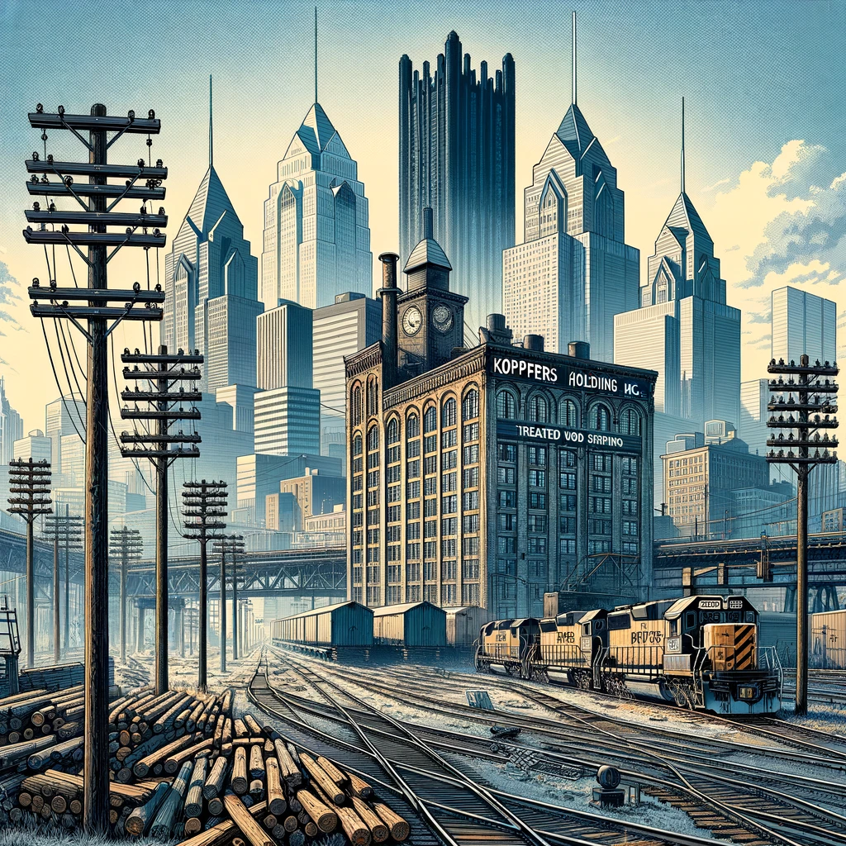


BUY
Upside: 13.65%
Blended Price Target: $58.60
Closing as of Report: $51.56
Analysts: Eric Curtis, Amelia Haddox, Gabriel Hepler, Matthew Mrozek, Alexander Sayre
Faculty Advisor: Frank DeGeorge | Industry Mentor: Cale Grove
Stop, Look, Listen, and Wait,
Koppers to Weather Rocky Economy!

Slide 2
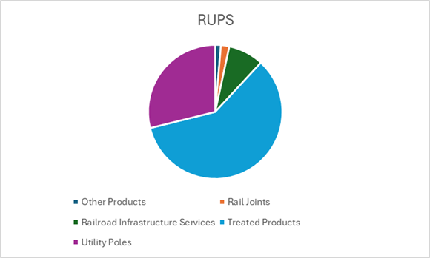
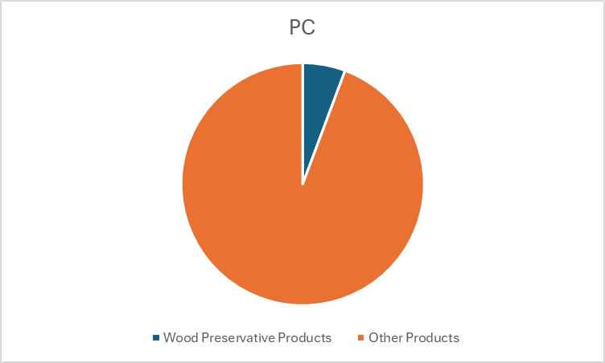
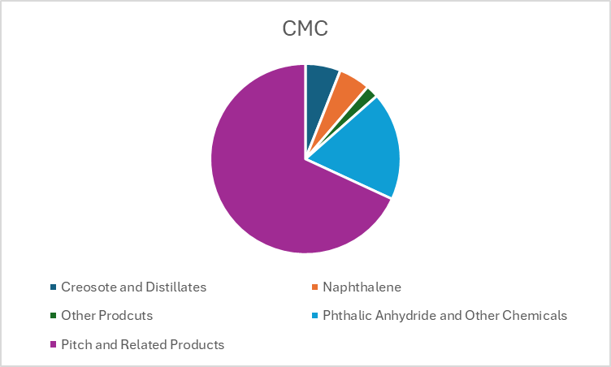
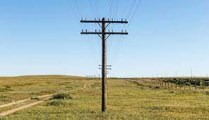
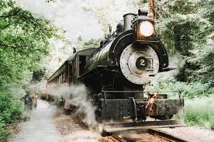
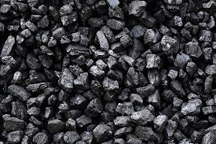
Business Description
Railroad and Utility Products (RUPS)
Carbon Materials and Chemicals (CMC)
Performance Chemicals (PC)
*Company Data / Team Analysis

Slide 3
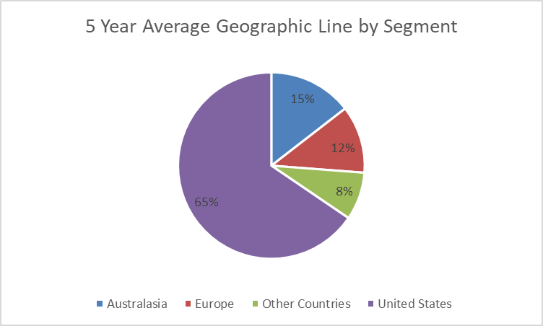
Business Description (Continued)
Railroad Products and Services (RUPS)
Utility Products and Services (RUPS)
Engineering and Maintenance Services (RUPS)
Direct Sales to Railroads and Utilities
Final Products and Services Delivery and End-Market
Treated crossties, switch ties, and various products for railroads.
Utility products in U.S. and Australia.
Engineering, design, repair, and inspection for railroads.
Direct sales through long-term contracts.
Wood Crossties and Utility Poles Treatment (RUPS)
Rail Joint Bars Manufacturing (RUPS)
Treated Wood Product Manufacturing
Utilize creosote and copper-based preservatives from CMC and PC.
Produce steel bars to join rails.
Intensely Vertically Integrated
Creosote (CMC)
Carbon Pitch (CMC)
Naphthalene and Phthalic Anhydride (CMC)
Copper-Based Wood Preservatives (PC)
Intermediate Chemical Production
Produced from coal tar.
Component in aluminum.
Intermediate chemicals.
Copper based wood preservatives.
Base Raw Material Extraction and Processing
1. Coal tar, by-product of steel production.
2. Scrap copper sourced globally.
Coal Tar Processing (CMC)
Scrap Copper Processing (PC)
*Company Data / Team Analysis

Slide 4
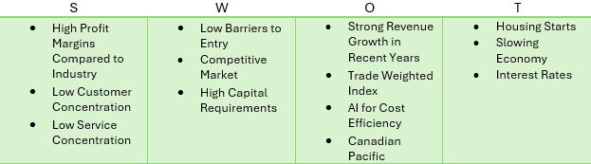
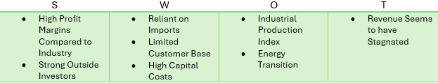
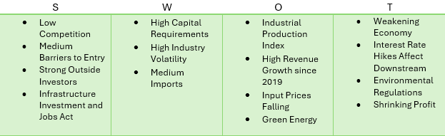
Industry Overview & Competitive Positioning
Wood Product Manufacturing (PC and RUPS)
Inorganic Chemical Manufacturing (CMC)
Organic Chemical Manufacturing (CMC and PC)
*Company Data / Team Analysis / Deloitte

Slide 5
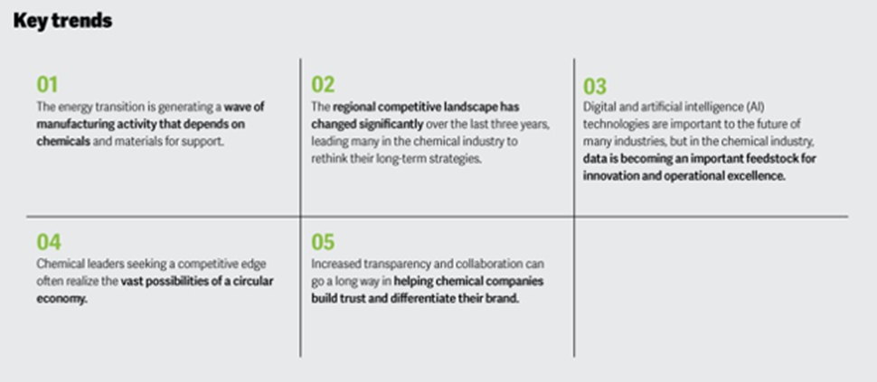
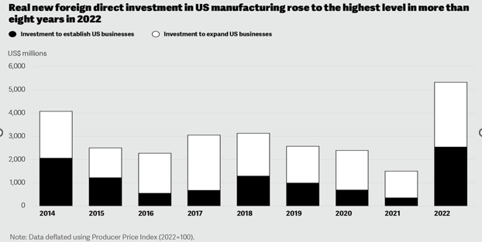
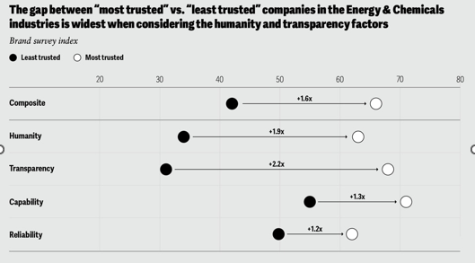
Industry Overview & Competitive Positioning (Continued)
*Deloitte

Slide 6
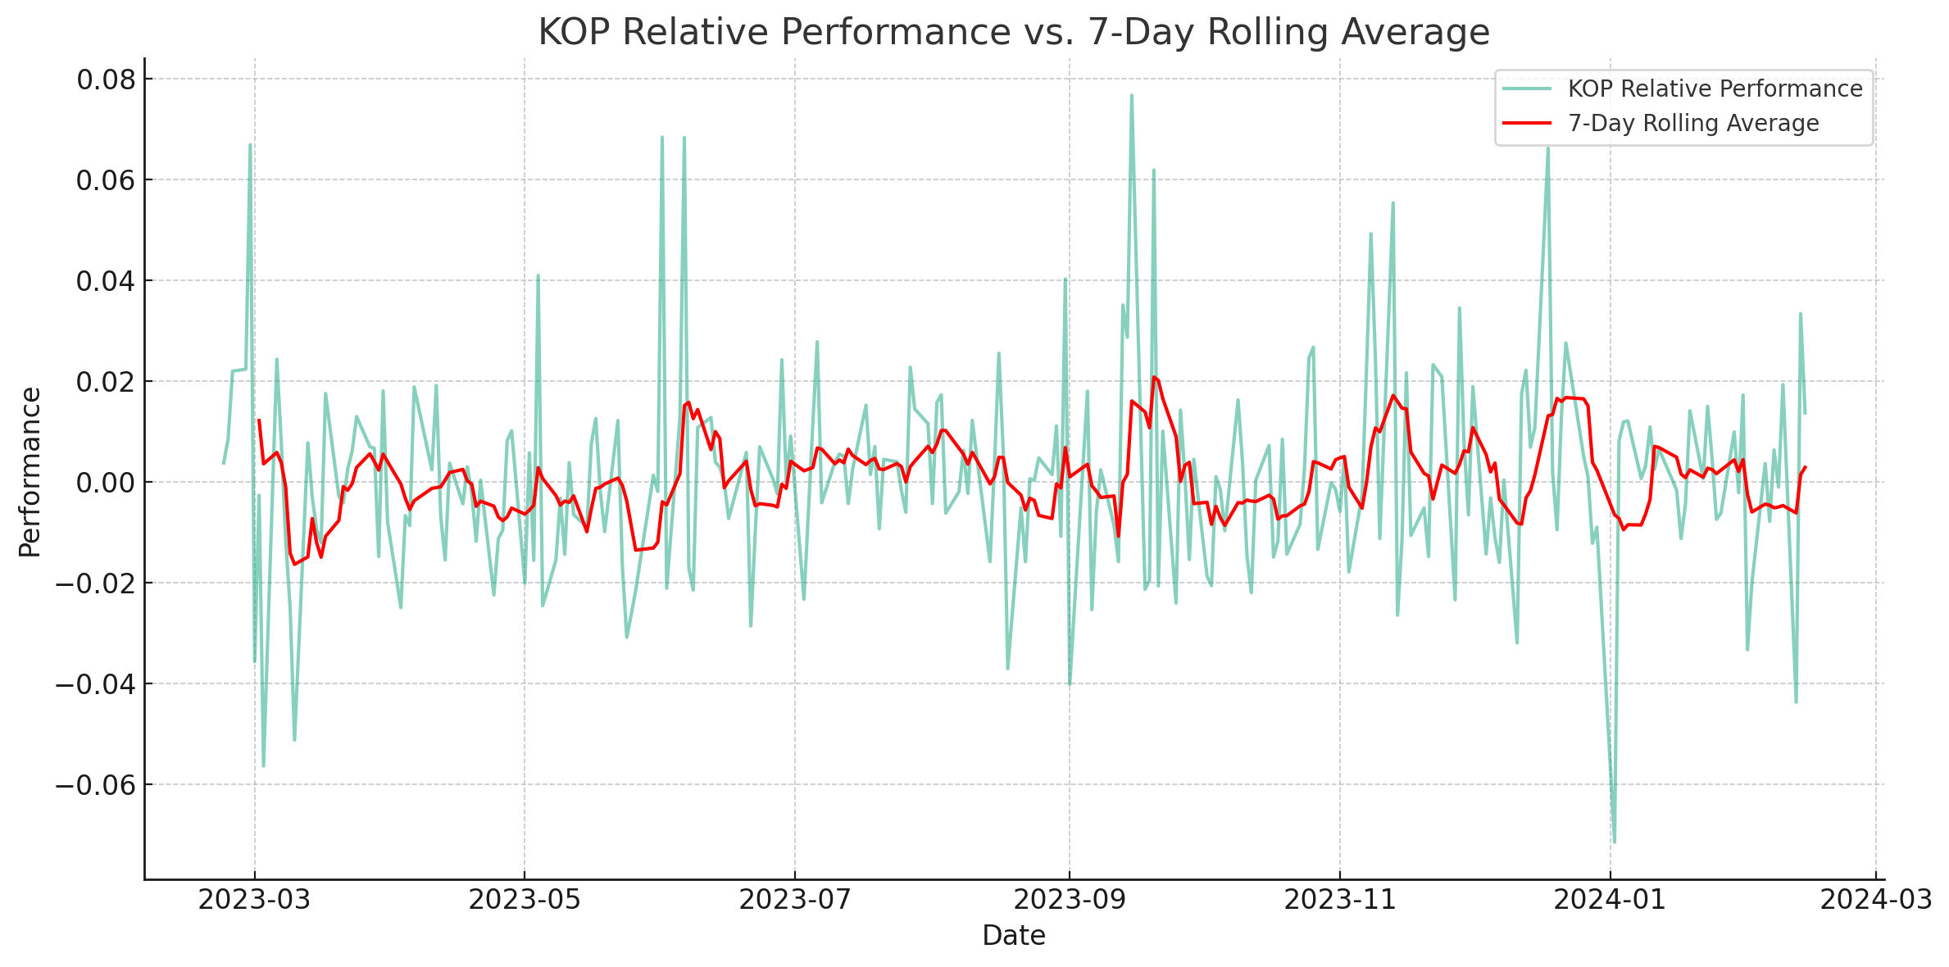
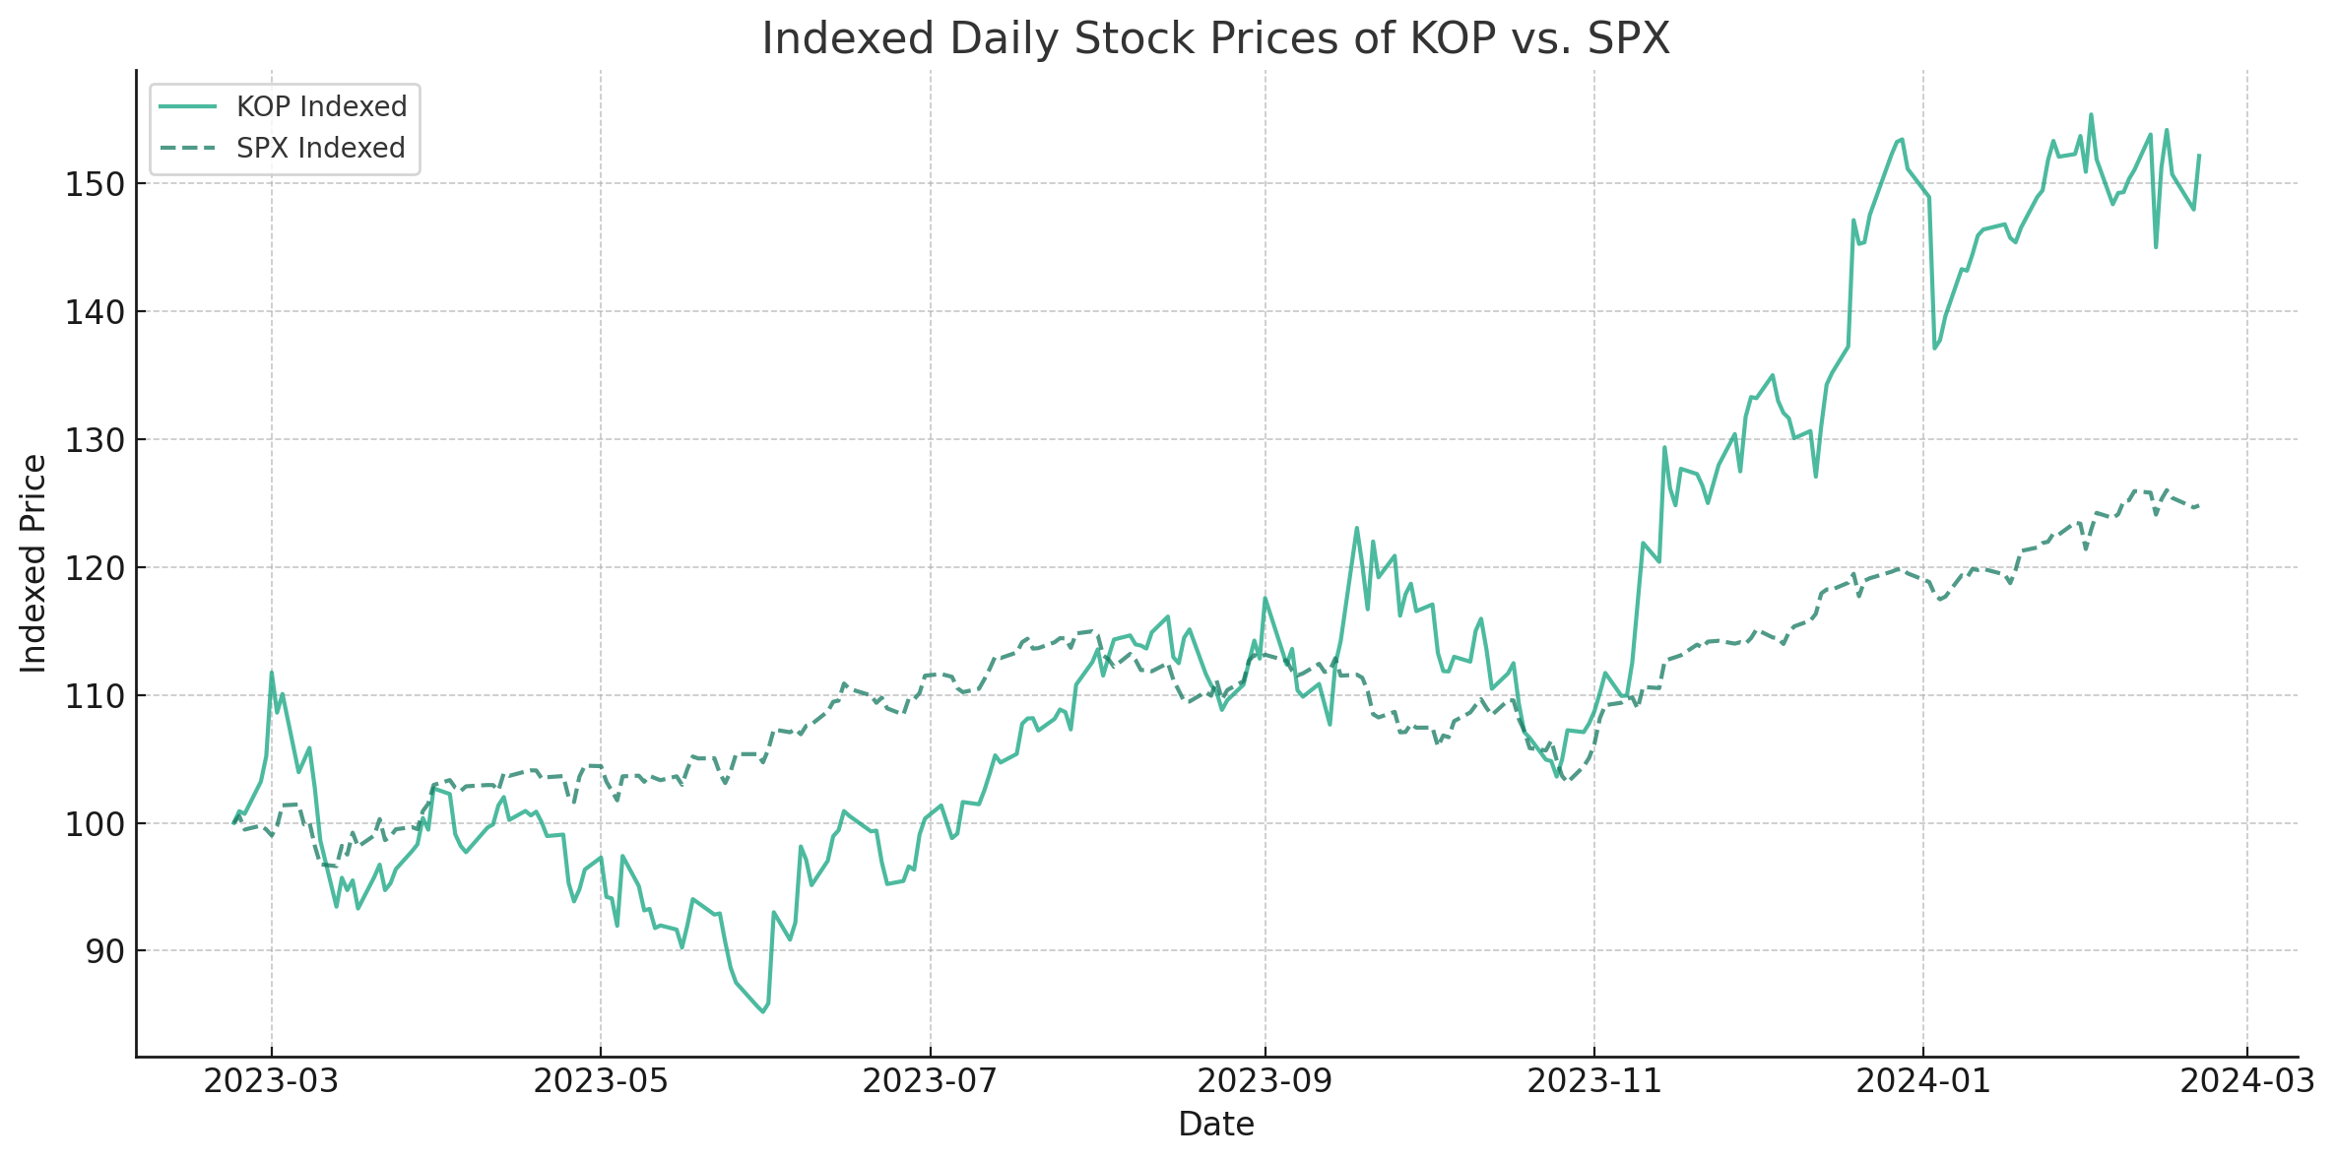
Investment Summary
*Company Data / Team Analysis

Slide 7
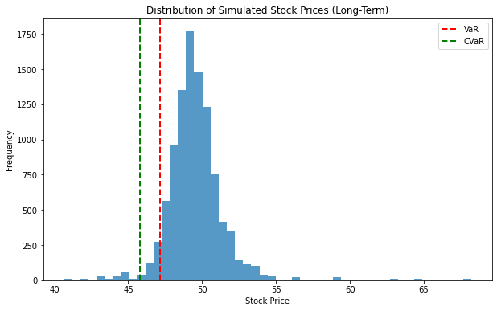
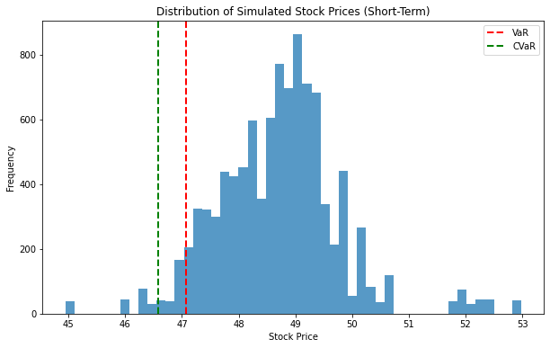
Monte Carlo Empirical (10,000 Iterations):
Daily (Conditional) Value at Risk
Long Term VaR: 6.85% ($3.46)
Long Term CVaR: 9.53% ($4.82)
Short Term VaR: 6.97% ($3.53)
Short Term CVaR: 7.96% ($4.03)
KOP vs. SPX
Long Term Log Norm Beta: 1.59
Short Term Daily Beta: 1.30
1 Year Annualized Sharp: 1.29
5 Year Annualized Sharp: 0.23
MAR = Rf
1 Year Sortino Ratio: 2.00
5 Year Sortino Ratio: 0.32
1 Year Treynor: 2.22%
5 Year Treynor: 0.51%
1 Year Annualized Alpha: 20.01%
5 Year Annualized Alpha: -5.73%
*Company Data / Team Analysis / Python

Slide 8
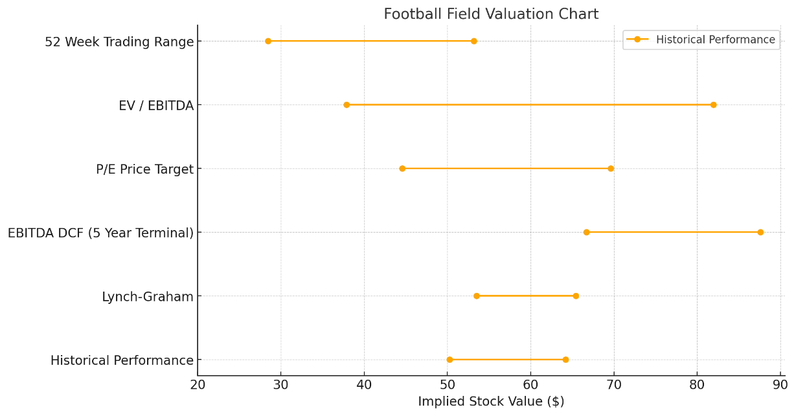
Valuation: Blended Average
*Company Data / Team Analysis

Slide 9
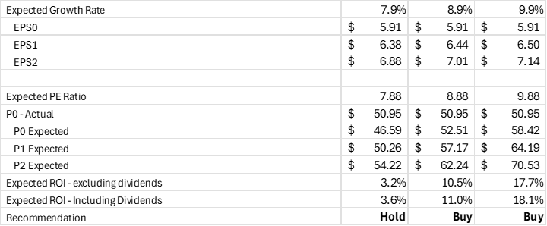
Valuation: Historical Analysis of Key Growth Rates to Generate Sustainable and Expected Growth
As Reported
Reclassified
Recurring
*Company Data / Team Analysis

Slide 10
Valuation: EBITDA DCF (5 Year Terminal)
*Company Data / Team Analysis

Slide 11
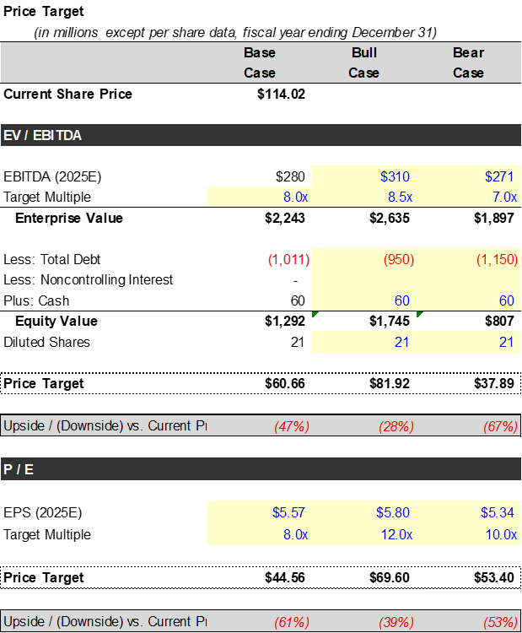
Valuation: EV / EBITDA, P/E, and Lynch-Graham
*Company Data / Team Analysis

Slide 12
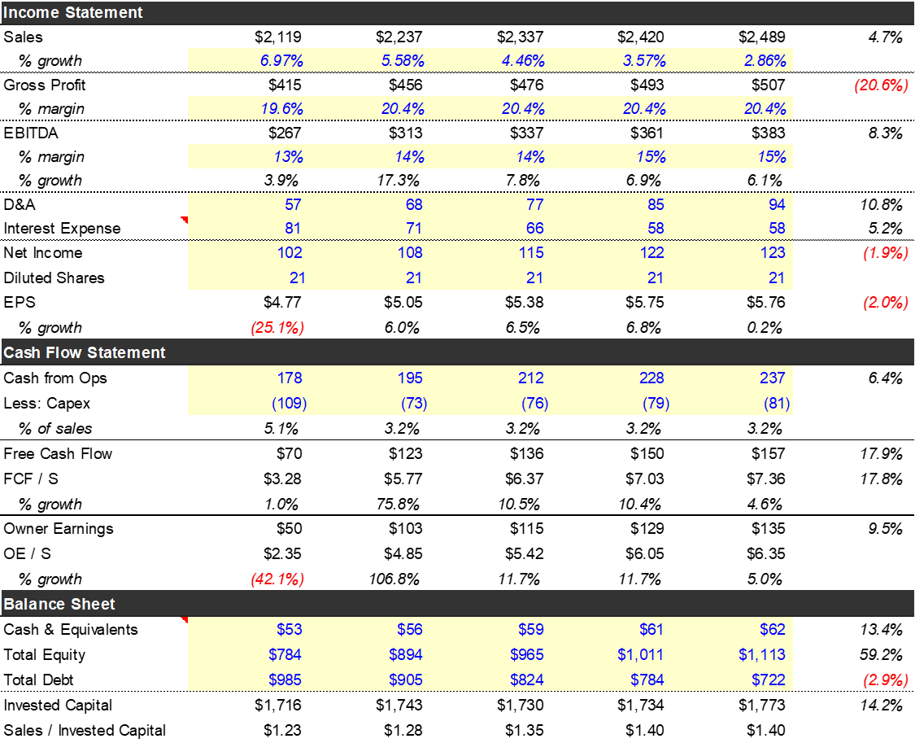
Valuation: Projected Financial Statements
*Company Data / Team Analysis

Slide 13
Financial Statement Analysis of Recurring Data: Top Line and Value Added
*Company Data / Team Analysis

Slide 14
Financial Statement Analysis of Recurring Data: Liquidity, Capital Structure, Solvency, and Financial Flexibility
*Company Data / Team Analysis

Slide 15
Financial Statement Analysis of Recurring Data: Profitability, Efficiency, and Effectiveness
*Company Data / Team Analysis

Slide 16
Financial Statement Analysis of Recurring Data: Channel Stuffing / Top Line Flexibility
Organic Growth Trend
*Company Data / Team Analysis

Slide 17
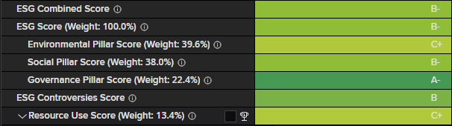
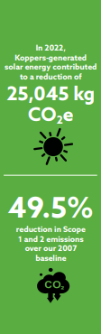
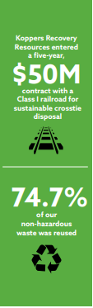
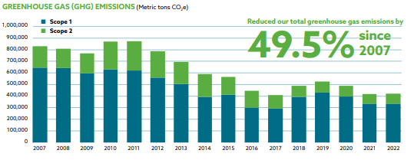
ESG: Environmental
Decreasing impacts to global climate change and decrease risk of climate change impact throughout operations.
Eliminate waste from operations.
*Koppers Sustainability Report

Slide 18
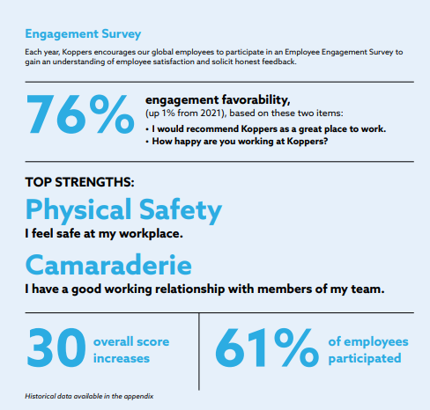
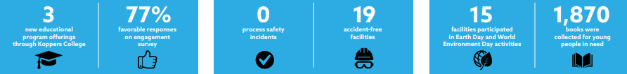
ESG: Social
Provide secure and meaningful work to diverse team of employees who feel engaged, included, and valued.
Advance Zero Harm culture that places the care and protection of employees, community, and environment first.
Help build strong communities.
Inclusion and diversity.
*Koppers Sustainability Report

Slide 19

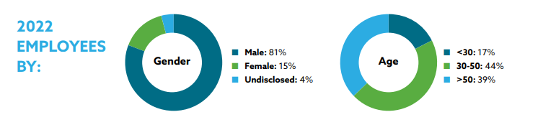
ESG: Governance
Maximize value and reduce risk to stakeholders by operating profitably, transparently, sustainably, and with integrity.
Invest in the future through innovation in new products, processes, and technologies that provide sustainable solutions.
Entering the DCOI market with own EPA, environmental impact lower at end-of-life options for utility poles.
*Koppers Sustainability Report

Slide 20
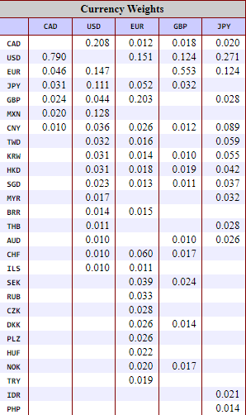
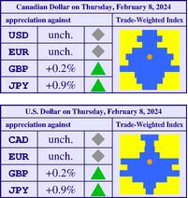
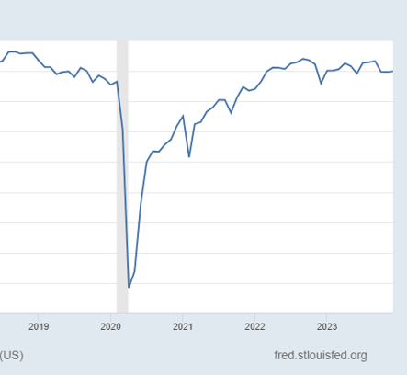
Investment Risks and Opportunities
Trade Weighted Index +
Industrial Production Index =
Housing Starts -
Green Energy / Energy Costs -
Development of coal tar pitch used in graphite coating material for electrical batteries +
*University of British Columbia and FRED

