Slide 1

Sun City Grand
Amateur Radio
Coming changes in Federal Law regarding antennas
The amateur radio parity act of 2017
Presentation to Sun City Grand
Architectural Review Committee
July 6,2018

Slide 2
introduction
There are 95 licensed amateur radio operators in sun city grand. (11,800 in Maricopa county, 730,000 USA)
A Special Interest Group of Grand Computers Charter Club is the Ham Radio SIG. An “Antenna Committee” was formed to conduct research.
This Antenna Committee would like to provide the Architectural Review Committee, the findings of our research on the upcoming Amateur Radio Parity Act, and the value of Amateur Radio Operators to this community.

Slide 3
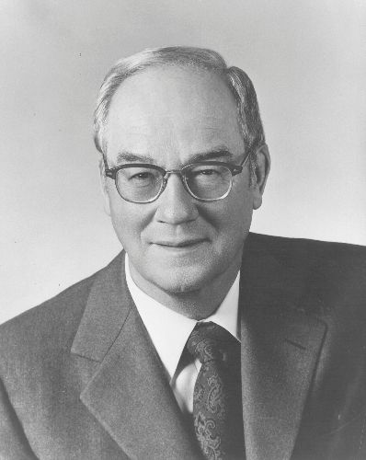
What is amateur (ham) radio?
Hams come from all walks of life: physicians, lawyers, engineers, housewives, students, astronauts and US Congressional Representatives.
Senator Barry Goldwater
Walter Cronkite
Del Webb
Astronaut Sally Ride
Notes:
Sen. Barry Goldwater provided communications between overseas Armed Forces Service members and their family members via Ham Radio
Walter Cronkite of CBS News was a very active Ham – even had Ham radios on his sailboat
Del Webb was a active ham and supported it in some of his communities such as Sun City West
Most astronauts earn their Amateur Radio license so that they can communicate from the Space Station with other Amateur operators
Space Station Ham operators routinely contact schools via Ham Radio to provide aerospace educational sessions

Slide 4

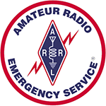
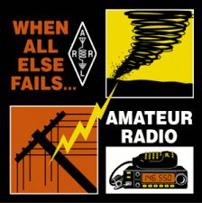
What is amateur (ham) radio?
AMATEUR RADIO promotes the development of emergency communication capability, through Public Service.
Notes:
- Local hams are closely tied to the nearby Banner Hospitals to provide emergency comms
We have a Ham repeater transmitter installed on top of Banner Del Webb Hospital
Some local Hams are officially certified as Emergency Communicators (EmComm)
The American Red Cross requested from the ARRL communications support for recent Puerto Rico hurricane – 50 Hams were flown there to provide emergency comms
ARRL: American Radio Relay League – the National organization for Amateur Radio

Slide 5
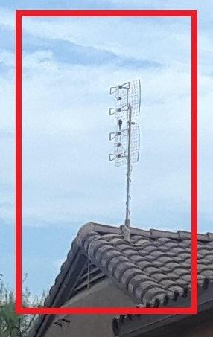
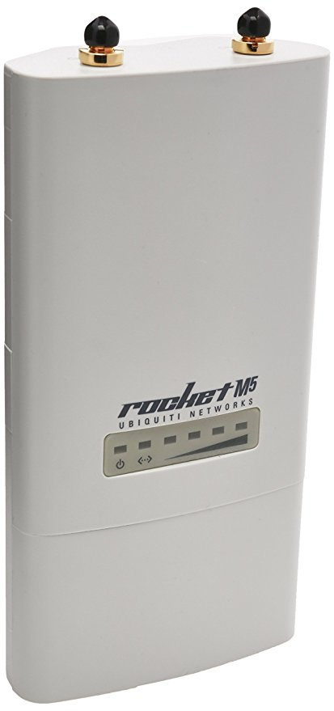
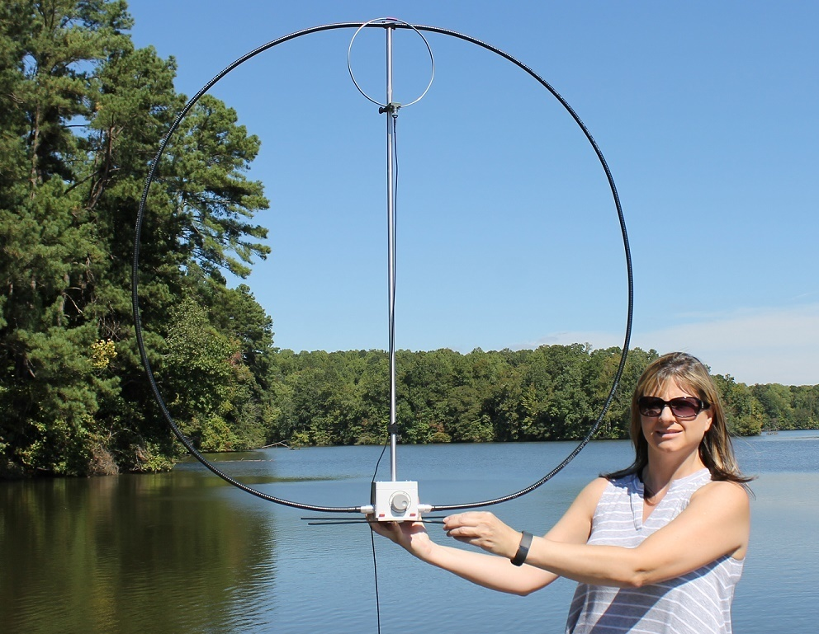
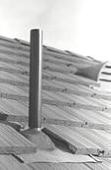
What is amateur (ham) radio?
AMATEUR RADIO OPERATORS use various types of antennas to send/receive their voice or Digital DATA (like text messaging). Even Morse Code! We are able to communicate across the globe, without the use of the Internet and the power grid.
Notes:
Antennas can be relatively small

Slide 6

What can we do for SCG in an Emergency?
Provide Emergency Communication in a Disaster:
  Train Derailment - Chemical Spill, Fire, Evacuation
  Flood – Dam Failure
  Major Power Failure
  Terrorist Activity
  Palo Verde Nuclear Power Plant Incident
(We train for this EVERY November!)
Notes:
-Rogue nation could disrupt the power grid via Internet
-Terrorist risk especially related to Luke AFB or the Nuclear Power plant
Hams can operate with emergency power (generators and solar power)
Hams train year-round for potential emergencies

Slide 7
History of Federal Antenna Regulations
OTARD: Over-The-Air Reception Devices Rule-1996 Telecommunications Act
This rule prohibits most restrictions that: (1) unreasonably delay or prevent installation, maintenance or use; (2) unreasonably increase the cost of installation, maintenance or use; or (3) preclude reception of an acceptable quality signal.
SCG Design Guidelines use this language, which covers television reception only.
According to scg design guidelines - Appendix d:
“all antennas not covered by the FCC rule are prohibited.”

Slide 8
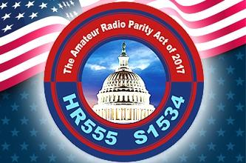
Amateur Radio Parity Act of 2017
Requires HOA to establish “reasonable written rules” regarding height, location, size, aesthetic impact and installation requirements of “EFFECTIVE outdoor antennas”.
Passed the HOUSE, pending in the SENATE.
Federal Law to impact all HOA’s.
FCC Chairman, Ajit Pai, applauded Bill in January.
FCC to revise its Residential Land Use Regulations within 120 days of passage.
Notes:
Parity Act is part of NDAA (National Defense Appropriates Act) bill and has high probability of passing
National Association of Homeowners Associations (CAI – Community Associations Institute) is onboard with this bill
HOA’s should get in front of this Bill in order to prevent future potential litigation from individuals

Slide 9
Senators sponsoring this bill
“Mississippians learned firsthand after Hurricane Katrina, how Amateur Radio Operators can provide a resilient, distributed network to first responders and disaster relief organizations when other communications tools fail.”~ Senator Roger Wicker, R-MISS.
“Amateur Radio Operators provide an invaluable service to their communities by assisting local emergency communication efforts when disasters occur and main lines are down. This bipartisan measure ensures that operators have access to the tools they need to support our first responders when lives are at stake.”~ Senator Richard Blumenthal, D-Conn.

Slide 10
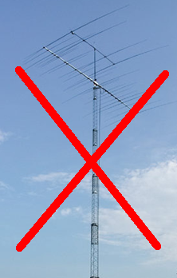
Proposal
Once the Amateur Radio Parity Act becomes Federal Law, HOA’s must provide written rules regarding the height, location, size, aesthetic impact and installation requirements of “effective” antennas for Amateur Radio Operators.
Our group of Amateur Radio Operators, here in Sun City Grand, can provide guidance. We are NOT advocating large towers or unsightly antennas, which would detract from our property values.

Slide 11
Summary
Amateur radio – can serve the community as a resource for emergency communication.
AMATEUR RADIO – can provide guidance to the ARC and the SCG Board members in revising the Design Guidelines to include Amateur Radio antennas and comply with the Amateur Radio Parity Act.
AMATEUR RADIO – can support the SCG Board in educating the community regarding compliance with upcoming Federal Law, while considering aesthetics of the community.
AMATEUR RADIO – can “self-police”, to assure that current and future Amateur Radio Operators remain within the compliance structure.

Slide 12

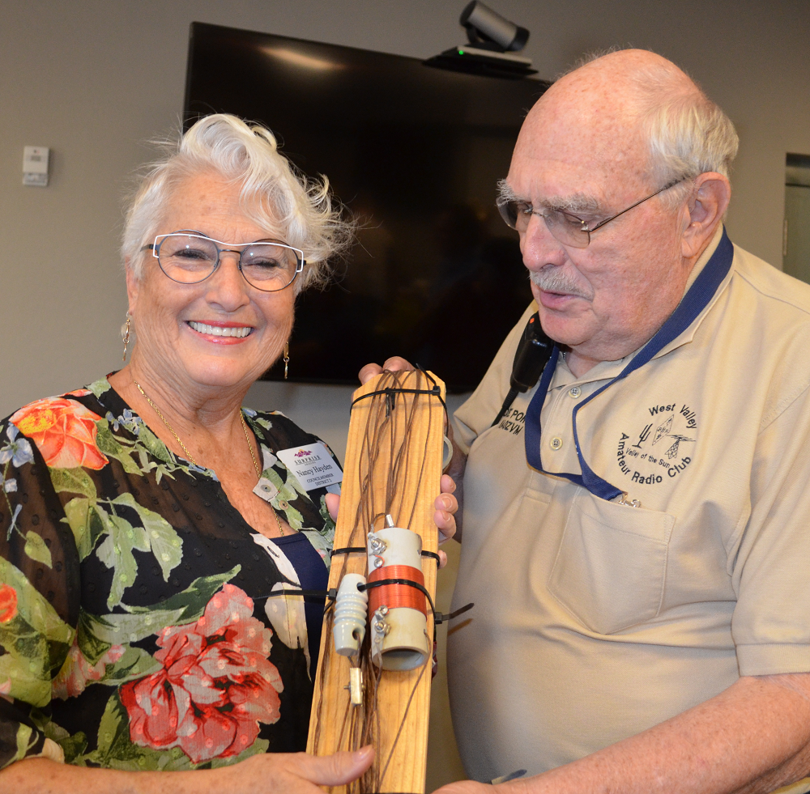
questionS ? We are here to help
Helpful Resources for your reading enjoyment:
http://www.arrl.org/prb-1 Link to info on prb-1, from 1985 and still valid.
https://www.fcc.gov/media/over-air-reception-devices-rule otard rule info.
http://www.arrl.org/amateur-radio-parity-act amateur radio parity act of 2017
Surprise City Councilwoman Nancy Hayden, enjoys Amateur Radio Field Day June 23-24, 2018.
Notes:
Amateur Radio Field Day is an annual 24-hour long emergency test for Amateur Radio Operators to demonstrate emergency communication skills and capabilities using emergency power and temporary antennas

