Slide 1
Underwriting the Elderly
Michael H. Wetzel, MD, DABFM, DBIM, CLU®
Senior director, medical underwriting
Transamerica

Slide 2
What’s the plan?
Definition
Natural process of aging
Why are they different?
Causes of death
How to assess the elderly
Concerns
Specific diseases

Slide 3
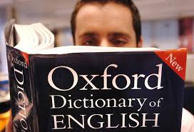
Definition
Elderly > 70 years
Young old 65 – 75
Old 75 – 85
Very old > 85
Notes:
No one definition but this is usually used

Slide 4
Natural process of aging
Loss of organ reserve
Sarcopenia
Diastolic dysfunction
Normal abnormal findings
Notes:
No talk

Slide 5
Loss of organ reserve
The ability of an organ to successfully return to its original physiological state following repeated episodes of stress.
Notes:
For instance, When we’re young, we don’t require 100 of our organs to be functioning. Our heart beats faster but not at max, our lungs oxygenate without difficulty, the liver metabolizes as needed, the kidney excretes well. We have reserves.
So a good example is comparing someone with pneumonia – a 30 year old feels sick, has a cough, fatigue, fever and then may recover in few days, to a couple of weeks at home. An older person may be hospitalized, may need oxygen, may have to be treated for a secondary infection as their immune system is stressed. When I saw an older patient in the hospital, very early into their stay we would start making plans for discharge. They will so quickly loose muscle mass from resting that discharge to a rehab facility is often needed.

Slide 6
Loss of organ reserve
Pulmonary
Loss of 30% by age 70
Renal
Hepatic
Notes:
Loss of 30% of normal lung function occurs by age 70
Renal – think about your CKD calculator – we always put in their age, right? There is less muscle mass contributing to creatinine levels.
Slowing of the liver functions as well.

Slide 7
Natural process of aging
Sarcopenia – muscle loss
Diastolic dysfunction
Assessed by E/A ratio
Mild < 0.8
Moderate > 0.8 - <2
Severe > 2
Notes:
Sarcopenia – combo of aging, lifestyle/environmental and chronic disease factors. Some examples: Hormonal changes (testosterone contributes to muscle building and that decreases with age). Lifestyle change example more sedentary, obesity; chronic diseases – insulin resistance, chronic inflammation can accelerate muscle loss.
Diastolic function refers to how well the heart’s ventricles relax and fill with blood between beats (in diastole), As we age, the ventricles do not expand as readily and mild diasolic dysfunction may be noted on ECHO. Grade I or mild may not be significant, esp without any symptoms . Just a word of caution, if the echo is being done because of shortness of breath, fatigue, swelling in the legs, etc, then that mild DD may be progressive and ultimately lead to heart failure.

Slide 8
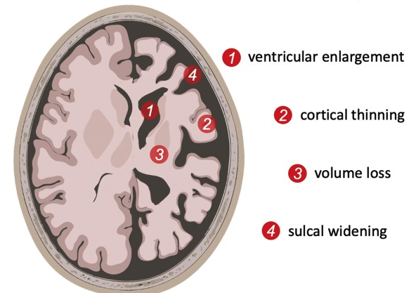
Normal abnormal findings
White matter changes on brain MRI
Common after age 60
Increases with age
Decreased brain volume
Notes:
Look for radiologist commenting on something like “expected for age” or “white matter changes more than expected for age.” Like DD, look for the reason for the MRI or CT scan. Are they symptomatic? Are other studies warranted.

Slide 9

Chronologic vs. Physiologic age
Notes:
WE want to focus on physiologic age rather than chronologic age.
Phys – what is the age of their reserve and body function, not focusing on how many years they have been on this earth.

Slide 10
What makes the elderly unique?
Increased heterogeneity
Subclinical disease
Comorbid conditions
Polypharmacy
Notes:
Fast – deeper dive in next few slides

Slide 11
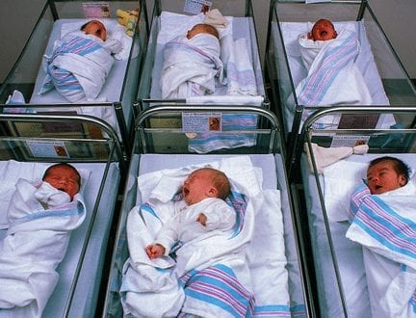
Heterogeneity
Notes:
We start off looking similar except for eye color, hair color, skin color

Slide 12


Heterogeneity
Notes:
The good and bad decisions we make through life start to have an effect on how we age
These decisions add up with time.

Slide 13


Heterogeneity
Notes:
Those decisions will determine what type of older person an individual becomes. Is this 75 year old you’re underwriting Biking around Europe or…something else?

Slide 14
Epigenetics
Behaviors and environment can cause changes that affect gene function without altering the underlying DNA sequence
Notes:
How do those decisions manifest? Through epigenetics. Doesn’t change our genome but the rather how these genes are regulated and ultimately expressed.
Couple of good books – interesting stuff: Change your Genes, Change your life by Kenneth Pelletier.

Slide 15
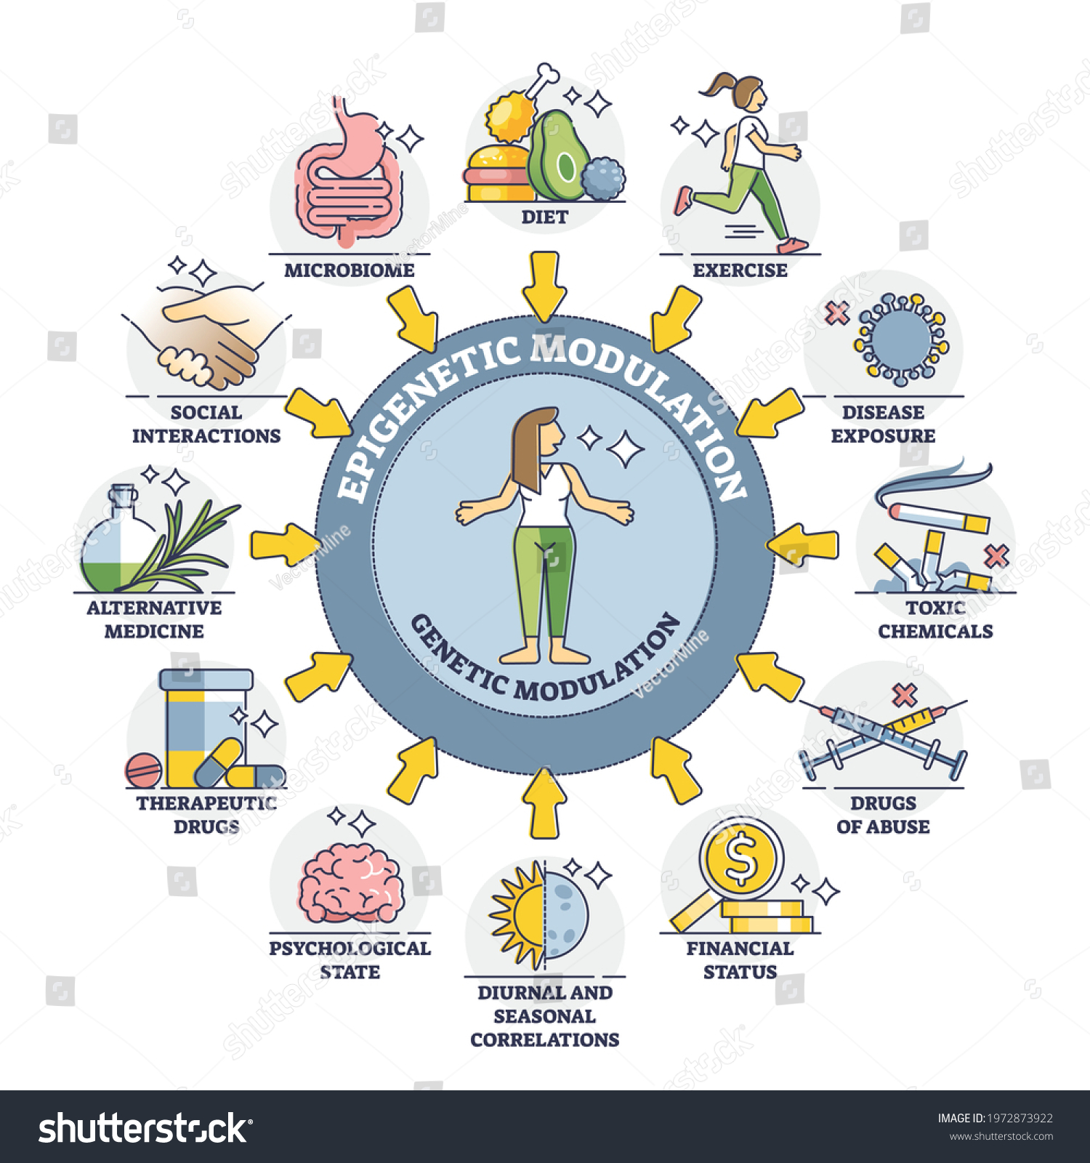
Epigenetics
Notes:
In a very simplistic overview, these external factors lead to methylation of DNA proteins that lead to the regulation and ultimately the changes we see.

Slide 16

Subclinical disease
Notes:
Subclinical disease is asymptomatic and needs to be looked for. An older person may have had an MI and never had chest pain. Younger people are active with work, family, driving the kids around town. Life may serve as mini stress tests where as in an older person their activity may be walking from the living room to the kitchen to make a meal. Older people don’t have those family or work demands and may respond to sxs by simply doing less.
When I would ask a patient if they had shortness of breath or chest pain with activity and they said “no.” Then I was sure to ask, “what keeps you from walking faster or longer “ And sometimes their answer woul be– my legs hurt or I get short of breath. They adapt as they need to and many don’t ask themselves why.

Slide 17
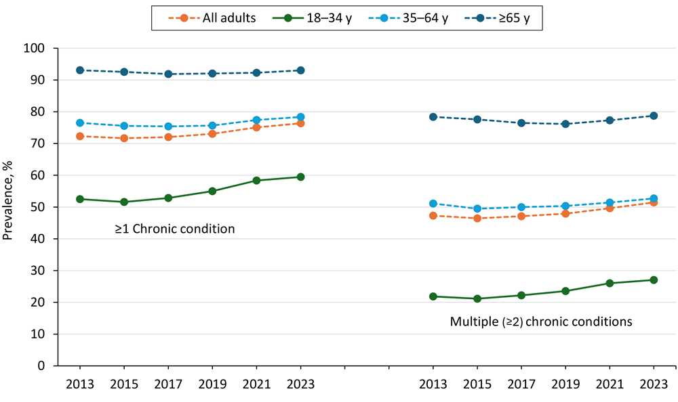
Comorbid conditions
Notes:
Comorbid conditions can reduce that reserve by placing greater stress on our organ systems. This study simply looked at age and chronic conditions. Explain. Not a big surprise, but something worth noting as we look at aging.
Epidemiol Rev
. 2013:35:75-83.
doi: 10.1093/epirev/mxs009. Epub 2013 Jan 31.
Multimorbidity in older adults
Trends in Multiple Chronic Conditions Among US Adults, By Life Stage, Behavioral Risk Factor Surveillance System, 2013–2023
ORIGINAL RESEARCH — Volume 22 — April 17, 2025
Article has an altmetric score of 302
Kathleen B. Watson, PhD1,2; Jennifer L. Wiltz, MD, MPH3,4,5; Kunthea Nhim, DrPH6; Rachel B. Kaufmann, PhD, MPH3; Craig W. Thomas, PhD1; Kurt J. Greenlund, PhD1
It becomes very common to have multiple conditions that can overlay and comorbids….

Slide 18
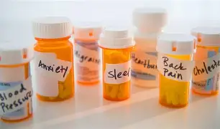
Polypharmacy
> 5 medications
Prevalence of 65% over the age of 65
Notes:
Lots to keep track of – how many times a day, with or without food, not to mention side effect profiles, overlapping risks of the medications, etc.

Slide 19
Polypharmacy
Absorption – aging doesn’t affect extent of absorption, but rate may be slower – delay in effect
Distribution – less body water and lean body mass, increased fat, reduced albumin
Metabolism – decreased clearance by liver
Excretion – decreased renal function
Notes:
What are the different ways polypharmacy can negatively impact on older person?
Pharmocokinetics – delay over not metabolizing. Some drugs are fat stored vs water based.
Reduced metab by the liver and reduced excretion by the kidneys leads to the drug staying in blood stream longer.

Slide 20
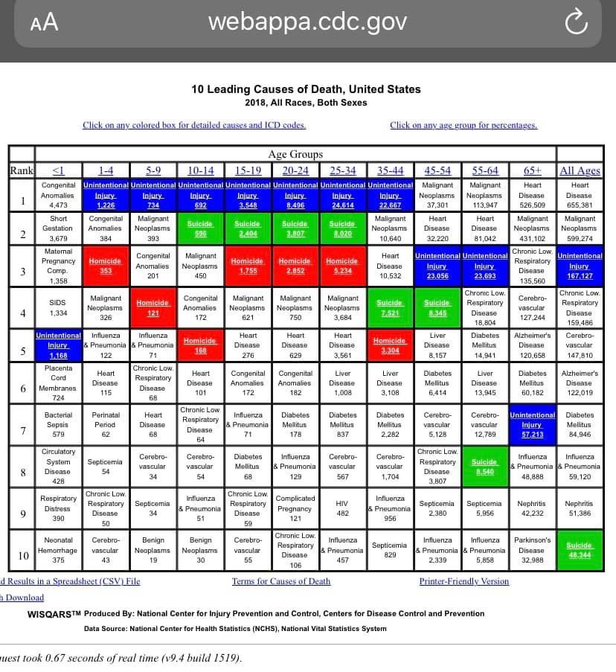
Notes:
General comment on the top causes of death
Blue: unintentional
Green: death by suicide
Red homicide
Let’s focus on the elderly, topic of talk

Slide 21
Notes:
Focus on age > 65, the #1 cause goes from CA to heart disease
Unintentional injury drops to 7, death by suicide does not make the top 10.

Slide 22
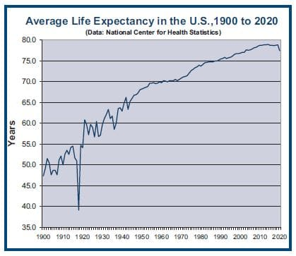
Notes:
General improvement in life expectancy over the 20th century, 1917 flu epidemic
start to plateau in 2010’s d/t opioids, then in 2020…. Dips from about 79 to 76
?obesity related conditions

Slide 23
Underwriting the elderly
History
Tests
Senior Exam
Assess for frailty
Notes:
What we use to UW the elderly
Use to assess for frailty – can be subtle if not directly tested for.

Slide 24

Frailty
Aging-related syndrome of physiological decline, characterized by marked vulnerability to adverse health outcomes
Notes:
Similar to our discussion about lack of reserve

Slide 25
Frailty screening
●Fatigue ("Have you felt fatigued? Most or all of the time over the past month?") Yes = 1, No = 0
●Resistance ("Do you have difficulty climbing a flight of stairs?") Yes = 1, No = 0
●Ambulation ("Do you have difficulty walking one block?") Yes = 1, No = 0
●Illnesses (“Do you have any of these illnesses: hypertension, diabetes, cancer (other than a minor skin cancer), chronic lung disease, heart attack, congestive heart failure, angina, asthma, arthritis, stroke, and kidney disease?”) Five or greater = 1, fewer than 5 = 0
●Loss of weight (“Have you lost more than 5 percent of your weight in the past year?”) Yes= 1, No = 0
Frail scale scores range from 0 to 5 (0 = best, 5 = worst) and represent frail (3 to 5), pre-frail (1 to 2), and robust (0) health status.
Notes:
Morely et al developed a self-reported questionnaire which then became adopted by the International Association of Nutrition and Aging – quick method for medical providers to assess frailty. Also we love acronyms, so easier to remember.

Slide 26
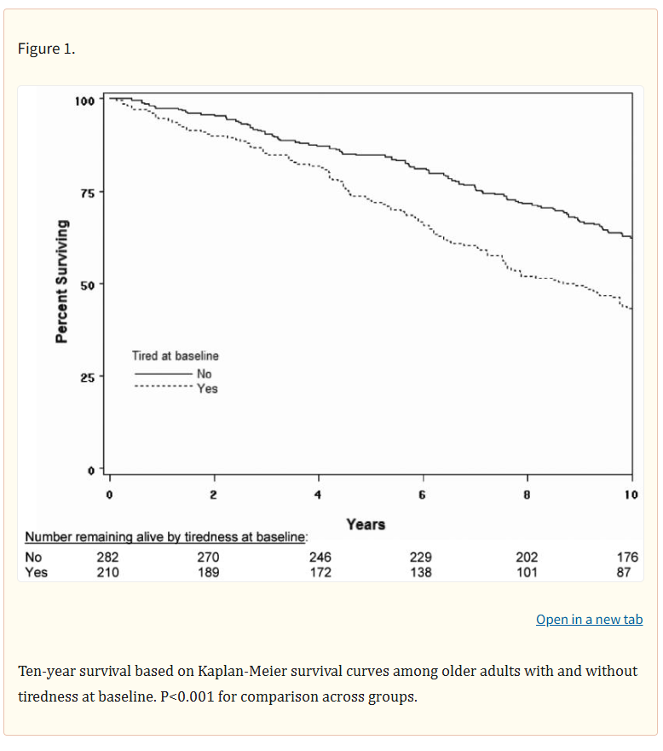
Fatigue
During the past month, have
you been feeling tired
most of the time?
Notes:
Study asked people this question and then collected data over the course of 10 years. The difference in mortality for yes and no. In the APS, a statement about how the person feels about their health should be taken seriously.
If they self report or complain about being tired or hey don’t feel well, we shouldn’t blow it off.
in final edited form as: J Am Geriatr Soc. 2008 Sep 22;56(10):1910–1914. doi: 10.1111/j.1532-5415.2008.01957.x
Fatigue Predicts Mortality among Older Adults

Slide 27
Activities of daily living
Basic self-care tasks
Bathing
Dressing
Toileting
Transfer from bed or chair
Eating
Urinary and bowel continence
Notes:
Explain are just for basic survival needs.

Slide 28
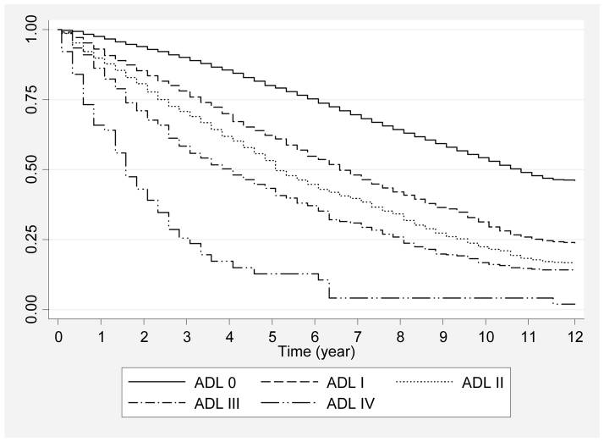
0 – No limitation
I – Mild
II – Moderate
III – Severe
IV - Complete
Notes:
Study took a group of people that reported the loss of any 1 ADL and compared them to a group that reported no loss of an ADL. For example, the study group said they needed help with dressing themselves and then subjective rating of how badly they’ve lost that single ADL. Another Kaplan Meyer survival curve.
All-Cause 1-, 5-, and 10-Year Mortality Among Elderly People According to Activities of Daily Living Stage
Margaret G Stineman ^{1,2}, Dawei Xie ¹, Qiang Pan ¹, Jibby E Kurichi ¹, Zi Zhang ¹, Debra Saliba ³, John T Henry-Sanchez ⁴, Joel Streim ⁵

Slide 29
Instrumental activities of daily living
Allow independent living
Telephoning
Personal finances
Using transportation services
Shopping
Meal preparation
Housework
Taking medications
Notes:
Not just a survival but allows for independent living

Slide 30
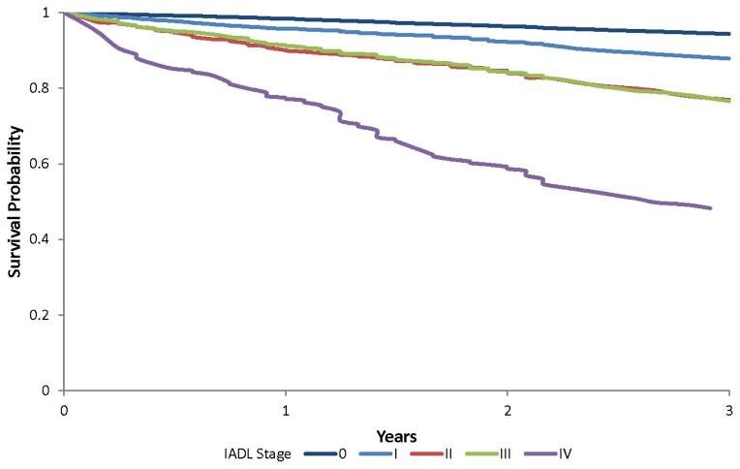
0 – No limitation
I – Mild
II – Moderate
III – Severe
IV - Complete
Notes:
Like last one in which just 1 AADL
Disability Stage Is an Independent Risk Factor for Mortality in Medicare Beneficiaries 65 Years of Age and Older
Sean Hennessy ^{1,2}, Jibby E Kurichi ¹, Qiang Pan ¹, Joel E Streim ³, Hillary Bogner ⁴, Dawei Xie ¹, Margaret G Stineman ⁵

Slide 31
Advanced activities of daily living
Add meaning and
richness to life
Working
Active in community
Going out to social activities
Participating in recreational activities
Driving
Playing cards
Traveling independently
Notes:
These are what we want to see the applicants doing – living and enjoying their golden years. Very positive factors in UW.

Slide 32
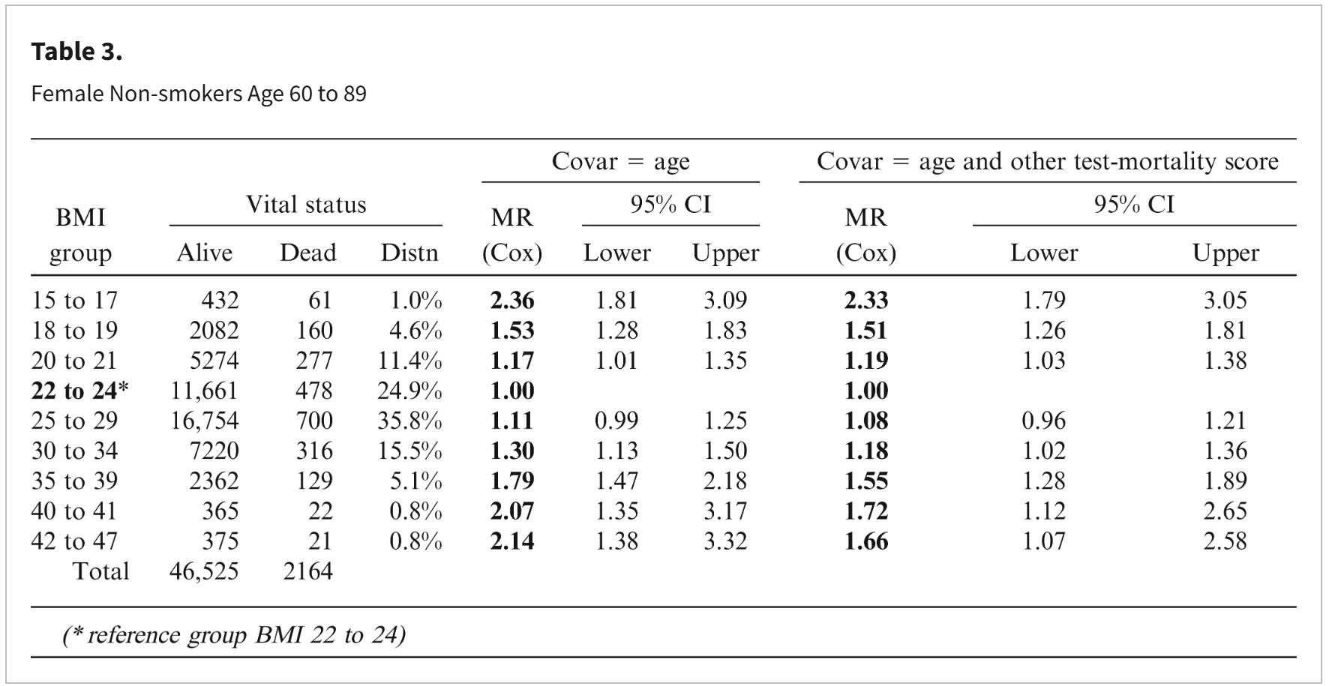
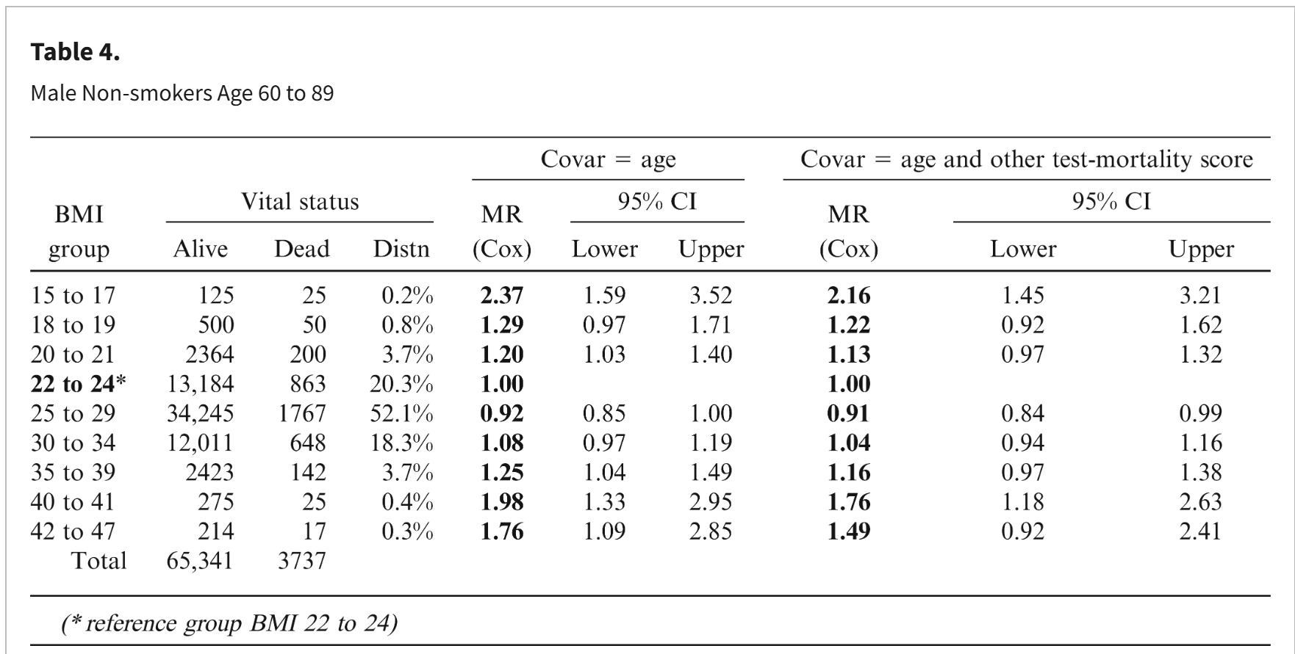
BMI
Notes:
2014 CRL Build Study of Life Insurance Applicants: BMI and mortality rates
I try to think of anything positive and I’ve come up with three. One, I won’t be replaced by AI. Two, being overwt doesn’t have that significant of an impact on mortality. Overwt though. Not obese. (3rd point to come) both men and women.
Sig risk in underweight range.

Slide 33
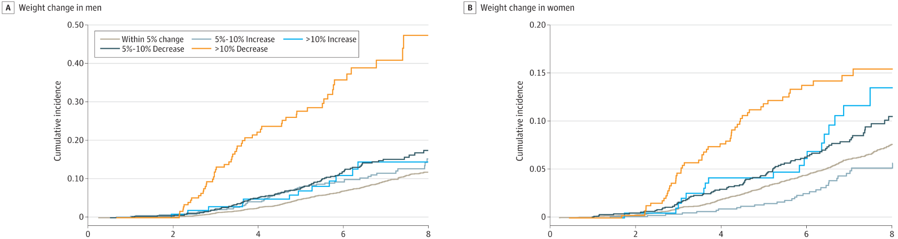
Beware of weight loss!
Body
Notes:
First thing I do going through an APS is record their weight on the exam and follow from APS office visits.
It is very very difficult to lose wt at older ages. If they’ve been overwt their whole adulthood, how can they lose wt now? I tell of my older pt who was always borderline obese and struggled for years to lose wt. He presented for a PE, proud he lost 15# since I last saw him through increased exercise and strict diet. I detected splenomegaly and dx him with lymphoma.
Even with GLP-1 usage, which we don’t have long-term studies on in the elderly population, we recommend waiting for some sort of Stability, 6 – 12 months.
Associations of Change in Body Size With All-Cause and Cause-Specific Mortality Among Healthy Older Adults
Sultana Monira Hussain, PhD^{1,2}; Anne B. Newman, PhD³; Lawrence J. Beilin, MD⁴
et al

Slide 34
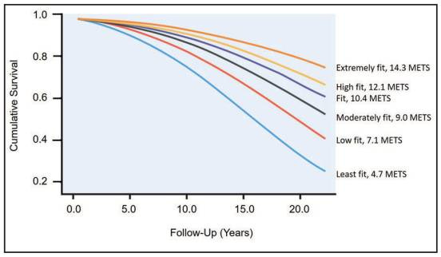
Exercise capacity
Notes:
If available, be aware for mortality with decrease exercise capacity
Look at stress test result.
My mother is a very young 83 year old. She participates twice a week in exercise classes, pilates, walks daily and very active. She goes into see her physician with a complaint of back pain or knee pain and while they have a discussion about “just keep moving.”

Slide 35
Falls
●Past history of a fall*
●Lower-extremity weakness
●Age
●Female sex
●Cognitive impairment
●Balance problems
●Hearing loss
●Psychotropic drug use
●Arthritis
●History of stroke
●Orthostatic hypotension
●Dizziness
●Anemia
Falls are the leading cause of injury-related death among adults ages 65 and older
Notes:
I came across a study that showed a single fall was associated with increased morbidity and need for NH care rather than mortality. But mx falls are sig for increased mortality. It also depends on the reason for the fall. Was cooking and turned and fell. Or was skiing in Vail and fell. I had a pt in her 80s who fell and broke her ankle. She was teaching an ice skating class at the time. No so concerning.

Slide 36
Tests
Serum albumin
Serum creatinine
Cholesterol
ABI
Pulse pressure
Notes:
Tests that indirectly point to mortality.

Slide 37
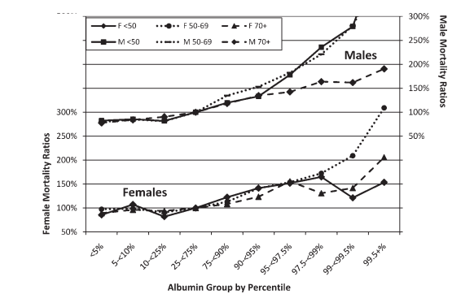

Serum albumin
CRL study
on life
insurance
applicants
< 3.95
< 3.80
< 3.5
Notes:
CRL: Albumin and All-Cause Mortality Risk in Insurance Applicants
High values on left
Mortality down, up

Slide 38
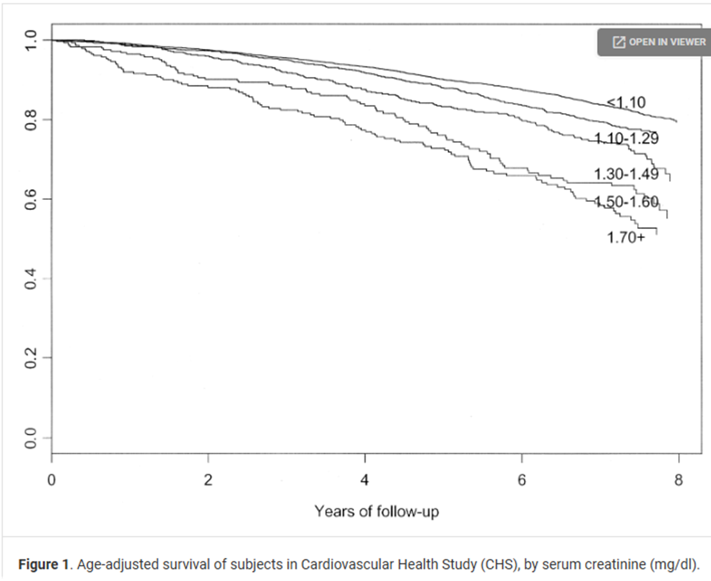
Serum creatinine
Used to calculate GFR, renal function
May be inaccurate due to lower muscle mass
Notes:
Age > 65
After adjusting for cardiovascular risk factors and subclinical disease measures, elevated creatinine remained a significant predictor of all-cause and cardiovascular mortality,
Renal insufficiency as a predictor of cardiovascular outcomes and mortality in elderly individuals
Authors: Linda F. Fried, MD, MPH lff9+@pitt.edu, Michael G. Shlipak, MD, MPH, Casey Crump, MD, PhD, Richard A. Kronmal, PhD, Anthony J. Bleyer, MD, John S. Gottdiener, MD, FACC, Lewis H. Kuller, MD, DrPH, FACC, and Anne B. Newman, MD, MPHAuthors Info & Affiliations

Slide 39
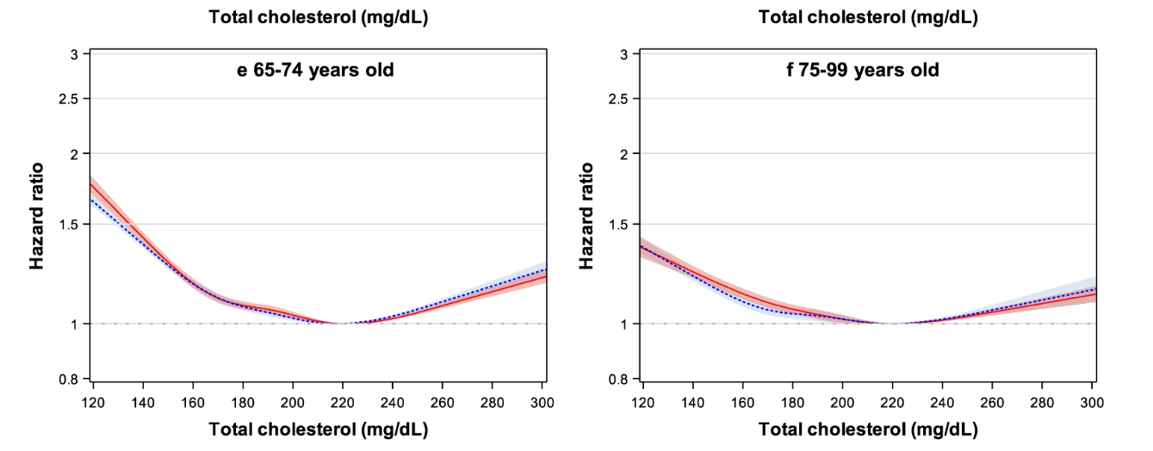
Cholesterol
Notes:
Total cholesterol and all-cause mortality by sex and age: a prospective cohort study among 12.8 million adults
Sang-Wook Yi,
Jee-Jeon Yi &
Heechoul Ohrr
Scientific Reports volume 9, Article number: 1596 (2019)
U shaped mortality curve. Not on statins. Increased CA death
Similar in younger ages as well

Slide 40
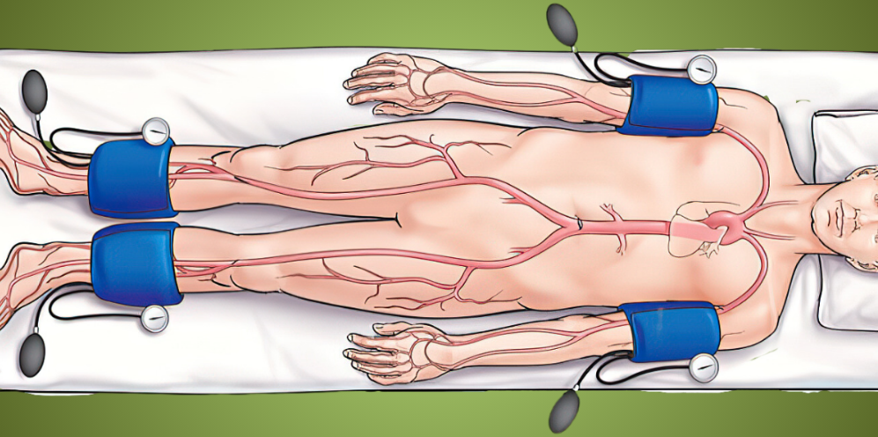
Ankle-Brachial Index (ABI)
ankle
SBP = brachial
Normal
0.9 – 1.3
Notes:
How it’s measured – BP in arm and legs same laying flat, pressure lower – Not increased work of heart, should be about 1: same in arm and leg. If there is blockage further away from the heart, like the ankle then there is less flow in the vessels and the and the P ankle >P brachial then the ABI is low. Another scenario we see in the elderly is there is so much blockage and calcifications of the peripheral vessels the pressure in the ankle is significantly higher than the arm.

Slide 41
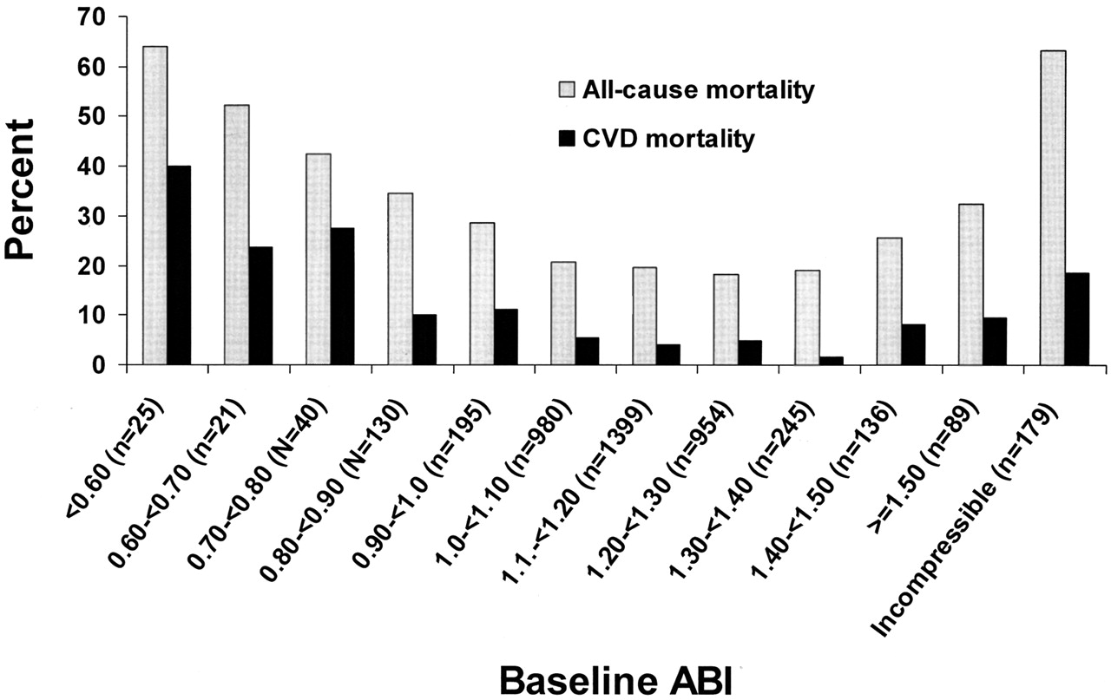
ABI
Body
Notes:
Relationship of High and Low Ankle Brachial Index to All-Cause and Cardiovascular Disease Mortality: The Strong Heart Study
Helaine E. Resnick, PhD, MPH, Robert S. Lindsay, MB, PhD, Mary McGrae McDermott, MD, Richard B. Devereux, MD, Kristina L. Jones, MPH, Richard R. Fabsitz, PhD, and Barbara V. Howard, PhD
Iso as you can see there is increased mortality not just for low but also for elevated.

Slide 42
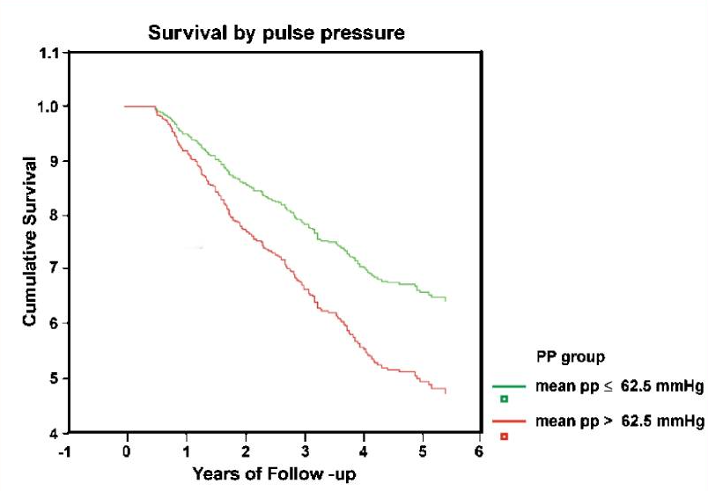
Pulse pressure
SBP – DBP = PP
SBP – DBP = PP
Notes:
Pulse Pressure Predicts Mortality in Elderly Patients
Avraham Weiss ^{1,5,✉}, Mona Boaz ², Yichayaou Beloosesky ¹, Ran Kornowski ³, Ehud Grossman ⁴
Increased PP and mortality. Decreased PP not an issue – sig valve disease
Very common consult in young people. When both of these pressures are low or normal, the PP is not an accurate representation of risk or we are more skeptical about the accuracy of the reading. When one of the values is abnormal in our older population, these survival curves are much more reliable.

Slide 43
Senior Testing
Delayed word recall
Get up and go
Mini mental status exam

Slide 44
Delayed Word Recall
Targets the ability to form new memories, generally one of the first areas of objective impairment in mild cognitive impairment and early Alzheimer’s disease.

Slide 45
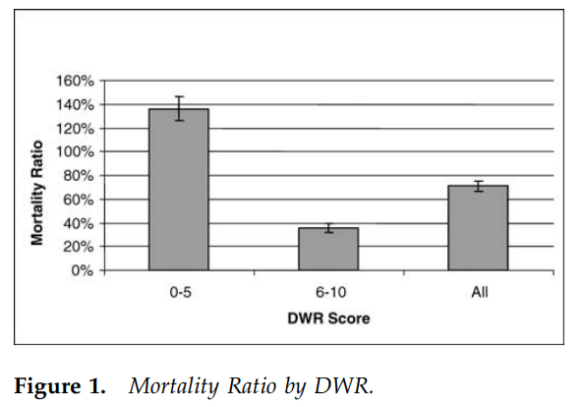

Slide 46
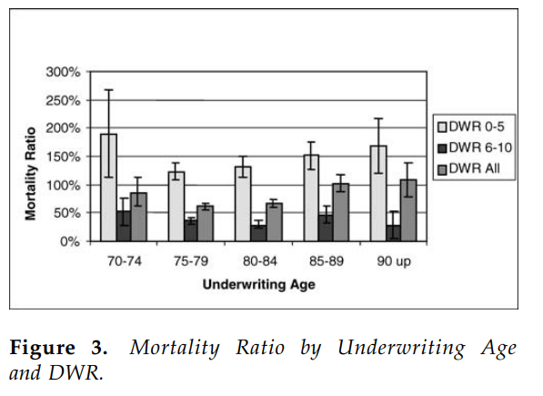

Slide 47
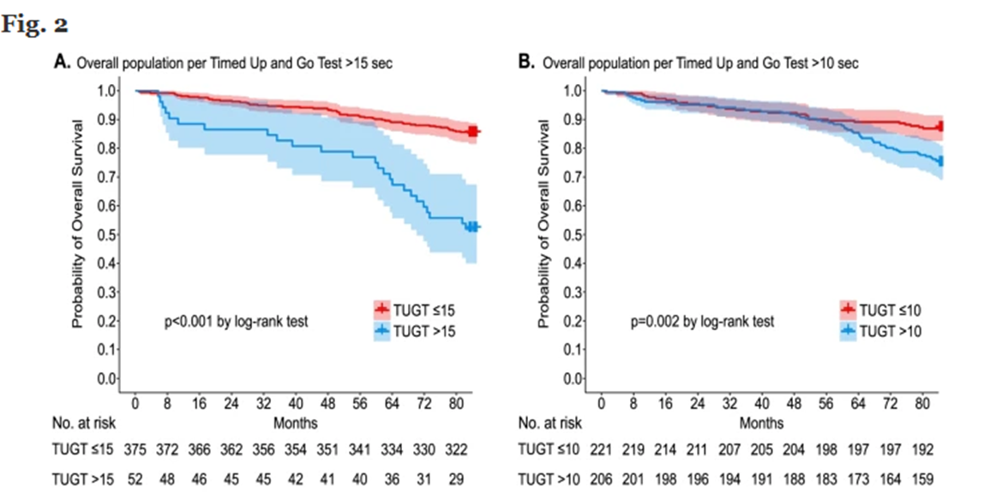
Get up and go
Notes:
First one if 15 second and second in 10 secs
Shouldn’t be someone requiring from a hip replacement or major event or a walking aid, ideally at baseline

Slide 48
Mini mental status exam (MMSE)
Assesses orientation (time and space)
Memory (registration and recall)
Attention/concentration
Language, verbal and written
Visuospatial function
Score < 23 out of 30 are considered impaired
Affected by age, education and race/ethnicity
Notes:
30 is very reassuring.
23-30 may require further investigation

Slide 49
Diseases in the elderly
New onset DM
Alcohol misuse
Asthma vs COPD
Depression
Dementia

Slide 50
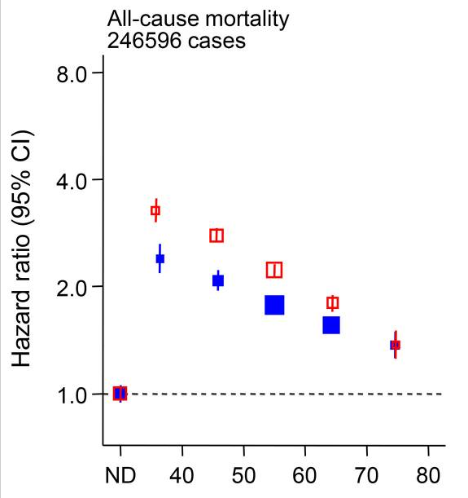
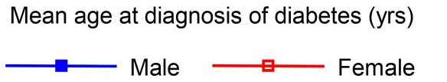
New onset DM
Age at diagnosis
Notes:
Dx of DM at later ages less of a mortality impact
Published in final edited form as: Lancet Diabetes Endocrinol. 2023 Sep 11;11(10):731–742. doi: 10.1016/S2213-8587(23)00223-1
Life expectancy associated with different ages at diagnosis of diabetes: 23 million person-years of observation

Slide 51
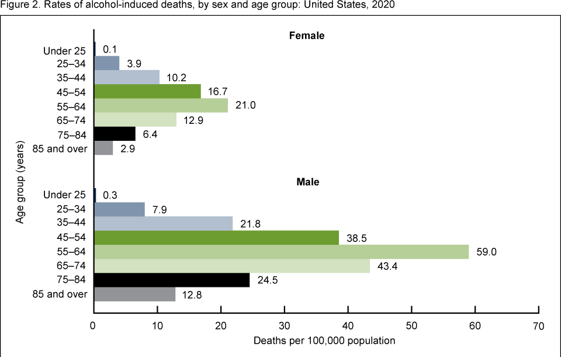
Alcohol
Notes:
Alcohol less of an issue at older ages compared to middle age. Why? Probably drinking at home and not driving, violence, etc. They made it this long, there’s probably some protective
3rd factor good as we age

Slide 52
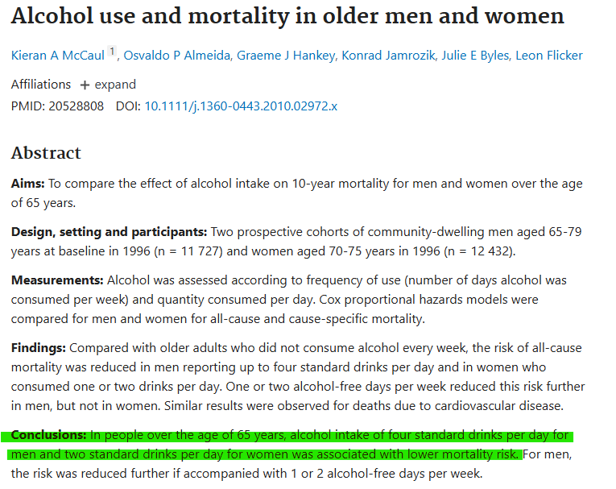
Alcohol
Body
Notes:
Here’s my 3rd good thing about approaching older age

Slide 53
Asthma vs. COPD
Both are an obstructive lung disease
Reduced FEV1
Reduced FEV1/FVC
Notes:
I see underwriters struggle with differentiating which it is. Some due to poor documentation
Difficulty blowing out a straw
FEV1 on PFTs – deep breath and blow fast and how much air blown out in first sec
FVC – total blown out

Slide 54
Asthma vs. COPD
Asthma obstruction is reversible
Bronchodilator response = ([Postbronchodilator value – Prebronchodilator value] x 100)/Predicted value, where "value" is either FEV₁ or FVC.
An increase of >10 percent is considered significant.
Notes:
Updated definition of bronchodilator response

Slide 55
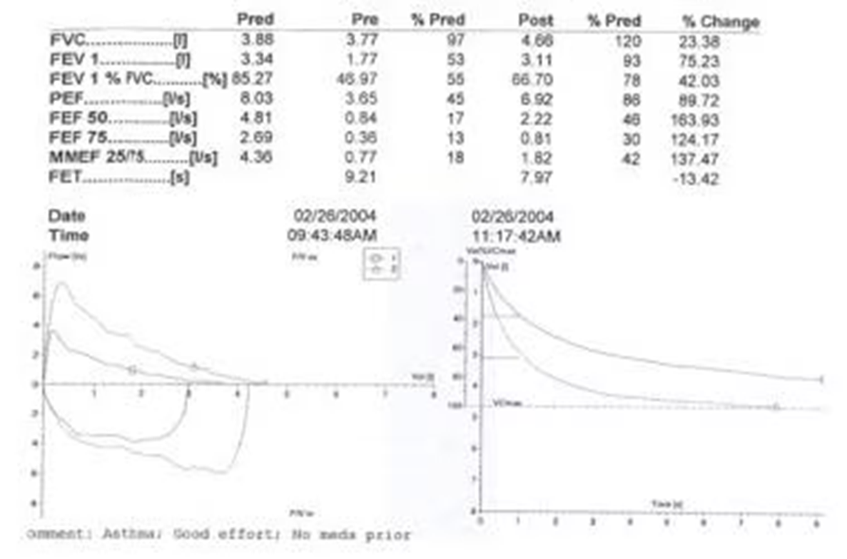
Asthma
FEV1: (3.11-1.77)x100/3.34= 40.12%
FVC: (4.66 – 3.77)x100/3.88= 22.93%
Notes:
Here’s an example. Notice the % changes don’t match. Old definition was an improvement of > 12% as of 2022 it’s >10% of FEV1 or FVC. More predictive of progression to COPD.

Slide 56
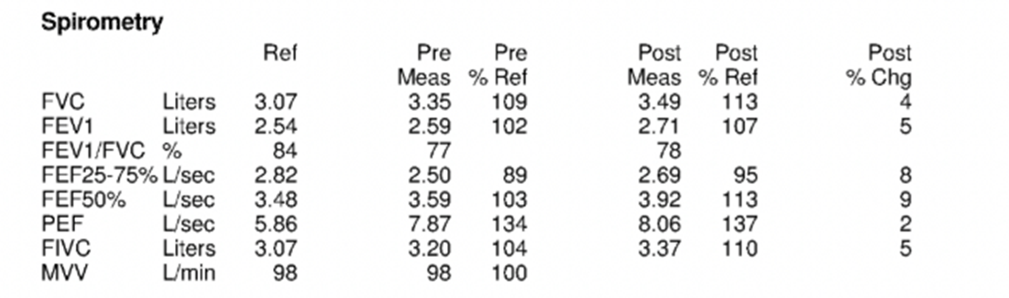
COPD
Notes:
NO reversibility

Slide 57
Late life depression
Risk Factors
●Female sex
●Social isolation
●Widowed, divorced, or separated marital status
●Lower socioeconomic status
●Comorbid general medical conditions
●Uncontrolled pain
●Insomnia
●Functional impairment
●Cognitive impairment

Slide 58
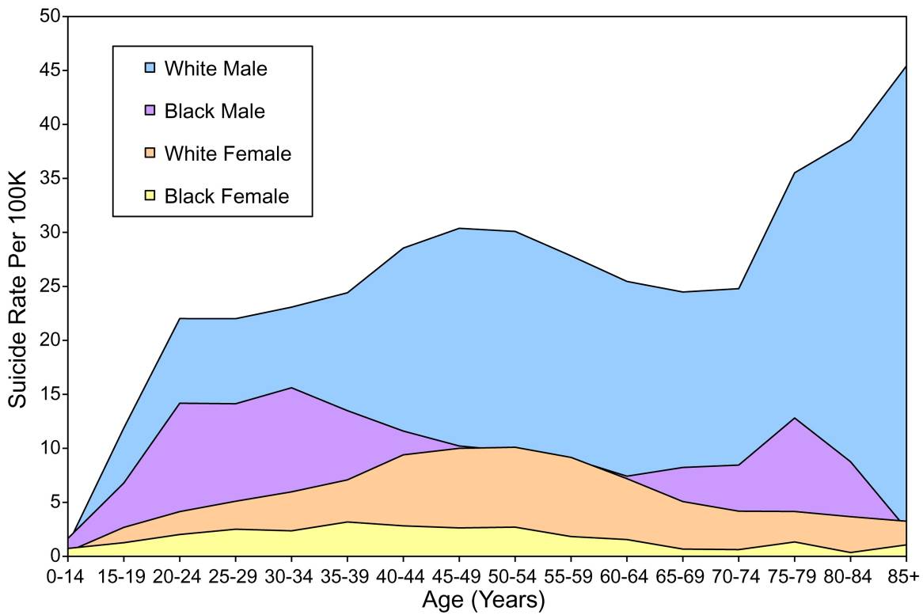
Notes:
Death by suicide is sig for older men

Slide 59
Cognitive domains
Learning and memory
Language
Executive function
Complex attention
Perceptual-motor
Social cognition
Notes:
These are the cognitive domains.
Learning and memory
Confabulation – describing place instead of saying “garage”
Decision making, multitasking
Working with distractions
Hand-eye coordination, driving, depth perception
Crazy Uncle Al at Thanksgiving dinner making inappropriate comments about Lisa’s new boyfriend (less socially inhibited)

Slide 60
Cognition
Older people are concerned about memory loss.
A family member’s concern about memory is more serious.
Notes:
Older people are more sensitive about memory. Young person can’t find her keys, brushes it off. An older person may think this is the beginning. Especially if they had experience with family member, friend recently diagnosed, etc. Very nervous about dementia. If they are nervous and no objective findings, further questioning.
Complaint by a family member should be investigated – more weight.
? Really good at hiding

Slide 61
Dementia
Mild cognitive
impairment
Decline in one or more cognitive domains that is severe enough to interfere with daily function and independence
Intermediate state between
normal cognition and dementia
Objective cognitive impairment
No decline in overall function

Slide 62

Depression vs. dementia
Late life depression is associated with an increased risk of developing dementia
Late-life depression may be a prodromal stage of dementia
Late-life depression may be an independent risk factor for dementia
Dementia is associated with an increased risk of depression
Notes:
Not clear, a lot of uncertainty
A newly dx older person should be followed over time to see which it is
PP x 1 year
Test of time may be needed, wait a year, a response? Improved symps? Worsen? More people/family members commenting?

Slide 63
Conclusion
Underwrite the physiologic age and not just the chronologic age
Properly assess for frailty using the medical history, tests and senior exam
Recognize the significance of certain tests in the elderly
Appreciate how some diseases have more and less impact at older ages

Slide 64

Why did the lady get fired from the ice cream shop?

Slide 65

Why did the lady get fired from the ice cream shop?
She refused to work on sundaes.

Slide 66


