Slide 1
Alcohol Use and Misuse
Dr. Robert Coates, Swiss Re
May 15, 2019

Slide 2
Agenda
Alcohol cases
Note your initial opinion of the case:
1. Little or no excess mortality risk
2. Low excess mortality risk
3. Moderate excess mortality risk
4. High excess mortality risk
Alcohol notes with application to the alcohol cases

Slide 3
Alcohol Case 1
38 yo m non-smoker, 6’5” 249lbs, BP=125/74; no medications; occupation: president of a family business; admits to 1-2 drinks 3x/week; MVR–clear
Insurance labs-glycolysis: AST=27 (0-41), ALT=20 (0-45), GGT=23 (2-65), Chol=199, HDL=71.9, ratio 2.76
APS review: Only a few pages–annual CPE 2017-one year prior to application: vasectomy, appy; FH: F-68, M-67, 2 siblings all healthy; SH: exercises regularly; wine 2-3x/week; normal exam; CBC normal: MCV=90.4, platelets=188,000, normal LFTs. Chol=243, HDL=69

Slide 4
Alcohol Case 2
57 yo f smoker
1/18 insurance labs-glycolysis: BUN=8, GGT=21, chol=204, HDL=73, trigs=64, cotinine-positive
Alcohol use: 10 units per week

Slide 5
Alcohol Case 3
33 yo m
2009 DWI
Application: drinks alcohol 2-3 days/week, 2-3 drinks per occasion
9/17 insurance labs-glycolysis: GGT=24, alb=5.5, chol=201 HDL=75.2, trigs=89, cotinine-negative

Slide 6
Alcohol Case 4
40 yo m 6’0” 185 lbs, BP=110/70
12/15 PAF hospitalization; f/u visits only minimal brief PAF episodes per patient
Alcohol and substance use history-prior to 12/15-cocaine and MJ-no details
12/15: 6 beers per day before PAF onset
2017 app: 3 beers per day
9/17 insurance labs: AST=24, ALT=23, GGT=46, Hep B and C negative, alb=4.4, chol=179, HDL=34.7, Trigs=180, cotinine neg

Slide 7
Alcohol Case 5
31 yo m 5’9” 132# BP= 115/78
4/19 insurance labs: wnl, except BUN=5, AST=47, GGT=124, CDT-pos, chol=276, HDL=179, cot >1.00
MVR: no DWI
Admits to 3-5 beers per week, 10-15 beers per month and no alcohol issues ever
Last AP visit 2015

Slide 8
Alcohol Use Disorder-Global View
Alcohol use disorder is number one on the global burden of disease list of substance use disorders. Of the two million total disability adjusted life-years lost to substance use disorders, not including tobacco, the rank of the individual substance use disorders were: Alcohol – 47% Opioids – 24.3% Amphetamines – 7.0% Cannabis – 5.5% Cocaine – 2.9% Other illicit drugs – 13.4%
Degenhardt L, et al. The Global Epidemiology and Contribution of Cannabis Use and Dependence to the Global Burden of Disease: Results from the GBD 2010 Study. PLoS One 2013; 8:e76635

Slide 9
Alcohol-US Epidemiology
Alcoholism in the National Comorbidity Survey: 2.5 times more prevalent in men than in women. During the past year, alcohol abuse/dependence rates were 10-12% for men and 4-5% for women, or about 7-8% of the population.
US National Longitudinal Alcohol Epidemiologic Study: Alcoholism is present in 1 in 5 (20%) of adult hospital inpatients. 1 in 6 (~17%) patients in community-based primary care practices had problem drinking.
Excessive alcohol consumption is the third leading preventable cause of death in the United States. More than 85,000 deaths a year in the United States are directly attributed to alcohol use, including medical illness, traffic fatalities, drowning, and suicide.
Stahre M Prev Chronic Dis. 2014;11:E109

Slide 10
Alcoholism Etiology
The exact cause of alcoholism is unknown.
Alcoholism is a primary, chronic, progressive, and often fatal disease. Life expectancy is shortened.
There is a strong genetic component to alcoholism:
1) There is a higher concordance of alcohol dependence in monozygotic twins compared to dizygotic twins.
2) Adopted children with a biologic parent who is alcoholic have a 2-3x increased risk of alcoholism compared to adopted children whose biologic parents are not alcoholic.
Youth who start drinking before age 15 are 6 times more likely to develop alcohol dependence/abuse than those who begin drinking at or after age 21. Center for Behavioral Health Statistics and Quality. 2015 National Survey on Drug Use and Health: Detailed Tables. Substance Abuse and Mental Health Services Administration, Rockville, MD; 2016.

Slide 11
Alcohol Use Definition Problems
The difficulty with alcohol use and misuse diagnosis is there is no exact definition of alcohol misuse and there is no diagnostic test to separate the subset of drinkers at high risk for alcohol-related fatalities.
Alcohol use disorder, diagnosis based on DSM-5 criteria, replaced two psychiatric disorders in DSM-IV, alcohol abuse and alcohol dependence.
Alcohol misuse definition: Drinking of alcohol to an extent that the drinking causes problems (relationships, health, occupation, legal, financial) in one’s life, and, in spite of the problems, drinking of alcohol continues.
Important note: There is no scale for 1-severity of the problems, 2-how many of those five categories need to be affected, 3-the quantity of alcohol consumed, 4-nor the frequency of alcohol consumption.

Slide 12
Alcohol Use Disorder DSM-5
The American Psychiatric Association has developed strict criteria for the clinical diagnosis of alcohol use disorders. The Diagnostic and Statistical Manual-5 (DSM-5) defines Alcohol Use Disorder as:
A problematic pattern of alcohol use leading to clinically significant impairment or distress, as manifested by at least two of the following, occurring within a 12 month period:
1. Alcohol is often taken in larger amounts or over a longer period of time than intended.
2. There is a persistent desire or unsuccessful efforts to cut down or control alcohol use.
3. A great deal of time is spent in activities necessary to obtain alcohol, use alcohol, or recover from its effects.
4. Craving, or a strong desire or urge to use alcohol.
5. Recurrent alcohol use resulting in a failure to fulfil major role obligations at work, school, or home.
6. Continued alcohol use despite having persistent or recurrent social or interpersonal problems caused or exacerbated by the effects of alcohol.

Slide 13
Alcohol Abuse DSM-5
7. Important social, occupational, or recreational activities are given up or reduced because of alcohol use.
8. Recurrent alcohol use in situations where it is physically dangerous.
9. Alcohol use is continued despite knowledge of having a persistent or recurrent physical or psychological problem that is likely to have been caused or exacerbated by alcohol.
10. Tolerance
11. Withdrawal
Severity of Alcohol Misuse:
Mild: 2-3 symptoms
Moderate: 4-5 symptoms
Severe: 6 or more symptoms
DSM-5, Diagnostic and Statistical Manual of Mental Disorders, ed. 5. Washington DC: American Psychiatric Association (APA). 2013.

Slide 14
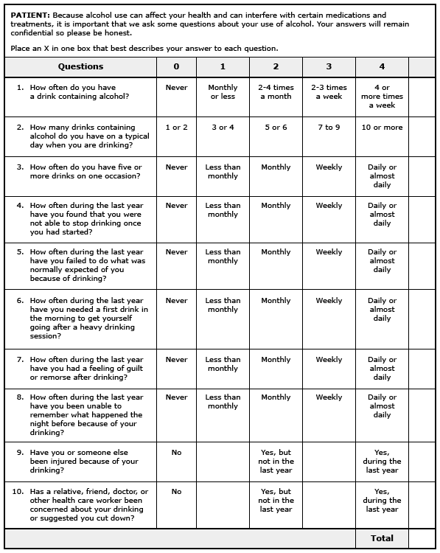
Alcohol Screening AUDIT
The epidemiology of alcohol-related interpersonal violence
AU
Martin SE
SO
Alcohol Health Res World. 1992;16:230.
The epidemiology of alcohol-related interpersonal violence
AU
Martin SE
SO
Alcohol Health Res World. 1992;16:230.

Slide 15
Alcohol Screening-Audit-C
The epidemiology of alcohol-related interpersonal violence
AU
Martin SE
SO
Alcohol Health Res World. 1992;16:230.
The epidemiology of alcohol-related interpersonal violence
AU
Martin SE
SO
Alcohol Health Res World. 1992;16:230.
The AUDIT-C is scored on a scale of 0 to 12 (scores of 0 reflect no alcohol use). In men, a score of 4 or more is considered positive; in women, a score of 3 or more is considered positive
Question #1: How often did you have a drink containing alcohol in the past year?
• Never | (0 points)
• Monthly or less | (1 point)
• Two to four times a month | (2 points)
• Two to three times per week | (3 points)
• Four or more times a week | (4 points)
Question #2: How many drinks did you have on a typical day when you were drinking in the past year?
• 1 or 2 | (0 points)
• 3 or 4 | (1 point)
• 5 or 6 | (2 points)
• 7 to 9 | (3 points)
• 10 or more | (4 points)
Question #3: How often did you have six or more drinks on one occasion in the past year?
• Never | (0 points)
• Less than monthly | (1 point)
• Monthly | (2 points)
• Weekly | (3 points)
• Daily or almost daily | (4 points)
.

Slide 16
Alcohol Screening-CAGE Questionnaire
The CAGE questions are:
●Have you ever felt you should Cut down on your drinking?
●Have people Annoyed you by criticizing your drinking?
●Have you ever felt bad or Guilty about your drinking?
●Have you ever taken a drink first thing in the morning (Eye-opener) to steady your nerves or get rid of a hangover?
Two affirmative responses are 77 percent sensitive and 79 percent specific for alcohol abuse and dependence, but only 53 percent and 70 percent, respectively, for unhealthy alcohol use.
Fiellin DA, Reid MC, O'Connor PG: Screening for alcohol problems in primary care: a systematic review; Arch Intern Med. 2000;160(13):1977.

Slide 17
Alcohol Tidbits
According to Dr. Bob Stout of CRL, 1.2% of life insurance applicants have detectable alcohol in their serum and 0.6% (one half of those apps with alcohol in their serum) have a blood alcohol level >0.08 mg/dl, the legal limit of acute intoxication.
Presented at TCAHOU conference, Bloomington, MN, May 19, 2011
Alcohol abuse is a common co-morbidity of smoking, occurring in 30% of smokers willing to quit.
Miller and Gold, 1998
Almost 30% of people with psychiatric illness exhibit substance abuse with 25% abusing alcohol, 40% abusing nicotine, and 15% abusing other drugs.
Essentials of Addiction Medicine, 2nd ed, 2015; AJ Herron, TK Brennan; p 12

Slide 18
Alcohol Mortality Concerns
Motor vehicle accidents: May 31, 2018: A new report from the study by the Governor’s Highway Safety Association stated alcohol was involved in 38% of fatal accidents in 2016. 44 % of fatalities tested positive for drugs, a statistic up 28% from 2006. 38% of the drivers killed tested positive for marijuana, 16% were positive for opioids, and 4% had both.
Medical problems: hypertension, cardiomyopathy, arrhythmias, GI bleeding, liver disease, pancreatitis, cancer-not a complete list
Suicides: 95% of all suicides have a mental disorder: 80% with depression, 10% with schizophrenia, 5% with dementia. 75% of suicide victims have comorbidity. ~25% also have alcohol abuse.
Alcoholism factors at the time of suicide: recent life disruption, loss of a close relationship, major depression (75%), health problems (50%), unemployed (50%), living alone (33%)
Accidental drug overdoses

Slide 19
Alcohol Mortality Concerns
A meta-analysis of 31 studies pooling data from over 400,000 participants found an association between
alcohol use disorder and suicidal ideation (odds ratio = 1.86; 95% CI 1.38, 2.35),
suicide attempt (odds ratio = 3.13; 95% CI 2.45, 3.81); and
completed suicide (odds ratio = 2.59; 95% CI 1.95, 3.23 and risk ratio = 1.74; 95% CI 1.26, 2.21).
The lifetime rate of suicide attempts among frequent alcohol users in the United States was 7 percent, well above the United States general adult population rate of 1 percent
Darvishi N, Farhadi M, Haghtalab T, Poorolajal J: Alcohol-related risk of suicidal ideation, suicide attempt, and completed suicide: a meta-analysis. PLoS One. 2015;10(5):e0126870. Epub 2015 May 20

Slide 20
Alcohol Mortality Concerns
The epidemiology of alcohol-related interpersonal violence
AU
Martin SE
SO
Alcohol Health Res World. 1992;16:230.
The epidemiology of alcohol-related interpersonal violence
AU
Martin SE
SO
Alcohol Health Res World. 1992;16:230.
Alcohol use increases the risk of violence.
Alcohol is involved in one-half to two-thirds of all homicides, at least one-half of serious assaults, and more than one-quarter of all rapes.
Martin SE: The epidemiology of alcohol-related interpersonal violence; Alcohol Health Res World. 1992;16:230

Slide 21
Alcohol Case 1
38 yo m non-smoker, 6’5” 249lbs, BP=125/74; no medications; occupation: president of a family business; admits to 1-2 drinks 3x/week; MVR–clear
Insurance labs-glycolysis: AST=27 (0-41), ALT=20 (0-45), GGT=23 (2-65), Chol=199, HDL=71.9, ratio 2.76
APS review: Only a few pages–annual CPE 2017-one year prior to application: vasectomy, appy; FH: F68, M67, 2 siblings all healthy; SH: exercises regularly; wine 2-3x/week. Normal PE. CBC normal: MCV=90.4, platelets=188,000, normal LFTs. Chol=243, HDL=69
CDT-positive

Slide 22
Carbohydrate Deficient Transferrin (CDT)
Chronic heavy alcohol consumption reduces the number of carbohydrate moieties attached to transferrin, leading to increased CDT levels. An average daily consumption of more than 60 grams of alcohol (~4 drinks) during the previous 2 weeks increases the percentage of transferrin that has a deficient carbohydrate content.
CDT is thus used as a biomarker to detect heavy daily alcohol consumption.
CDT typically normalizes within several weeks of abstinence of alcohol use.
CDT is currently the only FDA-approved test for the detection of heavy alcohol use. Different laboratories and commercial kits report wide ranges in CDT sensitivities and specificities. Sensitivity of CDT remains a controversial issue.

Slide 23
Carbohydrate Deficient Transferrin (CDT)
According to the Mayo clinic, specimen stability for CDT measurement is 7 days at room temp and 28 days, if refrigerated.
Congenital disorders of glycosylation (CDGs), hereditary fructose intolerance, galactosemia, and liver disease may result in increased levels of CDT.
In addition, pre-analytic variables such as bacterial contamination may cause falsely elevated CDT values.
Several factors may cause variability in CDT analysis, including: ethnicity, gender, pregnancy, body mass index, smoking, blood pressure, iron metabolism, drug interactions, chronic medical illness

Slide 24
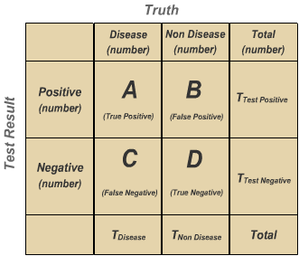
Carbohydrate Deficient Transferrin (CDT)

Slide 25
Carbohydrate Deficient Transferrin (CDT)
Tests are not the event: We have a heavy alcohol use test, but it is separate from the event of actually having heavy alcohol use.
Tests are imperfect: Tests detect things that don’t exist (false positives), and miss things that do exist (false negatives).
Tests give us test probabilities, not the real probabilities. Don’t consider the test results directly, without considering the errors in the tests.
Prevalence of Disease= T_{disease}/ Total × 100
Sensitivity: A/(A+C) × 100; Specificity: D/(D+B) × 100
Positive Predictive Value: A/(A+B) × 100: PPV=sensitivity × prevalence/sensitivity × prevalence + (1−specificity) × (1−prevalence)
Negative Predictive Value: D/(D+C) × 100: NPV=specificity × (1− prevalence)/(1−sensitivity) × prevalence + specificity × (1−prevalence)

Slide 26
Carbohydrate Deficient Transferrin (CDT) CDT AND SERUM ALCOHOL: WHAT IS THE RISK? VF Dolan, et al: ON THE RISK vol.27 n.1 (2011)
CDT identifies a substantial portion of heavy regular alcohol users. Accepting a real-world specificity of 98.5% (published values of 98-100%), sensitivity of 75%, and a heavy alcohol use prevalence in applicants of 7.5%, the positive predictive value (PPV) is only 0.3. Roughly, one out of three positive CDT results is a true positive result! The low PPV argues against using CDT as a general population screening test.
Based on CRL research, GGT elevation triples the pre-test likelihood of heavy alcohol use, HDL >50 doubles it, and positive tobacco may cause a 4-fold increase.
If any two of these conditions are present and CDT is positive, we estimate the pre-test likelihood increases sufficiently so that the final PPV is 0.7 or better.

Slide 27
Sensitivity and Specificity of Alcohol Biomarkers*
Biomarker | Sensitivity (%) | Specificity (%)
AST | 15-69 | 47-68
ALT | 18-58 | 50-57
GGT | 34-85 | 11-95
MCV | 34-89 | 26-95
CDT | 39-94 | 82-100
CDT + GGT | 90 † | 98
Alcohol | 0-100 | 0-100
*Values vary considerably according to gender, age, drinking pattern, prevalence of alcohol abuse/dependence, and prevalence of comorbidity, among other factors Keep in mind, any and all combination of abnormalities of the above tests can occur with alcohol misuse, and all tests can also be normal.

Slide 28
Alcohol Mortality Risk in Males

Slide 29
Alcohol Mortality Risk in Females

Slide 30
Relative Risk of Death According to Alcohol Use in Drinks per Day Compared to Lifelong Abstainers Klatsky et al. Ann Intern Med, 1992
age/usual drinks per day
>0-1 1-2 3-5 6+
<30
30-39
40-49
50-59
60-69
>70
1.4 1.5 1.6 3.3
1.3 1.5 2.6 2.6
0.7 0.9 1.0 1.6
1.0 0.9 1.1 1.7
0.8 0.8 0.9 1.0
0.8 1.0 0.9 0.8

Slide 31
Alcohol Case 2
57 yo f smoker
1/18 insurance labs-glycolysis: BUN=8, GGT=21, chol=204, HDL=73, trigs=64, cotinine-positive
Alcohol use: 10 units per week
CDT-positive

Slide 32
Alcohol Volume Definitions
1 drink=14 g of pure alcohol=0.6 fl oz; 1 drink=one 12 oz beer, 5 oz of wine, 1.5 oz of 80 proof whiskey
1 pint 80 proof liquor ~160 gm alcohol; 1 six-pack of 12 oz beers ~84 gm alcohol; 1 liter of wine ~80 gm alcohol
Moderate drinking is defined as
females: 1 or less drink per day (drink for drink, women get higher blood alcohol levels)
males: 2 or less drinks per day
Heavy drinking is currently defined as
females: >1 drink per day; 98 g/wk; Harmful >40 g/day (3 drinks per day)
males: >2 drinks per day; 196 g/wk; Harmful >60 g/day (4 drinks per day)
Keep in mind for an individual user, no volume or amount of alcohol is without some health risk.

Slide 33
Alcohol Consumption Risk Thresholds
The purpose of the study was to define alcohol consumption thresholds associated with the lowest risk of all-cause mortality and cardiovascular disease.
Data from 599,912 current drinkers from 83 prospective studies, 1964-2010; mean age=57 years; 56% males, 44% females; 21% current smokers; 50% drank >100 g alcohol per week
In current drinkers of alcohol in high-income countries, the threshold for lowest all-cause mortality was about 100 g/week (~7 drinks per week). Associations were similar for men and women, but weaker at older ages.
It is suggested that drinkers of beer or spirits, as well as binge drinkers, had a higher all-cause mortality risk than wine drinkers.
Wood AM, et al: The Lancet: vol 391; April 14, 2018; p 1513-1522

Slide 34
Alcohol Case 3
33 yo m
2009 DWI
Application: drinks alcohol 2-3 days/week, 2-3 drinks per occasion
9/17 insurance labs-glycolysis: GGT=24, alb=5.5, chol=201 HDL=75.2, trigs=89, cotinine-negative
CDT-positive

Slide 35
Alcohol and DWI/DUI
One drink in an “average 70 kg person” results in a blood alcohol level or concentration of ~30 mg/dl (0.03%).
Legal limit of alcohol for DWI:
0.00%-Czech, Slovakia, Russia, Hungary, new drivers-Canada
0.02%-China, Poland, Norway, Sweden, Estonia
0.03%-India, Japan, Serbia
0.04%-Lithuania, Saskatchewan-Canadian province
0.05%-Europe-not listed above, Finland, Latvia, Taiwan, Turkey, Canada-BC, ON, MB, NS, NF, Hong Kong, Israel, Iceland, Australia
0.08%-Canada (criminal offense), Mexico, UK, since 2002-USA, New Zealand

Slide 36
Alcohol and DWI/DUI
>1 million people arrested each year for DWI-1/3 are repeat offenders. Fell, Jim. “Repeat DWI Offenders in the United States.” Washington, DC: National Department of Transportation, National Highway Traffic Safety Administration Traffic Tech No. 85, February 1995
35,000-40,000 DWIs per year in MN, about 100 per day; one in 17 MN drivers has two or more DWIs; 0.15 mg% average blood alcohol level for a DWI arrest-almost twice the legal limit data from MN MADD, Minneapolis Star Tribune 5/31/2011
A convicted drunk driver has driven drunk 80 times before the first arrest-avg. Arrest data: Federal Bureau of Investigation, “Crime in the United States: 2014”: Centers for Disease Control and Prevention. “Alcohol-Impaired Driving Among Adults — United States, 2012.” Morbidity and Mortality Weekly Report. August 7, 2015 / 64(30);814-817.
Every 50 minutes in the US, someone is killed in a drunk driving crash, 29 people per day. National Highway Traffic Safety Administration. “Traffic Safety Facts 2016: Alcohol-Impaired Driving.” Washington DC: National Highway Traffic Safety Administration, 2017.
Nov 21-Dec 29, 2018 MN: 2,757 DWIs issued; one 29 yo woman BAC=0.41; one driver’s car speed=108 mph; one woman-12th DWI Minneapolis Star Tribune 1/10/2019

Slide 37
Alcohol Case 4
40 yo m 6’0” 185 lbs, BP=110/70
12/15 PAF hospitalization; f/u visits only minimal brief PAF episodes per patient
Alcohol and substance use history-prior to 12/15-cocaine and MJ-no details
12/15: 6 beers per day before PAF onset
2017 app: 3 beers per day
9/17 insurance labs: AST=24, ALT=23, GGT=46, Hep B and C negative, alb=4.4, chol=179, HDL=34.7, Trigs=180, cotinine neg

Slide 38
Effects of Alcohol on the Body
Neurologic: CNS (central nervous system), PNS (peripheral nervous system) neuropathy, muscles-myopathy; psychiatric comorbidities
Gastrointestinal: esophagus-reflux-GERD; stomach-gastritis, ulcers; pancreatitis; liver-fatty liver, hepatitis, cirrhosis
Cardiac: arrhythmia=PAF, dilated cardiomyopathy; high BP
Hematologic: Hgb-anemia, low WBC/PMNs, low platelets
Endocrine: elevated lipids-chol, HDL, trigs, elevated uric acid-gout
Cancer: oropharynx (worsened with smoking), esophagus-SCC-not adenoca, pancreas, liver, colon, breast, cervix, prostate
Fetal Alcohol Syndrome: ~31 to ~99 per 1000 children Observational study funded by the National Institute on Alcohol Abuse and Alcoholism; co–lead investigator Christina D. Chambers, PhD, professor of pediatrics at the University of California, San Diego, in La Jolla

Slide 39
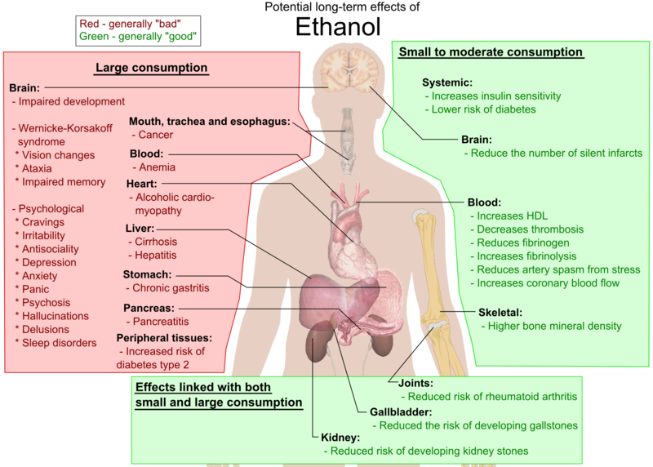

Slide 40
Alcohol Case 5
31 yo m 5’9” 132# BP= 115/78
4/19 insurance labs: wnl, except BUN=5, AST=47, GGT=124, CDT-pos, chol=276, HDL=179, cot >1.00
MVR: no DWI
Admits to 3-5 beers per week, 10-15 beers per month and no alcohol issues ever
Last AP visit 2015

Slide 41
CDC Binge Drinking Facts
Binge drinking is the most common, costly, and deadly pattern of excessive alcohol use in the US.
National Institute on Alcohol Abuse and Alcoholism binge drinking definition: drinking that results in blood alcohol concentration >0.08 grams percent. It occurs when men consume >5 drinks or women consume >4 drinks in 2 hrs.
The prevalence of binge drinking among men is twice the prevalence among women.
1 in 6 US adults binge drink ~4 times a month, consuming ~8 drinks per binge. Most binge drinkers are not alcohol dependent.
Binge drinking is most common among younger adults aged 18–34 years, but is reported across the lifespan.
Kanny D, Liu Y, Brewer RD, Lu H. Binge drinking — United States, 2011. MMWR Suppl. 2013;62(suppl 3):77–8

Slide 42
Underwriting Alcohol Use
VOLUME
FREQUENCY
PROBLEMS
health: physical problems/psychological comorbidities-depression
social/relationships
occupation
legal-DWI
financial
GENDER
AGE

Slide 43
Rating Alcohol Use
Lower risk | → | Higher risk
Moderate volume | → | Heavy volume
Chronic drinking | → | Binge drinking
Older age | → | Younger age
No health complications | → | Major, chronic or recurrent health complications
No psych comorbidities | → | Psych co-morbidities
Non-treatment center | → | Treatment center

Slide 44
Alcohol Workshop Key Points
Alcohol use disorder is common, affecting men more often than women, and is the third preventable cause of death in the US, causing deaths from medical illnesses, motor vehicle accidents, and suicides.
Alcohol use disorder has no exact definition or specific diagnostic test. The DSM-5 has diagnostic criteria and a scale for severity.
Alcohol use disorder is associated with psychiatric comorbidities and smoking.
Alcohol use in people under age 40 is associated with an increased mortality risk.
Heavy alcohol use in people over age 60 is not associated with an increased mortality risk, if there are no comorbidities or health problems related to alcohol use.

Slide 46
Legal notice
©2019 Swiss Re. All rights reserved. You are not permitted to create any modifications or derivative works of this presentation or to use it for commercial or other public purposes without the prior written permission of Swiss Re.
The information and opinions contained in the presentation are provided as at the date of the presentation and are subject to change without notice. Although the information used was taken from reliable sources, Swiss Re does not accept any responsibility for the accuracy or comprehensiveness of the details given. All liability for the accuracy and completeness thereof or for any damage or loss resulting from the use of the information contained in this presentation is expressly excluded. Under no circumstances shall Swiss Re or its Group companies be liable for any financial or consequential loss relating to this presentation.

