Slide 1
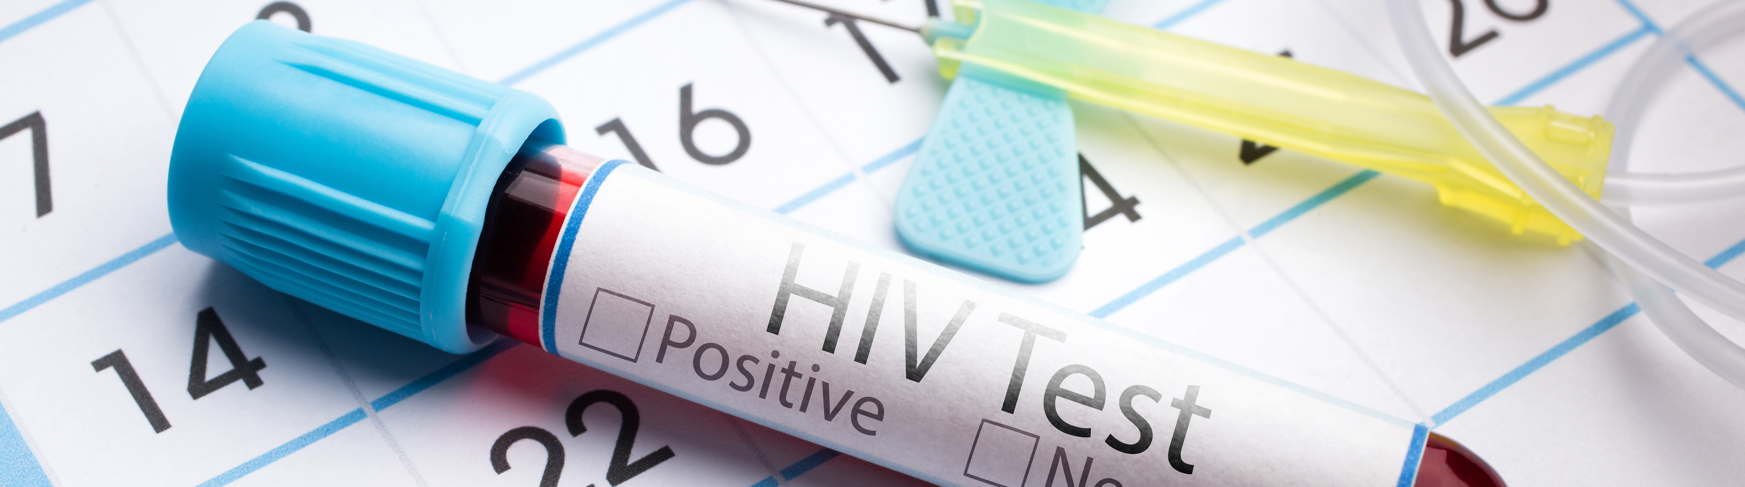
Insuring HIV
Ready for the Mainstream?
Image licensed from Shutterstock
Insuring HIV
Ready for the Mainstream?
Bradley Heltemes, MD, DBIM

Slide 2
Human Immunodeficiency Virus Infection
HIV is a retrovirus that infects humans via transmission through sexual contact (generally intercourse), exposure to infected blood, and through the birthing process.
Once an individual is infected by the retrovirus, replication begins.
The extent to which it evolves is heavily dependent on the interplay of various immune functions.
Left untreated, the vast majority of people infected with HIV will progress to acquired immune deficiency syndrome (AIDS), although approximately 7% of those with HIV maintain an asymptomatic state, and about 1 in 300 are non-viremic "elite controllers.”
Current treatments however have become very effective at delaying or preventing AIDS in most people who can adhere to treatment.
              Spontaneous control of viral load and CD4 cell count progression among HIV-1 seroconverters. Madec Y, Boufassa F, Porter K, Meyer L, CASCADE Collaboration. AIDS. 2005;19(17):2001.
              Long-term nonprogressive disease among untreated HIV-infected individuals: clinical implications of understanding immune control of HIV. Migueles SA, Connors M. JAMA. 2010;304(2):194.

Slide 3
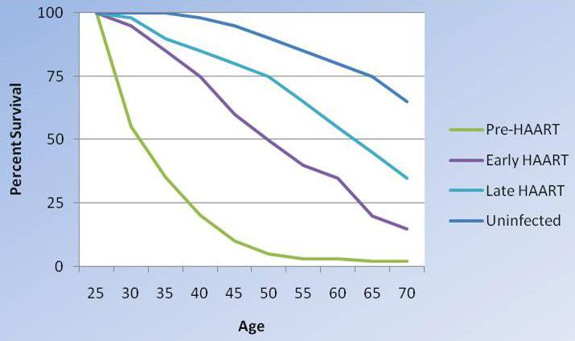
Changes in survival of people infected with HIV
As therapies have become more aggressive, they have been more effective, although survival with HIV infection is not yet equivalent to that in uninfected people. Modified from Lohse N et al. Survival of persons with and without HIV infection in Denmark, 1995-2005. Ann Intern Med. 2007;146(2):87-95.

Slide 4
Epidemiology
Estimated 0.8% of the world’s population is infected with HIV
  Including an estimated 5% of population in sub-Saharan Africa
Per the CDC, ~1.15 million people living with HIV in the U.S. by 2017, including 991,447 who have been diagnosed (up 100,000 since 2012)
  Of those, it is estimated that half are under treatment and have achieved viral suppression (and potentially insurable?)
  Largest increase in prevalence rates (56%) was among persons aged 65 years and older
Reportedly 38,739 new HIV infections in the U.S. in 2017, down ~8% from 2012
  Incidence rate increased however for ages 25-29, and was unchanged for ages 20-24 and 30-39
                CDC. Hes KL, Johnson SD, Hu X, et al. HIV Surveillance Report 2018;v.29

Slide 5
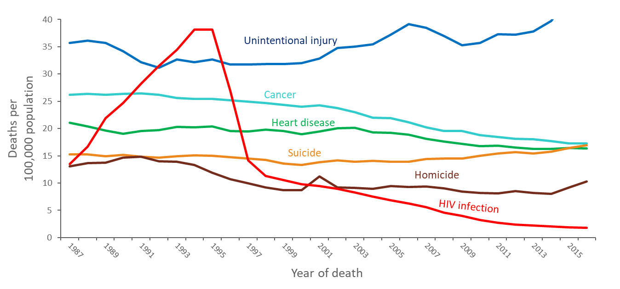
Trends in Annual Rates of Death due to the 6 Leading Causes among Persons
25–44 Years Old, 1987–2016 — United States
Note: For comparison with data for 1999 and later years, data for 1987−1998 were modified to account for ICD-10 rules instead of ICD-9 rules.
Notes:
Focusing on persons 25 to 44 years old emphasizes the importance of HIV infection among causes of death. Compared with rates among other age groups, the rate of death due to HIV infection is relatively high in this age group, but rates of death due to other causes are relatively low.
HIV infection was the leading cause of death among persons 25 to 44 years old in 1994 and 1995. In 1995, HIV infection caused about 32,000 deaths, or 20% of all deaths in this age group. The rank of HIV infection fell to 5th place from 1997 through 2000, to 6th place from 2001 through 2009, then fell to 9th place in 2016 causing about 1,500 deaths, or 1% of all deaths in this age group.
The data for this slide come from death certificate data compiled by the National Center for Health Statistics.

Slide 6
Adults with Diagnosed HIV by Age, 2015 Cycle
Notes:
Three-quarters (75%) of persons were at least 40 years of age. From 2012 through 2016, the rate for persons aged 25–29 years increased
Demographic data were collected using in-person or telephone interviews.

Slide 7
Adults with Diagnosed HIV by Gender, 2015 Cycle
Note: Transgender defined as those who self-identified as transgender or who reported a gender identity different from sex assigned at birth
Notes:
An estimated 75% of persons were male, 24% were female, and 1% were transgender (defined as either self-identifying as transgender or reporting a gender identity that was different from their reported sex assigned at birth).
Demographic data were collected using in-person or telephone interviews.

Slide 8
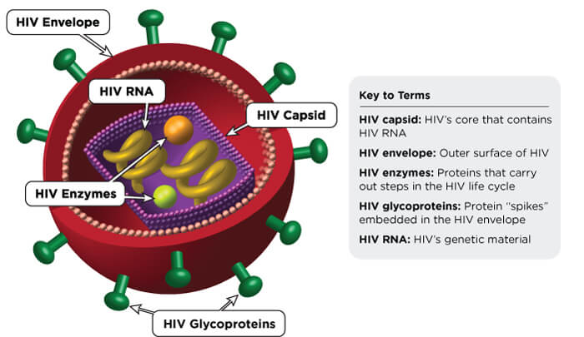
Schematic of Human Immunodeficiency Virus

Slide 9
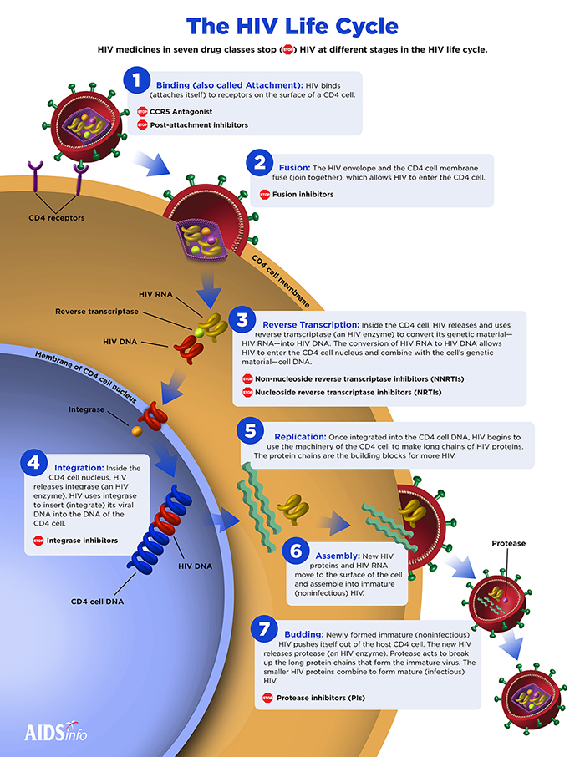
Attaches to CD4 cell
HIV envelope and cell membrane fuse
HIV RNA converts to HIV DNA which can enter into cell nucleus
HIV DNA inserted into CD4 DNA
Uses cell machinery to replicate
HIV RNA and proteins assemble into new immature virus
Mature (infectious) virus buds out

Slide 10
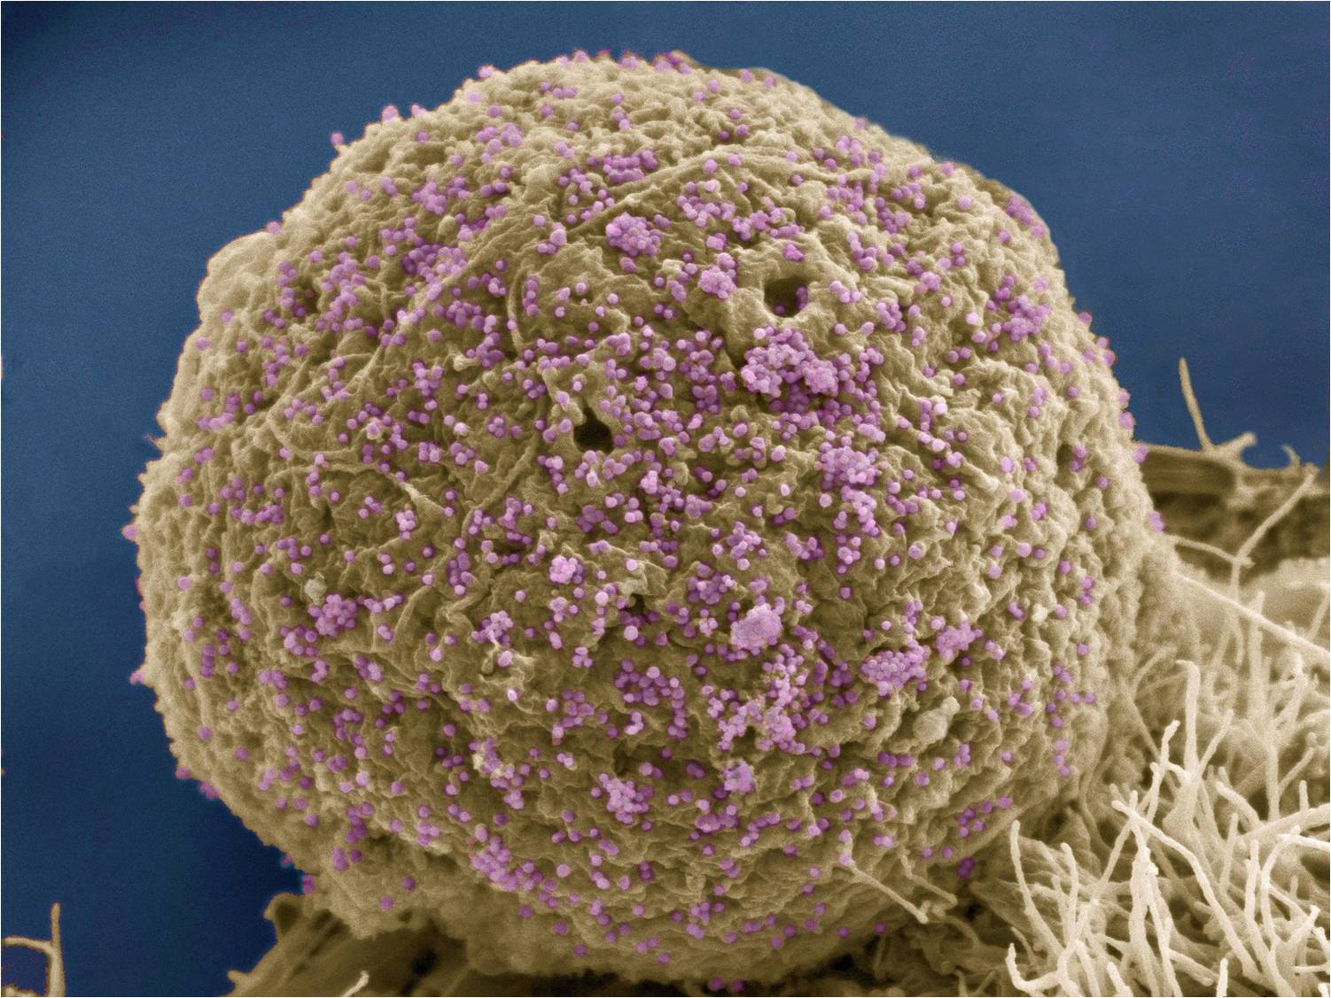
CD4 cells
Helper T lymphocytes - express cluster determinant 4
CD4 molecules are immunoglobulins
HIV selectively targets and infects activated, expanding CD4 T cells
Leads to depletion of CD4 T cells in the gut-associated lymphoid tissue and then reduced blood levels of CD4
CD4 count at diagnosis (baseline) is predictive of HIV infection duration:
  Estimated median time from infection to CD4 cell count decline to <500 is 1.2 years, but range is wide3
HIV infected T-cell_Credit Mark Ellisman and Tom Deerinck
National Center for Microscopy and Imaging Research

Slide 11
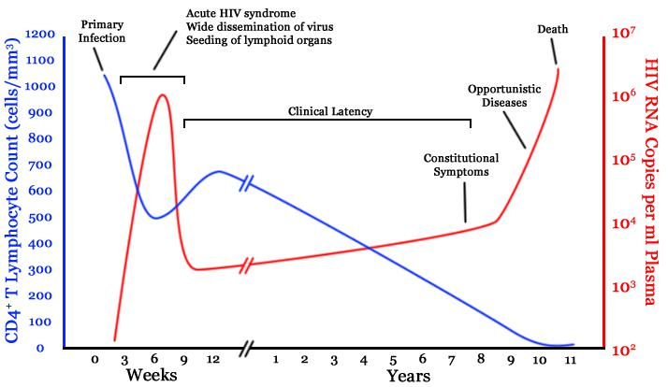
Timeline of CD4 T-cell and viral-load changes over time in untreated human immunodeficiency virus (HIV) infection
Courtesy of Wikipedia (based on an original from Pantaleo, et al 1993)

Slide 12
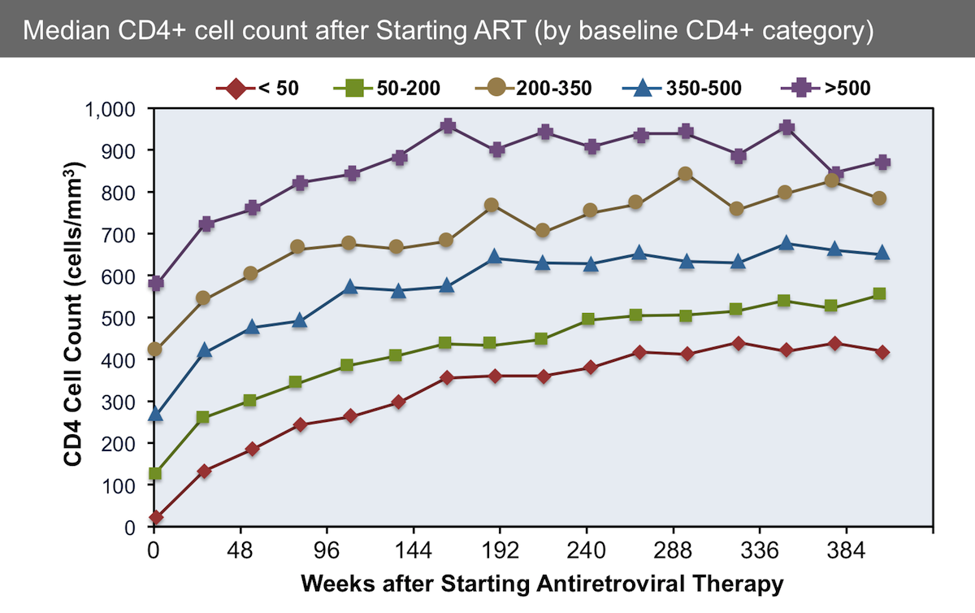
Source: Gras L, Kesselring AM, Griffin JT, et al. CD4 cell counts of 800 cells/mm3 or greater after 7 years of highly active antiretroviral therapy are feasible in most patients starting with 350 cells/mm3 or greater. J Acquir Immune Defic Syndr. 2007;45:183-92.
www.hiv.uw.edu/go/antiretroviral-therapy/general-information/core-concept/all#figures

Slide 13
Case 1: 50 year old female
Dx 2015, on ART triple therapy since
Unknown method of infection
No history of AIDs defining condition
Date | CD4 | VL
3/2019 | Not done | <20
3/2018 | 628 | <20
9/2017 | 742 | <20
3/2017 | 589 | <20
3/2016 | 499 | 102
10/2015 | 305 | <20
7/2015 | 268 | 19,712
Notes:
Diagnosed in 2015 viral load quickly became undetectable then a blip in viral count and note 2018 and 2019 visits 1 year apart-MD said because stable could come in once a year. CD4 count not done on last visit as optional

Slide 14
Mortality prognostic factors
Consistently identified
CD4 counts – current and trends
Viral load – current and past
Age
Duration of ART
Concomitant Hep B or Hep C
IV drug use history
Interruptions in treatment
Associated – but an independent risk?
Smoking
STD history
CD4/CD8 ratio
Cumulative time at low CD4 counts
Year of ART initiation
Education level
Anemia

Slide 15
CD4 T-cell count
Reference range, 500-2000 cells/μL
Counts normally vary by as much as 30%
  Serial counts are a better measure of significant changes
Reflects the current risk of acquiring opportunistic infections:
  Stable CD4 counts >500 is especially favorable
  CD4 counts 350-499 also fare well
  A CD4 count below 200/μL is considered AIDS-defining in the US
  An adequate response on treatment is defined as an increase in CD4 count in the range of 50-150 per year
CD4 count at start of ART is a strong predictor of short-term mortality, however becomes less prognostic over time and probably not important after 3-5 years ^{4,5}

Slide 16
HIV Viral load in peripheral blood
Surrogate marker of viral replication rate; not a diagnostic tool
With therapy, viral loads can often be suppressed to an undetectable level (< 20-75 copies/mL)
Related to rate of progression to AIDS and death
  Viral loads >30,000/μL are 18.5x more likely to die of AIDS than those with undetectable viral loads
Viremia “blips” can occur, typically < 400 copies/mL, but this is not thought to predict virologic failure (defined as a confirmed viral load of > 200 copies/mL)

Slide 17
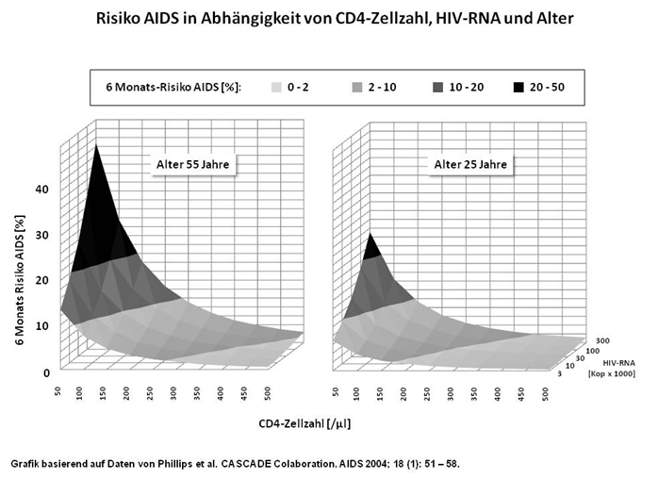
Risk of developing AIDS based on CD4 count and HIV viral load

Slide 18
Additional prognostic factors – impact of age
Mortality rates increase some with age but MRs drop significantly
Collaboration of Observational HIV Epidemiological Research Europe (COHERE) in EuroCoord.
All-cause mortality in treated HIV-infected adults with CD4 500/mm3 compared with the general population: evidence from a large European observational cohort collaboration. International Journal of Epidemiology 2012; 41: 433–445.

Slide 19
Importance of treatment adherence
Higher mortality seen with:
  Interruptions in treatment ⁸
  Cumulative time at low CD4 counts (e.g. <100 cells/μl) ⁹
Both are likely markers of adherence to treatment, which could be related to:
  Health care access
  Treating facility
  Comorbid behavioral risks

Slide 20
Adherence to Antiretroviral Therapy (ART) among Adults with Diagnosed HIV taking ART, 2015 Cycle
 | % | 95% CI
Took 100% of prescribed ART doses in past 30 days | 60 | (57-62)
How well did you do at taking your HIV medicines in the way you were supposed to? Very poor Poor Fair Good Very good Excellent | 1 2 5 12 26 54 | (1-2) (1-2) (4-6) (11-13) (24-28) (51-56)
How often did you take your HIV medicines in the way you were supposed to? Never Rarely Sometimes Usually Almost always Always | 1 1 2 5 23 69 | (1-2) (1-1) (1-2) (4-6) (21-25) (67-70)
Notes:
CDC slide public domain
.

Slide 21
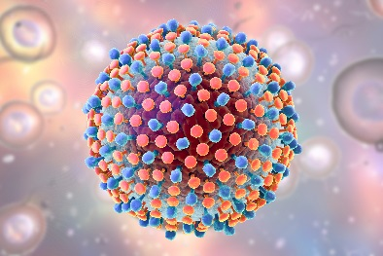
Additional prognostic factors
Duration of ART ⁶
  Mortality is high during the first year, then levels off. MR probably stable after ~3 years.
AIDS defining illness history
Concomitant Hep B or Hep C
  Co-infection accelerates liver disease progression and may worsen HIV prognosis
  Not clear though if risk is more than additive ^{6.3, 6.5}
IV drug use history ⁵
  Both current and past use
  Likely comorbid risk with multiple other factors but even controlled for these still a significant factor

Slide 22
Veterans Aging Cohort Study (VACS) Index
The VACS Index incorporates HIV-specific measures (HIV-1 RNA and CD4 count), hepatitis
C infection, and measures of organ system injury (anemia, renal disease, and liver disease)
https://vacs-apps2.med.yale.edu/calculator/IC
Adjusted mortality HR of 2.1, 5.3, and 31.8 for scores 20-34, 35-54, and 55+ compared to <20
Has been shown to predict AIDS and non-AIDS morbidity and mortality in multiple settings
Viremia copy-years, CD4-years, and VACS Index-years even more closely associated with mortality (and acute MI risks)

Slide 23
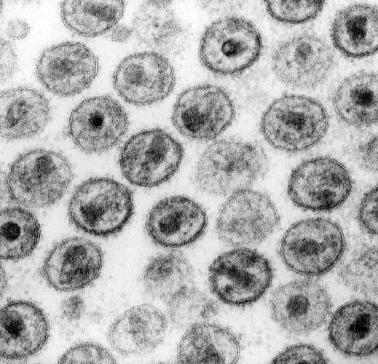
Prognostic factors in long treated HIV infection
After 10 years on ART (ART-CC cohort) ⁷:
  Low CD4 counts (but not CD4 count at ART initiation)
  Detectable viral load
  IV drug use transmission
  Prior AIDS-defining illness
Electron microscopy of human immunodeficiency virus (HIV)–1 virions. Courtesy of CDC (Dr Edwin P Ewing, Jr)

Slide 24
Current understanding of HIV mortality risk
With proper treatment, many with HIV now have a relatively good 10-15 year prognosis
  Select groups have a life expectancy similar to the general population
Limited data beyond that point – some concerns for possible longer term risk, but just as much or more reason to predict newer treatments will lead to better outcomes.
          .

Slide 25
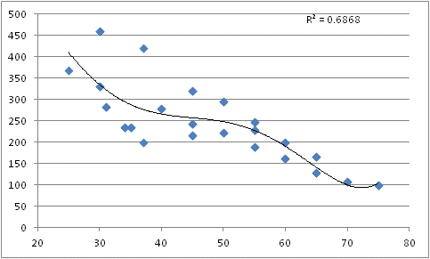
HIV Mortality – Overall composite of data analysis
Summary data: Dr. Robert Lund

Slide 26
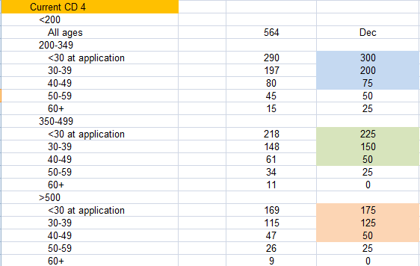
Calculated MRs – European and South African analysis
With viral suppression and no adverse prognostic factors (unisex MR)
Blended ART-CC and South African dataset 2015

Slide 27
Is the favorable prognosis durable?
Studies that focus on current CD4 counts found short-term mortality to be increased by factors of 1-1.5 and 1.8-2 for current counts of >500 cells/μl and 350–499 cells/μl, respectively, compared to the general population
MunichRe data show that the observed mortality ratios were stable within the first ten years of treatment and longer

Slide 28
Percent 5-year risk of death (95% CI) from 10 years after start of ART, by age
Virologically suppressed, No IV drug use, No AIDS
13,011 patients during follow-up from 10 years after starting ART, median age 46, 80% male
  Median CD4 count was 250 cells/μL at ART start and increased to 550 at ten years (81% >350)
  88% had HIV-1 RNA <200 copies/mL at ten years
IDU transmission, AIDS diagnosis, and low CD4 count and/or detectable viral replication ten years after starting ART were associated with higher subsequent mortality, but not CD4 count at ART onset
CD4 | 0-99 | 100-199 | 200-349 | 350-499 | 500-749 | >750 | Gen pop. (Fr)
Age 16–39: | 6.9 | 3.9 | 2.2 | 1.7 | 1.2 | 1.2 | 0.3
Age 40–49: | 10.9 | 6.1 | 3.5 | 2.7 | 1.9 | 1.9 | 1.0
Age 50–59: | 18.8 | 10.8 | 6.1 | 4.8 | 3.4 | 3.3 | 2.5
Age 60+: | 36.4 | 22.1 | 12.9 | 10.1 | 7.2 | 7.1 | 5.8
Trickey A, May MT, Vehreschild J, et al. Cause-Specific Mortality in HIV-Positive Patients Who Survived Ten Years after Starting Antiretroviral Therapy. PLOS ONE | DOI:10.1371/journal.pone.0160460 August 15, 2016

Slide 29
Percent 5-year risk of death from 10 years after start of ART, by age Virologically suppressed, No IV drug use, No AIDS

Slide 30
Case 1: 50 year old female
Dx 2015, on ART triple therapy since
Unknown method of infection
No history of AIDs defining condition
Date | CD4 | VL
3/2019 | Not done | <20
3/2018 | 628 | <20
9/2017 | 742 | <20
3/2017 | 589 | <20
3/2016 | 499 | 102
10/2015 | 305 | <20
7/2015 | 268 | 19,712
Notes:
Diagnosed in 2015 viral load quickly became undetectable then a blip in viral count and note 2018 and 2019 visits 1 year apart-MD said because stable could come in once a year. CD4 count not done on last visit as optional

Slide 31
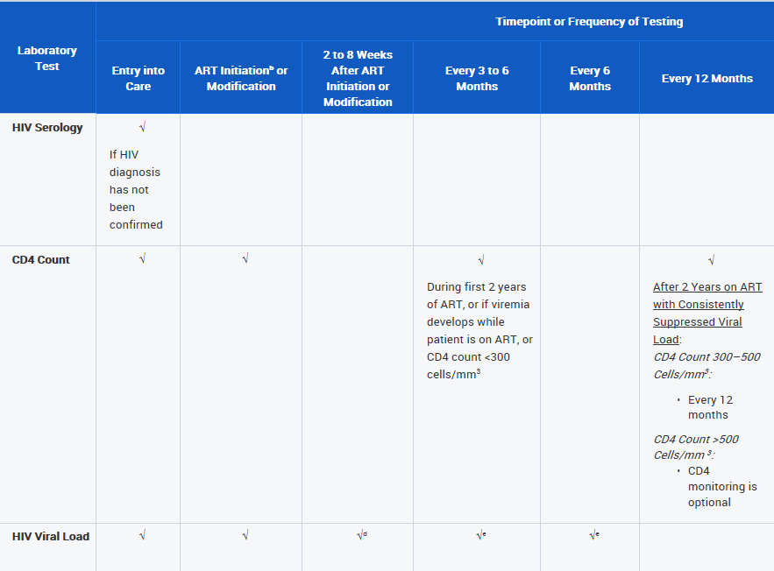
CDC Guidelines for HIV management
Notes:
https://aidsinfo.nih.gov/guidelines/htmltables/1/63414/1/2019 public domain

Slide 32
Case 2: 49 year old male
HIV diagnosed 2011. Inconsistent adherence with ART - multiple missed doses - until 2014
  CD4 count >500 since 2014 and viral load suppressed
  Hep B and C neg, RPR neg
OSA, Ca score 85 (89%), Depression
App stated non smoker but HOS + cotinine
Recent STD (GC-urethra)
Notes:
Ca++score up; Depression; Smoker; STD

Slide 33
Associated factors – but an independent risk?
Smoking
Cardiac risk
Depression
STD history
Notes:
Smoking
Important comorbid risk, but may not be more than additive
STD history
Risk of acquiring HIV, but any additional risk in HIV positive patients?
Year of ART initiation
Short-term outcomes better in more recent years due to earlier ART initiation and improvements in Rx and care coordination
However, better outcomes with stability on longer duration of treatment often offsets this
Education level
Found in Swiss cohort to be an independent factor on multivariate analysis ⁵
Anemia
An adverse factor when analyzed but multiple potential HIV comorbid causes

Slide 34
Cigarette Smoking among Adults with Diagnosed HIV 2015
Notes:
The estimated prevalence of cigarette smoking in the past 12 months was 36%. An estimated 29% of persons smoked daily, 3% weekly, 1% monthly, and 2% less than monthly.
Smoking data were collected using in-person or telephone interviews.

Slide 35
Comorbid smoking risk
Rates of tobacco smoking tend to be substantially higher amongst HIV-infected persons
Kaiser study comparing HIV infected to non-infected HIV patients:
  More likely smoking (45.2% vs. 31.1%), drug/alcohol abuse (20.6% vs. 8.6%), and HBV or HCV infection (11.5% vs. 1.7%)
Per the ART-CC cohort, 60% were ever smokers:
  MR vs. nonsmoker was 1.94
In the VACS, 59% smokers and 14% former smokers:
  MR compared to NS was 1.86
Swiss cohort, 41% current and 16% former smokers:
  MRs 2.20 and 1.15 compared to never smokers
Notes:
Excess risk seen due smoking is similar in degree to that incorporated into insurance smoker rates

Slide 36
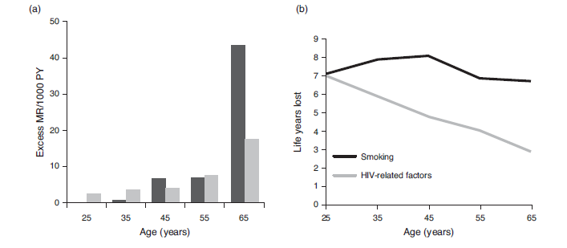
Smoking and Life expectancy among HIV infected
Smokers 2 fold increase in mortality, 1/3 of smokers from lung cancer. Life expectancy average of 8 years less.
Helleberg M et al, AIDS 2015; 29:221
Notes:
Only information on slide will be presented
Smokers 2 fold increase in mortlity 1/3 of smokers from lung cancer. Life expectancy average of 8 years less

Slide 37
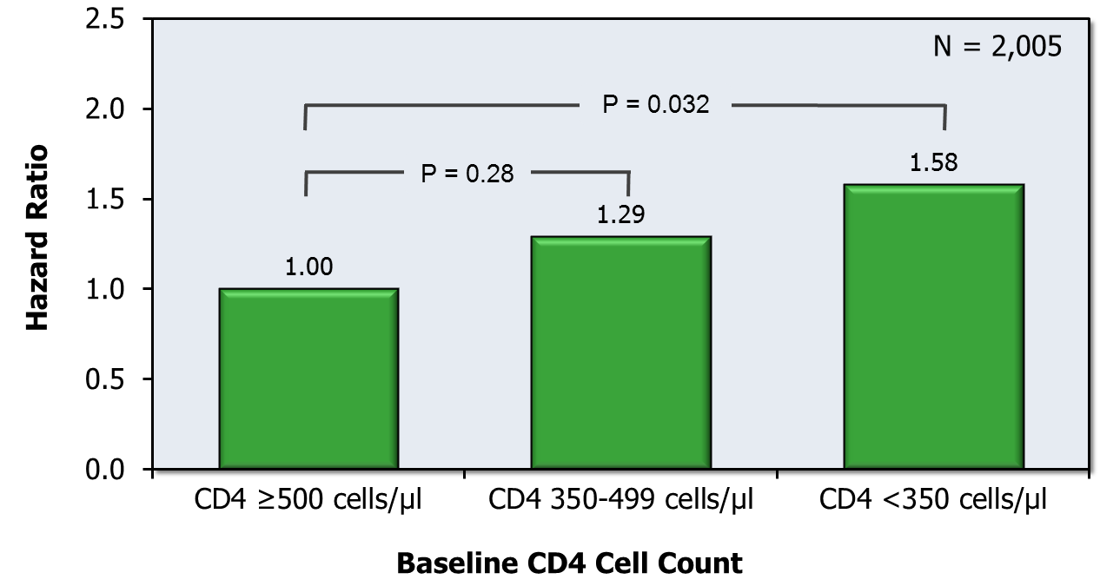
Baseline CD4 Count Associated with Cardiovascular Disease Events
HIV Out Patient Study (HOPS)
Cox Proportional Hazard: Relationship of Baseline CD4 and Risk of Subsequent Cardiovascular Events
Even after accounting for established risk factors, HIV+ individuals have 50%–75% greater risk of acute MI than demographically similar uninfected individuals
Freiberg MS JAMA Intern Med 2013; 173:614
Source: Lichtenstein KA, et al. Clinical Infectious Diseases. 2010;51:435-447.
Notes:
Chronic inflammation, immune suppression, effects of Rx
Investigators in HIV Out Patient Study, commonly referred to as the HOPS Study, examined the relationship of CD4 cell count and risk of having a cardiovascular event
The study involved 2005 HIV-infected persons during the years 2002-2009.
In a multivariable Cox analysis, patients with a CD4 cell count lower than 350 had a statistically significant increased risk of having a cardiovascular event when compared with those who had a CD4 count greater than 500.
Similarly, patients with CD4 cell count between 350 and 500 had an increased risk of having a cardiovascular event when compared with those who had a CD4 count greater than 500, but this difference was not statistically significant.
These findings are consistent with the growing evidence that HIV itself can cause a chronic inflammatory response, which in turn contributes to the development of atherosclerosis.
Source:
Lichtenstein KA, et al. Clin Infect Dis. 2010;51:435-447.

Slide 38
Depressionª among Adults Receiving HIV Medical Care, 2015 Cycle
ª Assessed for the past 2 weeks; responses to the 8 items on the Patient Health Questionnaire (PHQ-8) were used to define “major depression” and “other depression,” according to criteria from the Diagnostic and Statistical Manual of Mental Disorders, 4th ed. (DSM-IV-TR)
Notes:
The estimated prevalence of major and other depression was 12% and 11%, respectively. 77% reported no depression.
Surveillance system monitoring clinical outcomes and behaviors of adults with diagnosed HIV infection in the United States
6.7% of US population has it
Objectives
Provide locally and nationally representative estimates of risk behaviors and clinical outcomes
Describe health-related behaviors
Determine accessibility and use of prevention, care, and support services
Increase knowledge of HIV care and treatment
Examine variations of factors by respondent characteristics
Depression was assessed for the past two weeks. Responses to the 8 items on the Patient Health Questionnaire (PHQ-8) were used to define “major depression” and “other depression,” according to criteria from the Diagnostic and Statistical Manual of Mental Disorders, 4th ed. (DSM-IV-TR).
Depression data were collected using in-person or telephone interviews.

Slide 39
Sexually transmitted infection history an added risk?
A history of STIs a strong risk for acquiring HIV infection, but is there added risk in someone being treated for HIV?
  Limited data found on outcomes
  U.S. military study found an STI history did not impact mortality (RR 1.0) ¹²
  Potential concerns include:
    Possible marker of other behavioral risks
    Direct risk from the STI (syphilis, hepatitis B and C)
    Increased risk of HPV-related malignancy
    Risk of acquiring different HIV strains (and higher risk of Rx resistance?)
More of a red flag than an absolute contraindication?
Notes:
Potential concerns include:
Possible marker of other behavioral risks (EtOH/drugs, mental health, decreased Rx adherence?)
Direct risk from the STI (syphilis, hepatitis B and C)
Increased risk of HPV-related malignancy (cervical, anal, and oropharyngeal cancers)
Risk of acquiring different HIV strains (and higher risk of Rx resistance?)
Conversely, HIV care screening recommendations may make the incidence rates appear higher in those who are actually more compliant
More of a red flag than an absolute contraindication?
One study found a history of STI was associated with younger age, greater STI knowledge, substance use, and ART non-adherence, though another large study, found only unprotected sex and multiple partners predicted STIs, not substance use.

Slide 40
Case 2: 49 year old male
HIV diagnosed 2011. Inconsistent adherence with ART - multiple missed doses - until 2014
  CD4 count >500 since 2014 and viral load suppressed
  Hep B and C neg, RPR neg
OSA, Ca score 85 (89%), Depression
App stated non smoker but HOS + cotinine
Recent STD (GC-urethra)
Notes:
Ca++score up; Depression; Smoker; STD

Slide 41
Issues To Consider Outside Usual UW
State regulators
  “Are you going to take these people for a ride”
  “Are you developing a new product to possibly discriminate against HIV + applicant?”
Marketing - reputational risk
Confidentiality
Brokers - medically complex exclusions
Not BAU – more labor intensive with checks and balances
Notes:
State regulators
“Are you going to take these people for a ride”
“Are you developing a new product to possibly discriminate against HIV + applicant?”
Marketing-reputational risk if not marketed carefully and 99% declines
Confidentiality –high profile applicant identified as HIV positive-damage to individual and Prudential
Brokers-medically complex exclusions
Not BAU- Labor intensive with checks and balances. (Limited to 2 UWs, 2 MDs and Underwriting standards

Slide 42
More Unique Underwriting Aspects
CD4 and viral load variability – similar to PSA
  What is a significant variation in CD4 and viral loads?
Viral acquisition - often not known
Medication changes and adherence to f/u appointments
  Do we need to know all the meds?
  Pharmacy data base not 100% - but good for compliance assertion?
EtOH or drug use assessment
  Value of additional testing?
  Do we need all possible records?
Employment – affordability?
Risk with additional impairments
  Additive? Stacked? Compounded?
Notes:
CD8 T cells “killer cells” sometimes as ratio ot CD4 not useful at present and more expensive
CD4 count a reliable indicator of risk of acquiring opportunistic infections nl >500 -1600 with mean at ~1000
Viral load is a surrogate marker of viral replication
Virologic failure is defined as a confirmed viral load of more than 200 copies/mL; although this is a research definition
ART key goal-achieve & maintain viral suppression
The minimal change in viral load-statistically significant is a three-fold change (equivalent to a 0.5 log10 copies/mL change)
Optimal viral suppression persistently below the level of detection (HIV RNA <20 to 75 copies/mL, depending on the assay)
ART adherent individuals generally achieve viral suppression 8-24 weeks after ART initiation
Monitoring of lymphocyte subsets other than CD4 (e.g., CD8,
CD19) has not proven clinically useful, is more expensive, and is not routinely recommended
CD4/CD* ratio mixed results
Anemia
An adverse factor when analyzed but multiple potential HIV comorbid causes may be bone marrow suppression sometimes treated with erythopoieten usually hgb drops nl MCV but multifactorial

Slide 43
Underwriting HIV in summary – the “Ideal” Applicant
Pre-screened
Single provider with excellent documentation
Good track record of compliance
CD4 consistently >500 and viral load undetectable
Non-smoker
No substance abuse
No psych issues
Few STDs
No hx of Hepatitis or IV drug use

Slide 44
What Does the Future Hold
Berlin and London patients
  Received stem cell transplants from donors with two genetic mutations that remove the CCR5 receptor from the surface of the CD4 T-cell
  Without that receptor, most HIV strains can't gain access to the cell and can't spread
  Precision medicine - uses lentiviral vectors and nucleases to target ablation or down-regulation of CCR5 expression
UB-421 -- investigative monoclonal Ab directed against the host's CD4 cell surface receptor, blocking HIV entry into cells
  Monotherapy maintained suppression of plasma viremia in the absence of ART for up to 8 weeks
Immunotherapy – Targeted therapies to open up the HIV-1 envelope protein to allow one’s own immune response to react
Accelerated aging – chronic immune stimulation
  Age advancement found to be related to persistent CMV or HepB infection, prior immunodeficiency, and cumulative saquinavir exposure

Slide 45
Questions to answer for the future of HIV treatment
Current Integrases Inhibitor-based Rx regimens more effective than prior ART?
Vaccines?
How frequent is anti-retroviral drug resistance?
Two drug ART?
Injectables?
Implantables?
Cures? HIV-1 provirus integrates into host cell leaving a important reservoir – how can it be reached?

Slide 46
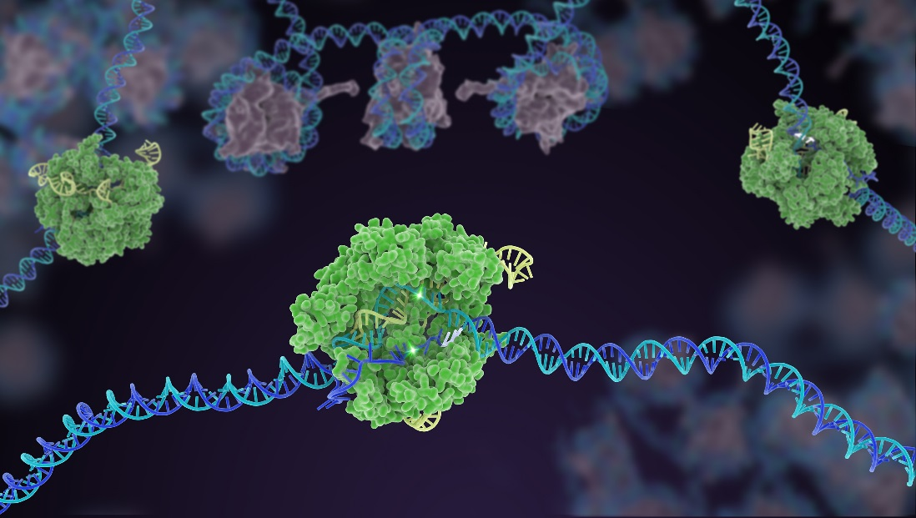
CRISPr gene editing to snip out HIV genome
Image courtesy Janet Iwasa for the Innovative Genomics Institute at UC Berkeley

Slide 47

Questions?
iStock-613543010

Slide 48
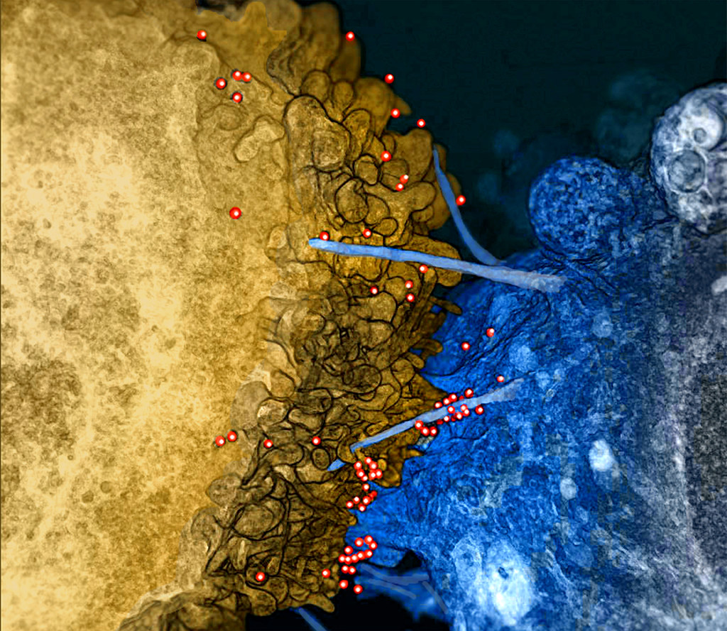
Thank you!
HIV on Bridges Between Infected Immune Cell and Uninfected Brain Cell

Slide 49
References
1 CDC. Hess KL, Johnson SD, Hu X, et al. Diagnoses of HIV infection in the United States and dependent areas, 2017. HIV Surveillance Report 2018;v.29.
3 Lodi S, Phillips A, Touloumi G, et al. Time from human immunodeficiency virus seroconversion to reaching CD4+ cell count. CASCADE Collaboration in EuroCoord. Clin Infect Dis. 2011 Oct;53(8):817-25.
4 May MT, Gompels M, Delpech V, et al. Impact on life expectancy of HIV-1 positive individuals of CD4R cell count and viral load response to antiretroviral therapy. AIDS 2014; 28:1193–1202.
5 Gueler A, Moser A, Calmy A, et al. Life expectancy in HIV-positive persons in Switzerland: matched comparison with general population. AIDS. 2017;31(3):427–436.
6 Trickey A, May MT, Vehreschild JJ, et al. Survival of HIV-positive patients starting antiretroviral therapy between 1996 and 2013: a collaborative analysis of cohort studies. Lancet HIV 2017
6.3 van der Helm J, Geskus R, Sabin C, et al. Effect of HCV infection on cause-specific mortality after HIV seroconversion, before and after 1997. Gastroenterology 2013; 144:751.
6.5 COHERE (2017). Is response to anti-hepatitis C virus treatment predictive of mortality in hepatitis C virus/HIV-positive patients? AIDS, 31(5):661-668.
7 Trickey A, May MT, et al. PLOS ONE | DOI:10.1371/journal.pone.0160460 August 15, 2016
8 Group, S.S., et al., Risk for opportunistic disease and death after reinitiating continuous antiretroviral therapy in patients with HIV previously receiving episodic therapy: a randomized trial. Ann Intern Med, 2008. 149(5): p. 289-99.
9 Lawn, S.D., et al., Changing mortality risk associated with CD4 cell response to antiretroviral therapy in South Africa. AIDS, 2009. 23(3): p. 335-42.
10 Marcus JL, Chao CR, Leyden WA, et al. Narrowing the gap in life expectancy between HIV-infected and HIV-uninfected individuals with access to care. J Acquir Immune Defic Syndr 2016.
10.1 Heltemes BR. Mortality and Risk Stratification of HIV Infected Individuals. J Insur Med 2015;45:000–000
10.3 Rodger AJ, Lodwick R, et al. Mortality in well controlled HIV in the continuous antiretroviral therapy arms of the SMART and ESPRIT trials compared with the general population. AIDS. 2013 Mar 27; 27(6): 973-9.
10.5 Lewden C, et al. All-cause mortality in treated HIV-infected adults with CD4 ≥500/mm3 compared with the general population: evidence from a large European observational cohort collaboration. Int J Epidemiol. 2012 Apr; 41(2): 433-45.
11 Helleberg M, May MT, Ingle SM, et al. Smoking and life expectancy among HIV-infected individuals on antiretroviral therapy in Europe and North America. AIDS 2015; 29:221–229.
12 Marconi VC, Grandits GA, Weintrob AC, et al. Outcomes of highly active antiretroviral therapy in the context of universal access to healthcare: the U.S. Military HIV Natural History Study. AIDS Res Ther. 2010;7:14.
13 Legarth RA, Ahlstrom MG, Kronborg G, Larsen CS, Pedersen C, Pedersen G, et al. Long-Term Mortality in HIV-Infected Individuals 50 Years or Older: A Nationwide, Population-Based Cohort Study. J Acquir Immune Defic Syndr. 2016; 71(2):213–8.
14 Freiberg MS, Chang CC, Kuller LH, et al. HIV infection and the risk of acute myocardial infarction. JAMA Intern Med 2013; 173:614–22.

Slide 50
Increased risk of acquiring HIV
Major risk factors:
Long term risk pre-ART
Current long-term risk?

Slide 51
Mortality associated with increased HIV risk
Male, age at application 44, at a risk of HIV conversion of 2%/year
 | Assuming an EDR of 2/1000 following HIV infection
Age | q' | q add | MR w HIV | Year | Incidence | Uninfected | Combined MR
45 | 0.000866 | 0.002866 | 3.31 | 0 | 0 | 1 | 1.000
46 | 0.000917 | 0.002917 | 3.18 | 1 | 0.020 | 0.980 | 1.044
47 | 0.000983 | 0.002983 | 3.03 | 2 | 0.040 | 0.960 | 1.081
48 | 0.001072 | 0.003072 | 2.87 | 3 | 0.059 | 0.941 | 1.110
49 | 0.001168 | 0.003168 | 2.71 | 4 | 0.078 | 0.922 | 1.133
50 | 0.00129 | 0.00329 | 2.55 | 5 | 0.096 | 0.904 | 1.149
51 | 0.001453 | 0.003453 | 2.38 | 6 | 0.114 | 0.886 | 1.157
52 | 0.001622 | 0.003622 | 2.23 | 7 | 0.132 | 0.868 | 1.163
53 | 0.001792 | 0.003792 | 2.12 | 8 | 0.149 | 0.851 | 1.167
54 | 0.001972 | 0.003972 | 2.01 | 9 | 0.166 | 0.834 | 1.169
55 | 0.002166 | 0.004166 | 1.92 | 10 | 0.183 | 0.817 | 1.169
56 | 0.002393 | 0.004393 | 1.84 | 11 | 0.199 | 0.801 | 1.167
57 | 0.002666 | 0.004666 | 1.75 | 12 | 0.215 | 0.785 | 1.162
58 | 0.003 | 0.005 | 1.67 | 13 | 0.231 | 0.769 | 1.154
59 | 0.003393 | 0.005393 | 1.59 | 14 | 0.246 | 0.754 | 1.145
60 | 0.003844 | 0.005844 | 1.52 | 15 | 0.261 | 0.739 | 1.136
 |  |  |  |  | Average MR |  | 113%

Slide 52
Mortality associated with increased HIV risk - PrEP
Male age 44 with 2% per year risk of HIV acquisition, roughly +13%
With use of PrEP and assuming an 80% risk reduction, overall MR comes to 103%
Risk is higher at younger ages – at age 34 average MR of approximately 130%, drops to 107% with PrEP
Of note: Estimated MR is from HIV alone, not considering comorbid factors

