Slide 1
Underwriting Autoimmune Conditions with Prescription Data and Medical Data
TCAHOU
Kyle Schimek, PharmD, BCPS
May 2022

Slide 2
Agenda
Immune system
Autoimmune overview and mortality
Select autoimmune diseases
Underwriting autoimmune disorders
Medications and disease activity

Slide 3
The immune system defends your body against infection.
Immune system
Adaptive
Innate
Adaptive
Barriers
Cellular and molecular
Targeted cells
Targeted antibodies
Chemical
Physical

Slide 4

Autoimmune overview and mortality

Slide 5
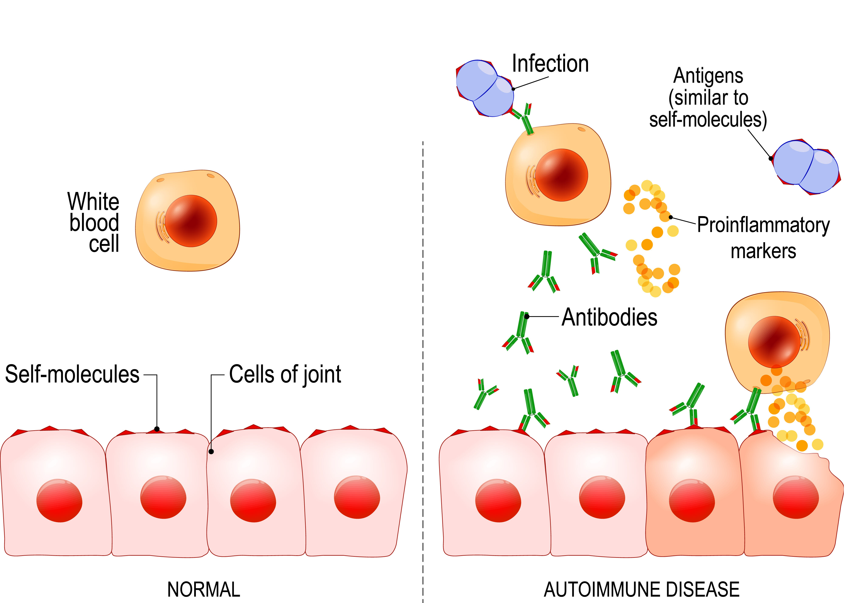
Autoimmune diseases cause harmful inflammation.

Slide 6
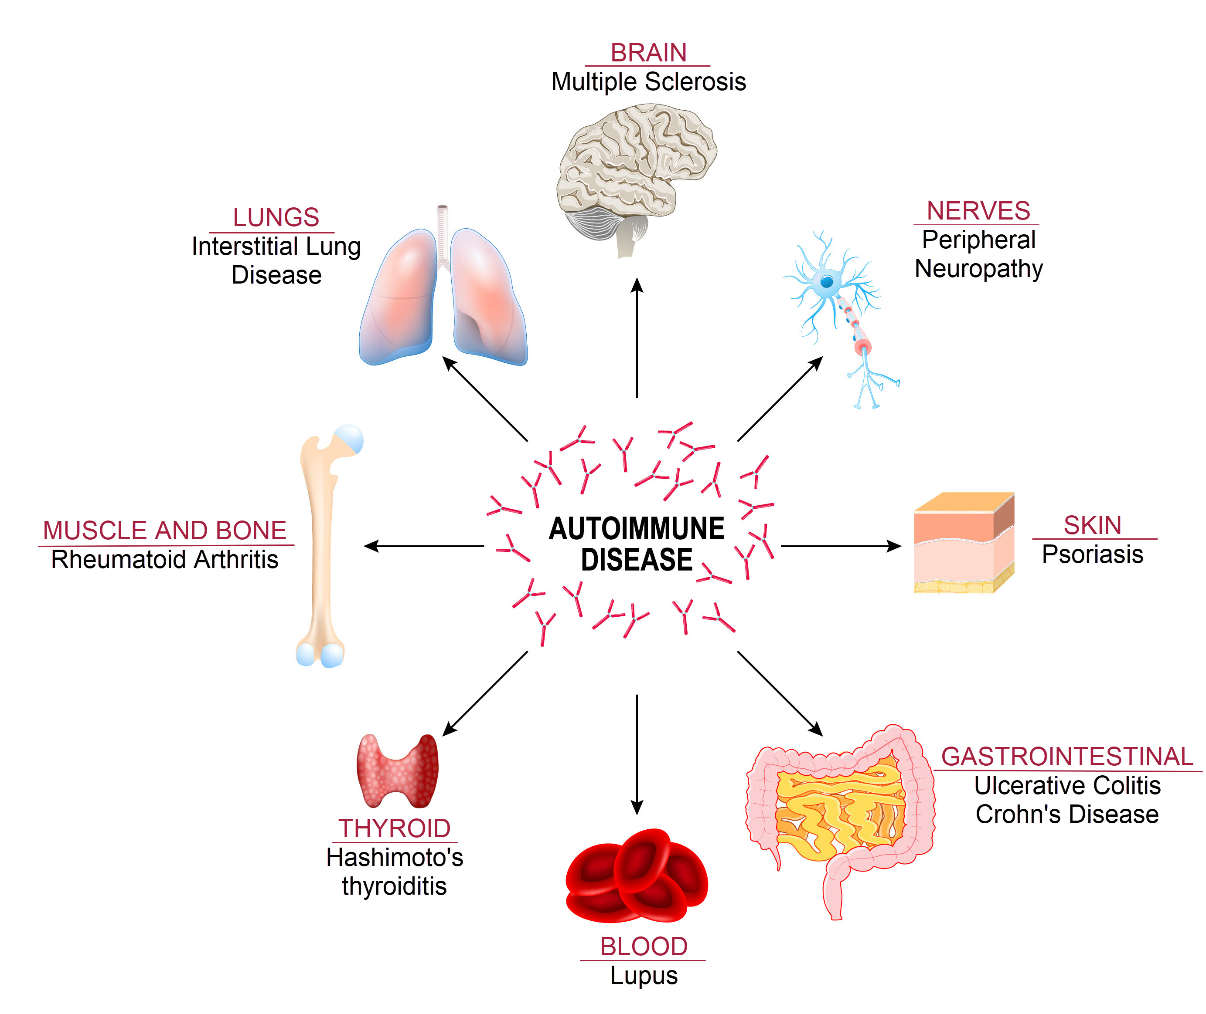
Autoimmune diseases may affect any part of the body.

Slide 7
Autoimmune diseases are common.
http://www.autoimmuneregistry.org/autoimmune-statistics

Slide 8


Autoimmune diseases disproportionately affect women.
50%
50%
90%
77.8%
Ulcerative colitis
Lupus
All autoimmune diseases
Desai MK, et al. Front Endocrinol. 2019;10:265.
Fairweather D, Rose NR. Emerg Infect Dis. 2004;10(11):2005-2011.

Slide 9
The immune system relies on inflammation.
Immune system
Innate
Adaptive
Barriers
Inflammation
Chemical
Physical
Cellular and molecular
Targeted cells
Targeted antibodies

Slide 10
Autoimmune inflammation increases risk of comorbidities.
Inflammation
Immune-mediated inflammation
Local
- Systemic
- Tissue damage and . proliferation
Comorbidities
Increased risk of
- Pulmonary disease
- Anemia
- Cancer
- Heart disease
Increased mortality
Increased risk of
Pulmonary disease
Anemia
Cancer
Heart disease
Medical claims data | % CAD Diagnosis
Autoimmune disease | 10.8%
No autoimmune disease | 3.9%
Local
Systemic
Cell damage and proliferation
Milliman IntelliScript Data, 2020

Slide 11
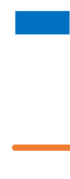
Autoimmune medications are associated with cardiovascular risk.
Percent with serious antiplatelet
Relative mortality
Without autoimmune medications
With autoimmune medications
2017 Milliman IntelliScript Mortality Study

Slide 12
Autoimmune diseases increase mortality.
van den Hoek J, et al. Rheumatol Int. 2017 Apr;37(4):487-493.
Gelfand JM, et al. Arch Dermatol. 2007;143(12):1493-1499.
Jussila A, et al. J Crohns and Colitis. 2014; 8(9):1088-1096.

Slide 13
Select autoimmune diseases

Slide 14
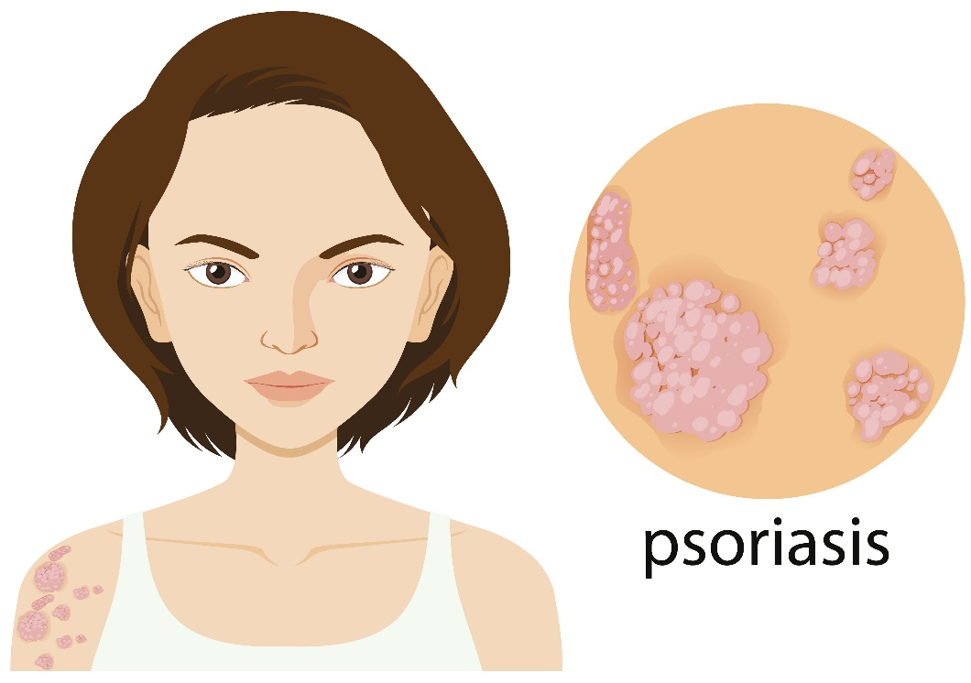
Psoriasis is not just a benign skin condition.
Characterized by flaky, irritated skin plaques
Peak incidence in 30-year-olds
Increased risk of myocardial infarction
As a group, mortality risk not increased

Slide 15
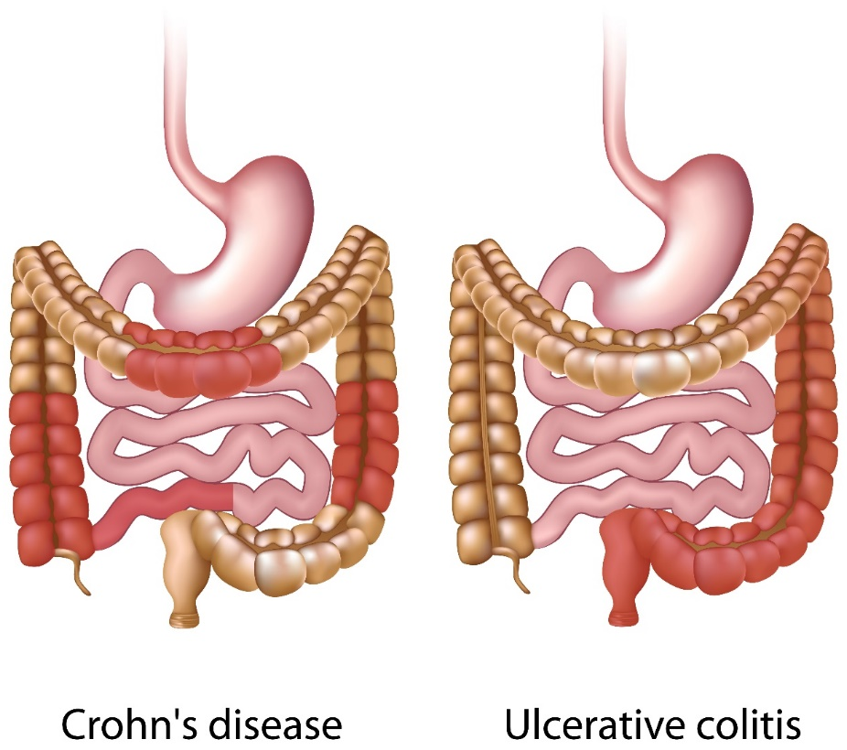
Inflammatory bowel disease comprises two separate diseases.
Characterized by pain, bleeding, diarrhea
Peak incidence between 15–30 years old
Increased comorbid anxiety and depression
Relative mortality ~120%
Milliman IntelliScript Data, 2020

Slide 16
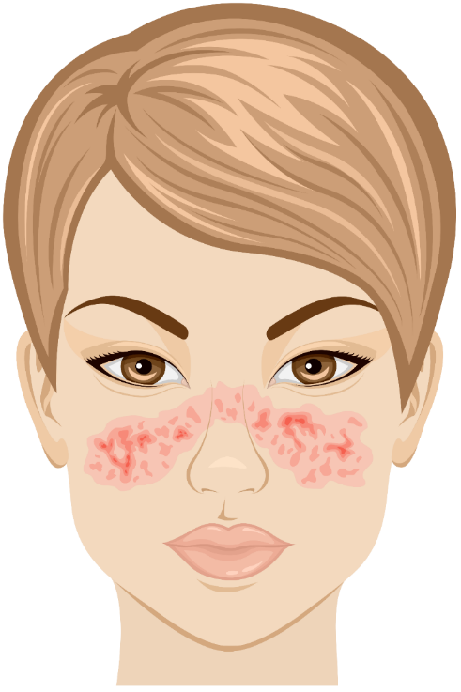
Lupus is associated with elevated mortality.
Characterized by fatigue, arthralgia, rash
Primarily affects women of childbearing age
Increased risk of infection, renal disease, MI
Five-year survival rate = 40% without treatment
Wallace DJ. UpToDate. 2019.

Slide 17
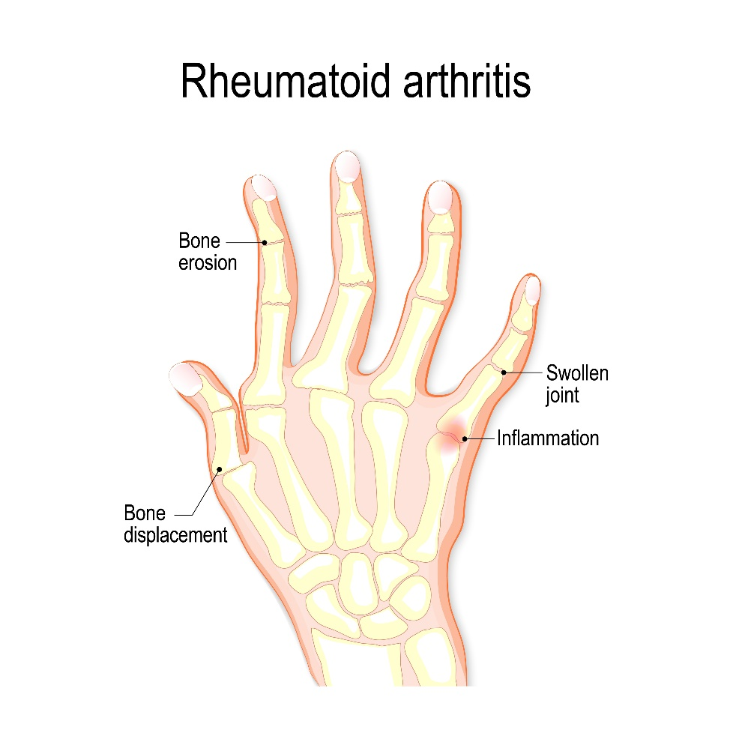
Rheumatoid arthritis primarily affects older individuals.
Symmetrical joint pain, stiffness, and swelling
Inflammation leads to erosion of the bone
Women > men, incidence peaks in 50s
Relative mortality of ~150-200%

Slide 18
Underwriting autoimmune disorders

Slide 19


Medical claims codes reveal valuable healthcare information.
ICD-9 / ICD-10 codes
Diagnosis codes | Procedure codes
CPT codes – Category I and II
Procedure codes (clinic visits, surgery, etc.)
HCPCS codes
Facility-administered drugs | Medical equipment
REV codes
Revenue codes (additional procedure details)
Real-time provider claims
Provider
Specialty | Contact information | Place of service
Interpreted by Irix
FCRA-compliant

Slide 20
Underwriting autoimmune disorders requires multiple data points.
1
Identify condition
Medical Data
+
prescriptions
Stratify risk
Underwriting autoimmune diseases
2
Determine disease activity

Slide 21
Prescription Data plus Medical Data stratify autoimmune risk.
Prescription
Data
Medical
Data
Synergy
Ulcerative colitis, unspecified, without complications
K51.90
Mild to
moderate
ulcerative colitis
Sulfasalazine

Slide 22
Medications and disease activity

Slide 23
Autoimmune medications can be divided into two main targets.
Medications for Autoimmune Conditions
NSAIDs
Steroids
Anti-inflammatory
Immunomodulators
Immunomodulators
Prednisone
Methylprednisolone
Dexamethasone

Slide 24
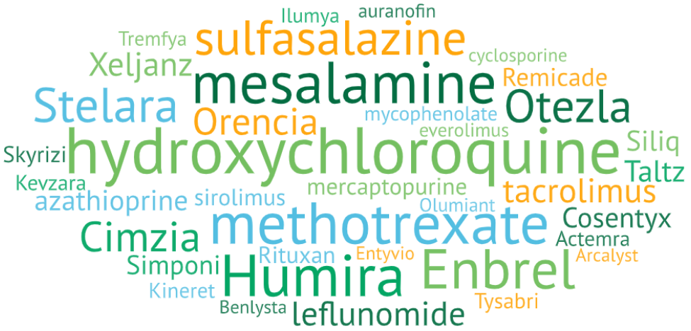
Immunomodulatory medications are numerous.

Slide 25


Irix makes underwriting faster, easier, and more accurate.
Data Inputs
Prescription
Medical
✓
Credit
Lab
1.46
✓
!
X
Application
Criminal
  UW Guidance
  Conditions
  Severity
  Decisions
  Risk Score
Other (MIB, MVR…)
  Irix Rule Variables
  Drug and medical claim combinations
  Medical encounter location
  Claim timing / frequency / dosage
  Provider specialty
  Risk Score thresholds
Notes:
25

Slide 26




Key medications reveal likely conditions.
Psoriasis
Lupus
Inflammatory Bowel Disease
Topical vitamin D analogs
  Calcipotriene
  Calcitriol
hydroxychloroquine +
one of the following
  Azathioprine
  Aycophenolate
  Tacrolimus
  Cyclosporine
Any of the following
  Mesalamine
  Budesonide (oral)
  Mercaptopurine

Slide 27
Severe psoriasis can be differentiated using medications.
Mild to moderate activity
Moderate to severe activity
Topical treatments
(creams, lotions, ointments)
Steroids
(clobetasol, fluocinonide)
Retinoids
(tazarotene)
Vitamin D analogs
(calcipotriene)
Topical treatments
Oral therapy
Mycophenolate, methotrexate, cyclosporine
Injection therapy
Taltz, Cosentyx, Siliq,
Humira, Enbrel
Relative mortality ~100%
Relative mortality ~150%

Slide 28
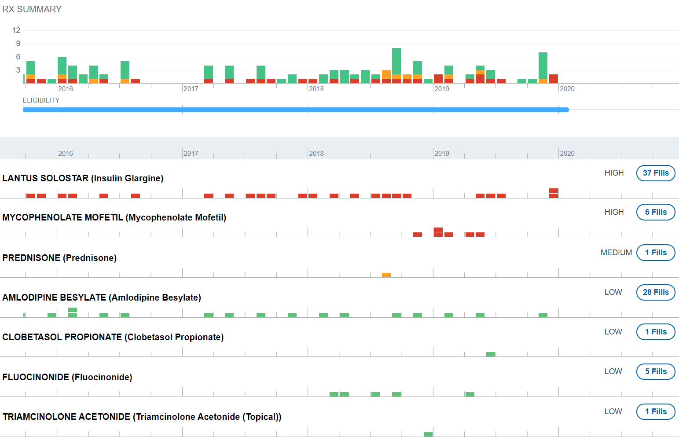
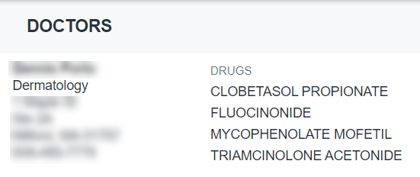
What is the autoimmune disease and activity?
Age: 84 | Gender: M
Application Date: 1/7/20
Rx Fills: 198

Slide 29
Mild to moderate IBD is associated with lower risk.
Mild to Moderate Activity
Additional Maintenance Therapies
aminosalicylates
mesalamine
sulfasalazine
suppositories, enemas, or tablets all common
azathioprine
mercaptopurine
Moderate to Severe Activity
budesonide (oral)
Oral + Injection Therapy
tofacitinib (Xeljanz)
Relative Mortality ~110%
Relative Mortality ~160%

Slide 30
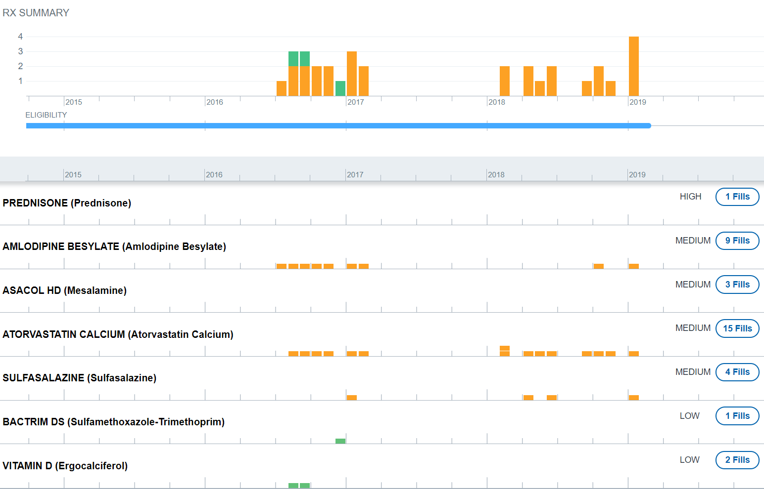
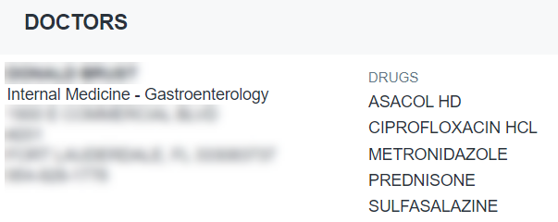
What is the autoimmune disease and activity?
Age: 48 | Gender: M
Application date: 2/9/19
Rx Fills: 40

Slide 31
Drug therapies can be used to differentiate lupus severity.
Mild to moderate lupus
Signs of advanced disease
Mild lupus
Topical steroids
Hydroxychloroquine
any
Azathioprine
Hydroxychloroquine
Mycophenolate
Disease activity | Relative mortality
Mild | ~130%
Moderate | ~200%
Severe | ~270%
Cyclosporine
Belimumab (Benlysta)

Slide 32
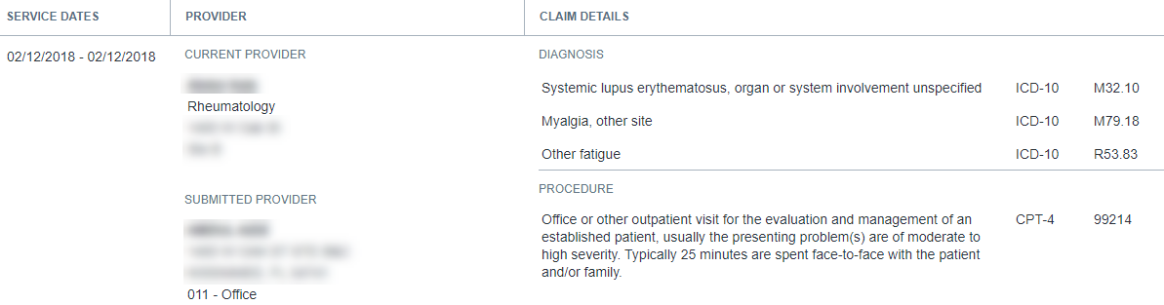
Medical Data identifies the condition.
Age: 52 | Gender: F
Application date: 9/23/21
Rx Fills: 412

Slide 33
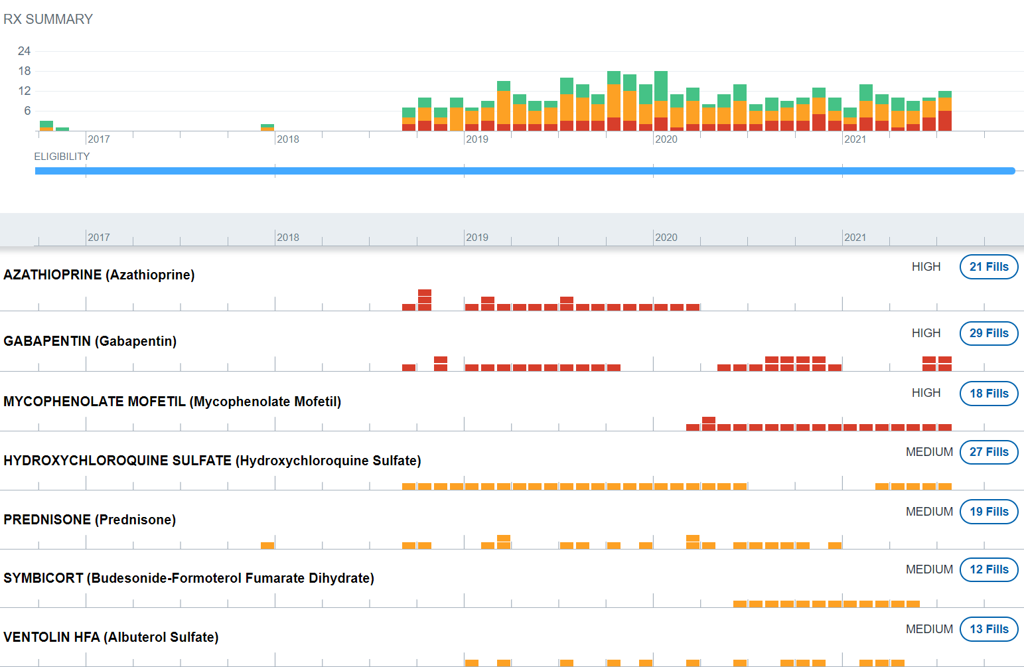
What is the lupus activity?
Age: 52 | Gender: F
Application Date: 9/23/21
Rx Fills: 412
Rule names
Rx—Lupus likely Dx—Systemic lupus Persistent asthma Unmanaged rescue inhaler use

Slide 34
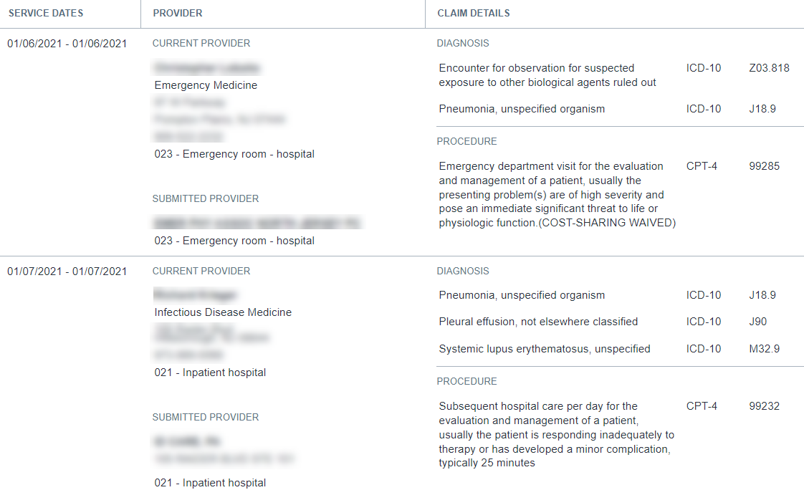
What is the lupus activity?
Age: 52 | Gender: F
Application Date: 9/23/21
Rx Fills: 412

Slide 35
Medications can be used to stratify mortality in RA.
Lowest mortality
Moderate mortality Elevated mortality
DMARDs*
Methotrexate
Sulfasalazine
Hydroxychloroquine
Leflunomide
DMARDs
Multiple DMARDs
Injectable biologics
Injectable biologics
Recent steroid
Recent steroid
Azathioprine
Azathioprine
Tofacitinib (Xeljanz)
Tofacitinib (Xeljanz)
*Disease-modifying anti-rheumatic drug
~140% Mortality >200%

Slide 36
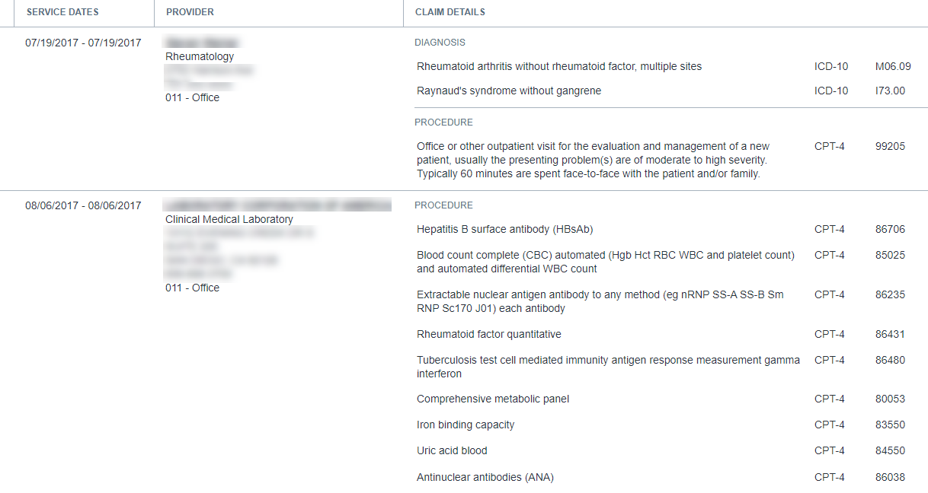
Medical Data confirms the diagnosis.
Age: 59 | Gender: M
Application date: 1/20/20
Rx Fills: 156

Slide 37
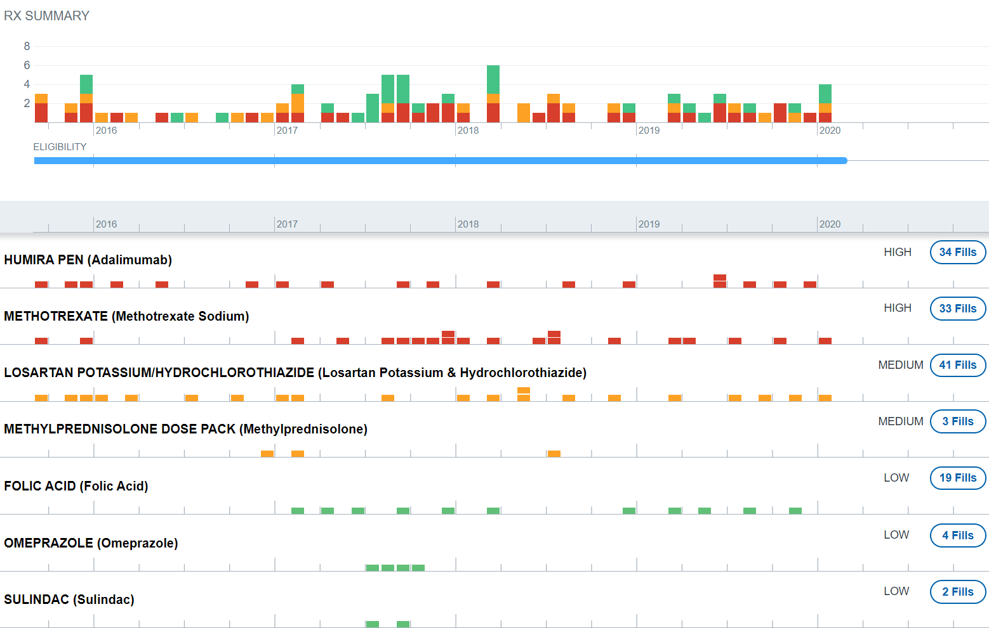
What is the rheumatoid arthritis activity?
Age: 59 | Gender: M
Application date: 1/20/20
Rx Fills: 156

Slide 38
Case Example
Notes:
To the end the day, I have one case example. It should only take a couple of minutes, but it will help pull together everything from this presentation.

Slide 39
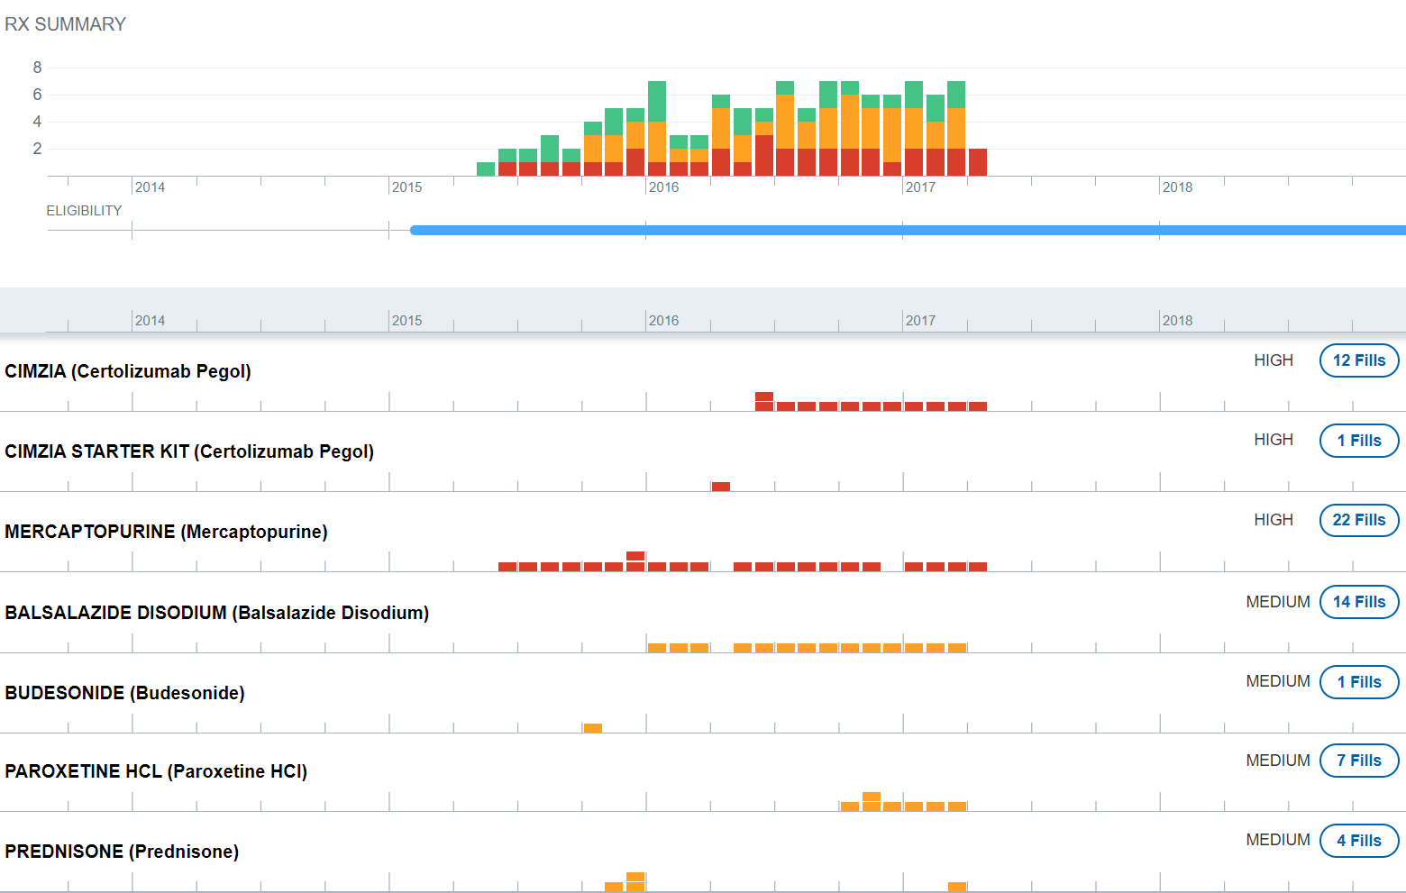
What is the autoimmune disease and activity?
Age: 29 | Gender: F
Application date: 12/12/18
Rx Fills: 113

Slide 40
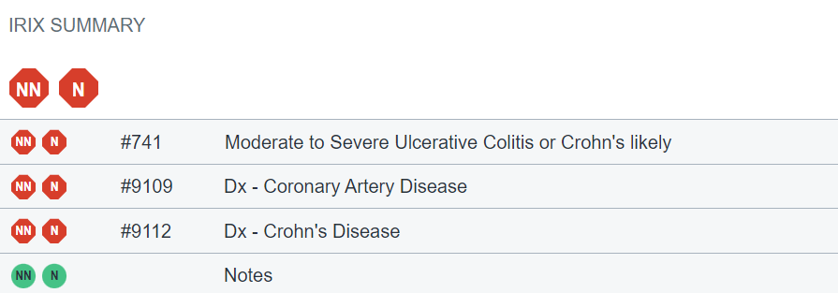
What is the autoimmune disease and activity?
Age: 29 | Gender: F
Application date: 12/12/18
Rx Fills: 113

Slide 41
Autoimmune Summary
The immune system relies on inflammation
Autoimmune inflammation increases comorbidities and mortality
Prescription Data and Medical Data stratify autoimmune risk
Rules engines automate differentiation of autoimmune diseases

Slide 42
Thank you!
Kyle Schimek, PharmD, BCPS
Manager, Clinical Services
kyle.schimek@milliman.com

