Slide 1

Emotional Intelligence and Clear Communication
Enhancing Conversations through Empathy & Awareness
Presented by Connie Perez and Yvette Thomas
7/25-262025

Slide 2

By the end of this session 100% of participants will be able to:
Describe 2-3 connections between EQ and communication.
Identify 1-2 key EQ attributes with a practical strategy and model an example to support communication.
Explore and align 2 active listening & empathy techniques.
Develop a draft plan to enhance one component of your EQ awareness and empathy.
Goals
This Photo by Unknown Author is licensed under CC BY

Slide 3

Key Messages:
Emotional Intelligence (EQ) supports communication effectiveness.
Empathy is at the heart of EQ and conversations.

Slide 4
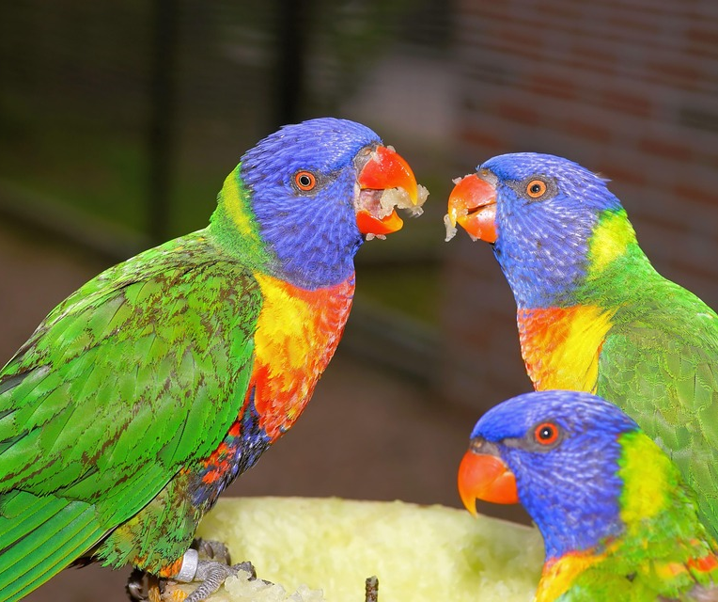
How EQ Supports Communication:
1.Putting yourself in another’s shoes.
2.Understanding feelings and perspectives.
3. Which Leads to:
  Clearer self-expression.
  Active listening.
  Stronger relationships.
  Positive interactions.

Slide 5

Components of EQ
Self-Awareness
Self-Management
Social Awareness
Empathy
Relationship Building

Slide 6

Required Self-Awareness Skills:
Recognize your own emotions.
Communicate authentically.
Manage reactions during conversations.
Example: Staying calm under pressure.

Slide 7

Social Awareness & Empathy:
Read body language and tone.
Adapt your style for better connection.
Group Activity: Example where reading nonverbals helps you. 3 min
This Photo by Unknown Author is licensed under CC BY

Slide 8

Building Positive Relationships:
Empathy builds trust.
Open, productive interactions.
Quote: “Walking in someone else’s shoes.” 2 min share
This Photo by Unknown Author is licensed under CC BY-NC-ND

Slide 9

Self-Empathy & Reflection:
Practice journaling.
Ask: What am I feeling? Why?
Identify patterns in emotions & reactions.
This Photo by Unknown Author is licensed under CC BY-NC-ND

Slide 10

Verbal & Nonverbal Skills:
Pay attention to words tone, gestures, and expressions.
Nonverbal cues speak volumes.
Tip: Check your own body language!
This Photo by Unknown Author is licensed under CC BY-SA-NC

Slide 11
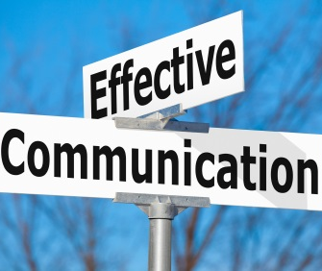
Communication Techniques:
Calmly responds to criticism.
Adjust your style to match audience.
Inspire teams by knowing their needs.
This Photo by Unknown Author is licensed under CC BY-ND

Slide 12

Role Play Activity
Practice: Active Listening.
Pairs take turns- speaking & reflecting back.
No interrupting, judging, or imposing opinions.
This Photo by Unknown Author is licensed under CC BY-SA-NC

Slide 13
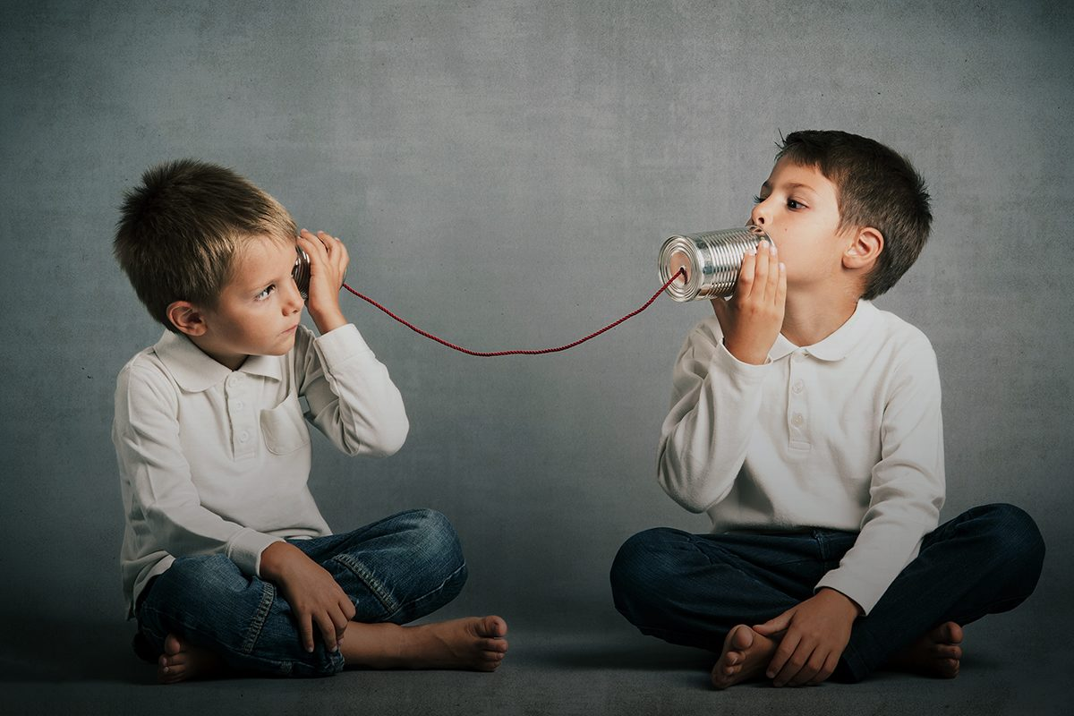
Active Listening Skills:
Prepare to listen.
Observe verbal & nonverbal signals.
Respond to show understanding.
Body Language
This Photo by Unknown Author is licensed under CC BY

Slide 14

Emotional Regulation:
Master self-control.
Keep negative emotions in check.
Respond thoughtfully — don’t react impulsively.
This Photo by Unknown Author is licensed under CC BY-NC-ND

Slide 15

Self-Regulation Strategies:
Activities: Let’s Practice:
The 4 Corners
Pause & breathe.
Hand tracing
Draw the figure 8 in the air.
Mentally count 1-5 backwards
Reflect before responding.
Use mindfulness & take breaks.

Slide 16
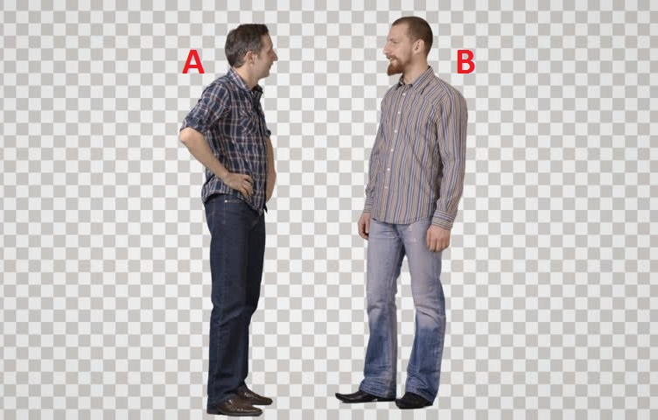
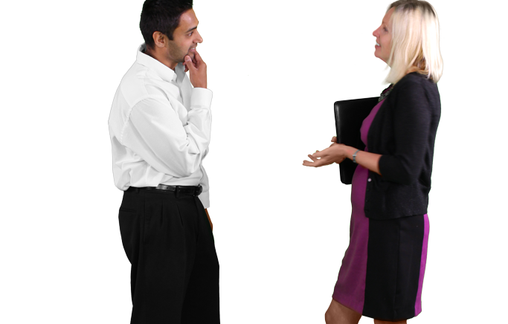
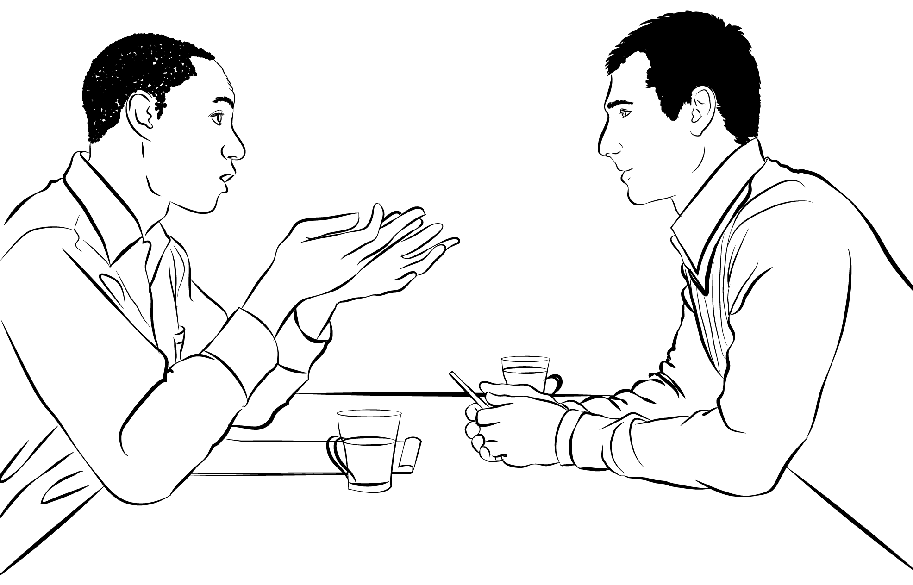
This Photo by Unknown Author is licensed under CC BY-SA
This Photo by Unknown Author is licensed under CC BY-NC
This Photo by Unknown Author is licensed under CC BY-NC
Body Language Awareness:
Eye contact.
Facial expressions.
Tone & volume.
Personal space.

Slide 17
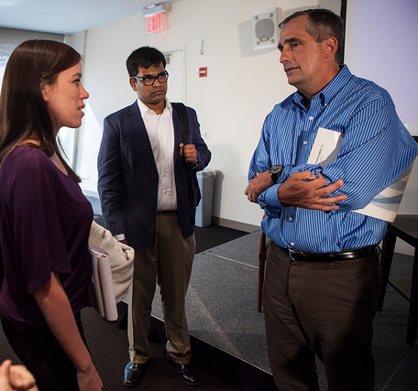
Practical Examples: (Role Play) 3 min.
Principal addresses frustration empathetically.
Team leader adjusts style for rapport.
Coordinator motivates with emotional insight.
This Photo by Unknown Author is licensed under CC BY-SA

Slide 18
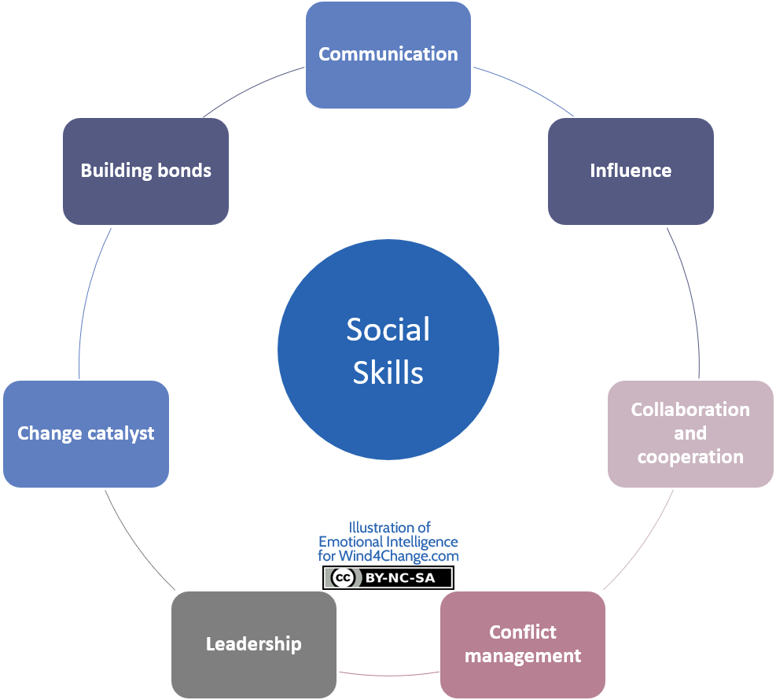
Techniques for Building EQ:
Journaling.
Meditation.
Identifying emotional triggers.
Modeling behavior for others.
This Photo by Unknown Author is licensed under CC BY-SA-NC

Slide 19
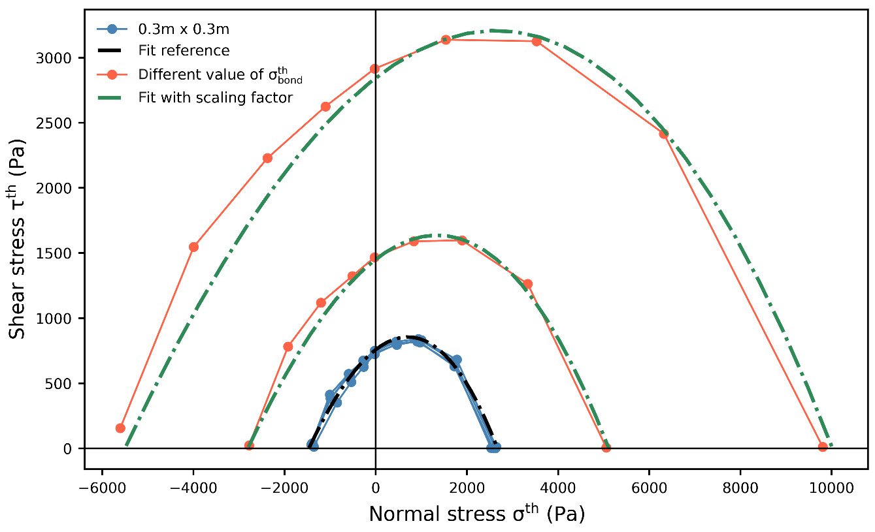
Modeling Emotional Intelligence:
Builds strong relationships.
Manages change.
Reduces stress.
Boosts morale.
Improves decision-making.
This Photo by Unknown Author is licensed under CC BY

Slide 20
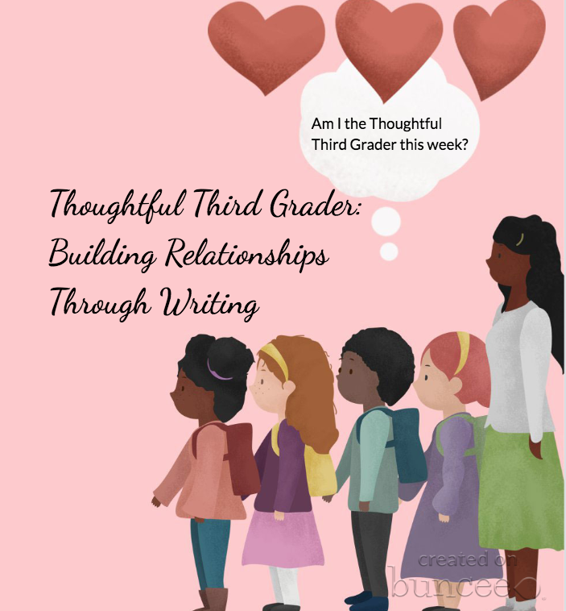
Building Relationships:
Build rapport.
Respond, don’t react.
Show gratitude.
Find common ground.
Set healthy boundaries.
This Photo by Unknown Author is licensed under CC BY-SA-NC

Slide 21

Group Activity:
Small groups: Share a time you used EQ to handle a tough conversation.
What worked? What could improve?(3 min)
This Photo by Unknown Author is licensed under CC BY-NC

Slide 22
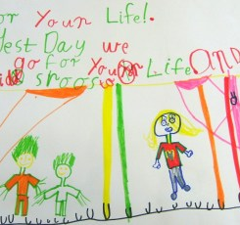
What is a Personal EQ Plan?
Think of one EQ skill you want to build?
How will you practice it this week?
Write it down & share with a partner.
This Photo by Unknown Author is licensed under CC BY-SA-NC

Slide 23
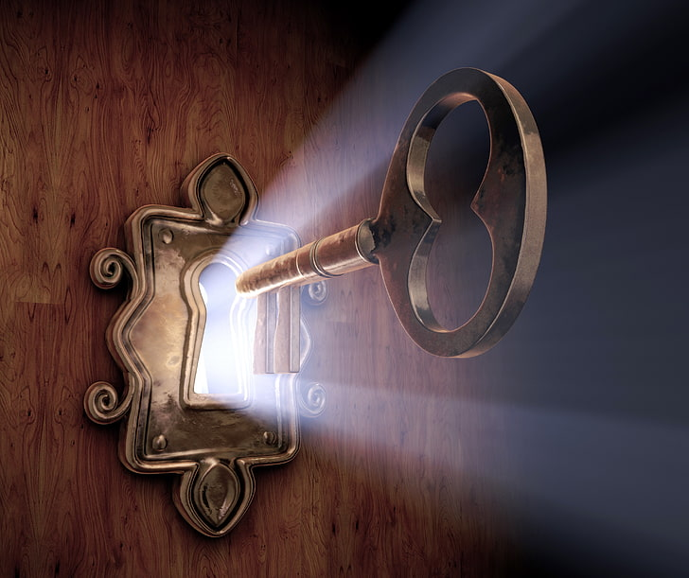
Closing Key Takeaways:
EQ strengthens communication.
Empathy is the root foundation.
Clear expression + active listening = trust.
Practice daily — Small changes matter!

Slide 24
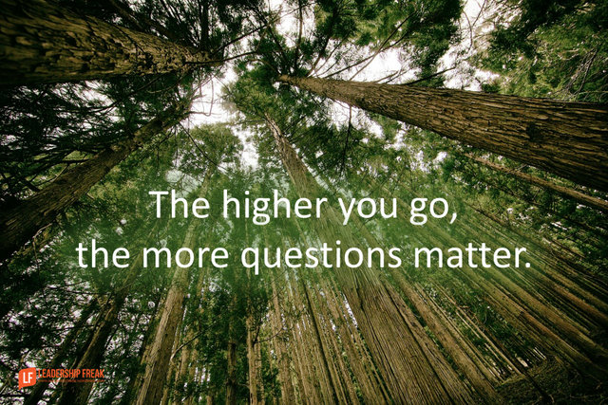
Q&A
Open discussion.
Questions, thoughts, reflections.
This Photo by Unknown Author is licensed under CC BY

Slide 25
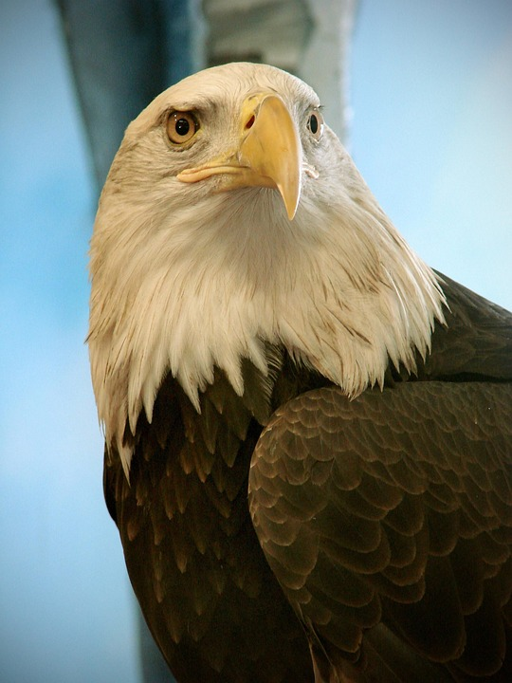

Continue to soar high like Eagles for you are loved, needed and appreciated.
This Photo by Unknown Author is licensed under CC BY-NC-ND
Notes:
Continue to soar high like Eagles for you are loved, needed, and appreciated.

