Slide 1

Authentic Engagement
Powerful Learning Component for teachers and students

Slide 2

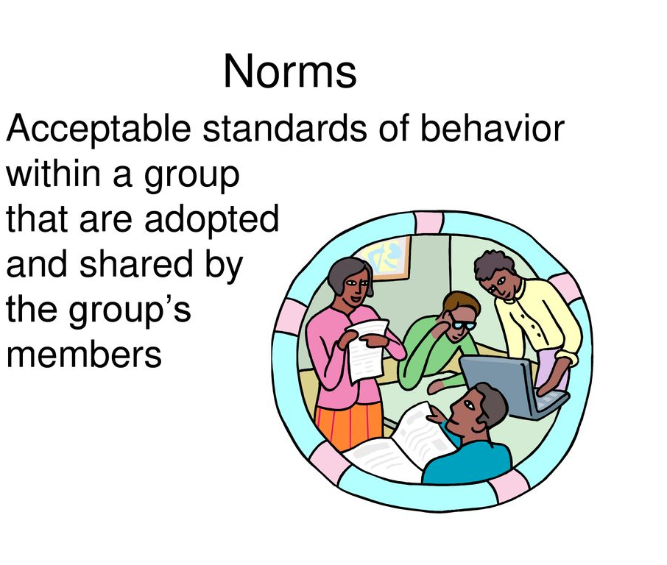
Norms:
Start and End on time
Active Participation
No Side Bars
Cell phones on Silent
Take care of your needs
Don’t focus on the problem focus on the solution.

Slide 3

Key Messages:
How, Where and when does Authentic Engagement Happen?
Who can create Meaningful tasks and projects ?
When should thoughtful discussions be conducted?
What motivates Inquiry and problem-based learning techniques?
Question: Can any subject or grade level be used to inspire Authentic Learning Engagement projects and Activities?

Slide 4

Objective:
By the end of this session, 100% of participants will be able to define, understand, and demonstrate the importance of developing a creative lesson using diversive activities through Authentic Engagement for meeting all student’s learning needs.

Slide 5
Authentic Engagement and learning opportunities:
How does this happens?
When does this happen?
Where can this Happen?: in the classroom, home and in other places:
The importance: of the WHY does this need to happen in today’s day and age ?

Slide 6
Authentic Engagement | Non-Engagement
Student-led projects | Passive listening
Collaborative problem-solving | Worksheet completion with no purpose
Real-world tasks | Busy work
Examples vs. Non-Examples

Slide 7
Four Conditions required for a successful Authentic Engagement Learning activity:
1. Intellectual Individual challenges
2. Relevance to students’ own lives
3. Student choices and voices are respected and listened to.
4. A Safe and supportive environment for all

Slide 8

Small Group Discussion and activity : How do we create an authentic Learning environment Draft? Chart out!
Got any ideas? 3 min.

Slide 9
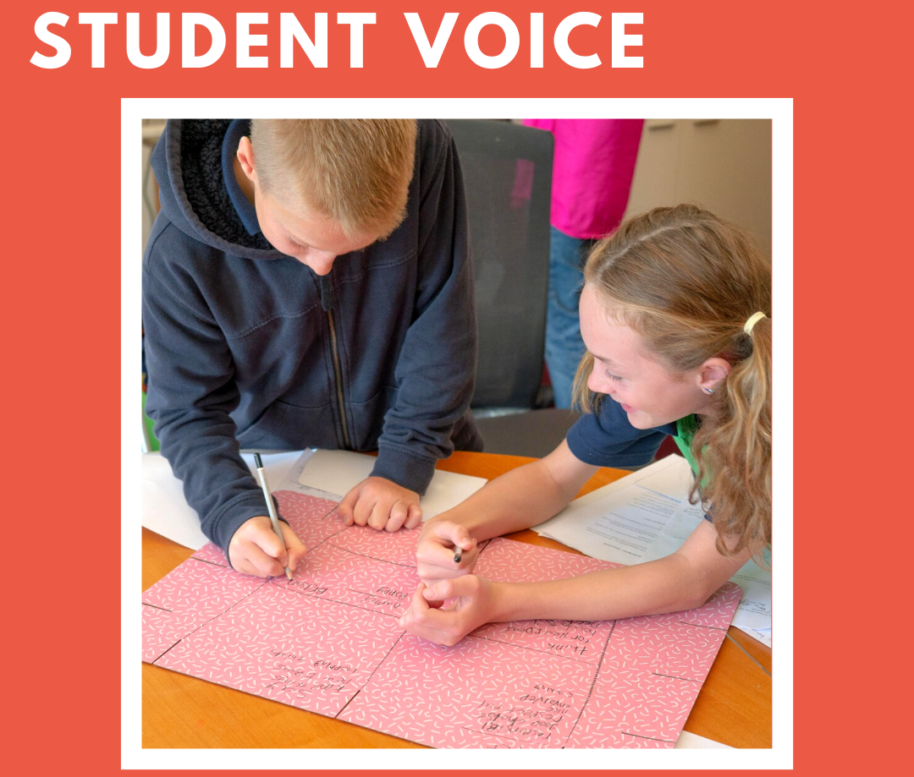
Student Voice "When I care about what I’m learning, I work harder." — 8th Grade Student

Slide 10

Let’s Examine four key roles:
What is “The Design for Creativity”?
The Culture? Where everyone counts and is listened to and respected?
The Space? Big enough for all to work collaboratively with the necessary equipment and supplies needed?
The Mindset? A We mindset not an I mindset?
The relationships? Is there trust and a sense of responsibility, accountability and dependability in the team members.

Slide 11

The Role of the Culture:
1.Build trust and respect
2.Celebrate diversity and identity
3.Establish norms for risk-taking and curiosity

Slide 12
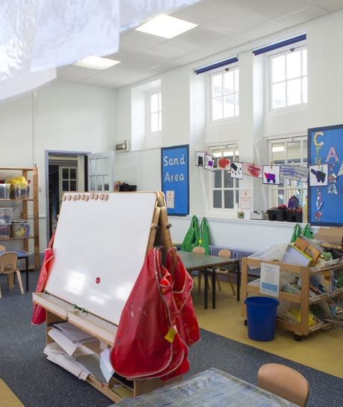
Role of the Physical & Virtual Space:
1.Flexible seating arrangements
2.Displays of student work
3.Online spaces for collaboration
4.Access to resources and materials
5.Group tables, reading corners, standing desks
6.Virtual: Breakout rooms, discussion boards

Slide 13

The Role of the Mindset:
1. A Growth mindset for students and teachers
2. Model curiosity and resilience
3. Celebrate effort, not just outcomes

Slide 14
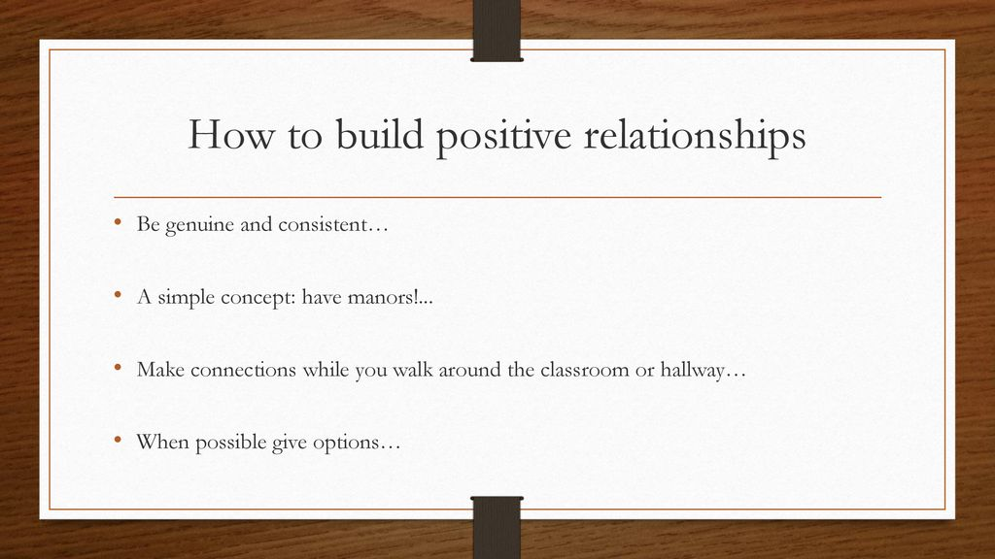
The Role of Relationship-Building Ideas:
1. Morning meetings/check-ins
2. Student interest surveys
3. Collaborative games and activities

Slide 15
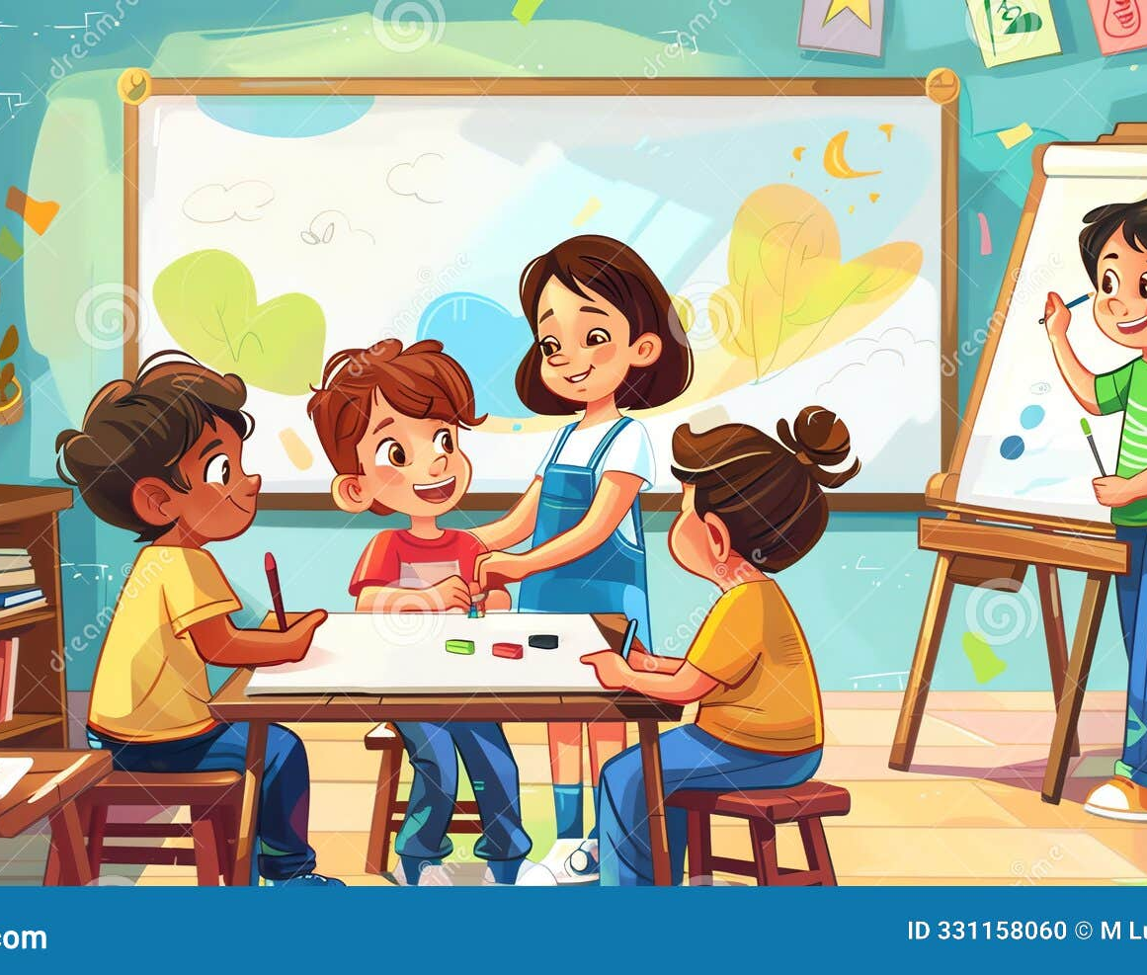
Strategies to Foster Engagement:
1. Offer choices in tasks and topics
2. Connect learning to real-world contexts
3. Use active learning: discussions, debates, simulations
Incorporate student feedback

Slide 16

Journaling, thinking, Reflecting and sharing time. 2 min.
“Ms. Lopez greets every student by name and invites their ideas for class projects.”

Slide 17


Benefits: For all students:
1. Increases motivation and achievement skills.
2. Builds a deeper sense of understanding and acceptance.
3. Promotes lifelong learning mindset and self confidence.
4. Empowers student’s taking ownership and accountability for their own learning.

Slide 18

Create a Protocol- Foster Authentic Student Engagement:
Review Team (groups) Norms and expectations.
Offer 2-3 topics or ask students for their own topic ideas?
Teacher models the how to in seeking information, research or exploring other possibilities with whole group.
4. Have each small group designate individual roles.(Facilitator or Lead, writer, timekeeper, Bird walker, materials person, cleanup people, and Tech person etc. etc. Everyone needs to have a role for success of the project/activity.
5. Small groups conduct explorations, discussions, take time to think, reflect, and create a first draft/ plan.
6. Make a list of materials or the teacher can provide a variety of materials for small groups to go pick and choose from for their project, lesson, or activity.
7. Mark designated stations/areas around the classroom for teams to plan and work together.
8. Everyone shares and presents on due dates.

Slide 19

The Evidence of Authentic Engagement Learning:
What should this scenario look like in the classroom with students?
A Total focus and emersion of students in an impactful learning experience.
The Discovery- Intellectual and emotional immersion learning.
The Creativity-Goes beyond compliance and participation.
The Vision- Students are focused, curious, invested, and motivated are getting the big picture using Powerful Learning techniques.
–

Slide 20

A Small Group Activity: To Do
Select one of the four Roles described to create a successful Authentic Learning Environment. Describe the role and why you think is most important for you to have in creating your lesson and or in your classroom environment for inspiring your student’s Learning projects, Activities, or lesson:What should this look like for you?
Please chart out and be prepared to present. 5 minutes

Slide 21

Wrap-Up
Objective, Review Key messages & Takeaways

Slide 22

Key takeaway: REMEMBER
”The Act of Engagement is intentional and relational”
Final question: What’s one thing you’ll try next week?

Slide 23

Thank you It has been wonderful being here with you today.

