Slide 1

Social Emotional Learning (SEL)
Building Strong Minds and Hearts
OST- 2026
YES, Inc. / MiLEAP

Slide 2
Learning Objective
By the end of this training, 90% of participants will demonstrate understanding of SEL by identifying two strategies that support:
• Student self-awareness
• Emotional regulation
• Positive peer interactions

Slide 3
Section 1: Introduction to SEL (15 min)
The Value of social-emotional learning
What is Social Emotional Learning
Guided discussion
Reflection activity

Slide 4

The Value Of Social Emotional Learning
There are three key values of Social Emotional Learning (SEL) for both students and teachers.
1. Strengthens Self- Awareness and Emotional Regulation for Students and Teachers
2. Builds Positive Relationships and Stronger Communication Skills
3. Improves Academic Success and Creates a Positive Learning Environment
Notes:
1. Strengthens Self-Awareness and Emotional Regulation
Social Emotional Learning helps students and teachers develop the ability to recognize, understand, and manage emotions effectively. This includes identifying feelings, understanding emotional triggers, and responding appropriately to challenging situations.
For students, this value is essential because it teaches them how to cope with frustration, disappointment, anxiety, and conflict in healthy ways. Students who can regulate their emotions are more likely to stay focused during instruction, recover from setbacks, and make thoughtful decisions rather than impulsive ones. Emotional regulation also supports academic perseverance, allowing students to work through difficult tasks without becoming discouraged.
For teachers, self-awareness and emotional regulation improve classroom leadership and professional effectiveness. Educators regularly navigate stressful situations such as classroom disruptions, student behavioral challenges, and competing demands. SEL equips teachers with strategies to remain calm, respond intentionally, and model healthy emotional management for students.
Why it matters:
When both students and teachers practice emotional regulation, classrooms become more stable, focused, and supportive learning environments where challenges are handled constructively rather than reactively.
2. Builds Positive Relationships and Stronger Communication Skills
A core value of SEL is its focus on developing interpersonal skills such as empathy, active listening, cooperation, respect, and conflict resolution.
For students, these skills help them build meaningful peer relationships, work effectively in groups, and communicate their thoughts and feelings appropriately. Students learn how to understand different perspectives, show compassion, and resolve disagreements peacefully. These abilities are critical not only for school success but also for future workplace and life success.
For teachers, SEL strengthens relationships with students, colleagues, and families. Teachers who practice empathy and intentional communication create trusting classroom environments where students feel seen, heard, and valued. Positive teacher-student relationships often lead to increased student engagement, improved behavior, and stronger academic outcomes.
Strong communication also supports collaboration among educators, allowing for more effective teamwork, problem-solving, and shared decision-making.
Why it matters:
Healthy relationships create a sense of belonging. When students and teachers feel connected and respected, classrooms become communities where learning and collaboration thrive.
3. Improves Academic Success and Creates a Positive Learning Environment
SEL directly supports academic achievement by addressing the emotional and social factors that influence learning.
For students, skills such as self-management, goal setting, responsible decision-making, and resilience help them stay motivated and engaged. Students who feel emotionally safe and supported are better able to concentrate, participate, take academic risks, and persist through challenges.
SEL also reduces barriers to learning by helping students manage stress, anxiety, and behavioral difficulties that can interfere with academic performance.
For teachers, SEL contributes to a more productive and positive classroom climate. When students demonstrate stronger emotional regulation and social skills, teachers spend less time managing behavior and more time delivering meaningful instruction. This leads to greater instructional effectiveness and reduced teacher stress.
In addition, SEL supports teacher well-being by promoting reflection, resilience, and healthier responses to workplace challenges, which can reduce burnout and improve job satisfaction.
Why it matters:
A positive learning environment increases engagement, improves academic performance, supports mental wellness, and creates conditions where both students and teachers can succeed.

Slide 5
What Does the Research
Say?
CASEL- Callobortive for Academic , Social and Emotional Learning
“SEL programs appear to have as great a long-term impact on academic growth as has been found for programs designed specifically to support academic learning. ”
_~Mahoney, Durlak, and Weissberg, 2018

Slide 6
What is Social Emotional Learning?
Social Emotional Learning (SEL) is the process through which students and adults develop the knowledge, attitudes, and skills needed to understand and manage emotions, set and achieve positive goals, show empathy for others, build healthy relationships, and make responsible decisions.
Notes:
SEL focuses on helping individuals develop essential life skills that support both academic success and personal growth. It teaches people how to recognize their emotions, regulate their behavior, communicate effectively, solve problems, work collaboratively, and respond positively to challenges.
In educational settings, Social Emotional Learning helps create safe, supportive, and inclusive learning environments where students feel valued and empowered to succeed both inside and outside the classroom.
SEL is commonly built around five core competencies:
Self-Awareness – Recognizing one’s emotions, strengths, values, and areas for growth
Self-Management – Managing emotions, behaviors, and stress effectively
Social Awareness – Understanding and empathizing with others from diverse backgrounds
Relationship Skills – Building and maintaining healthy, positive relationships
Responsible Decision-Making – Making thoughtful, ethical, and constructive choices
Simple definition:
Social Emotional Learning is teaching students and educators how to understand emotions, build positive relationships, and make responsible choices that support success in school and life.

Slide 7
Section 2: SEL Strategies (25 min)
Emotion management
Empathy building
Communication skills
Collaborative brainstorming and case studies
Notes:
1. Emotional Engagement
Emotional engagement focuses on helping students connect personally to learning, feel safe expressing emotions, and stay motivated.
Strategy 1: Emotion Check-Ins (Mood Meter or Feelings Chart)
Start class with a quick emotional check-in where students identify how they are feeling using a chart, color scale, or emotion words. This builds self-awareness and helps teachers adjust support based on student emotional states.
How it works:
Students select a feeling (happy, stressed, tired, excited, etc.)
Optional: brief explanation (“I feel ___ because…”)
Teacher acknowledges responses without judgment
Strategy 2: Personal Connection Journals
Students reflect on how lesson content connects to their own life experiences, goals, or challenges.
How it works:
Prompt example: “How does this topic relate to your life?”
Students write or draw a short response
Optional sharing in pairs or small groups
2. Empathy Building
Empathy building helps students understand and respect the feelings, perspectives, and experiences of others.
Strategy 1: Perspective-Taking Scenarios
Students analyze real-life or classroom scenarios and discuss how different people might feel.
How it works:
Present a conflict or situation
Ask: “How might each person feel?”
Students discuss in groups or write responses
Strategy 2: “Walk in Their Shoes” Role Play
Students act out different roles to experience situations from multiple perspectives.
How it works:
Assign roles in a scenario (student, teacher, peer, parent, etc.)
Students act out responses and emotions
Group reflection on feelings and insights
3. Communication Skills
Communication skills focus on expressing ideas clearly, listening actively, and responding respectfully.
Strategy 1: Active Listening Triads
Students work in groups of three to practice speaking, listening, and observing.
How it works:
Speaker shares thoughts for 1–2 minutes
Listener repeats key points (“What I heard you say is…”)
Observer gives feedback on communication skills
Strategy 2: Sentence Starters for Respectful Dialogue
Provide structured sentence starters to guide respectful conversations.
Examples:
“I agree with you because…”
“I see it differently because…”
“Can you explain what you mean by…?”
This builds confidence and reduces communication barriers.
4. Collaborative Brainstorming and Case Study
This focuses on teamwork, problem-solving, and shared decision-making.
Strategy 1: Think–Pair–Share Brainstorming
Students first think individually, then pair up, and finally share with the group to build ideas collaboratively.
How it works:
Step 1: Individual idea generation
Step 2: Partner discussion
Step 3: Group sharing and combining ideas
Strategy 2: Small Group Case Study Analysis
Students work together to solve a real-world or classroom-based scenario.
How it works:
Present a case study (conflict, workplace issue, decision problem)
Groups identify the problem, possible solutions, and best action
Groups present findings to class

Slide 8
Activity 1: Feelings Charades
Participants act out emotions without words
Others guess and discuss regulation strategies
Builds emotional recognition and empathy

Slide 9
Section 3: Hands-On SEL Activities (25 min)
Role-play scenarios
Interactive social skills practice
Small group collaboration

Slide 10

Activity 2: Kindness Circle Challenge
Participants pass a ball and share one positive action
Discuss real-life classroom applications
Promotes positive peer interactions

Slide 11
Section 4: Reflection & Application Planning (10 min)
How to integrate SEL strategies
Journaling
Group discussion
Action planning

Slide 12
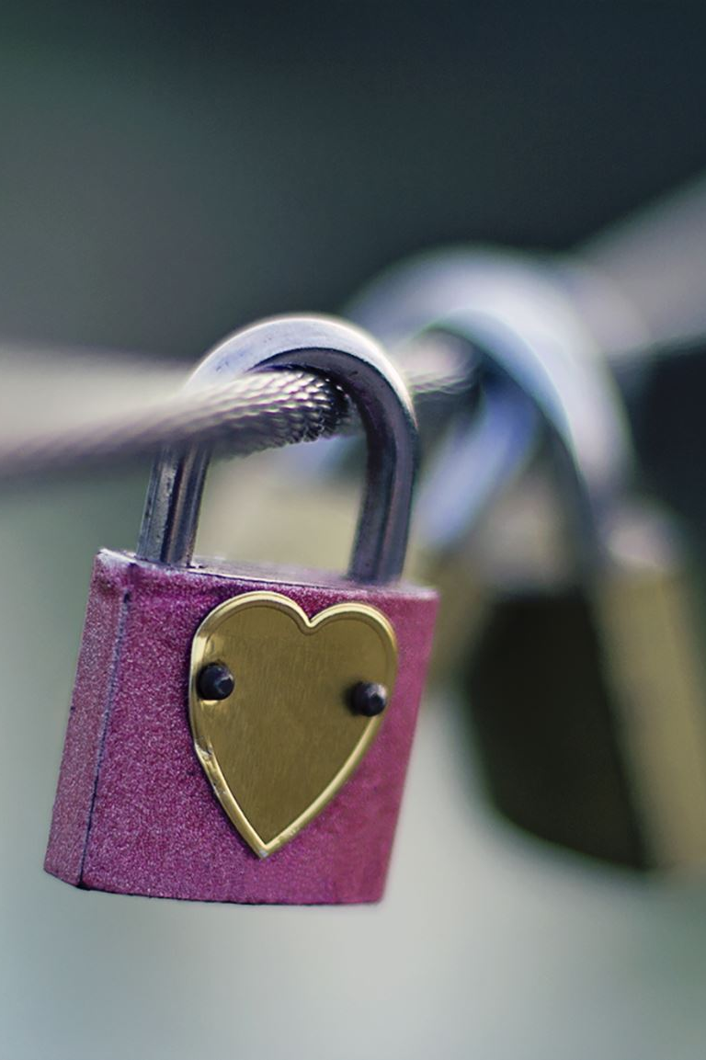
Key Takeaways
SEL strengthens student success
Small daily practices make big impacts
Consistency builds strong minds and hearts

Slide 13
