Slide 1

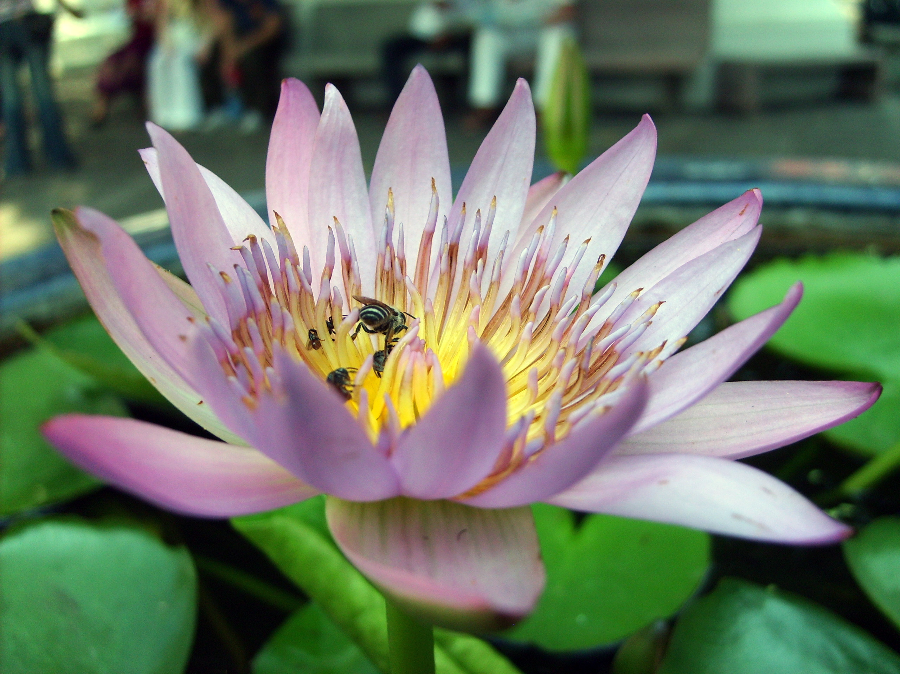
Science in Action: Explore, investigate,and Discovery!
Engaging children every minute of the day!
Notes:
Always be sure to explain how to be neat and safe during science experiments, Have students assigned each week to ensure all materials used are put away neatly.

Slide 2

GRANT Requirements….. INTRODUCTION TO HANDS-ON ACADEMIC PROGRAMMING for the 2026 OST program:
.
Science Exploration, Investigating and Discovery
This session introduces educators to inquiry-based science strategies that encourage curiosity, exploration, and discovery. Participant will experience hands-on investigations that help students observe, ask questions and explore scientific concepts. Aligned with Great Start to Quality professional development goals, this training supports the development of critical thinking skills and promotes engaging science learning experiences that inspire student curiosity.

Slide 3
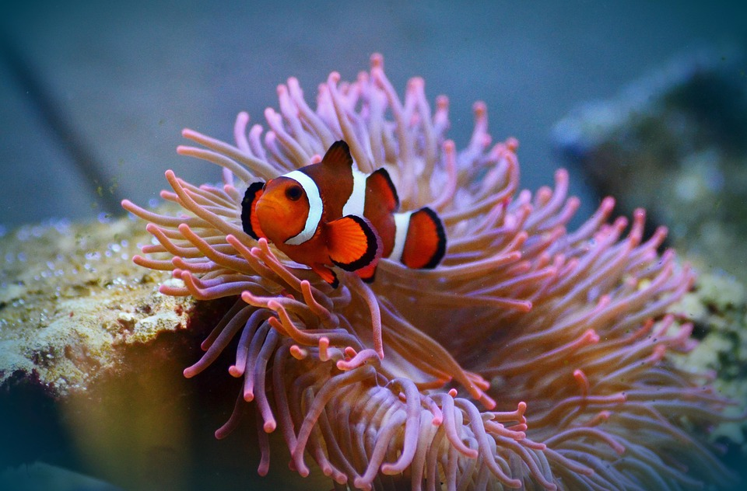
Objective: By the end of this sessions, educators will be able design a guided inquiry-based hands-on science lesson that integrates hands-on investigation, that allows students to independently discover a core scientific concept.

Slide 4

Hands-On Science exploration/inquiry
Hands-On Science:
Students manipulate materials and actively explore
Kinesthetic, visual, sometimes auditory
Encourages exploration and multiple strategies
Often done in pairs or groups
Stronger conceptual understanding
Examples: What makes plants grow? How does solar work?

Slide 5
Why Hands-On Science is Powerful ‘in OST Programs?
Keeps students engaged after a long school day
Supports struggling learners with concrete representation
Builds real-life skills (predicting, analyzing, measuring, food content)
Encourages Science talk and collaboration
Makes abstract science concepts visible and understandable

Slide 6
Science Activities Ages 5-7
Time: 25 Minutes:
Objective: Students will demonstrate a chemical reaction between an acid (vinegar) and a base (baking soda) that produces carbon dioxide gas
Age 5-7 Fizzing Volcano
Materials:
A 2- liter soda bottles, dish soap
Baking soda, white vinegar, warm water, food coloring, safety goggles large tray and some paper cups
Safety note: Remind students not to ingest the mixture and they should keep their safety goggles on during this experiment to protect their eyes from possible splashing
Steps: Place bottles in the middle put in 1 cup of warm water, I teaspoon of dish soap and 3 drops of food coloring add one cup of vinegar
Carefully pour the mixture into the bottle, step back and observe as the carbon dioxide gas is produced and the foamy lava erupts from the volcano.
In a separate cup mix ½ cup of baking soda and water to until it’s a a smooth mixture

Slide 7
Hand-on Science Investigation:
Examples: handle tools that are age appropriate
A learning method where you find answers to questions physically interacting with materials rather than just reading a book or watching a video
Learn by doing, experimenting and observing results firsthand.
Data Collection: record observations, measurements, time, tempertures, or visual changes.
Problem Solving: You test a guess (hypothesis)

Slide 8
Science Discovery Ages 8-10
Solar Oven Experiment:
Time: 30 Minutes
Objective: Students will demonstrate how sunlight can be captured and converted into thermal energy to cook
Activity Materials:
Empty pizza box or shoe box
Aluminum foil and plastic wrap
Black construction paper
Scissors, tape, and ruler
Graham crackers, chocolate and marshmallows
What happens?
How much time before you see results?
Cut a three-sides flap into the top lid of the pizza box leaving one side .attached to act as a hinge.
Line the the bottom with the black construction paper
Put graham cracker, chocolate and marshmallow on a plate and cover with the plastic wrap

Slide 9
EXIT TICKET:
Three things you learn today.
Two things you will complete by next week.
One thing you learned about Hands on Learning today?

