Slide 1
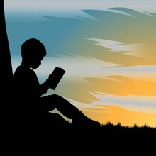
Hands-On Reading Bringing Stories to Life:
Hands-On Strategies for Stronger Reading Comprehension
Find the Love and the Passion!

Slide 2
NORMS:
Start on Time/End on time
No Side Bars/Cell Phones on silent
Take care of your needs
Active Participation
Focus on Solutions not the Problem
Notes:
Norms

Slide 3
Objective:
By the end of the training, 90% of participants will identify and plan to implement one interactive literacy strategy that strengthens children's reading comprehension through discussion, visualization, or storytelling.

Slide 4
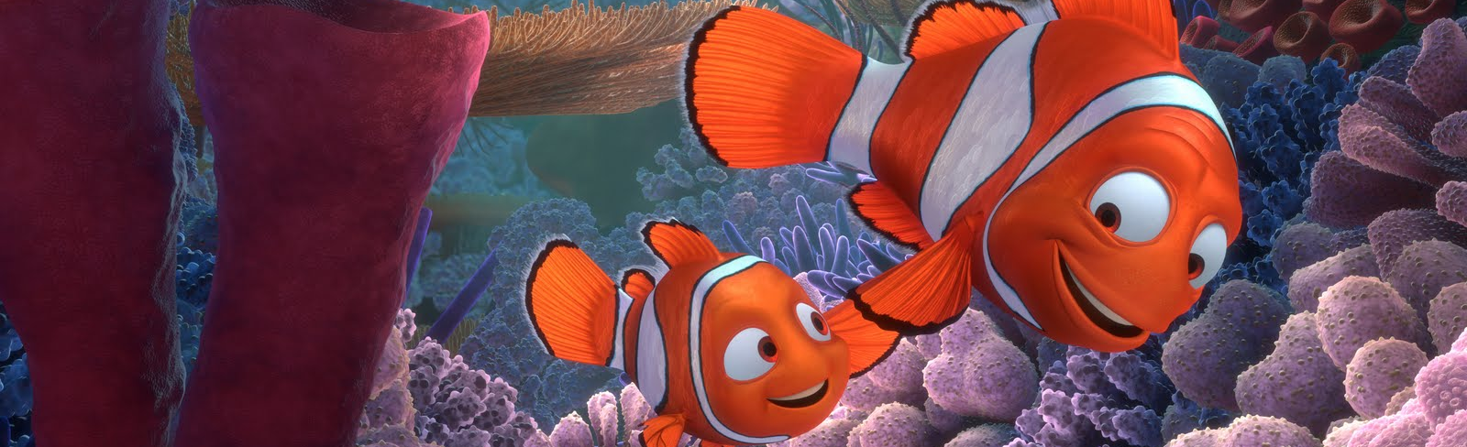
What is a Good Story?
What does a Good Story look like?
What does a Good story feel like?
What should be the impact of a good Story?
This Photo by Unknown Author is licensed under CC BY-SA-NC

Slide 5
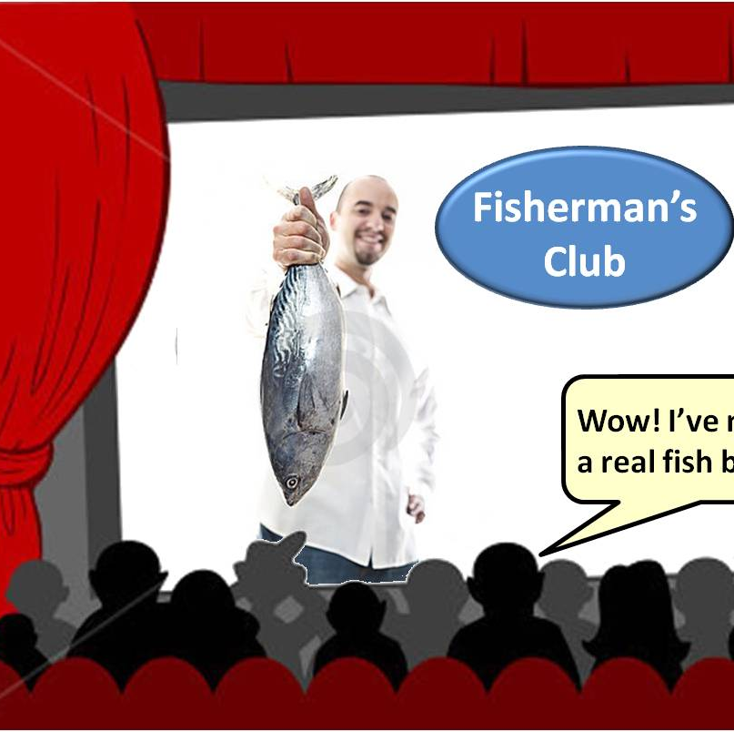
Share Out!
What do you think makes a good story? 1 min
This Photo by Unknown Author is licensed under CC BY-NC-ND
Notes:
Let’s Share Out

Slide 6
This session focuses on:
1) Engaging literacy strategies that help students develop stronger reading comprehension and communication skills.
2) Educators will explore interactive approaches such as storytelling, visualization, and creative expression to deepen students’ understanding of texts.
3) Aligned with a Great Start to Quality standards, this training emphasizes developmentally appropriate practices that support language development, literacy growth, and a love for an adventure in reading.

Slide 7

Section 1
Foundations of Reading Comprehension (3 minutes)
Content:
Overview of literacy development and strategies that strengthen reading comprehension.
Training Methods: Presentation and group discussion.
This Photo by Unknown Author is licensed under CC BY-NC

Slide 8

Developing a strong reading comprehension program for children requires a balance of :
1) Instructional strategies
2) Language development
3) Engagement and
5) intentional support.
The most effective programs build foundational literacy skills while helping children think critically, communicate, and connect meaning to text.
This Photo by Unknown Author is licensed under CC BY

Slide 9
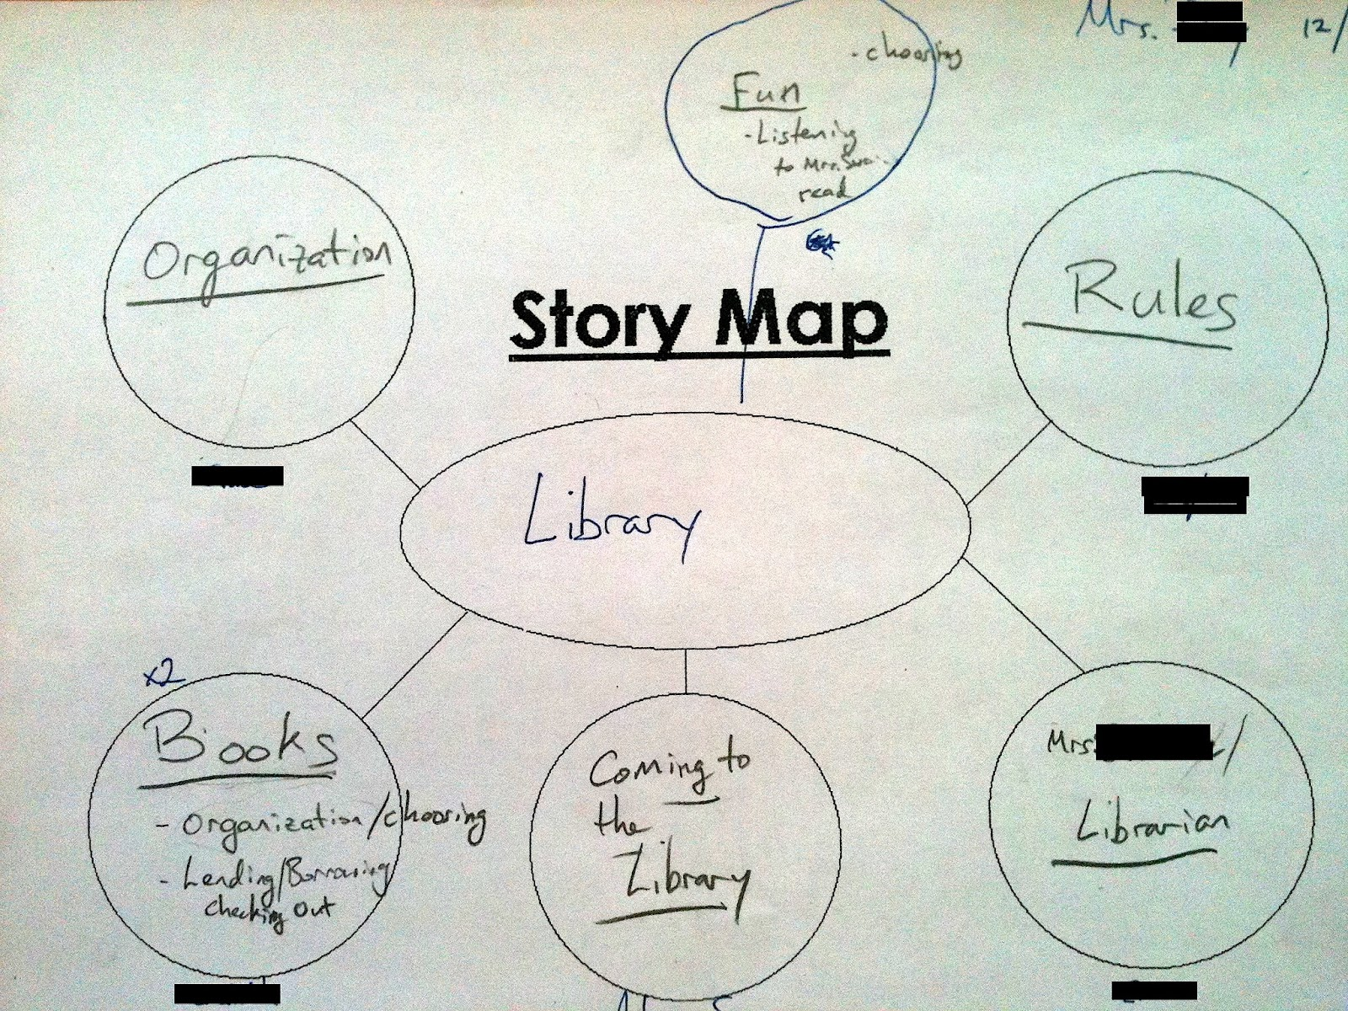
Section 2 Interactive Reading Strategies (5 minutes)
Content:
Participants will explore strategies such as:
Story mapping
Questioning, and
Visualization.
Training Methods: Demonstration and small group activities.
This Photo by Unknown Author is licensed under CC BY-NC

Slide 10
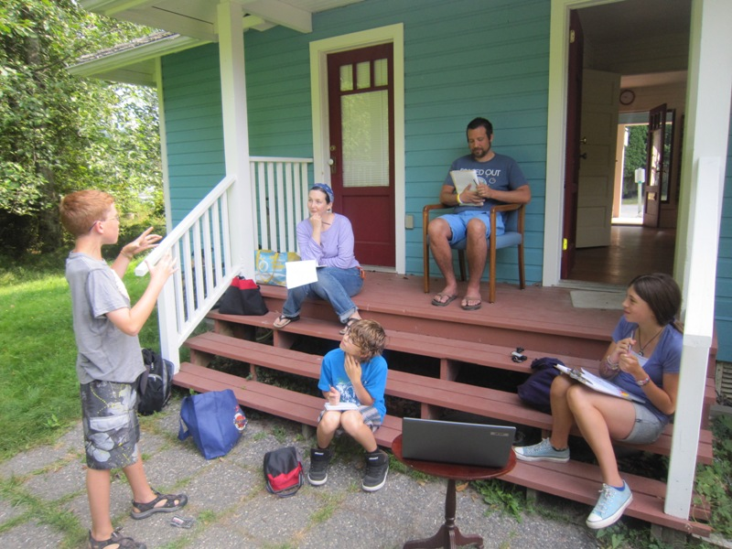
Successful interactive reading strategies help children:
1)Actively participate in the story.
2) Strengthen comprehension skills.
3) Build and use stronger vocabulary and
4) Develop critical thinking skills
The most effective approaches encourage conversation, movement, imagination, and meaningful engagement before, during, and after reading.
This Photo by Unknown Author is licensed under CC BY-SA-NC

Slide 11

Small Group Discussion 2 min
This Photo by Unknown Author is licensed under CC BY-SA-NC
Notes:
Small Group Discussion

Slide 12
A. Creating Engaging literacy Activities Helps Students To:
1) Build confidence
2) Strengthen comprehension and
3) Develop a lifelong love of reading.
B. The most effective activities combine:
1) Movement
2) Creativity
3) Discussion and
4) Making real-world connections while allowing students to actively use reading, speaking, listening, and writing skills.

Slide 13
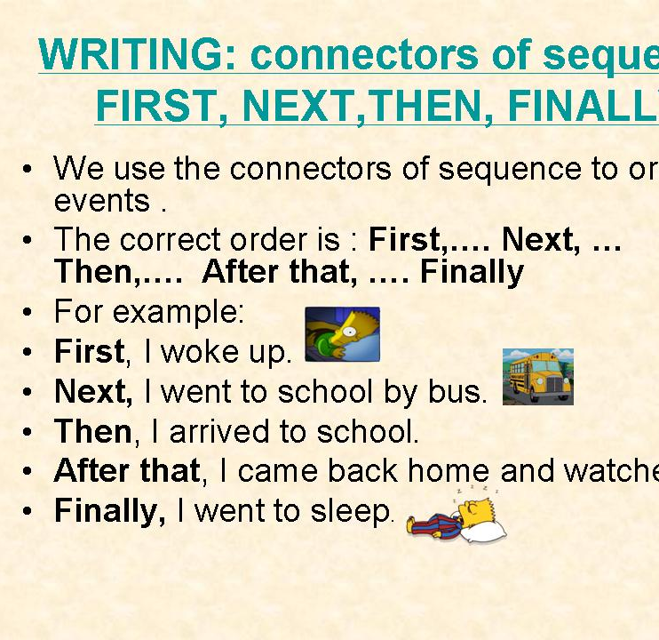
Section 3
Creative Literacy Activity (3 Min minutes)
Content: Participants engage in puppet storytelling and story retelling activities.
Training Methods: Hands-on activity and collaborative storytelling.
This Photo by Unknown Author is licensed under CC BY-NC

Slide 14
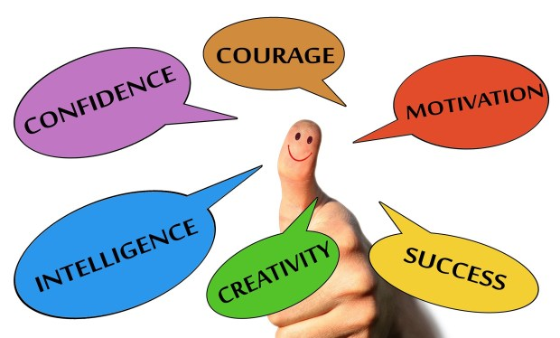
Creating Engaging Literacy Activities Helps Students To:
Build confidence
Strengthen comprehension and
Develop a lifelong love of reading.
This Photo by Unknown Author is licensed under CC BY-SA-NC

Slide 15
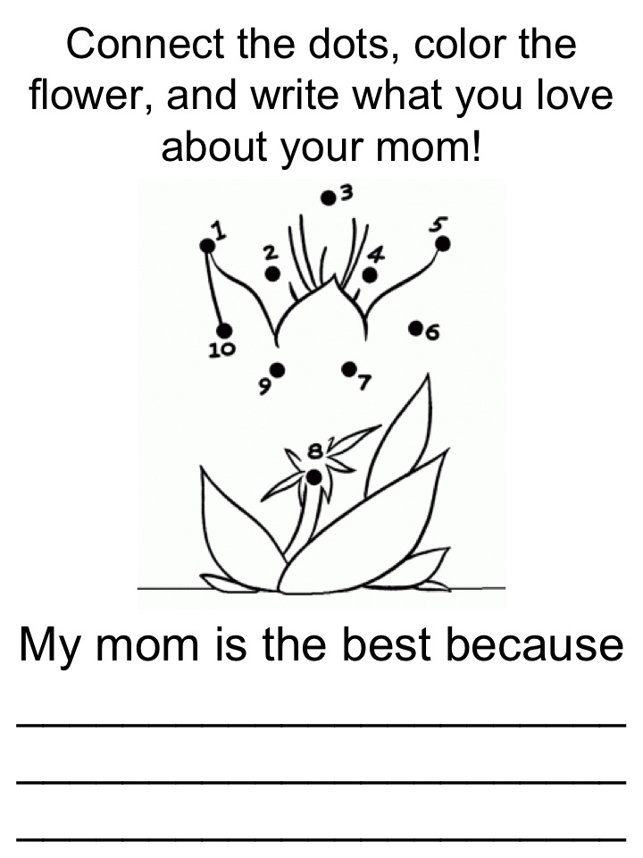
The most effective activities combine:
Movement
Creativity
Discussion and
Make real-world connections
While allowing students to actively practice and use their reading, speaking, listening, and writing skills.
This Photo by Unknown Author is licensed under CC BY-SA

Slide 16
Section 4
Reflection and Application (3 minutes)
Content:
Let’s discuss how these strategies support literacy development.

Slide 17
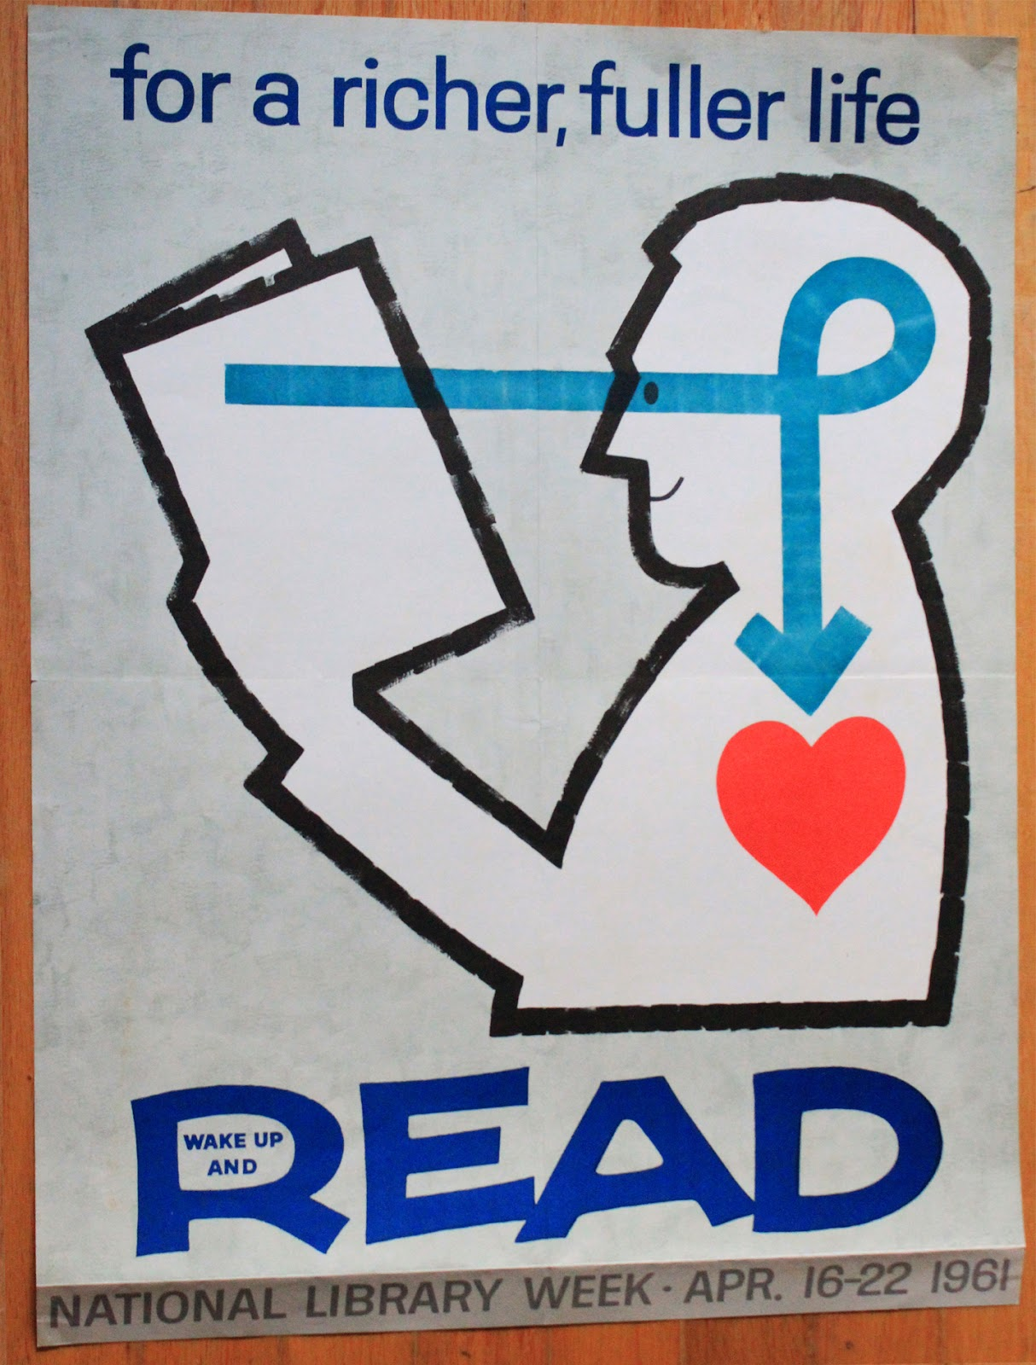
Outcome 1
Have an Increased Knowledge of Interactive Literacy Strategies
where At least 90% of participants will demonstrate an increased understanding of interactive literacy strategies that will support students in :
1) Reading comprehension
2) Vocabulary development and
3) Student engagement.
This Photo by Unknown Author is licensed under CC BY-NC-ND

Slide 18
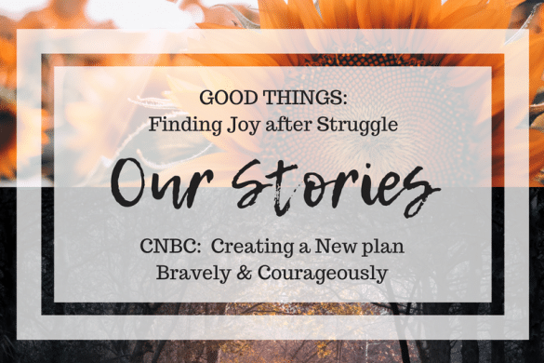
Let’s discuss how knowing and Increasing the Knowledge of Interactive Literacy Strategies will support in meeting our diverse student population reading literacy needs? (2 min)
This Photo by Unknown Author is licensed under CC BY
Notes:
Let’s Discuss how applying and practicing these skills will

Slide 19
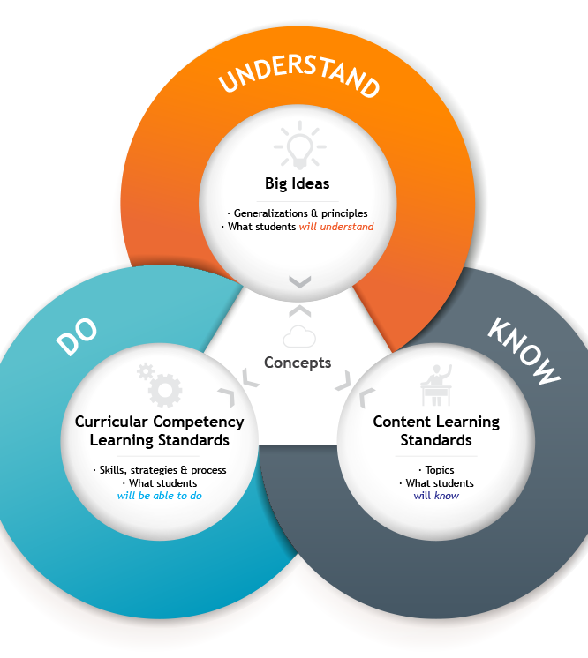
Outcome 2
The ability to Apply Literacy Engagement Strategies:
At least 85% of educators will demonstrate the ability to apply an interactive literacy strategy that encourages discussion, visualization, or storytelling to deepen students’ understanding of texts.
This Photo by Unknown Author is licensed under CC BY

Slide 20
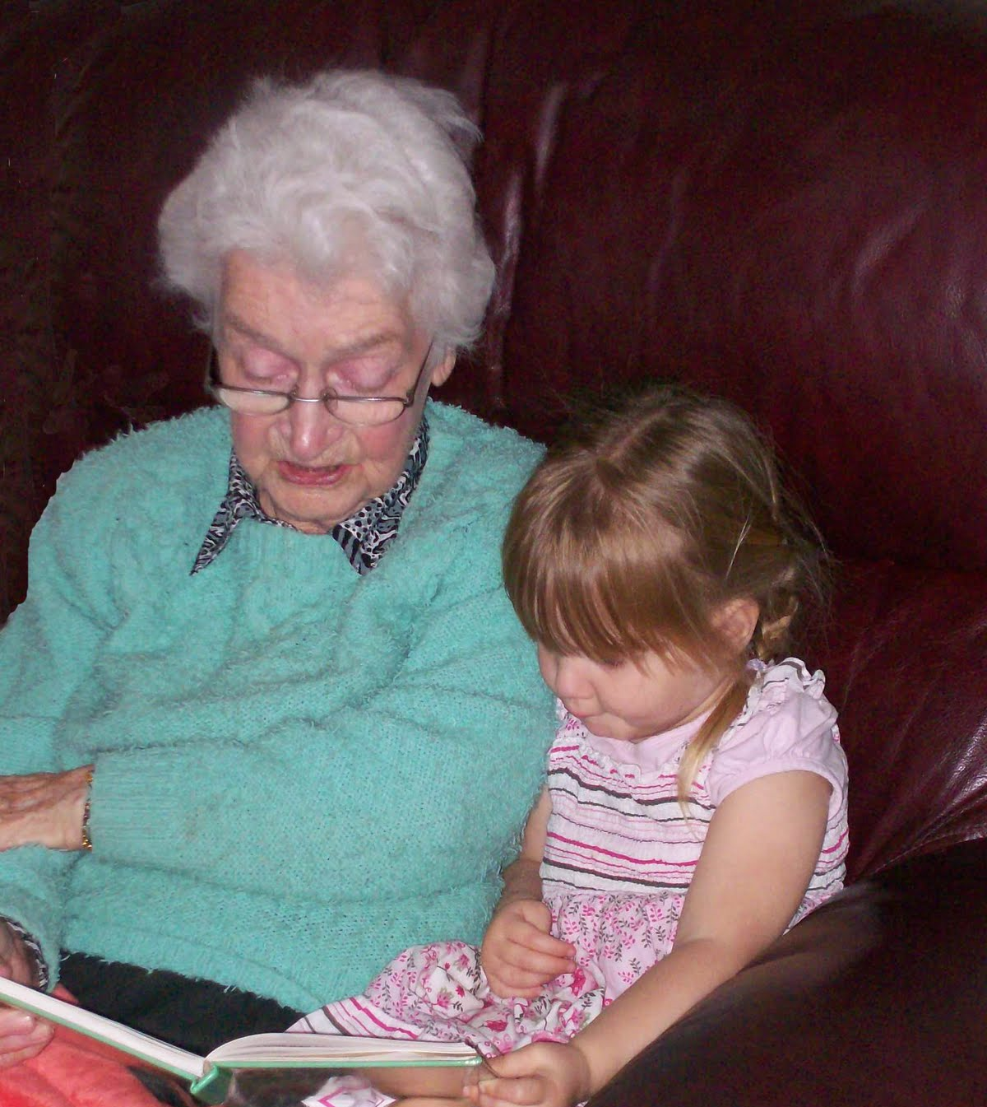
To Apply Powerful Literacy Engagement Strategies:
Recipe:
1) Provide a big Heart!
2) Mix in special Feelings!
3) Stir and Pour in some Drama! (Music)
4. Expand that delight and Joy!
5) Give the Drum Roll for the excitement!
6) Make real world connections with the students.
This Photo by Unknown Author is licensed under CC BY-NC-ND

Slide 21
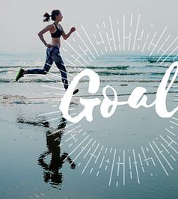
Outcome 3
Program Goal For:
The Implementation of Creative Literacy Activities:
At least 90% of participants will successfully participate in and model one creative literacy activity, such as in:
1)Story telling
2)Story Retelling or
3) Dramatization
to support reading comprehension and student engagement.

Slide 22
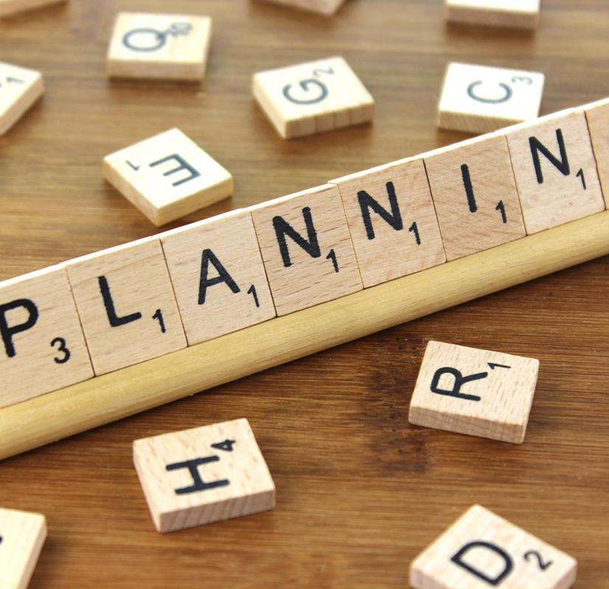
Assessment of Learning Objectives To Do:
1) You will complete a literacy strategy planning activity in which to identify one interactive reading strategy to support student comprehension.
2) You will describe how the strategy encourages discussion, visualization, or storytelling.
3) By Sharing your ideas with peers will demonstrate the HOW of the understanding using engaging literacy practices.
This Photo by Unknown Author is licensed under CC BY-SA

Slide 23
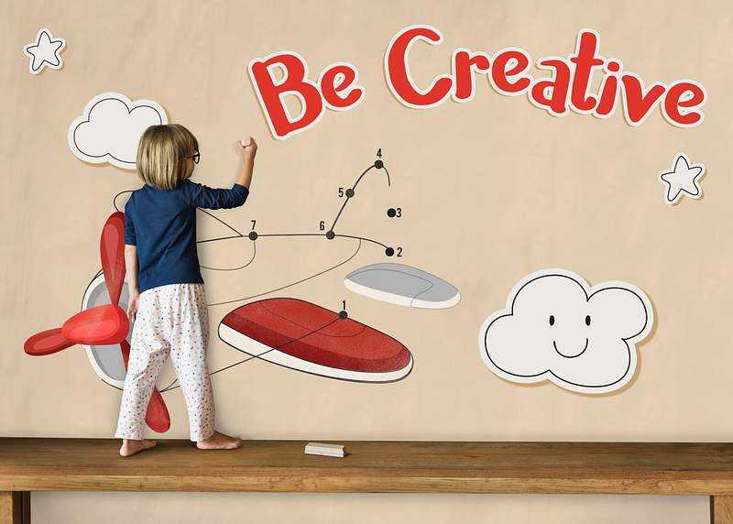
Suggest A Creative Literacy Activity for your students to do that you will readily implement .
Small Group Activity
Notes:
Group Activity

Slide 24
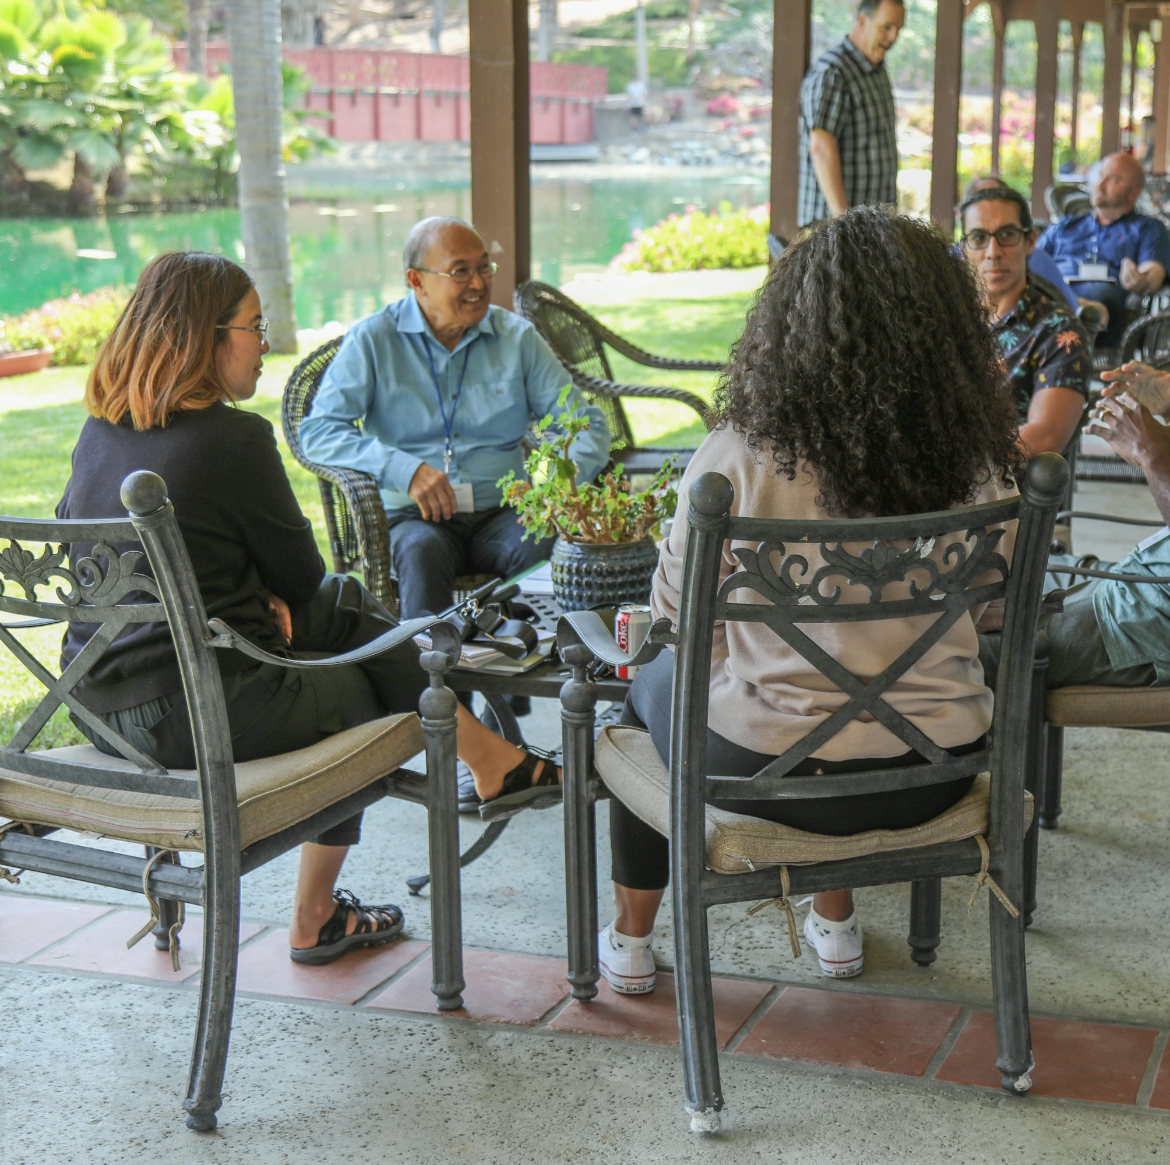
Small Group Reflection/Discussion/
Sharing OUT (3 min)

Slide 25

Training Evaluation:
Participants will complete an evaluation survey at the end of the training session to provide feedback on the literacy strategies presented.
The survey will include rating questions and open-ended responses asking participants what they learned and how they plan to apply the strategies.
Feedback will be reviewed to strengthen future literacy training sessions and ensure the content remains relevant and effective.

Slide 26

Burning Questions???

Slide 27
Hours/Credits/CEUs:
1.25 Hours Credit
Course Level:
Developing
Course Type:
Reading Enhancement/ Strategies

Slide 28
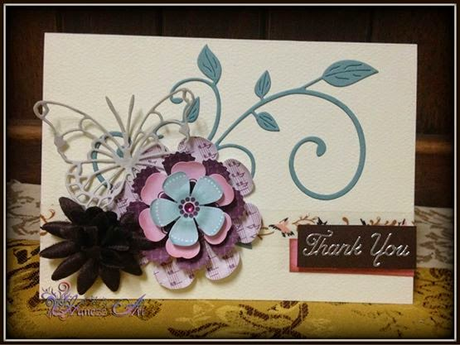
Thank you for your wonderful participation –
A Door Prize Book Draw
This Photo by Unknown Author is licensed under CC BY-NC-ND
Notes:
Thank you for your wonderful participation –Door Prize

