Slide 1
Core Value: Reflection
Core Value Team

Slide 2
Handbook Quote (Page 10)
We deliberately “think” about our “thinking” in order to continuously learn and grow!

Slide 3
Quote
“Do what you can, with what you know, where you are.”
Teddy Roosevelt

Slide 4

Why does reflection MATTER to Our Work?
At YES, Inc. we believe the more reflective you are the more effective you will be.
A work connection: “The DC Story”.

Slide 5
Reflect ‘N’ Sketch
It is drawing your reflection and it can help you develop deeper reflections with an inspiring medium.

Slide 6



Activity
Reflect for 1 minute
Sketch
Share out
Reflect on the quote
Sketch about the quote for 1 minute
Share your reflections about this activity

Slide 7
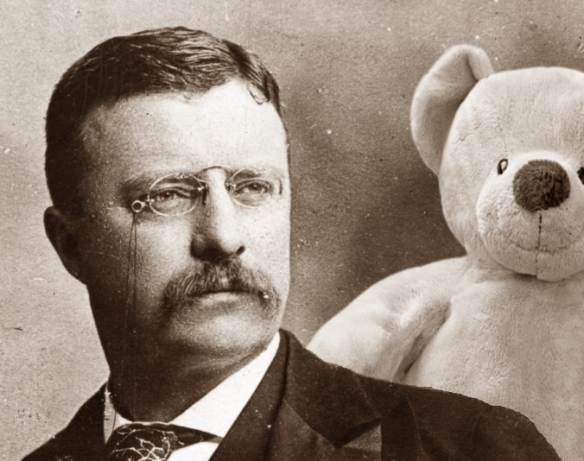
Quote
“Do what you can, with what you know, where you are.”
Teddy Roosevelt.
This Photo by Unknown Author is licensed under CC BY-NC

Slide 8
THANK YOU
The Core Value Team:
Cirby
Daniel
Tree
Ms. Yarbrough
Terri

