Slide 1

Growth Mindset
What’s It ALL About?
Let’s Talk about it…
OST/MiLEAP-2026

Slide 2
Mindset Definition
A person’s habitual mental attitude, set of beliefs, or inclination that indicates how they interpret and respond to situations.
An established set of attitudes held by an individual or group, often formed by previous experience.
Function: It influences how people perceive the world (i.e... Situations and circumstances), make decisions and behave.

Slide 3

Developing a Growth Mindset, is it an attitude of an altitude? And Why?
People with open growth mindsets embrace challenges, persist through obstacles, learn from criticism, and are inspired by the success of others. With an open growth mindset, we can acknowledge our failures and find inspiration to keep improving in our lives.
(Small Group Discussion)

Slide 4
What Does the
Research Say?
Growth mindset research, pioneered by Carol Dweck ( researcher and author of “Growth Mindset”), shows that believing intelligence and abilities can be developed (growth mindset) rather than being fixed (fixed mindset) leads to higher achievement, greater resilience, and improved learning outcomes. Evidence-based interventions, especially for low-achieving students, foster this mindset, improving grades and motivation

Slide 5
A Growth Mindset:
What do you think the value is of having a “Growth Mindset?”
.

Slide 6
1. Characteristics of an Open Growth Mindset:
1.A growth mindset can help you become more resilient in the face of setbacks.
2. An open growth mindset can help become more adaptable.
3. An open growth mindset can help develop a positive attitude.
4. An open growth mindset takes small steps towards reaching goals, get out of comfort zones, and roll with the punches.
5. an open growth mindset take positive steps and trust the results will come in time, seek new perspectives and new points in books.
6. An open growth mindset sees the world, explores new matter with an open mind, seeks new perspectives in books, views existing challenges in new lights, and make it easier to spot solutions.

Slide 7
2. Characteristics of a Fixed mindset:
1. Those with fixed mindsets are often better at focusing on the things they know, they are good at, and in mining their expertise for greater results.
3. They are content and like to stay in place familiar of their specialties and where they shine.

Slide 8
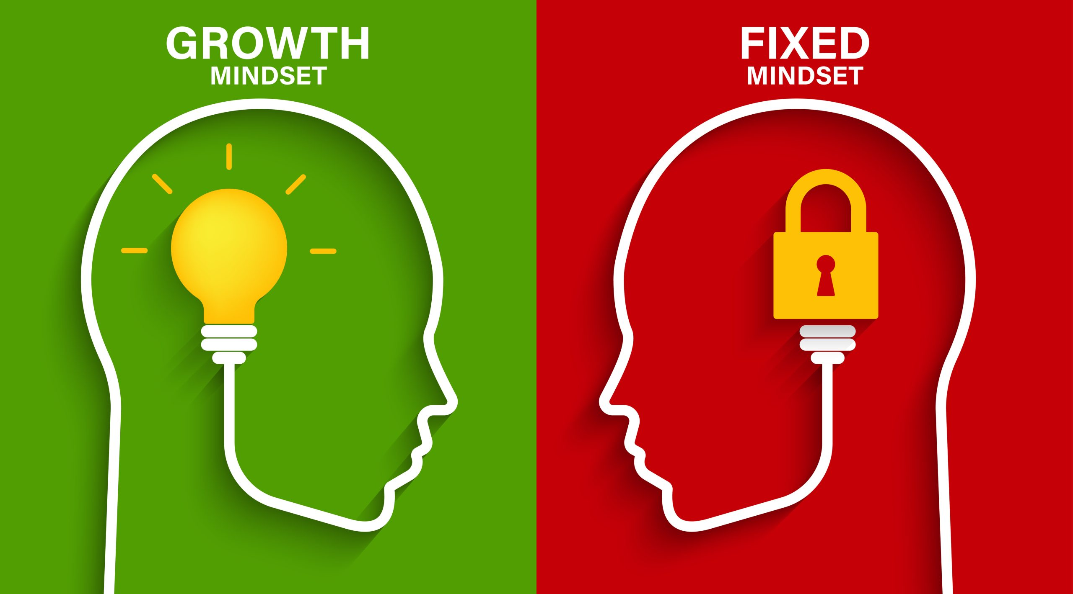
Having an open growth mindset, flexibility, and the willingness to learn, grow, and change for the better:
In Real-world settings, showcasing positive impacts, modeling an open growth mindset within children’s interactions and activities with other adults and children’s peers. Modeling positive attributes and strategies using kindness, compassion, honesty, truth, positive emotions, sharing a spirit of warmth, the gift of embracing others, valuing others as er value ourself, finding joy daily, caring of others, and finding the good in others.
This Photo by Unknown Author is licensed under CC BY-SA-NC

Slide 9

Strategies for Practicing a Growth Mindset
Practice through play activities, nurturing of self and others, sharing the gift of love with others, and in group activities with a sense of fairness in a culture of equity.
Seeking kindness in managing self and others, stressful situations, learning and sharing feelings, using vocabulary words to express feelings and emotions and by consistently modeling these attributes with the children by displaying a sense of gratitude and compassion.
In exercises through physical activities, in being a good helper to others, in sharing of self and of self time.

Slide 10

Strategies Continued…
In Sports, by developing and expressing concepts of being valued by self and others.
Through Artistic expressions, personal celebrations, acknowledgements and recognitions.
Through music, dance, instruments, role plays, and poetry.
Through story telling involving a variety of different characters, roles, and by stepping up into finding new expressions and creations in the work they do.
Small groups create chart of having an Open Mindset Characteristics in the classroom

Slide 11
