Slide 1
Understanding Implicit Bias in OST
Subtitle: Creating Equitable Classrooms for All Students
OST Parent Volunteer Training

Slide 2
Introductions:
Please tell us your name, and what location your children or grandparents attend.
Please share a little about your self as you are comfortable sharing.

Slide 3
Welcome + Objective
Welcome and thank you!
Objective:
By the end of this training, 100% of participants will be able to define implicit bias in their own words and Identify 2 ways implicit bias impacts OST interactions with children.
Implicit Bias Definition: Unconscious attitudes and their impact
Implicit bias refers to unconscious attitudes or stereotypes that affect understanding, actions, and decisions toward certain individuals or groups. These biases operate outside of awareness and can influence behavior without conscious intention, according to the American Psychological Association (APA).

Slide 4
Ground Rules
• Growth, not guilt
• Everyone has bias — it’s part of being human
• Respect all voices and experiences
• Listen, reflect, and be honest

Slide 5
What is Implicit Bias?
• Unconscious attitudes or stereotypes that affect actions/decisions
• Everyone has bias — awareness helps us do better
Pay attention, get to know them, listen to them.
Show your know aspect – they will have to demonstrate this when they share out,

Slide 6
Dissecting Implicit Bias
You may unconsciously be biased about a child.
"Dissecting implicit bias means figuring out why we sometimes treat people differently without realizing it, just because of things we’ve seen or heard before.“
🧠 "It means looking at how our brain makes quick choices about people without us knowing — and learning how to be more fair and kind."

Slide 7
Reflection Discussion
Do you think your child has ever been subject of implicit bias. Please take a minute to write down yes or no.
If yes, then take a minute to describe it
If no, do you think you did or have had implicit bias toward another child.

Slide 8
What is our why? Why is Implicit Bias Important to discuss:
As parent volunteers it is important, you may come across children in the OST program who attitudes or actions or behavior is different than how you may expect or be used to and as a result of that you may unconsciously project certain stereotypes that affect understanding, actions, and decisions toward certain individuals or groups.
Implicit bias connection to discrimination

Slide 9
Snap Judgments Game – Instructions
• We will show you images for 1–2 seconds each
• Notice your first thought or feeling
• Be ready to reflect afterward

Slide 10
Debrief – Why Snap Judgments Happen
From your experience
• What did you notice?
Where might that thought come from that you had? ( Media? Culture? Family Beliefs?)
How could it influence how you treat children or other families in the OST program?
•How does what you just did connect to the definition of Implicit Bias and why is it important for us to be taking the time today to have a discussion with you on this topic.

Slide 11
🧠 Why This Matters in OST Programs:
Some parents and children may already feel judged when they walk in the door.
This type of assumption or snap judgment can lead to:
  Not greeting a child or parent, the same way
  Not offering the same information or encouragement to everyone
  Undervaluing the parent’s/child's contributions or commitment
It sends subtle but powerful messages to children about whose parents/or other children are seen and respected.

Slide 12
Our brains take shortcuts
• Snap judgments are shaped by media, culture, experiences
• These thoughts are automatic but influence behavior

Slide 13

Pair Share Out
Share Out
Directions:
  Share your thoughts or reflection with someone sitting next to you.

Slide 14
Examples of Implicit Bias
Assuming boys are better at math.
Expecting better behavior from children who are more articulate.
Discouraging certain children from AP or honors courses.
Over-disciplining students of color.

Slide 15
What are some examples of Implicit Bias from your experience?

Slide 16
Where Can Bias Show Up in OST?
• Greeting other
• Disciplining children
• Assigning praise or attention
• Assuming involvement or roles

Slide 17
Activity: Bias in Action Scenarios
Instructions:
• Small groups discuss 2–3 scenarios
• Where is bias present?
• How could it be handled better?
• What would YOU do differently?

Slide 18
Group Debrief – Scenario Activity
• What stood out to your group?
• What changes (if any) do you believe that parent volunteers can make as it relates to decreasing Implicit Bias?

Slide 19
BREAK
Take 5 minutes to stretch and reset.
Hydrate, Hydrate, Hydrate

Slide 20
Activity: Assumption Circles
• At your table with those sitting with you please discuss any assumptions you have or thought (if you are comfortable doing do)
• Reflect as a group on the following:
How might assumptions impact children/families in our OST program?
Assumptions and stereo types can hurt anyone and everyone, what steps or actions do you believe we can take to prevent this from happening in this program.

Slide 21
Activity: Bias Bingo
Sometimes, our brain makes super-fast guesses about people before we really know them. It’s like our brain fills in the blanks, even if it's wrong! That’s called a bias.
We’re playing a game called Bias Bingo to help us notice when our brain might be making those fast guesses. Each box in the game has something someone might have thought, said, or done. If it happened to you—or if you’ve done it before—you check the box!
It’s not about being right or wrong. It’s about learning what our brain does and thinking about how we can be kinder, fairer, and better listeners to everyone, especially our children.
Directions:
Mark boxes you’ve seen, done, or experienced
• No judgment — just self-awareness
• Debrief: What surprised you? What did you notice?
Why? Open acknowledgment of that fact that Bias is everywhere without shame, is one of the first steps to change.

Slide 22
✅ 5 Strategies to Reduce Bias
1. Treating All Children Fairly (Equity in Action)
When volunteers use strategies like “be fair to every child” and “notice the good stuff” in all children, they’re actively working against favoritism or stereotypes — two common forms of bias.
2. Using Gentle Reminders Instead of Harsh Discipline
Sometimes adults respond more harshly to certain children because of unconscious bias (e.g., seeing assertiveness in one child as “leadership” and in another as “rude”). Teaching calm, consistent responses helps prevent those uneven reactions.
3. Pausing Before Reacting
Taking a breath before responding gives volunteers time to interrupt automatic judgments and ask themselves: “Am I reacting to the behavior, or my assumptions about this child?”
4. Asking, Not Assuming
When volunteers ask questions instead of jumping to conclusions, they create space for each child’s voice and experience. This reduces assumptions based on race, gender, ability, or behavior.
5. Modeling Respect for All
When adults model kindness, curiosity, and fairness — regardless of a child’s background — it shapes how children treat each other. That’s a long-term investment in a bias-free culture.

Slide 23
🌟 Why These Strategies Matter
Using these simple, kind strategies isn’t just about good behavior — it’s how we create a program where every child feels safe, valued, and seen. When parent volunteers treat all children fairly, listen without judgment, and pause before reacting, they help stop bias before it starts. These everyday choices support an inclusive, welcoming space where no child is treated differently because of how they look, speak, or learn. This is how we practice equity — not just in what we say, but in what we do every day.

Slide 24
🧸 Key Messages for Parent Volunteers
Everyone has bias — and that’s okay.
👂 When we notice it, we can choose to do better.
Little things make a big difference.
👋 A smile, a kind word, or listening to a child can change their whole day.
You make our program strong.
💪 Your kindness and care help every child feel safe, happy, and ready to learn.

Slide 25
Exit Ticket: Reflection & Commitment
• Write down 2 ways bias can affect OST interactions
• Write down in your own words 2 strategies that you could use or already do use when interaction with children?
Write down one strategy that you will you will commit to using?

Slide 26
Thank You!
🌈 You help make OST a place for everyone
💛 That means every child feels like they belong — no matter what they look like, how they learn, or where they come from.
👐 When you can smile, listen, and treat everyone kindly, you make the group better for all of us!

Slide 27
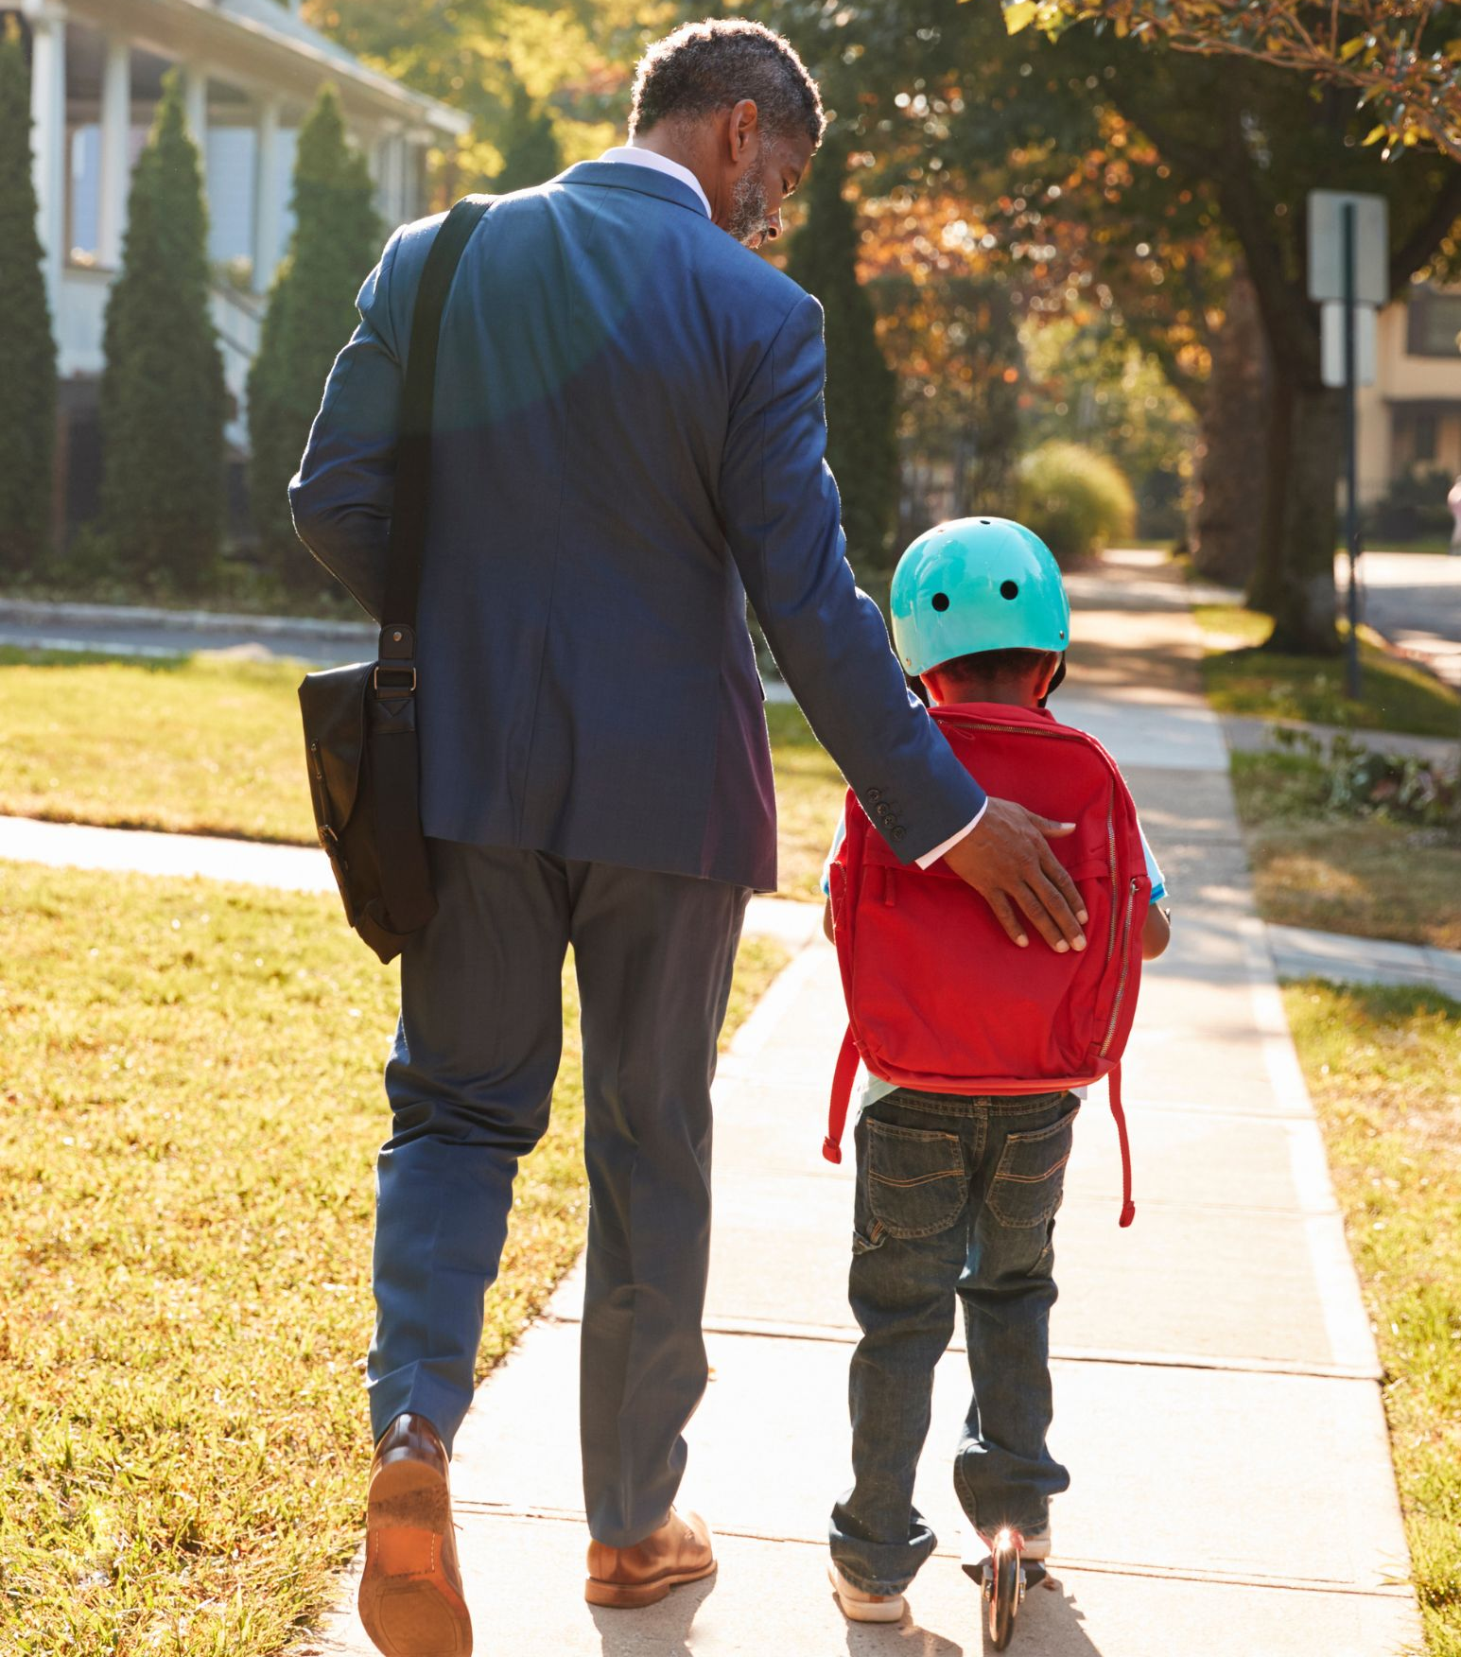
Snap Judgments Game – Image 1

Slide 28
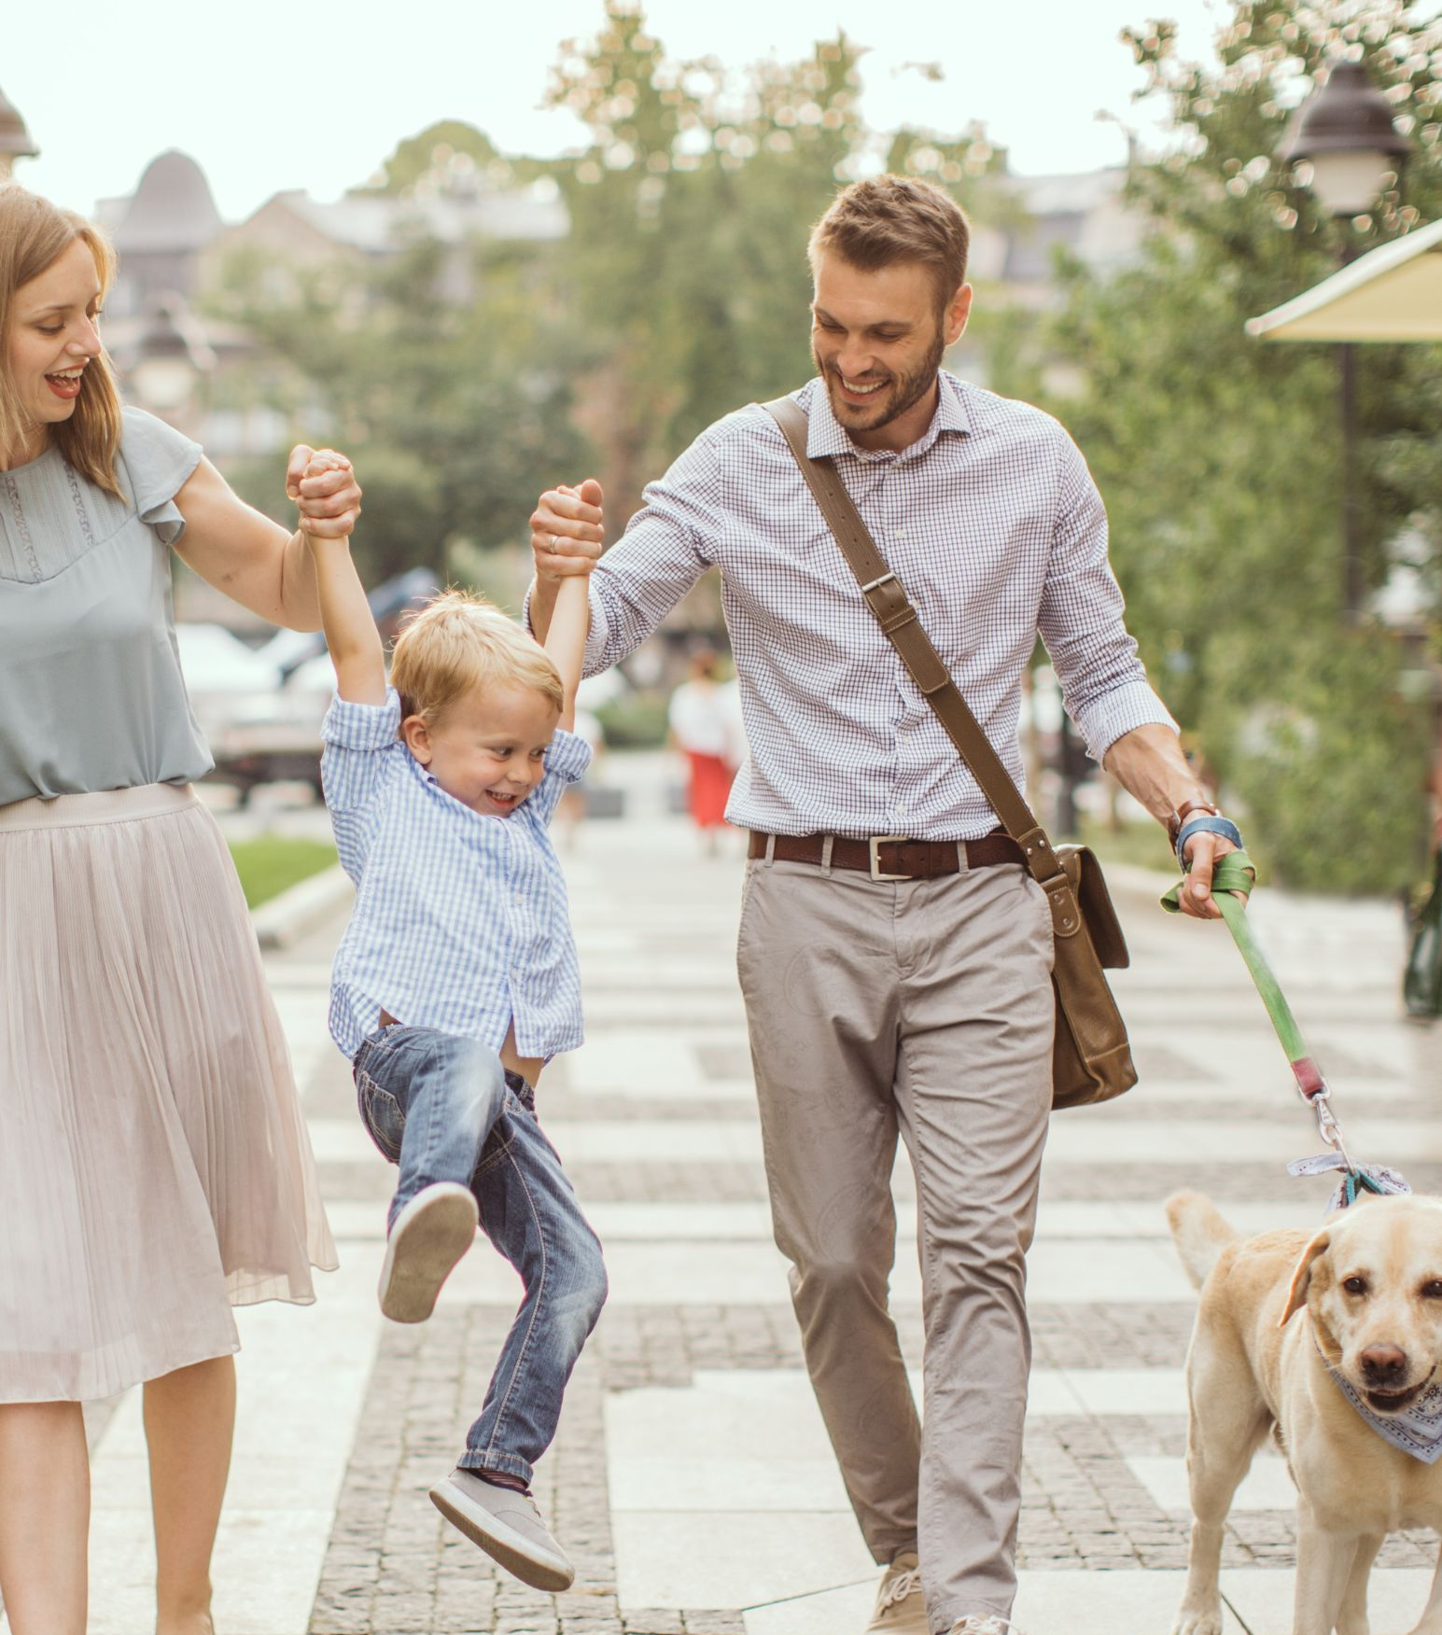
Snap Judgments Game – Image 2

Slide 29
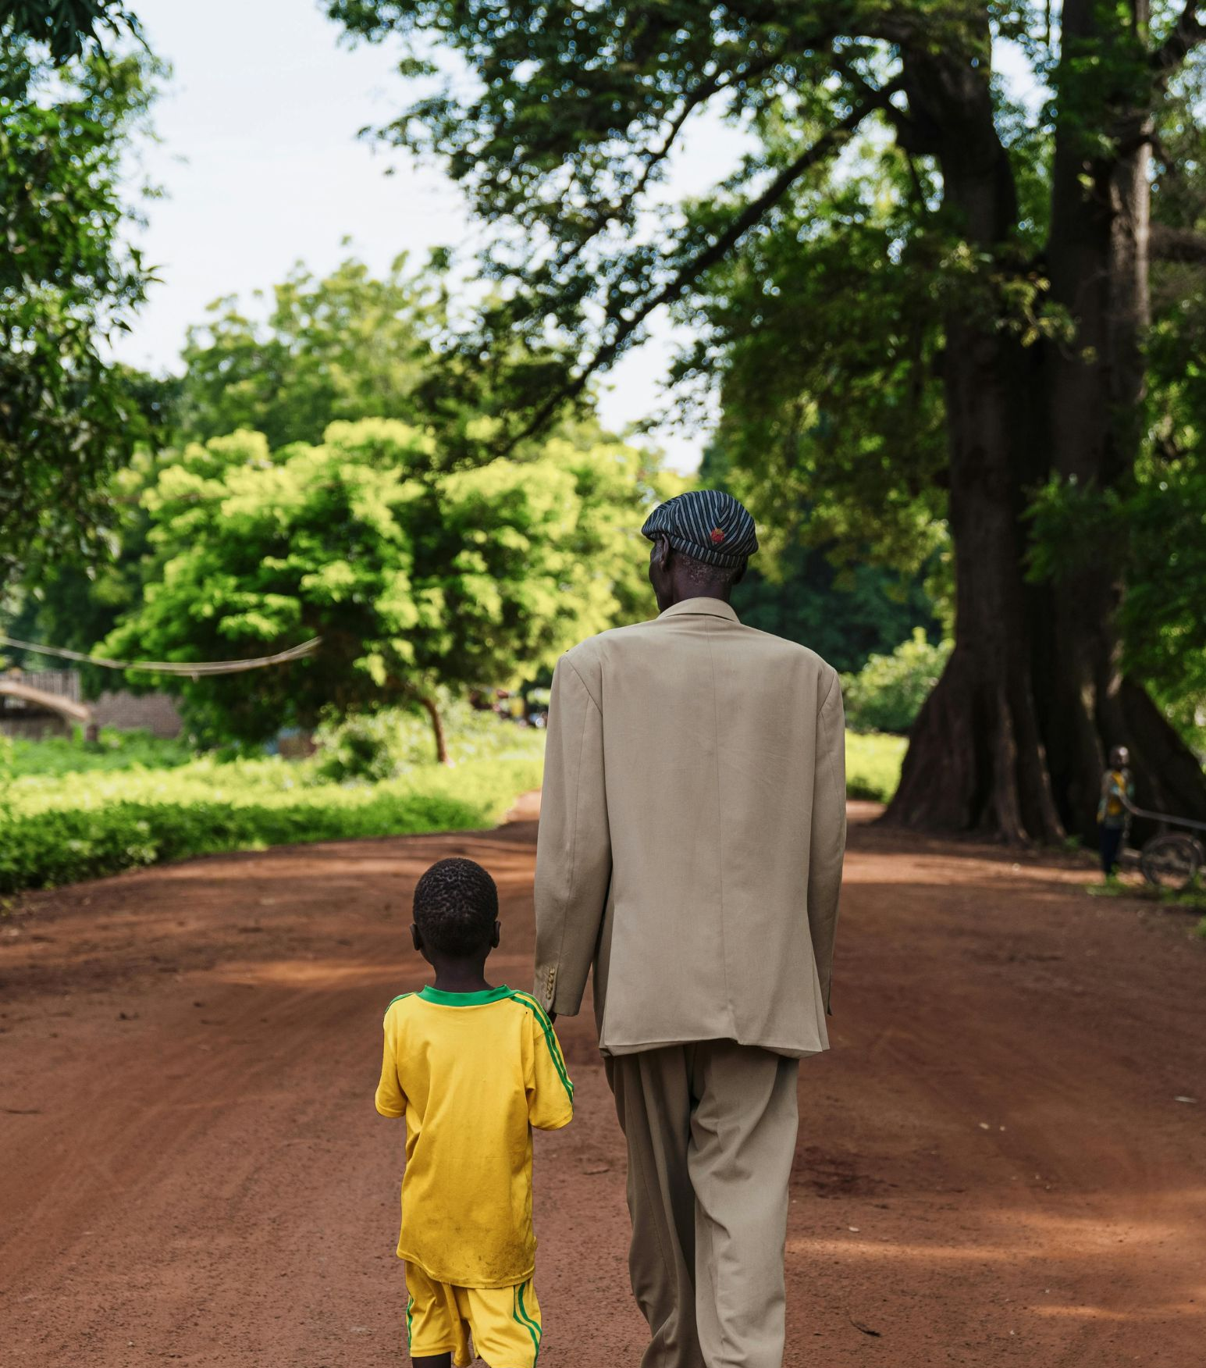
Snap Judgments Game – Image 3

Slide 30
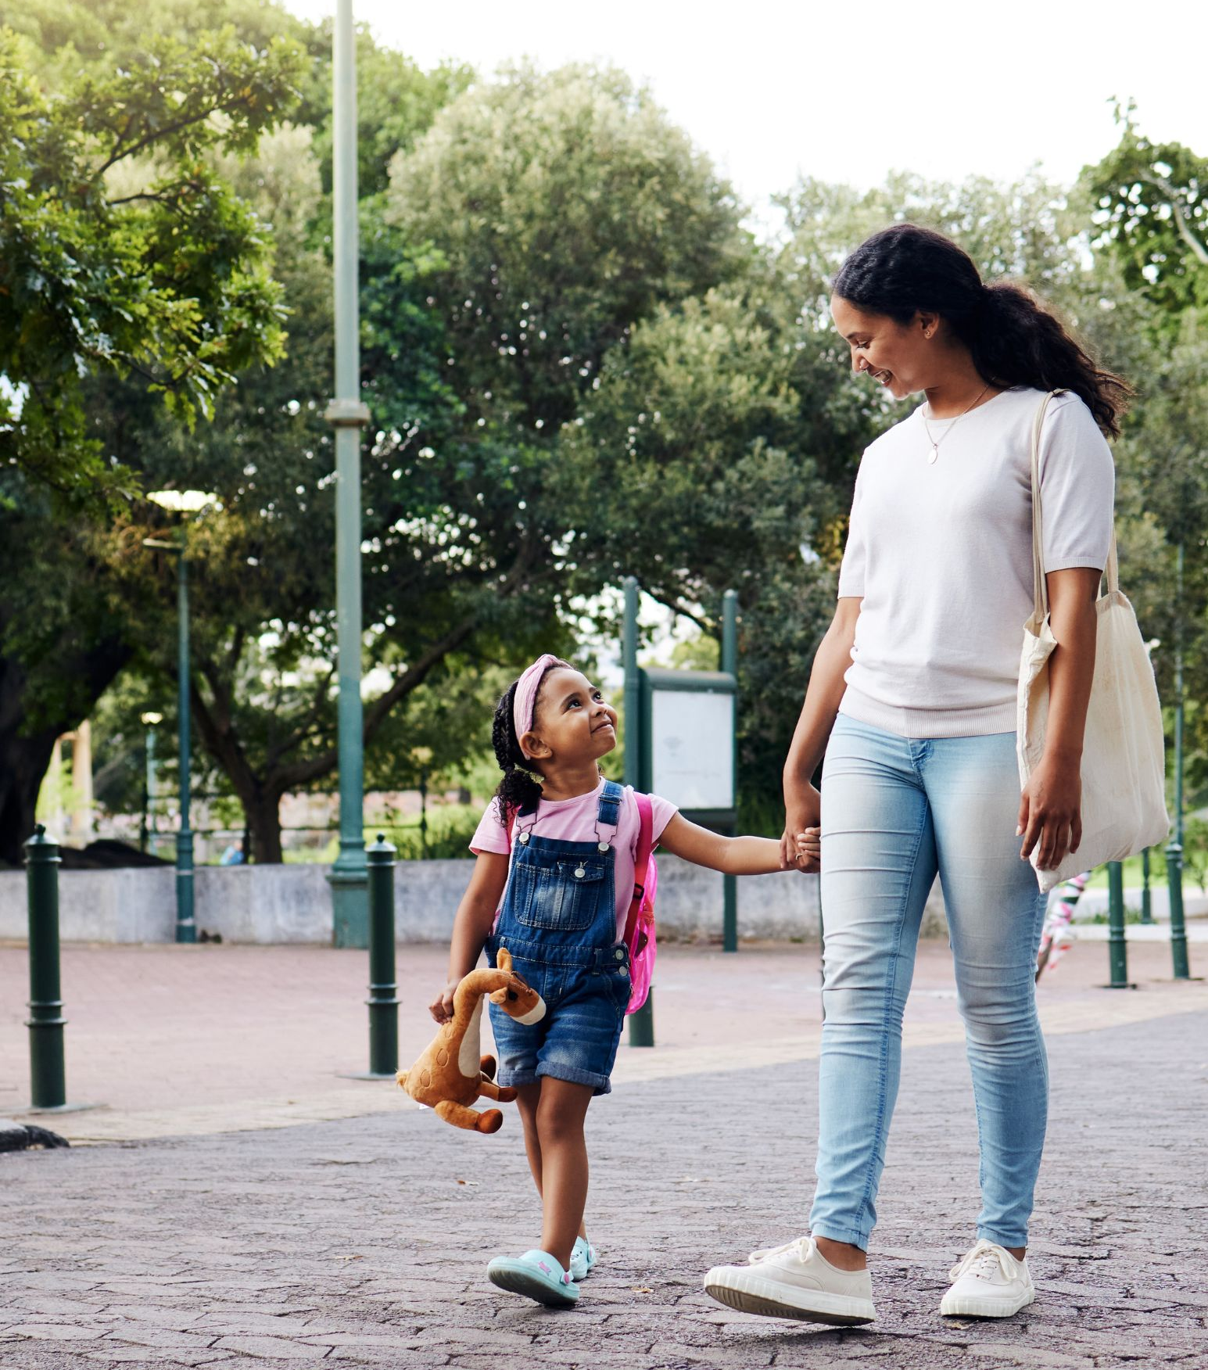
Snap Judgments Game – Image 4

Slide 31
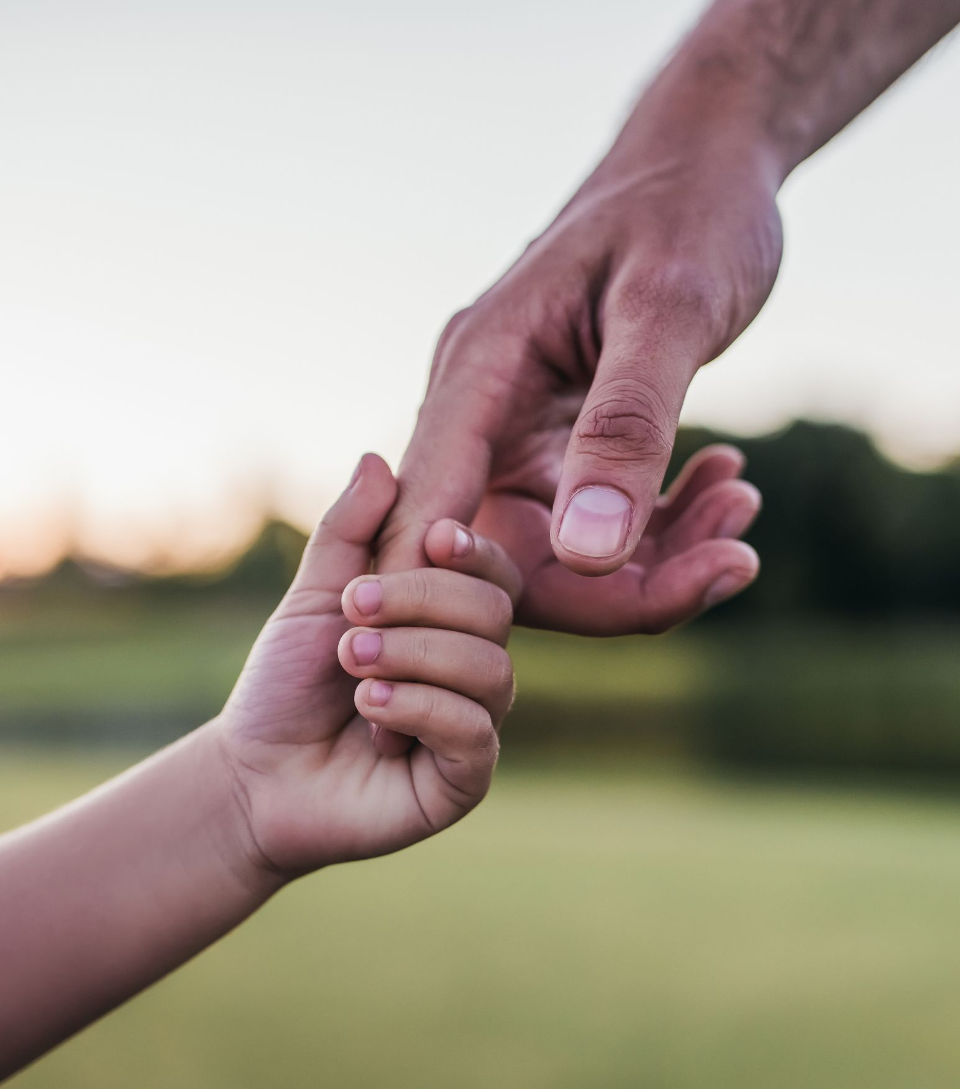
Snap Judgments Game – Image 5

Slide 32
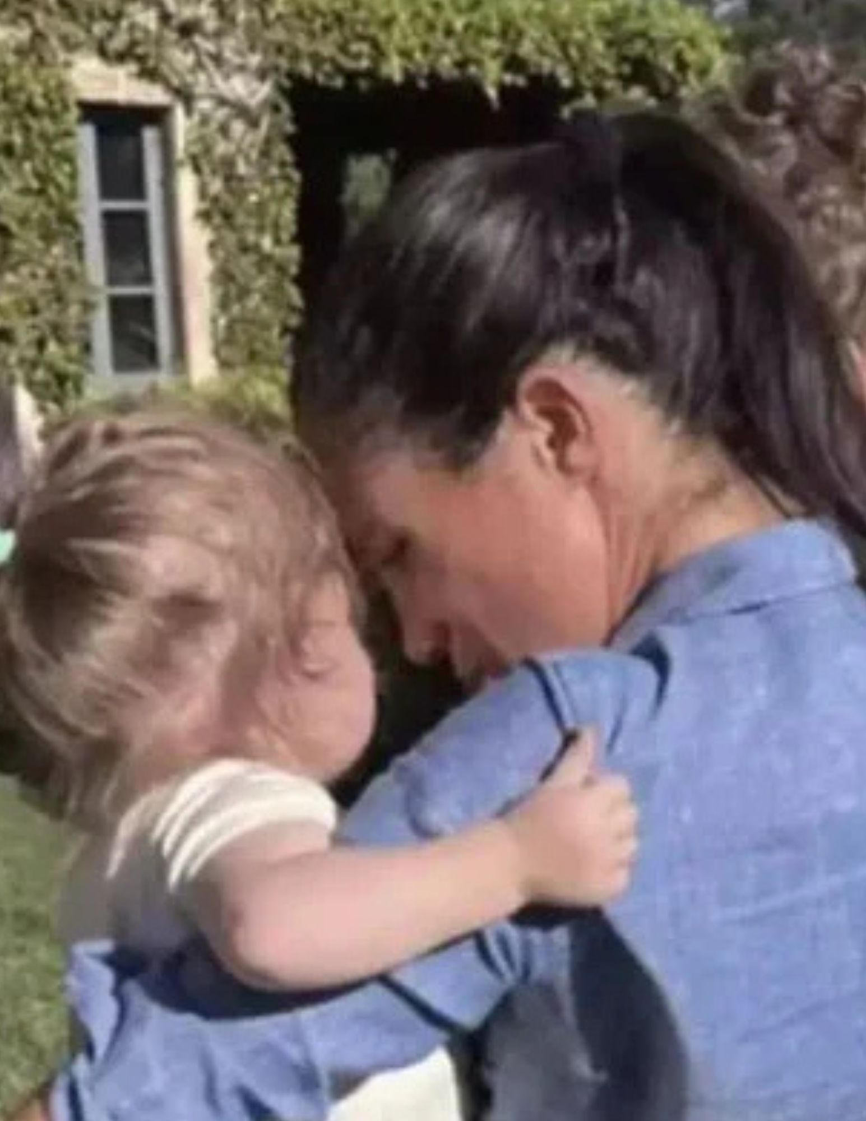
Snap Judgments Game – Image 6

Slide 33
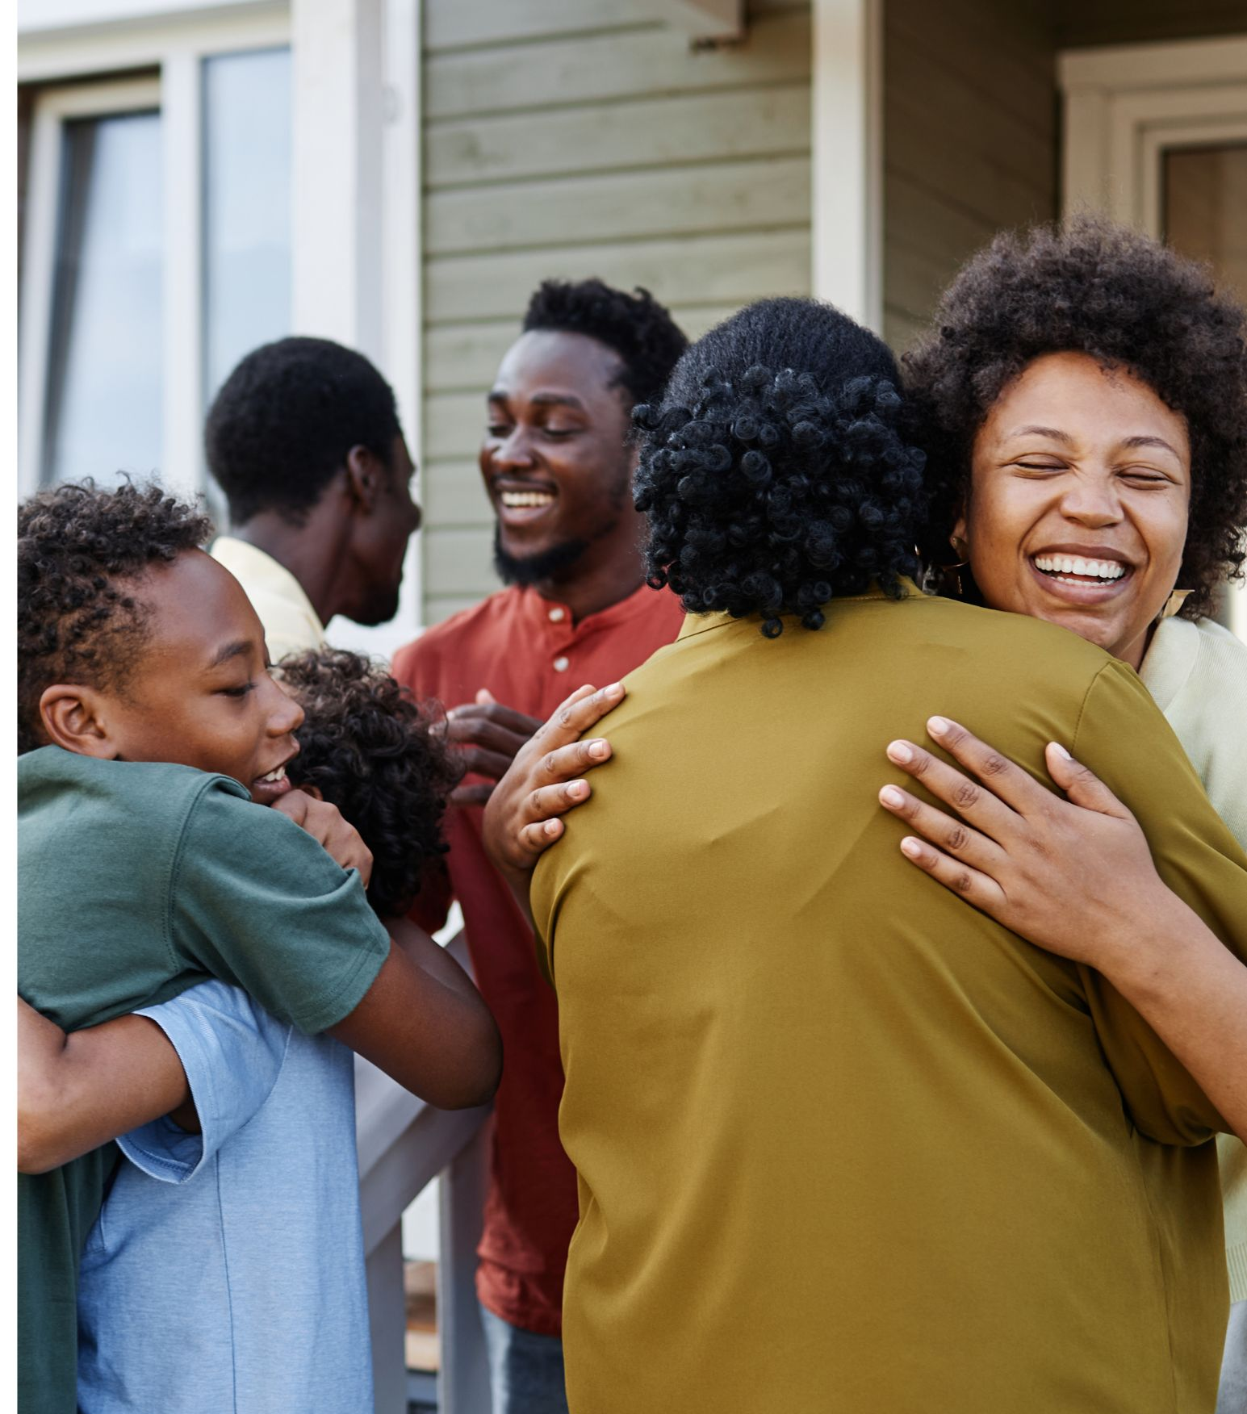
Snap Judgments Game – Image 7

Slide 34

Snap Judgments Game – Image 8

