Slide 1
Leo Gutterres
Tying the Leo Gutterres version of the Crease Fly

Slide 2
Warning: Unfortunately some of the images in the presentation are blurry. Sorry, we’ll do a redo in a month or so. Please know that Leo was not responsible for the photography.

Slide 3
Materials needed to tie the Crease Fly

Slide 4
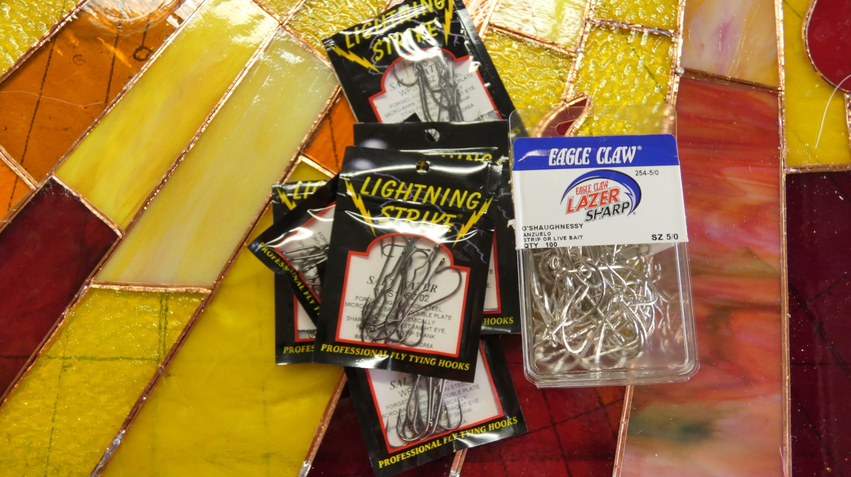
3x or 4 x long hooks appropriate for the target fish

Slide 5
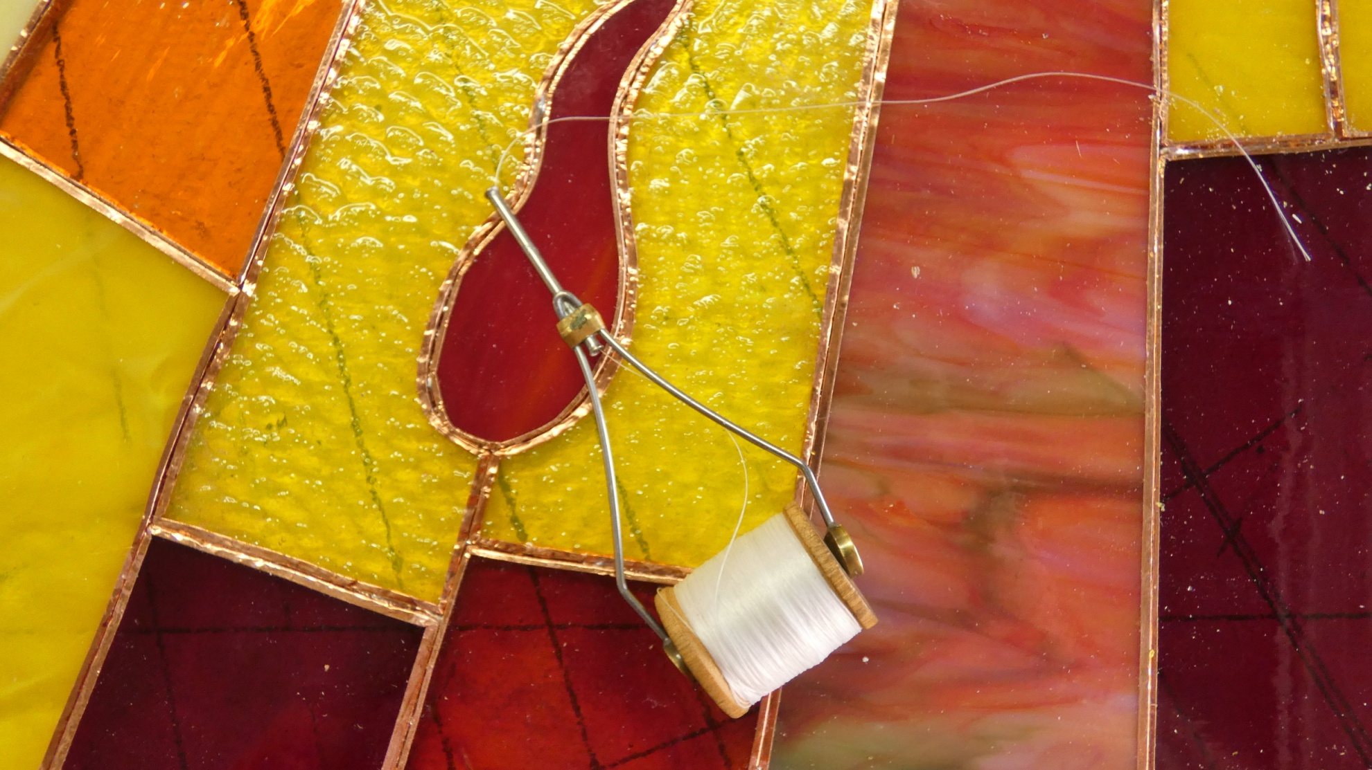
Strong tying thread such as flat waxed, color not important.

Slide 6
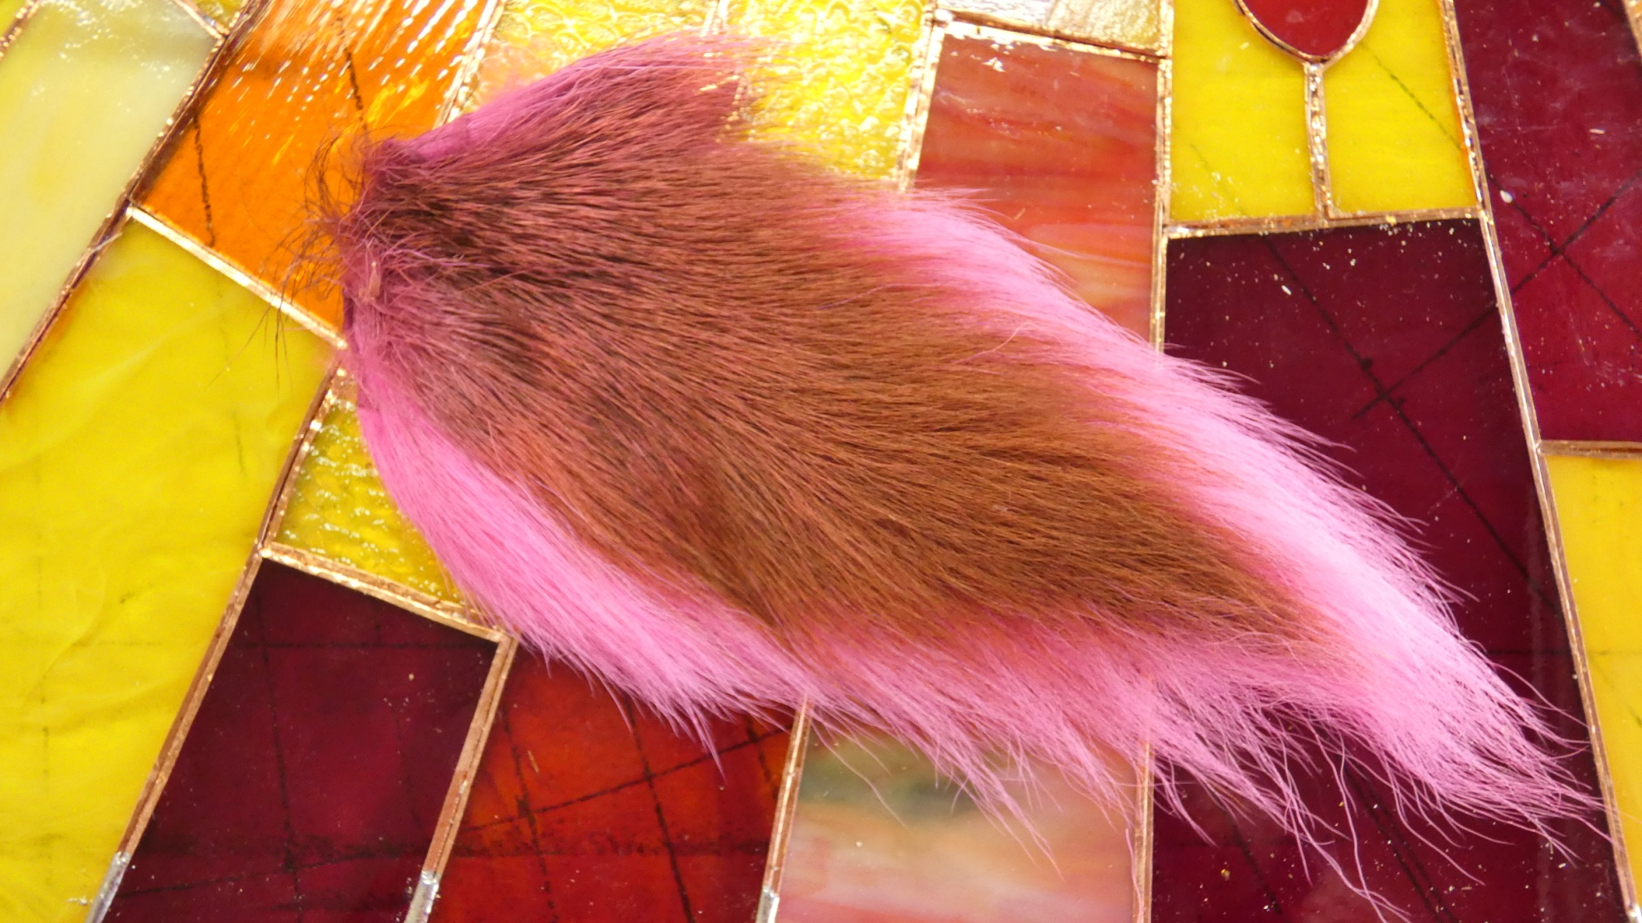
Bucktail or other synthetic tail material

Slide 7
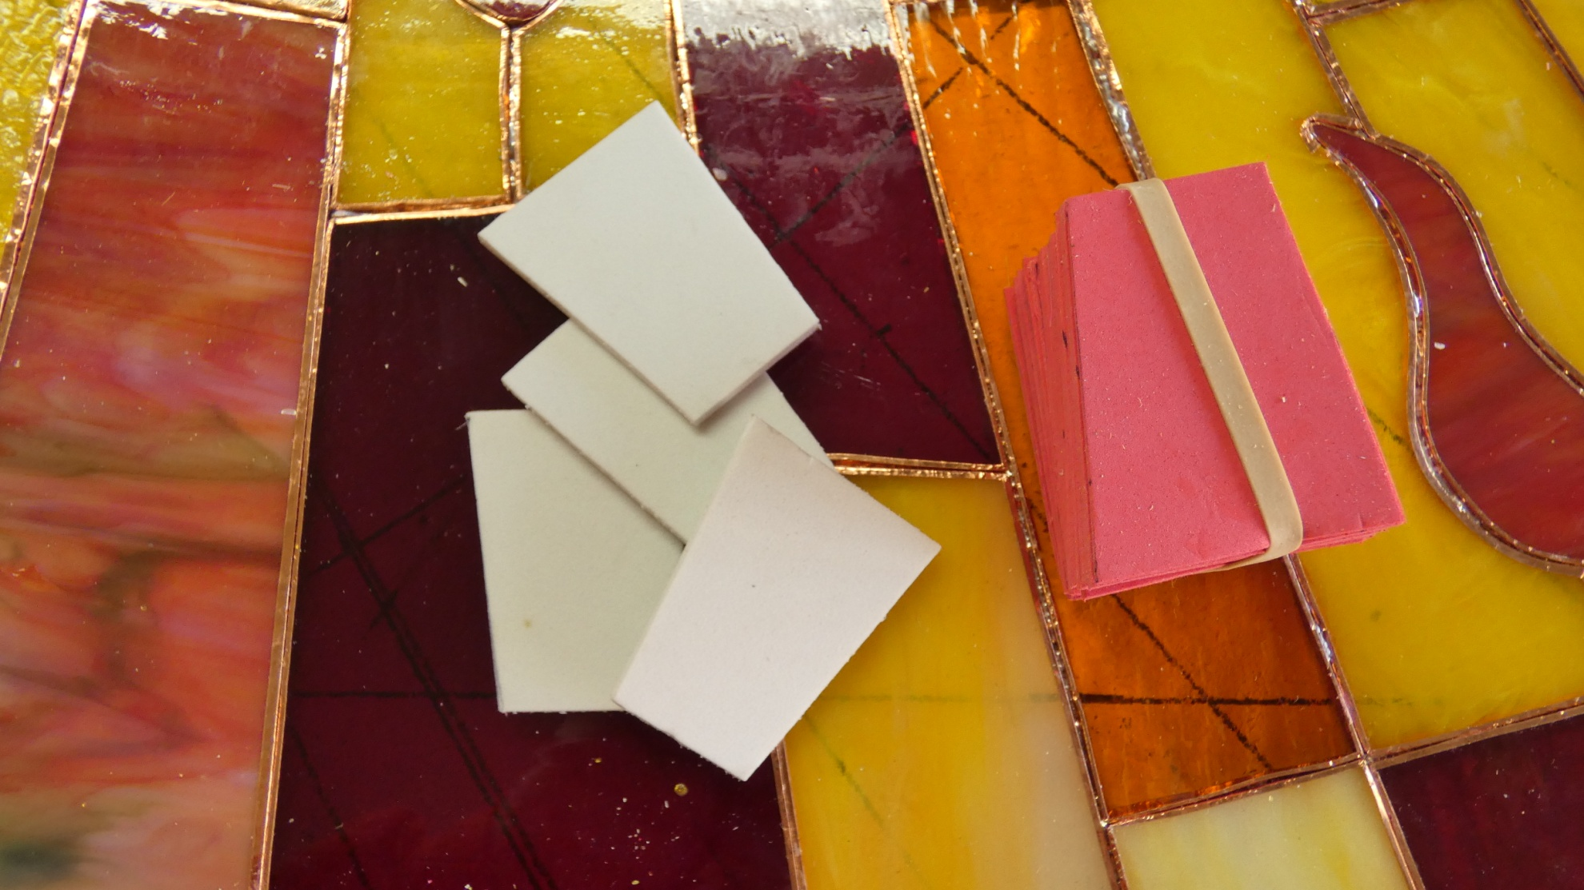
3 mm foam, again, color not important

Slide 8
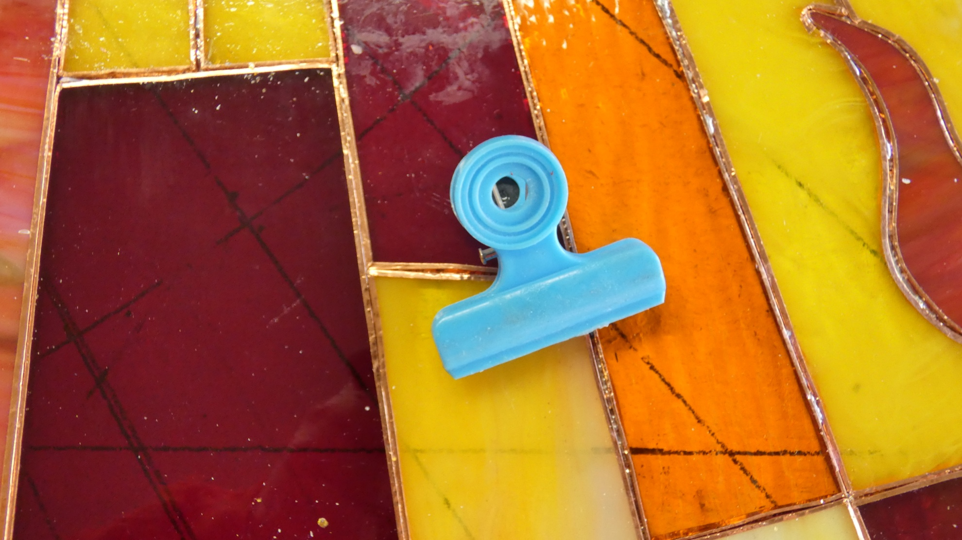
Small, medium or large squeeze clips, depending on fly size

Slide 9
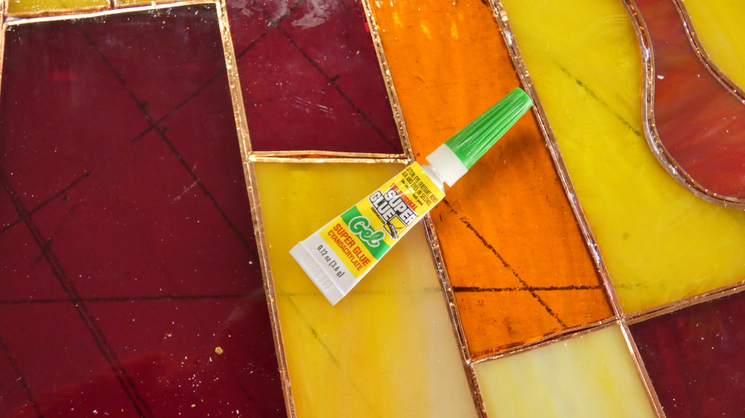
A tube of Super Glue gel

Slide 10
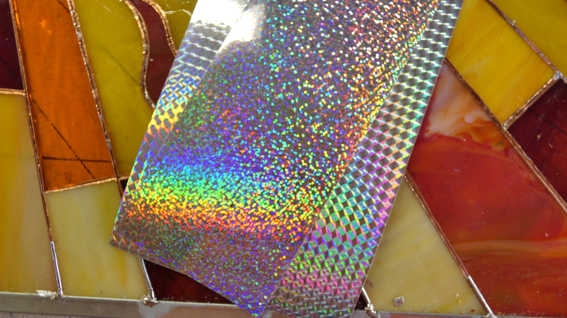
Holographic Mylar peel and stick sheeting

Slide 11
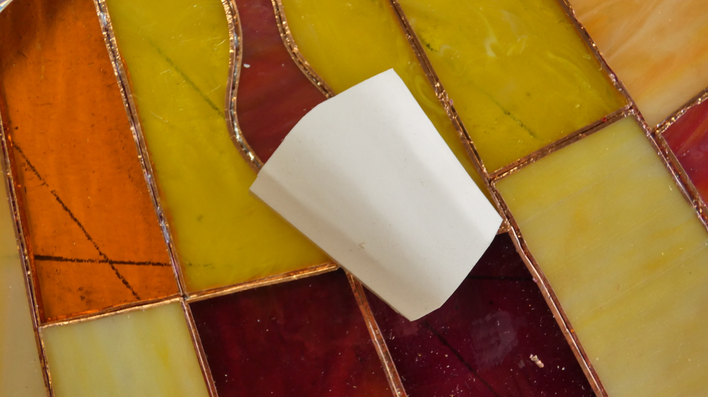
A pattern to cut out the sheeting

Slide 12
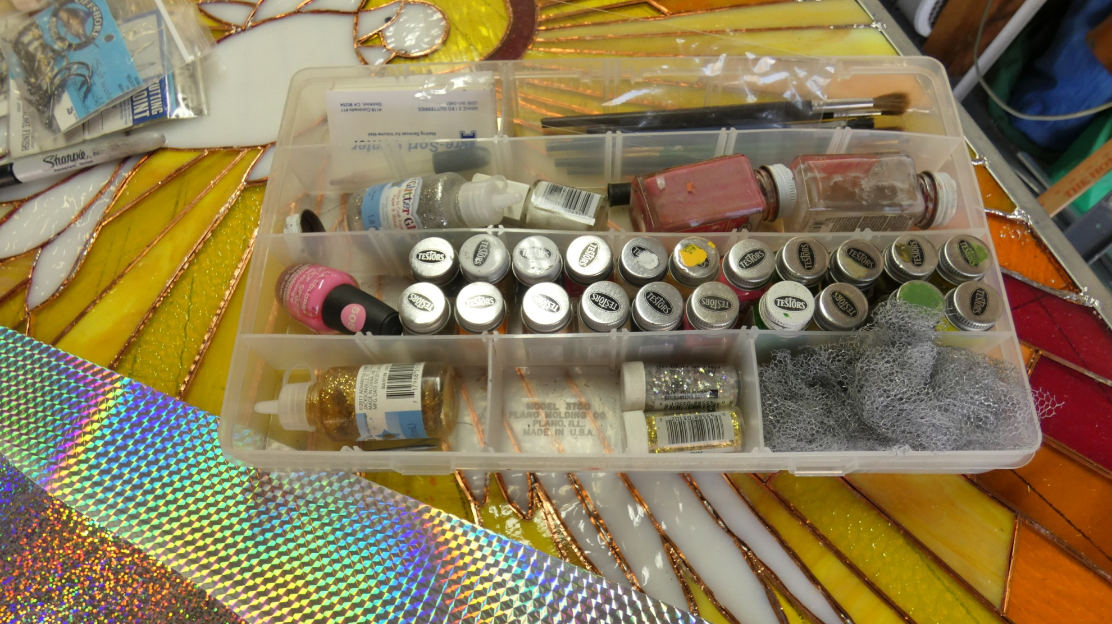
Jars of hobby paint for details such as eyes, gills and other markings

Slide 13
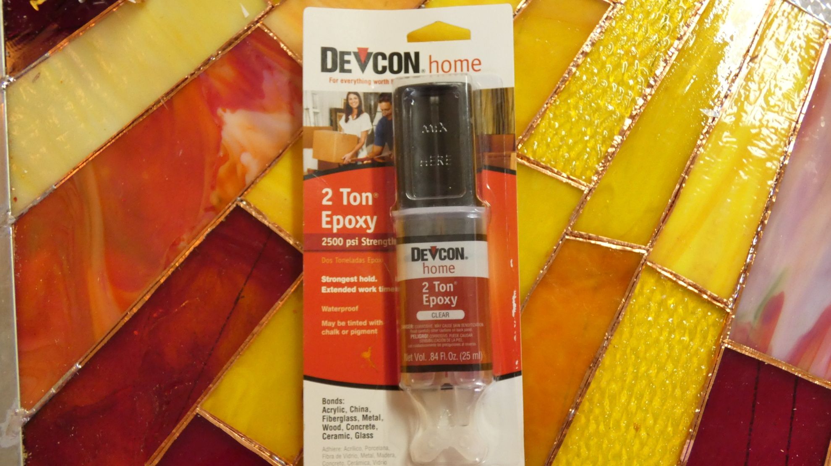
Fast setting epoxy for final finish

Slide 14
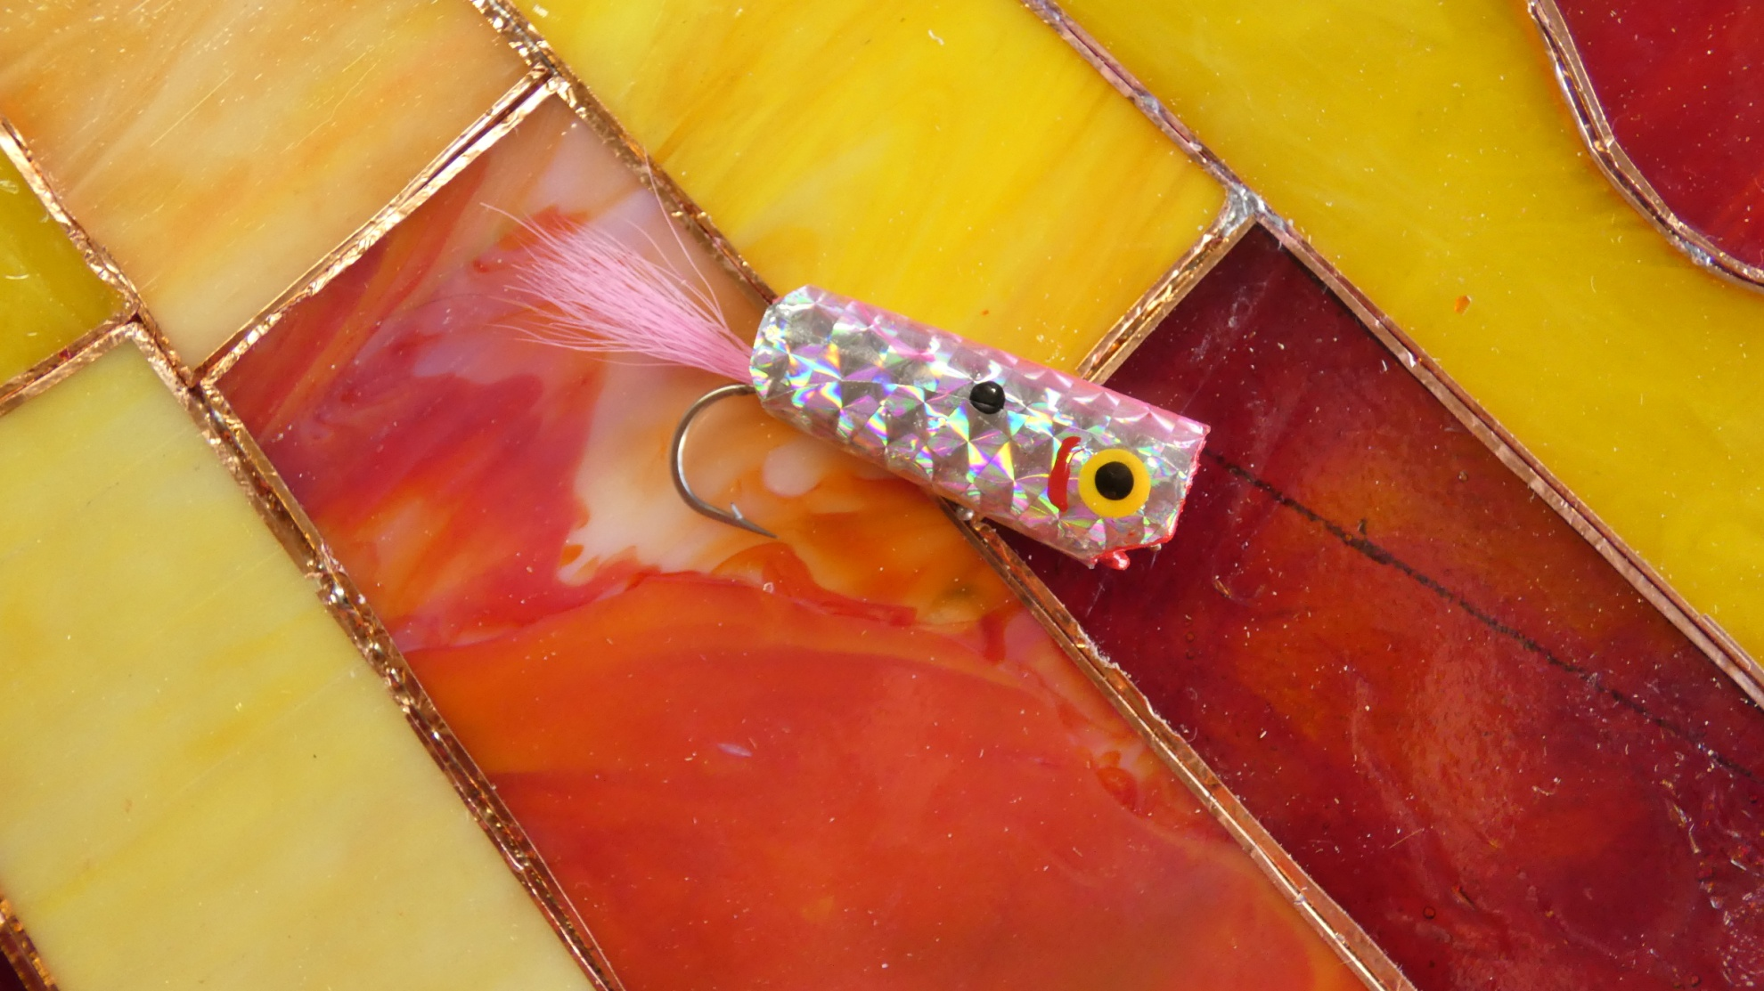
Tying the fly

Slide 15
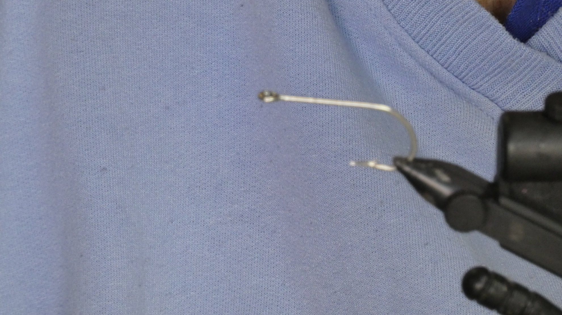
Mount the hook in the vice

Slide 16
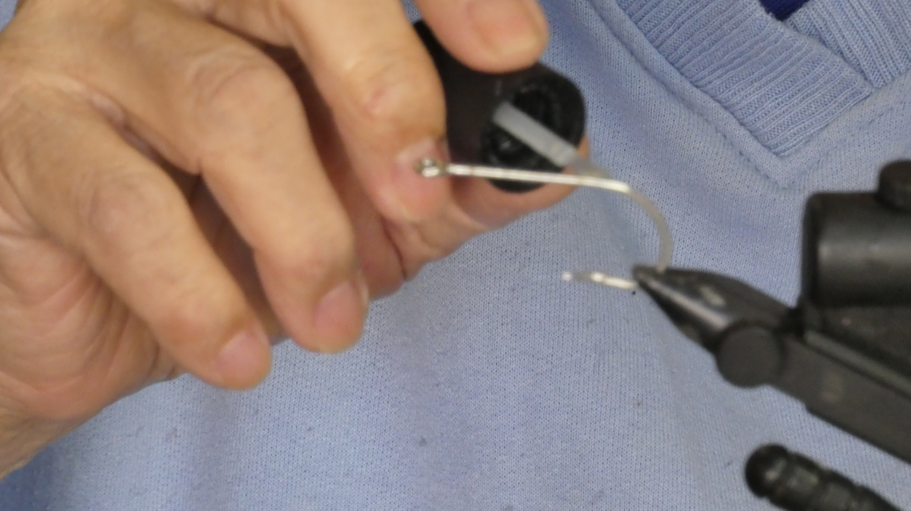
Coat the hook with some head cement

Slide 17
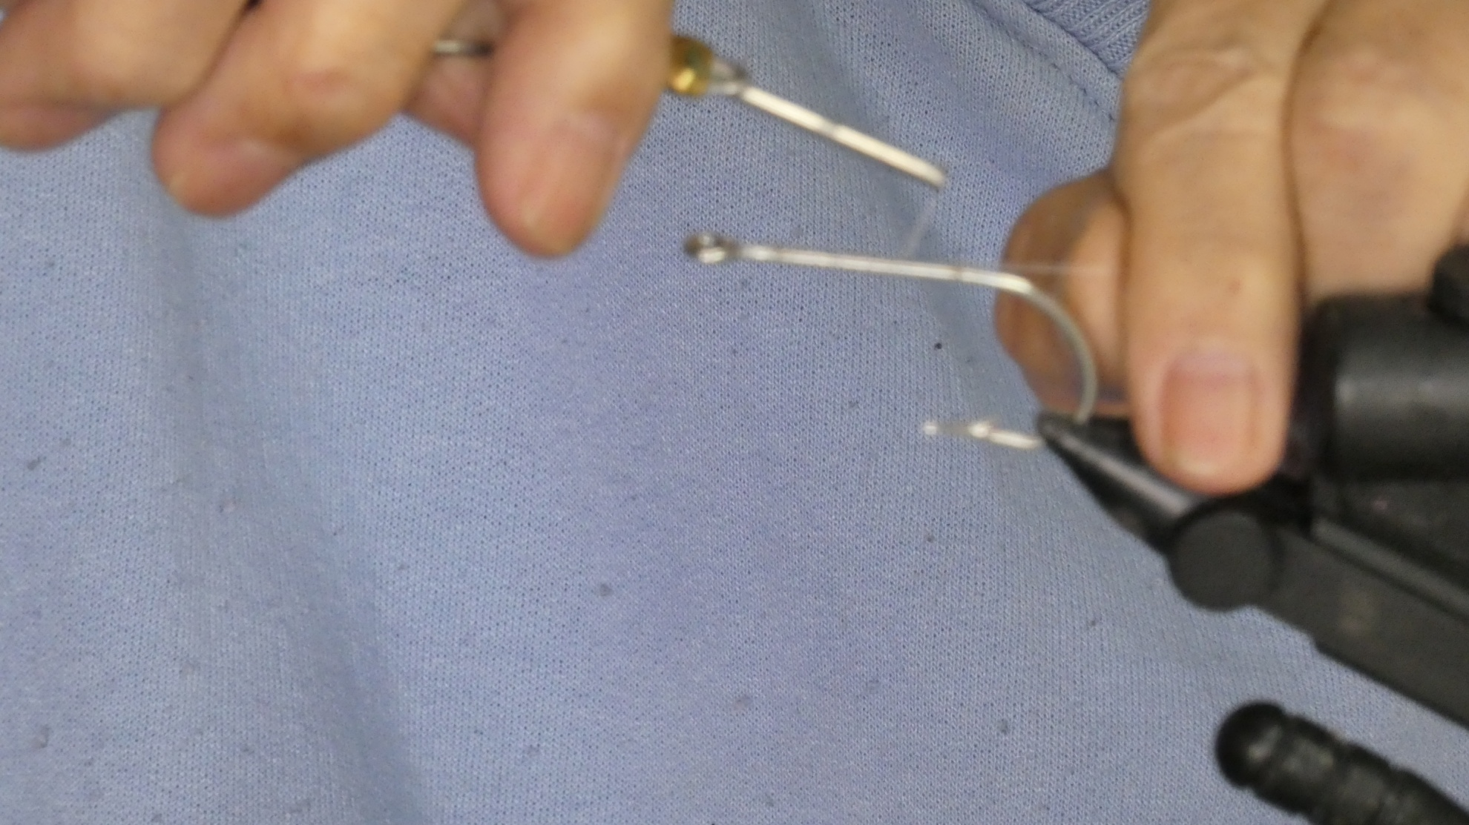
Wrap a thread body onto the hook

Slide 18
Wind the thread back to the eye of the hook and secure with a few half hitches.

Slide 19
Cut a length of tailing material, as long as the hook shank and and the amount you wish to extend past the bend of the hook. (For a 3/0 hook about a thickness of two pencil leads would be the proper amount.)

Slide 20
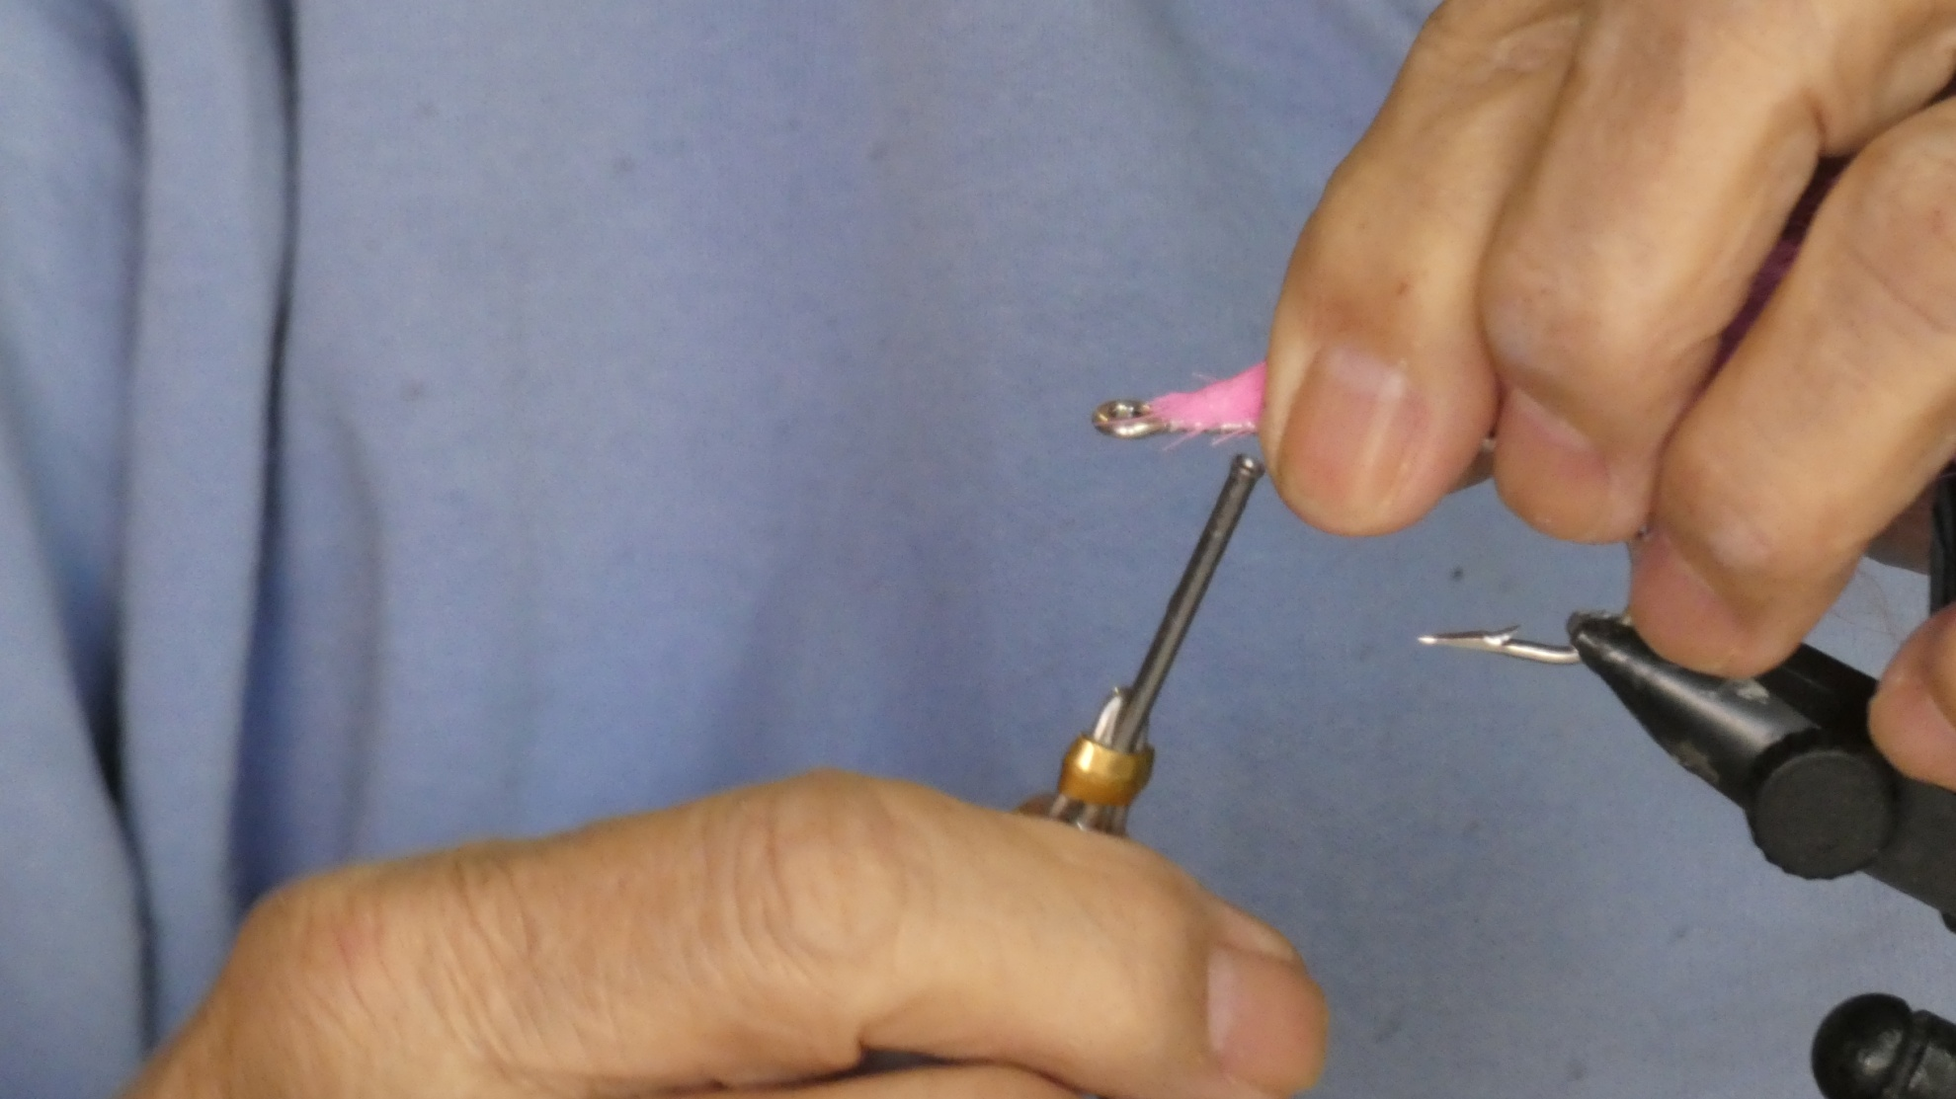
Starting just behind the eye, make a few loose wraps.

Slide 21
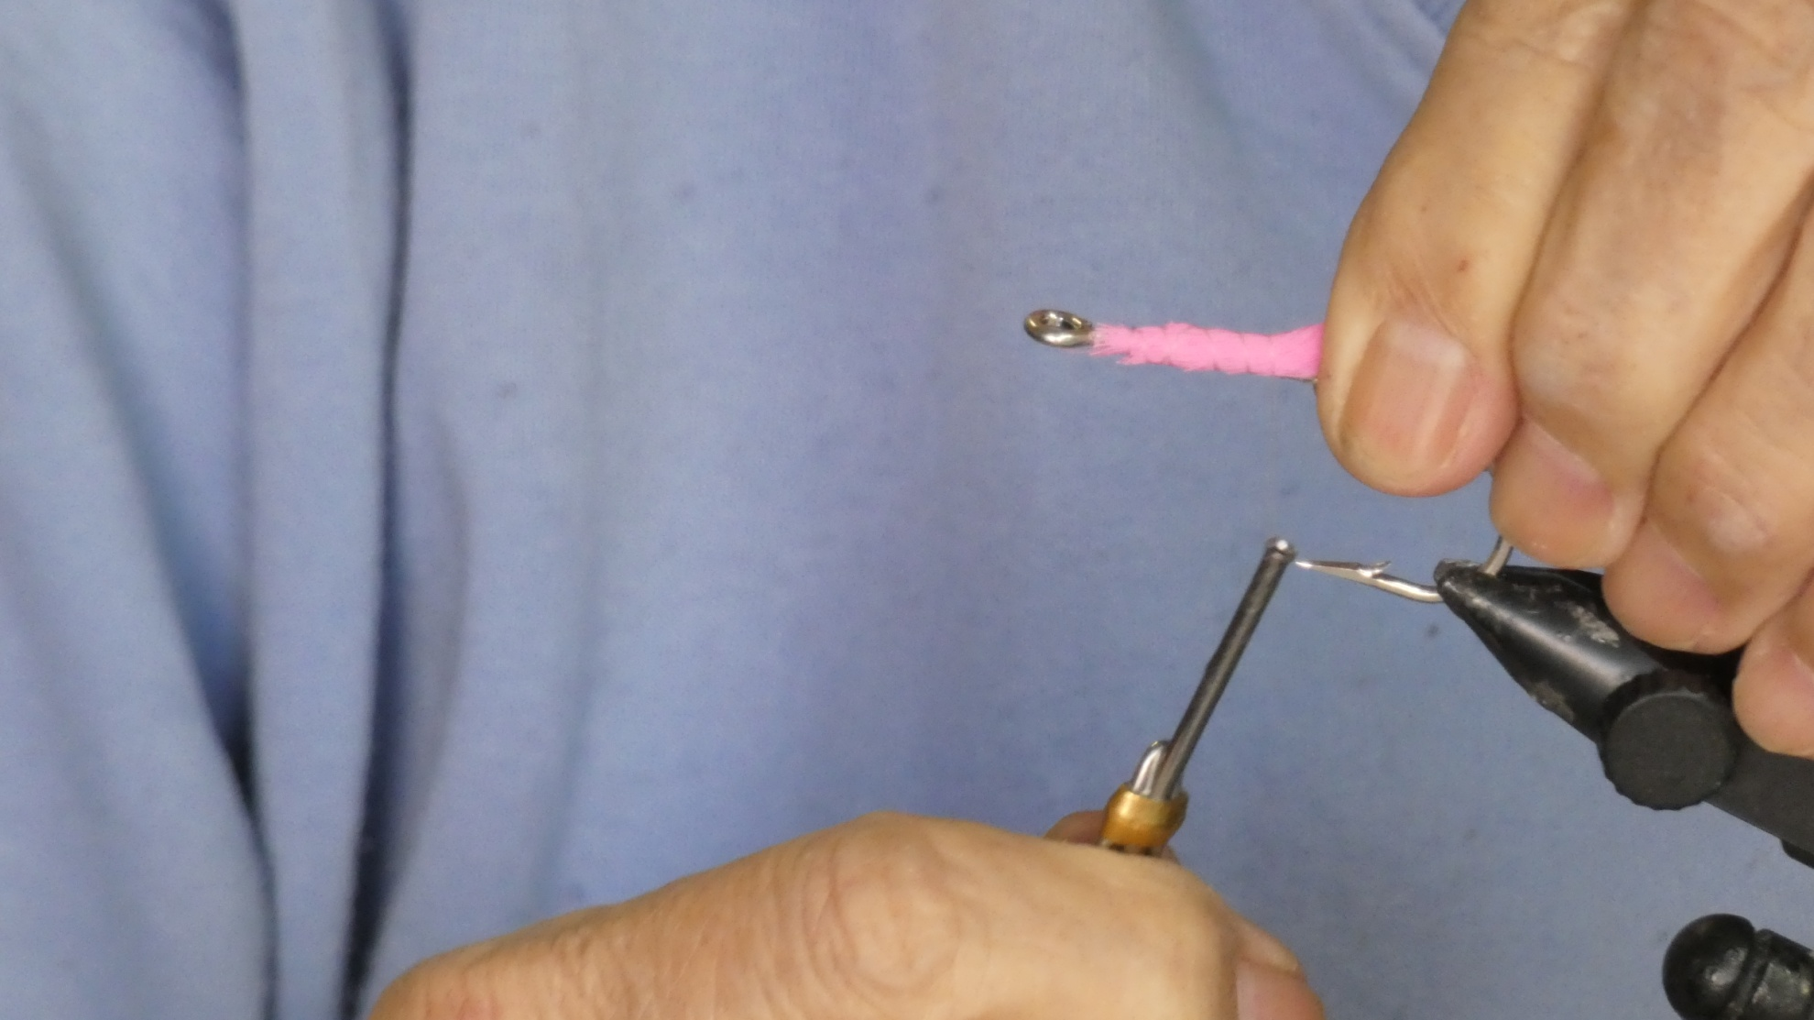
Release the material to allow it to surround the hook shank and pull tight.

Slide 22
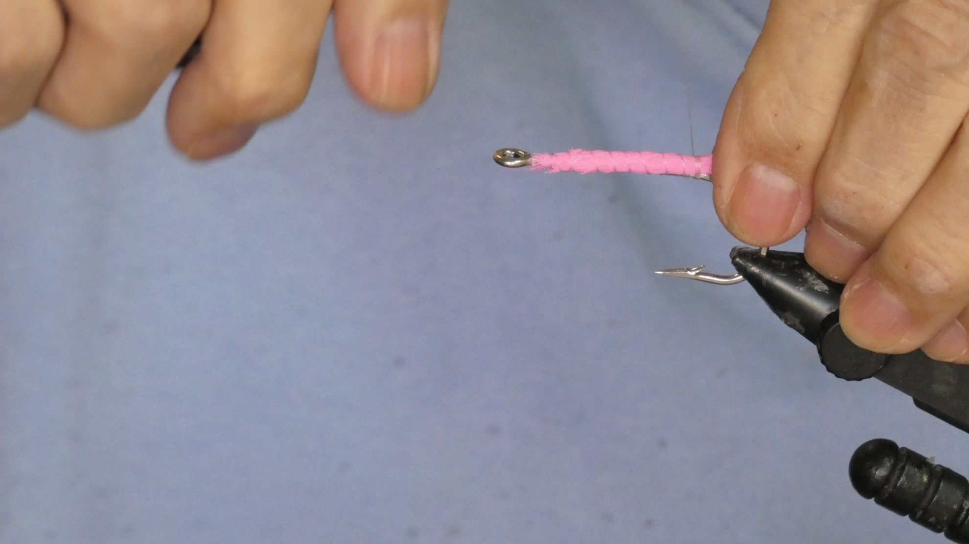
Continue wrapping to bend and then wrap forward again.

Slide 23
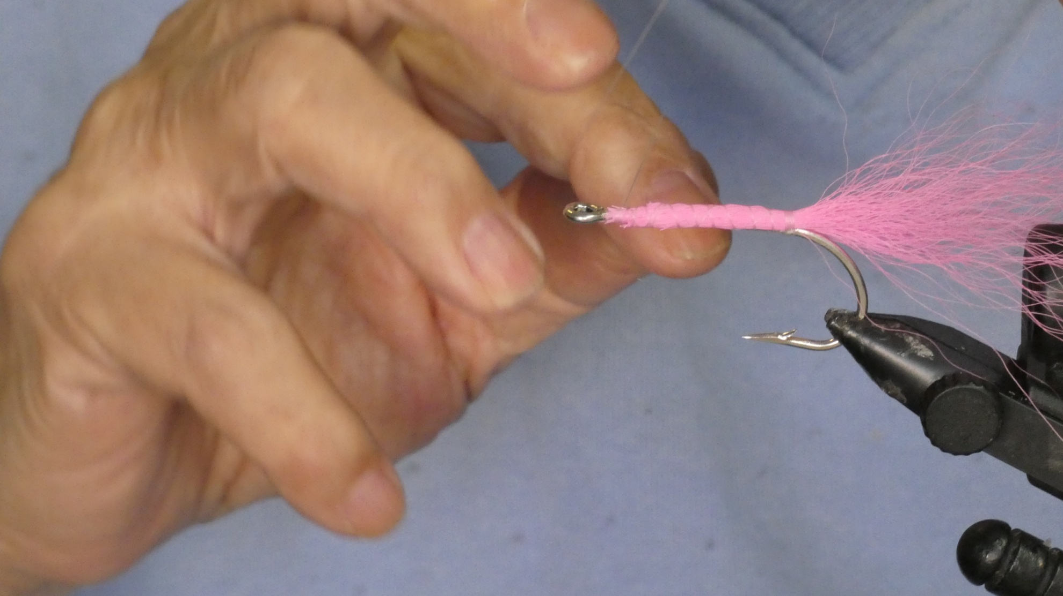
Tie off using several half hitches and cut.

Slide 24
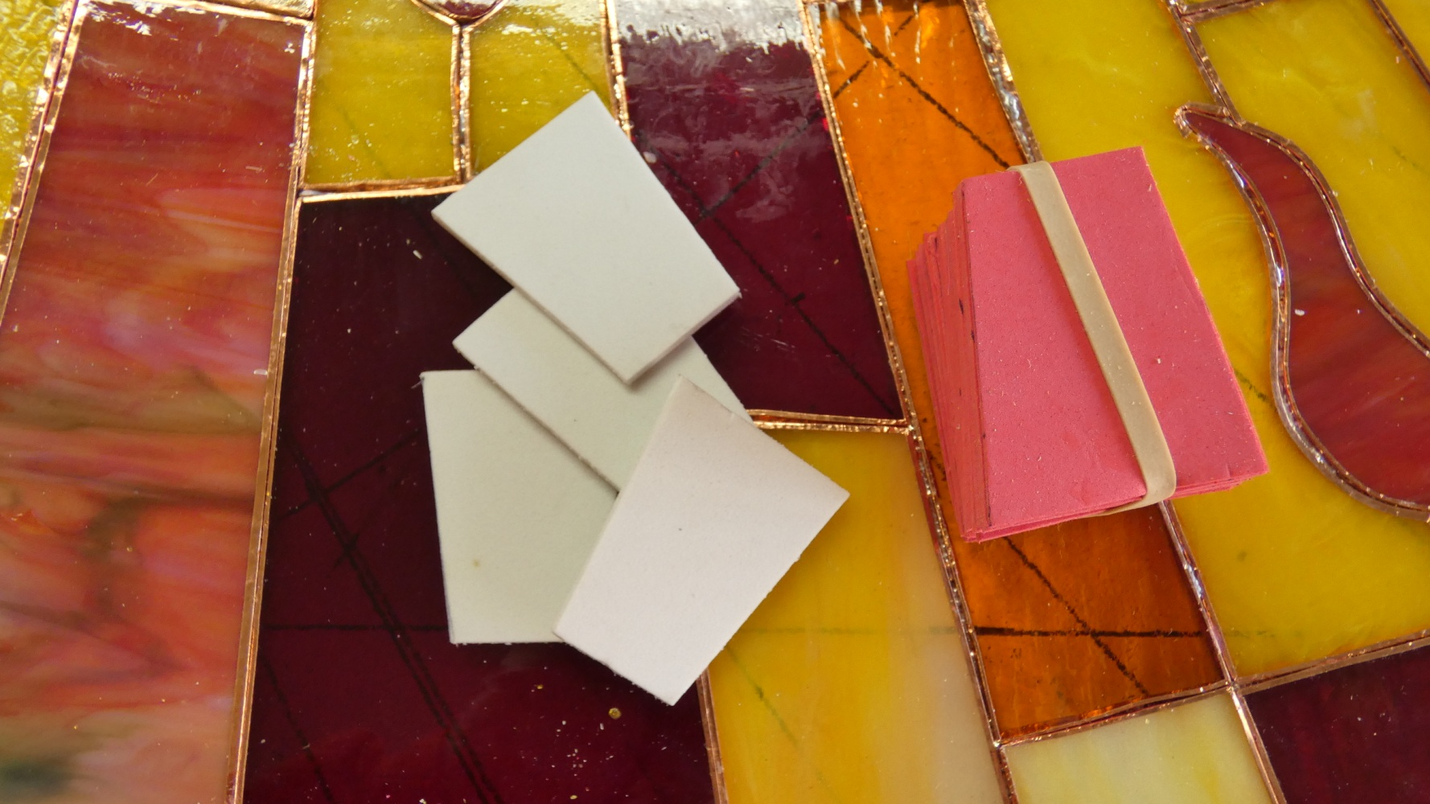
Using some card stock, make a pattern similar to the shape below, appropriate to the fly size

Slide 25
Fold the pattern in half and try it over the fly. Once satisfied, lay the pattern on some 3mm foam, color not important, trace the pattern and cut the foam to match.

Slide 26
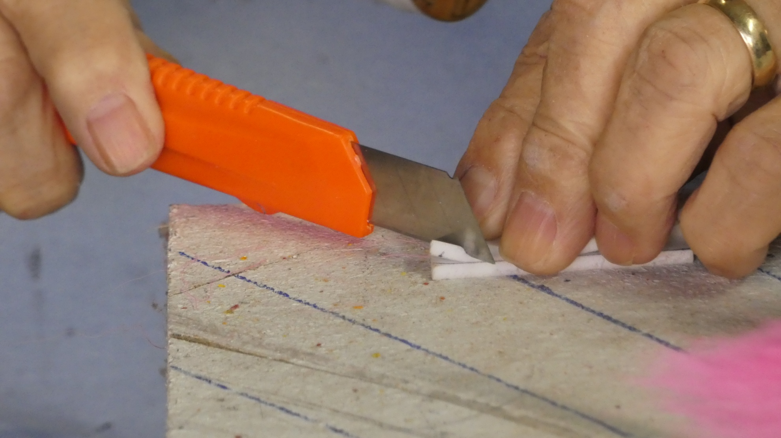
Fold the foam in half and cut the front and rear slants to the fly

Slide 27
Try the folded foam body on the fly with the lower edge of the foam placed and over lapping the edges of the hook shank..

Slide 28
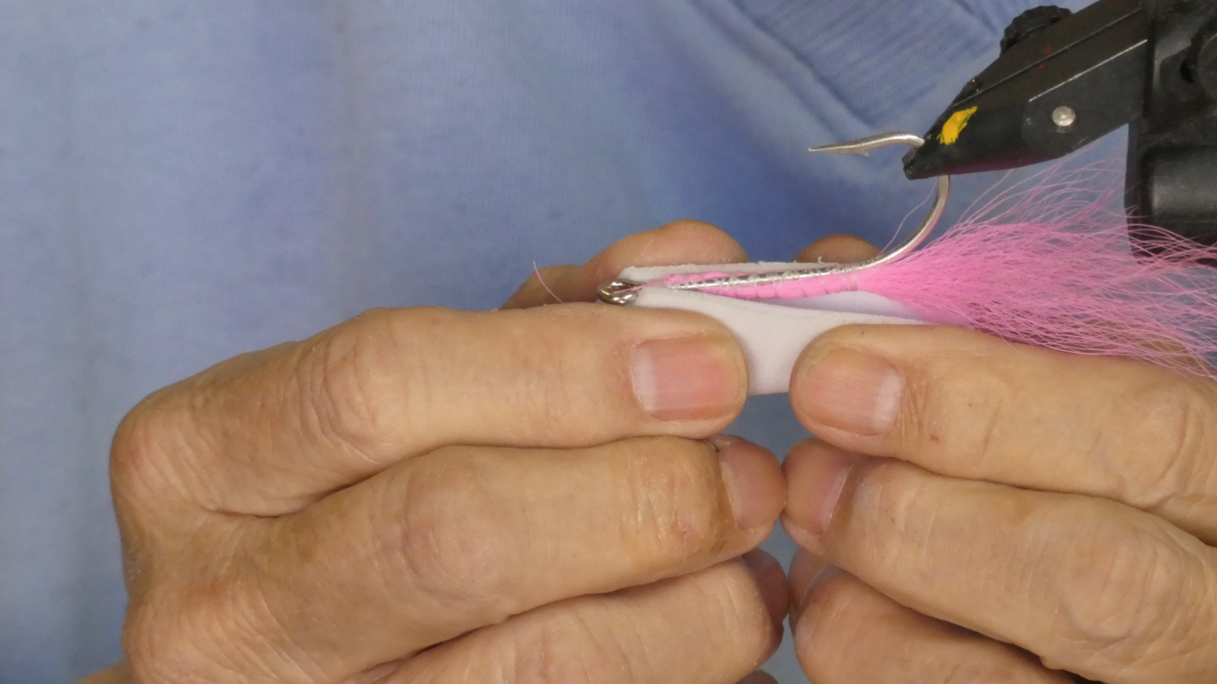
Fitting the body to the fly

Slide 29
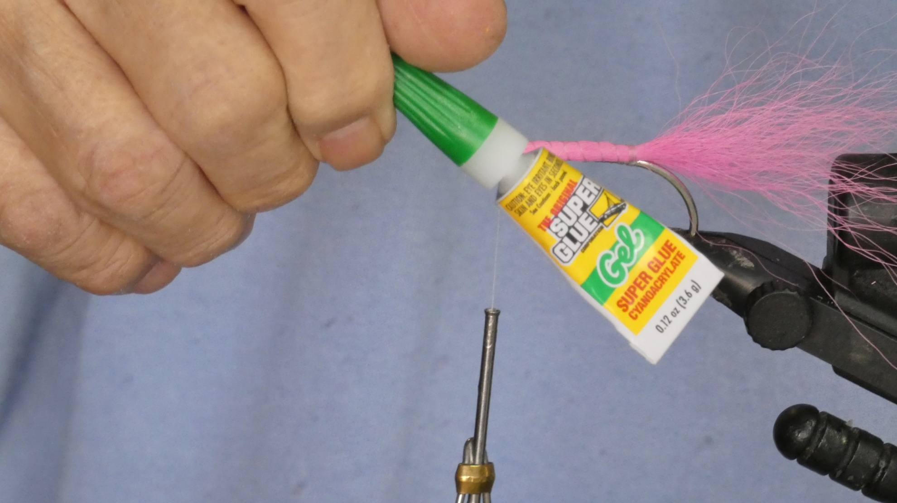
Run a bead of super glue down both sides of the hook portion of the tail.

Slide 30
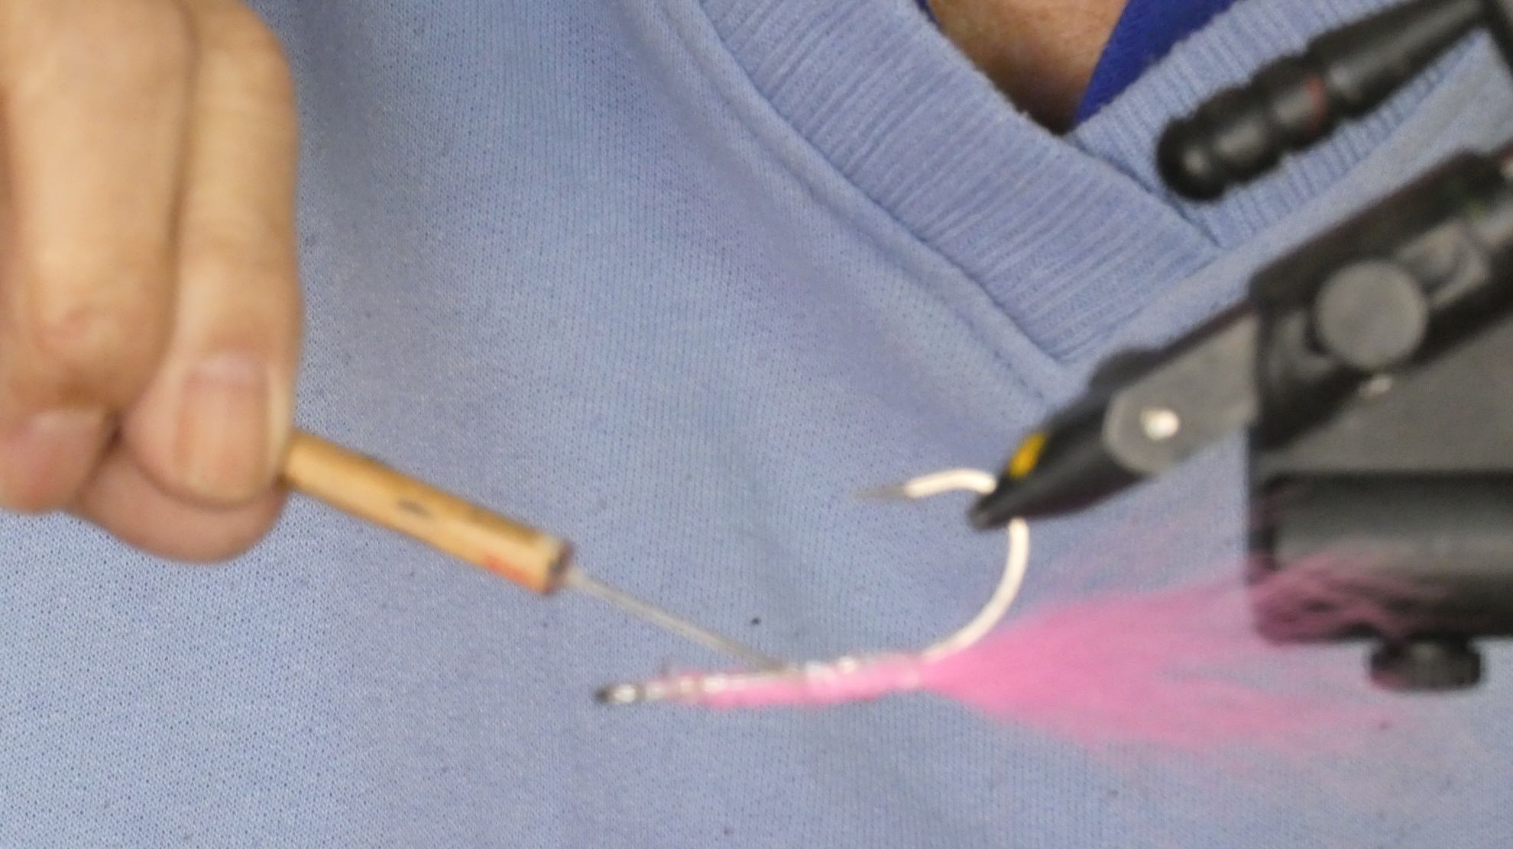
Using a toothpick or other tool, spread the glue out evenly.

Slide 31
Using the appropriate sized clamp, fit the folded body into the clamp, open edges at mouth of clamp.

Slide 32
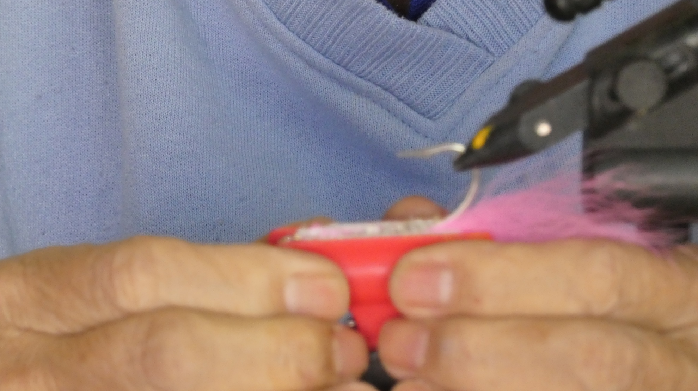
Clamp the body to the fly, lining up the edges with the hook shank

Slide 33
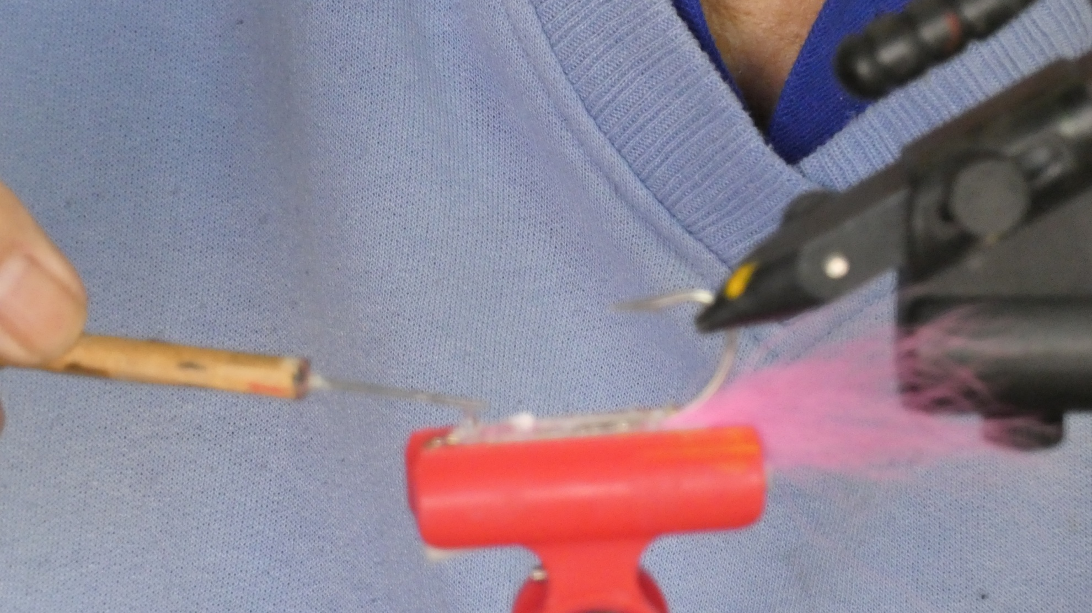
Spread out any glue that oozes out.

Slide 34
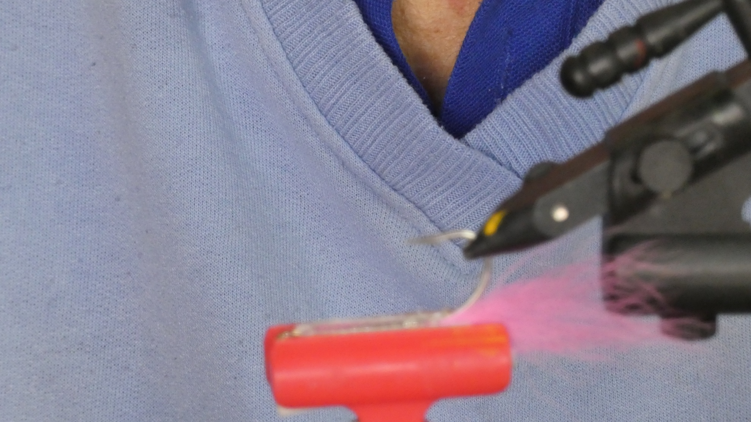
Let the glue set until totally dry

Slide 35
While the glue is setting, make a card stock pattern to cut a piece of Mylar sheeting, allowing for an additional amount on one side to overlap when wrapped around the fly. Make sure to include the bottom of the fly as part of the coverage.

Slide 36
The pattern for the Mylar sheething.

Slide 37
Try the pattern on the foam of the fly, It should overlap slightly in the front and rear and overlap by at least half an inch on one side.

Slide 38
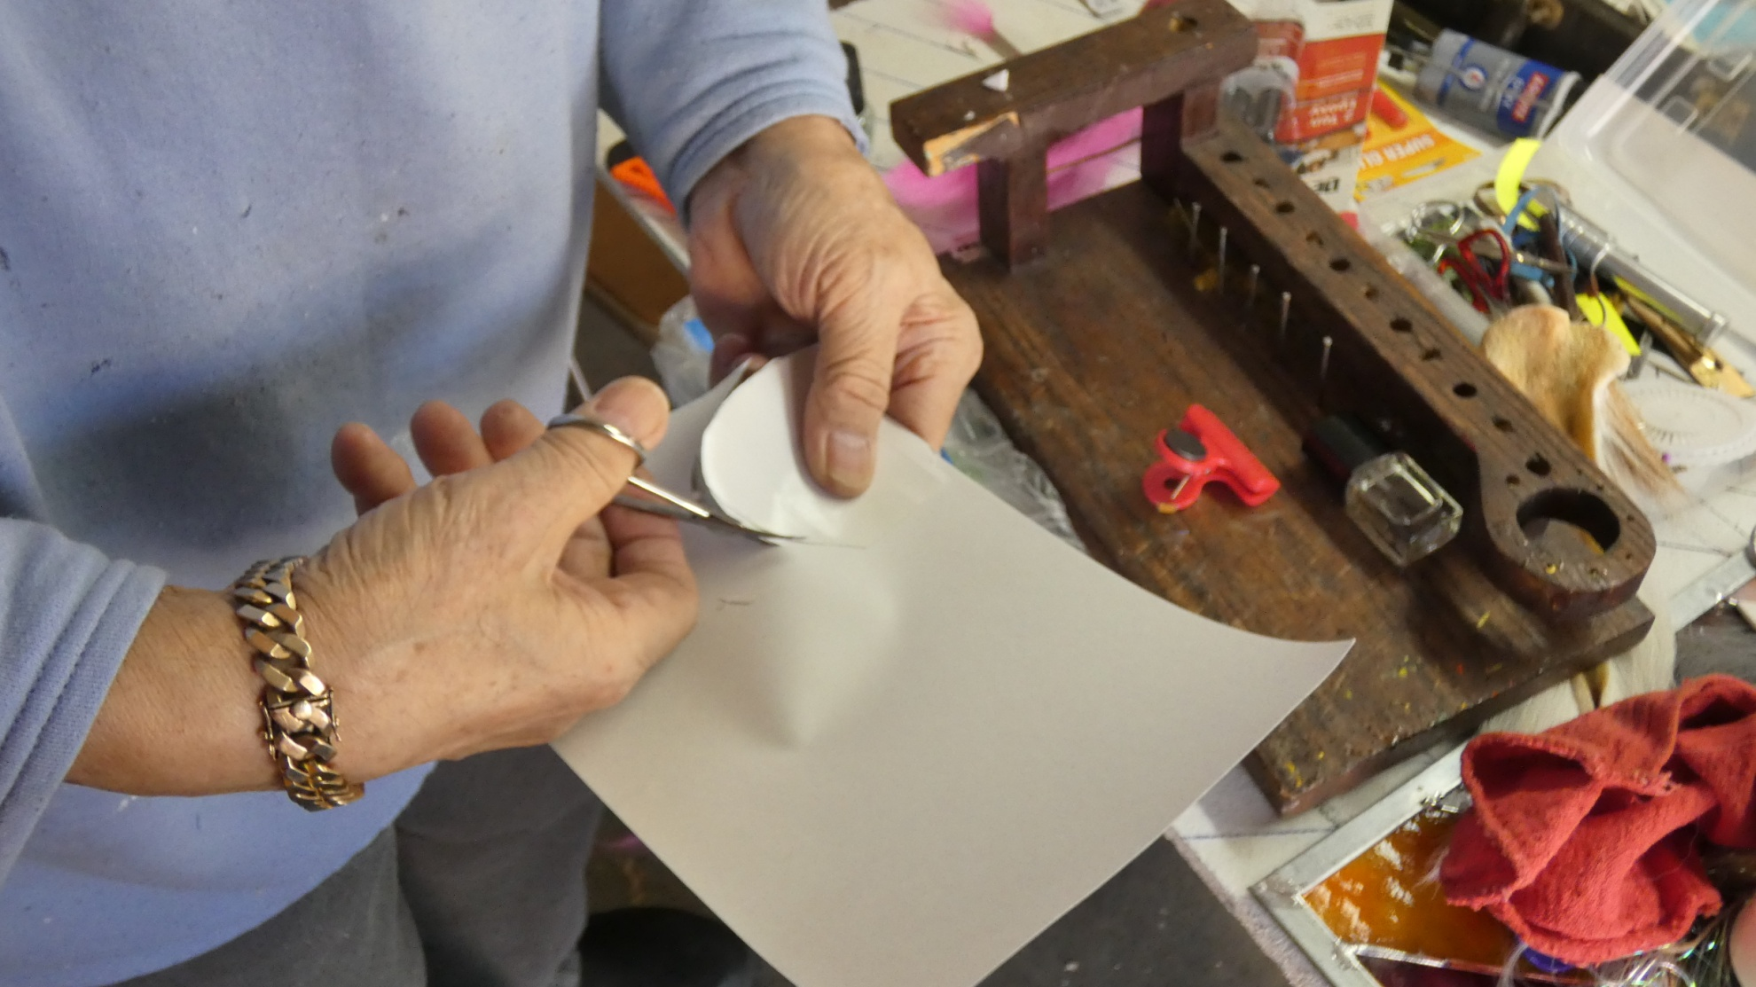
Once satisfied, use the pattern to cut out the Mylar material.

Slide 39
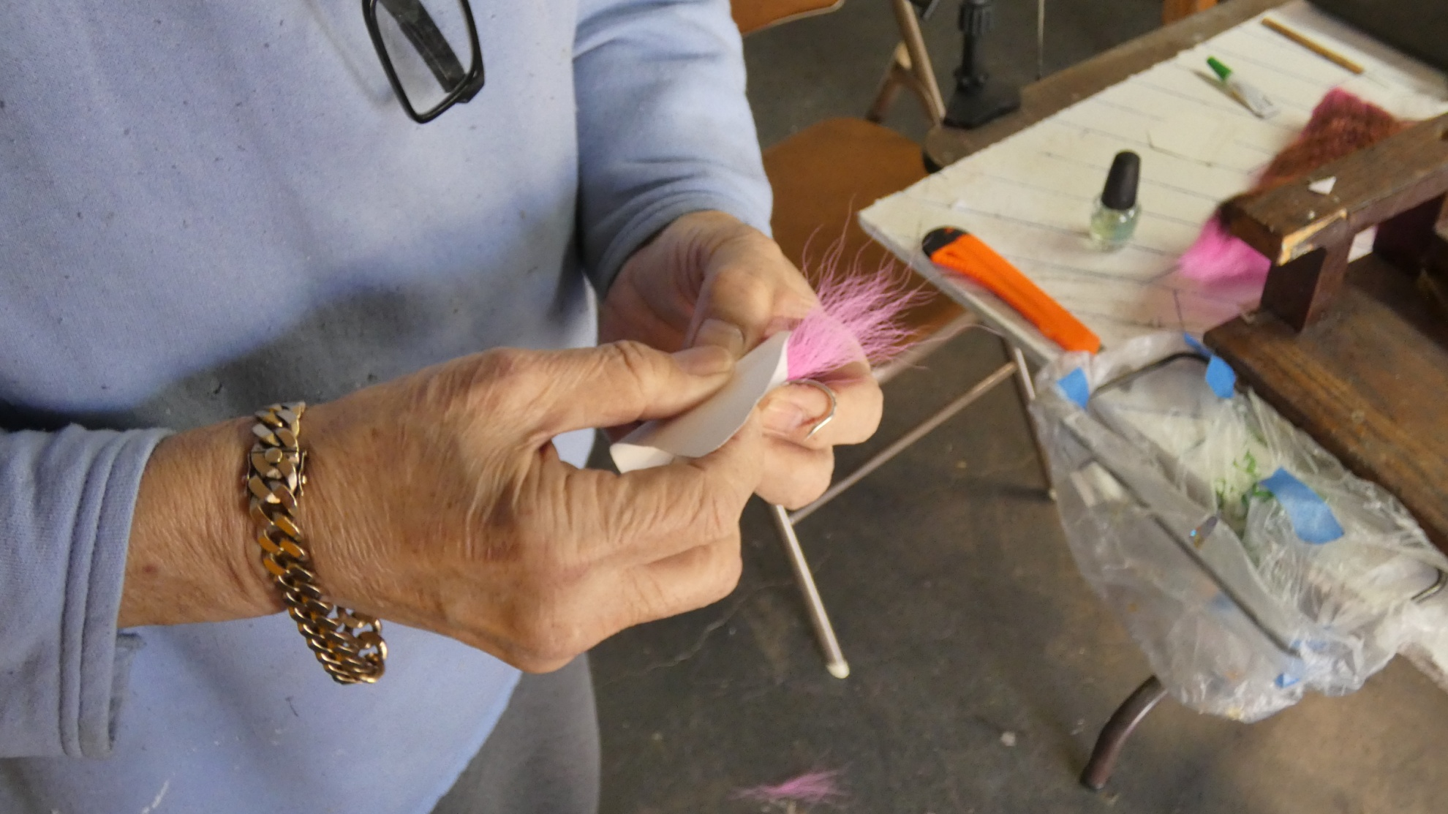
Check the fit of the Mylar. It should wrap around the fly and overlap on one side.

Slide 40
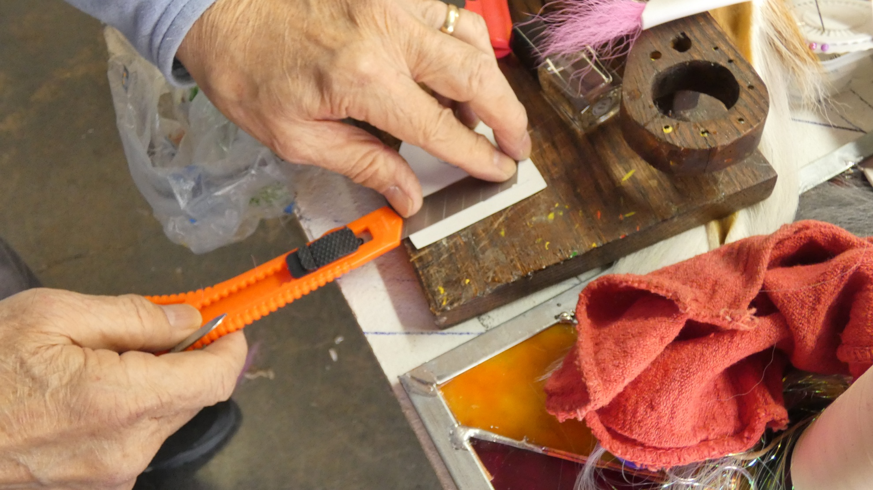
Score the edge of the Mylar so that it folds easily at the bottom of the fly

Slide 41
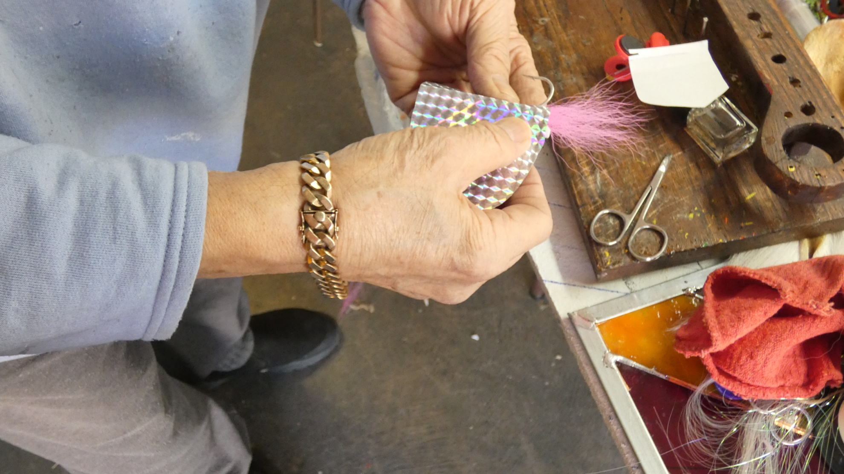
Hold the Mylar in place and mark where it covers the hook bend

Slide 42
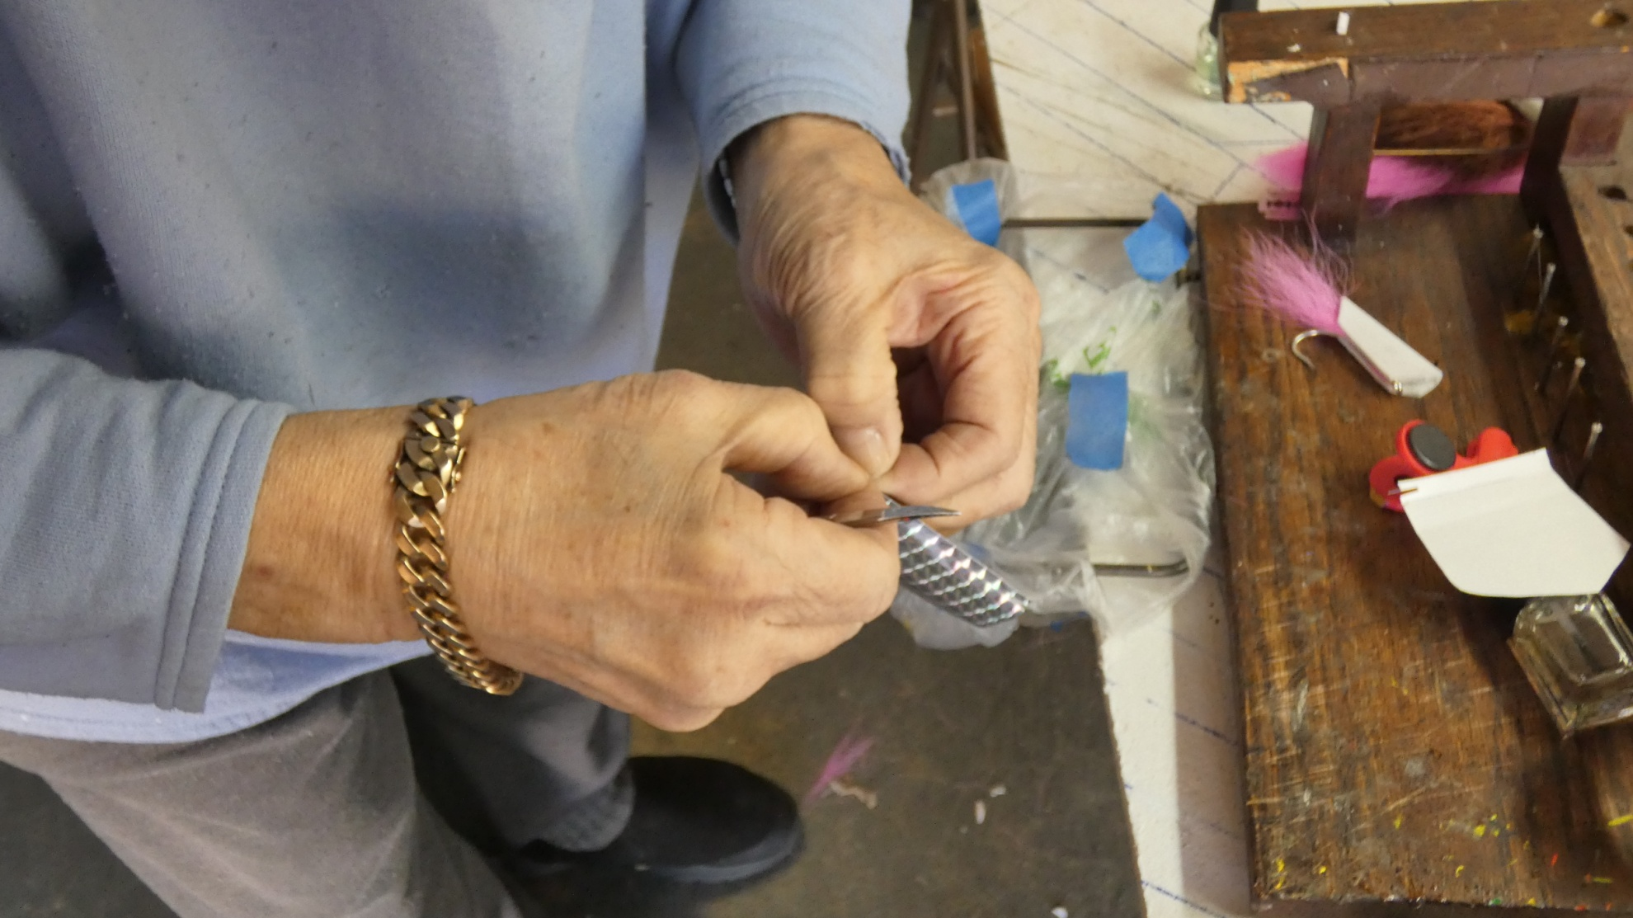
Cut a small slot for the hook shank and remove the material.

Slide 43
Partially peel the Mylar away from its backing along the straight edge

Slide 44
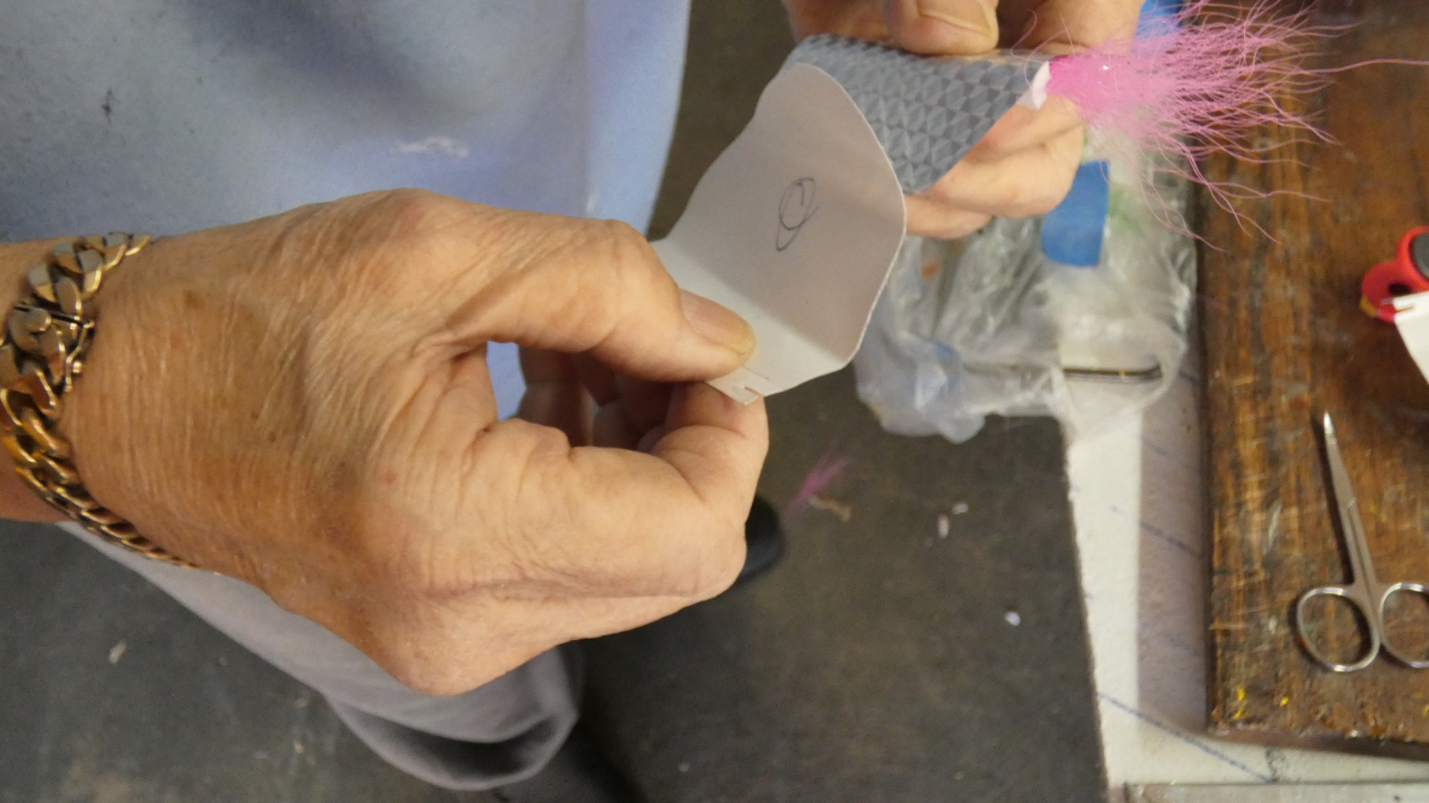
Stick the Mylar to the fly, starting along the bottom, peeling and wrapping as you go, overlapping on one side.

Slide 45
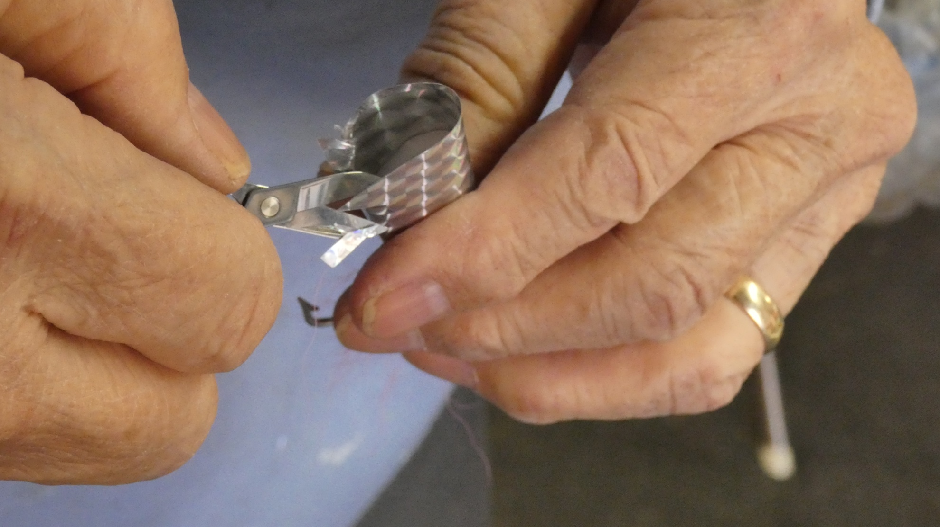
Use a small scissors to trim the Mylar back to the edge of the foam.

Slide 46
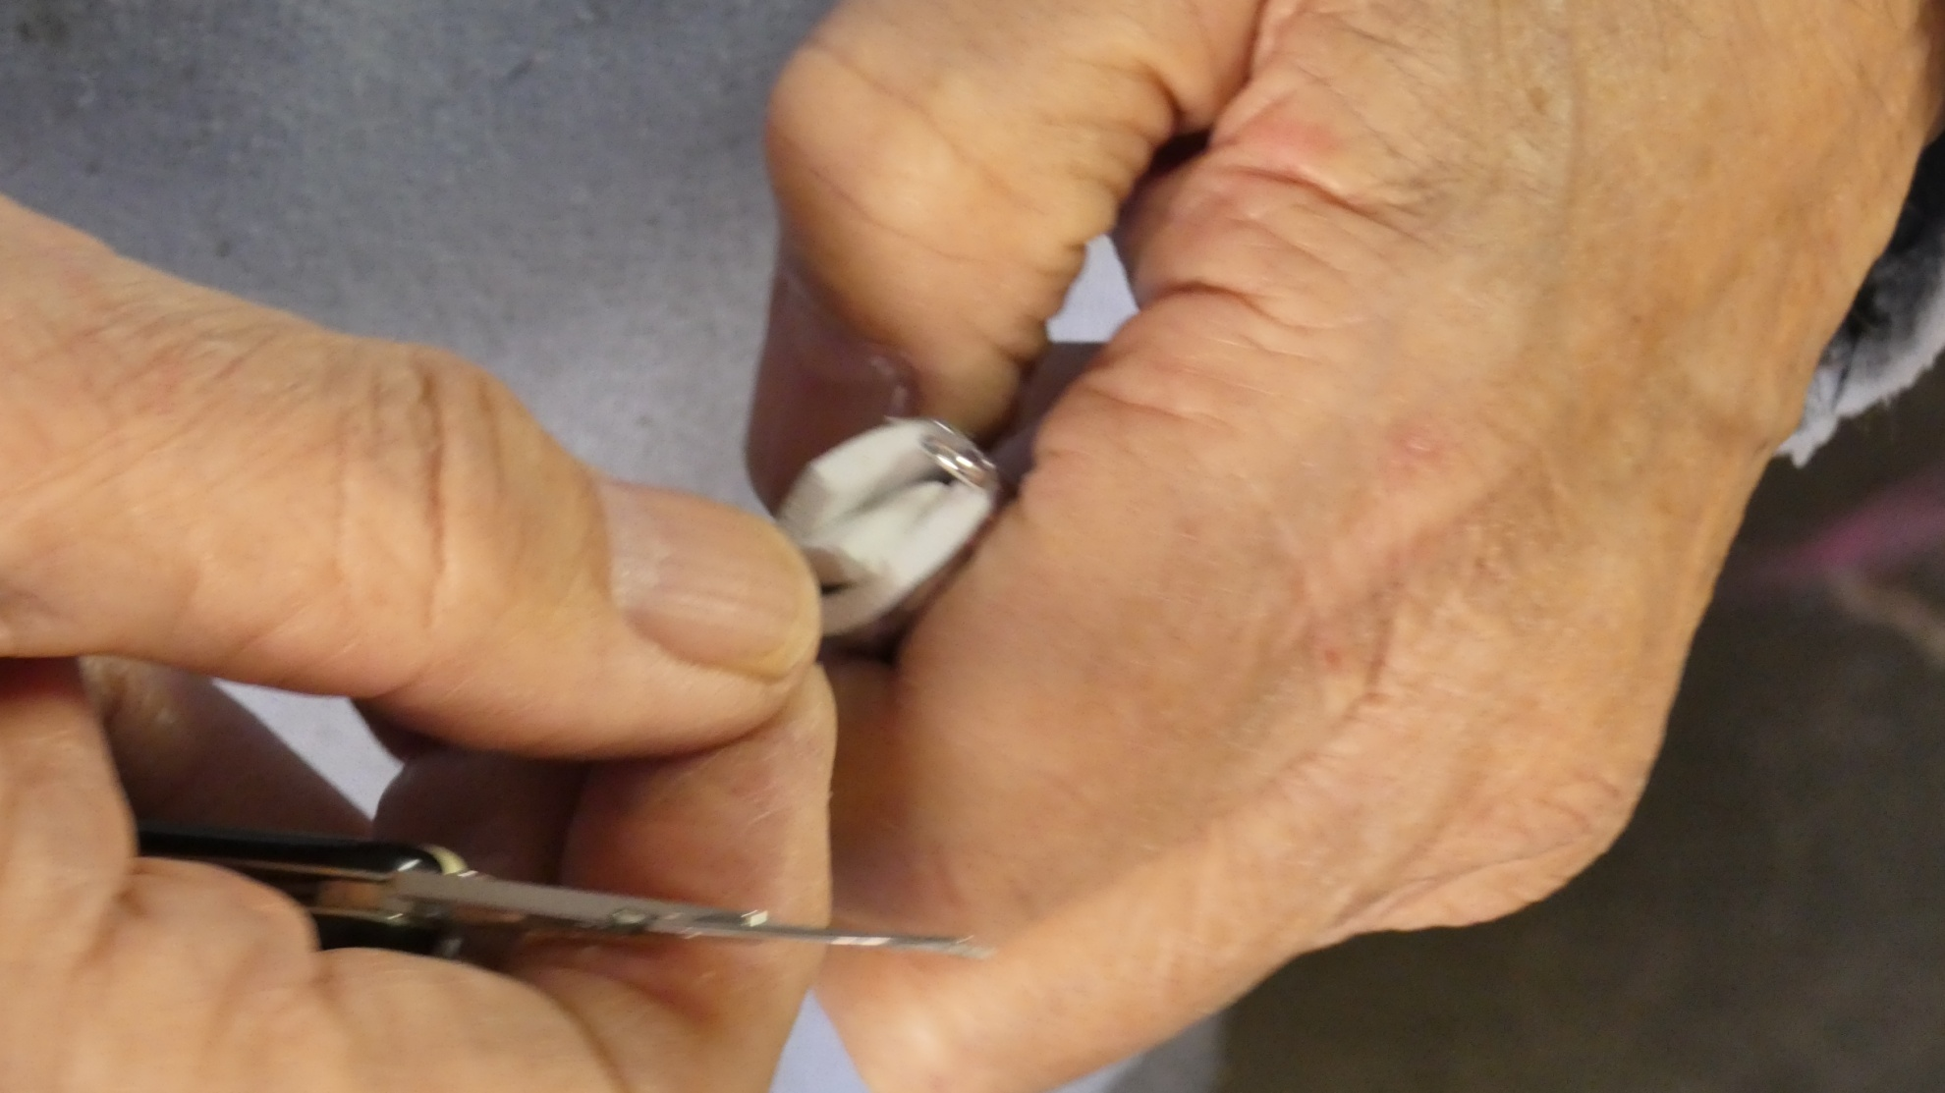
Cut a small piece of foam and super glue it into the mouth of the fly

Slide 47
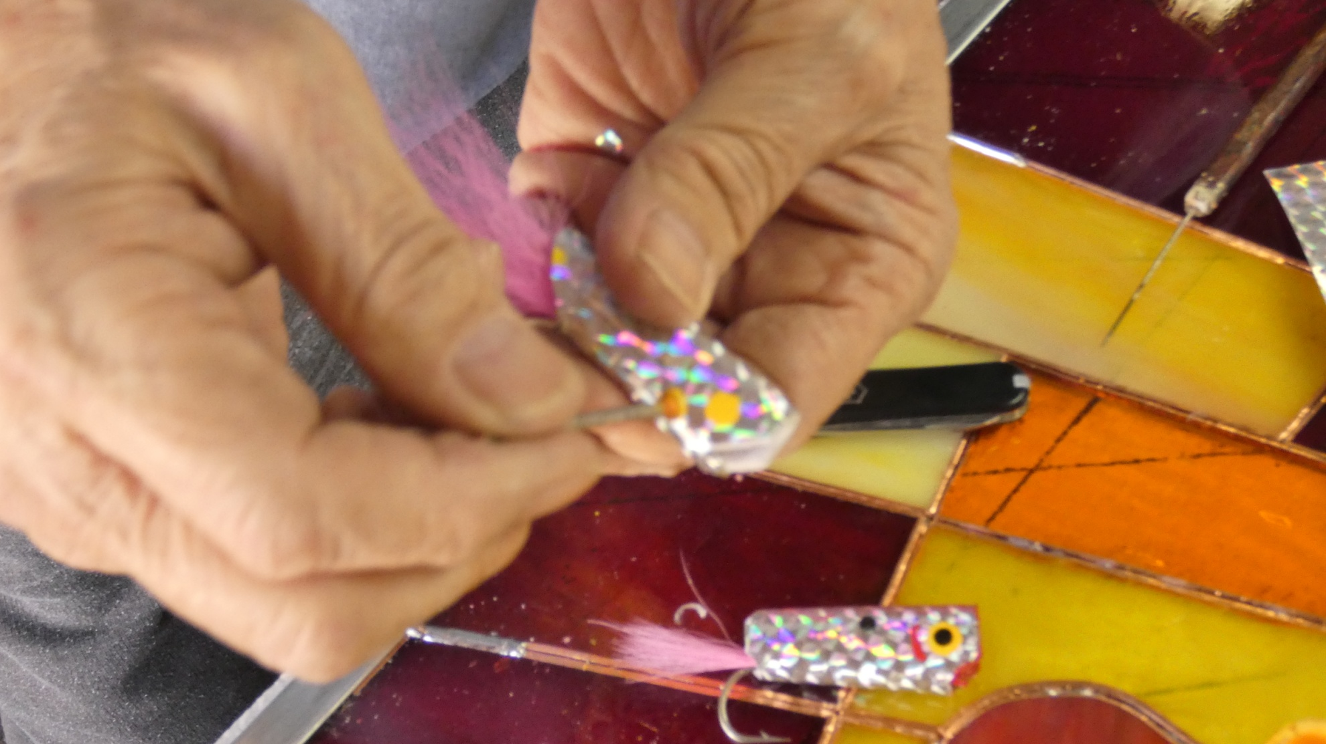
Dip a nail head into the hobby enamel and use it to make eyes

Slide 48
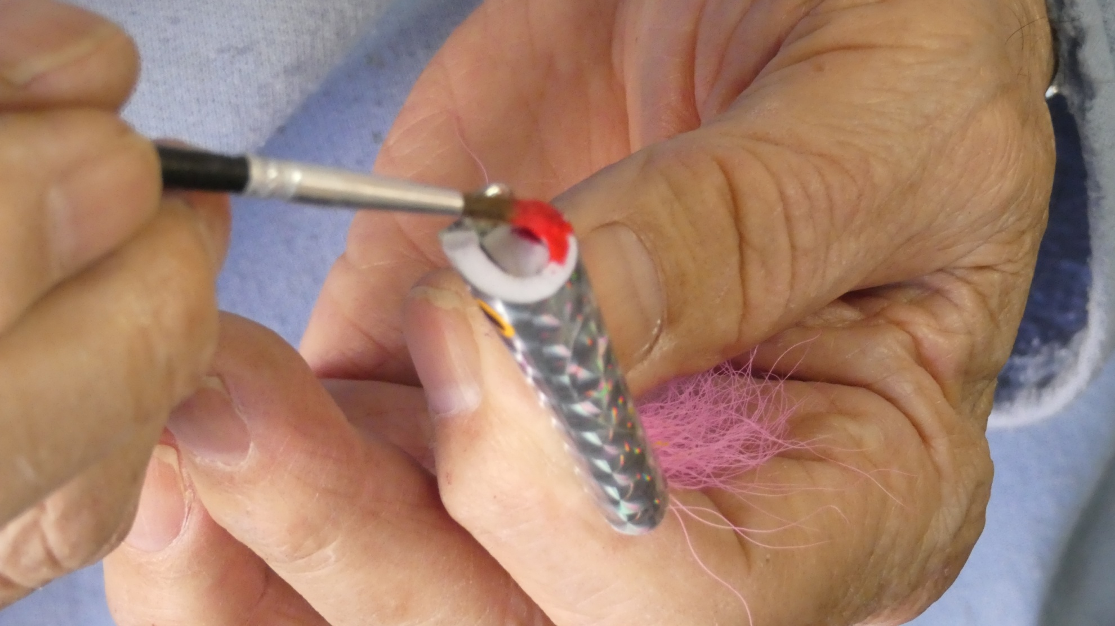
Use a paint brush to paint the throat red

Slide 49
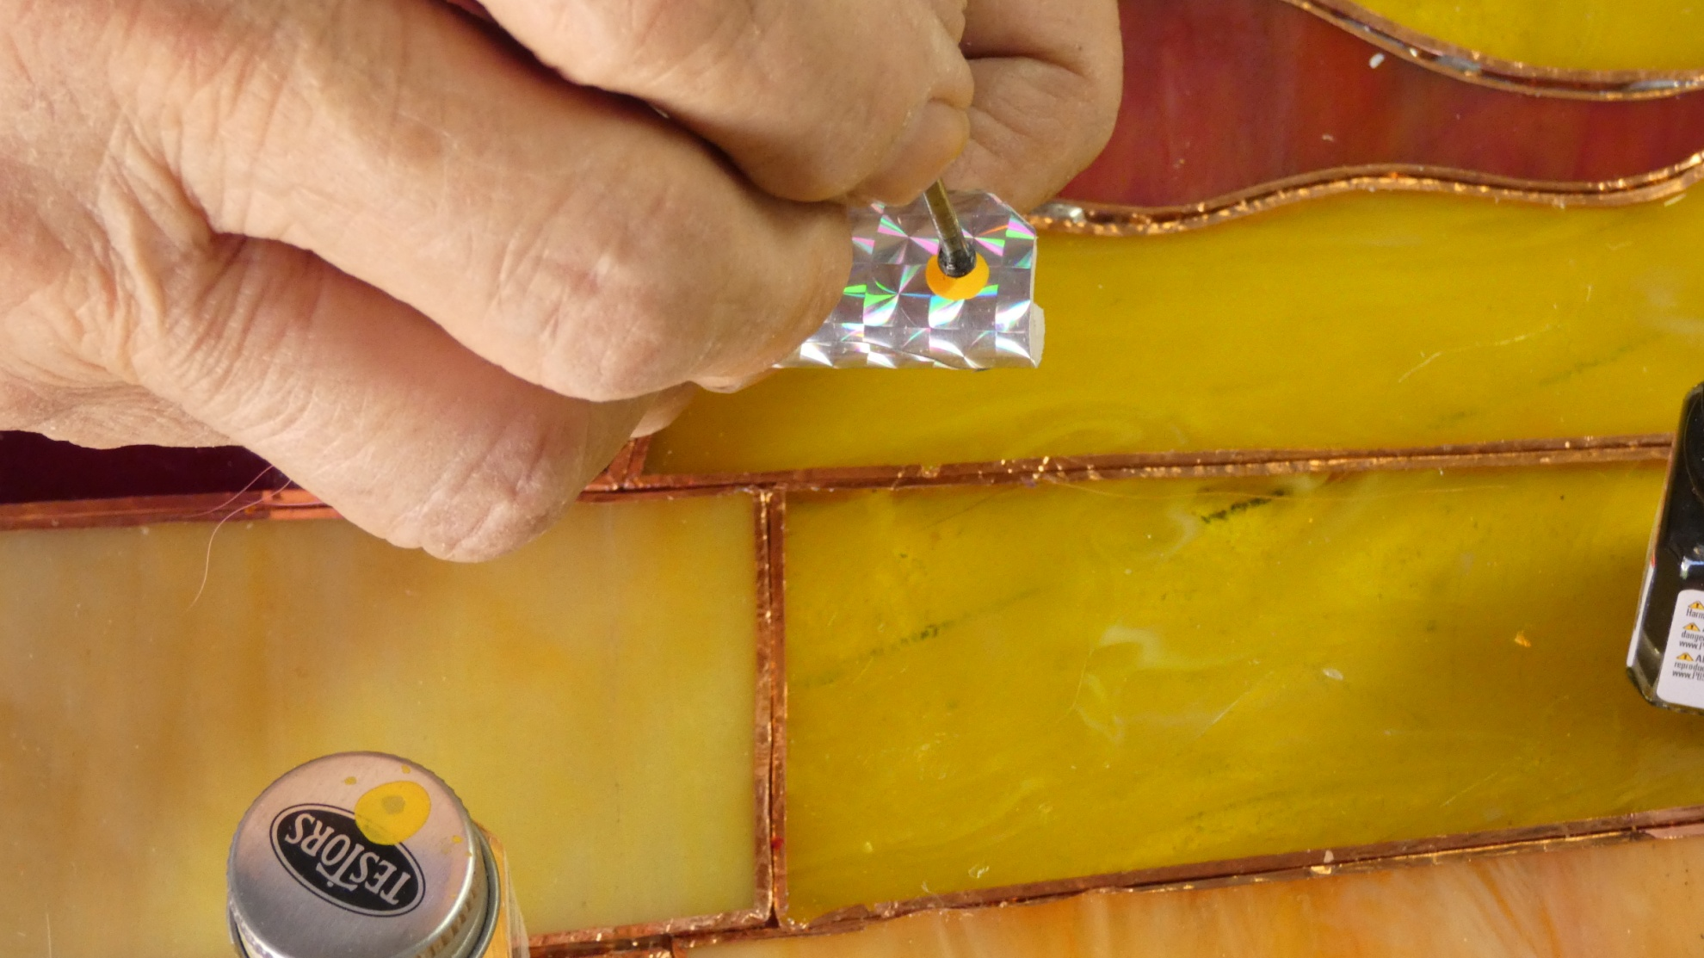
Use a smaller nail head to paint the pupil.

Slide 50
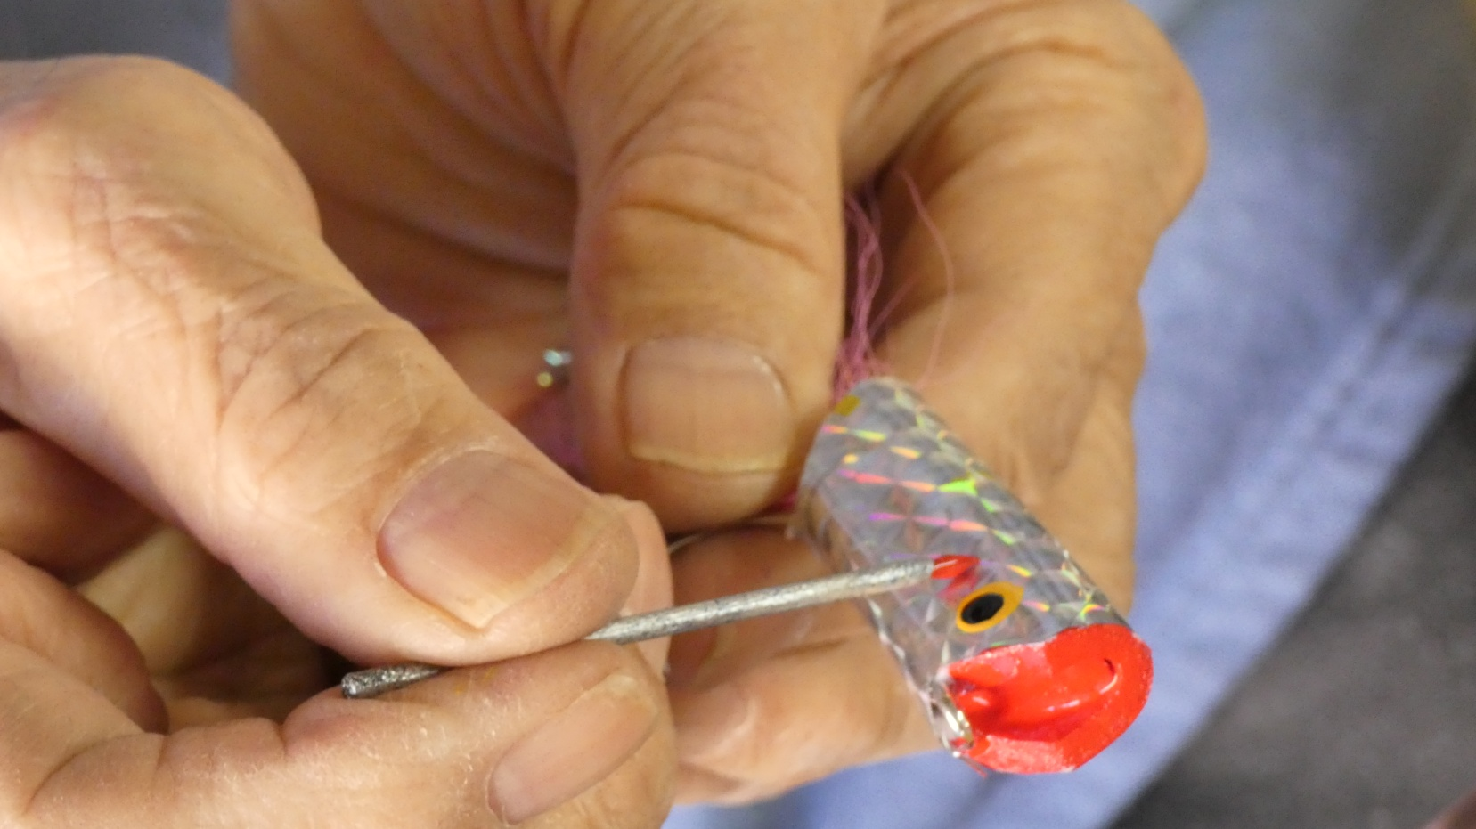
Add gills, dots or other markings to suit yourself using toothpicks and nails as brushes.

Slide 51
When finished, coat the whole thing with several layers of epoxy for durability.

Slide 52
To make tying easier, it’s suggested that you have a number of clamps and tie the flies in stages, say six at a time.

Slide 53
The materials, the 3mm foam and Mylar sheeting are available at most larger fly shops but considerable savings can be made by purchasing the foam at hobby stores such as Michael’s and the Mylar sheeting at Tap Plastics.

Slide 54
Leo’s flies have been responsible for landing anything from sailfish, tarpon and dorado in the salt to top water feeding freshwater fish including striped bass, largemouth and smallmouth. Many fly fishers regard them as their go to fly for any top water presentations.

Slide 55
Thanks for watching!!!

