Slide 1

ZAKAT MADE EASY

Slide 2
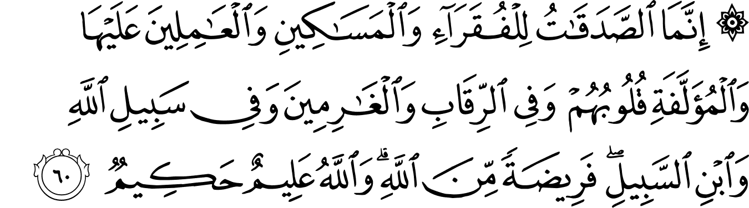

“As Sadaqat are only for the Fuqara' (destitute), and Al-Masakeen (the poor) and those employed to collect (the funds), and to attract the hearts of those who have been inclined (towards Islam), and to free the captives, and for those in debt, and for Allah's Cause, and for the wayfarer (a traveller who is cut off from everything); a duty imposed by Allah. And Allah is All-Knower, All-Wise.”​
[Qur'an: Surah Tawbah, 9:60]​

Slide 3
Zakat vs Other Forms of Charity
Zakat
Charity
Obligatory
Prescribed rate
Given by Muslims, to Muslims
Restricted to 8 categories
Given at a specific time
Due on specific assets
Voluntary
No prescribed rate
Given by anyone, to anyone
No restrictions on beneficiaries
Can be given at any time

Slide 4

8 CATEGORIES​ OF
ZAKAT RECIPIENTS

Slide 5
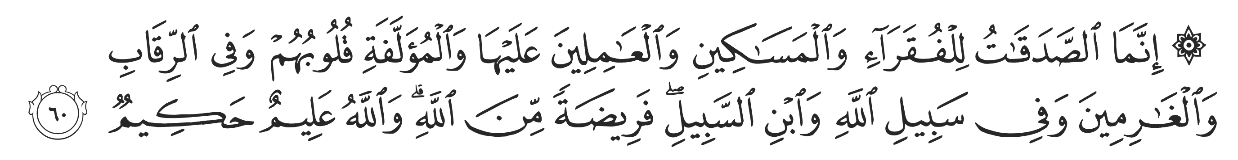
Fuqaraa’
Masakeen
Al ‘Amileena ‘Alayha
Al Muallafati Quloobuhum
Fi Ar-Riqab
Al Gharimeen
Fi Sabilillah
Ibn Al-Sabeel
The Destitute
The Needy
Zakat Workers
Softening the Hearts
The Captives
The Indebted
In the Path of Allah
The Stranded Traveler
8 Categories

Slide 6
UNLAWFUL
RECIPIENTS OF ZAKAT

Slide 7


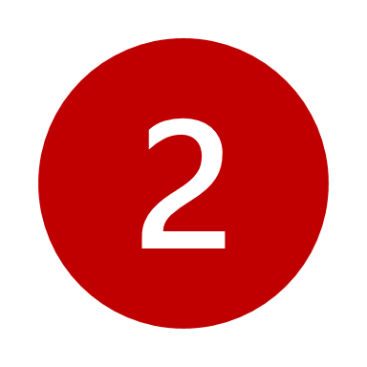
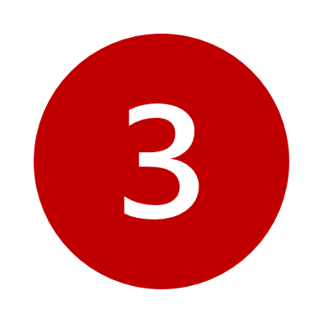
The Rich:
Those who are wealthy cannot receive Zakat
Those Capable of Earning an Income:
One who is able to earn an income but does not do so out of laziness
It is not honourable for a person to depend on Zakat unnecessarily
Unlawful Recipients of Zakat
The Disbelievers:
As a general rule, non-Muslims are not eligible to receive Zakat
Notes:
The rich exception: The ownership goes from Zakat giver to zakat recipient. The malik can do whatever they want with their wealth. Meaning the recipient if Zakat can choose to give their wealth to another person (rich or poor)
Capable of earning: Narrated Abu Hurairah: the Messenger of Allah (sallallahu ‘alayhi wasallam) said, “It is not permissible to give charity to a rich man (or one who is independent of means) or to one who is strong and healthy.” [Sahih, Sunan al-Nasa’i Book 23, Hadith 163]​
And… Narrated ‘Ubaidullah bin Adi bin Al-Khiyar: two men informed him that they went to Allah’s Messenger asking for Sadaqah. He then looked at them up and down, and seeing that they were strong, said, ​“If you wish I will give you something, but there is no share in it for a rich man or for one who is strong and able to earn a living.” [Sahih, Sunan al-Nasa’i Book 23, Hadith 164]​
Non-Muslims under muallafati quloobuhum: Opinion 1: Can be given (Hanbali/Maliki), Opinion 2: Cannot be given (Shafii/Hanafi). This is due to the potential abrogation of this category during the time of Omar RA.

Slide 8
Tamleek – Transfer of Ownership in Zakat
Tamleek is a prerequisite for giving Zakat: Transfer of ownership from payer to recipient.
Complete transfer of ownership means the recipient must become the full owner of the Zakat without conditions or partial control.
Exclusion of Public Services: Zakat should not be used for public benefits, like roads, hospitals, schools, etc.
Exception: With a clear agreement and consent from the Zakat recipient, the Zakat payer can pay for services on behalf of the recipient. E.g., Counselling, Quran education.
Notes:
Zakat can be utilized with the agreement and consent of the zakat recipient that they will receive their zakat in this service. They themselves allocate their zakat to this service.
Similar to someone who needs to learn and education themselves. For example: skills upgrading, Islamic education, etc.
This should be looked at as a Zakat for service. Mental health services and counselling are treated similarly with respect to giving Zakat services to those who are Zakat eligible.

Slide 9
FUNDAMENTALS OF
NISAB

Slide 10
GOLD:
“Verily, the Prophet (ﷺ) used to take (Zakat from people) – in every 20 dinars, half a dinar”
SILVER:
“…For silver the Zakat is one-fortieth of the lot* and if its value is less than two-hundred Dirhams, Zakat is not required, but if the owner wants to pay, he/she can.”
Nisab is the threshold that one’s wealth must reach to be liable to pay Zakat
Mathematically: 0.5/20 = 1/40 = 2.5%

Slide 11
Gold and Silver Nisab
Nisab of Gold
Nisab of Silver
20 dinars or 85g or
~ $12,170 CAD
(Feb 2025)
200 dirhams or 595g or
~ $950 CAD
(Feb 2025)
Why the difference?
20 dinars used to equal 200 dirhams (exchange rate of 1:10)
Gold Nisab is recommended by many scholars in Canada,
Silver Nisab is the safer approach

Slide 12
WHAT IS ZAKAT
PAID ON?

Slide 13

Cash and cash-like assets
Gold and Silver: coins, ingots, jewellery*, etc.
Debts owed to you: money lent to others that will be repaid
Shares and Investments: TFSA / RRSP / RESP / Pensions
Properties for sale
Business inventory and other business assets*
What is
Zakat
paid on?
Notes:
Properties are subject to Zakat if they are marked for sale. Example someone is in the business of buying and selling houses.
House you live in is not Zakatable.
House you own but rent out is not Zakatable. Zakat is only due on the net rent you have saved.
Pensions RRSPs, RESPs have their own rules.
One should do their business Zakat separately from their personal Zakat

Slide 14
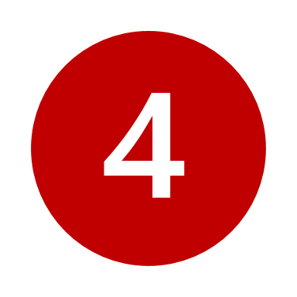
Have complete ownership of the wealth
Wealth is free of haram income
  Zakat is not due on earnings from haram sources.
  Haram wealth must be disposed of by giving it in charity, and seeking forgiveness from Allah
Pay Zakat
if you meet
the following criteria:
Wealth meets the Nisab
  The threshold of wealth one must own to be liable to pay Zakat
One lunar year passes over the wealth after attaining the Nisab amount
Notes:
This is not to convey that haram money is free of Zakat, but instead that it should not be in your possession or eat from that wealth.

Slide 15
Zakat Calculation
Zakatable Assets – Deductibles = Net Zakatable Assets
*IF your Net Zakatable Assets are ABOVE the Nisab….
.. Your Zakat Payable = 0.025 * Net Zakatable Assets

Slide 16
Zakat And Deductible Debts
Short-Term Debts
Long-Term Debts
Short-term debts due within the 12 lunar months can be deducted in full.
Long-term debts can be deducted also, with some considerations:
Not Making Payments: If not making any payments toward your long-term debt right now, then nothing is deducted, and you simply pay Zakat on your Zakatable assets.
Making Payments: If you are committed to a monthly repayment program for your long-term debt, then you may deduct 12 lunar months of upcoming principal payments (not including interest)
Notes:
Short term debts are deducted if you intend to pay off the debt within the next 12 lunar months.
long-term debts are deducted if one is actually making the payments towards it, or intends to pay off part of it in the next 12 lunar months.
Deductible cannot include interest
Principle payments are considered only
Up to 12 months can be deducted from long-term debts. You can choose to forgo the deduction, which results in higher zakat paid, and this is acceptable.

Slide 17
Example: Long-term Debt Deductible
Your Zakatable assets are $20,000. You pay $550/month toward a long-term loan, of which $500 is toward the principal and $50 is interest.
Excluding interest, $500 x 12 months = $6,000. This $6,000 is your deductible.
Your Net Zakatable assets are $20,000 - $6,000 = $14,000 (Higher than Nisab)
Zakat rate of 2.5% applied to $14,000 = $350 Zakat Payable

Slide 18
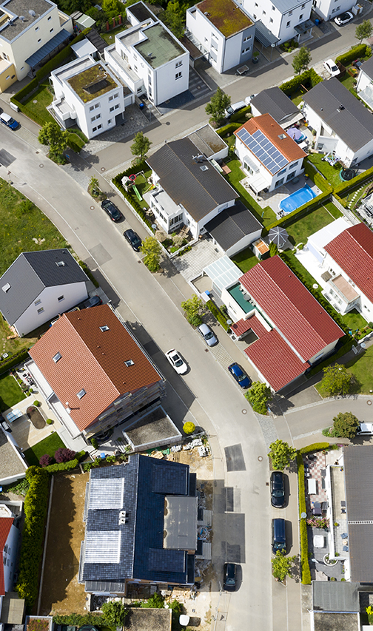
Zakat and Mortgages
Short-term portion of the mortgage is deductible
For monthly mortgage payments, you may deduct 12 months of upcoming principal payments (not including interest)
Difference of opinion here:
Some scholars recommend you do not deduct mortgage liability, unless you are fearful that you will be unable to pay your mortgage
Notes:
This opinion is minority opinion, and if someone wants to deduct less of their loan, this is okay.

Slide 19
Zakat Anniversary Date
Your Zakat anniversary date is the day you first reached Nisab.
If the exact date is unknown, one should estimate a date on the Hijri calendar.
Zakat is calculated on that Hijri day every year.
Zakat is not necessarily due in Ramadan.
  People often choose to pay in Ramadan due to increased rewards.
  Zakat payment should not be delayed unnecessarily.
Example: You first reached Nisab on 20th of Muharram 1435. Your Zakat is due on 20th of Muharram every year, if you continue to attain the Nisab.

Slide 20
USE CASES

Slide 21
Zakat on Shares and Investments
Short Term Investment
Long Term Investment
Intention is not to hold for more than a lunar year.
Example: Day trading or swing trading
Zakatable amount: Include the entire value of your portfolio and pay Zakat on it
Intention is to hold for more than a lunar year. Example: These investments could be held in TFSA’s or other investment vehicles.
Zakatable amount: The Zakatable portion of the companies you hold shares in
How?? Use the Asset Ratio Formula

Slide 22
Zakatable Portion of Shares =
Zakatable Asset Ratio X Current Value of Your Holdings in Dollars
Where…
Zakatable Asset Ratio = Total Current Assets / Market Cap
Zakatable Asset Ratio Formula
Notes:
Example: The bakery with the building, furniture, the oven, the baked goods, and the ingredients. Zakat is only on the ingredients and the baked goods.

Slide 23
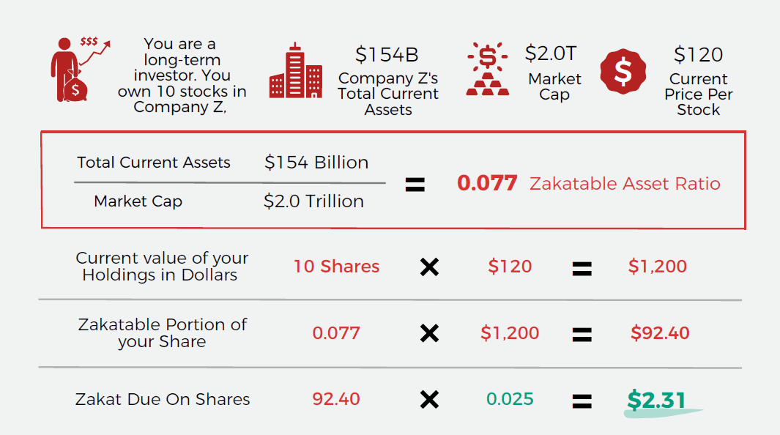
Example
Notes:
With many stocks in your portfolio, mutual funds, or with ETF’s you can use a proxy of 30%. (0.3 Zakatable asset ratio)
Example: The bakery with the building, furniture, the oven, the baked goods, and the ingredients. Zakat is only on the ingredients and the baked goods.

Slide 24
Zakat on RESP
Example:
RESP contains $14,000 ​
of which you contributed $10,000 ​
and the government contributed $2,000 ​
the remaining $2,000 is from capital gains​
Deduct gov’t contribution (as this would be the penalty for early withdrawal prior to maturity).
Zakat due = 2.5% * $12,000 = $300​
RESP’s can be liquidated prior to children’s education; thus, the fund is Zakatable.​
​
However, you only pay Zakat on the amount you contributed plus/minus any growth/losses
Notes:
In the Hanafi madhab, you either pay it or not pay it depending on the age of the child, and secondly, if you have full intent to not take the money out and consider it your child’s wealth, then this can be dismissed as a Zakatable asset.
If this is considered the child’s wealth, then the child must reach the nisab. In this example, 10,000 is above the nisab but a young child may have less than that in the RESP account.
It is the safer approach to pay Zakat on this wealth since RESP is under the ownership of the parent, and the parent can do anything with it before the child enrolls in post-secondary education.

Slide 25
Zakat on RRSP
Zakat on RRSP =
(Total RRSP value - Withholding tax) * 0.025
Note: Withholding tax amount is dependent on the amount in the fund and the province you reside in.
Group RRSP:
Zakat is due only on the portion you own and can access.
If you cannot withdraw funds due to restrictions (e.g., employer controls access until retirement), no Zakat is due until withdrawal.
If withdrawal is possible: Calculate Zakat (2.5%) on the total zakatable assets, after deducting any penalties/taxes.
Zakat on RRSP
RRSP’s can be liquidated, thus the fund is Zakatable.​
​
The withholding tax can be deducted accordingly.
Notes:
Additional details regarding Group RRSP’s missing on this slide. Some Group RRSP’s are locked and some aren’t.

Slide 26



Gold and Silver Jewellery: worn or not worn
Opinion 1: Zakat is not paid on jewellery that is worn regularly*
Opinion 2: Zakat should be paid on all gold or silver jewellery.
NZF Stance
Note: If gold/silver is mixed with other metals, Zakat is paid on the proportion that is gold/silver.
Example: if a gold bracelet is 75% gold and 25% other metals, and the total weight is 200 grams. Then Zakat is paid on the 150g (75%) of gold in it.
Notes:
Jewellery that is worn regularly:
*what is regular? According to the scholars, even one use per year is considered regular and under opinion 1, it can be applied.
What if all wealth in gold?
If you wear it, you have option to not pay zakat on it, if you take that opinion.
How do you value your Jewellery. Get the resale value and pay on it how she wills (a. sell part of it or gives it away, or b. someone from her family (husband or father) pays it).
Alternatively, find the spot price of your gold online (e.g. www.goldprice.org) and take 80% of it (to estimate the resale value). Then apply 2.5% to it for Zakat.
This is important if you use spot price. Because resale price is always less than spot price, 80% is a good estimate.

Slide 27

Zakat on properties depends on the intention and how the property is being utilized.
Non-Zakatable Properties:
Properties being utilized as households or businesses, including those rented out
Zakatable Properties:
Properties that are marked for sale or purchased with the intention of reselling
Side note: debts on the property are deductible
Properties
Zakat on properties
depends on the intention and how the property is being utilized
Notes:
All properties that are being lived in or rented out (utilized) are not Zakatable. Only the ones that are being held for sale, or as a business of buying/selling with clear intent, are Zakatable at the current market value.
Second point to mention: debts that are on other properties like mortgages (even if the property is not Zakatable), is deductible.

Slide 28
Retirement Funds
RRIF (Registered Retirement Income Fund):
Consider someone who has $500,000 RRIF, withdrawing $35,000 per year for living expenses.
  $500,000 * 0.7 (withholding tax) = $350,000
  Zakat on $350,000 = $8750
That’s 25% of what they are withdrawing for living expenses!!
Alternative:
Consider the RRIF as an investment property, pay Zakat on the withdrawal amount.
  $35,000 * 0.025 = $875
Notes:
This opinion is valid based on the need of the individual who has no income and relies only on their RRIF. If the person has other income, it’s better to be safe and pay Zakat on the whole amount in the RRIF.

Slide 29


Zakat on Pensions
For pensions to be Zakatable, they must meet one or both conditions:
Accessible: You can withdraw funds.
Controllable: You can manage investments
Non-Zakatable Pensions:
Funds are locked (cannot be accessed until maturity).
You have no control over the investments.
Start paying Zakat after maturity or when funds become accessible.
Zakatable Pensions:
If accessible or controllable, pay 2.5% Zakat annually on:
The current value of Zakatable assets (cash, stocks, etc.).
Deduct withdrawal penalties/taxes if applicable.
Notes:
https://www.canadalife.com/investing-saving/retirement/pension-plans/registered-pension-plan-rpp/defined-contribution-pension-plan.html

Slide 30
Specific Types of Pensions
DCPP (Defined Contribution Pension Plan):
DCPP is inaccessible but controllable. Zakat liability depends on how it is invested...
If in an equity fund, then purify the gains and pay Zakat on whole amount
If in the money market or low-interest vehicle, then pay Zakat on your own contributions
LIRA (Locked-in Retirement Account):
LIRA's are Zakatable, if the investment is controlled.
Otherwise they are not Zakatable.
CPP (Canada Pension Plan) & DBP (Defined Benefit Plan):
These are neither controlled nor accessible. Thus, they are not Zakatable.
Notes:
Explanation: Under DCPP, Point a, the goal is capital gains and growing the wealth so the Zakat is applicable to both the contribution and the gains. In point b, the goal is to seek employer contribution only so it is acceptable to pay Zakat on your own contributions only.
LIRA’s cannot be withdrawn, but if the investment is controlled, then it is Zakatable.
Note here, if there is no access and the fund is not even invested anywhere, then there is nothing to control, and there is nothing to pay Zakat on.

Slide 31

Q&A
Notes:
Q/A Slide

Slide 32


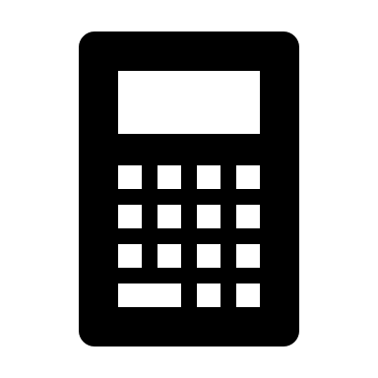

HAVE MORE QUESTIONS?
Email
1:1 Zakat Consults
Zakat Calculator
zakat@nzfcanada.com
Book a Consultation: nzfcanada.com/ask-an-expert
nzfcanada.com/calculate
Stay Connected
@nzfcanada

