Slide 1
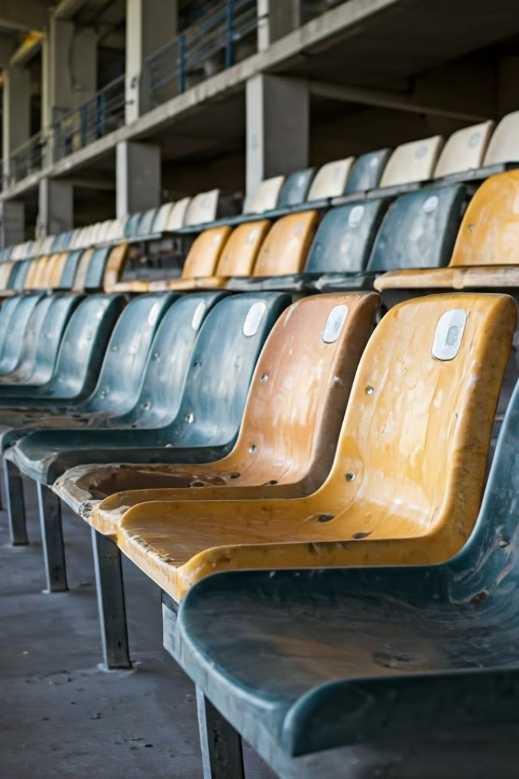
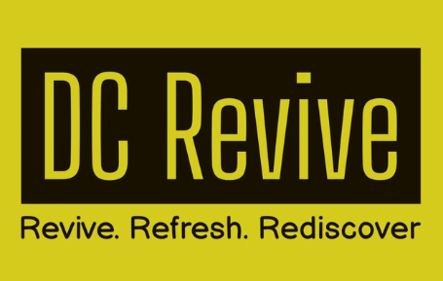
Revive, Refresh, Rediscover
Stadium seat owners, It's time to change the way you revive your venues. Save money and down time with our stadium seat revive system and not replacing them. Keeping the historic seats in place and not removed.
Our patented innovative solutions offer a cost-effective, environmentally friendly alternative to stadium seat replacement.
Let's explore how we can work together and transform your stadium.
Notes:
Manchester United stadium seats

Slide 2
Substantial Cost Savings
Replacement Costs
Restoration Savings
Long-term Benefits
New seating requires a significant investment driving up costs, manufacturing, shipping with logistical challenges, a need for large man power, increased down time and installation.
Our patented restoration process significantly reduces the cost compared to seat replacement. We use the existing infrastructure which reduces materials, labour and operational costs, next to no down time and zero logistics cost.
Revived seats have enhanced durability. This means fewer replacements over time, leading to sustained savings both financially and on the environment. Fans may wish to keep their iconic seat that has witnessed many victories.

Slide 3
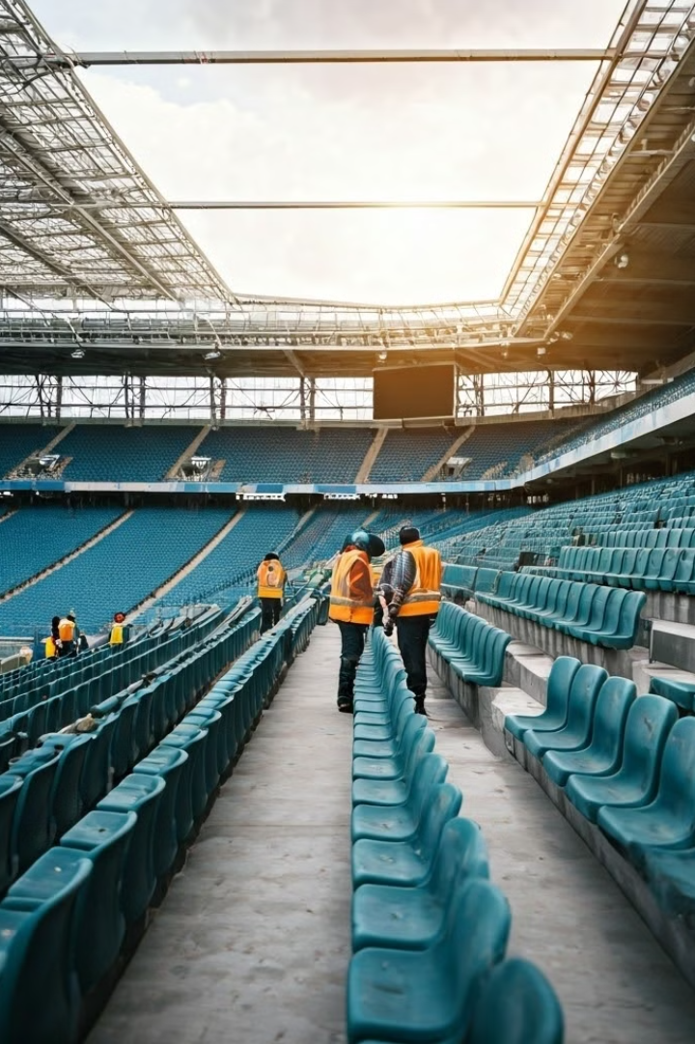
Safety First:
1
The current fire rating status of your seats is a priority to identify areas of concern.
UV Damage Assessment
Reinstating the Class "O" Fire Rating
2
Specialised Coating Application
Class "O" rating fire resistant coating will be restored. This ensures legal compliance.
3
Rigorous Testing
Each seat undergoes thorough inspection to ensure it meets or exceeds current safety standards.
4
Ongoing Protection
The new coating provides long-lasting fire resistance, maintaining the safety and integrity of your seats for years to come.

Slide 4
Environmental Impact: A Greener Choice
1
Reduced Waste
Our revival process eliminates the need to dispose of old plastic seats preventing tonnes of plastic waste.
2
Lower Carbon Footprint
By avoiding new manufacturing, we significantly reduce energy consumption and CO2 emissions, working towards your Net Zero Commitments.
3
Minimal Transportation
On-site restoration eliminates the need for long-distance shipping, and local logistics further reducing environmental impact.

Slide 5
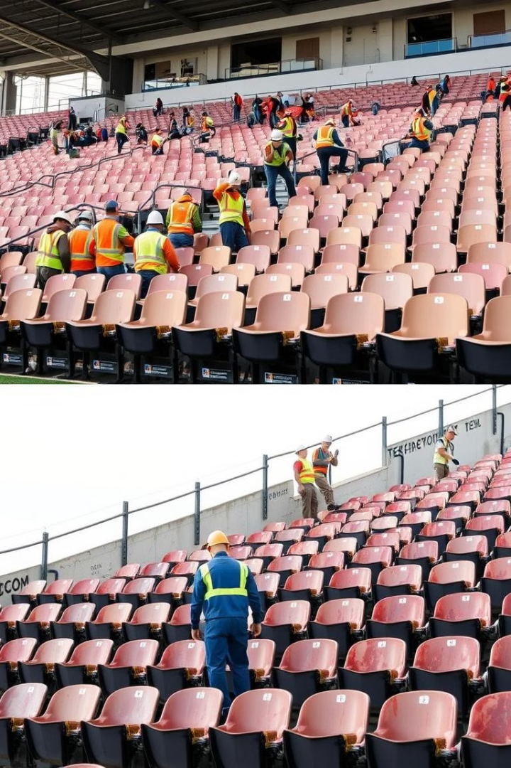
Efficiency and Convenience
Quick Turnaround
Our efficient process allows for rapid restoration, minimising stadium downtime with no need to remove the seats, eliminating damage to existing infostructure fixings.
Minimal Disruption
On-site work means less noise, dust, and interference with your regular operations.
Flexible Scheduling
Flexible working arrangements ensure seamless integration with your activities.
Immediate Results
See the transformation unfold quickly, with sections completed on timely. This includes the installation of new seating should a seat be damaged beyond repair/revival

Slide 6
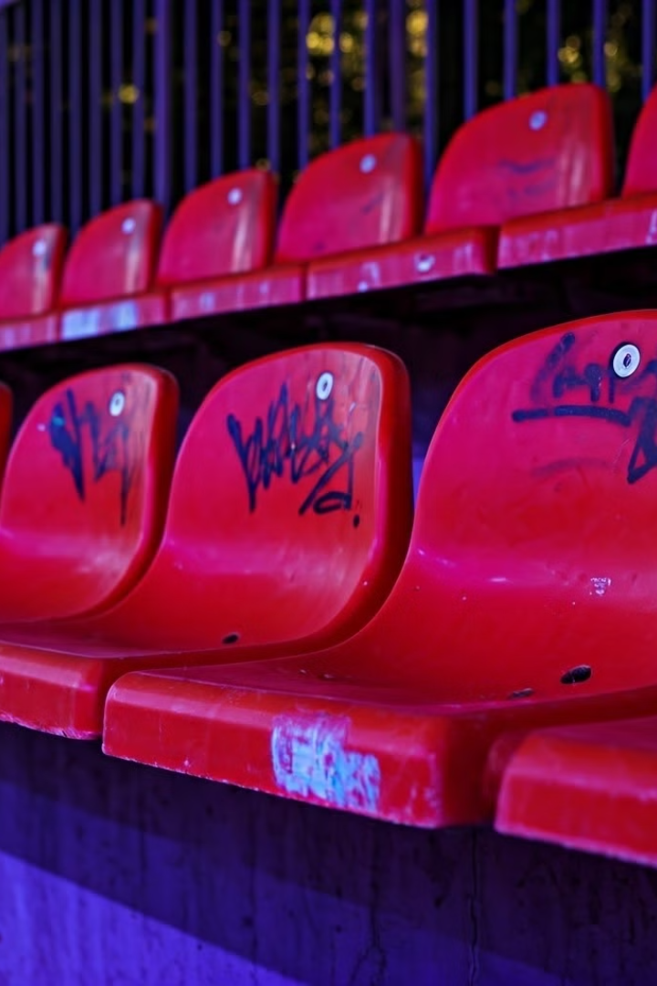
Enhanced Functionality and Aesthetics
UV Protection
Our coating includes advanced UV inhibitors, preventing future fading and degradation.
Graffiti-Proof
A special finish makes coated seats resistant to permanent marker. paint damage and chewing gum resistant.
Easy Maintenance
Smooth surfaces and anti-microbial properties make cleaning quicker and more effective.
Like-New Appearance
Restore the original bright colour that your stadium is famously known for worldwide.
Hygiene
Microbial resistant, reducing cross contamination between spectators.
5 Years Warranty
Exceeds most seat manufactures warranties on UV fading.

Slide 7
Revive vs. Replace: The Cost-Effective and Sustainable Choice
Reviving existing seats is substantially more cost-effective than seat replacement, saving hundreds of thousands in material and labour costs.
Revitalisation dramatically reduces waste, preventing tonnes of plastic from entering landfills and aligning with your sustainability goals.
Even if recycled the energy used in the recycling process is drastic from logistics to the recycle process.
Restored seats maintain their vibrant, like-new appearance with advanced UV protection, ensuring your stadium retains its iconic look.
Our efficient, on-site process minimises disruption and maximises convenience, with a quick turnaround and flexible scheduling.
Reinstating the crucial Class "O" fire rating ensures the continued safety of the supporters
A FREE X10 seat application demonstration.

Slide 8
See The Transformation.
You can see the black seat starts looking ghosted and faded. The seat had previously been cleaned with our bespoke plant based degreasing agent. You can then see us wiping the corner of the seat with a wet cloth in the movie. As you can see that when wiped the residue just dries and the ghosted faded black seat reappears. We then apply our bespoke coating and buff to the same corner which creates a nearly new look finish. While there are also other procedures to the protocol which gives the final finish, this shows the transformation section that as you can see is very impressive. Why not book your FREE X10 demonstration, transformation on your stadium seating?

Slide 9
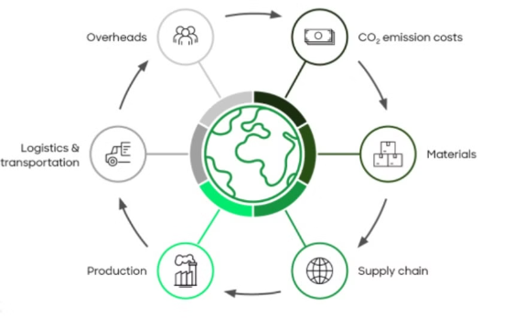
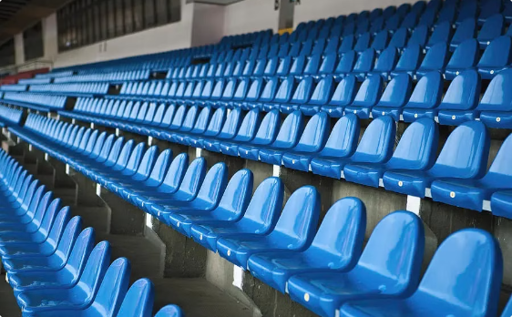
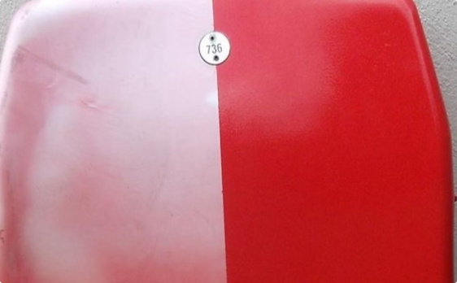
Revive vs. Replace:
The Cost Savings
Environmental Cost
Manufactured Seat Cost
Revived Seat Cost
Revived cost per seat = £19.
Huge impact in Manufacturing a seat.
Seat manufacturing
How can we reduce the cost by this amount?
Almost ZERO impact on Reviving a seat.
Shipping
No Seat manufacturing
Ultimately reducing the CO2 footprint with Revive
Extended labour hours
No Shipping
Local Logistics, Time & Fuel
No Extended labour hours
Land Fill or Recycle costs
No Local Logistics, Time & Fuel
No Land Fill or Recycle costs

Slide 10
DC Revive, transforming stadium seats for fans, owners and the planet🌏
DC Revive, Refresh, Rediscover your stadium seating
118 Battle Road, Hastings, East Sussex, England TN37 7AN
UK Reception -0333 772 9803
Europe Spain - +34601987692
www.dcrevive.com

