Slide 1
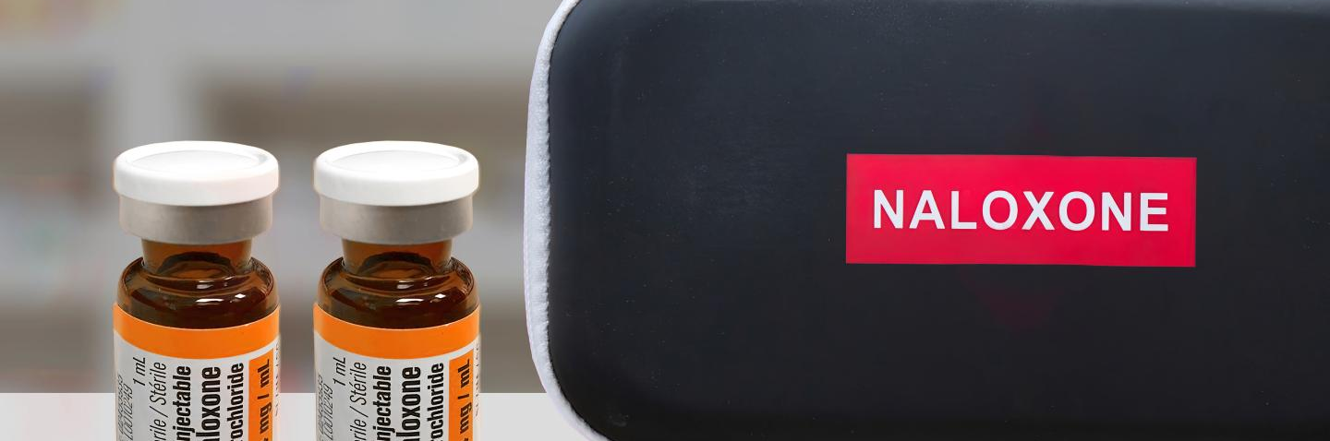
Take Home Naloxone Training
Be someone's second chance at life
Notes:
Start with an overview of what is naloxone and how it works, also that it does not cause any issues if an overdose is not what is occurring –say this multiple times. Reaffirm the low risk of naloxone and that you are unlikely to do harm if you use it on someone even if you are not 100% sure

Slide 2
What is Harm Reduction?
Substance use harm reduction
Needle exchange programs
Take home Naloxone provision
Opioid agonist treatment (OAT)
Outreach, education and prevention services
Harm reduction in day-to-day life
Wearing a seatbelt
Wearing a helmet
Wearing oven mitts
Wearing sunscreen

Slide 3
Less potential
Abstinence
Reduced use, change mode of consumption
Potential harms
Using at a safe consumption site, use while with others, regular medical check ins
Use of sterile supplies, having and being trained in naloxone, semi-regular contact with orgs
More potential
Reuse of supplies, sharing supplies, no contact with orgs, lack of substance use education, & low substance use literacy
# of people

Slide 4
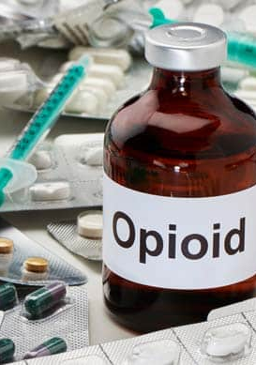
What are Opioids?
Opioids are depressants that slow the body down, especially our breathing. They include fentanyl, carfentanyl, heroin, oxycodone, codeine, morphine, methadone, hydromorphone and others.

Slide 5
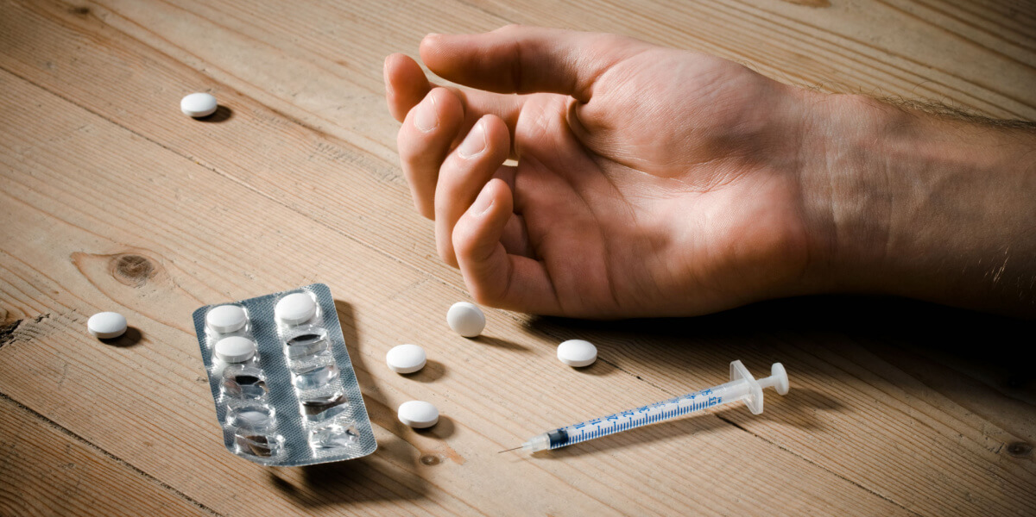
Who is most impacted by overdoses/poisonings?
We often use the term "poisoning" because many people are not purposively using fentanyl or its analogues.
Think of some recent cases with multiple fatalities in Saskatoon, they were people who thought they were using cocaine.
BC Coroners Service =
44% of overdose deaths in BC were employed
55% of those were in the trades and transport
Typical case, men in their 30s and 40s using alone.

Slide 6
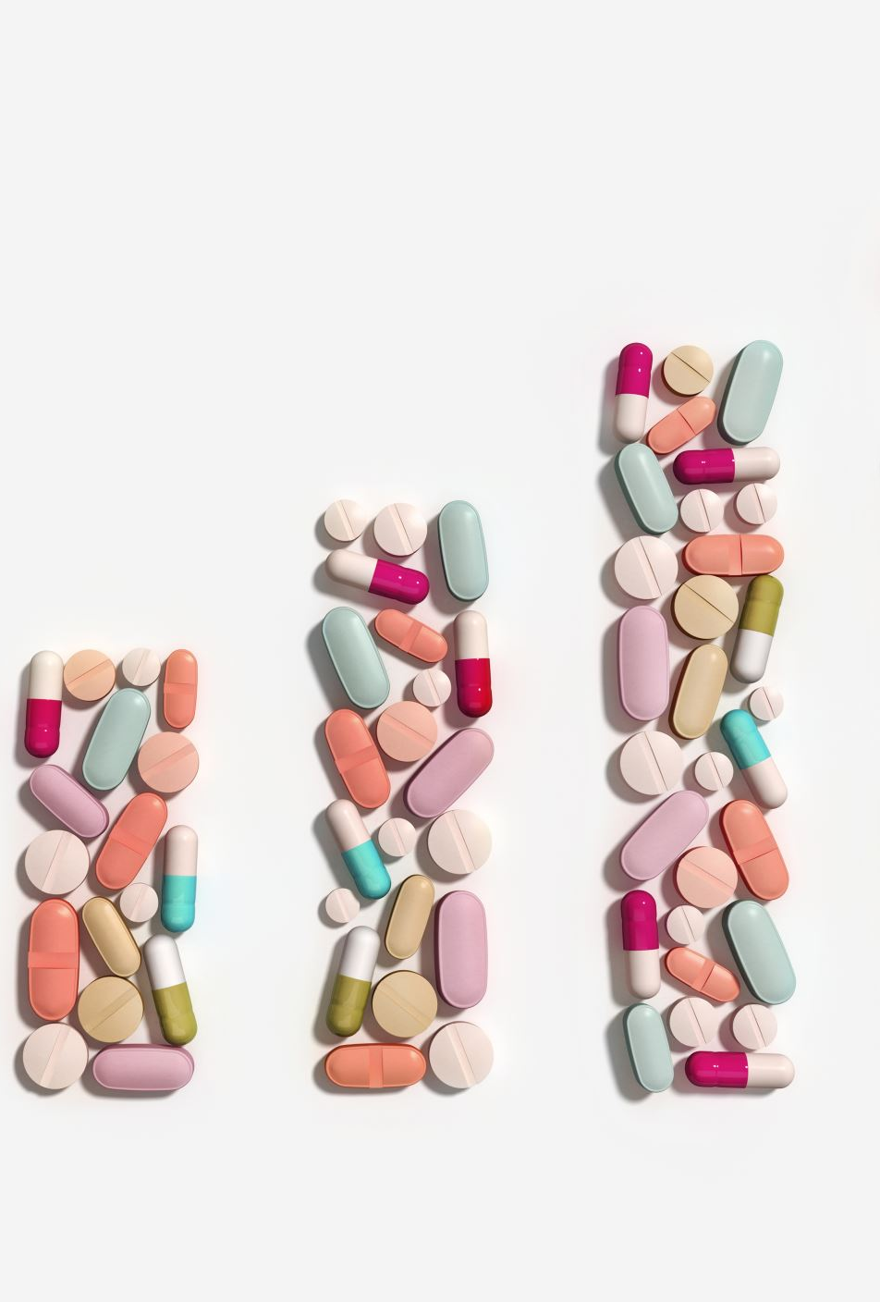
WHY??
Back to the pyramid = lack of connection to community services + lack of drug awareness or tolerance
Use of stimulants is VERY common in careers that require long work hours, don't support healthy sleep schedules, and are physically demanding
Use of stimulants also often results in the use of some form of ‘downer’ or sedative to be able to sleep or rest
Opioids and other pain medications are often used by people who work in careers where they need to "push through" pain

Slide 7
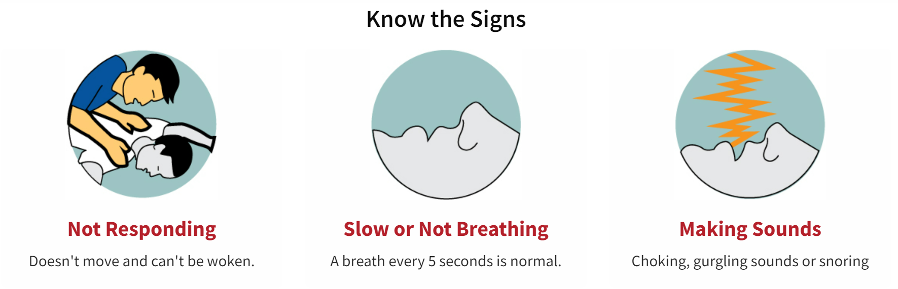

Signs of a typical opioid overdose

Slide 8
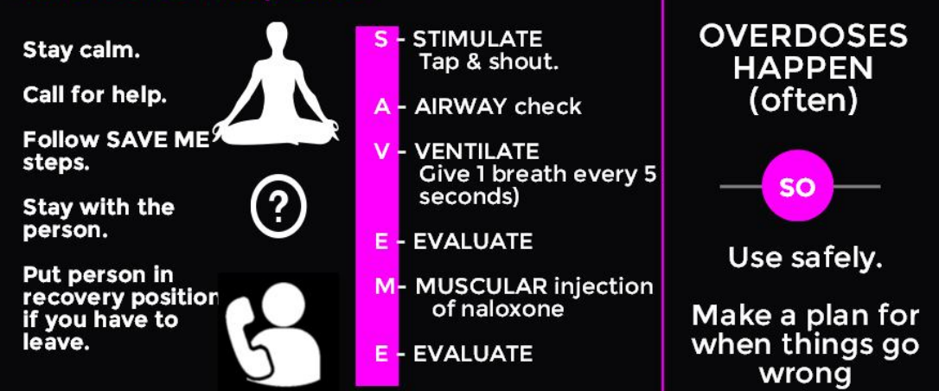
How to respond to an opioid overdose

Slide 9
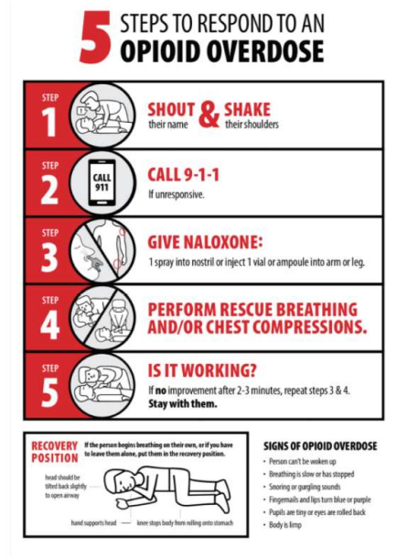
5 STEPS TO RESPOND TO OPIOD OVERDOSE SAVE ME STEPS

Slide 10
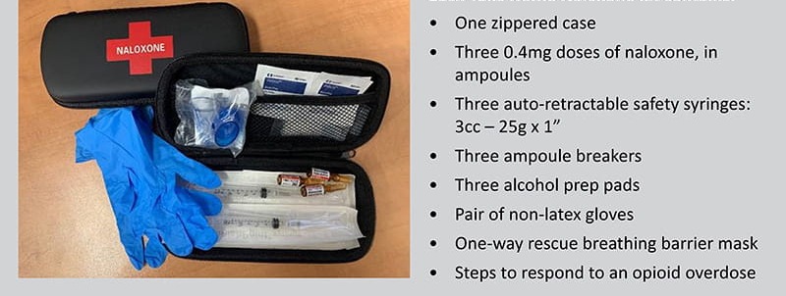
What is included in a Naloxone kit?

Slide 11
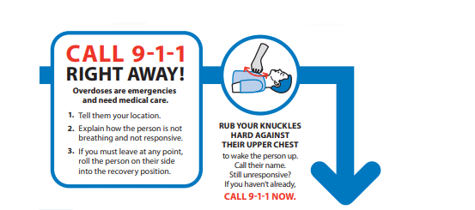
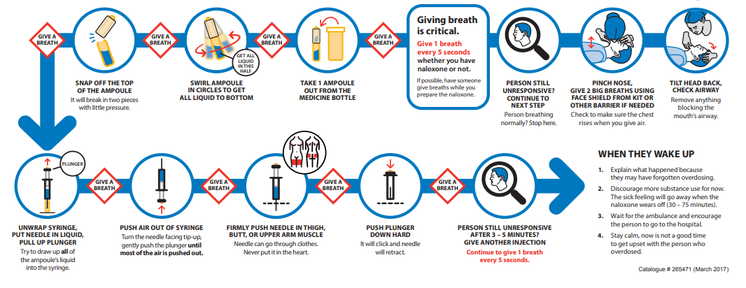
Naloxone Administration

Slide 12
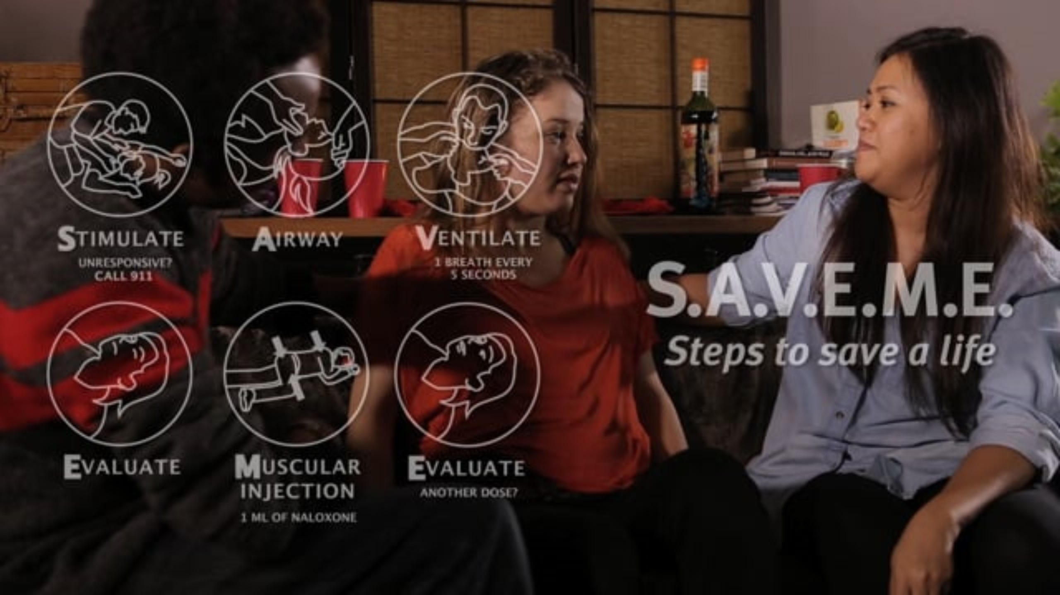

Videos: Naloxone administration
Watch this video at
https://vimeo.com/164669763
Watch this video at
https://vimeo.com/185012011

Slide 13


Evaluation & Aftercare
Stay with the person and explain what happened.
Explain that the sick feeling will subside when the Naloxone wears off (if that person is dependent on opioids).
Encourage the person not to take any more substances, more use increases the risk for overdose to return when the effects of Naloxone wear off.
Opioids will likely have no effect while Naloxone is active.

Slide 14
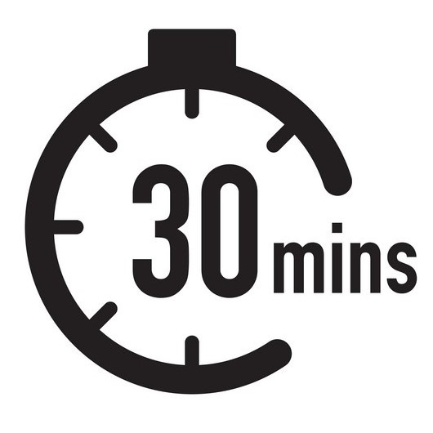

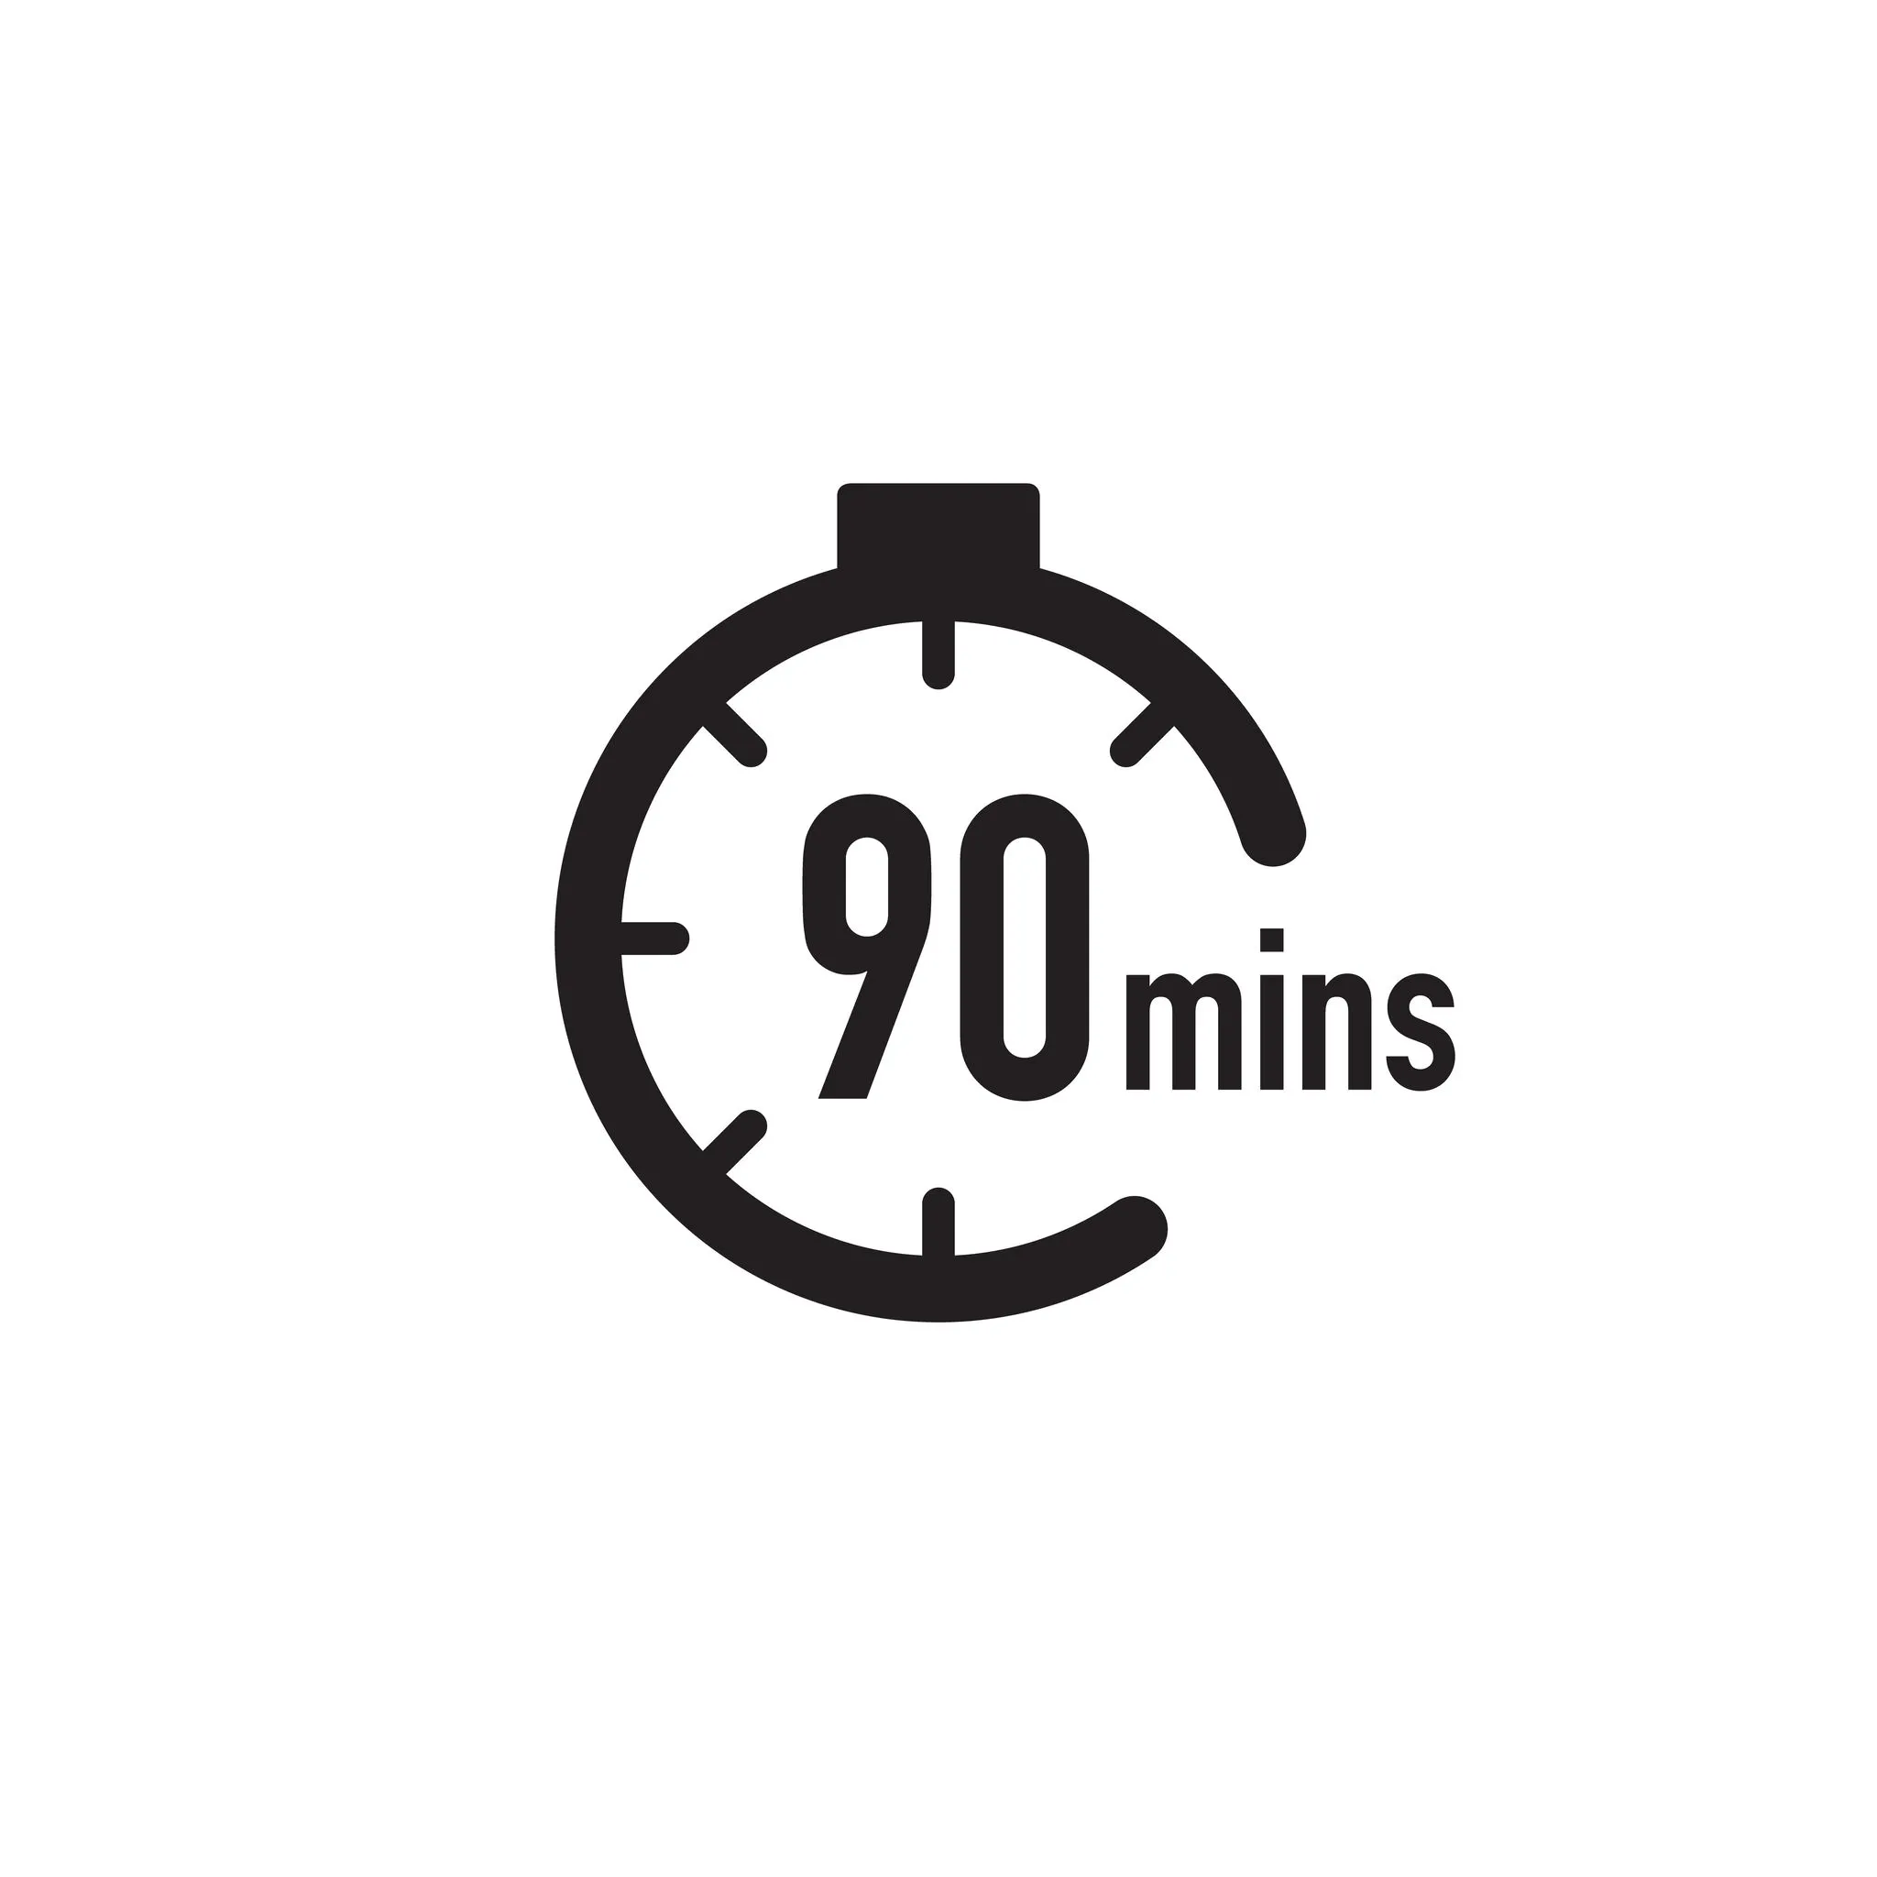
The effects of Naloxone only last 30-90 minutes, after this time, overdose CAN return.
Monitor closely for returning overdose symptoms.
Evaluation & Aftercare Cont..

Slide 15
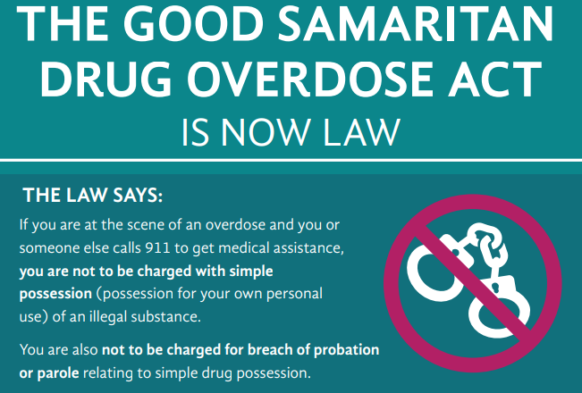


Slide 16


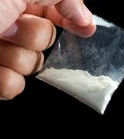

What about stimulants?
Stimulants or “uppers” speed the body up, like amphetamines, crystal meth, cocaine, MDMA (Ecstasy), Ritalin/Adderall and caffeine.

Slide 17
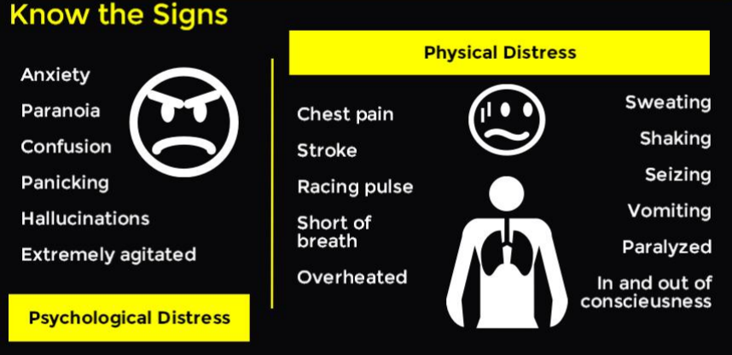
Signs of a Typical Stimulant Overdose

Slide 18
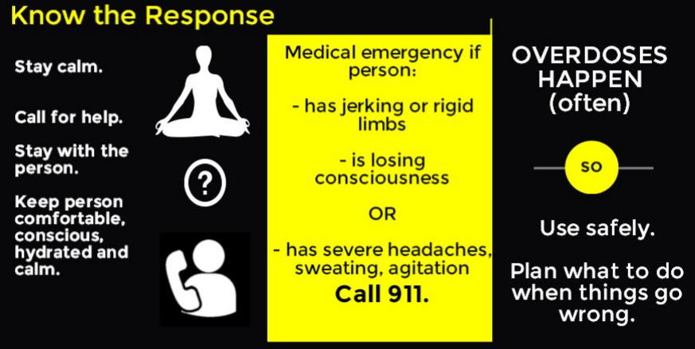
How to Respond to a Stimulant Overdose

Slide 19
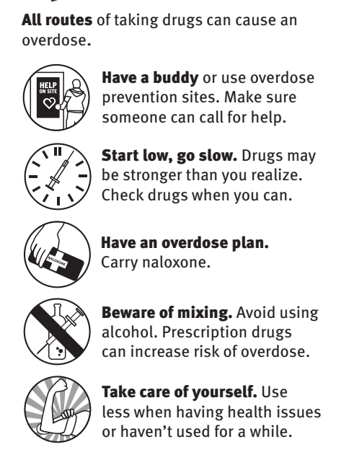
Prevention Strategies

Slide 20
Watch the expiry date on the ampoules/vials
When your kit has expired, been used, or becomes lost or stolen, contact a local Take Home Naloxone site to obtain a new one!
Naloxone should be stored at room temperature and away from light
Keep Naloxone in a regular place and let others know where it is in case of emergency
Storing and Refilling Naloxone

Slide 21
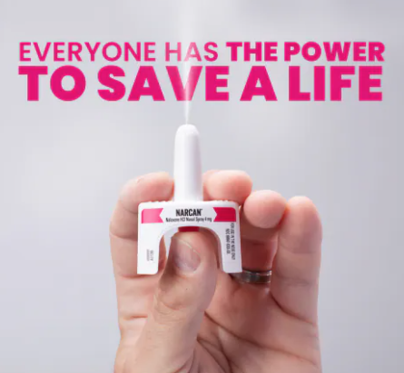
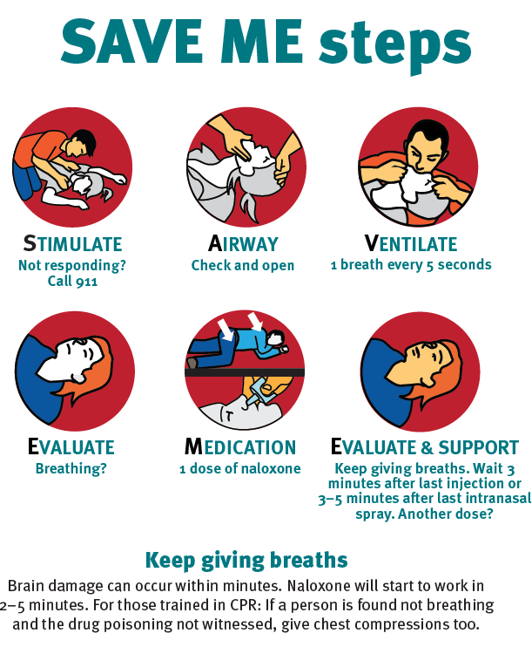
SAVE ME
STIMULATE
AIRWAY
VENTILATE
EVALUATE
MUSCULAR INJECTION
EVALUATE

Slide 22

Questions? More Training? Resources?
Maryellen Gibson
Maryellen.Gibson@usask.ca
Barb Fornssler
Barb.Fornssler@usask.ca
Kayla Irvine
Kai022@usask.ca

Slide 23


Slide 24










Role
As
A
Trainer

Slide 25



Slide 26
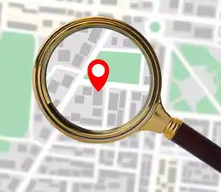
Where to locate Naloxone Kits for training sessions?
Health Authority
Payton.Klitch@saskhealthauthority.ca

Slide 27

What to bring to a Naloxone Training event?
Naloxone practice kits
Demo kit
Squeeze balls
Printed Certificates
Printed Ppowerpoint slides
Snacks
Refreshments
Pre evaluation sheets
Post evaluation sheets
Pens/pencils
Laptop with slideshow
Breakers
Saline vials
Syringes
Pamphlets
Sharps container
Testing strips
*20% extra supplies*
Naloxone kits (Take home)

Slide 28

How to enter data into health authority database
Data collection ensures accountability and will inform program evaluation and potential expansion. No unique identifiers (names, birthdates, health card numbers, etc.) will be used for this process.
Program data will be collected through an online software called REDCap.

Slide 29
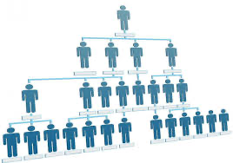
Structure of a training session
Welcome & Introductions (5-10 min)
Trainer introduction and purpose of session
Ice breaker
Pre evaluation
Context & background (5-10min)
The opioid crisis in saskatoon
The role of naloxone in preventing overdose deaths
Stigma and harm reduction principles
Why training others is so important
PowerPoint (15-20 min)
Go through presentation
Practice Teaching and Role Play (15-20 min)
Wrap up & Evaluation (5-10 min)
Review key takeaways
Final Q&A
Distribute certificates
Post-training evaluation and feedback

Slide 30

Certificates:
Certificate template can be found on USB in everyone's tote bag
Fill them out before training session and print them off

Slide 31
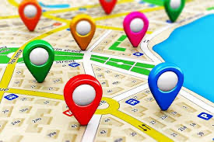
Suggested locations for training sessions

Slide 32

Frequently asked questions:
Q: Is naloxone safe?
A: Yes. It only works if opioids are in the body. If given to someone not experiencing an opioid overdose, it will not cause harm.
Q: Can naloxone be addictive?
A: No. Naloxone is not addictive and has no potential for misuse.
Q: How long does naloxone take to work?
A: It usually works within 2–5 minutes after administration.
Q: How long does it last?
A: Naloxone lasts about 30–90 minutes, but opioids can last longer in the body. Always call 911, as more doses may be needed.
Q: What if one does doesn’t work?
A: Give a second dose after 2–3 minutes if there is no improvement, while continuing rescue breathing or chest compressions if trained.
Q: Can naloxone fail to work?
A: Yes, if the overdose involves very strong opioids (like fentanyl or carfentanil) or a mix of drugs. That’s why calling 911 is critical.
Q: Can I get in trouble for giving naloxone?
A: No. Good Samaritan laws in Canada protect people from simple drug possession charges when calling for help during an overdose.
Q: Are there side effects?
A: The main side effect is withdrawal symptoms (nausea, sweating, irritability) in the person revived. These are uncomfortable but not life-threatening.
Q: is it safe for children or pregnant people?
A: Yes. Naloxone is safe for all ages and in pregnancy.

Slide 33
Trainer Specific Questions:
Q: What if someone in my training asks a question I don’t know the answer to? A: Be honest — say you’ll find out and get back to them. Trainers don’t need to know everything, just how to connect people to resources.
Q: How do I handle people who are resistant or judgmental about substance use? A: Bring it back to compassion and saving lives. Remind them overdose can affect anyone, and naloxone is about giving people another chance.
Q: Do I need to track who I train? A: You need to track kits being used for training but not who you are training

Slide 34
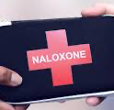
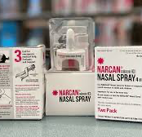
https://redcap.rqhealth.ca/apps/surveys/index.php?s=HNA339NPN8
How to become a distribution center?

Slide 35

Setting up a training session

Slide 36

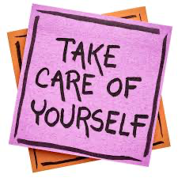

Notes:
An overdose event is traumatic for the person who experiences the event as well as for the person who administers naloxone. Using a naloxone kit can be a stressful experience for many individuals and talking to someone about it right away or days after the event may be helpful. It is important to remember that you may experience changes in your thoughts and feelings as a result of a traumatic event. Encourage people to reach out for help should they find themselves struggling with negative emotions after administering naloxone.
Remember to reach out for help when you experience challenges with coping. HealthLine 811, Kids Help Phone, and Mobile Crisis phone lines along with the federally funded Hope for Wellness chat line are available throughout the province. In the case of a mental health emergency, do not hesitate to call 911. • Suggest that participants complete a self-care action plan found in the appendix. A self-care action plan should be completed before experiencing a potentially traumatic event. It is best to discuss the plan with your family or close friends so they can help you recognize your triggers and provide support.

