Slide 1
Objectives = WHAT
Measures = DONE
Values/Meaning = WHY
WHO is the next critical step!
If you are anxious about HOW you do not have the right person or the first step in a plan!

Slide 2
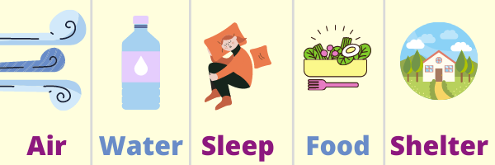
The Five Basic Human Needs to Survive…
And, once met humans want…

Slide 3
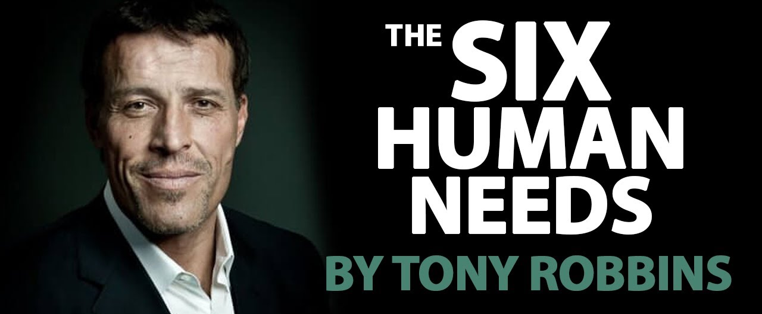
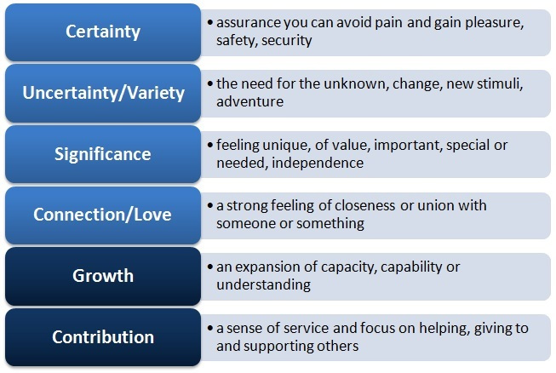
https://www.ted.com/talks/tony_robbins_why_we_do_what_we_do

Slide 4

Needs/Wants
Motive
Ability
Character
Track Record

Slide 5
Status
Contract
250,000 years old
250 years old
Clan
Honor/Shame
Hospitability
Revenge
Feud
Relationships
Restore/Atone
Emotion/Perception
“How do I feel?”
STORY
Individual
Achievement
McDonald’s
Police
Litigation
Transactions
Punish
Logic/Reason
“What do I think?”
PP, Sound Bites, Speeches
by Lt. Col. Scott Mann
Retired US Army

Slide 6
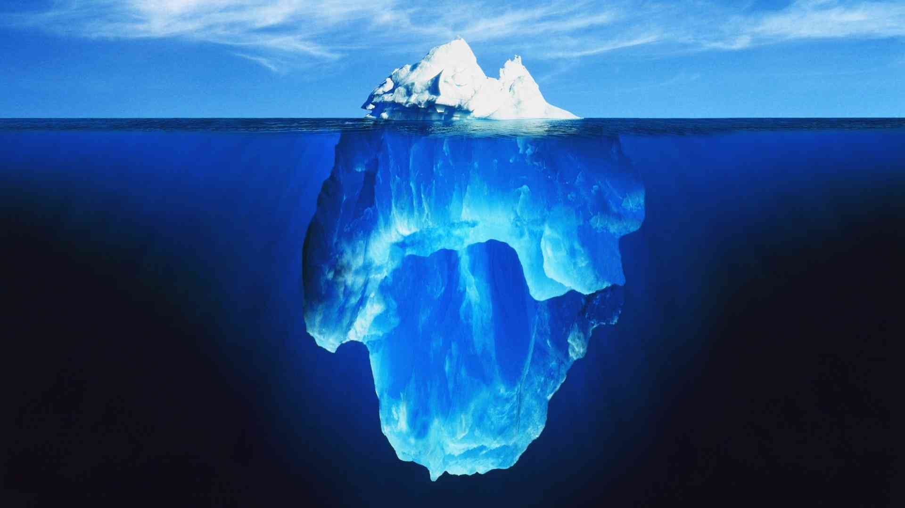
PP
Sound Bites
Speeches
STORY
10%
Achievement
Honor/
Shame
Logic
Emotion
Transaction
Relationship
What do
you think?
How do
you feel?
Individual
Clan
90%
We have evolved more in the last 250 years than we have in the last 250,000!!!

