Slide 1
Your resume
You send your resume and get no response
Today you will learn what happens

Slide 2
When you send a resume
Who needs it
Who sees it first
What they do with it
What they see
What you want them to see

Slide 3
Who needs it
Hiring Manager

Slide 4
Who sees it first
Professional shopper

Slide 5
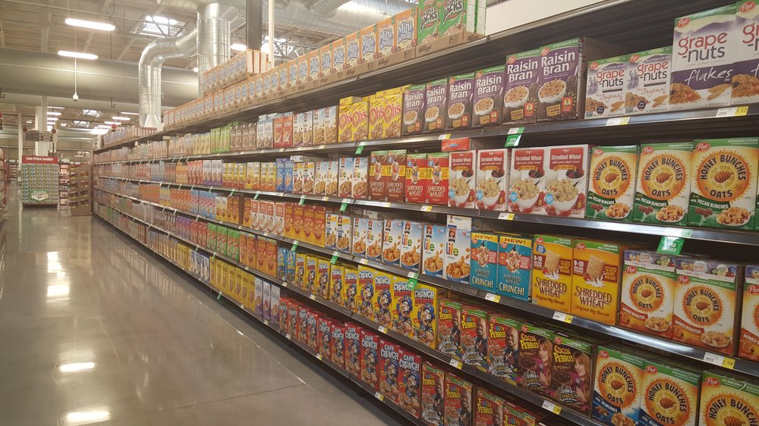
What they do with it
They need to turn this:

Slide 6
What they do with it
Into this:

Slide 7
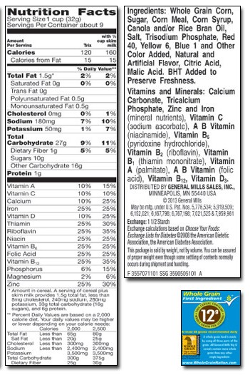
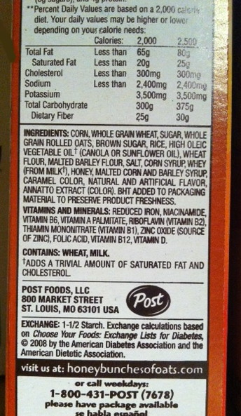
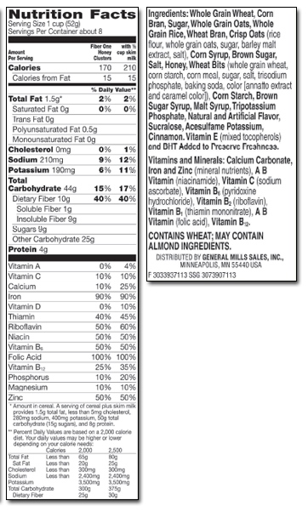
What they see

Slide 8
What you want them to see

Slide 9
Your goal
Find out what the hiring manager wants
Make sure human resources finds you

Slide 10
Everything needed

Slide 11
How it can be found
Meats
Dairy
Produce
Cash Registers

