Slide 1
Biorefinery Cellulose Nanomaterials

Slide 2

Worlds collide
By Credit: NASA; ESA; Z. Levay and R. van der Marel, STScI; T. Hallas, and A. Mellinger - http://www.nasa.gov/mission_pages/hubble/science/milky-way-collide.html, Public Domain, https://commons.wikimedia.org/w/index.php?curid=19992539

Slide 3
Worlds collide
Biorefineries and pulp mills
MCC and CNC/CNF
By Credit: NASA; ESA; Z. Levay and R. van der Marel, STScI; T. Hallas, and A. Mellinger - http://www.nasa.gov/mission_pages/hubble/science/milky-way-collide.html, Public Domain, https://commons.wikimedia.org/w/index.php?curid=19992539

Slide 4
Biorefinery cellulose nanomaterials
Low cost feedstock vs pulp
Feedstock contains lignin
Co-products can include lignin, C5 and C6 sugars, ethanol
Cellulose nanomaterials can include lignin and can be blends or hybrids of MCC/CNC/CNF

Slide 5
What is a cellulose nanomaterial?
Material composed predominantly of cellulose, with any external dimension in the nanoscale, or a material having internal structure or surface structure in the nanoscale, with the internal structure or surface structure composed predominantly of cellulose.
Source: https://www.iso.org/obp/ui/en/#iso:std:iso:ts:20477:ed-2:v1:en (2023)
BioBased
Markets

Slide 6
Types of “nano” “cellulose”
It used to be simple:
Cellulose nanocrystals (CNC): Sulfuric acid hydrolysis “dissolves” the amorphous regions leaving CNC.
Cellulose nanofibrils (CNF): entangled fibrils with high aspect ratio formed by mechanical process, sometimes with enzymatic or chemical pretreatment.
Microfibrillated cellulose (MFC): like CNF, but micro-scale rather than nano-scale
BioBased
Markets

Slide 7
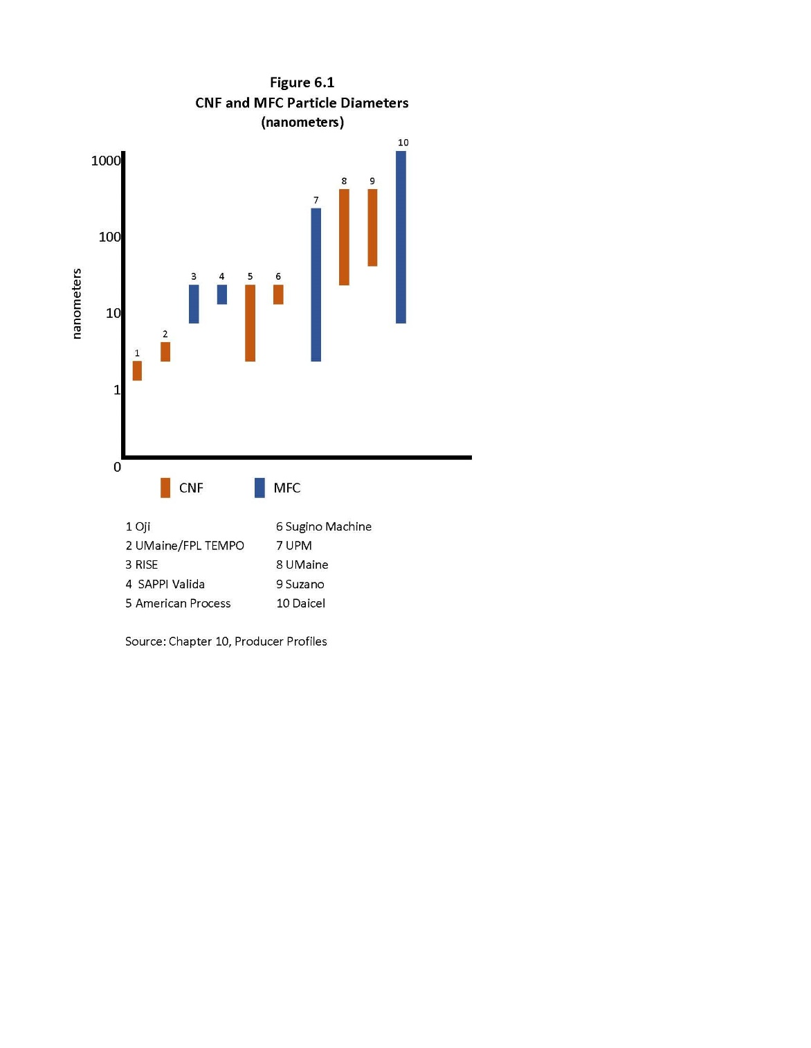
CNF or MFC??
(particle diameter in nanometers)
BioBased
Markets
Source: J. Miller, Nanocellulose Producers, Products, and Applications: A Guide for End Users, TAPPI, 2017
Notes:
Characteristics, not “specifications”

Slide 8
Types of “nano” “cellulose”
It used to be simple:
Cellulose nanocrystals (CNC): Sulfuric acid hydrolysis “dissolves” the amorphous regions leaving CNC.
Cellulose nanofibrils (CNF): entangled fibrils with high aspect ratio formed by mechanical process, sometimes with enzymatic or chemical pretreatment.
Microfibrillated cellulose (MFC): like CNF, but micro-scale rather than nano-scale
But now, biorefineries are producing a variety of materials such as hybrid CNC/CNF, lignin containing CNC or CNF, and MCC which is agglomerated CNC or CNF.
BioBased
Markets

Slide 9
What is a cellulose nanofibril?
Cellulose nanofiber composed of at least one elementary fibril that can contain branches, a significant fraction of which are in the nanoscale.
The dimensions are typically 3 nm to 100 nm in cross-section and typically up to 100 μm in length.
CNF can form entanglements between particles or network-like structure when the distance between CNF fibres is sufficiently close.
Cellulose nanofibrils from plant sources, produced by mechanical processes, can be accompanied by hemicellulose, and in some cases lignin.
Source: https://www.iso.org/obp/ui/en/#iso:std:iso:ts:20477:ed-2:v1:en (2023)
BioBased
Markets

Slide 10
What is a cellulose nanocrystal?
Nanocrystal composed predominantly of cellulose containing predominantly crystalline and paracrystalline regions, with at least one elementary fibril, not exhibiting longitudinal splits.
The aspect ratio of cellulose nanocrystals is usually smaller than 50 but usually greater than 5, where aspect ratio refers to the ratio of the longest to the shortest dimensions.
Cellulose nanocrystals do not exhibit interparticle entanglement or network-like structures.
Source: https://www.iso.org/obp/ui/en/#iso:std:iso:ts:20477:ed-2:v1:en (2023)
BioBased
Markets

Slide 11
Biorefineries
AVAP Process – GranBio
Sweetwoods Project – Fibenol
Borregaard
CELLiCON
CelluComp
Genera
Melodea
Nordic Bioproducts Group
Re-Fresh Global

Slide 12
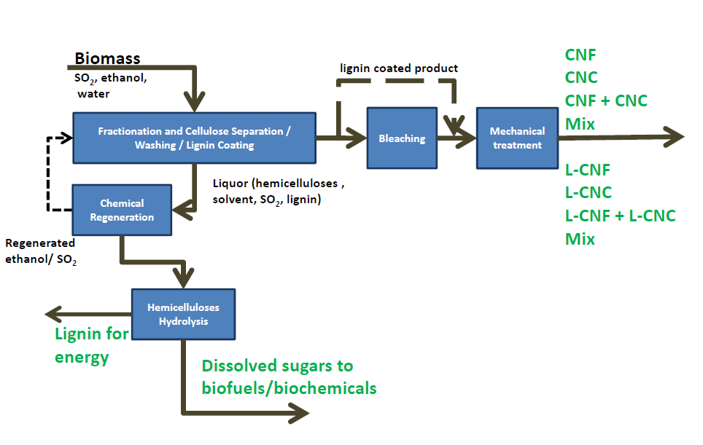
AVAP Process
BioBased
Markets
Source: J. Miller, Nanocellulose Producers, Products, and Applications: A Guide for End Users, TAPPI, 2017 (originally K. Nelson, presentation at TAPPI Nano, Vancouver, 2014)

Slide 13
Sunburst Reactive Extrusion
BioBased
Markets
Source: J. Miller, Lignin 2021: a Pivotal Year; Sweetwater Energy

Slide 14
Sweetwoods Project
BioBased
Markets
Source: J. Miller, Lignin 2021: a Pivotal Year

Slide 15
Fibenol
MCC from hardwood
Sunburst reactive extrusion - fractionation
MetGen enzymatic hydrolysis to separate the fractions
Lignin, cellulosic wood sugars
BioBased
Markets
Source: J. Miller, Lignin 2021: a Pivotal Year

Slide 16

Borregaard
Exilva® microfibrillated cellulose from Norway spruce
Entangled, fibrillated cellulose fibres with the ability to interact both physically and chemically through hydrogen bonding
Fibrils retain crystallinity features
Barrier coatings, rheology modifiers, etc.
BioBased
Markets
Sourcehttps://www.borregaard.com/product-areas/cellulose-fibrils/

Slide 17
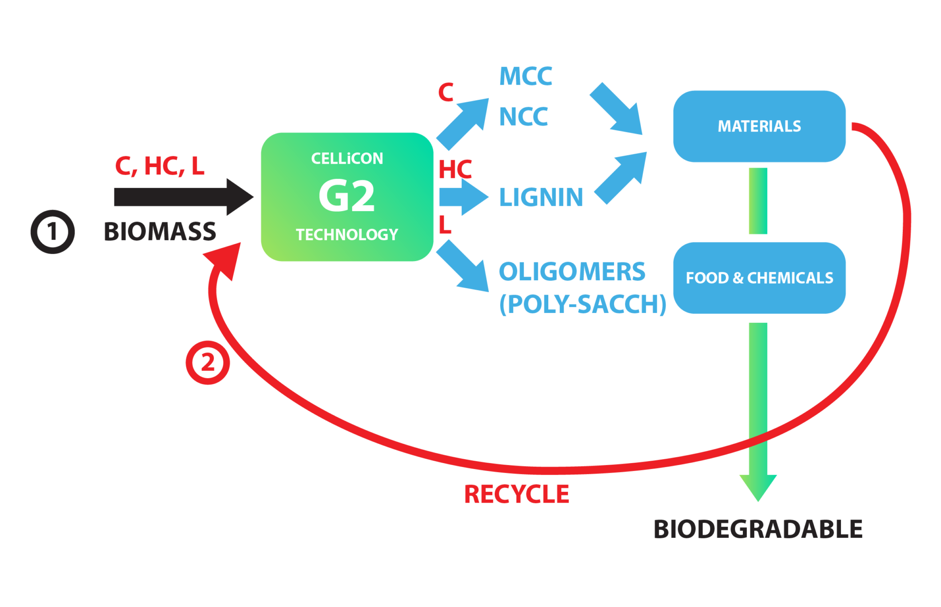
CELLiCON
G2 technology fractionates biomass and textile waste into lignin, MCC and NCC
Proprietary technology based on simple molten salt hydrates
Low cost, low energy process uses no enzymes
BioBased
Markets

Slide 18
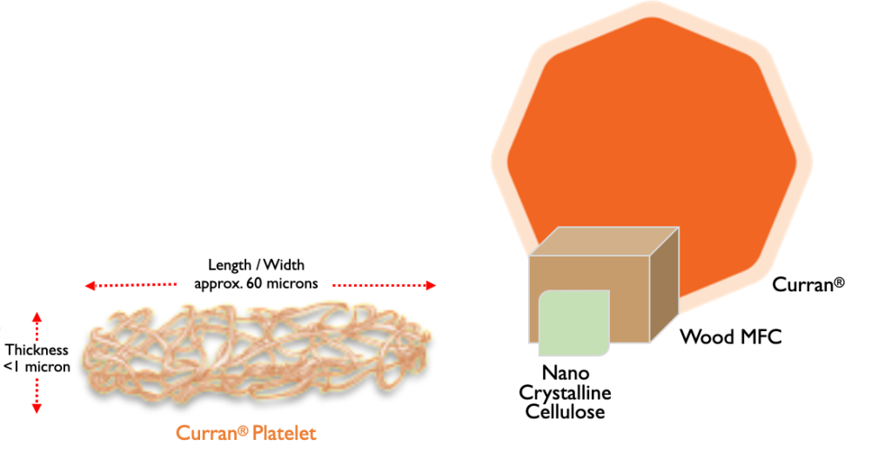
CelluComp
Curran® Microfibrillated Cellulose from sugar beet pulp
Relatively flat, microscopic fibre bundles which are actually portions of cell walls
Paste or granules
Barrier coatings
BioBased
Markets
Source: https://www.cellucomp.com/

Slide 19
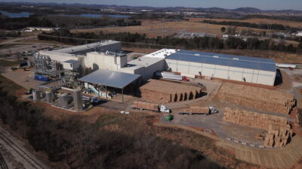
Genera
Vonore TN Fiber Products Mill
Vonore TN Biomass Innovation Park
Ag-based compostable molded fiber products with MFC
Market pulp
Lignin co-product
BioBased
Markets

Slide 20
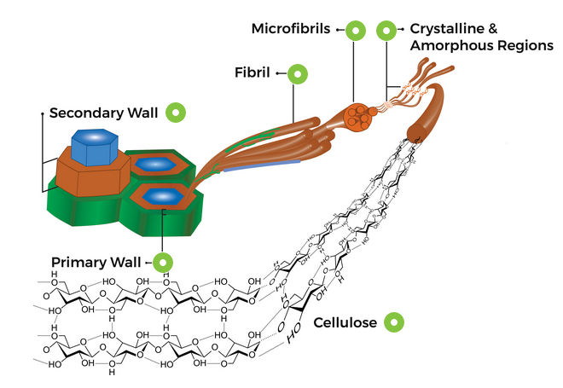
Melodea
CNC from wood pulp and paper production side streams
MelOx™, a plant-sourced barrier coating that protects packaged products from oxygen transmission
VBcoat™ & Melodea VBseal™ which protects packaged goods from water vapor and oil & grease transmission.
BioBased
Markets
Source: https://melodea.eu/

Slide 21
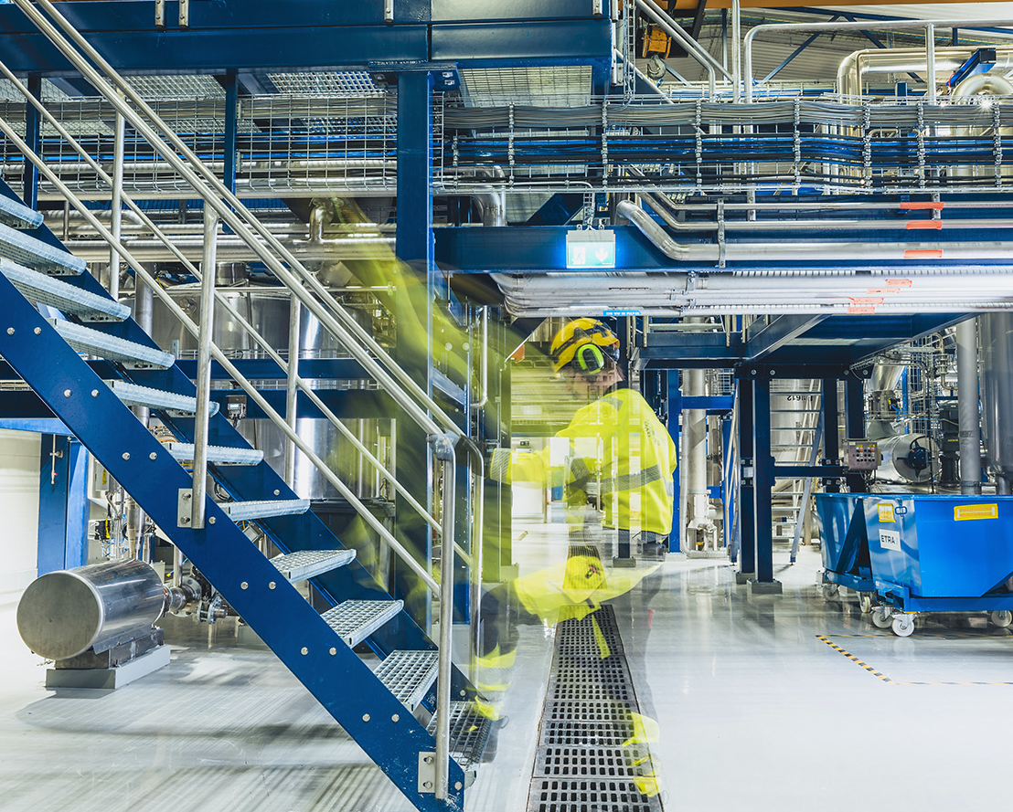
Nordic Bioproducts Group (NBG)
Microcrystalline cellulose (MCC) from kraft pulp with AaltoCellTM
  Novel hydrolysis process
  10,000 t/a
  Pharma, supplements, food ingredients, cosmetics and biocomposites
Pilot scale production of carboxylated cellulose nanomaterials from MCC
Partner with CMPC Ventures to produce textile fibers with Norratex process
BioBased
Markets

Slide 22
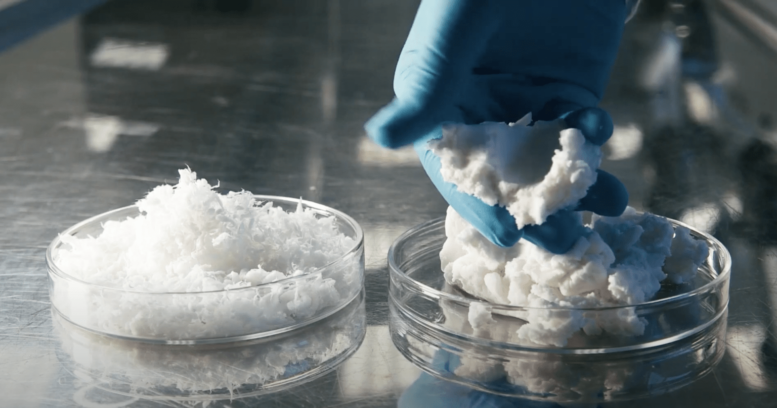
Re-Fresh Global
Biotech company with a patented process that converts textile waste into cellulose nanomaterials called Re-Nano™
Patented microfibrillated cellulose that enhances the strength, stability, and flexibility of numerous natural products
BioBased
Markets

Slide 23
Conclusions
Different economics
  Low cost feedstock vs pulp
  Different outputs: Iignin, C5 and C6 sugars, biochemicals, ethanol
Different products: MCC - definitions are evolving
Cellulose nanomaterials can include lignin and can be blends or hybrids of MCC/CNC/CNF
Different characteristics: particle size, crystallinity, surface chemistry, charge, purity, thermal stability, rheological behavior, optical
Notes:
behaviour

Slide 24
References
Miller J. The Directory of Cellulose Nanomaterials 2024. Biobased Markets, Market-Intell LLC, 2024. https://biobasedmarkets.com/directory
Delepierre, G.; Vanderfleet, O.M.; Niinivaara, E.; Zakani, B.; Cranston, E.D.* Benchmarking Cellulose Nanocrystals Part II: New Industrially Produced Materials. Langmuir 2021, 27 (28), 8393-8409. ACS Editor’s Choice article and journal cover. https://pubs.acs.org/doi/10.1021/acs.langmuir.1c00550
Miller, J. Nanocellulose Producers, Products, and Applications: A Guide for End Users. TAPPI, 2017
Reid, M.; Villalobos, M.; Cranston, E.D.* Benchmarking Cellulose Nanocrystals: From Laboratory Scale to Applications. Langmuir (Feature Article) 2016, 33 (7), 1583-1598. Invited Feature Article. https://pubmed.ncbi.nlm.nih.gov/27959566/

Slide 25
Thank you
Jack Miller
Biobased Markets
jackmiller@biobasedmarkets.com
BioBased
Markets

