Slide 1


Nanocellulose:
Packaging Applications and Commercial Development
PRESENTED BY:
Jack Miller
Principal Consultant
Biobased Markets
BioBased
Markets

Slide 2
Agenda
Opportunities in packaging
Challenges to commercial development
State of commercial development
Forecast
BioBased
Markets

Slide 3
Spoiler Alert:
Today, 75% of all nanocellulose is produced by mills and used in their own paper and paperboard production.
BioBased
Markets

Slide 4

Opportunities for nanocellulose in packaging…
Obviously, strength…

Slide 5

Opportunities for nanocellulose in packaging…
Obviously, strength and barrier

Slide 6
Packaging Opportunities
But there’s much more
BioBased
Markets

Slide 7
Packaging Opportunities
lightweighting to reduce environmental impact
BioBased
Markets

Slide 8
Packaging Opportunities
lightweighting to reduce environmental impact
lightweighting to reduce material cost
BioBased
Markets

Slide 9
Packaging Opportunities
lightweighting to reduce environmental impact
lightweighting to reduce material cost
lightweighting to reduce transport cost
BioBased
Markets

Slide 10
Packaging Opportunities
lightweighting to reduce environmental impact
lightweighting to reduce material cost
lightweighting to reduce transport cost
But it’s not just about light weighting
BioBased
Markets

Slide 11
Packaging Opportunities
wet-end web strength permits greater productivity lower cost fiber: recycled vs. virgin; hardwood vs softwood more low-cost filler; less fiber more filler means more opacity and better printability coatings to eliminate harmful materials such as fluorocarbons replace non-biobased plastics with biobased improved barrier to replace plastic, glass, or metal
eliminate non-recyclable films and foils
biodegradable materials to replace non-biodegradable materials
BioBased
Markets

Slide 12
Applications with paper and paperboard
Surface applications
Holdout/porosity
Barrier
Smoothness
Opacity
Printability
Reduce cost
Base sheet additives
Strength: tear, tensile, Scott bond
Wet web strength: runnability
Porosity
Opacity
Reduce fiber cost
BioBased
Markets

Slide 13
An example…MFC in white top liner
BioBased
Markets
Source: Svending, P. Developments in Use of MFC in Packaging Specialties, Specialties Paper Europe 2018, Cologne, April 24, 2018. https://fiberlean.com/developments-in-use-of-mfc-in-packaging-specialties/

Slide 14
Technical Challenges
Drying and dispersion
Compatibilization
Cost
Consistent quality from batch to batch
Safety and regulatory issues
BioBased
Markets

Slide 15
Commercial Challenges
Proof of concept
Need solid value proposition through the supply chain
Funding challenges: the Valley of Death
Applications development
Who develops the applications? Who does the R&D? Who owns the IP?
Which material is best for a given application?
What loading is optimal?
It is not a “drop in”: implications for customer process
End user learning curve
Market development
Scale up in production
Scale up of applications
Consistent quality from batch to batch
Competitive materials
Low oil prices
Lack of multiple sources of supply
Safety and regulatory issues
BioBased
Markets

Slide 16
Classic Challenges
Drying and dispersion
Compatibilization
Cost
Value proposition
Regulatory
BioBased
Markets

Slide 17
Mills producing their own CNF or MFC
Drying and dispersion: moot
Compatibilization
Cost
Value proposition
Regulatory
BioBased
Markets

Slide 18
Mills producing their own CNF or MFC
Drying and dispersion: moot
Compatibilization: not an issue
Cost
Value proposition
Regulatory
BioBased
Markets

Slide 19
Mills producing their own CNF or MFC
Drying and dispersion: moot
Compatibilization: not an issue
Cost: minimized
Value proposition
Regulatory
BioBased
Markets

Slide 20
Mills producing their own CNF or MFC
Drying and dispersion: moot
Compatibilization: not an issue
Cost: minimized
Value proposition: internal
Regulatory
BioBased
Markets

Slide 21
Mills producing their own CNF or MFC
Drying and dispersion: moot
Compatibilization: not an issue
Cost: minimized
Value proposition: internal
Regulatory: may not be an issue
BioBased
Markets

Slide 22
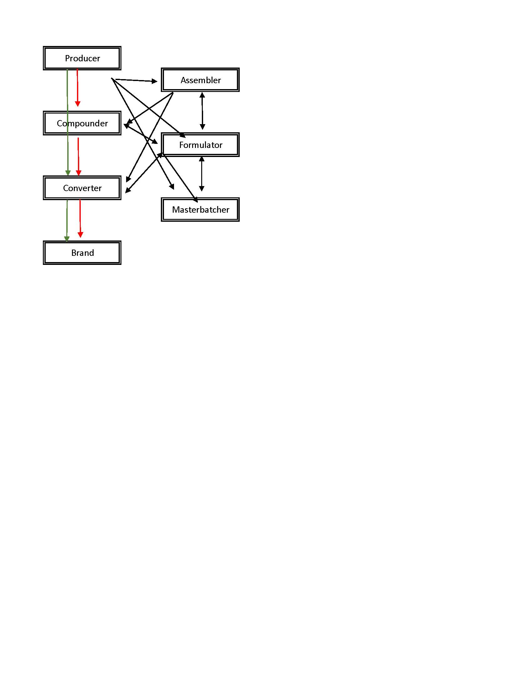
Nanocellulose Supply Chain
BioBased
Markets
Source: J. Miller Nanocellulose: Packaging Applications and Markets, RISI, Jan, 2019

Slide 23
Commercial Development Highlights:
Paper and Paperboard
FiberLean: 8,800 tpy MFC including NorPaper, 800 tpy for WTL
GranBio: GreenBox++ collaborations with containerboard mills in Malaysia, Canada, United States
Melodea: partner with Klabin and Holmen: pilot plant for CNC in Israel and 35 tpy CNC plant in Örnsköldsvik, Sweden in final stage of commissioning
Norske Skog: 1 tpd MFC in SC magazine paper
Stora Enso: test market Eastern Europe – 100 million Elopkak packages with liquid packaging board containing MFC. Potential for up to 500,000 tonnes of paperboard packaging with MFC.
BillerudKorsnäs and RISE Innventia: collaboration for MFC trials; full-scale testing in 2017 of packaging products using Exilva MFC from Borregaard.
Sherpack: created in 2017 to reinvent paper-based flexible packaging. Borregaard, Ahlstrom Munskjö, and Cargill, plus CTP, ITENE, and PCF: “replace materials such as plastics or aluminum foil currently used on the market by an advanced biomaterials.”
BioBased
Markets
Source: J. Miller Nanocellulose: Packaging Applications and Markets, RISI, Jan, 2019

Slide 24
Nanocellulose Producers at Demonstration Scale or Larger (tonnes per year, dry basis)
Producer | Material | Capacity
FiberLean Technologies, UK | MFC | 8,800
Kruger, Canada | CF | 6,000
Borregaard, Norway | MFC | 1,100
Nippon Paper, Japan | CNF | 560
CelluForce, Canada | CNC | 300
Norske Skog, Norway | MFC | 260
University of Maine, U.S.A | CNF | 260
Daicel, Japan | MFC | 200
RISE, transportable container factory | MFC | 200
American Process, U.S.A | CNC | 130
American Process, U.S.A | CNF | 130
CelluComp, UK | CNF | 100
Chuetsu Pulp and Paper, Japan | CNF | 100
International Paaper | MFC | *
Stora Enso | MFC | *
International Paper and Stora Enso are also reported to be producing MFC, largely for use in their own paper and paperboard. The 2017 Stora Enso Annual Report says "Stora Enso invested €9 million in new MFC production at Imatra, Ingerois and Fors mills. The new capacity corresponds to 500 000 tonnes of board made with MFC after a ramp-up period of 3–5 years."
BioBased
Markets
Source: J. Miller Nanocellulose: Packaging Applications and Markets, RISI, 2019

Slide 25
Cellulose Nanomaterials
Potential Volume in Packaging Applications
(million tonnes)
 | Market volume | Potential CNM loading | Potential CNM
Containerboard | 171 | 5% | 8.6
Boxboard | 60 | 5% | 3.0
Specialty and packaging papers | 24 | 5% | 1.2
Plastics | 71 | 3% | 2.1
TOTAL | 326 |  | 14.9
BioBased
Markets
Source: J. Miller Nanocellulose: Packaging Applications and Markets, RISI, Jan, 2019

Slide 26
Nanocellulose in Packaging Forecast
(tonnes)
2018 Estimate 22,000
2020 Forecast 44,000
2025 Forecast 162,000
CAGR 2018-2025 33%
Source: J. Miller Nanocellulose: Packaging Applications and Markets, RISI, Jan, 2019
BioBased
Markets
Notes:
2018 20 out of 22.5 is mills captive, and that does not include FiberLean.
2025 90 out of 162 is mills captive, again not including FiberLean.
Packaging is just over half of 2018 nanocellulose; more than 60% by 2026.

Slide 27
Thank you
  Nanocellulose: Producers, Products, and Applications – a guide for end users, TAPPI 2017
  Nanocellulose: Challenges and Opportunities – end user perspectives, TAPPI, 2018
  Nanocellulose: Packaging Applications and Markets, RISI, 2019
PRESENTED BY
Jack Miller
Principal Consultant
Biobased Markets
jackmiller@biobasedmarkets.com
BioBased
Markets

