Slide 1

Nanocellulose Demystified
PRESENTED BY:
Jack Miller
Principal Consultant
Biobased Markets
BioBased
Markets

Slide 2
Acknowledgments
  Nanocellulose: Producers, Products, and Applications – a guide for end users, TAPPI 2017
  Nanocellulose: Challenges and Opportunities – end user perspectives, TAPPI, 2018
  Nanocellulose: Packaging Applications and Markets, RISI, 2019
BioBased
Markets

Slide 3
Agenda
Why nanocellulose?
What is nanocellulose?
The road to commercialization
Opportunities in specialty paper and packaging
BioBased
Markets
Notes:
Cellucomp Curran

Slide 4
Why nanocellulose?
Very strong
Light weight
Large surface area
Defect-free
Chemically reactive
Electrically charged
Unique optical, electrical, and magnetic properties
Renewable
Non-toxic
Biodegradable
Relatively inexpensive
BioBased
Markets

Slide 5
What is nanocellulose?
Is it nano?
Is it cellulose?
BioBased
Markets
Notes:
Cellucomp Curran

Slide 6
What is nano?
Very, very small:
  10⁻⁹ meters
  Virus: 50 nm
  Wavelength of light: 400 nm to 700 nm
  Bacteria: 5,000 nm
  Human hair: 100,000 nm
BioBased
Markets

Slide 7
1 - 100 nm in at least one dimension…
But…
What percent of the material has to be nano before you can consider it “nano”?
At what percent nano MUST you consider it nano?
What if it is agglomerated?
BioBased
Markets

Slide 8
What is nano?
In the U.S. the “EPA Nano rule” requires one-time reporting and recordkeeping when manufacturing, importing, or processing nanoscale substances. A reportable chemical substance is: (1) solid at 25°C and standard atmospheric pressure; (2) has particles, aggregates, or agglomerates in the size range of 1–100 nm in at least one dimension (present at concentrations above 1% by weight); and (3) is manufactured to have “unique and novel” properties as a function of its size (meaning it has different properties than conventional material).
In the EU, the Biocidal Products Regulation defines a nanomaterial as “a natural or manufactured active substance or non-active substance containing particles in an unbound state or as an aggregate or as an agglomerate and where, for 50% or more of the particles in the number size distribution, one or more external dimensions is in the size range of 1–100 nm.”
Furthermore, the EU-recommended definition of a nanomaterial also states that when warranted by EHS concerns, the size distribution threshold of 50% or more may be replaced by a threshold between 1% and 50%.
Source: J Miller, Nanocellulose Producers, Products, and Applications: A Guide for End Users, TAPPI press, 2017; U.S. EPA Toxic Substances Control Act (TSCA) [FRN 2017-00052], https://www.gpo.gov/fdsys/search/pagedetails.action?granuleId=2017-00052&packageId=FR-2017-01-12; Hansen, S.F., Review and Discussion of Recent Regulatory Developments in Europe When it Comes to Nanomaterials, NanoWorld Conference, Boston, April, 2017; https://www.gpo.gov/fdsys/pkg/FR-2017-01-12/html/2017-00052.htm

Slide 9
What is cellulose?
Source: Nanocellulose: Packaging Applications and Markets, RISI, 2019
BioBased
Markets

Slide 10
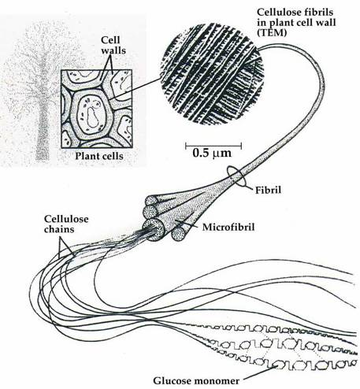
What is cellulose?
BioBased
Markets
Source: CelluForce

Slide 11
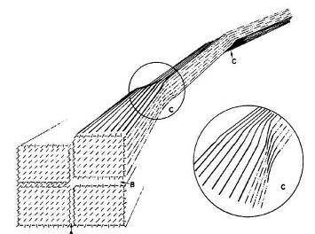
What is nanocellulose?
crystalline region:
amorphous region
BioBased
Markets

Slide 12
Types of “nano” “cellulose”
Cellulose nanofibrils (CNF)
Cellulose nanocrystals (CNC)
Microfibrillated cellulose (MFC)
Cellulose filaments (CF)
Different forms of CNC
Different forms of CNF
Different forms of MFC
And… MCC, CMC, etc.
BioBased
Markets
Notes:
Cellucomp Curran

Slide 13
What is CNC?
Cellulose nanocrystals, also called nanocrystalline cellulose (NCC) or cellulose nanowhiskers
Less than 100 nm in at least one dimension: e.g., 5 nm x 100 nm
Typically produced by acid hydrolysis
Can have surface charge and chiral nematic properties
Discrete nanoparticles with high crystallinity
Good for strength, reinforcement, rheology, optical, electrical, chemical properties
BioBased
Markets

Slide 14
What is CNF?
Cellulose nanofibrils, also called nanofibrillated cellulose (NFC)
Less than 100 nm in at least one dimension: e.g., 5-20 nm x 500 – 3,000 nm
Produced primarily by mechanical means, sometimes with enzymatic or chemical pre-treatment
Not discrete particles: nano-sized bundle of fibrils
Good for strength, reinforcement, rheology
BioBased
Markets

Slide 15
What is MFC?
Microfibrillated cellulose (MFC)
Likely not less than 100 nm in at least one dimension
Often produced at mill for use on-site in papermaking
Produced primarily by mechanical means
Not discrete particles: micro-sized bundle of fibrils
Good for strength, reinforcement, rheology
BioBased
Markets

Slide 16
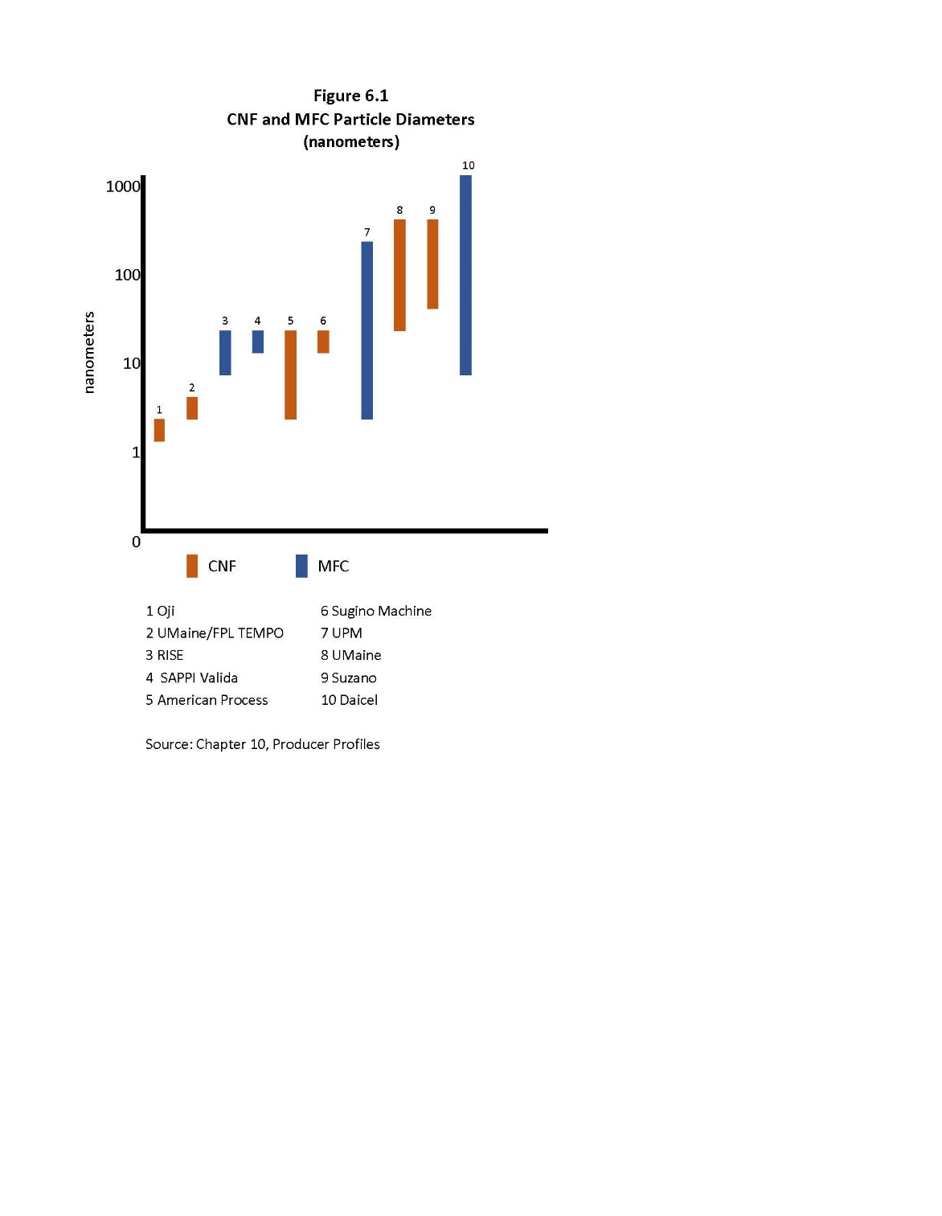
CNF and MFC Characteristics
(particle diameter in nanometers)
BioBased
Markets
Source: J. Miller, Nanocellulose Producers, Products, and
Applications: A Guide for End Users, TAPPI, 2017

Slide 17
Characteristics of nanocellulose
Compatibilization
Dispersibility
Crystallinity
Degree of fibrillation
Charge
Chemistry
Purity
Particle size
Aspect ratio
Powder, paste, slurry, gel
Is it cellulose?
Is it nano, micro, macro?
BioBased
Markets

Slide 18
Characteristics of nanocellulose
Compatibilization
Dispersibility
Crystallinity
Degree of fibrillation
Charge
Chemistry
Purity
Particle size
Aspect ratio
Powder, paste, slurry, gel
Is it cellulose?
Is it nano, micro, macro?
What’s best for your application?

Slide 19
Challenge:
Prove the business case through the supply chain!
BioBased
Markets

Slide 20
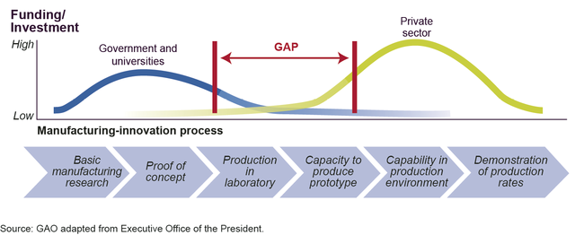
The road to commercialization
YOU ARE HERE
BioBased
Markets
Source: GAO

Slide 21
Commercial challenges
Proof of concept
Need solid value proposition through the supply chain
Competitive materials
Low oil prices
Funding challenges: the Valley of Death
Market development
Applications development
Who develops the applications? Who does the R&D? Who owns the IP?
Which material is best for a given application?
What loading is optimal?
It is not a “drop in”: implications for customer process
Scale up in production
Scale up of applications
Consistent quality from batch to batch
Lack of multiple sources of supply
Safety and regulatory issues

Slide 22
Cost alone does not define the business case
loading
BioBased
Markets
Source: Biobased Markets
Notes:
1% loading, $1 polymer, 10% weight reduction, can afford $10 for NCC. 0.3% loading; 5% weight reduction, close to $20 per lb.

Slide 23
Opportunities for nanocellulose in packaging and specialty papers …
Obviously…
BioBased
Markets

Slide 24

Opportunities for nanocellulose in packaging and specialty papers …
Obviously, strength
BioBased
Markets

Slide 25

Opportunities for nanocellulose in packaging and specialty papers …
Obviously, strength and barrier
BioBased
Markets

Slide 26
Enhanced strength and barrier enable lightweighting
lightweighting to reduce environmental impact
lightweighting to reduce material cost
lightweighting to reduce transport cost
BioBased
Markets

Slide 27
Enhanced strength and barrier enable lightweighting
lightweighting to reduce environmental impact
lightweighting to reduce material cost
lightweighting to reduce transport cost
But it’s not just about light weighting
BioBased
Markets

Slide 28
Applications development with paper and paperboard
Surface applications
Holdout/porosity
Printability
Barrier
Smoothness
Opacity
Reduce cost
Base sheet additives
Strength: tear, tensile, Scott bond
Wet web strength: runnability
Porosity
Opacity
Reduce fiber cost
BioBased
Markets
Source: Nanocellulose: Packaging Applications and Markets, RISI, 2019

Slide 29
Specialty and Packaging Opportunities
wet-end web strength permits greater productivity lower cost fiber: recycled vs. virgin; hardwood vs softwood more low-cost filler; less fiber more filler means more opacity and better printability coatings to eliminate harmful materials such as fluorocarbons improved barrier to replace plastic, glass, or metal
eliminate non-recyclable films and foils
biodegradable materials to replace non-biodegradable materials
BioBased
Markets

Slide 30
Key takeways
There are several different types of nanocellulose
Many opportunities – especially in specialty paper and packaging Applications development is needed
BioBased
Markets

Slide 31
Thank you
  Nanocellulose: Producers, Products, and Applications – a guide for end users, TAPPI 2017
  Nanocellulose: Challenges and Opportunities – end user perspectives, TAPPI, 2018
  Nanocellulose: Packaging Applications and Markets, RISI, 2019
PRESENTED BY
Jack Miller
Principal Consultant
Biobased Markets
jackmiller@biobasedmarkets.com
BioBased
Markets

