Slide 1
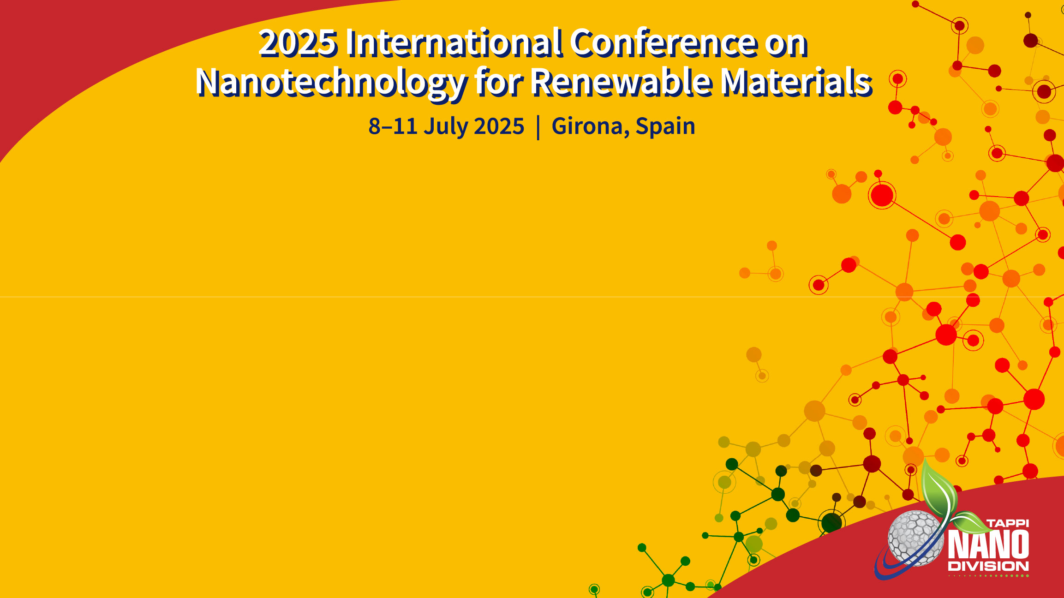
Valorization of Lignin and Cellulose Nanomaterials: State of the Industry
Presented by
Jack Miller, Biobased Markets, Market-Intell LLC

Slide 2
Agenda
Challenges
Cellulose nanomaterial valorization
Lignin valorization
State of the Industry
Appendix

Slide 3
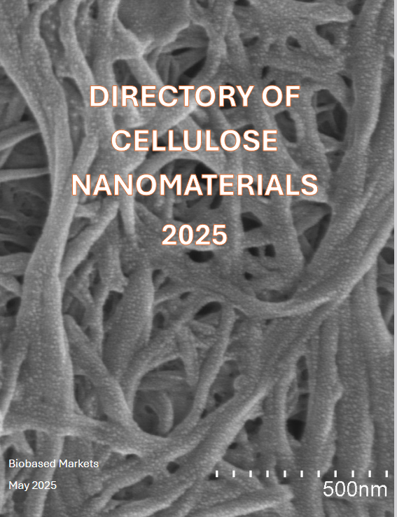

Slide 4
Key Points
Valorization equals commercialization.
Total system economics are critical: energy, capex, opex.
Commercial challenges can be more significant than technical challenges.
Collaboration with key customers needed.

Slide 5
Commercial challenges for new materials
Need solid value proposition through the supply chain
Total system economics
It is not a “drop in” solution
Market and applications development
Which material is best for a given application?
Collaboration
Lack of multiple sources of supply
Scale up in production
Funding challenges: the Valley of Death
Safety and regulatory issues
BioBased
Markets

Slide 6
Cellulose Nanomaterials Valorization
Strength
Barrier
Rheology
Environmental

Slide 7
Cellulose Nanomaterials Economics
Scale
Location
Raw material cost
Technology
Drying and redispersion
Compatibilization

Slide 8
Commercial Development
CelluForce
  Schlumberger: drilling fluids
  10 year agreement with multinational cosmetics company
  Wet spinning of smart textiles
Sappi
  Rheology for cosmetics, cement, coatings
  Barrier for molded fiber and food packaging
Borregaard
  Exilva® entangled, fibrillated cellulose fibres for barrier coatings, rheology modifiers, etc.
Nippon
  TEMPO
  CNF reinforced plastic
  Food and cosmetics
GranBio
  Scale-Up of Nanocellulose Dispersion Composite (NDCTM) rubber masterbatch with Birla Carbon
Fibenol
  Woodcell flagship project: micro-scale specialty cellulose for paper and packaging, energy storage, etc. with DS Smith, Coatex, Skeleton Technologies, RISE, EPFL, others

Slide 9
GranBio BioPlusTM Industrial Process

Slide 10
FiberLean® MFC in White Top Liner
Case Study – Filler Increase & Lightweighting (White Layer)
Source: FiberLean

Slide 11
FiberLean® MFC in FBB (top layer)
Case Study – Filler Increase & Lightweighting & Improved Coating Hold-out
Source: FiberLean

Slide 12
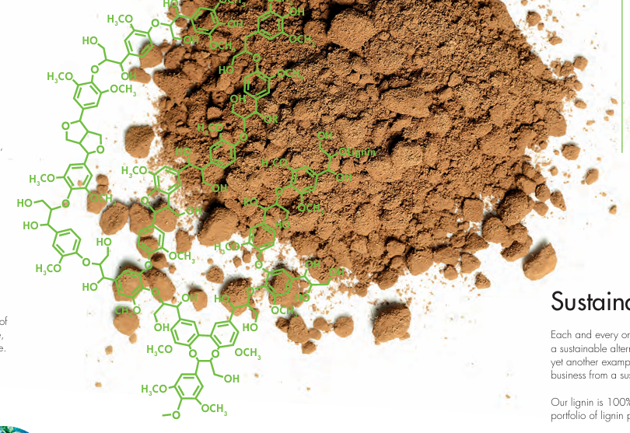
Lignin
“to render sugar/biofuel biorefineries economically more successful, the main focus should be on lignin”
– Mikhail Balakshin, Aalto University
Image courtesy of UPM

Slide 13
Lignin Valorization
What could we make with lignin?
Well, what does it do in a tree?
  UV Protection
  Waterproofing
  Rigidity/strength
  Glueing/adhesion
  Disease protection
Prof. Claire Halpin, University of Dundee, Introduction at Marcus Wallenberg Prize Symposium, November 2024

Slide 14
Lignin Economics
Scale
Raw material cost
Cost of alternative energy
Technology
Kraft mill chemical balance
Valorization of all side streams

Slide 15
Lignin valorization
 | Lignin Applications Potential Value
 | (000 tonnes)
 |  | Current | Potential | Value/ tonne
 | Graphene | <1 | n/a | $20,000+
 | Energy storage | <10 | 700 | $3,000+
 | Activated carbon | <10 | 15,000 | $2,500
 | Sustianable Aviation Fuel | <10 | 850 | $2,400
 | Vanillin | 30 | 300 | $2,000
 | Carbon fiber | <10 | 250 | $1,500
 | Phenolic resins/phenol derivatives | 40 | 5,000 | $1,200
 | BTX | <10 | 200,000 | $500
 | Cement/concrete additives | 400 | 4,000 | $500
 | Biofuels | 30 | >200,000 | $500
 | Bitumen, asphalt | 10 | 25,000 | <$500
 | Misc dispersants and binders | 400 | 1,000 | various
 | All other | 200 | n/a | various
 | Total | 1,100 | >400,000
 | Sources: Biobased Markets; Borregaard Business Model, Businesses & Strategy, presentation, July 2020; Miller J. Lignin: Technology, Applications and Markets, RISI, 2017; Heikkilä M. MetGen, Collaboration to Drive Innovation, Presentation at IFBC, June 2019; Balakshin M. et al., ChemSusChem 10.1002/cssc.202002553; Jiang, Xiao; de Assis, Camilla. Lignin Fractionation from Laboratory to Commercialization: Chemistry, Scalability and Techno-economic analysis. Green chemistry, submitted August 31, 2020.
BioBased
Markets

Slide 16
Lignin valorization
VTT: LigniOx oxidation for plasticizers and dispersants
VTT: LigniSmart thermal conversion for carbonized materials
UPM BioPivaTM: resins for OSB, plywood, laminates; polymer blends
UPM Leuna: lignin-based renewable functional fillers
Vertoro : Goldilocks hydrogenation
Stora Enso Lineo®: Lignode® batteries; NeoLigno® binders
Suzano Ecolig®: rubber, resins, thermoplastic, cosmetics, construction, etc.
Fibenol LignovaTM: resins, PU foams, composites
Praj Industries: bitumen
MetGen: depolymerization, debottlenecking biorefineries
Lignin Industries Renol: industrial packaging, polymer compounds, ABS
BioBased
Markets

Slide 17
VTT High-value lignin applications

Slide 18
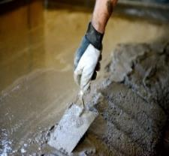
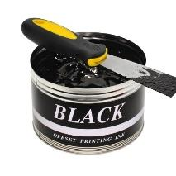
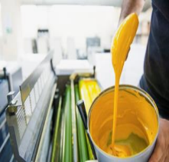
VTT LigniOx technology
NaOH (alkali), O₂
LigniOx oxidation
LigniOx post-treatment
Evaporation / spray drying
Lignin
by-stream
LigniOx plasticizers & dispersants
Alkali-O₂ oxidation
TRL 7
Membrane filtration
TRL 7
Biodispersants
TRL 5-6
LigniOx Process Concept to Produce Lignin Dispersants at a Kraft Pulp Mill and an Organosolv Biorefinery - VTT's Research Information Portal
LigniOx™ lignin recovery
LigniOx | Circular Bio-based Europe Joint Undertaking (CBE JU)
BA5404 Lignin and sidestream valorization - VTT's Research Information Portal
VTT Technology 409: NWBC 2022 - The 10th Nordic Wood Biorefinery Conference

Slide 19
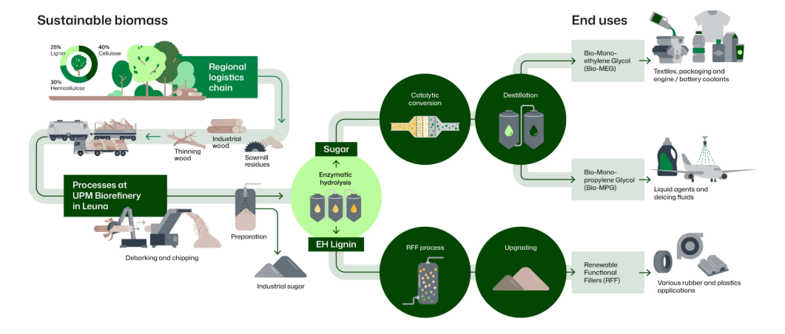
UPM Leuna
Source: UPM

Slide 20
Energy storage
Lithium-ion
  10 to 20 grams of graphite per amp hour
  700 billion watt hours 2022
  1 million tonnes graphite in 2022
  7 million tonnes graphite in 2030
Sodium-ion:
  Stora Enso Lignode® and Altris
  20 Ah, 3V
Source:
https://poweringautos.com/how-much-graphite-in-a-lithium-ion-battery/
Lithium-ion battery demand forecast for 2030 | McKinsey
Graphite Market Forecast: Top Trends for Graphite in 2025 | INN /

Slide 21
Lignosulfonates
Market and applications well established
Market is mature and declining as sulfite mills are in decline

Slide 22
State of the Industry
Old business model
  Pulp and paper mills produce pulp and paper; lignin is burned for fuel
  Biorefineries produce ethanol; lignin is burned for fuel
New business model
  Pulp and paper mills produce pulp, paper, lignin, biochemicals, specialty cellulose, nanocellulose
  Biorefineries produce ethanol, lignin, biochemicals, specialty cellulose, nanocellulose
BioBased
Markets

Slide 23
Cellulose nanomaterials
Overall capacity ’18 to ’23 CAGR 16%.
Large recent increases at Suzano (20 ktpy MFC), Sappi (6 ktpy MFC), and Performance Biofilaments (7 ktpy CF)
Also: Fibenol, NBG, Norske Skog, ITENE, Re-Fresh Global, Weidmann, ANPOLY, Sugino
“Mills Captive” continues to dominate with ~70% of the market, but growth in this mature market will slow
In general, production grows slightly faster than capacity as demand growth leads capacity growth
Mature markets will see slower growth ‘23-’30 than ’18-23; emerging markets will see faster growth
BioBased
Markets

Slide 24
Lignin
Lignosulfonate remains ~90% of the market, but is mature and declining due to decline of sulfite pulping.
The future is kraft lignin and biorefinery lignin.
Known kraft lignin capacity grew at about 3% from 2015-23.
Shutdowns at Sunila, Charleston and West Fraser created a shortfall in supply, but Södra in 2027 will replace much of what was lost.
Biorefinery lignin will get a significant increase with startup of UPM Leuna this year.
BioBased
Markets

Slide 25
Conclusions
Development of markets and applications for new materials is time consuming.
Commercial challenges can be greater than technical challenges.
New applications and markets are emerging every day as are new technologies for production as well as valorization.
I believe the future is bright!

Slide 26
Thank you
Jack Miller
Biobased Markets
jackmiller@biobasedmarkets.com
BioBased
Markets

Slide 27
Appendix
BioBased
Markets

Slide 28
Cellulose Nanomaterials: CNC
CNC Capacity 2025
(tonnes per year, dry basis)
Producer | Process | Capacity
CelluForce, Canada | sulfuric acid hydrolysis | 300
Anomera, Canada | carboxylated | 170
GranBio, U.S. | SO₂ fractionation | 130
Navitas, Slovenia | proprietary | 50
Fibenol, Estonia | reactive extrusion | 40
Forest Products Lab, U.S. | sulfuric acid hydrolysis | 3
Blue Goose Biorefineries, Canada | metal catalyzed oxidation | 2
Innotech Alberta | sulfuric acid hydrolysis | <1
Cellulose Lab, Canada | various | <1
ANPOLY, Inc., Korea | sulfuric acid hydrolysis | n/a
FPInnovations, Canada | sulfuric acid hydrolysis | pilot
Hangzhou Yeuha Technology Co., China | proprietary | pilot
Nordic Bioproducts Group | from MCC | pilot
Tianjin Haojia Cellulose Co. Ltd., China | modified and unmodified | pilot
Source: 2025 Directory of Cellulose Nanomaterials

Slide 29
Microbrillated Cellulose (MFC)
MFC Capacity 2025
(tonnes per year, dry basis)
Producer | Process | Capacity
Suzano, Brazil | mechanical | 20,000
FiberLean Technologies, UK | mechanical | 13,000
Sappi Biotech, Global | proprietary | 6,220
Borregaard, Norway | proprietary | 1,000
Woodspin, Finland | mechanical | 1,000
Norske Skog, Norway | mechanical | 526
Klabin, Brazil | mechanical | 350
RISE, transportable container factory | enzymatic pretreatment | 200
Daicel, Japan | high pressure homogenizer | 200
Weidmann Fiber Technology, Switzerland | mechanical | 150
CTP/FCBA, France | enzymatic pretreatment | 25
RISE, Sweden | enzymatic pretreatment | 25
Stora Enso, Finland | n/a | N/A
Empa, Switzerland | enzymatic pretreatment | pilot
InoFib, France | chemical pretreatment | pilot
ITENE, Spain | mechanical | pilot
KCL, Finland | n/a | pilot
Re-Fresh Global, Germany | enzymatic treatment | pilot
Tianjin Haojia Cellulose, China | modified: TEMPO, other | pilot
UPM, Finland | n/a | pilot
Source: 2025 Directory of Cellulose Nanomaterials

Slide 30
Cellulose Nanofibrils
CNF Capacity 2025
(tonnes per year, dry basis)
Producer | Process | Capacity
Sappi Biotech, Global | proprietary | 650
Nippon Paper, Japan | TEMPO, carboxylated | 560
University of Maine, U.S. | mechanical | 260
GranBio, U.S. | SO₂ fractionation | 130
CelluComp, UK | chemical pretreatment | 100
Oji Paper, Japan | phosphate esterification | 40
Sugino Machine, Japan | oblique collision | 39
Chuetsu Pulp and Paper, Japan | aqueous counter collision | 30
Seiko PMC, Japan | modified hydrophobic | 24
Cellulose Lab, Canada | TEMPO, other | 18
ANPOLY, Korea | TEMPO | 10
Tianjin Haojia Cellulose Co., Ltd, China | TEMPO, carboxylated | 3
Dai-ichi Kogyo (DKS), Japan | TEMPO | 1
U.S. Forest Products Lab, U.S. | TEMPO, mechanical | <1
NANOCEL, Spain | enzymatic, chemical, mechanical | <1
Marusumi Paper Co., Ltd.. Japan | chemical | n/a
Toagosei Co., Ltd., Japan | Sodium hypochlorite oxidation | n/a
ITENE, Spain | mechanical | pilot
Nordic Bioproducts Group | from MCC | pilot
Re-Fresh Global, Germany | enzymatic treatment | pilot
VTT, Finland | chemical, enzymatic, mechanical | pilot
Source: 2025 Directory of Cellulose Nanomaterials

Slide 31
Cellulose Filaments
Cellulose Filaments Capacity 2025
(tonnes per year, dry basis)
Producer | Process | Capacity
Performance BioFilaments, Canada | mechanical | 7,000
Kruger, Canada | mechanical | 6,000
Tianjin Haojia Cellulose, China | n/a | n/a
Source: 2025 Directory of Cellulose Nanomaterials

