Slide 1
Patriarch Athenagoras
The Dialogue of Love

Slide 2
The Dialogue of Love
What is Athenagoras’ contribution to the Ecumenical Movement?
What was Athenagoras’ ecumenical vision?
What part did relationships play in forming this ecumenical vision?
Did ecumenism shape Athenagoras’s environment or did his environment shape his ecumenism?
What texts did he leave us?

Slide 3
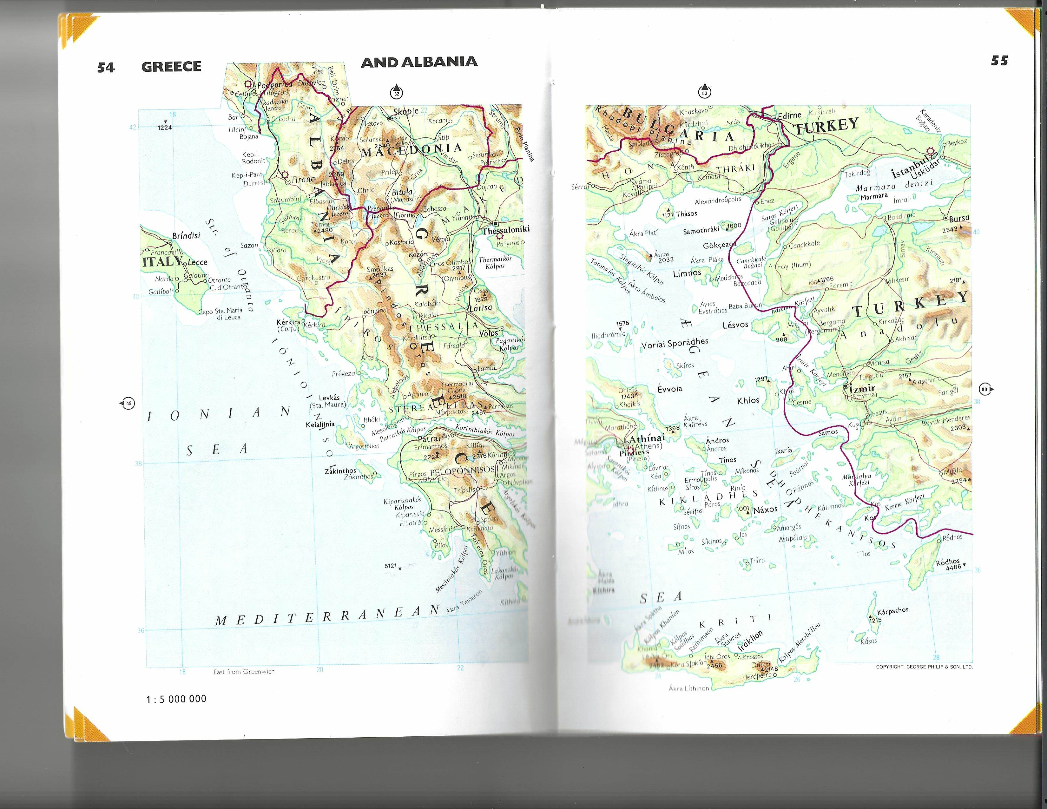

Slide 4
Points of View - texts
Tsaraplana
Monastir
Corfu
America
Istanbul

Slide 5
Formation
Formed by the loss of his mother and the death of his father
He placed his life under the protection of the Theotokos
The formal learning at Halki was rigid and sectarian: “our teachers spoke only of differences, of heresies, of what we were opposed to...” (p.17)
He spent six months on Athos at the small kellion of Mylopotamos, as archdeacon. He later returned to Athos as bishop, in 1930, and as Patriarch in 1963 for the millenium of the Grand Lavra.

Slide 6
Ecumenical Outreach
Response to Faith and Order Commission invitation - 1919
YMCA Assembly, Helsinki, 1926
Letter of condolences to the Catholic Church on the death of Pope Pius XII, 1958
Letter of welcome on the appointment of Pope John XXIII
Gestures that broke the ice of a centuries-long history of alienation and distrust. (Anastasios Kallis, 1980, p.124)

Slide 7
Ecumenical Vision
That they shall be one as we are one
The shared cup
The dream of climbing the mountain from either side to meet at the top with the shared cup
The intercession of the Theotokos, to whom he prayed each night, that the two Sister Churches should be one (Chiara Liubich)

Slide 8
Symbolic Visits – the power of the image
The meeting with Pope Paul VI in Jerusalem, 1964: the kiss of peace; the meeting as two brothers
Pope Paul VI’s visit to Istanbul, 1964. Kneeling at the site of the anathema in Hagia Sophia. The words of reconciliation: the Pope presented himself as Bishop of Rome and spoke of the two Sister Churches
Patriarch Athenagoras’ visit to Rome: the two leaders side by side on the Ambon, as the Western Patriarch and the Eastern Patriarch
Athenagoras laid pearls of gold on the grave of John XXIII.

Slide 9
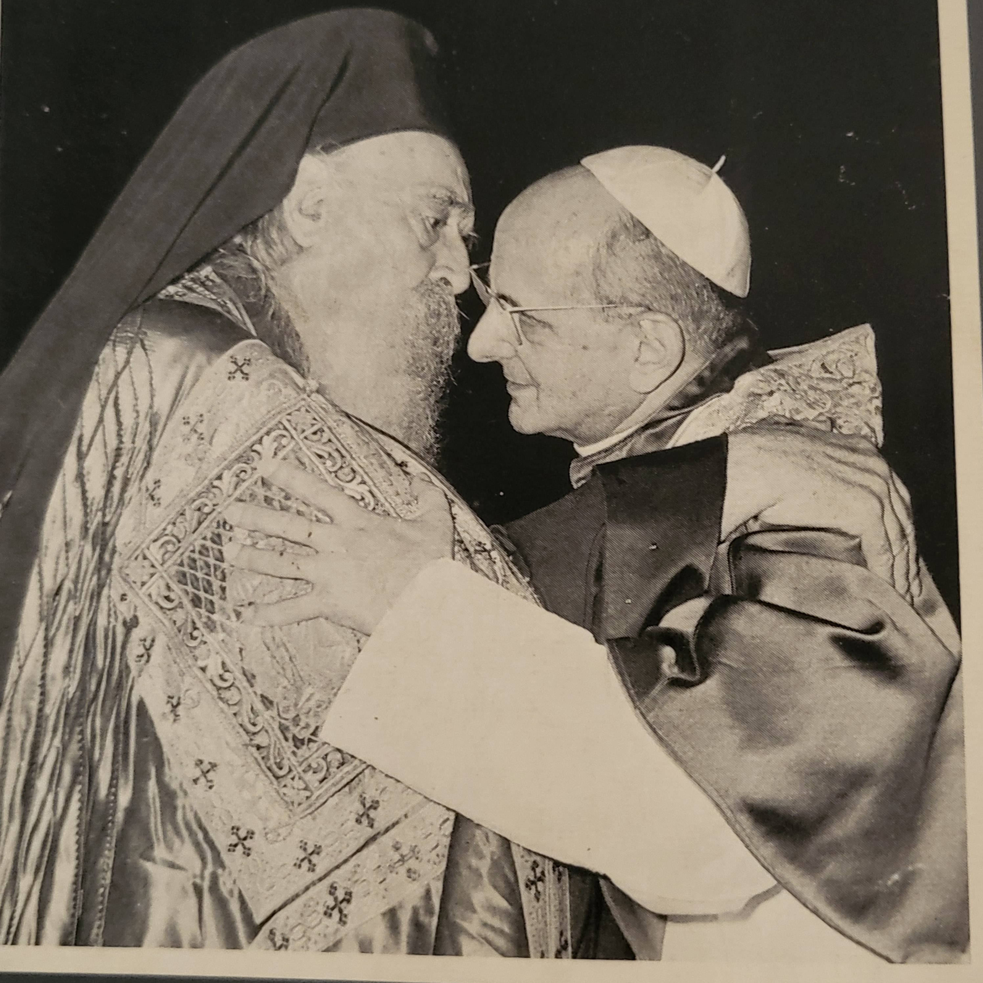

Slide 10
Synchronicities
Athenagoras’ opening up of dialogue in the Orthodox Church and Pope John XXIII summoning of Vatican II
The appointment of Orthodox observers to Vatican II agreed after the meeting in Jerusalem
The simultaneous setting aside of the anathemas: in Rome, as part of Vatican II: in Constantinople at St. George’s Patriarchal Church

Slide 11
The hard work of constructing unity and common understanding
The bureaucratic wrangling over formation of a joint commission
The careful wording of the setting aside of the anathemas – December 1965
The work started by Athenagoras, completed only by his successors
An opening to stop “poaching”: trying to convert each other’s flocks
The resistances – from the Catholic Church, from Moscow, from the Church of Greece
Retreat and backpedalling: the landscape today – Pope Francis’ striving for synodality and Orthodox disunity

Slide 12
The Literary Context
Two documented dialogues: The Dialogues with Patriarch Athenagoras and the Tomos Agapis
The Dialogues with Patriarch Athenagoras: Olivier Clément and Patriarch Athenagoras, Summer 1968
A literary recreation of a months-long conversation between ‘MOI’ and ‘LUI’ – validated by contemporaneous documentation
The Tomos Agapis: the full documentary record of all interchanges. A hard-to-find and forgotten resource, used in the introduction to the German translation of the Dialogues.

Slide 13
The Players
In 1968, Clément was primarily known as a historian of the Byzantine Church and the author of an Introduction to the Orthodox Church
Professor of History at the Lycée Louis le Grand and of Early Church History at the Institut Saint-Serge
Clément is remarkable in his willingness to sit, as a novice, at the feet of a master
Athenagoras has achieved an almost hieratic stripping bare to the ultimate pure profile, through what he describes as years of difficult struggle and through strict asceticism

Slide 14
In the background
The under-researched role of André Scrima as Athenagoras’ envoy to Vatican II
The under-researched role of Chiara Liubich as the Vatican’s personal emissary to the Phanar (German translation, p.20)
The key role of leading clerics doing the hard diplomatic work : Cardinal Bea; Metropolitan Meliton
How do breakthroughs happen?

Slide 15
The Dialogue of Love
What is Athenagoras’ contribution to the Ecumenical Movement?
What was Athenagoras’ ecumenical vision?
What part did relationships play in forming this ecumenical vision?
Did ecumenism shape Athenagoras’s environment or did his environment shape his ecumenism?
What texts did he leave us?

Slide 16
References
Dialogues with Patriarch Athenagoras, Olivier Clément, translated by Jeremy N. Ingpen, Holy Cross Orthodox Press, 2022.
Podcast with Bishop Anthony Vrame: Dialogues with Patriarch Athenagoras. A discussion with the translator, Jeremy N. Ingpen. https://transfiguringtime.com/
Patriarch Athenagoras: Porträt eines Propheten, Verlag Neue Stadt, 1982. Introduction by Johannes Bold and Albert Rauch. In German.
Anastasios Kallis: ‘Orthodoxy and the Catholic Church: from polemic to the “Dialogue of Love,”’ in Peter Lengsfeld (ed.) Oekumenische Theologie, Stuttgart, 1980, pp.124-151. In German.
Tomos Agapis, jointly published by Rome and Constantinople, 1971. German edition, Innsbruck, 1978.

