Slide 1
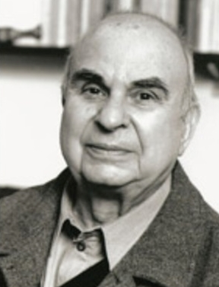
Olivier Clément
The Face as Icon:
the Face as Encounter
1921-2009

Slide 2
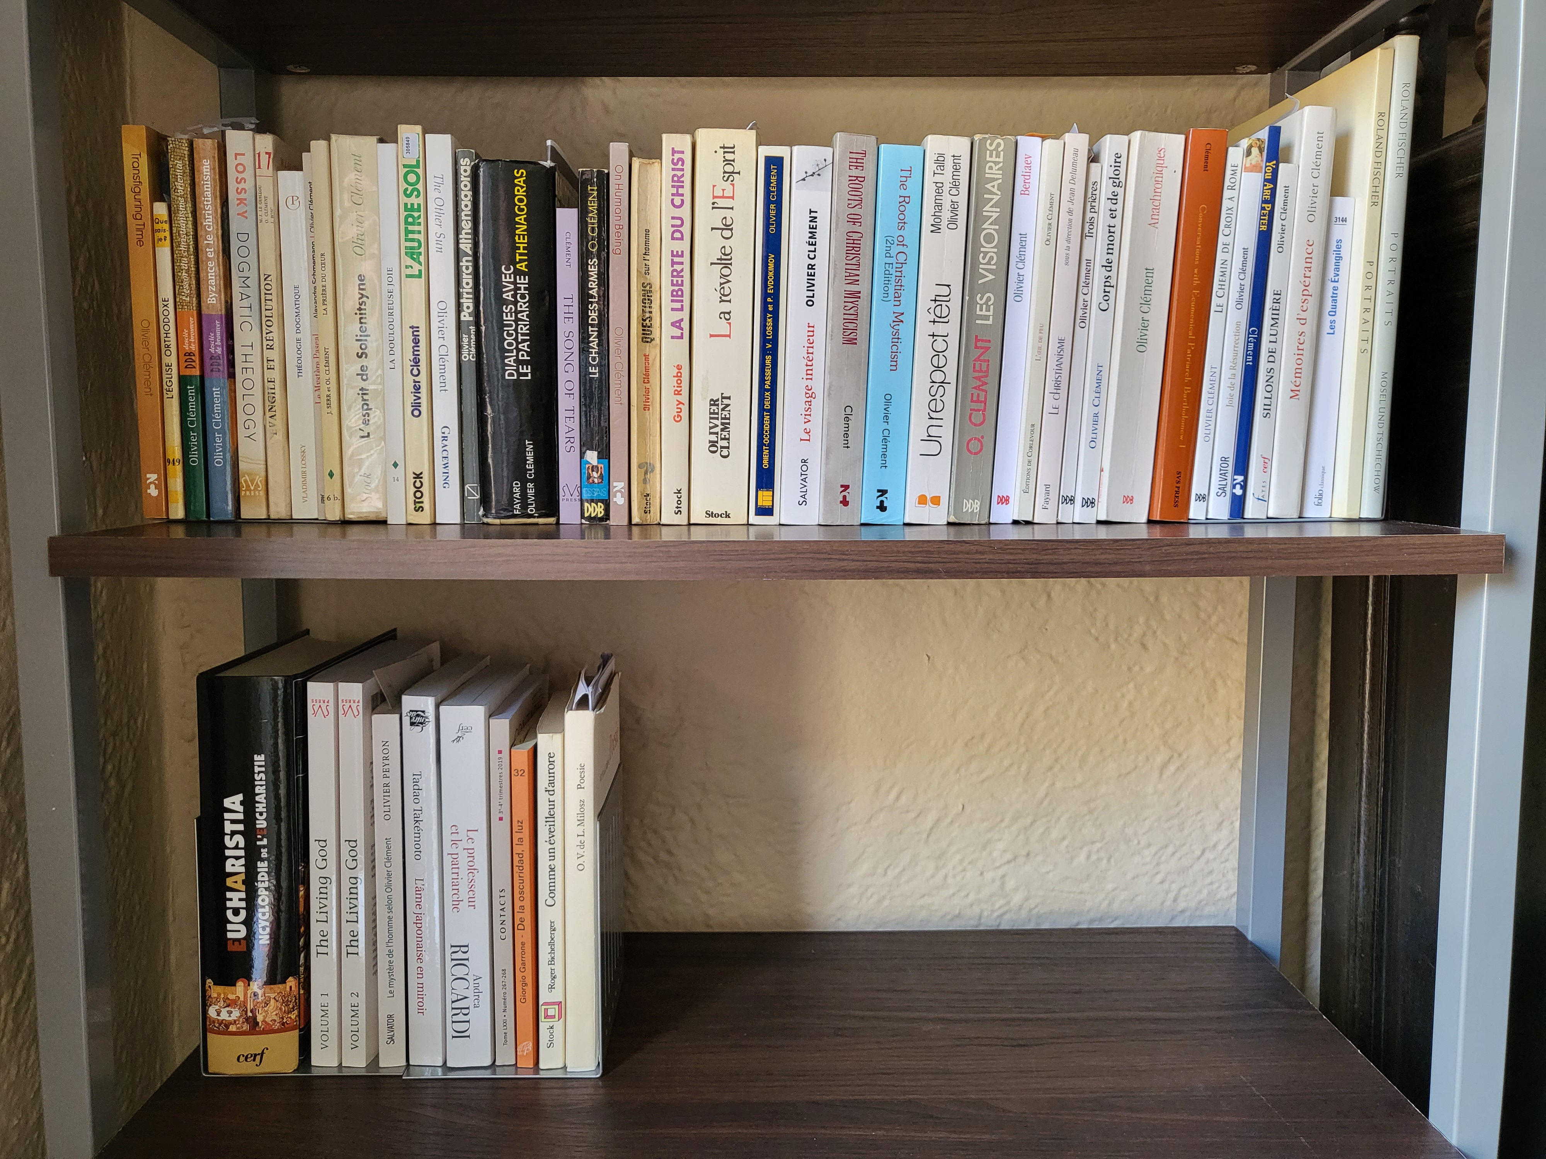
Olivier Clément’s
Theology of the Face

Slide 3
Alphonse Dupront - history professor
Paul Evdokimov - colleague at the Institut St. Serge
André Scrima - Romanian monk and theologian
Emmanuel Levinas - Philosopher, Talmudic scholar
Marie-Joseph Le Guillou - Catholic theologian
Christoph Schönborn - Catholic theologian
Eugene Trubetskoi - Russian Orthodox philosopher
Father Lev Gillet - Orthodox monk and writer
Osip Mandelstam - Russian poet of the Silver Age

Slide 4
The Encounter
In one of his last essays, Clément wrote: “More and more we are finding that the fabric of society is not just crumpled, it is torn apart. And through the torn fabric enter nihilism and nonbeing…. And therefore I think that today’s nihilism is the arena in which we must … sing out the good news of the Resurrection.”

Slide 5
The Encounter
“In the secularized city, one has the feeling that there are no more temples … but there are men and women and human faces, and these are the prophecy of the Kingdom”

Slide 6
becoming
FACE
ICON
PRESENCE
reveals
revealed in
PERSON

Slide 7
Theological Propositions on the Face
Philippians: “…who, though he was divine, took the form of a servant and humbled himself even unto death on the Cross.”

Slide 8
“Love seeks reciprocity. For God, the existence of the other implies a retreat and vulnerability”

Slide 9
“In Christ, God has become the ultimate face…. the face of the servant who has ‘no form nor charm to attract us’ yet who is radiant with a singular beauty”

Slide 10
“This face of faces … disfigured and transfigured by love, is indeed, the face of God”

Slide 11
“This light constitutes the essence of beauty, because beauty is a divine name”

Slide 12
Christ is the light of light.
Clément cites Cyril of Alexandria: “Christ is the glory of the Father, the glory issuing from the very substance of light.”

Slide 13
The Encounter
“The Judeo-Christian tradition… places the accent on the human face, with its extreme vulnerability. If I wish to offer a welcome to the nakedness of a face, I can only have an attitude of non-power (non-pouvoir).”

Slide 14
The Encounter
The attitude of non-pouvoir links back to the stripping bare of the ascetic process
.

Slide 15
The Encounter
This results in a shift from the acidic corrosion of the person encountered,
to the ascetic stripping bare of the person who encounters.

Slide 16
“The World only exists … in the field of encounter of the gaze.
Today, a poetry of the created world, tomorrow a poetry of faces”

Slide 17
“The world, the world of God and the human,
of God made man and human called to become God
only exists in the field of encounter of the gaze
in the communion of faces.”

Slide 18
Major Works in English
The Roots of Christian Mysticism
trans. Jeremy Hummerstone, New City Press, 1993 (2nd Ed.)
On Human Being
trans. Jeremy Hummerstone, New City Press, 2000
Transfiguring Time
trans. Jeremy N. Ingpen, New City Press, 2019
The Other Sun
trans. Michael Donley, Gracewing, UK, 2021
The Song of Tears
trans. Michael Donley, SVS Press, 2021

Slide 19
Major Works in English
“The Common Mission of Christians in the Secular City”
Afterword, in Evdokimov, Michel, Two Martyrs in a Godless World: Dietrich Bonhoeffer and Alexander Men, trans. Jeremy N. Ingpen, New City Press, 2021
Dialogues with Patriarch Athenagoras
trans. Jeremy N. Ingpen, Holy Cross Orthodox Press, 2022

Slide 20
Commentaries
Olivier Peyron: Le Mystère de l’Homme selon Olivier Clément (2014)
Rowan Williams, “Liturgical Humanism: Orthodoxy and the Transformation of Culture,” Orthodoxy in America Lecture, Fordham University (2014)
Giorgio Garrone: De la oscuridad la luz (2015)
Andrew Louth, Modern Orthodox Thinkers (2015), pp. 268-270
Andrea Riccardi: Le Professeur et le Patriarche (2020)

Slide 21
Commentaries
Carolina Blasquez Casado, “Olivier Clément’s Chalcedonian Anthropology: a new paradigm,” Salmanticensis 65 (2018), Universidad Pontificia de Salamanca
L’Oeuvre Théologique d’Olivier Clément, Contacts, No. 267-268, 2019.
Jeremy N. Ingpen, Time, Incarnation and Eternity (Interview), Road to Emmaus Journal (2022)
Michael Donley, Introduction to The Other Sun, Gracewing, 2021

