Slide 1


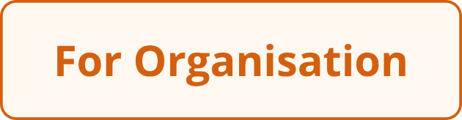
Neuropositivepath: Empowering Neurodiverse Individuals & Enabling Neuroinclusion in the Workplace
Tailored training, mentoring, and consulting to help neurodiverse individuals thrive — and organisations unlock the full power of neuroinclusive culture.

Slide 2


OUR MISSION
Discover Your Path: Transforming Neurodiversity into Strength
For Neurodiverse Individuals
For Organisations
Unlock tailored training and support designed specifically for neurodiverse individuals seeking career growth and workplace success. Our programmes equip you with practical skills, confidence, and a community that understands your unique journey.
Help your organisation embrace neuroinclusion to foster innovation, psychological safety, and authentic belonging for every employee. We guide teams from awareness through to lasting cultural change.

Slide 3

INDIVIDUALS
For Neurodiverse Individuals: Career Readiness & Ongoing Support
1
2
10-Week Mentoring
Flexible Options
Comprehensive sessions covering essential life and career skills, developed by experts in coaching, communications, and technology.
Tailored pathways to suit different needs, including ongoing job search coaching for up to six months after programme completion.
3
4
Expert-Led Design
Proven Success
Built by specialists in neurodiversity, our curriculum bridges the gap between unique talents and real-world workplace demands.
Graduates secure meaningful roles by leveraging their distinctive strengths — turning difference into competitive advantage.
"The programme helped me understand my strengths and gave me the confidence to pursue the career I always wanted." — Neuropositivepath Graduate

Slide 4

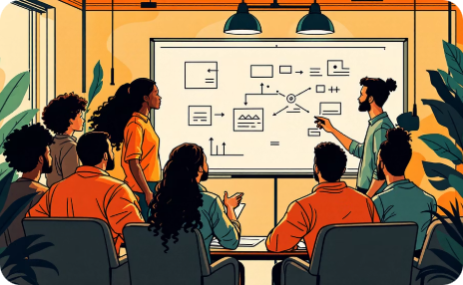



ORGANISATIONS
For Organisations: Building Intentional Neuroinclusive Workplaces
Awareness Sessions
Experiential Workshops
Consulting Services
Proven Impact
Introduce neurodiversity fundamentals and explore its critical role in driving innovation and team performance.
Identify suitable roles, prepare managers, and support the seamless integration of neurodiverse employees into your teams.
Companies reduce employee attrition and boost morale through intentional neuroinclusion initiatives that benefit everyone.
Hands-on training for managers and teams on communication, executive function, meetings, and inclusive hiring practices.

Slide 5





AWARENESS
Neurodiversity Awareness Sessions: The First Step to Inclusion
Natural Variation
1 in 5 Employees
Understand neurodiversity as a natural spectrum of human cognition — including autism, ADHD, dyslexia, dyspraxia, and more.
Up to one in five employees may be neurodivergent. Learn how their strengths drive creativity, focus, and problem-solving.
Psychological Safety
Open Registration
Gain practical insights on fostering an environment where colleagues feel safe to be authentically themselves at work.
Individuals, teams, and organisations can join our live or virtual sessions — flexible scheduling to suit your diary.

Slide 6

WORKSHOPS
Intentional Inclusion Workshops: Deepening Understanding & Skills
Our experiential workshops equip your teams with practical techniques for building a truly neuroinclusive culture, one skill at a time.
🗣️ Communications
🧠 Executive Function
📋 Meetings
🤝 Recruiting & Hiring
Create neuroinclusive meetings that enable meaningful participation — from agenda design to sensory considerations.
Master compassionate curiosity and reflexive communication to bridge differences and build trust across your teams.
Support colleagues' unique planning and organisational styles with empathy, practical tools, and structured flexibility.
Reimagine your recruitment process to attract, assess, and retain neurodiverse talent effectively and fairly.

Slide 7


INCLUSIVE HIRING
Inclusive Hiring: From Awareness to Action
Prepare Teams
Train managers to welcome and empower
Define Roles
Ongoing Support
Align tasks to neurodiverse strengths
Provide coaching for retention and growth
Our end-to-end approach ensures neurodiverse talent is not only recruited but genuinely supported to succeed — from role design through to long-term retention and career progression.

Slide 8



THE IMPACT
Why Neuroinclusion Matters: Benefits for Everyone
Enhanced Creativity
Diverse thinking styles spark innovation, generating novel solutions that homogeneous teams often miss.
Stronger Team Performance
Psychological safety and authentic engagement drive measurable improvements in collaboration and output.
Reduced Turnover
A culture of care and support lowers attrition, saving significant recruitment and retraining costs.
Leadership Excellence
Inclusive management practices empower all employees and develop more adaptive, empathetic leaders.

Slide 9

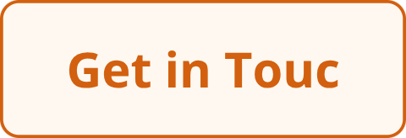
Join the Neuropositivepath Community Today
Whether you are a neurodiverse individual ready to launch or progress your career, or a company committed to genuine inclusion — your journey starts here.
Register
Connect
Thrive Together
Sign up for awareness sessions, workshops, or training programmes tailored to your specific needs and goals.
Contact us to discuss customised support, consulting, or partnership opportunities for your organisation.
Let's build workplaces where neurodiversity is celebrated and everyone has the opportunity to thrive.

