Slide 1
Save Guajome Park!
Citizens of Oceanside, let your council know that we
OPPOSE THE PROPOSED MELROSE LINK
Why?
This project is fiscally irresponsible. Estimated cost $42 Million and creates NO direct benefit to the Oceanside citizens at large.
2010 Traffic studies have shown that this link would provide less than 1 minute improvement for traffic and emergency services.
This project would DIVERT OCEANSIDE FUNDS from current road improvements for Oceanside’s residents and neighborhoods, to ALLOW MORE COMMUTER THRU TRAFFIC to and from Hwy 15.
This project was shown in 2010 to have detrimental impacts to Guajome Park wildlife and endangered species with increased noise, air pollution and traffic beyond comprehension.
Millions of Oceanside taxpayer money will be spent to take private lands through eminent domain from willing and unwilling property owners, only to fragment existing neighborhoods.
City ‘s Staff &Planning Commission BOTH OPPOSED this project!
Supported by the Buena Vista Audubon Society
What YOU Can Do
Email your City Council at council@ci.oceanside.ca.us
Email Guajome Park at askparks.lue@sdcounty.ca.gov
Help Distribute flyers email: SaveGuajome@gmail.com
Sign up on our email list for important events and meetings
Visit our website at SaveGuajomePark.org
“YOUR VOICE MATTERS - SAY NO TO THE MELROSE LINK ”
Save Guajome Park!
Citizens of Oceanside, let your council know that we
OPPOSE THE PROPOSED MELROSE LINK
Why?
This project is fiscally irresponsible. Estimated cost $42 Million and creates NO direct benefit to the Oceanside citizens at large.
2010 Traffic studies have shown that this link would provide less than 1 minute improvement for traffic and emergency services.
This project would DIVERT OCEANSIDE FUNDS from current road improvements for Oceanside’s residents and neighborhoods, to ALLOW MORE COMMUTER THRU TRAFFIC to and from Hwy 15.
This project was shown in 2010 to have detrimental impacts to Guajome Park wildlife and endangered species with increased noise, air pollution and traffic beyond comprehension.
Millions of Oceanside taxpayer money will be spent to take private lands through eminent domain from willing and unwilling property owners, only to fragment existing neighborhoods.
City’s Staff & Planning Commission BOTH OPPOSED this project!
Supported by the Buena Vista Audubon Society
What YOU Can Do
Email your City Council at council@ci.oceanside.ca.us
Email Guajome Park at askparks.lue@sdcounty.ca.gov
Help Distribute flyers email: SaveGuajome@gmail.com
Sign up on our email list for important events and meetings
Visit our website at SaveGuajomePark.org
“YOUR VOICE MATTERS - SAY NO TO THE MELROSE LINK ”

Slide 2
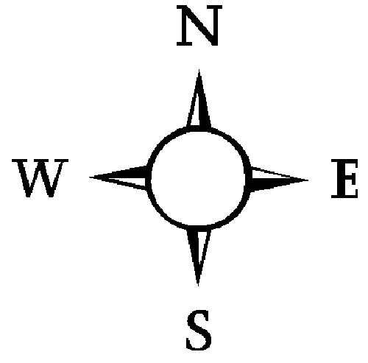
Melrose Link (aka Melrose “Extension” or “Gap”)
Melrose Link (aka Melrose “Extension” or “Gap”)
Home Depot
Home Depot
Green Paradise Farms “does not want to sell”
Green Paradise Farms “does not want to sell”
Bridge proposed over Guajome Lake Road
Bridge proposed over Guajome Lake Road
Guajome Regional Park
Guajome Regional Park
Proposed Melrose Link
Proposed Melrose
Link
Many affected properties in Oceanside, Vista and the County
“Don’t want to Sell”
Many affected properties in Oceanside, Vista and the County
“Don’t want to Sell”
Sante Fe Road
Sante Fe Road
$42 Million of Oceanside’s money for less than 1 min improved traffic?
$42 Million of Oceanside’s money for less than 1 min improved traffic?

