Slide 1
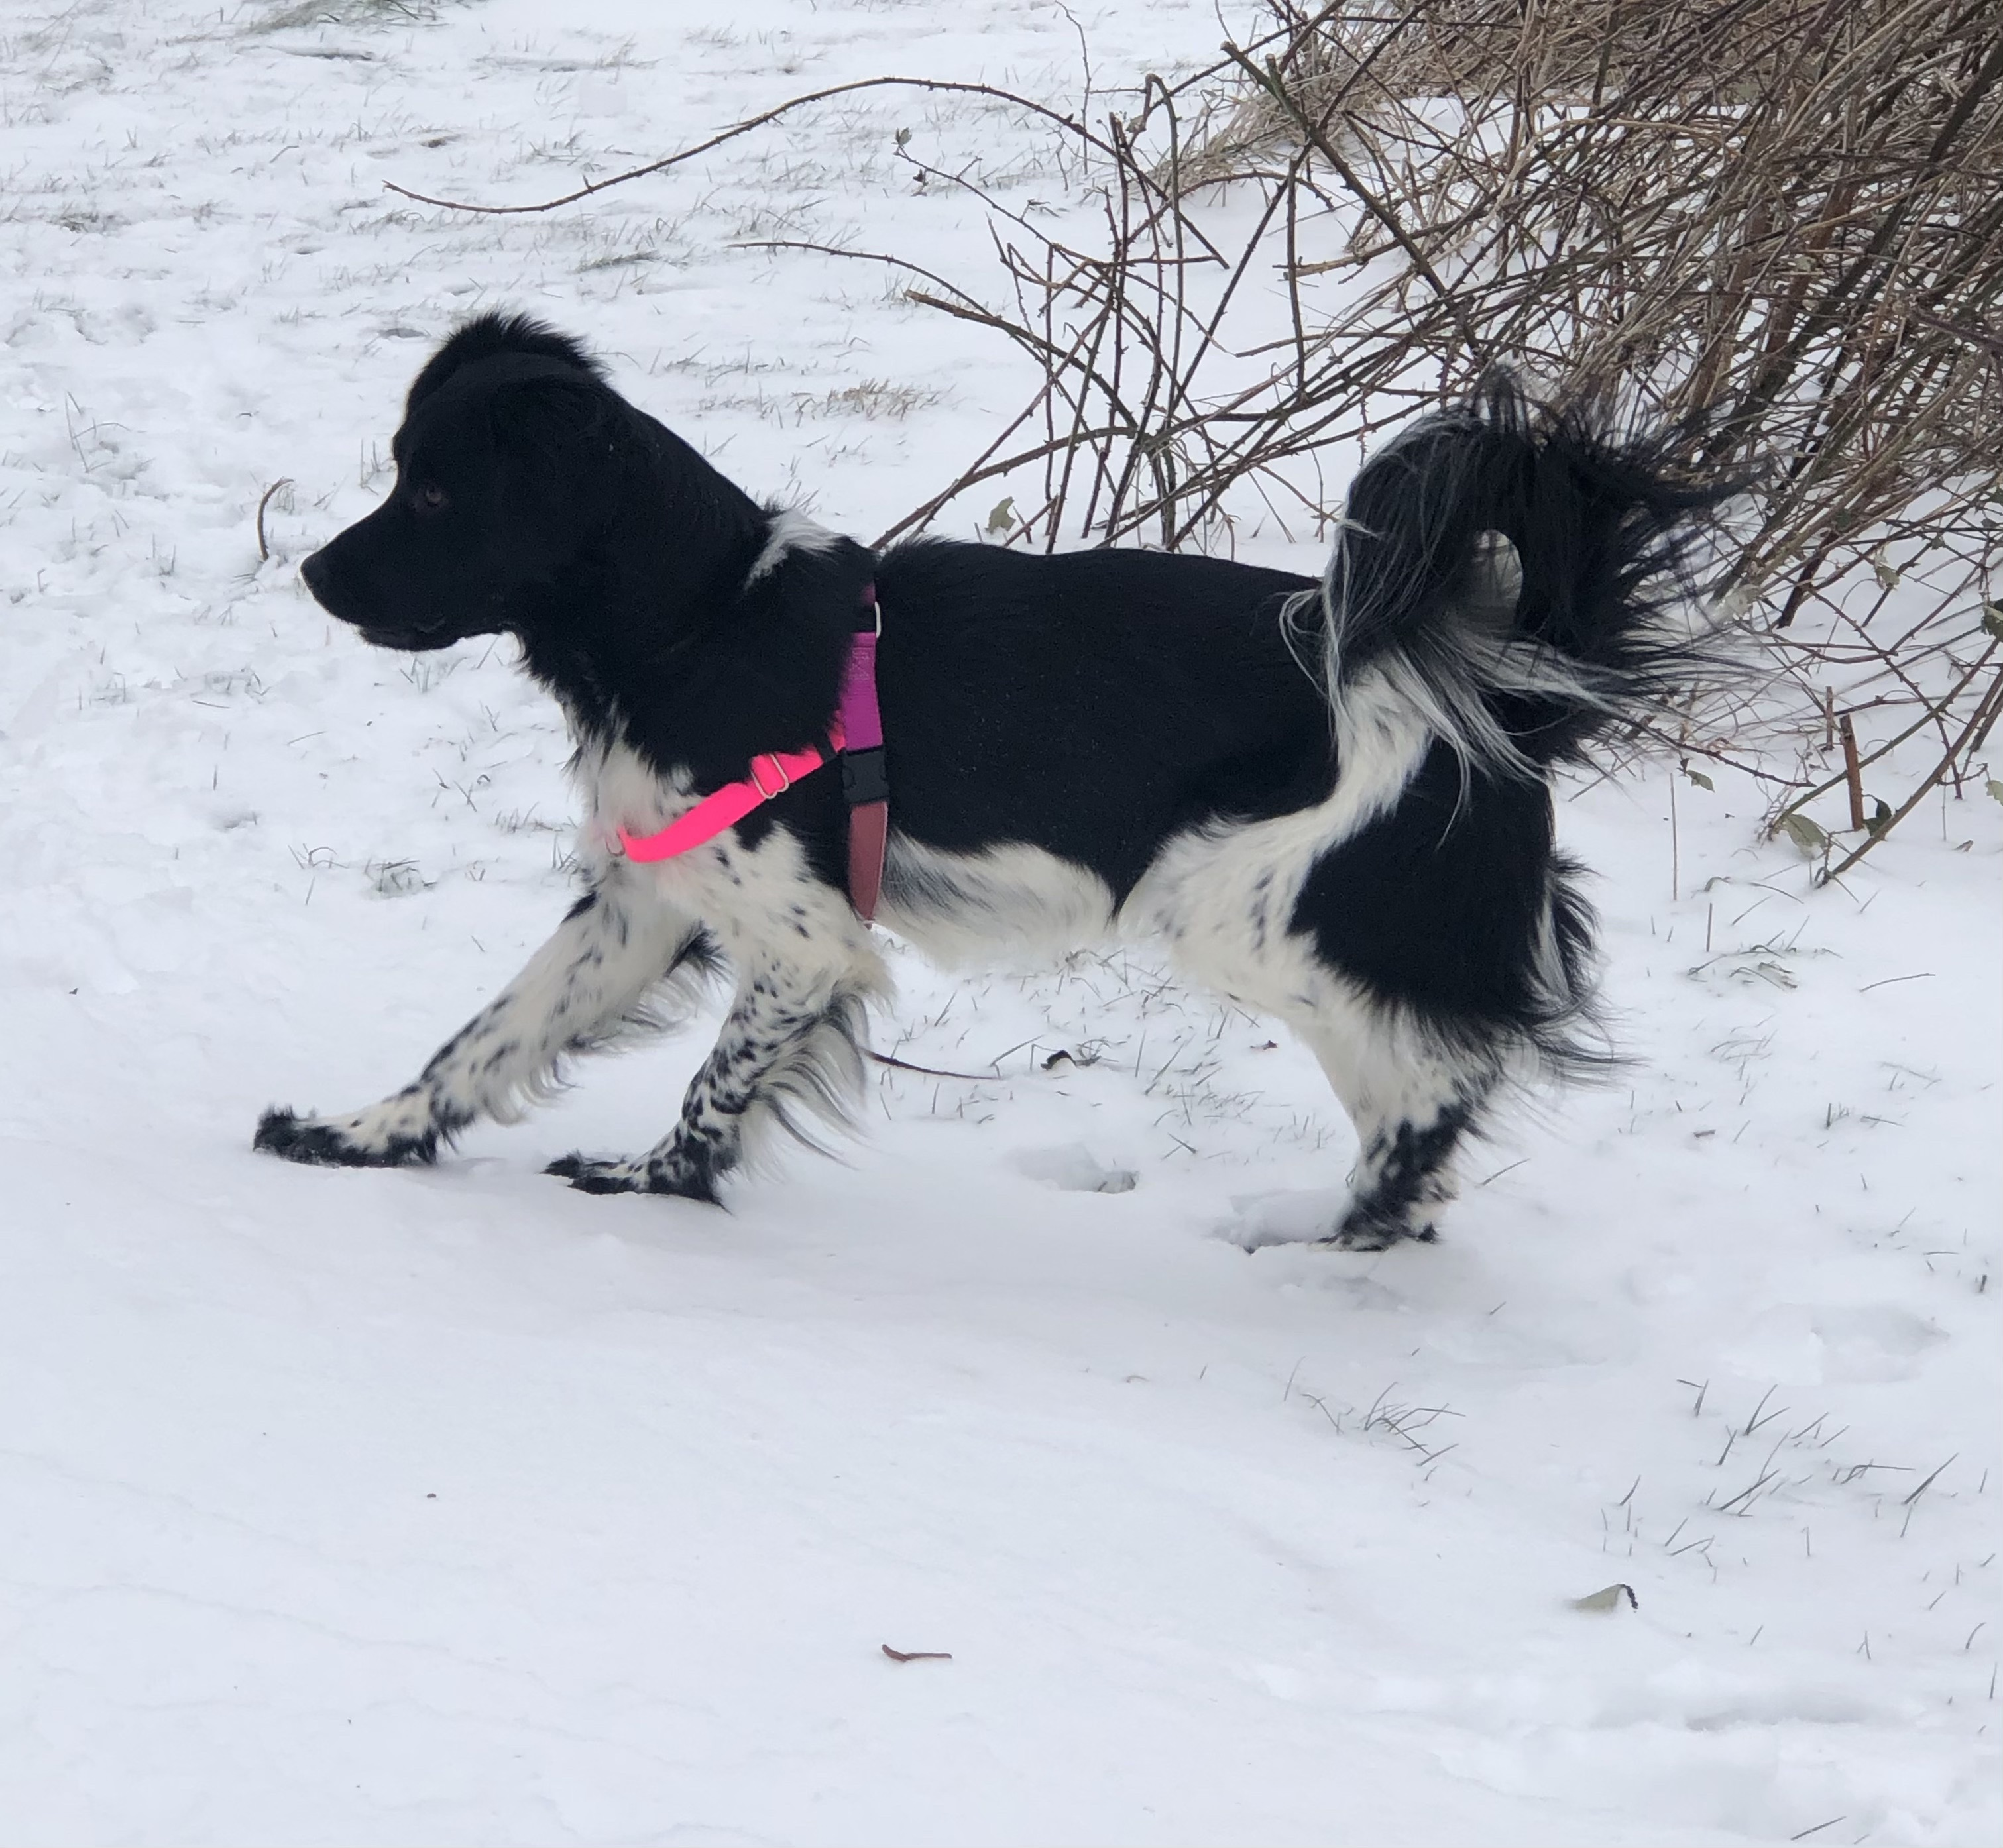
Seeing
Your
Dog
Part 1 - Foundations of Socialization and Training
Dawn Gilkison, presenter
(photos not otherwise credited are by Dawn)

Slide 2
Foundations of Training and Socialization
Seeing Your Dog: Body Language, Critical Periods, Categories of Socialization
Building Trust: Taking Treats, Eye Contact, Approach and Follow, Touch, Food Bowl
R+ Training: Marking, Capturing, Delivery, Collar Touch, Cueing
Building Confidence with Environmental Enrichment: Variety of Examples
Look at That: Objects, People, Sounds, Leash Pressure Training
Active Socialization: Approach & Retreat With Objects, People, Sounds, Check it

Slide 3
Body Language
– Fear, Anxiety, & Stress (FAS)

Slide 4
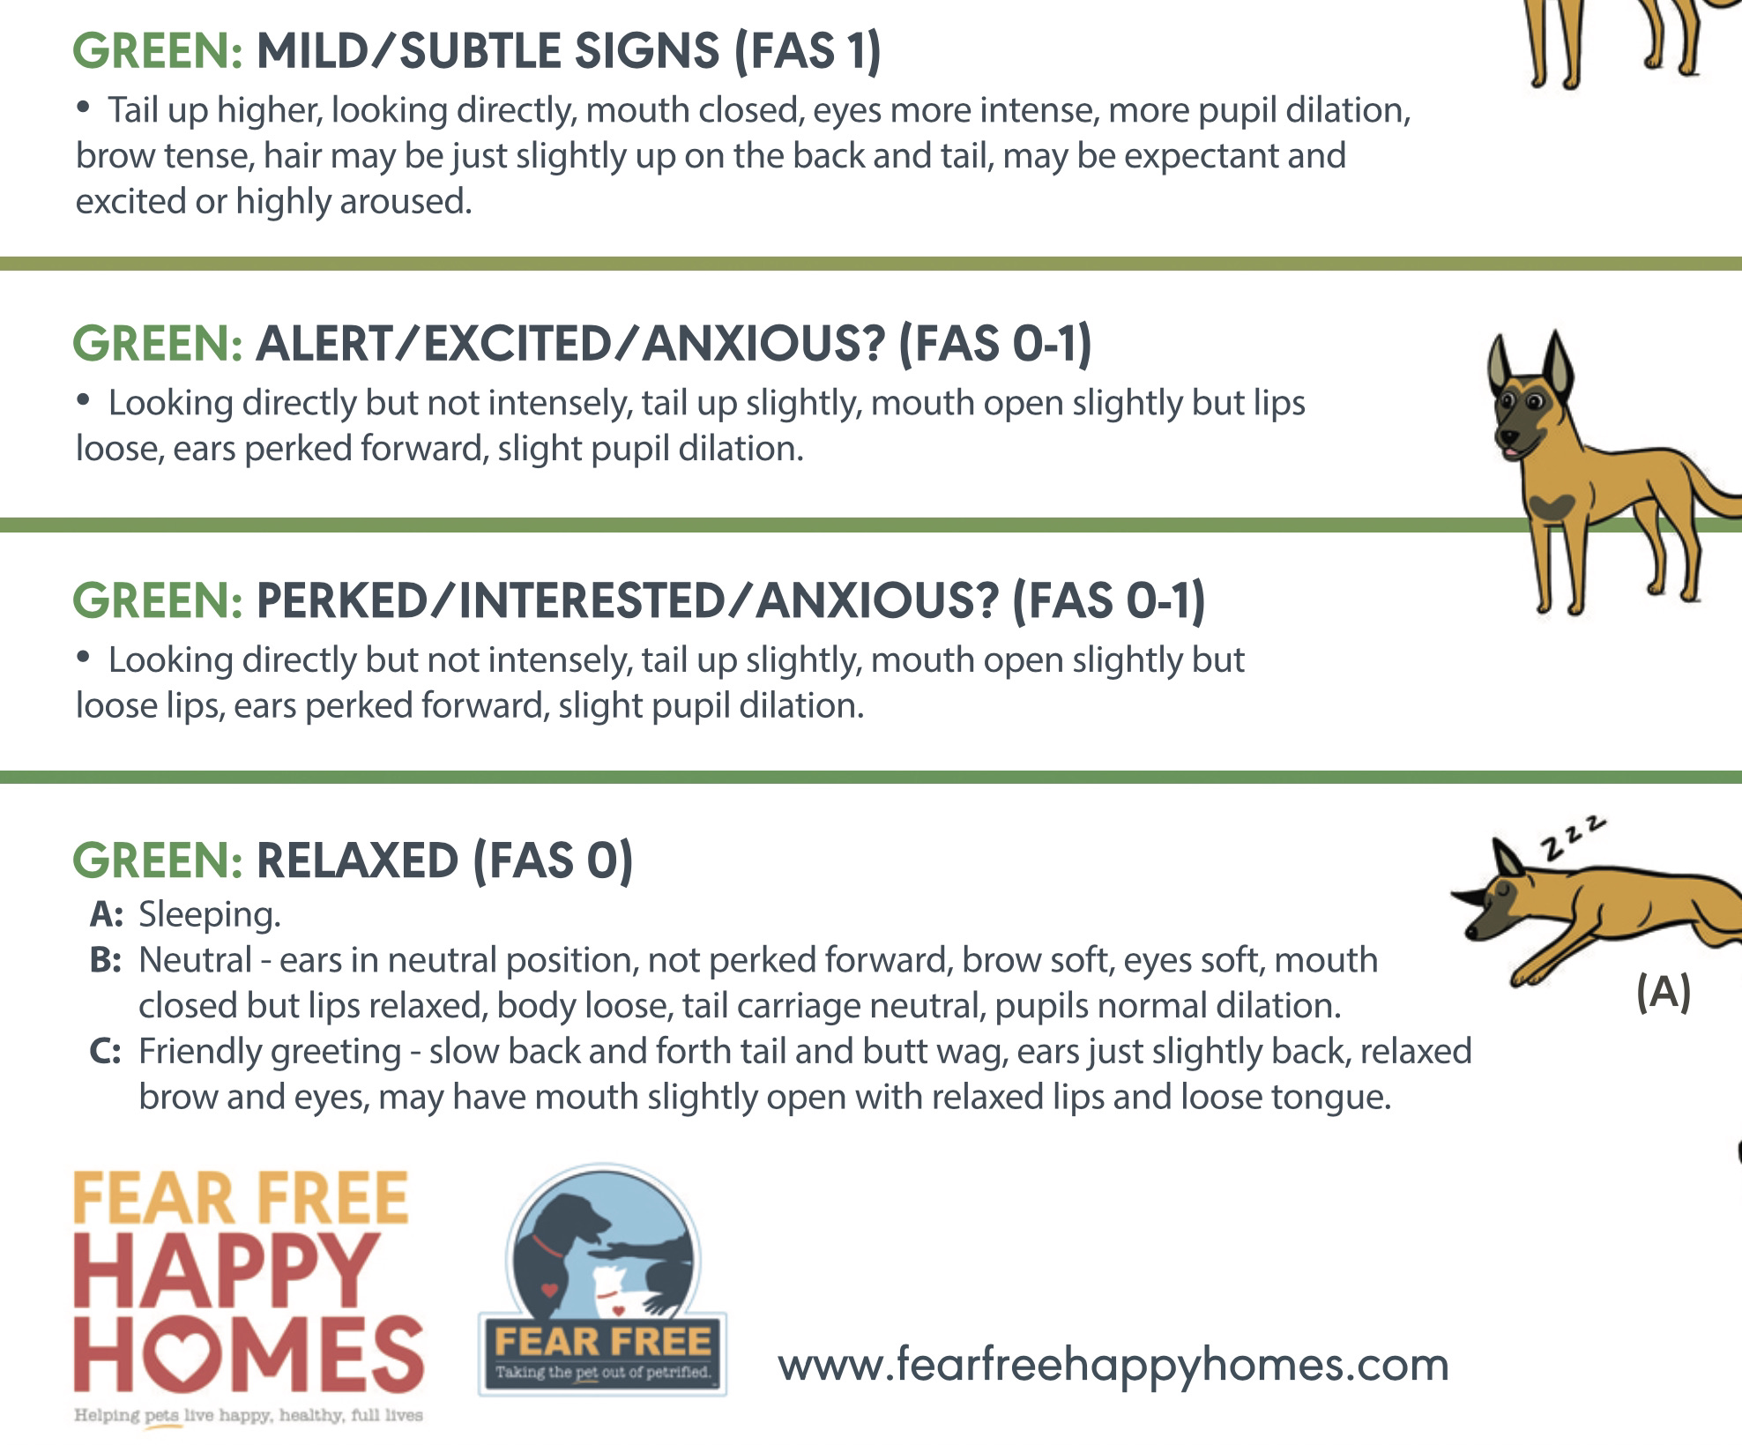
From relaxed to alert
From asleep to engaged
Muscles are loose and relaxed in body and face, lips are relaxed
As dog becomes more alert, muscles become engaged but not stiff or rigid

Slide 5
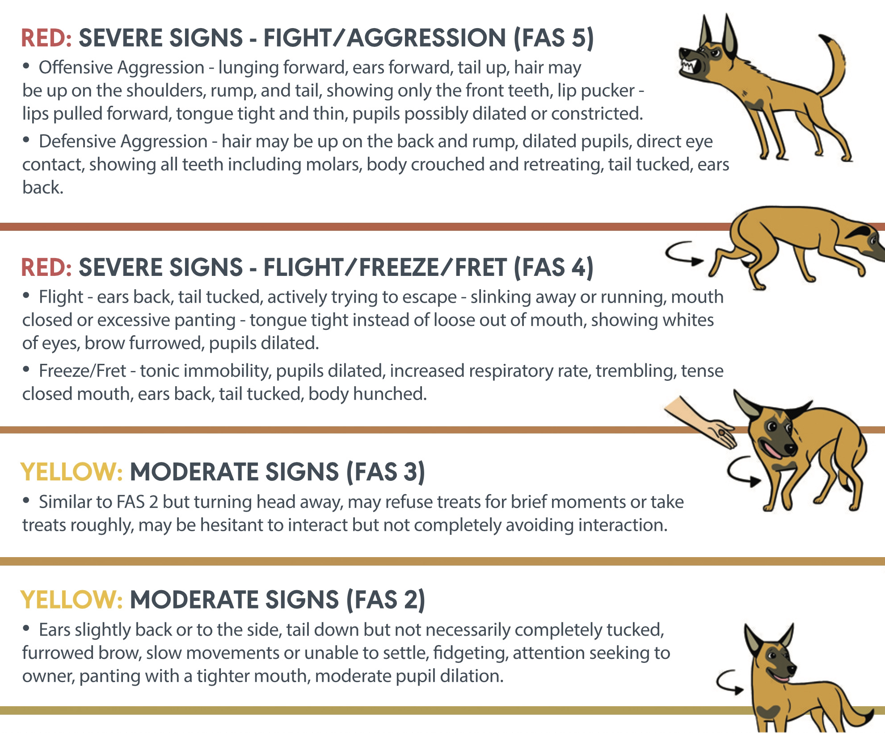
Fear, Anxiety & Stress
Muscles become tense and rigid, body posture becomes more extreme/exaggerated
“Red Flag” behaviors:
Taking treats roughly
Seeking attention
Unable to settle
The “Zoomies”
Freezing/Shutting down
Fleeing

Slide 6
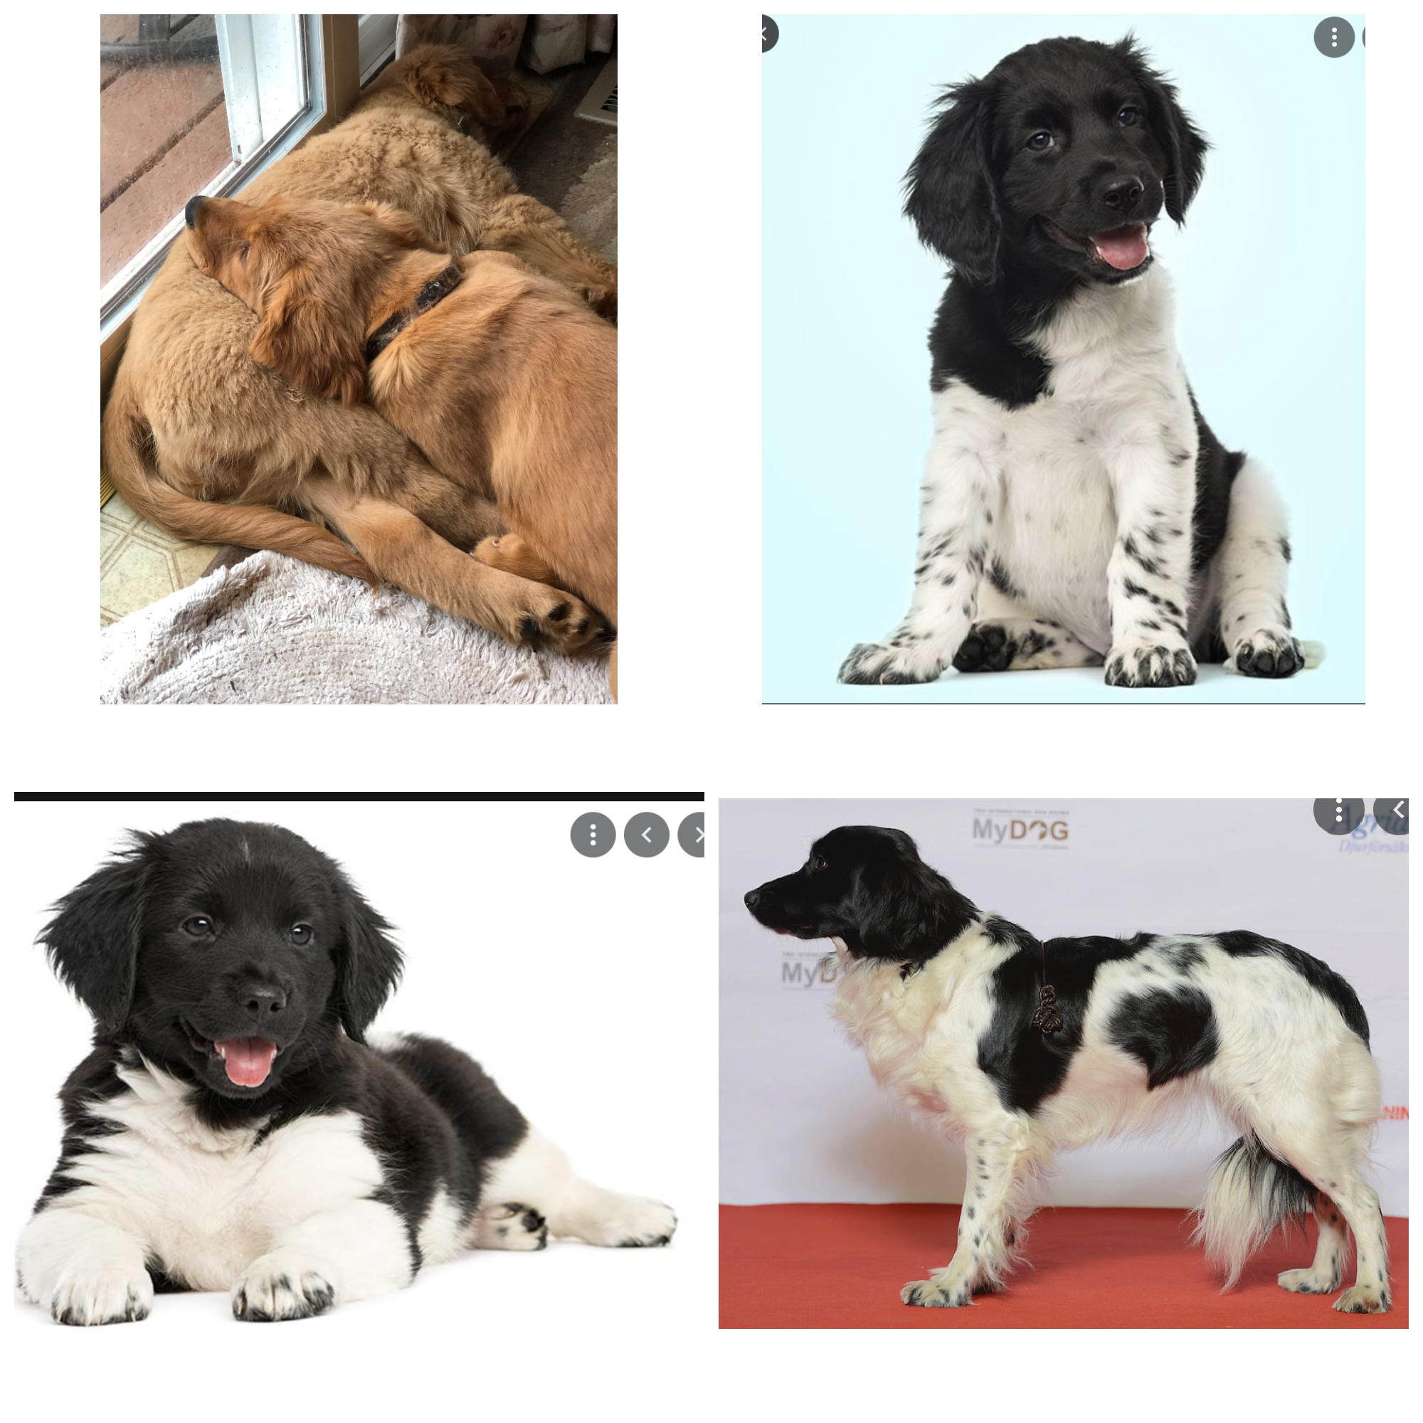
The Big Picture
OVERALL IMPRESSION
Am I relaxed
Or excited?
Do I feel safe?
Or not safe?
Facebook.com and Depositphotos
Notes:
Look at the big picture first –
What is you overall impression?
Relaxed or excited? Are muscles relaxed or tense?
Do I feel safe or not safe?

Slide 7
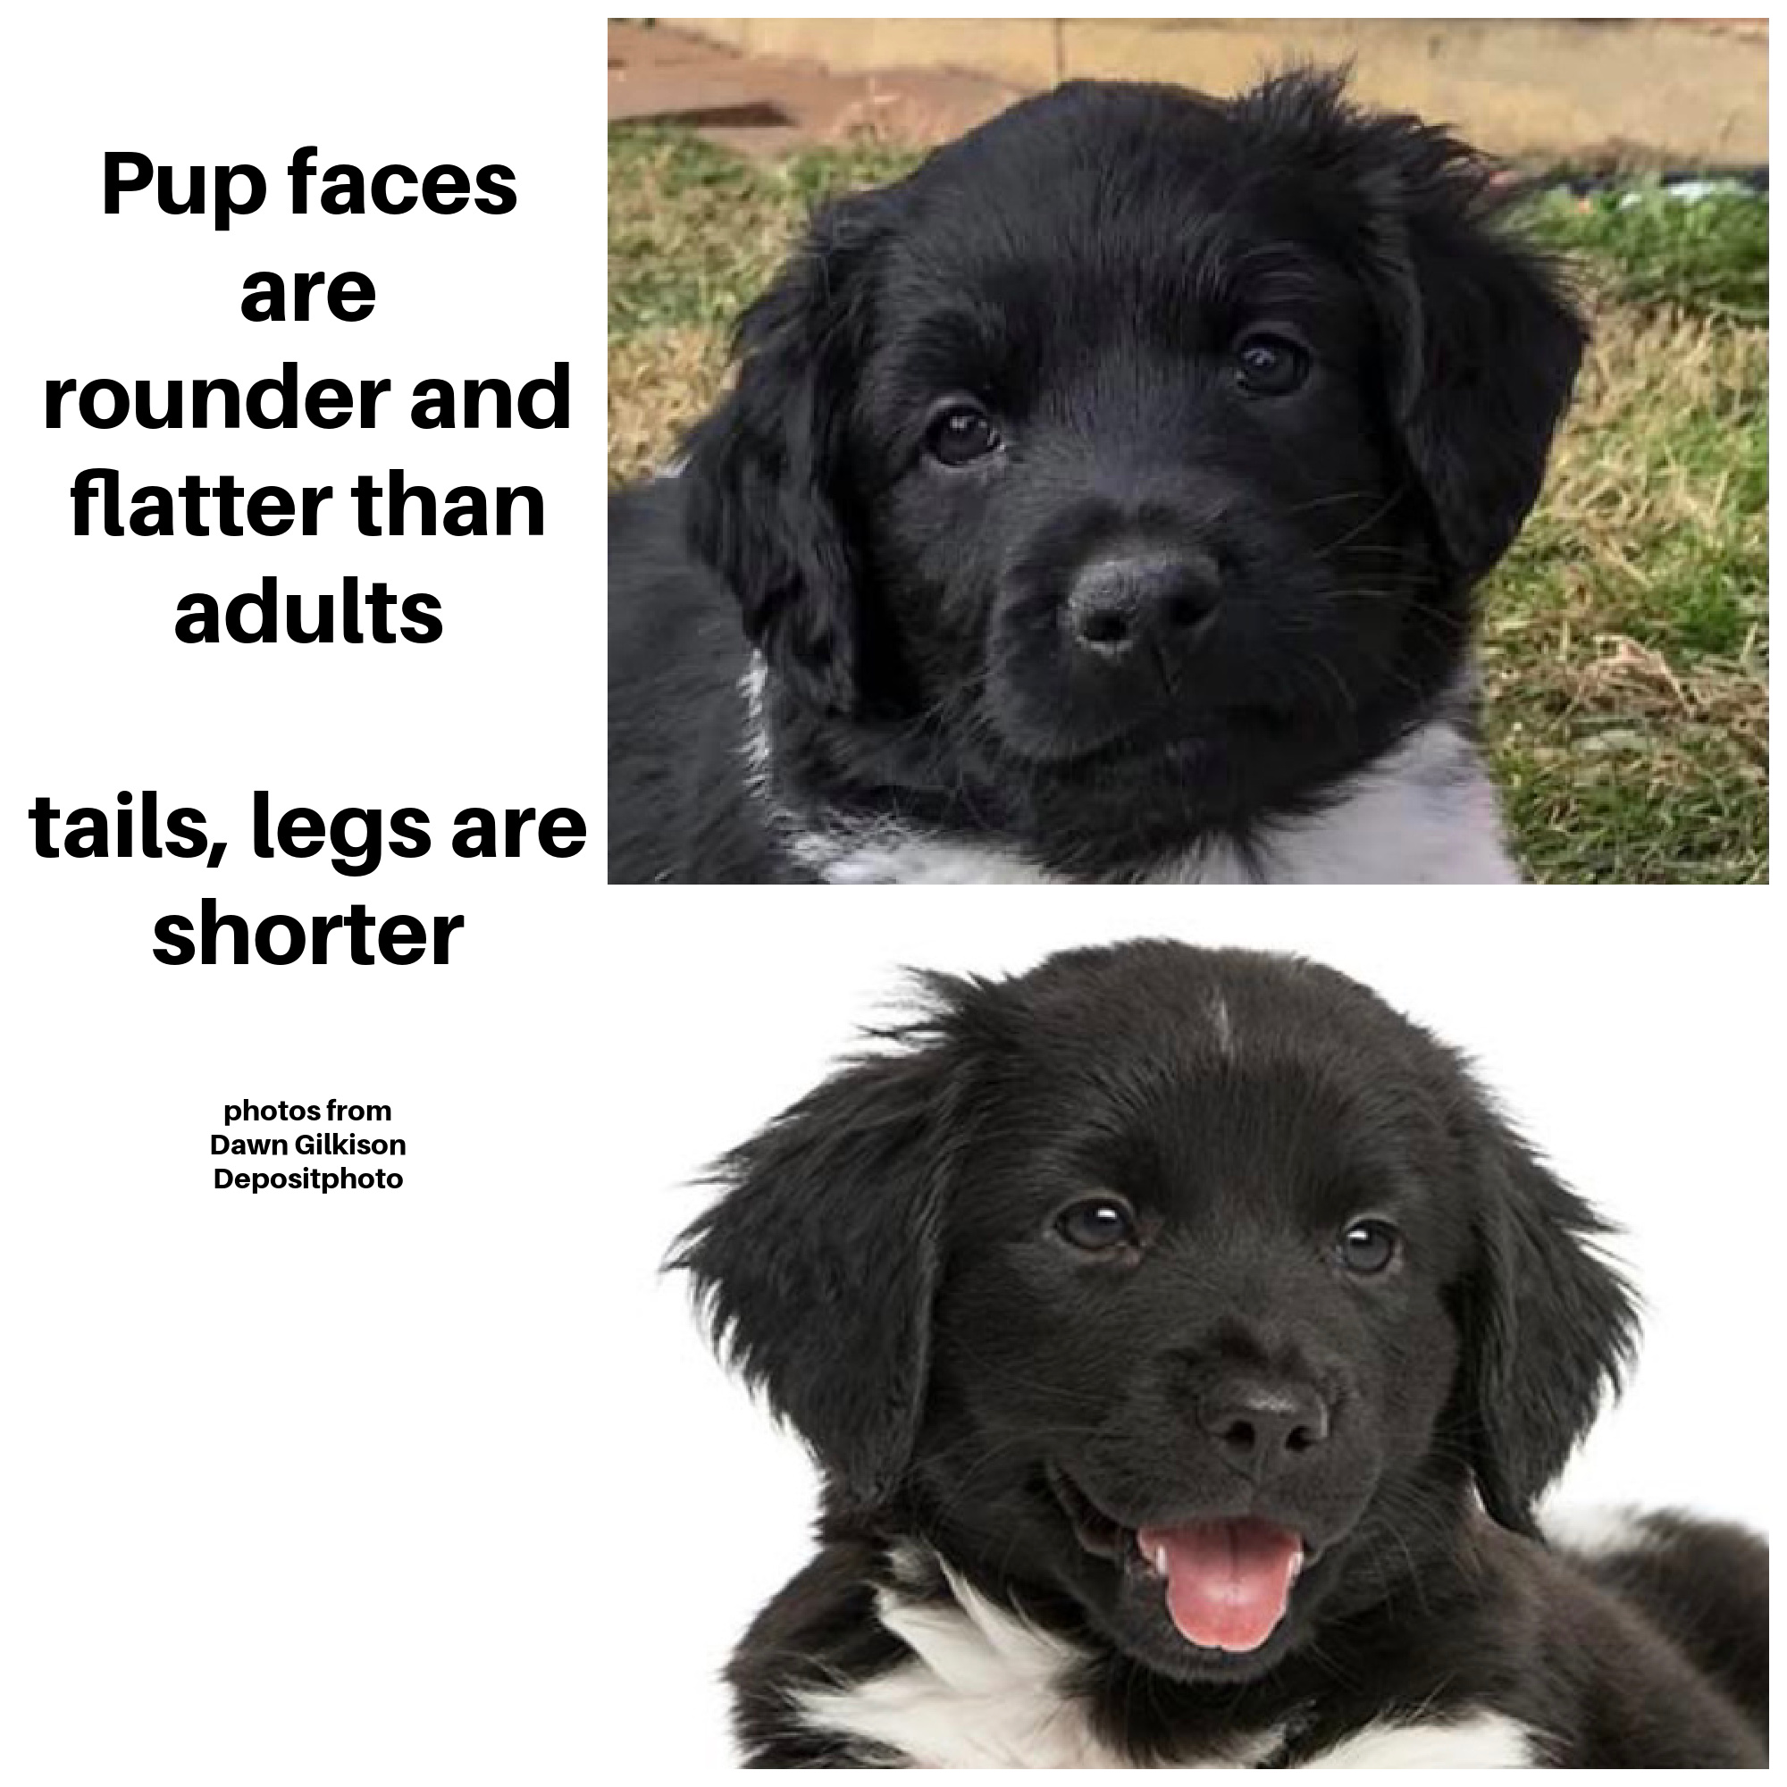
Head & Body
Changes with
Age:
Mobility and expression of Tail and body increase with maturity

Slide 8
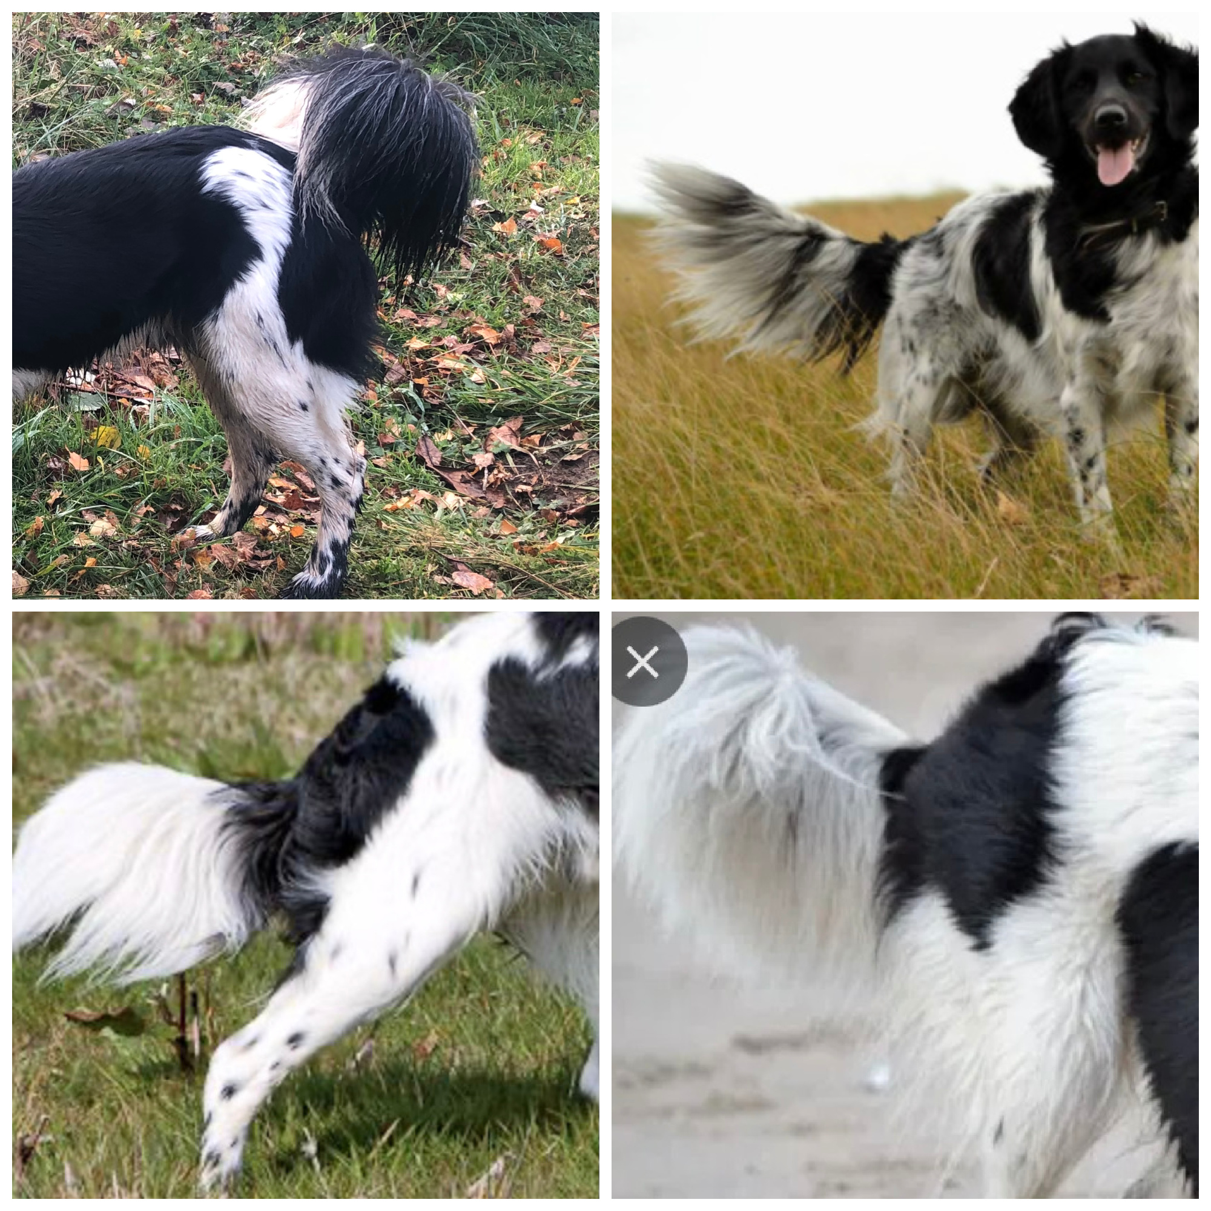
Tail – What is the resting position?
Lowered tail indicates stress
Raised tail indicates arousal

Slide 9
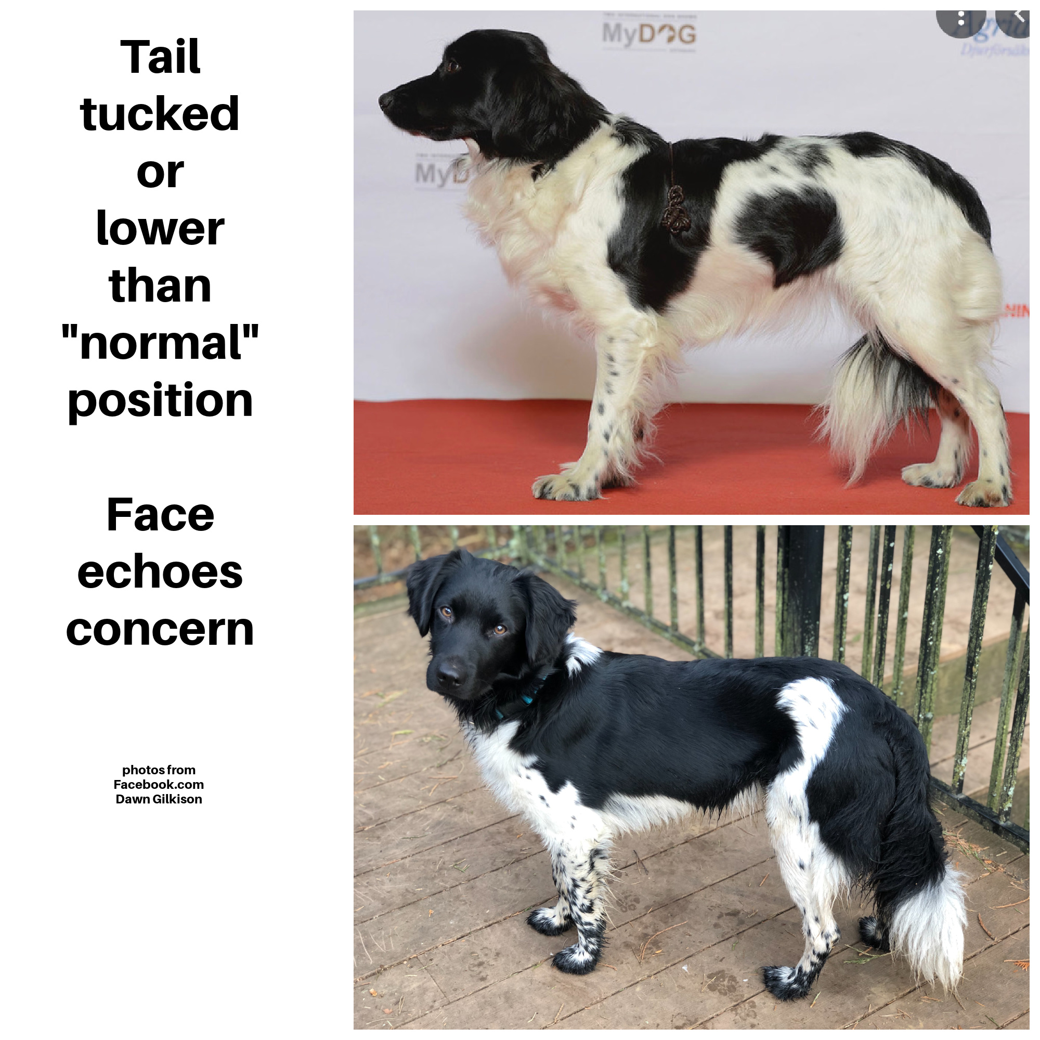
These lowered tails indicate stress/Fear
Movement &
Activity also change Tail
Position

Slide 10
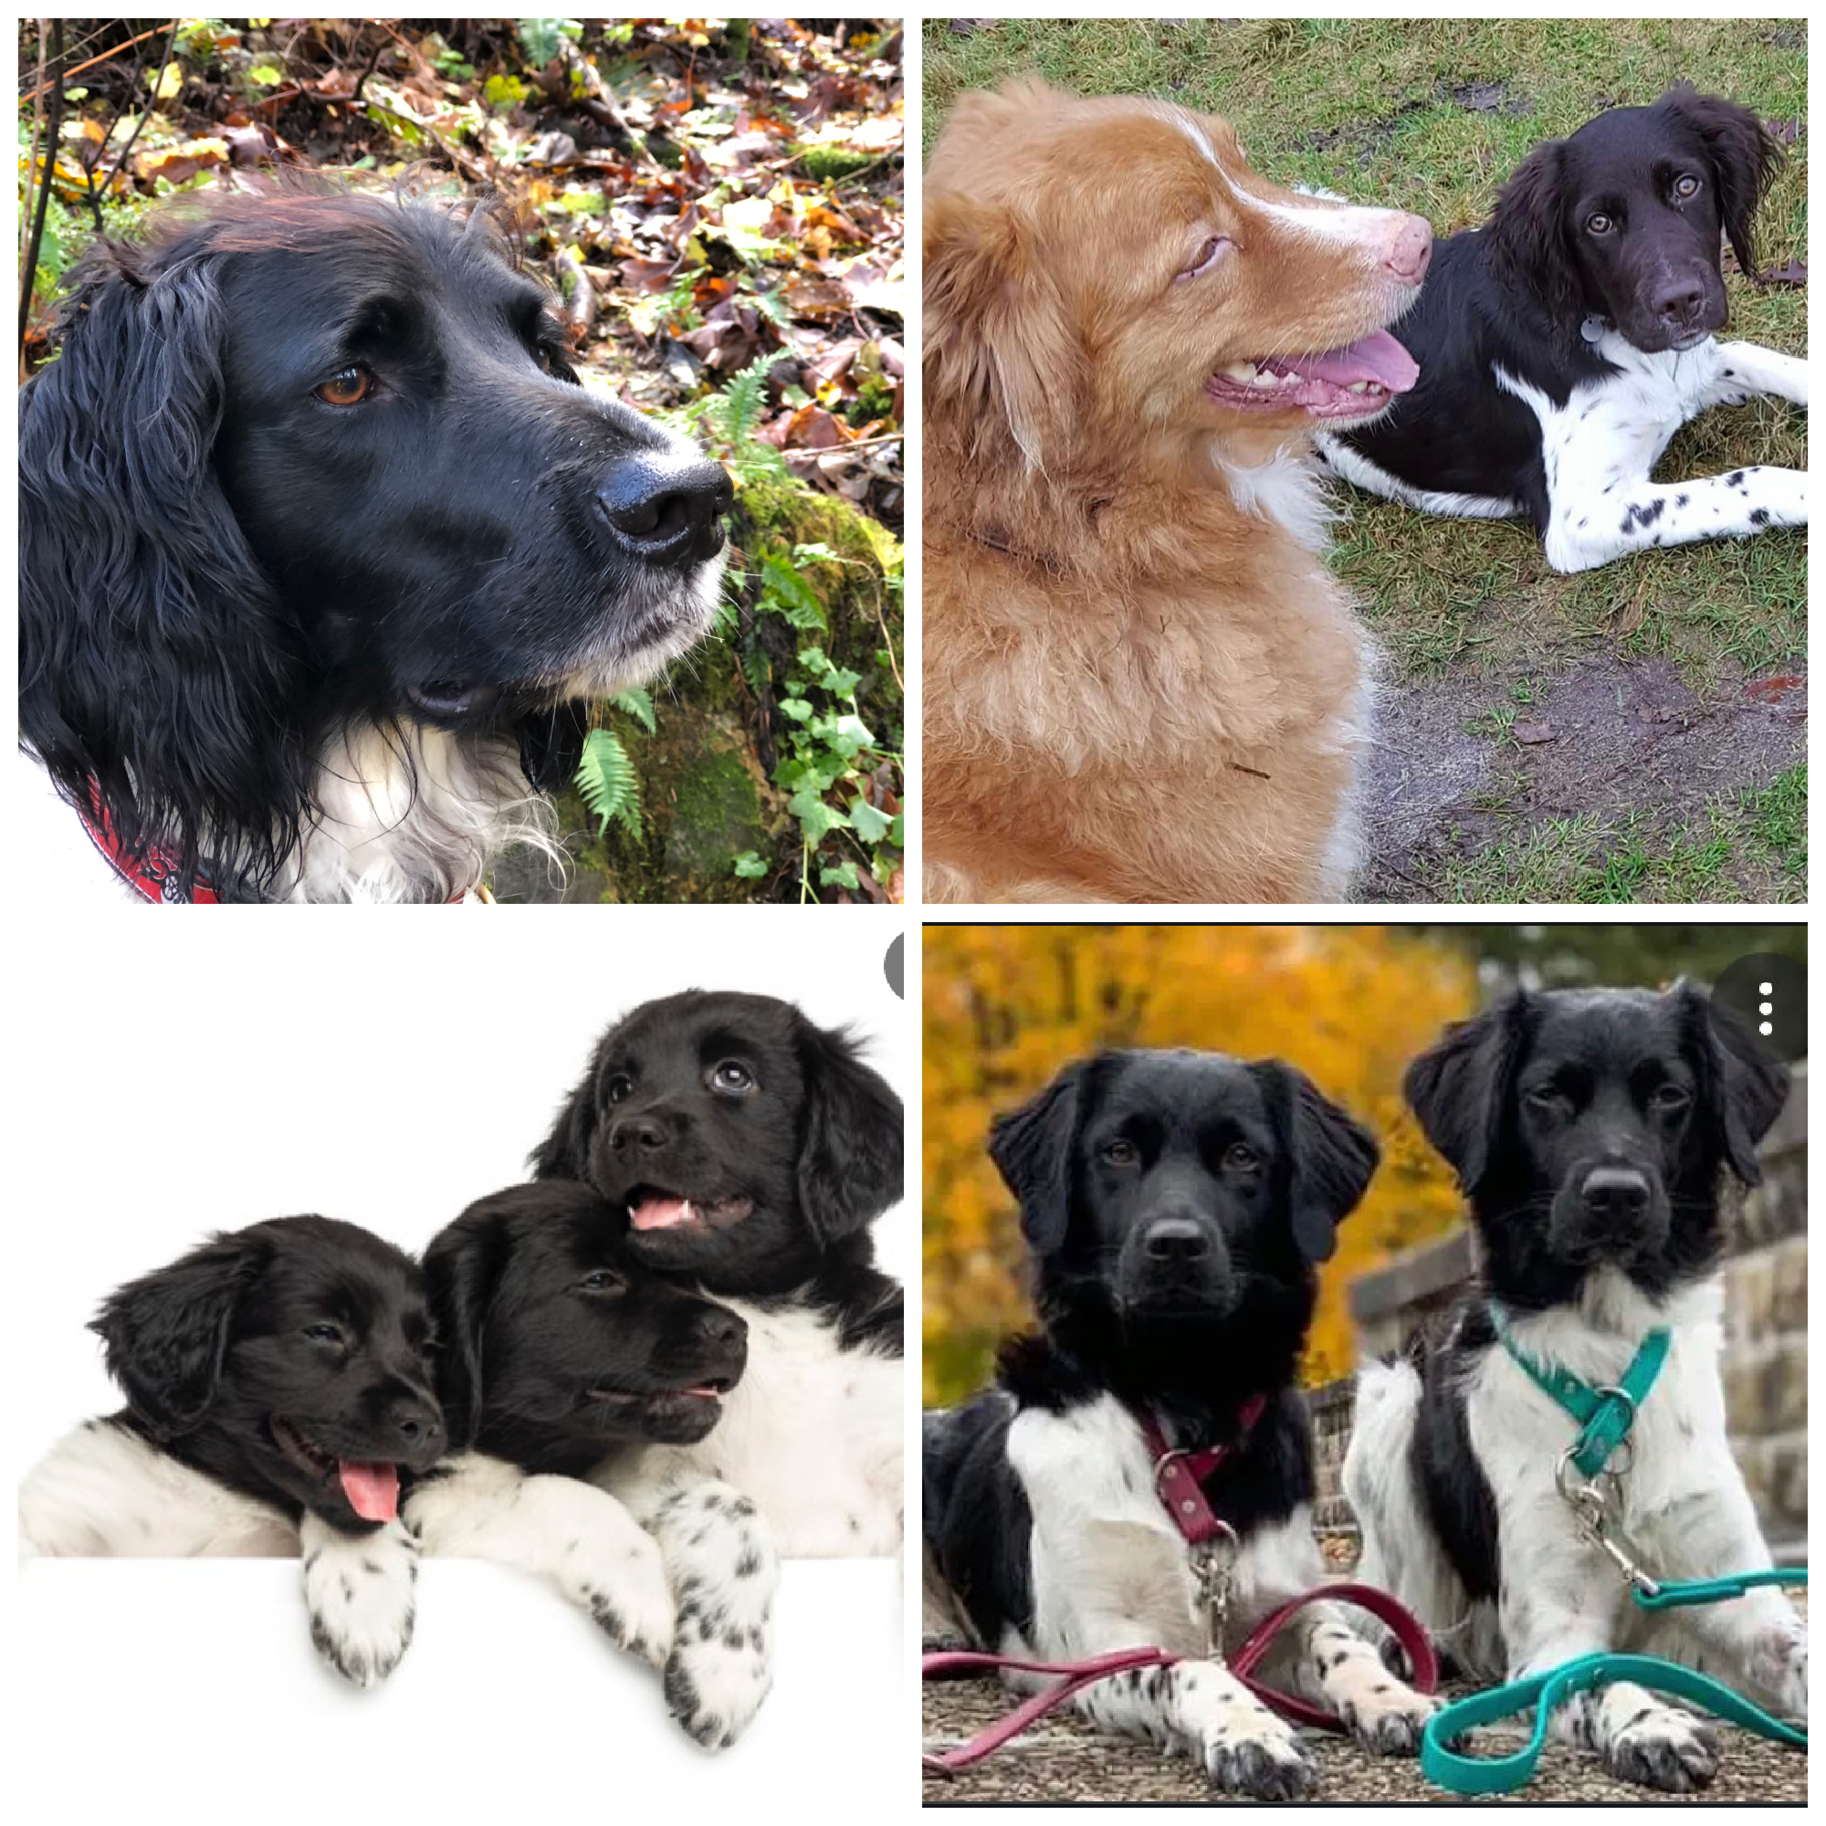
Head –
Relaxed or Tense?
EYE shape: relaxed to round to narrowed brows-relaxed to raised pupils-relaxed to dilated
EARS- Relaxed to Forward, up or back
(can move independently)
MOUTH – Open to closed, Lips relaxed to tight
Teeth exposed to displayed
PHOTOS FROM:
DAWN GILKISON
FACEBOOK.COM
DEPOSITPHOTOS
LISA BUCHSER

Slide 11
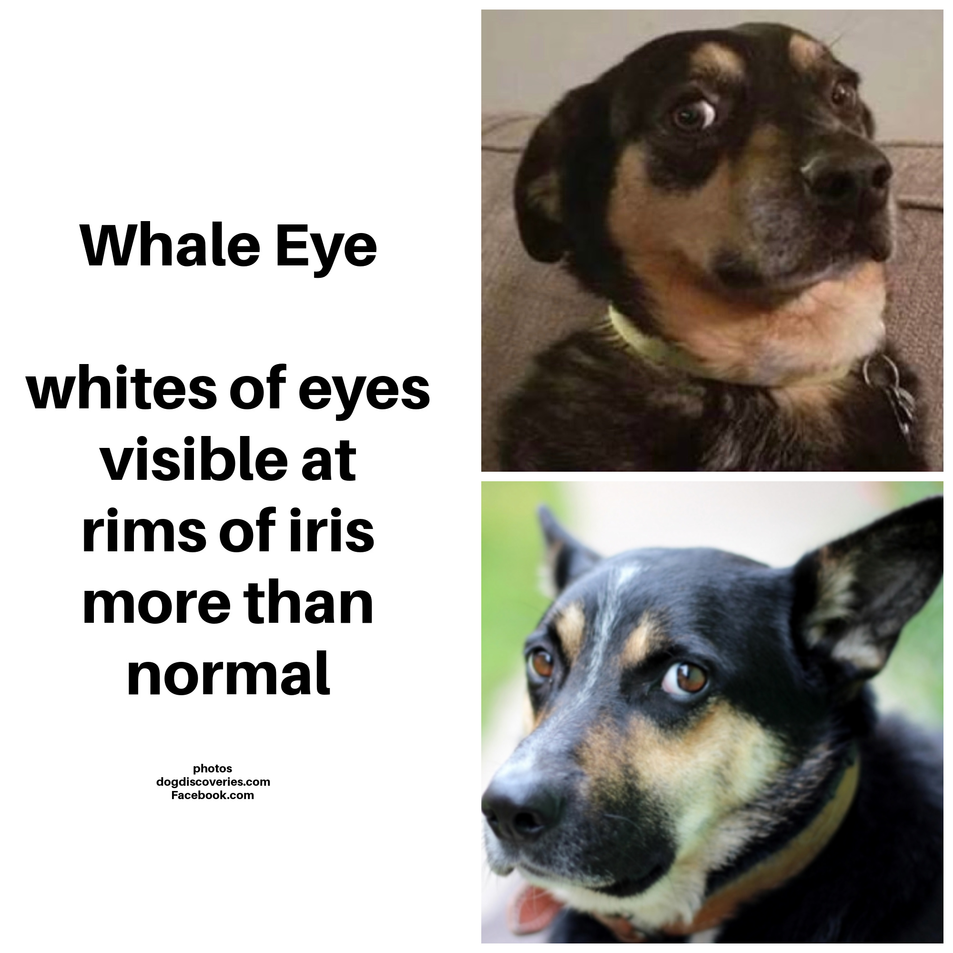
Whale Eye
&
Ears back mouth closed head pulled back

Slide 12
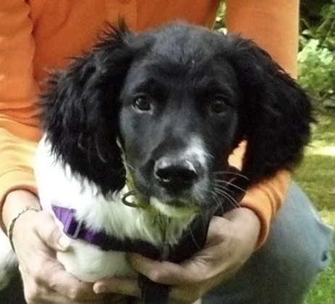
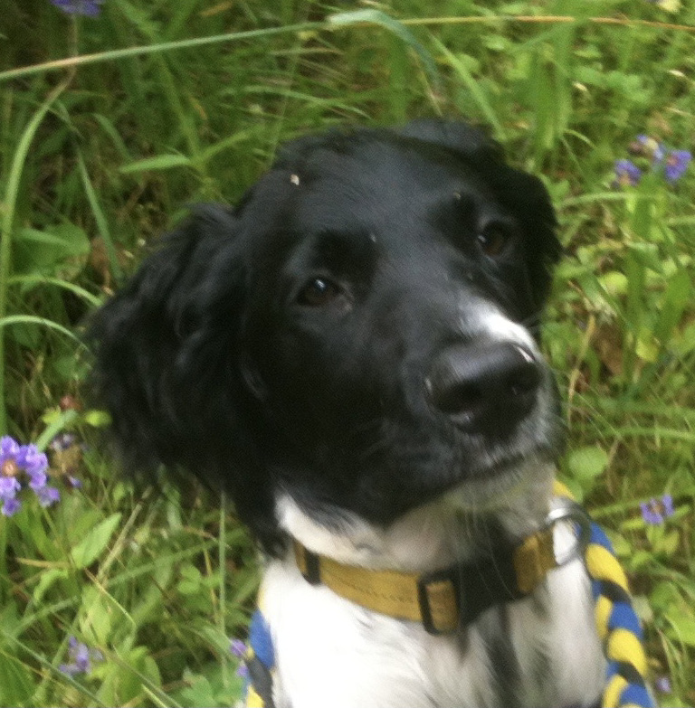
“Anxiety” Face – may look Blank, Flat, or without expression, Pupils dilated, eyes round, without whale eye, mouth tight, body still

Slide 13
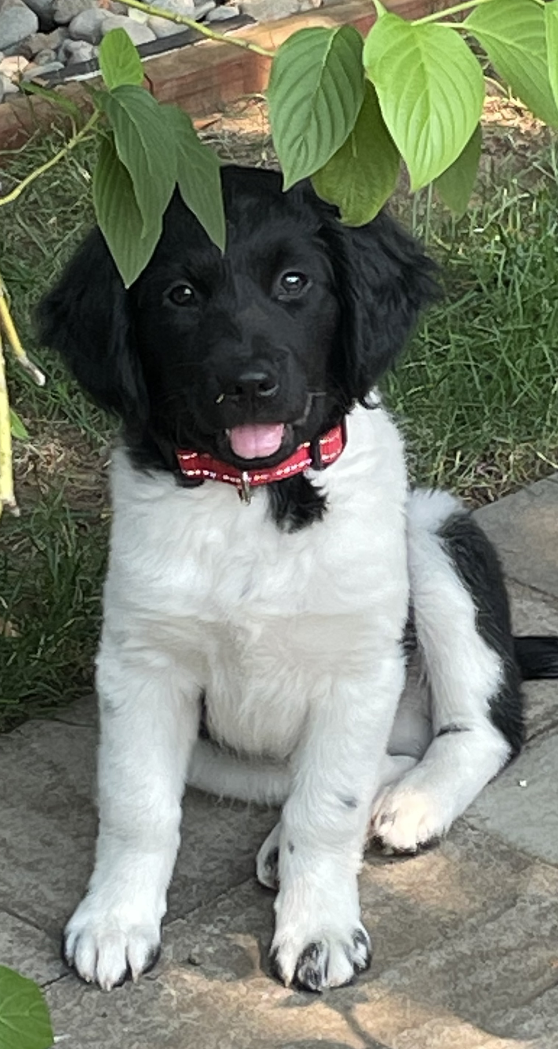
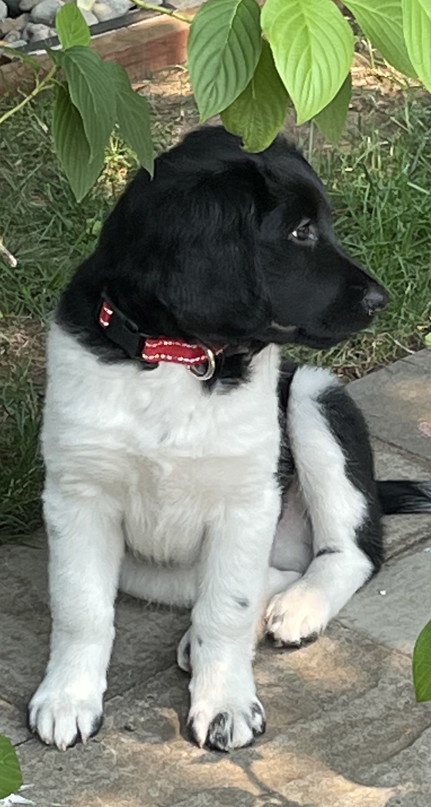
What do you see?
THe Big Picture?
Body?
Tail?
HEAD?
EYE shape?
Brows?
Pupils?
EARS?
MOUTH?
Lips?
Teeth?
PHOTOS FROM:
DAWN GILKISON

Slide 14
Socialization – lifelong process of Effectively* pairing encounters with novel Stimuli and new environments with positive reinforcement for the dog
*without causing Fear or avoidance
Environments – indoors, outdoors, public and private spaces
People – different ages, appearances, and movement
Animals – pets, farm animals,
wildlife
Novel Objects – vehicles, household appliances and yard equipment
Sounds – indoors, outdoors, natural, artificial
Surfaces – indoors, outdoors, different textures

Slide 15
Socialization –
Many future behavior problems can be prevented through proper socialization, including:
Puppy Start right (2011) page 25
Aggression to people and dogs
Anxiety -related problems
Nuisance behaviors such as jumping, chewing, stealing objects, and excessive barking
Fear of people, places, and things

Slide 16
Developmental Periods
Prenatal In utero
Neonatal Birth to 12 days limited sensory perception
Transitional 12 days to 3 weeks eyes open, starts walking, ears open
Socialization 3 weeks to 12 - 16 weeks - open to new experiences
Juvenile 12 weeks to sexual maturity - becomes more fearful, permanent teeth
Adolescent Sexual to Social Maturity (2 - 3 years) - becomes more independent
Adult Social Maturity to 7 + years - play behavior may decrease
Senior 7 + and older - activity level may decrease, sensory perception may become limited

Slide 17
Critical Periods for Socialization
Primary Socialization
3 – 5 weeks
Learns to be a dog
1st Fear Period
8-10 weeks of age
Avoid trauma
Juvenile
12 weeks to sexual maturity
Becomes more independent
2nd Fear Period
between 4-12 months
may last up to 3 weeks
Avoid trauma
Secondary Socialization
6 – 12 to 16 weeks
Open to new experiences

Slide 18
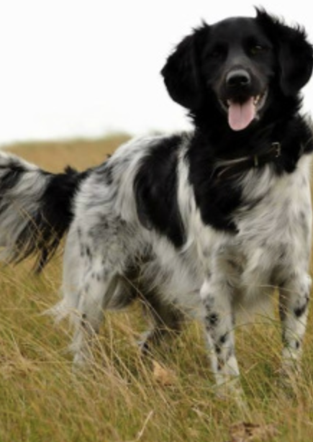
Questions?
Canine Behavior A Photo Illustrated Handbook Barbara Handelman (2008)
Fear in Dogs Lynda Taylor MSc (2020)
From Fearful to Fear Free Becker, M. et. al. (2017)
Puppy Start Right Kenneth M. Martin, DVM and Debbie Martin, RVT, VTS (Behavior) (2011)
American Veterinary Society of Animal Behavior www.avsab.org
Photo – Facebook.com

