Slide 1
Milfoil 2023 and 2024

Slide 2

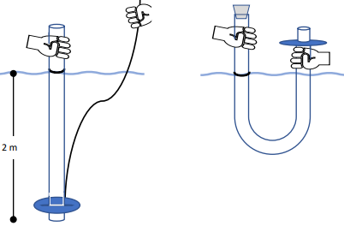
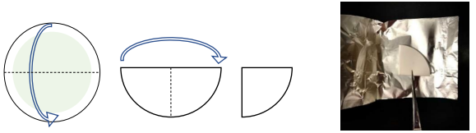
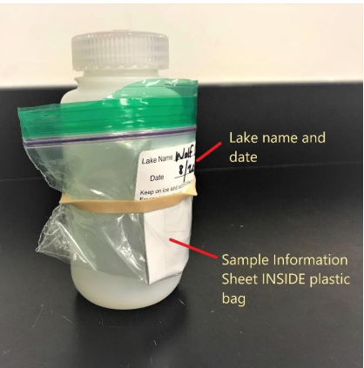
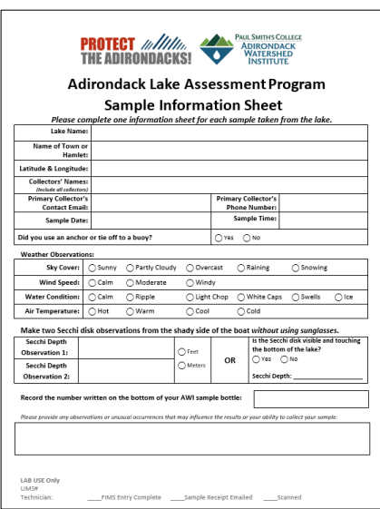
ALAP/AWI-June, July, August water samples
Our June water samples have been sent to Adirondack Watershed Institute in Paul Smiths for analysis. (thank you to our trained water sample collection volunteers Eileen Junbluth and Mary Wanzer)

Slide 3
Week 1, 2023
Indian Lake
Northwest Shore 42 bags @ 1050 lbs.
Southwest Shore 34 bags @ 850 lbs.
Total 76 bags @ 1900 lbs.

Slide 4
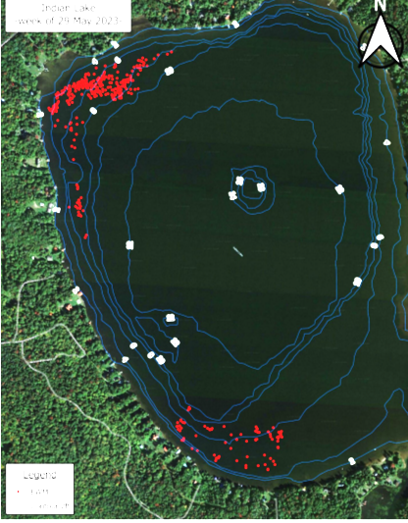

Slide 5
Week 2, 2023
Mountain View Lake 8.75 bags @218.8 lbs.
Indian Lake 17.75 bags @ 443.8 lbs.
Total 26.5 bags @ 662.5 lbs.

Slide 6
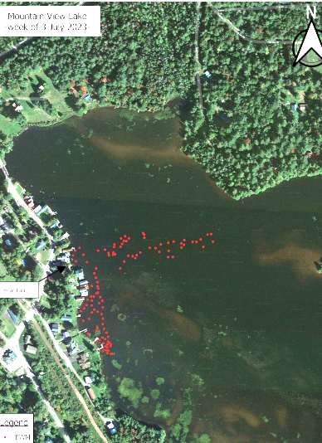

Slide 7
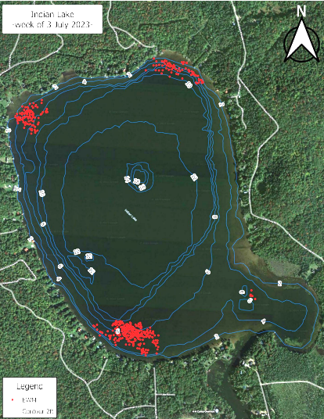

Slide 8
Week 3, 2023
Mountain View Lake 43.1 bags @ 1077.5 lbs.
Indian Lake 15 bags @ 375 lbs.
Total 58.1 bags @ 1452.5 lbs.

Slide 9
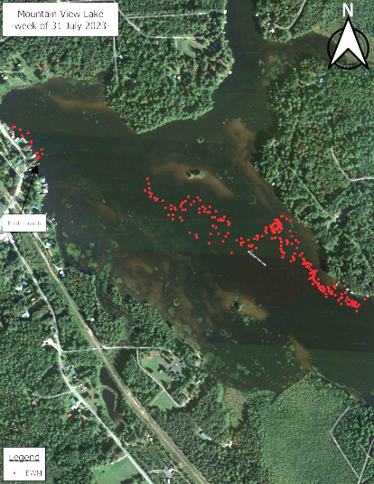

Slide 10
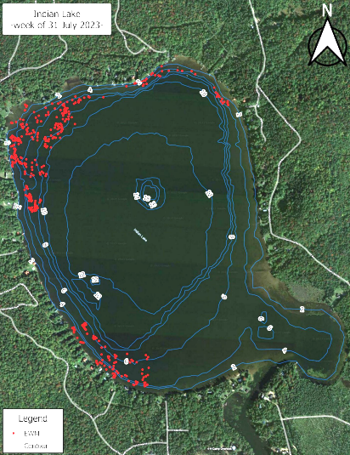

Slide 11
Week 4, 2023
Indian Lake
Northwest Shore 8 bags @ 200 lbs.
West Shore 8 bags @ 200 lbs.
Southeast Shore 0.5 bags @ 12.5 lbs.
Total 19 bags @ 475 lbs.

Slide 12
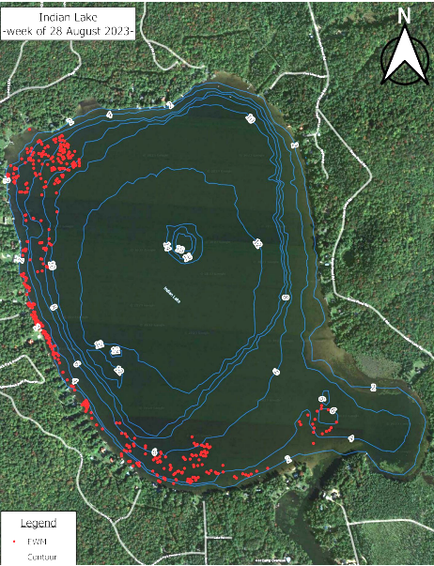

Slide 13
Week 5, 2023
Mountain View Lake
Southwest Shore of Channel 28 bags @ 700 lbs.
Northern (Poplar) Island Area 101 bags @ 2525 lbs.
Eastern Shore Area 23 bags @ 575 lbs.
Total 150 bags @ 3800 lbs.

Slide 14
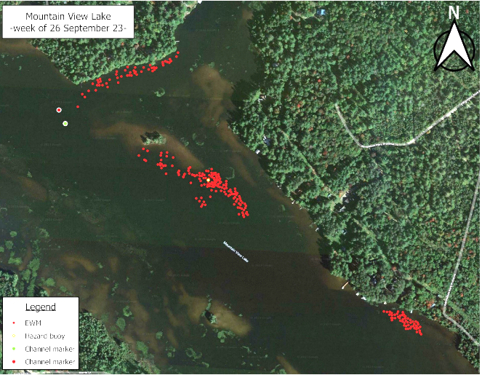

Slide 15
Summary
Week 1 76 bags @ 1900 lbs.
Week 2 26.5 bags @ 662.5 lbs.
Week 3 58.1 bags @ 1452.5 lbs.
Week 4 19 bags @ 475 lbs.
Week 5 152 bags @ 3800 lbs.
(wks 1-4 179.6 bags @ 4490 lbs.)
Total 331.6 bags @ 8290 lbs.

Slide 16
ProcellaCOR
Applied on Horseshoe Pond June 18, 2024
Applied on Chateaugay Lake June 28, 2024
Glenn Sullivan toured our lakes June 18, 2024 (Biologist with 30+ years experience)
  Mountain View Lake would be a good candidate (start with a 30-40 acre area at $1500/acre)
Example: Minerva Lake-used to spend $50-70,000 on divers; Treated for $35,000; no divers for 3 years; year 4 will have divers for 2-5 days

Slide 17
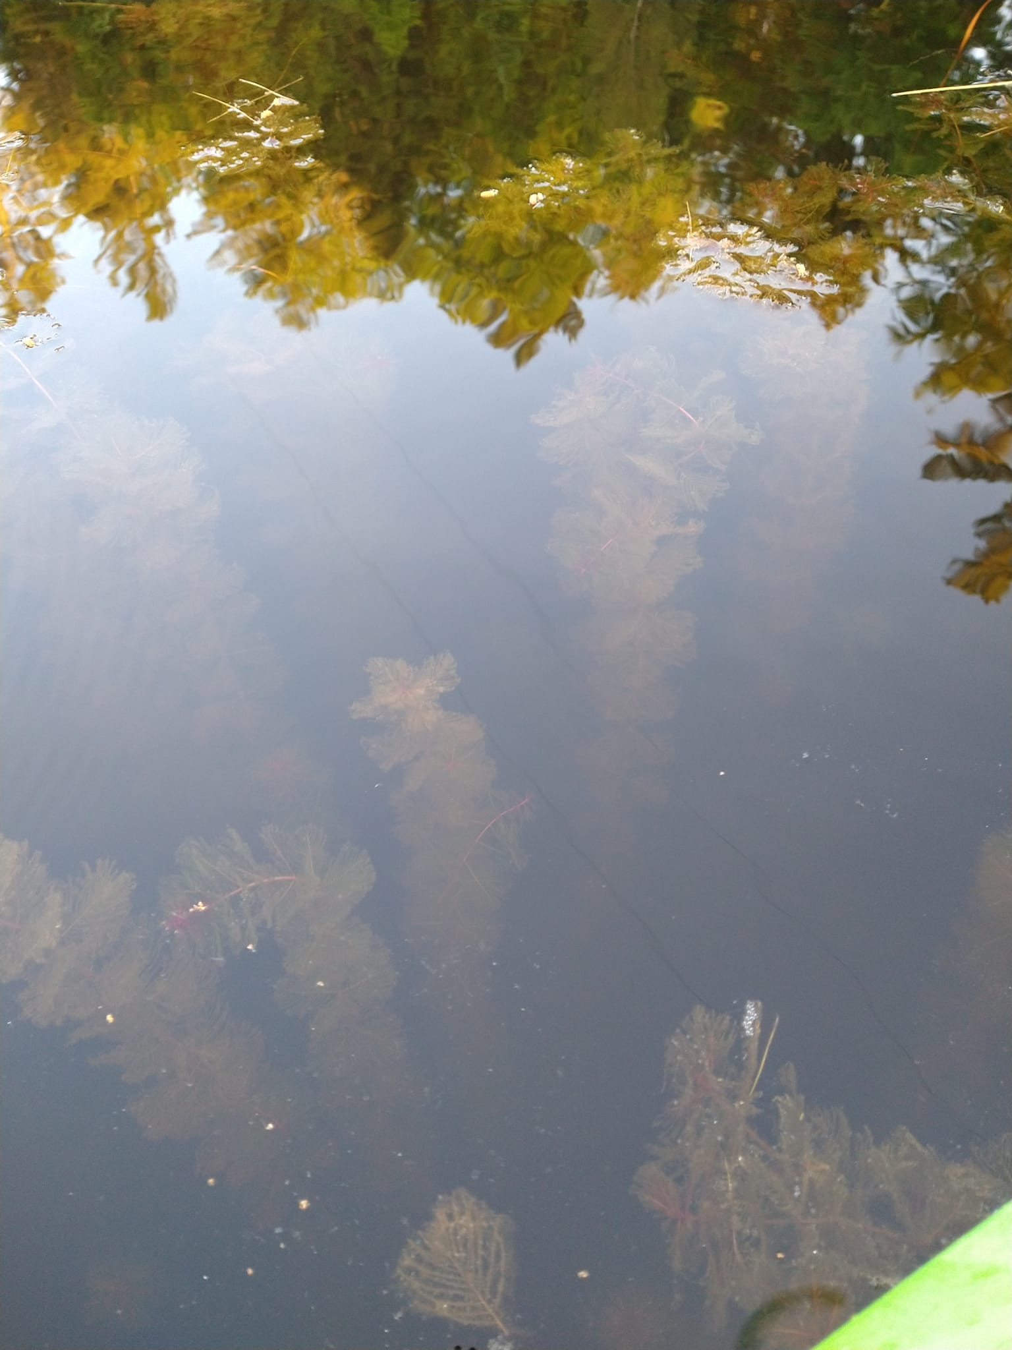
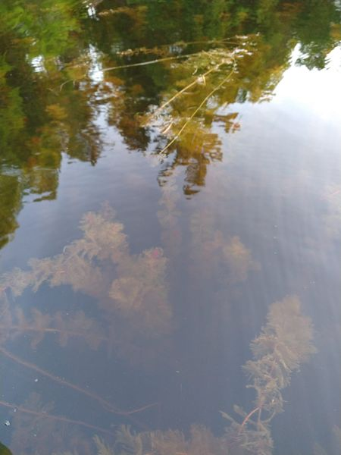
Horseshoe Pond

Slide 18
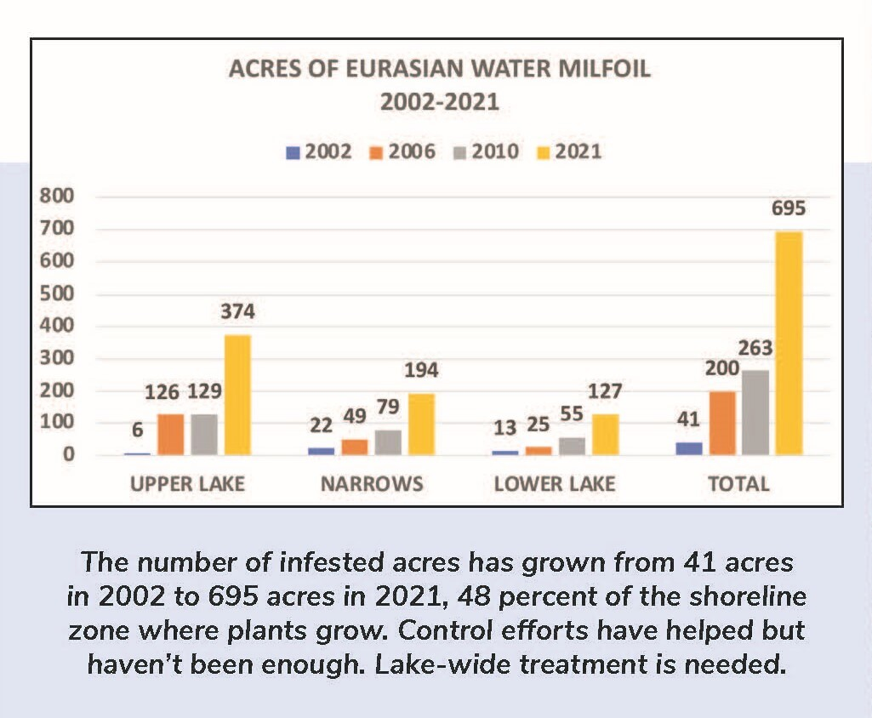
Chateaugay Lake

Slide 19
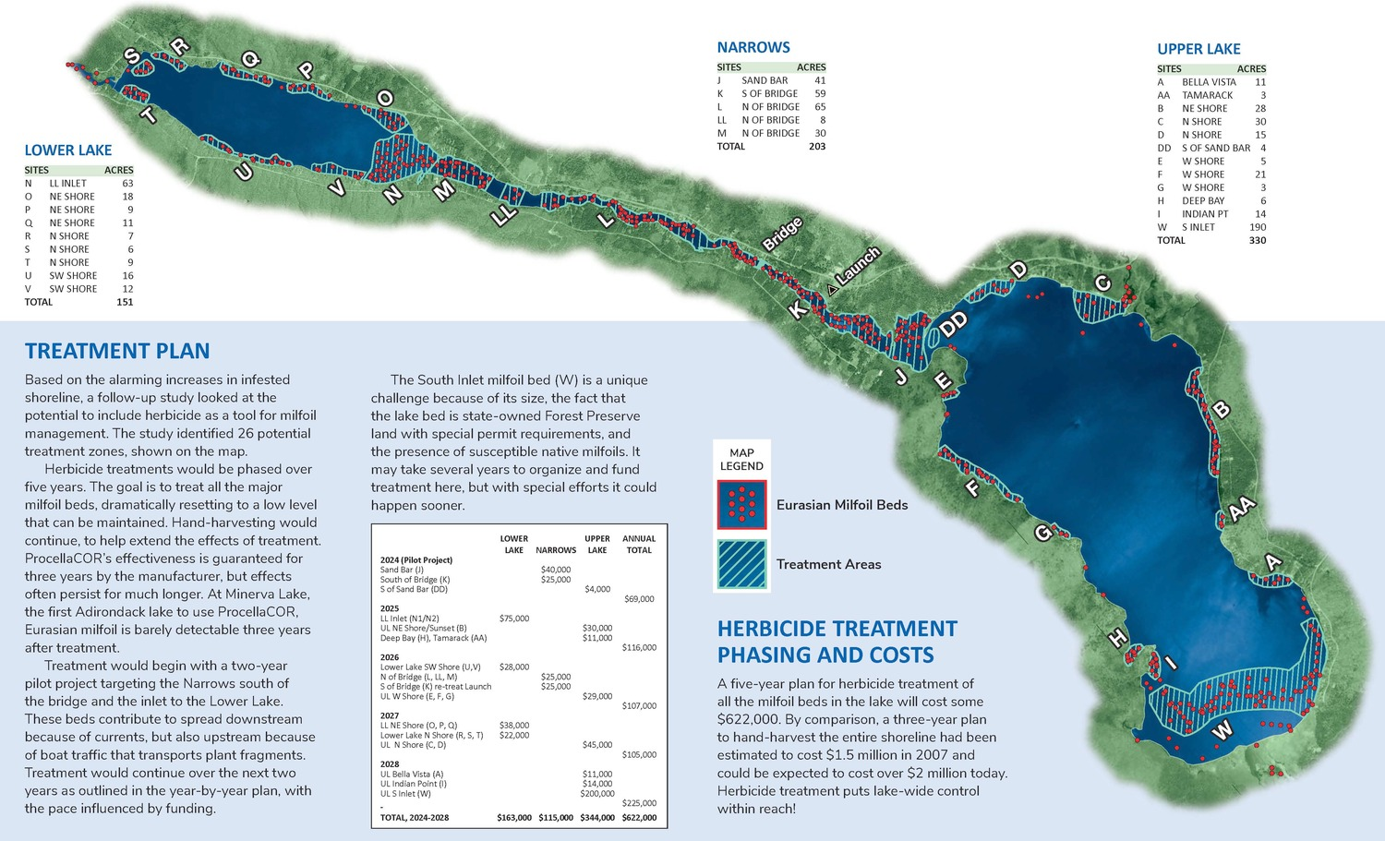
Cont’d.

Slide 20
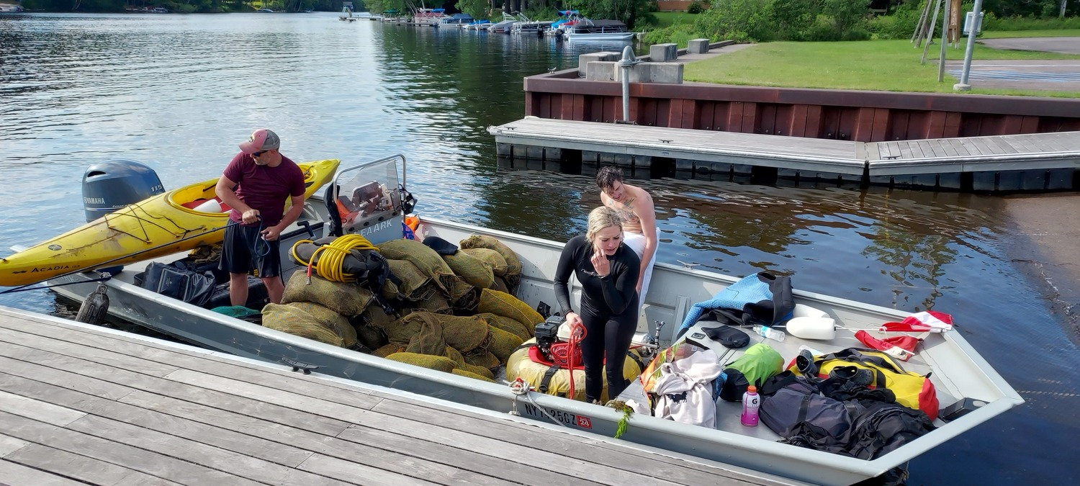
Cont’d – we will always need the divers

Slide 21
ProcellaCOR
ProcellaCOR works by mimicking a plant hormone specific to milfoil. "It causes the plant to grow so rapidly, the stems elongate, the stems collapse and the plant dies," said Johnson.
He says that compared to other herbicides, "it's used at a much lower dose than most of the aquatic ones. A lot of people were using Renovate [another chemical herbicide] before this. In fact Loon Lake and Lake Luzerne in the Adirondacks used to use Renovate...and you use it at about 2000 parts per billion. And this we're using about six parts per billion. So it's dramatically different.“

Slide 22
ProcellaCOR
"As an aquatic herbicide it's researched far more than most common chemicals," said Sullivan. "And researched with current technology, whereas a lot of the products that are on the market have been researched 20-30 years ago. So you have the ability to know a lot more about the product now than you certainly did before.“
ProcellaCOR has been registered and deemed safe for plants, wildlife, and humans by the EPA, the European Union, and the Canadian Government, where it was actually the third herbicide ever approved there.
Courtesy North Country Public Radio (link available via email-usskier@yahoo.com)

Slide 23
ProcellaCOR
There are no restrictions on swimming, fishing, bathing, dishwashing or even drinking treated water, as ProcellaCOR's mode of action is specific to plants and will not impact animals including humans.
Following treatment, there are no restrictions on water use for swimming, bathing, or dish washing. The application rate of the herbicide (about 7 ppb or parts per billion) is well below the threshold for drinking water (50 ppb).

Slide 24
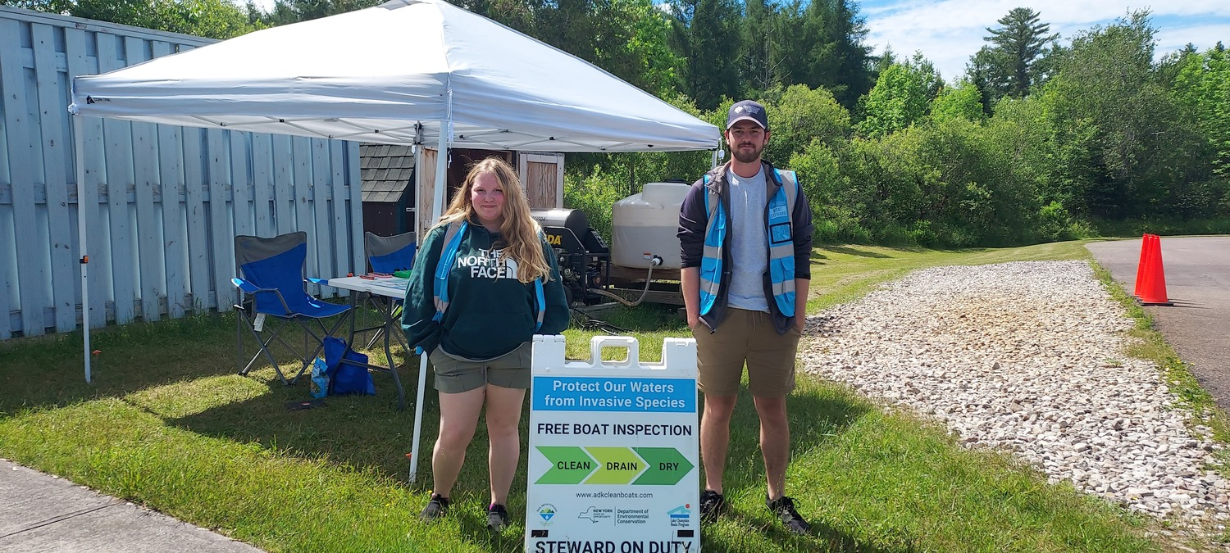
CLEAN, DRAIN AND DRY
Because we don’t have boat launch Stewards….

Slide 25
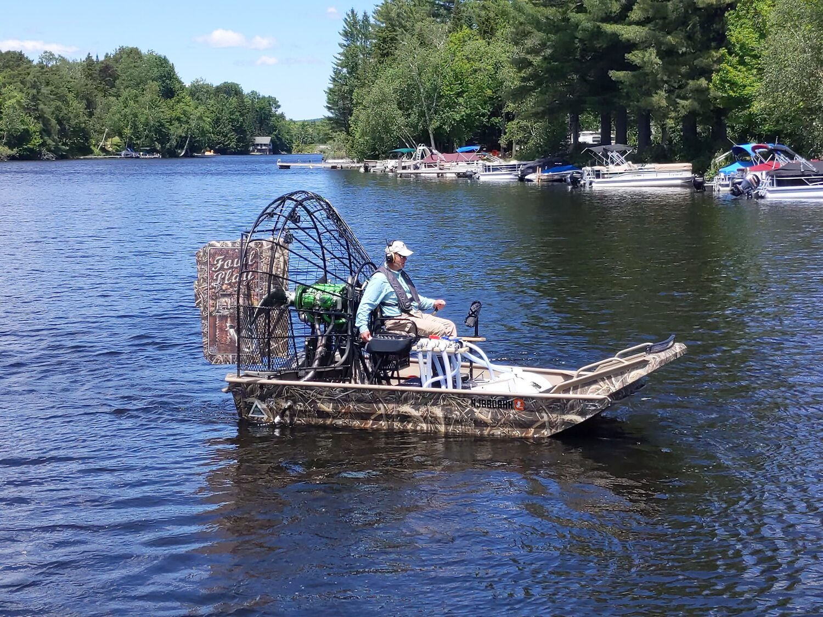
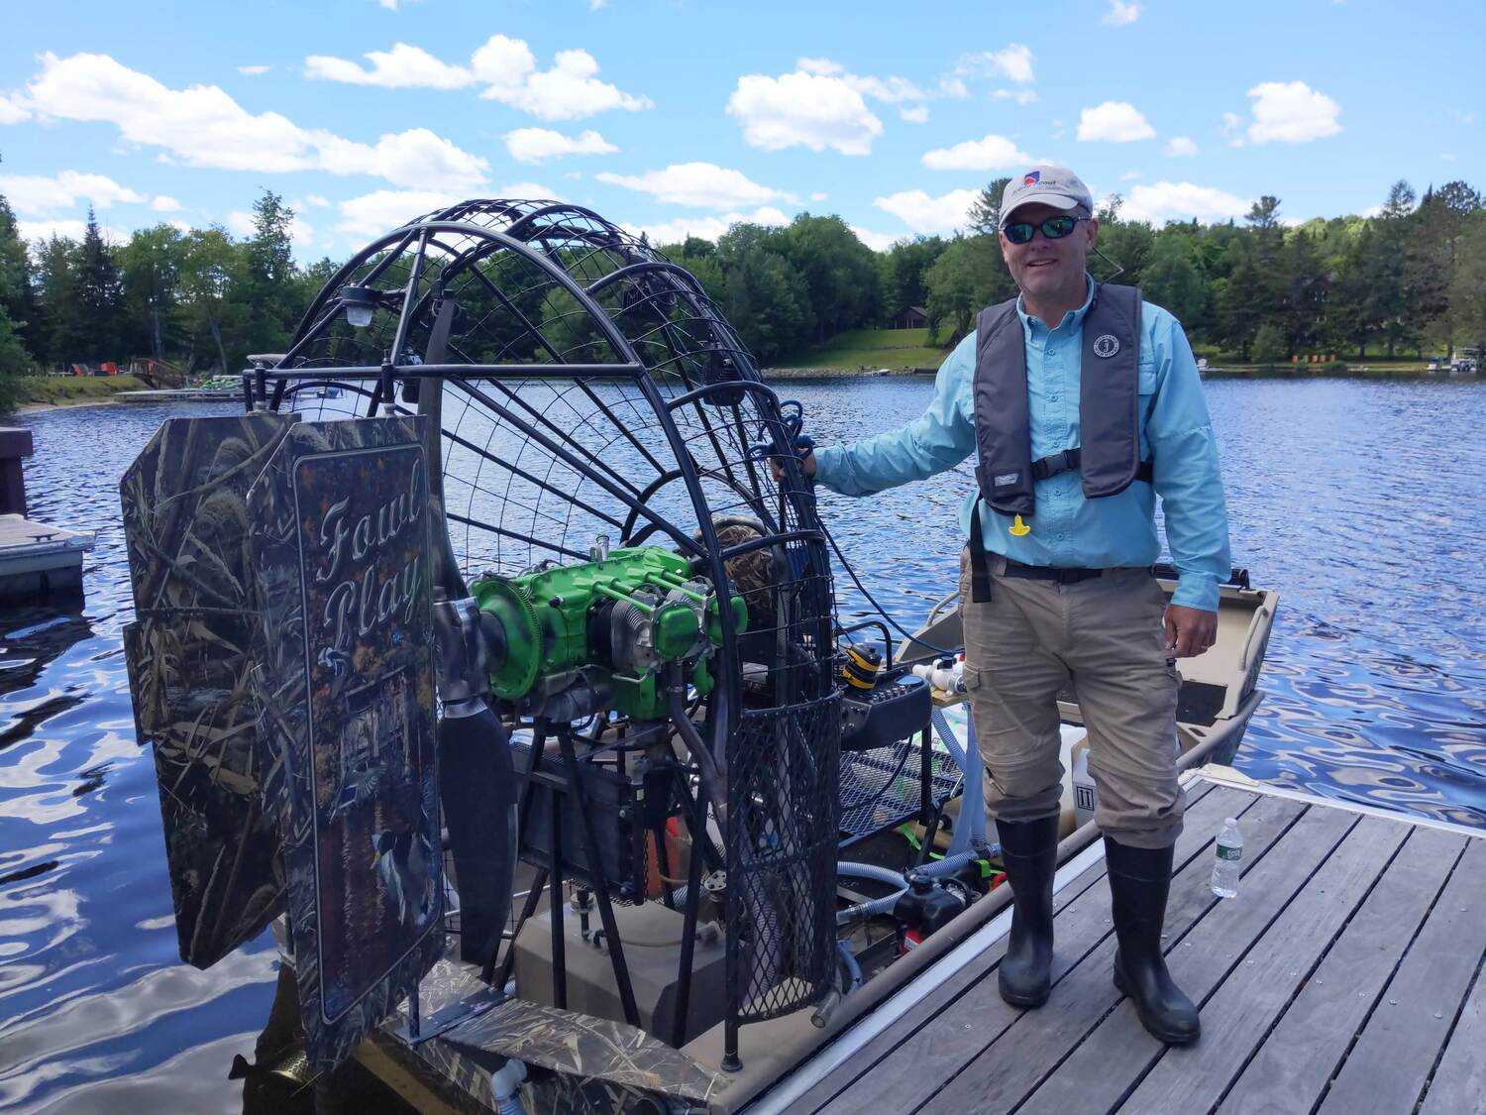
Glenn Sullivan-Ready Scout LLC

Slide 26


