Slide 1
Human Trafficking and Modern Day Slavery
An introduction
J L Rodriguez-Olveira, ba, mcil, cl, dci(6), iapti

Slide 2
Human trafficking – Modern Slavery
Outcomes:
  To have an overview of the offence of Modern Slavery and the connection with Human trafficking and Human smuggling
  To be aware of the situations that an interpreter may encounter when interpreting for victims or perpetrators of this offence.
  To know the types of crimes recognised within the offence of Modern Slavery.

Slide 3
Human trafficking – Modern Slavery
Section 1:
    Information regarding the offence of Modern Slavery, Human trafficking and Human smuggling and how they are connected.
Section2:
Overview about the interpreter´s role when working in this environment
Section 3:
Mental Health: Advice and strategies for interpreters working with victims and perpetrators.

Slide 4

Human trafficking – Modern Slavery
Human trafficking and Modern Slavery: do they really happen in the United Kingdom?
Let´s see some headlines from last year

Slide 5
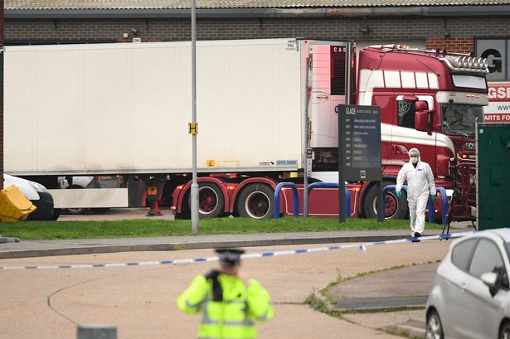
Human trafficking – Modern Slavery
24th October 2019
Essex lorry deaths: 39 found dead were Vietnamese nationals

Slide 6

Human trafficking – Modern Slavery
8th November 2019
Human traffickers jailed for selling Slovakian women in Glasgow
Four people who trafficked women from Slovakia to Glasgow and forced their victims into prostitution and sham marriages have been jailed.

Slide 7
Human trafficking – Modern Slavery
14th November 2019
Seventeen arrested in London in human trafficking crackdown
Operation worked in conjunction with Romanian police and rescued 29 women

Slide 8
Human trafficking – Modern Slavery
5th July 2019
UK’s largest modern slavery gang trafficked more than 400 victims
Vulnerable victims including homeless people and ex-prisoners forced to live in squalor as they earned ringleaders millions.

Slide 9
Human trafficking - Definition
The Palermo Protocol provides the first internationally recognised definition of human trafficking:
"Trafficking in persons shall mean the recruitment, transportation, transfer, harbouring or receipt of persons, by means of the threat or use of force or other forms of coercion, of abduction, of fraud, of deception, of abuse of power or of a position of vulnerability or of the giving or receiving of payments or benefits to achieve the consent of a person having control of another person, for the purpose of exploitation. Exploitation shall include, at a minimum, the exploitation of the prostitution of others or other forms of sexual exploitation, forced labour or services, slavery or practices similar to slavery, servitude or removal of organs."

Slide 10
People smuggling - Definition
The UN Protocol against the Smuggling of Migrants by Land, Sea and Air, adopted in 2000 defines human smuggling as "... the procurement, in order to obtain, directly or indirectly, a financial or other material benefit, of the illegal entry of a person into a state party of which the person is not a national".

Slide 11

Modern Slavery - Definition
Modern Slavery is defined as the severe exploitation of other people for personal or commercial gain.

Slide 12
Modern Slavery
Home Office classification (1)
Labour exploitation
1) Victims exploited for multiple purposes in isolated environments
2) Victims work for offenders
3) Victims work for someone other than offenders

Slide 13
Modern Slavery
Home Office classification (2)
Domestic servitude
4) Exploited by partner
5) Exploited by relatives
6) Exploiters not related to victims

Slide 14
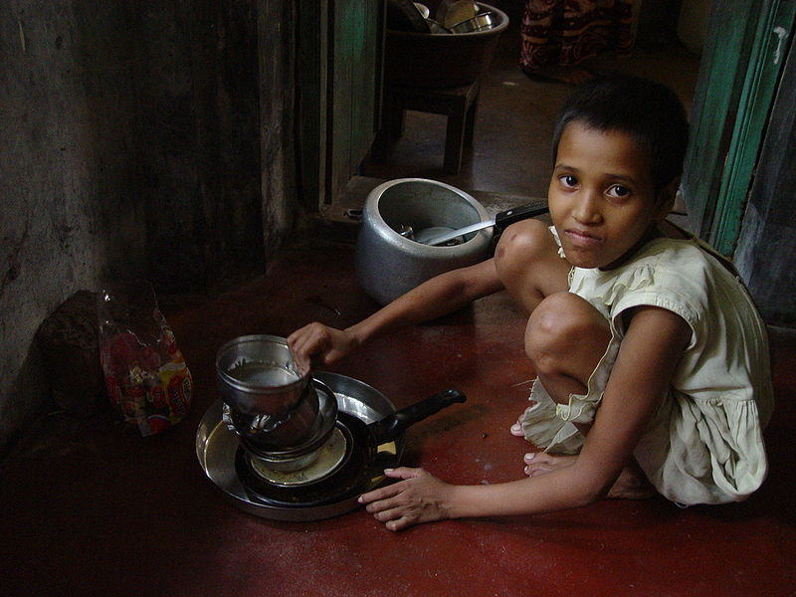
Domestic Servitude

Slide 15

Domestic Servitude

Slide 16
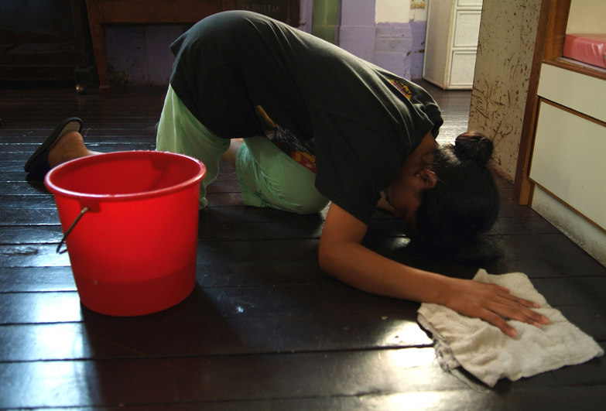
Domestic Servitude

Slide 17

Domestic servitude

Slide 18
Modern Slavery
Home Office classification (3)
Sexual exploitation
7) Child sexual exploitation – group exploitation
8) Child sexual exploitation – single exploiter
9) Forced sex work in fixed location
10) Forced sex work in changing location
11) Trafficking for personal gratification

Slide 19

Sexual Exploitation

Slide 20

Sexual Exploitation

Slide 21

Sexual Exploitation

Slide 22

Sexual Exploitation

Slide 23
Modern Slavery
Home Office classification (4)
Criminal exploitation
12) Forced gang-related criminality (County Lines)
13) Forced labour in illegal activities
14) Forced acquisitive crime
15) Forced begging
16) Trafficking for forced sham marriage
17) Financial fraud (including benefit fraud)

Slide 24
Methods of control
Repeated violence
Threats and occasional violence
Substances
Financial
Emotional
Social isolation

Slide 25
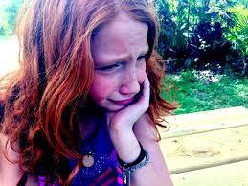
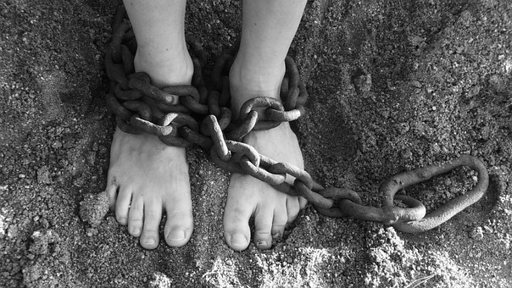
Human trafficking and Modern Slavery
Are we prepared to interpret in these cases?
Are we aware of what we are going to face?
Are we ready for the emotional and shocking statements we are going to hear and give a voice to?

Slide 26
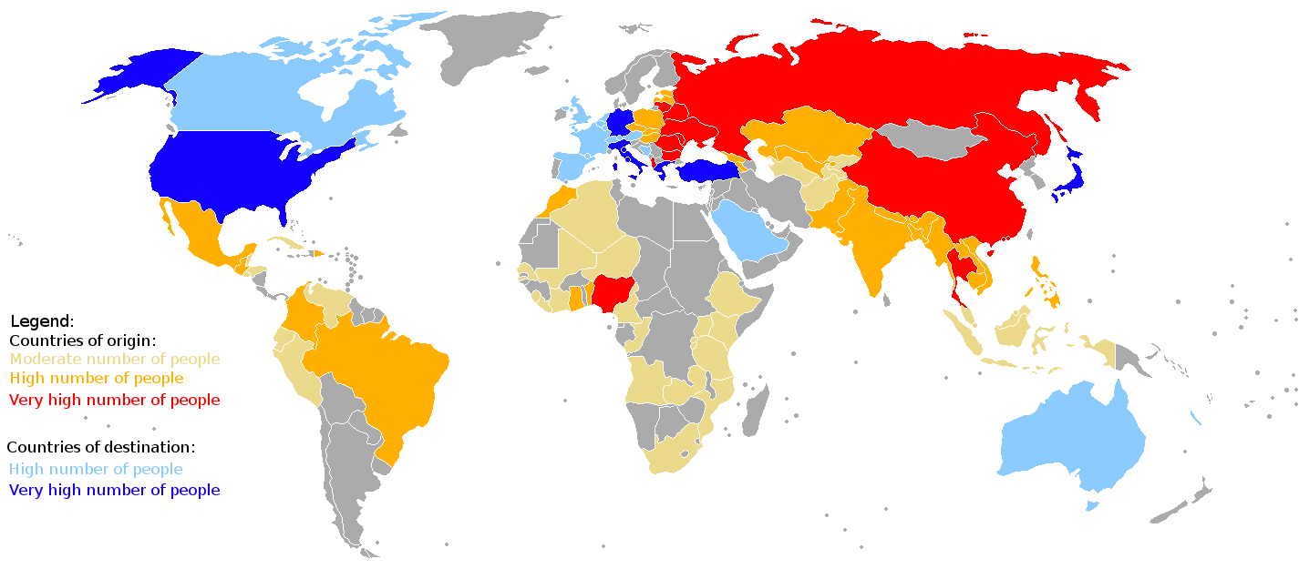

Slide 27
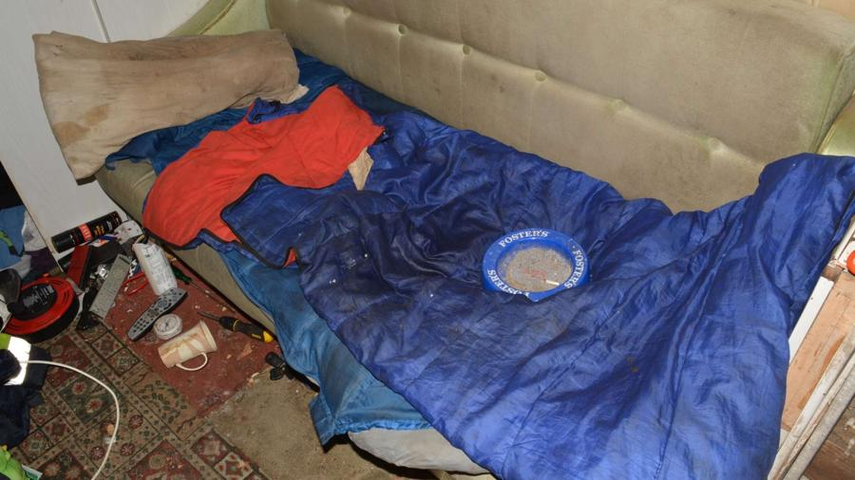
Living conditions

Slide 28
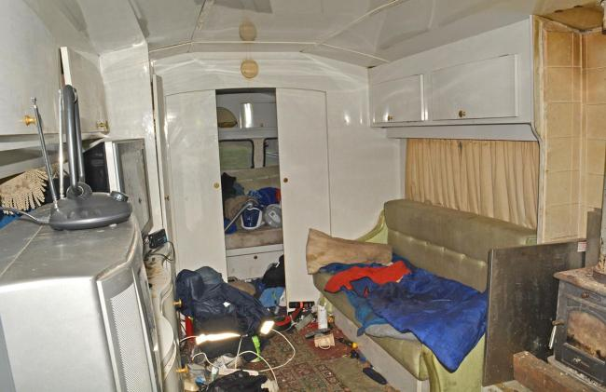
Living conditions

Slide 29

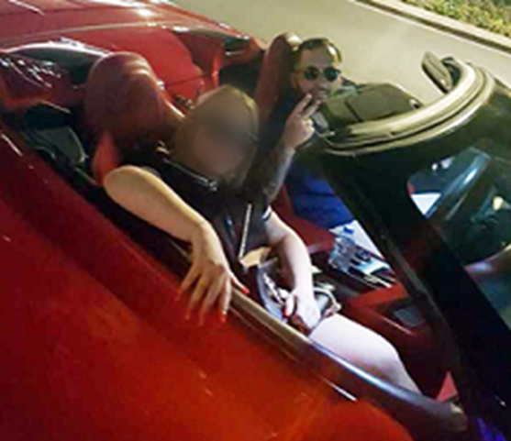
Offenders´ living conditions

Slide 30

Offenders´ living conditions

Slide 31


Slide 32
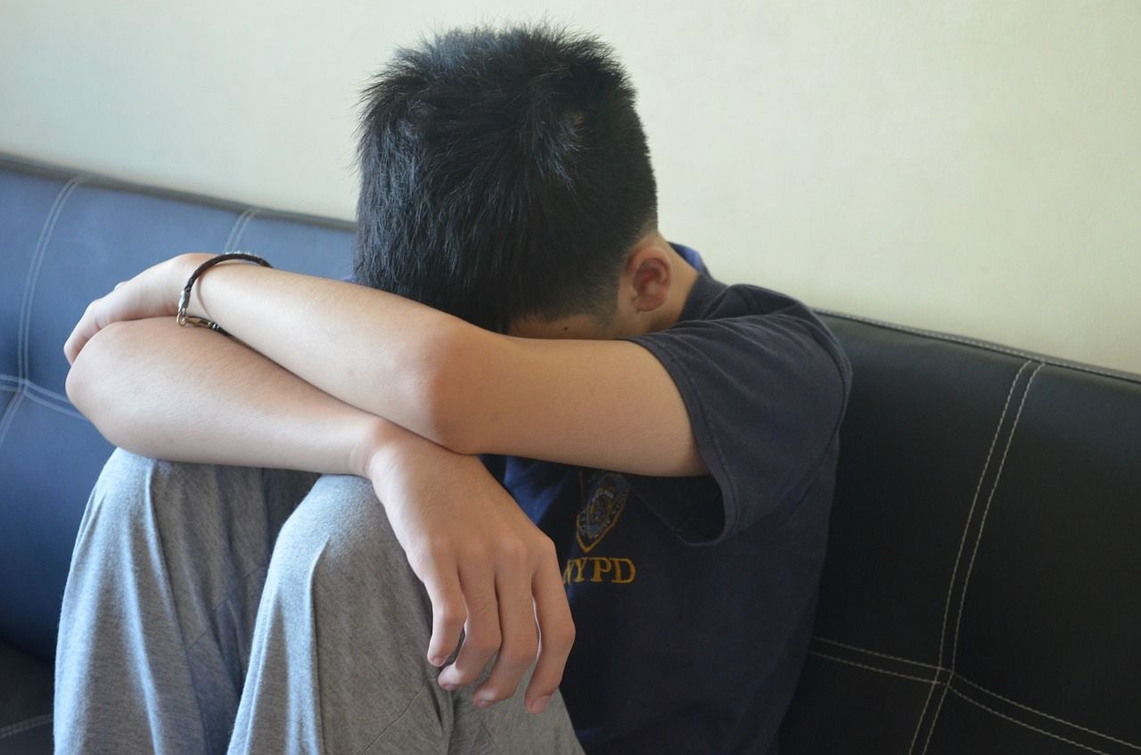

Slide 33

Couple kept woman as sex slave - Leicester

Slide 34

A couple kept a “slave” sleeping under the stairs - Bristol

Slide 35
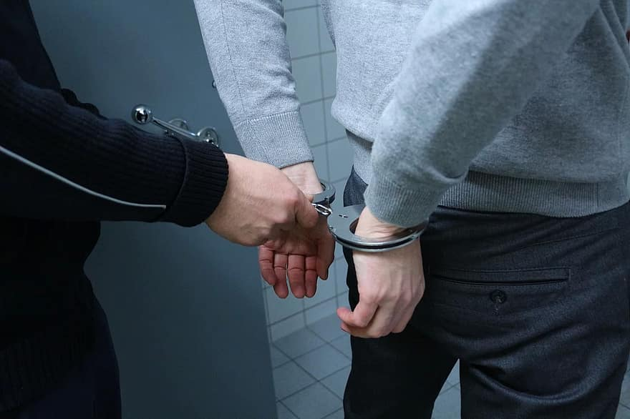

Slide 36
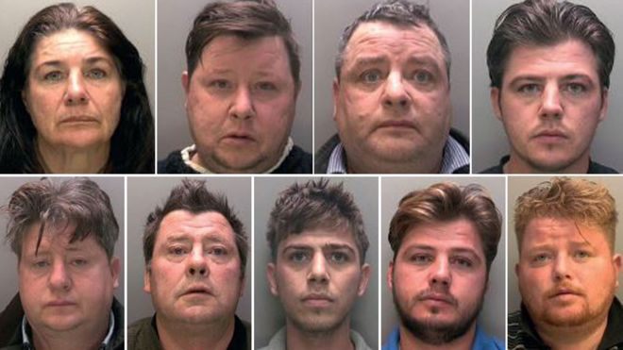
The Rooney family

Slide 37
NRSPI – Code of Professional conduct
3.10 | Practitioners shall disclose any potential conflict of interest or other factor which may make it inappropriate for them to accept work in a particular case

Slide 38
NRSPI – Code of Professional conduct
3.12 | Practitioners shall at all times act impartially and shall not act in any way that might result in prejudice or preference on grounds of religion or belief, race, politics, gender, age, sexual orientation or disability otherwise than as obliged in order to faithfully translate, interpret or otherwise transfer meaning.

Slide 39
NRSPI – Code of Professional conduct
4.2 | Practitioners are obliged (3.12 above) to carry out all work contracted to them with impartiality and shall immediately disclose to the Principal any factor which might jeopardise such impartiality. This shall include any financial or other interest they may have in the work contracted to them.

Slide 40
NRSPI – Code of Professional conduct
4.8 | Practitioners shall not, other than in exceptional circumstances, withdraw from or fail to complete a commission of work once accepted, without reasonable notice to the Principal.

Slide 41
Thank you for listening

