Slide 1
Compliance and Audits: Federal and Institutional Perspectives
Leading Excellence in Research Costing Practices
Gil Tran, CPA
Attain Partners
General Conference
October 30-November 1, 2024

Slide 2
Contents
Learning Objectives
What are some pressing audit issues?
History of audits and the audit process
Current and forward thinking about crucial audit issues

Slide 3
Learning Objectives
Participants will engage in an interactive discussion of key audit issues
Learning Objectives:
-Understand current and future federal agency perspectives on audits with goals to ensuring appropriate accountability of federal funds and emerging research compliance issues
-Understand proactive steps and considerations for institutions in reducing audit risks

Slide 4

Let’s Discuss……
Share some examples of what you think are important audit issues?

Slide 5


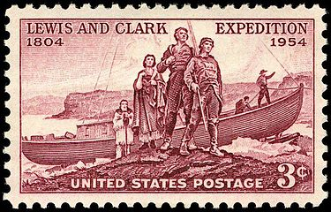
History of Audits
Government investment in research and discovery is not new….

Slide 6

Consequences of Non-Compliance
Fines and penalties
Required pay back of sponsored program funding
Reputational damage
Reduction in subsequent funding
Debarment and Suspension (PI and Institution)
Escalating audits
Loss of “low-risk auditee” status

Slide 7
Single Audit Progression
Background:
Before implementing the Single Audit, numerous audits were carried out on individual federally funded programs to ensure these funds were spent properly.
Federal agencies had the task of auditing all programs – tedious and time consuming.
Single Audit Act of 1984 standardized audit requirements for All Grantees (1996)
Although intended to reduce instances of individual agency conducting multiple audits, this has not proven to be the case…GAO reports indicate lack of confidence in effectiveness of the Single Audit.
GAO Report GAO-17-159

Slide 8
How areas of concern evolve ... Into Federal audits
Congressional concerns
Public concerns and perceptions
Administration concerns and priorities
Concerns over the efficacy of the Single Audit

Slide 9
When the Single Audit doesn’t reveal issues
Moffitt Cancer Center and Research Institute
  Self-disclosed $19.5M in billing related to clinical trial research
  Period for misbilling was 2014-2020
  Single Audit reported no audit findings and low risk audit opinion

Slide 10
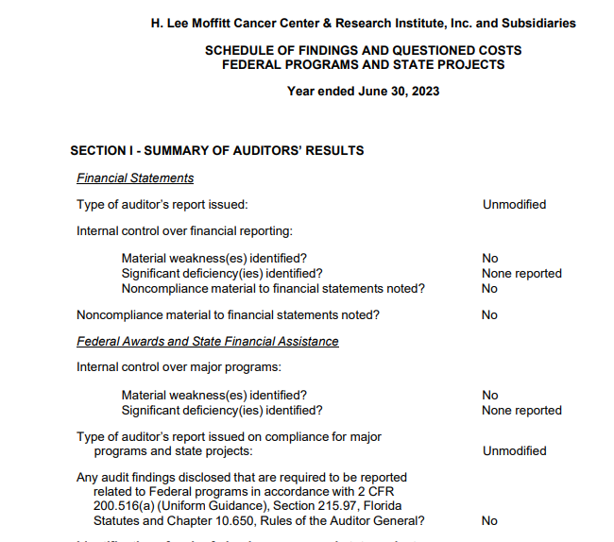
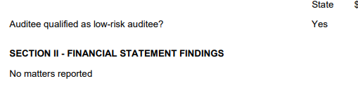
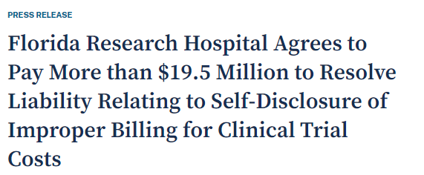





When the Single Audit doesn’t reveal issues
US Department of Justice
– January 4, 2024

Slide 11

The Federal Audit Scene
Escalation of audits and increased emphasis on compliance from federal agencies
Government concerns relating to waste, fraud, abuse of federal funds
Fight Club for Shrimp - $707,000: Researchers at Duke University spent more than $700,000 in money from the NSF and the Smithsonian’s Tropical Research Institute to get 68 different Panamanian mantis shrimp to fight over an artificial burrow.
https://www.youtube.com/watch?v=Rxjm-ueSrwc
https://discover.hubpages.com/technology/Military-Excited-About-Shrimps-Fists-of-Death

Slide 12
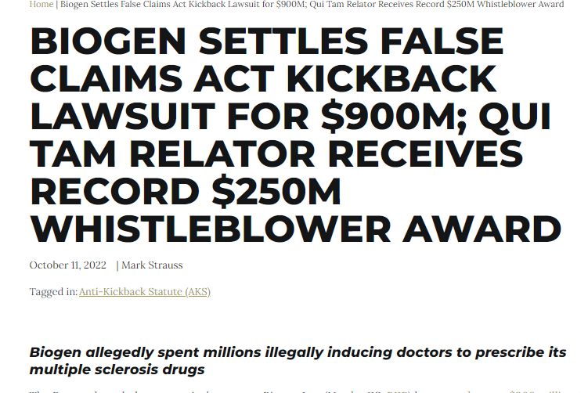
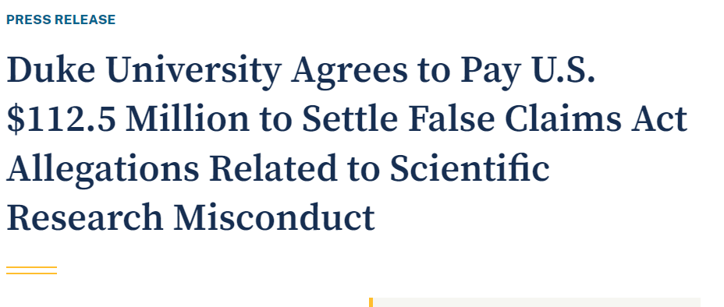
The Federal Audit Scene
Qui Tam cases under False Claims Act
Government recovers > $ 2.7 billion in fraud cases in 2023
Whistle blowers (“Relator”) gets up to 30%
“Mr. Thomas will receive $33,750,000 from the settlement.” March 2019

Slide 13

Federal Expectations: Address Fraud, Waste, and Abuse
Audit focus changes to address perceived and real instances of fraud, waste and abuse of federal funds
Emphasis on accountability and productivity
Realization of the federal investment…for the public good

Slide 14
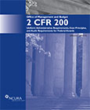
Let’s Review the Financial Aspect of Audits
Impact of 2 CFR 200 Uniform Guidance
  Emphasis on Internal Controls
  More responsibility on institution to determine appropriate oversight

Slide 15
What does the UG Say?
Revisions to 200.113 Mandatory Disclosures -04/24/24
§ 200.113 Mandatory disclosures.
An applicant, recipient, or subrecipient of a Federal award must promptly disclose whenever, in connection with the Federal award (including any activities or subawards thereunder), it has credible evidence of the commission of a violation of Federal criminal law involving fraud, conflict of interest, bribery, or gratuity violations found in Title 18 of the United States Code or a violation of the civil False Claims Act (31 U.S.C. 3729-3733). The disclosure must be made in writing to the Federal agency, the agency's Office of Inspector General, and pass-through entity (if applicable). Recipients and subrecipients are also required to report matters related to recipient integrity and performance in accordance with Appendix XII of this part. Failure to make required disclosures can result in any of the remedies described in § 200.339. (See also 2 CFR part 180, 31 U.S.C. 3321, and 41 U.S.C. 2313.)

Slide 16
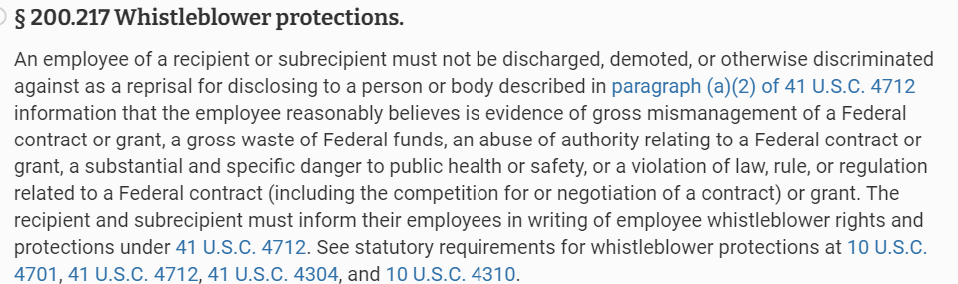


What does the UG Say?
New Addition – 200.217 - 04/24/24

Slide 17
What does the UG Say?
200.205 Federal awarding agency review of risk posed by applicants:
Financial Stability
Quality of management systems
History of performance (including reporting requirements)
Reports and findings from audits (both the Single Audit and other available audits)
Ability to effectively implement statutory, regulatory, or other requirements

Slide 18
What does the UG Say?
200.303 Internal controls.
The non-Federal entity must:
Establish and maintain effective internal control over the Federal award that provides reasonable assurance that the non-Federal entity is managing the Federal award in compliance with Federal statutes, regulations, and the terms and conditions of the Federal award.
These internal controls should be in compliance with guidance in “Standards for Internal Control in the Federal Government” issued by the Comptroller General of the United States or the “Internal Control Integrated Framework”, issued by the Committee of Sponsoring Organizations of the Treadway Commission (COSO).
Evaluate and monitor the non-Federal entity's compliance with statutes, regulations and the terms and conditions of Federal awards.
Take prompt action when instances of noncompliance are identified including noncompliance identified in audit findings.

Slide 19
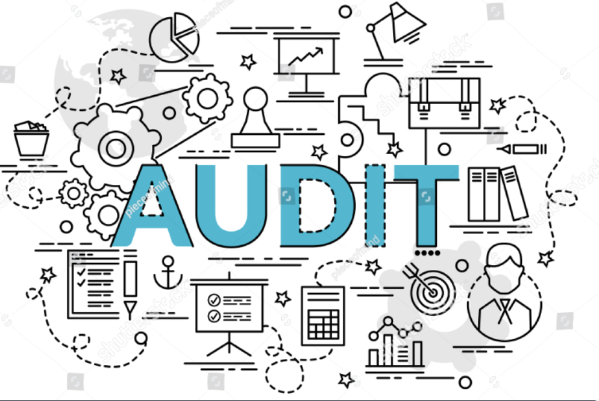
What does the UG Say?
200.503 Audit requirements.
… Federal agency, Inspectors General, or GAO may conduct or arrange for additional audits which are necessary to carry out its responsibilities under Federal statute or regulation.

Slide 20
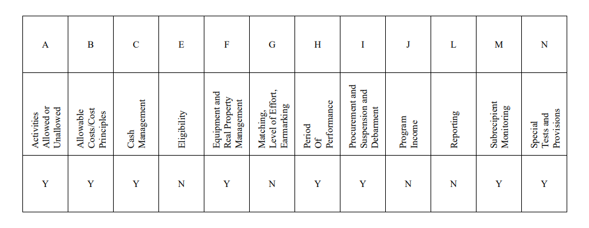
Compliance Supplement Specific to Research
OMB collaborates annually with research agencies to determine potential areas of concern
The eight specific compliance areas for research – Part 5 – Cluster of Programs

Slide 21
NSF Audit Analysis
The most common audit findings:
unallowable expenses
inappropriately applied indirect costs
inadequately supported expenses
inappropriately allocated expenses
non-compliance with policies and procedures.
https://oig.nsf.gov/sites/default/files/reports/2022-01/22-6-002-Promising-Practices-NSF-Award-ManagementRedacted.pdf

Slide 22
NSF Audit Analysis: A checklist
Award recipients should perform the following activities:
continually monitor and verify the allowability of high-risk expenses
strengthen controls over applying indirect cost rates
create and maintain sufficient, appropriate documentation
document and justify reasonable allocation methodologies
regularly review and update grant management policies and procedures.
https://oig.nsf.gov/sites/default/files/reports/2022-01/22-6-002-Promising-Practices-NSF-Award-ManagementRedacted.pdf

Slide 23
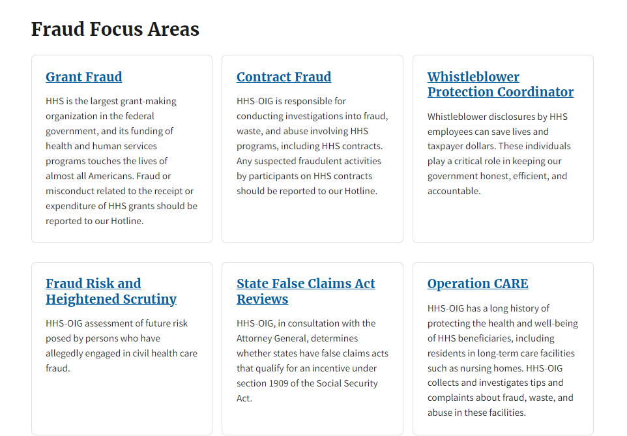
HHS Audit Work Plan
Fraud | Office of Inspector General | Government Oversight | U.S. Department of Health and Human Services (hhs.gov)

Slide 24
What about Non-Financial Concerns
Sexual Harassment
Subrecipient Monitoring and FFATA Reporting
Research Security
Foreign Influence
Performance Audits (Effectiveness of Agency Programs)

Slide 25
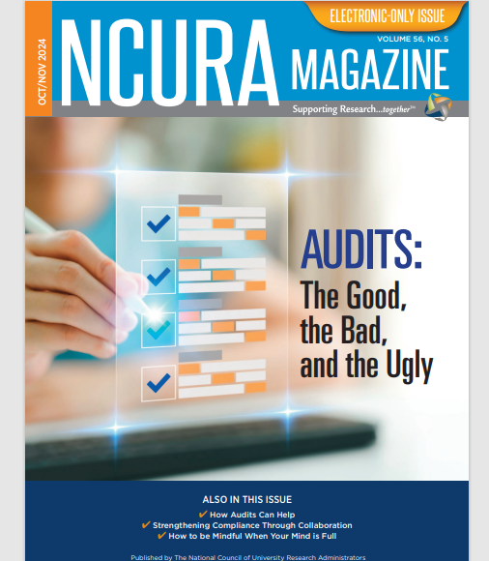

What should we anticipate in the 2025 audit and accountability space?
Article by Julie Cole - Clemson University & Gil Tran - Attain Partners

Slide 26
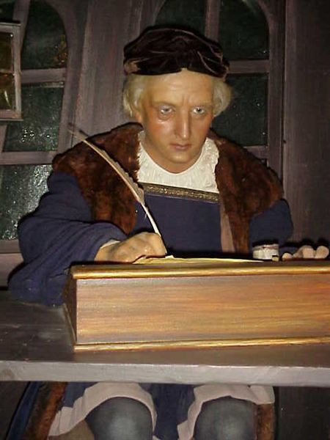
Thank you for your input!
We’re always watching!

