Slide 1
Optimizing Recharge Unit Management: Challenges, Strategies, Oversight, and Templates
Leading Excellence in Research Costing Practices
Jenny Smolnik, Maximus
Leann Lopez, Maximus
André Britten, University of Illinois
Minh Nguyen, University of Virginia
General Conference
October 30-November 1, 2024

Slide 2
AGENDA
Defining Service Centers
Defining Service Centers
Baselining Policy and Operations
Approaches to Service Center Issues
Managing Change for Service Centers

Slide 3
DEFINING SERVICE CENTERS

Slide 4
What is a Service Center?
Essentially a “non-profit business” within the university
  Provides goods or services
  On an on-going basis
  Fees are based on approved charge rates
  Customers are typically other units within the University
  Can be charged occasionally to outside entities

Slide 5
Terminology varies by Institution
Types of Service Centers
Specialized Service Facility
(Direct + Indirect = Fully loaded costs) e.g. , Solar farm, wind tunnel
University-wide Service/Recharge Center
(Managed by Central – e.g., Facility Management)
Pass Through Operations
(Incurs costs and passes only those costs along to customers)
Department Recharge Center
(Operated by a department – e.g., Machine shop)
Core Facilities
(Shared resources with a research aim) e.g., Genomics
Notes:
SSF and Core Facilities are given specific definitions within Federal Guidance. Best Practice would be to use these terms in line with guidance. Otherwise, choose what you want.
Provide clarity to your institution through defining in policy.

Slide 6
BASELINING POLICY AND OPERATIONS

Slide 7
Resources for Baselining
Federal Guidance
Service Center audits
Related internal policies
Policies of peer institutions

Slide 8
Baselining Internal Documents
POLICY
Background
Definitions
Criteria for Establishing/ Closing a Service Center
Rate setting in line with UG
Periodic Review
Record Retention

Slide 9
Baselining Internal Documents
PROCEDURES
Roles/Responsibilities
Establishing a Recharge Center
Rate Setting
Budgeting
Tracking Use
Timely Billing
Periodic Review
Closing a Service Center

Slide 10
Baselining Internal Documents
TEMPLATES
Rate Calculations
  Units of service
  Estimate usage
  Allowable rate components
  Surplus/Deficit
  Required Routing/ Approvals
SC Review
  At least every two years

Slide 11
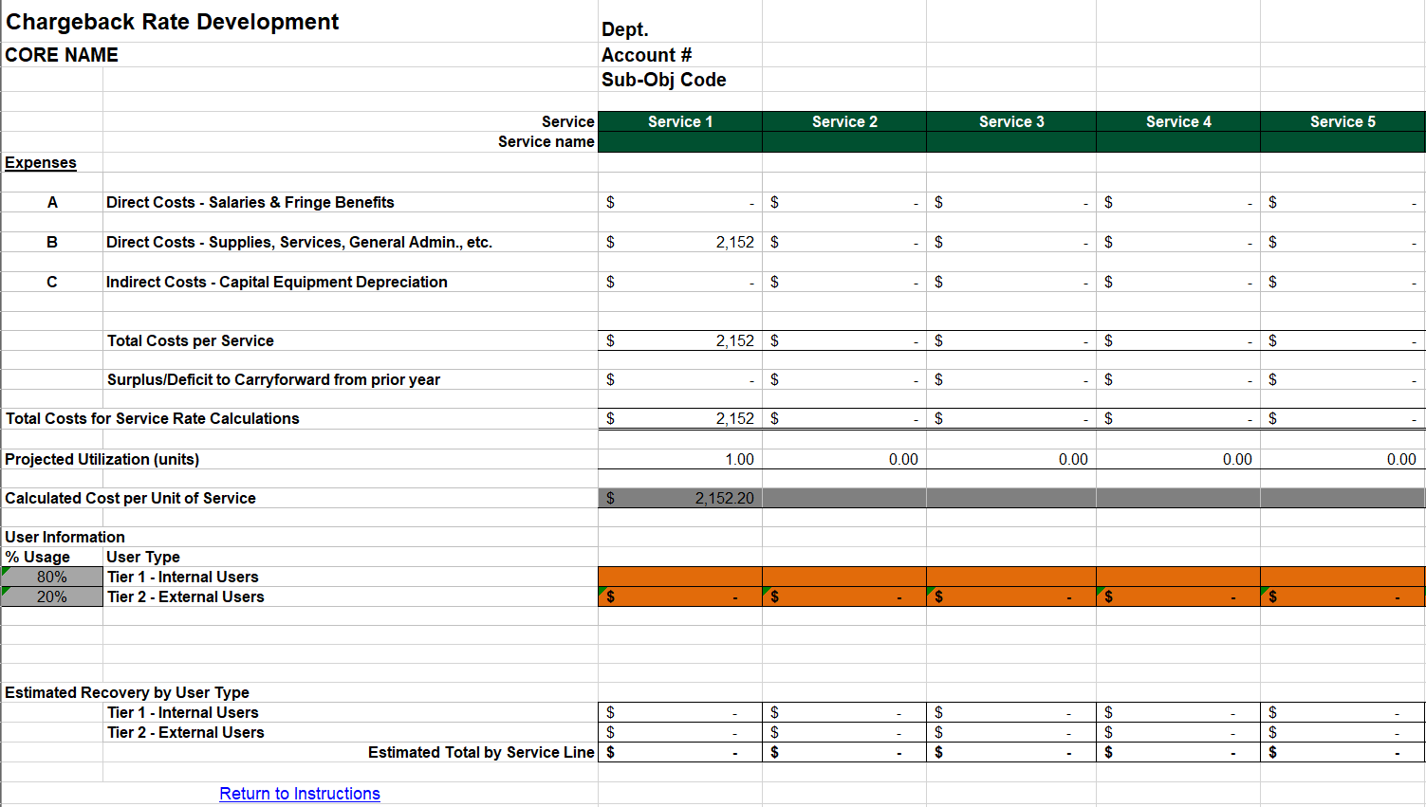
Template Examples
Calculate Rates: User types, external rates include F&A and other?, market rate analysis, track estimated vs. actual use

Slide 12
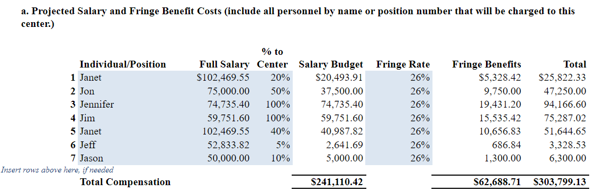
Template Examples
Salaries & Wages: Whether charged in SC account or elsewhere, this is usually where most of institutional investment lives.

Slide 13
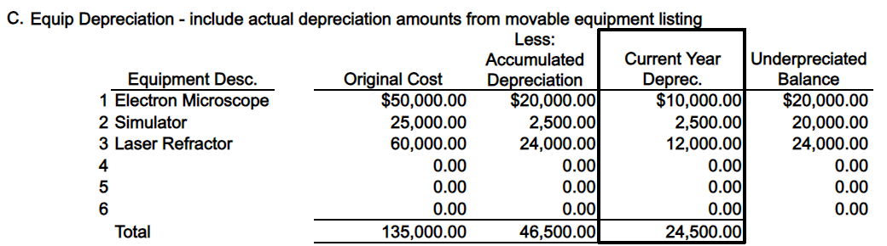
Template Examples
Equipment Depreciation: Capital asset ID, description, useful life, Acquisition cost/date, current year depreciation, funding source(s) (i.e. University/federal/private/cost share)
Notes:
Baseline: Cannot charge depreciation for federally funded equipment. Cannot charge depreciation on equipment past its useful life.

Slide 14
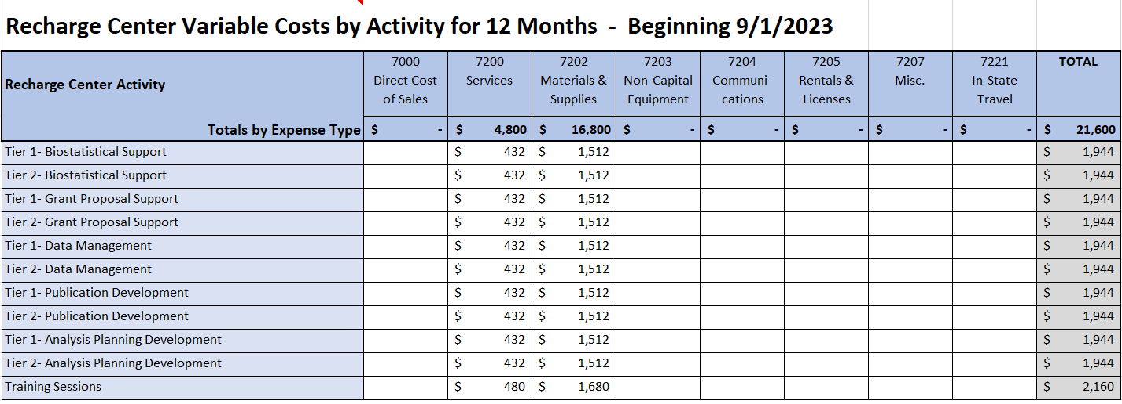
Template Examples
Other fixed/variable costs: Object code level budgeting communicates allowable costs and is more defensible in an audit.

Slide 15
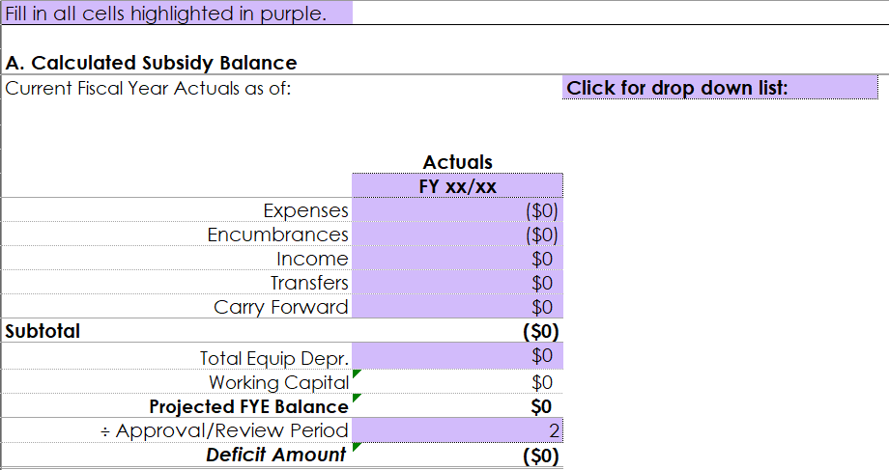
Template Examples
EOY Surplus/Deficit: Calculate Rates: Consider subsidy both before establishing rates and with each review period. Units providing subsidy will need to recommit periodically and account for this support in their budget.

Slide 16
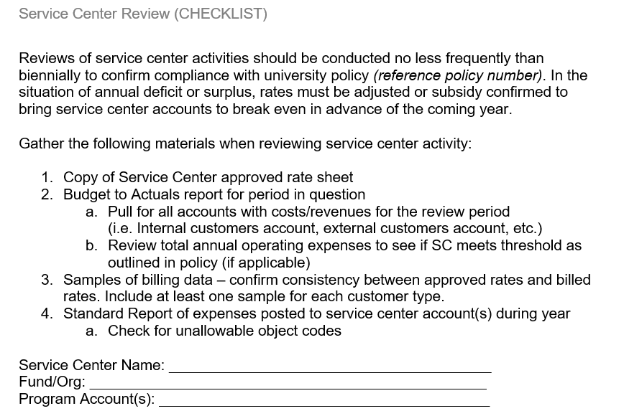
Template Examples
Service Center Review: Consider frequency and cadence of reviews.

Slide 17
Template Considerations
Use templates to communicate baselines, requirements, and important considerations.
No two service centers are exactly the same.
One size does not always fit all.
  A good template (or two) requires feedback.
Detailed enough to get what you need; simple enough to complete without an hour-long training.
  Should not make the process harder

Slide 18
Beyond Baselining
Minimizing Administrative Burden
Return on Investment
Benefitting University Users
Compliance
What matters most to your institution?
Notes:
These priorities can change over time and with changes in leadership. Create a baseline for policy, procedures, and templates that can flex with institutional change.

Slide 19
Addressing Institutional Priorities
Minimizing Administrative Burden
Return on Investment
Benefitting University Users
Compliance
POLICY
PROCEDURE
TEMPLATES
Notes:
Beyond the baseline elements previously discussed, there are lots of decisions that can be made that go beyond federal requirements. What do these look like at your institutions?
Discuss approaches to these priorities based on experience at different institutions. Request input from audience.
Minimize Administrative Burden
Policy – Capital assets in rates? Criteria for opening/closing service centers?
Procedures – Stagger review schedule for SC’s? Tracking use and billing looks like what?
Templates – Do you enable direct input from SC’s by establishing standard reports? How many approvals are required?
Return on Investment
Policy – Alignment with University mission/goals makes service more relevant, also helps to avoid UBIT. How do you define external users, and how does that play in to your ability to obtain revenue?
Procedures – What are your measures for success? How often do you check the,? What systems are in place to track ROI? Do you allow SC’s to stay open forever with subsidy? Some and not others?
Templates – Invest in qualified staff and charge their salaries here! Partner w/SPA and/or OGC to create template language for agreements with external users. Market analysis – what does this loo like? Do you require it, why or why not?
Benefitting University Users
Policy – Do you allow redundant operations across campus? If so, why? Do you treat other universities as internal or external?
Procedures – How do you approach subsidy? Do you incentivize use or think it can be justifiable to do so?
Templates – Balance internal and external use to allow for lower rates. Record imputed revenue when it happens. Bill timely to make everyone’s work easier!
Compliance
Policy – Frequency and cadence of reviews? Who is responsible for oversight?
Procedures – Internal monitoring is based on your risk level as shaped by the rigidity of your policies and processes. Trust but verify! Run recurring trainings.
Templates – Do your budgets include enough detail to see if unallowables are included/excluded? Have separate rate calculations if you expect different user types.

Slide 20
APPROACHES TO SERVICE CENTER ISSUES

Slide 21
When monitoring/reviewing, what are you looking for?
Current Rate Status
Surplus or Deficit position
Capital Equipment Expenses
Unallowable Expenses
Unidentified Service Center Activities
Rate Charging Compliance

Slide 22


Collaboration in Action
Approach
Group Peer Training
Training the whole recharge population to inform them of University wide recharge policies
and fundamental procedures.
This might look like “office hours” for open discussion and/or topic
specific training sessions.
Issue
Lack of Understanding
Blanket Recharge Policy
Fundamental Procedures

Slide 23
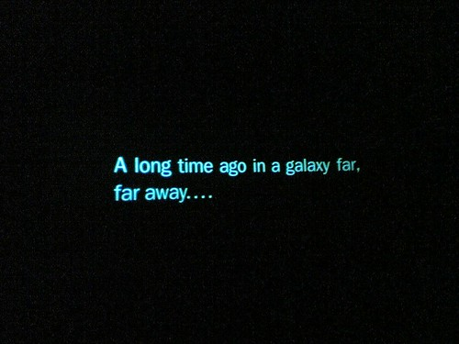
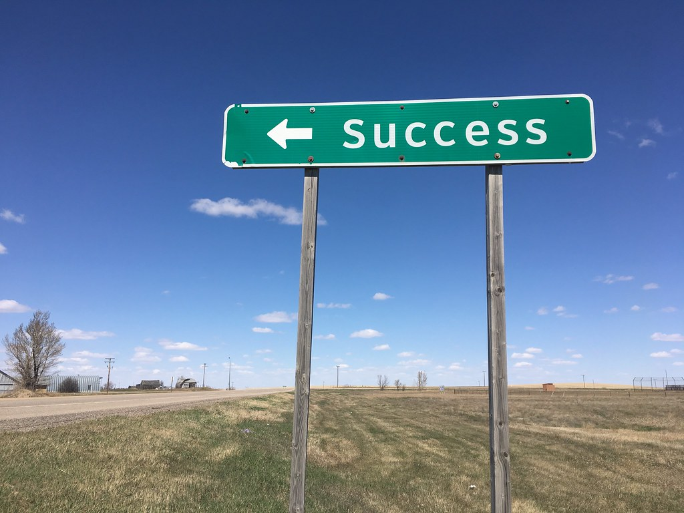
Collaboration in Action
Approach
2. Templates
Utilizing templates to help facilitate the review process.
Identifies required information.
Elicits effective and direct communication between all involved parties.
Issue
2. Long Review Times
Other priority tasks or
lack of focus
Unclear roles of responsibility or review coordination
Lack of communication

Slide 24


Collaboration in Action
Approach
3. Brainstorming
Identify a university or department-wide issue
Encourage feedback
Assist with a consensus on a sustainable solution
Issue
3. One Size Does Not Fit All
Current templates
Current procedures
Current roles and responsibilities

Slide 25



Potential Benefits
Foster confident through better understanding
Improve balances, with better chance of breaking even
Ensure audit readiness with more proactive approaches
Increased Productivity
Improved Quality
Less Risk

Slide 26
MANAGING CHANGE FOR SERVICE CENTERS

Slide 27
Establish a Service Center Review Board
Review institutional policy, procedures, and templates
Include interested parties from departments, SPA, GCA, Controller/Capital Assets
Designate an individual/office to moderate
Build a template agenda for periodic meetings

Slide 28
Managing Change
Develop a structural approach for implementing a new initiative or transformation.
Key steps :
Identify new requirements, system changes, or a common issue to be
addressed
  For issues, identify root cause
Define approaches that addresses change or the cause of the issue
  Require input from all interested parties
Gain buy-in through collaborative planning
Test the solution and get feedback from users
Build communication plan to inform and train as needed
Notes:
- Expect that more people will need to know than you may have identified
- Cast a wide net
- Have committee assist with spreading the word about any new processes or changes in policy.

Slide 29
Managing Change
In addition…
Communicate upcoming training activities
Review schedule for upcoming service center reviews
Encourage conversation and input from all participants!
  Find out what's not working

Slide 30
Contact Info
Leann Lopez leannlopez@maximus.com
Jenny Smolnik jennifersmolnik@maximus.com
André Britten abritten@uillinois.edu
Minh Nguyen mtn9ba@virginia.edu

