Slide 1
NACCA: Enduring Relevance of Libraries in Indirect Costs
Hilary A. Craiglow
David Beckstrom
Attain Partners
University of California

Slide 2
Introduction
Hilary A. Craiglow
Library Consulting Practice Lead Attain Partners
David Beckstrom
Senior Director, Business & Finance Solutions University of California, Los Angeles
Experience
Vanderbilt University
Libraries: Divinity, Biomedical, Management, Music, Education, Science and Engineering Acting University Librarian
Graduate School of Management Operations and Strategy Leadership Cabinet Senior Lecturer
Consulting
Library Cost Studies, Harvard Business School
Skills & Education
Master of Library and Information Science, University of Texas, Austin
Leadership Institute for Academic Librarians. Harvard University, Graduate School of Education
Financial Fundamentals. Owen Graduate School, Vanderbilt University
Experience
UCLA & the University of Utah
Indirect Cost & Fringe Benefit Rate Proposals
Service Centers & Business Contracts
Capital Assets Accounting
Effort Reporting
Subrecipient Monitoring
Skills & Education
Executive Program in Management, UCLA Anderson Graduate School of Education
Bachelor of Science in Accounting, University of Utah

Slide 3
Agenda
Agenda
Modern Research Libraries
Library Expenses
Library Component of Indirect Cost Rates
Special Library Cost Studies
Library Cost Pool Development
Demonstration of Library Expenses
Conversation

Slide 5
A modern research library extends far beyond being a quiet building and repository of books.

Slide 7
Modern Research Libraries
Access to Resources
Research Support Services
Technology and Infrastructure
Training and Development
Networking and Community Building
Innovation and Experimentation
Collaborative and Third Spaces

Slide 8
Research Lifecycle
The Research Lifecycle
Store & Manage
Project plan, onboarding to closure.
Access and reuse for other researchers.
Organization, integration, and collection of data and data processes.
Disseminate and share research for maximum impact.
Process and analyze data.
Evaluate research records for retention and archive.

Slide 9
Research Lifecycle
Libraries and the Research Lifecycle
Plan Literature reviews and data management plans.
Store & Manage
Access Licensing/access to published works and research discovery services.
Collection Licensing/access to secondary data, datasets, metadata creation.
Share Author rights, data sharing, Open Access, publishing.
Analyze Training on coding and data analysis tools.
Archive Institutional and data repositories.

Slide 10
Regulatory Developments
Open Science
Open Access

Slide 11
Research Data Management and Infrastructure
Data Management Planning
Metadata Creation
Data Repositories
Tools and Software
Policy Development
Data Curation and Preservation

Slide 12
Scholarly Communications
Curated Collections
Digital Libraries
Publishing Platforms
Discovery Systems
Copyright and Licensing
Bibliometrics
Altmetrics
Research Promotion

Slide 13
Repositories
Institutional
Data
Archive, collect, and disseminate intellectual output
Articles, theses, dissertations, and other scholarly works
Accessibility, long-term preservation, and showcase research achievements
Retrieve, manage, and analyze research objects
Structured, unstructured, or semi-structured
Integrity, security, and accessibility for reproducibility and transparency

Slide 14
Licensing Scholarly Research
“Read and Publish” and “Pure Publish” Licenses
Read
Publish
Access to publisher's subscription-based content, allowing read access to research articles behind paywalls.
Cover publishing fees for researchers, enabling open-access publication without individual researcher payments.

Slide 15
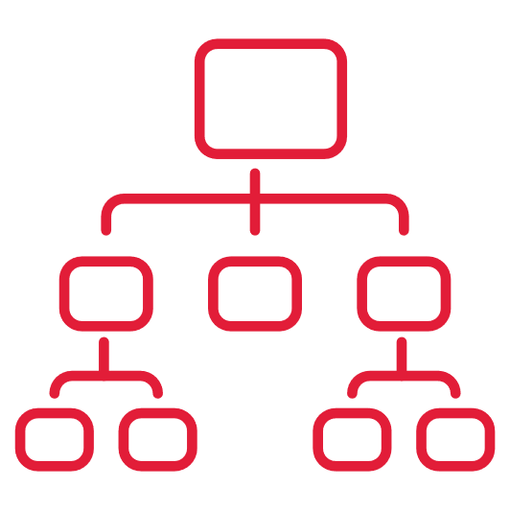
R1 Research Libraries
$26M
Total Annual Budget
150
Faculty / Staff
5 – 10
Branches
∞
Virtual Users
100s
Material Formats
840k
In-Person Users Annually
Source: ARL, 2023

Slide 16
University Library Budget
R1 Library Expenditures $26,004,503 (Median)
Source: ARL, 2023

Slide 17
Library Expenses in Support of Research
Enhance the research capabilities at your institution
Staff
Collection management, strategy, access
Consultation & Training
Systematic reviews
Research Data Management
Author rights
Coding and metadata creation
Data analysis
Other services
e.g., InterLibraryLoan, data lakes, repositories
Operations
Technology infrastructure
Hosting services
Facilities
Conference and meeting space
Collections
Licensed data and published scholarship
Journals
Databases
Datasets
eBooks
Discovery services, catalog

Slide 18
Library Component of Indirect Costs
Uniform Guidance 2 CFR Part 200 Appendix III
FTE
A standard calculation
Simple systematic approach to determining library costs
Allocates all library costs by FTE
Assumes 5-15% other users
Special Study
Refines and strategic assignment of library costs
Costs pooled and allocated based on the purpose of use
Specific to the institution
Accounts for the changing nature of library support for research
Documents actual other users

Slide 19
2 CFR Chapter 2, Part 200, Appendix III
Cost analysis studies may take into consideration weighting factors, population, or space occupied if appropriate. Cost analysis studies, however, must
(a) be appropriately documented in sufficient detail for subsequent review by the cognizant agency for indirect costs,
(b) distribute the costs to the related cost objectives in accordance with the relative benefits derived,
(c) be statistically sound,
(d) be performed specifically at the institution at which the results are to be used, and
(e) be reviewed periodically, but not less frequently than rate negotiations, updated if necessary, and used consistently.
Any assumptions made in the study must be stated and explained. The use of cost analysis studies and periodic changes in the method of cost distribution must be fully justified.

Slide 20
2 CFR Chapter 2, Part 200, Appendix III
Method and data gathered is documented and stored
(a) be appropriately documented in sufficient detail for subsequent review by the cognizant agency for indirect costs,
(b) distribute the costs to the related cost objectives in accordance with the relative benefits derived, (c) be statistically sound,
(d) be performed specifically at the institution at which the results are to be used, and
(e) be reviewed periodically, but not less frequently than rate negotiations, updated if necessary, and used consistently.
Cost centers specific to library
Tested, valid, and reliable
Data and insight derived from one institution is not used at another
Study is done specifically for a negotiation base year expenses

Slide 21
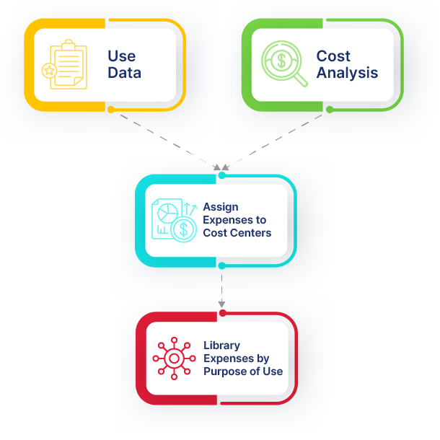
Library Cost Study Methodology

Slide 22
Library Cost Study Activities
Planning
Data Collection
Costing & Analysis
Perform a detailed inventory of library services and collections Create a detailed project timeline Identify team members Conduct a site visit Assign project tasks Develop survey instruments Document survey schedules Provide in-house survey instructions Integrate and test web survey Provide a detailed list of study materials Finalize project plan | Collect all study materials, e.g., organizational charts, financial data, collections expenditures, detailed facility data, community categories and affiliations In-House surveys; performed at select libraries; two-hour survey periods, monthly for twelve months Web Point-of-Use Surveys; integrated through the library portal, pop-up surveys during two-hour survey periods, monthly for twelve months Survey data is compiled and analyzed quarterly | Analyze survey data, expenditures, space, resource, and service use, in accordance with the OMB Uniform Administrative Guidance Develop Cost Centers The purpose or function of library use sponsored research, instruction, patient care, and other sponsored are assigned to cost centers Final report includes allowable library expenditures, the amount and percentage of library expenditures supporting sponsored research

Slide 23
Library Cost Study
Performed over 130 times at more than 40 institutions
National Institutions Submitted Rates
FTE 2.11 points
Library Cost Study 3.21 points

Slide 24
Developing Library Sub-Pools
Reflect a more accurate cost distribution of library services and materials
Identify relevant library cost centers
functions
locations
collection expenditures
access and discovery systems
salary and fringe supporting online collections, access, and discovery systems
Allocate library costs

Slide 25
University Library Budget
R1 Library Expenditures $26,004,503 (Median)
Source: ARL, 2023

Slide 26
Library Sub-Pool Construction
Collections
Physical Collections
Online Collections
Salary & Fringe
Support for Online Collections
Facilities
Main Library
Embedded Branches
Physical
GA
Online Collections
Facilities

Slide 27
Documenting Other Users
Physical Locations
Library access policies
Card swipe data
Survey
Online Collections
License agreements
Authentication systems
Weblogs
0 – 7%
Other Users
0 – 3%
Other Users

Slide 28
Library Sub-Pool Construction
Collections
Physical Collections
Online Collections
Salary & Fringe
Support for Online Collections
Facilities
Main Library
Embedded Branches
Physical
GA
Online Collections
Facilities

Slide 29
Sub-Pool Construction & Other Users
Collections
Physical Collections
Online Collections
Salary & Fringe
Support for Online Collections
Facilities
Main Library
Embedded Branches
0 – 3% Other Users
Physical
GA

Slide 30
COGR & Association of Research Libraries
RADS - Realities of Academic Data Sharing
A federally funded research project investigating the costs and practices of public access to research data across academic institutions.
What service and cost models do institutions use to support research data management and sharing policies?
What are the direct expenses for institutions, particularly academic libraries, in implementing federally mandated data-sharing policies?
What costs do researchers incur to comply with funded research data-sharing policies?

Slide 31
Conversation & Questions
Does anyone use library sub-pools?
Does your department have a relationship with your library?

Slide 32
Final Thoughts

Slide 33
Thank You

