Slide 1
Planning & Managing the F&A Projections Process
Leading Excellence in Research Costing Practices
-Caroline M Beeman, Director, Maximus
-Mira L. Levine, Sr. Manager, Maximus
-Charlotte Nacsa, Manager, Cost Analysis, Pennsylvania State University
General Conference
October 30-November 1, 2024

Slide 2
Topics
  Why Should I Consider a Projection and What is it?
  Source Documentation and Gathering Data
  Impact to Space Survey and Base
  Submission Requirements
  Communicating with Management
  University Experiences

Slide 3
Why Should I Consider a Projection and What is it?

Slide 4
Facilities Cost Projections- why should we care?
Vital for obtaining optimal rates during the 2 to 4 years life to the F&A Agreement
Potential increase of negotiated rates by 1 to 4 “points” (or, more)
Universities should be reimbursed for new, expensive Research building costs
Facilities Cost Projection Proposals (FCPP) are Allowable under Federal Regulations

Slide 5
Facilities Cost Projections- the what
A separate proposal (FCPP)
Provides an opportunity to recover costs that the university will incur during the Rate Agreement Period that were not reflected in the Base Year Period rate calculation
Must provide adequate documentation for the projection

Slide 6
Projections- Should I submit?
  If you answer “Yes” to all these questions:
  Is the University building, purchasing, or significantly renovating research facilities?
  Will the costs be incurred (or the capitalization be completed) after the base year?
  Will the new facilities be on-line for a substantial portion of the rate period?
  Will inclusion of the projected new facilities costs have substantial impact on your F&A rate(s)?

Slide 7
Federal Requirements

Slide 8
Federal Requirements
A Summary worksheet MUST be submitted
Supplementary information
Total project construction costs
Estimated Occupancy dates
Estimated Useful lives
Estimated Usage (e.g., RES Labs)
Academic department and research protocols in space
Total usable Sq Ft of each new facility / amount for RES
Projections of RES MTDC base growth over period
Based on the average increases over last 5 years
Need to explain if different data is used
Should reflect increase associated with new faculty / new grants

Slide 9
Federal Requirements
FCPP’s should be submitted at same time as F&A Proposals, but as separate Proposal
May submit after F&A Proposal, but need explanation to CAS
Must contain sufficient detail and support to allow CAS to make a determination as to Allowability
Assets “in planning” are NOT acceptable
MUST be under construction / Financing arrangements in place
Project cost must be identified by category including Depreciation, interest
Facilities cost increases after the CAS rate position has been submitted or during negotiations will NOT be accepted
“Projections are NOT a given or a right”
“Cost must be specifically identified and properly documented”

Slide 10
Federal Requirements- ONR
Cost Projections per ONR Long Form F&A Proposal Guide-
Cost projections related to material changes since the base year may be included in your F&A rate proposal.
These changes may include estimated impacts to facility components for anticipated changes in research facilities such as new buildings or major renovations.
Cost projections must be:
Well documented. Separately identified from F&A base year data. Separately identified if there are multiple changes (i.e. 2 new research buildings). Inclusive of all potential aspects (i.e. changes to space, changes to MTDC base dollars, etc.)

Slide 11
Federal Requirements- ONR
Future Year Cost Projections per ONR Short Form F&A Proposal Guide
A. Your F&A rate proposal may include estimated cost impacts to facility components for anticipated changes in research facilities.
B. Cost estimates must be well documented and separately identified from the F&A base year data. .
C. Cost estimates for multiple changes (i.e. 2 new research buildings) must be separately estimated.
D. Cost estimates should consider all potential aspects of expanding and contracting research related facilities (i.e. changes to space, changes to MTDC base dollars, etc.).

Slide 12
Source Documentation and Gathering Data

Slide 13
Projections- Source Documentation
  How do you find out if there will be new buildings and renovations?
    Monthly / annual capital reports
    University’s financing reports
    Board of Regents reports
    Facilities Management
    Upper Administration of the University (i.e., University Architect)
    Website, news sources, etc.

Slide 14
Projections- Source Documentation (con’t)
Who should you contact for information?
  Facilities Management – for depreciation, utilities, EH&S, custodial
  Financial Services – for interest expense
  Data Warehouse, Annual Reports – for award and base growth information
  Department/College Contacts – for space data, award data, base growth, equipment purchases

Slide 15
Impact to Space Survey and Base

Slide 16
Projections- Impact to Space Survey
Space Data – Mini Survey
  Use construction floor plans to assign projected occupants and space usage by room if possible
  WHO will be in the space - assignable square footage per PI (or department)
  WHEN they will occupy the space - may take years to fill a building to capacity
  WHAT activity will take place - if research, are they already funded? anticipating growth in research funds (i.e., base growth)?
  HOW will the vacated space be used - back filled with current researchers? vacant? new researchers?
  Be conservative with OR % in your space for the first and second years

Slide 17
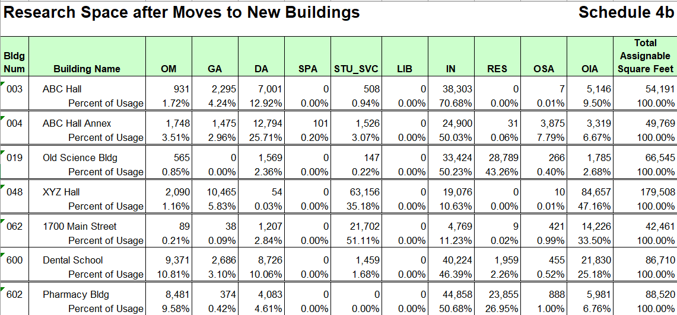
Projecting the Space – include updated usage for vacated space

Slide 18
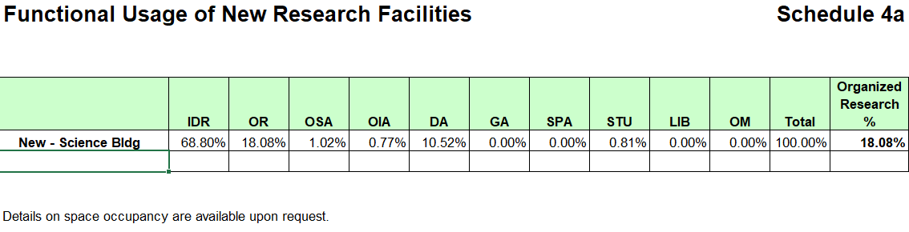
Projecting the Space – include projected usage for new space

Slide 19
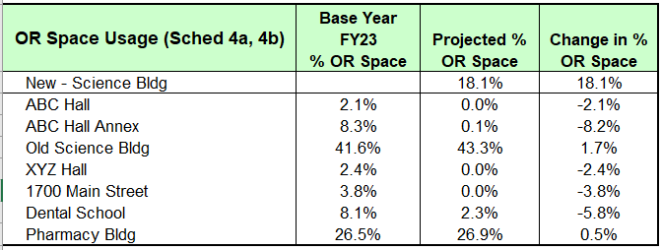
Projecting the Space – use change in OR% in the calculation

Slide 20
Projections- Impact to Base
Base Growth
  Historical trend may be the best indicator
    CAS Best Practices Manual (BPM) requires average MTDC base increase over past 5 years
    Research reported on Financial Statements
    NSF Survey data
  Know the trends of your sponsors - are the sources drying up? Which sources are growing and how quickly?

Slide 21
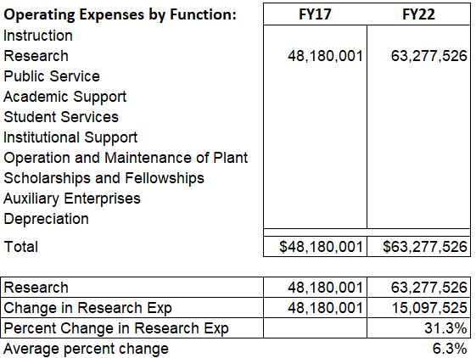
Example 1 - Projecting the Base

Slide 22
Example 2 - Projecting the Base

Slide 23
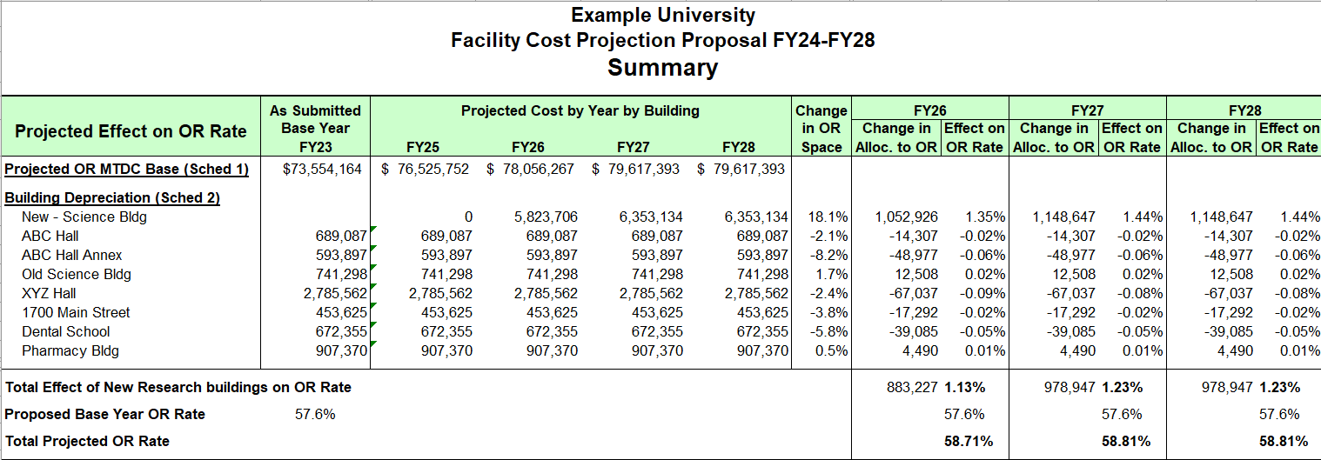
Include a Summary

Slide 24
Submission Requirements

Slide 25
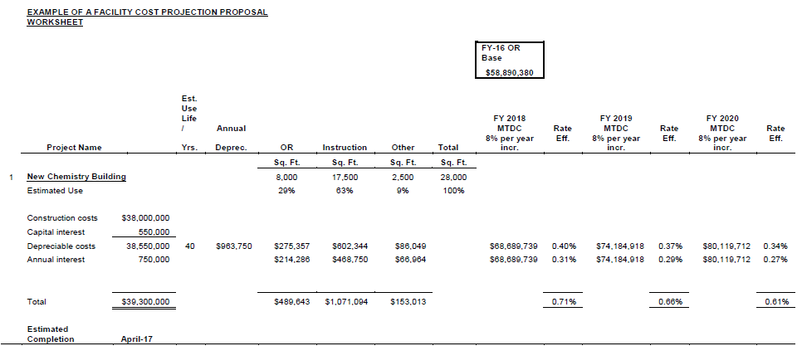
CAS Sample Template (assuming 8% RES growth/year)

Slide 26
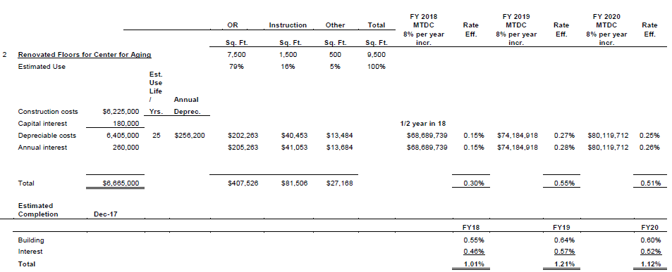
CAS Sample Template (assuming 8% RES growth/year)

Slide 27
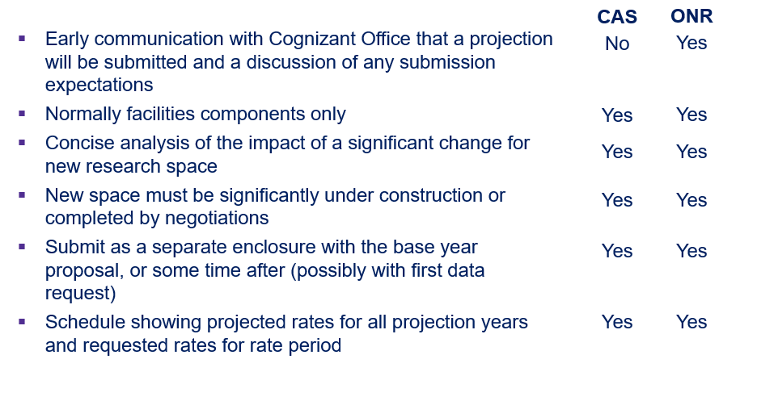
Projections- Submission

Slide 28
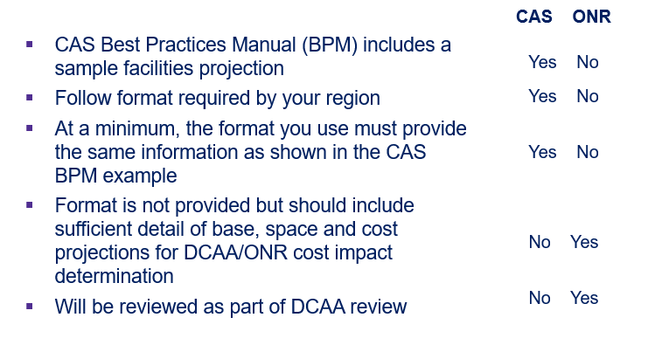
Projections- Submission

Slide 29
Projections- Submission- ONR Example (Task List)- part 1
Create a new directory
Set Current Data Directory to Base Year Model
Initialize projection model from base model to new directory
Set Current Data Directory to newly initialized model
Set Projection Data Directory to new and base models
Update Projection Tables
  Financial Factor Tables
S+W
Facilities
Utilities
Instruction
Research On
Research Off

Slide 30
Projections- Submission- ONR Example (Task List)- part 2
  Financial Mapping Tables
S+W --- all cpls except facilities/utilities
Facilities --- cpls 13x+16x
Utilities --- cpl 12x
Instruction --- cpl 9000
Research On --- cpl 9100
Research Off --- cpl 9150
  Adjustment Projection Tables
Review all --- Add mapping as necessary
  Transfer Projection Tables
Review all --- Add mapping as necessary
New Adjustments + Transfers
Run Projection Model
Review output (final cost by cpl) to determine where additional work is needed

Slide 31
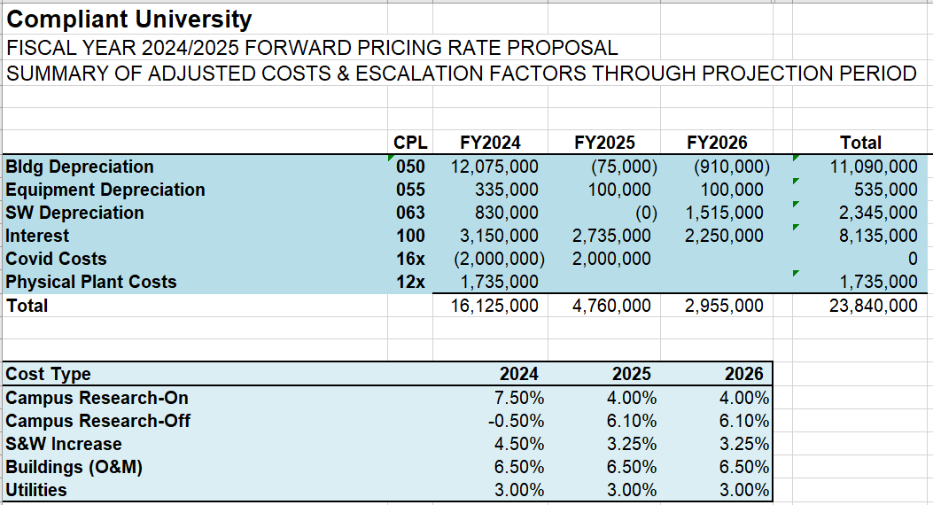
Projections- Submission- ONR Example (Summary)

Slide 32
Communicating with Management

Slide 33
CAS Concerns
Costs must project into FY’s where facilities are complete & occupied
Determine how Vacated Space is treated
Compare F&A Proposal MTDC base/RES SF to Projected MTDC/SF
If projected MTDC base per projected SF significantly Decreases, CAS will question
Ratio of Increase in space to the Increase in the MTDC base should be comparatively similar
Some “Decompression” may be considered (e.g., researchers doing same amount of grants but in more space)

Slide 34
CAS Concerns
CAS reviews for “Offsetting factors”
Could decrease University FCPP if:
Amount of old space being vacated and no longer used for RES
Space that will be become fully depreciated
RES MTDC base increases over same years as projected costs
Low Utility / Maintenance costs for new, more energy efficient buildings

Slide 35
Projections - Factors to Consider
  Do you have strong support documentation for ONR/DCAA?
  Level of confidence in your projection information
  Are feds being very critical in your region?
  Does your institution have a good relationship with your cognizant agency?

Slide 36
Projections - Factors to Consider
  Are you satisfied with base year rate calculated?
  Your Administration’s expectations - how big an increase are they pushing for?
  May create future issues if not sound, i.e., CAS has compared prior projections to current proposal
  If next rate is less, CAS may require paying back over-recovery dollars!
  Do you want HHS CAS to make a site visit?

Slide 37
University Experiences

Slide 38
ONR Cognizant University
  Pennsylvania State University
  Virginia Institute for Marine Science

Slide 39
HHS-CAS Cognizant Universities
  Mid-Atlantic $73.5M base, submitted 61.3% plus 0.75–0.79% projection. Initial offer = no change in rate. Negotiated 56.5%, 57.0%
  Mid-Atlantic $11.5M base, submitted 44.9% plus 0.3–1.5% projection. Negotiated 43.5%, 45.0%, 46.0%
  Mid-Atlantic $73.5M base, submitted 57.6% plus 1.7–2.2% projection. Current negotiated 58.5%. Still waiting for negotiation.

Slide 40
Questions?

Slide 41
Contact Information
Caroline Beeman carolinembeeman@maximus.com
540.308.3170
Mira L. Levine
mirallevine@maximus.com
703.582.5097

