Slide 1
Internal Controls
Leading Excellence in Research Costing Practices
Samantha Montgomery, University of Kentucky
Michelle Schardein, Huron Consulting Group
General Conference
October 30-November 1, 2024

Slide 2
Introductions
Michelle Schardein, Huron Consulting
17+ years in higher education
Post-award finance, IDC and fringe rate calculations, service center costing, animal per diem calculations, effort reporting, policy & procedures.
mschardein@hcg.com
Samantha Montgomery,
University of Kentucky
11 years in non-profit and local government audit
4 years in higher education
Service center costing, effort reporting, CAS and UG requirements, internal controls, and policy and procedures.
smontgomery@uky.edu

Slide 3
Agenda
Internal Controls Overview
Costing Principles and Internal Controls
Spotlight – Effort Reporting
Q&A
Appendix – Resources

Slide 4
Section 1:
Internal Controls
Overview

Slide 5
Internal Controls
What are Internal Controls?
Defined by Uniform Guidance
Internal Controls: processes designed and implemented by a non-Federal entity to provide reasonable assurance regarding the achievement of objectives in the following categories:
Effectiveness and efficiency of operations;
Reliability of reporting for internal and external use; and
Compliance with applicable laws and regulations.
Notes:
Efficiency and internal controls may seem like they don’t really go together, but I will talk about in a few minutes a few ways to focus your internal controls to find the balance.

Slide 6
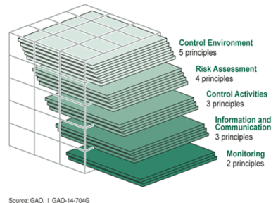
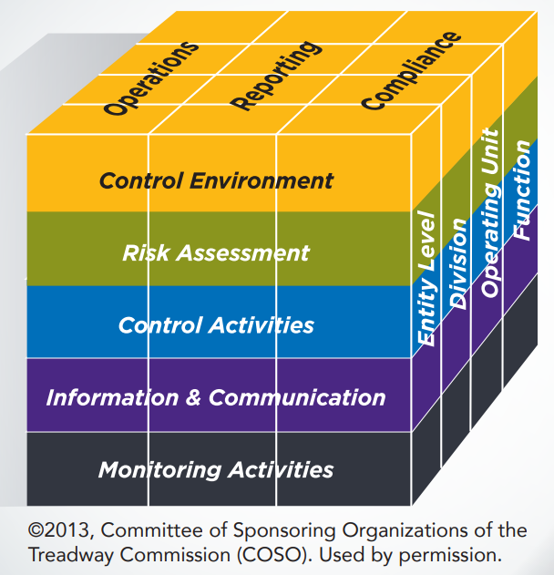
Internal Controls
Establishing Internal Controls
Uniform Guidance states that internal controls should be in line with:
  “Standards for Internal Control in the Federal Government” [i.e., the Green Book], issued by the Comptroller General of the United States;
  “Internal Control Integrated Framework”, issued by the Committee of Sponsoring Organizations (COSO); and
  OMB Compliance Supplement, Part 6.
Notes:
These are your guidebooks for internal controls, definitely think you should bookmark these are review, and I’ve put links to each one in the appendix for reference later as well.

Slide 7
Internal Controls
Role of Part 6: Applying internal controls to Federal Awards
OMB Compliance Supplement, Part 6 describes characteristics of internal control relating to each of the five components of internal control (as defined by the Green Book).
Part 6 serves dual purposes:
  For institutions, Part 6 serves as a guide to defining a control environment that facilitates compliance with Federal laws, regulations, and the terms and conditions of Federal awards.
  For auditors, Part 6 serves as a guide to conducting the Single Audit to auditing the institution’s compliance with Federal program requirements.
Notes:
Control environment, risk assessment, control activities, information & communication, monitoring activities

Slide 8
Application of Internal Controls
Cost
Service
Efficiency
Compliance
Are you striking the right balance?
Risk Analysis
Cost-Benefit Analysis
Focus on high-risk processes:
Greatest chance for misapplication of charges to Federal award.
High-dollar transactions
Transaction type (effort reporting, cost share, equipment, foreign travel, etc.)
How many controls impact a process?
How effective can the control be?
How broadly is the control applied?
Notes:
Cost: Labor hours; implementation of new software
Service: Is the additional admin burden going to impact the ability to provide service; how much will it slow operations down; how to account for the impact
Efficiency: How can you get all the work done without adding too many layers; how can technology assist
Compliance:
Risk Analysis: what to focus on Cost/benefit- as your considering implementation ask these questions.

Slide 9
Section 2:
Costing Principles and Internal Controls

Slide 10





COSO Framework
5 Components of Internal Controls
Control Environment | Risk Assessment | Control Activities | Information and Communication | Monitoring Activities
Sets the tone of an organization influencing the control consciousness of its people. It is the foundation for all other components of internal control, providing discipline and structure. | Institution’s identification and analysis of risks relevant to achievement of its objectives, forming a basis for determining how the risks should be managed. | Policies and procedures that help ensure that management directives are carried out. | Identification, capture, and exchange of information in a form and time frame that enable people to carry out their responsibilities. | Process that assesses the quality of internal control performance over time.
Notes:
Culture of Compliance

Slide 11
Costing Principles
Overview
Cost principles must be used in determining allowable costs of work performed by the non-Federal entity under Federal awards.
To charge a cost to a Federal award, a cost must be:
  Allowable;
  Reasonable; and
  Allocable.
Items of cost must be consistently treated.
Notes:
How can internal controls be established that support compliance with these costing principles?

Slide 12
Costing Principles
Potential Risk Areas
Entity Level
Guidance around cost principles is not defined in policy.
Division /
Operating Unit
Management lack's ability to restrict individuals who have access to make direct charges in the accounting system.
Management lack's ability to identify charges that were applied to an award in error.
Function
Individuals without full knowledge of policy are allowed to charge awards.
Individuals who charge awards do not have sufficient guidance to determine the allocability of a direct charge.
Lack of commitment to culture of compliance

Slide 13
Costing Principles
Mitigating Risk
Control Environment
Adequate training on costing principles
Adequate information and reporting systems for reviews
Monitoring Activities
Internal Audit work plan includes sponsored research
Clear expectations and follow up on monitoring
Risk Assessment
Approach to monitor direct charges
Processes for monitoring major indicators of noncompliance
Internal Controls
Information & Communication
Built-in System Controls
Adequate source documentation exists and is available for reporting
Records Retention policy
Control Activities
Segregation of Duties
Reconciliation schedules
Limit ability to override standard processes
.

Slide 14
Section 3:
Spotlight -Effort Reporting

Slide 15
Effort Reporting
Effort Reporting
    The mechanism used to provide assurance to federal sponsors that salaries charged, or cost shared on awards are reasonable in relation to the actual work performed.
Standards of Documentations, per Uniform Guidance
Be supported by a system of internal control that provides reasonable assurances
Reflect the total activity for which the employee is compensated by the entity
Comply with the entity’s established accounting policies and practices
Support the distribution of the employee’s salary and wages among specific activities or cost objectives
Encompass both federally assisted, and all other activities compensated by the institution
Be incorporated into the entity’s official records
Notes:
Quick refresher on what is effort reporting and what UG says

Slide 16
Effort Reporting
What do I need to know and
consider to maintain compliance?
Budget estimates continue to be considered insufficient support for charges.
Ongoing monitoring and review of salary charged to awards.
Salary must accurately reflect the work performed.
Cost sharing or matching must be supported in the same manner as direct charges.
The PI is typically in best position to certify to accuracy of effort report based on knowledge of award.
“Reasonable” estimates apply.
Notes:
The objective of these considerations is assurance that the salary charged towards a sponsored project is reviewed regularly and accounted for appropriately. At UK, we do not certify effort, but have elected to confirm payroll dollars charged to sponsored projects to meet UG standards. We utilize an electronic cloud-based system that allows our campus departments to review payroll dollars posted to sponsored projects and any of their cost centers. This review can occur at any time in what we call “non-confirmation” periods and must occur during “confirmation periods”. For sponsored projects, we have established a quarterly review of payroll that occurs strategically around pay periods to allow time for any corrections identified as needed by the business officer or PI, and this setup validates that the payroll dollars applied toward projects are monitored and reviewed regularly.

Slide 17
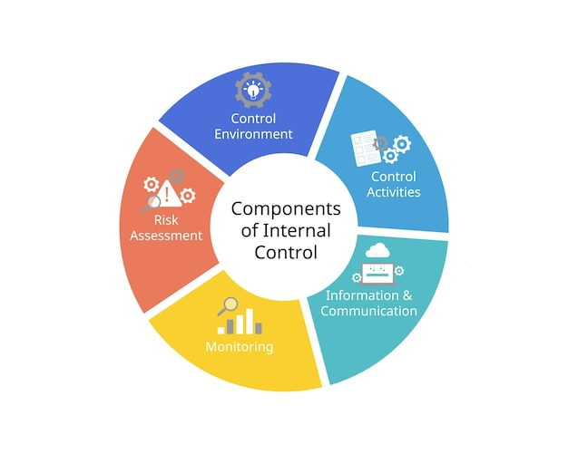
Effort Reporting
Internal Control Framework
Notes:
Validating that the dollars applied to a project are appropriate is a small portion of the overall internal control framework. Everyone here is aware of the internal control framework and its purpose, but it’s important to understand what part in this wheel that effort reporting plays.
Policies and procedures are built to guide the employees on the appropriate actions to take (an example being payroll correction workflows or the entry of a new employee on a project). It is up to the employees to complete these actions timely and effectively and within the systems provided by the organization. Validation of project effort is a mechanism of satisfying two of the elements shown here, Information & Communication and Monitoring. A department and PI demonstrating that effort applied to any project is being monitored in accordance with the institution’s and sponsor’s requirements provides assurance that the funds are being managed in a manner that lessens the risk of misuse. It’s important to understand that internal controls will never eliminate risk, but controls should be built in a way that if an error occurs, it’s discoverable and fixable.
Our usage of an online software platform allows our PIs and employees to gain access to information timely, regardless of where they are physically located. They simply need internet access, and they can review and complete any outstanding tasks. This system also allows the central office staff to monitor completion rates and work directly with departments when something is identified that requires additional attention.

Slide 18
Effort Reporting
What do I need to focus on when performing a salary review?
Is the documentation complete?
Is the account/project active?
Is salary requested within award budget period?
Was the individual in the original budget? What was their role? Is this role allowed on the project?
Is the award under/overspent?
Is the individual's salary over the NIH salary cap?
Is amount requested within original salary budget?
Are corrections/changes documented to support corrections made after salary is charged to a project?
Notes:
While not a comprehensive list, here are some key considerations when reviewing payroll. A recommendation for any reviews that are occurring is that they are completed frequently. As a department, it is important to ensure that the costs charged to a project are complete and accurate. This includes ensuring that ALL costs are included, and not leaving effort off a project that occurred. Discovering that payroll wasn’t charged to a project until it’s in closeout review will likely result in one of two things occurring. The department will be maintaining costs that could have been charged to the sponsored project, thus removing budget that could have been spent elsewhere. Or the payroll is updated to the account, depending on the systems and processes in place at your institution, and the sponsor has the right to question why that cost wasn’t accounted for when it was incurred. Neither situation is desirable, and both are preventable with timely reconciliations and appropriate supporting documentation being available.

Slide 19

Effort Reporting
System controls should provide for the proper allocation and review of compensation
Allow distinctions between IBS, supplemental compensation and excluded compensation for the purpose of charging awards.
Can limit payments to 100% of IBS.
Allow review of allocation of compensation across fund sources.
Can prevent non-allocable salary from outside the project period from posting.
Payroll corrections include attributes (not text description) that identify the person and prior individual earning periods being corrected in the General Ledger.
Information Systems
Notes:
The systems in place should assist the departments and PIs with completing their reviews of payroll charges. Internal controls should work towards the prevention of mismanagement without creating a significant administrative burden. It’s a balancing act that many face when assessing their level of risk tolerance and their susceptibility to error or fraud in a particular area.
As previously mentioned, we utilized a cloud-based platform that can be accessed by the appropriate personnel when needed, regardless of their locations, by utilizing a two-factor authorization process. Our IT systems utilize VPNs to add a layer of security to prevent unauthorized access. We also utilize a variety of system controls in our ERP system to support compliance with internal controls, such as budget availability checking.
These additional layers of protection have enabled our institution to become more efficient in its management of payroll charged to sponsored projects because we’re not having to wait on a PI to review something that may be in another country conducting research.
With this accessibility, there is also the risk of insufficient or ineffective training. Having tools in place is a step, but having the capability to utilize those tools appropriately is another key element. Simply logging in and clicking a button because “someone told me that’s all I had to do” is not utilizing the system as intended or appropriately managing the sponsor’s funds.

Slide 20

Effort Reporting
Ensure PIs/PDs, departments, and staff understand their roles and responsibilities to the varying controls that apply to them.
Confirm that individuals involved in reviewing payroll have an understanding of the basic UG concepts and requirements for compensation.
Provide education and training in the format of presentations, web content, webinars, personal interviews, etc. Individual tracking of training is not a requirement.
Education & Training
Notes:
For effective monitoring, the individuals must understand their role and what part it plays in the bigger picture. A key element in internal controls is segregating duties, and outlining roles documenting how that segregation occurs.
Example – you wouldn’t have the same person inputting new employees, including their direct deposit information, approving the time sheet of all the employees, and processing the payroll payments. All of these key functions would be handled by a variety of individuals to add layers of validation and oversight. Having designated roles in effort reporting is key in ensuring that payroll is appropriately applied to sponsored projects.
Training and education in roles provide the resources to ensure that work performed on a project is appropriately recognized; especially in those instances where individuals are tasked with responsibilities in multiple projects. Education and training also ensure that those charged with reconciling and validating information understand what their position is responsible for and where to find the resources when questions arise. If the PI doesn’t understand the system used to confirm effort, there is a higher risk of error because it’s likely the PI will rely on the business office personnel to tell them what buttons to click.

Slide 21
Effort Reporting
Establish routine activities (e.g. monthly) as part of the standard control framework and/or periodic activities (e.g. yearly) to test the effectiveness of specific controls.
Develop monitoring activities to identify control failures, exceptions, or errors.
Explore System-automated controls which prevent errors, as these require minimal oversight once established.
Consider institutional resources, systems, and risk tolerance when adopting activities.
Compliance Monitoring
Notes:
Visualization of compliance monitoring.

Slide 22
Effort Reporting
Common Errors and Risks
Late effort reports – signed after due date.
Unsigned effort certifications.
Effort statements certified by someone without suitable means of verification.
Principal Investigator with 0% or 100% effort charged to a sponsored award.
Minimum and maximum effort requirements.
Recertification of effort reports.
Significant data inconsistency between effort reports and other documentation
Cost Transfers (moving salary between accounts).
  Multiple cost transfers for the same salary.
  Movement of salary from one federal award to another.
  Cost transfers posted long after the salary was charged.
Notes:
This is not the complete list of risks and errors that can occur in payroll reporting for effort, but it does show common areas of weakness in payroll effort reporting at an institution. Depending on the type of reporting your institution utilizes, these may not be applicable to your current setup. As I discussed previously, our institution has elected to confirm payroll dollars charged to sponsored projects to meet UG standards. However, the internal controls that are developed through processes and procedures should be designed to identify and mitigate opportunities for non-compliance.

Slide 23
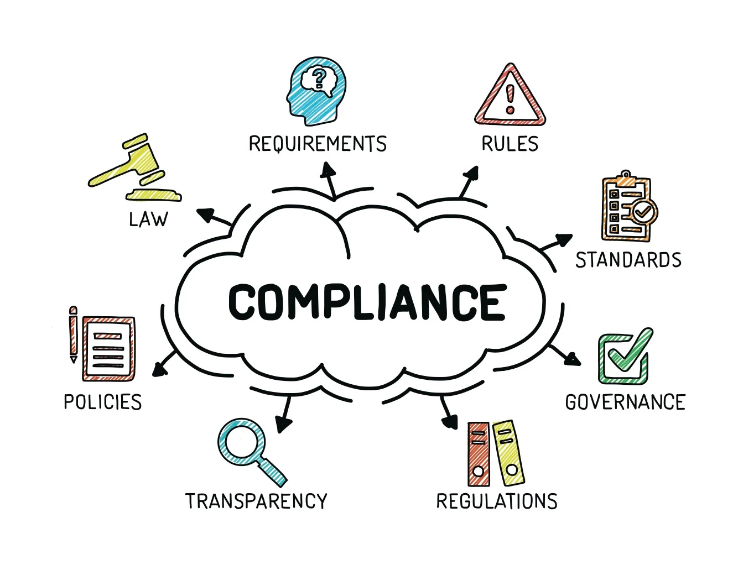
Effort Reporting
What can an institution do when there’s non-compliance
What about when there is non-compliance?
Policy or procedure in place to restrict cost transfers that are detrimental to the federal sponsor Example – Disallowing a cost transfer from being completed if later than institutional policy (e.g. 90 days upon discovery or after certification) or after a final financial statement has been submitted.
Notes:
UG 200.339, Remedies for Noncompliance, provides the framework for how an IHE can be penalized for non-compliance. Costs can be disallowed, payments can be withheld, or suspension/termination of the entire award can occur.
Institutions can put in place policies or procedures to protect sponsored project funds in the event an instance of non-compliance is detected. In effort reporting, this could be a PI refusing to confirm payroll dollars that are charged to a project, because they felt more expense should have been charged to the project, but the business office disagrees because time sheets indicate those individuals were working elsewhere. In cases where there is an impasse between the department, institution, and PI, the IHE could elect to have the costs removed from the project and placed on a department account. Any decisions like this are an institution-specific policy and can vary widely. Actions like these can demonstrate to the sponsor that along with appropriate oversight existing, there are processes in place to protect sponsor funds at all levels throughout the institution.

Slide 24
Effort Reporting
Impact on the Individual:
Susceptible for False Claims Act allegations.
Possible criminal charges.
May lose access to current institutional funding.
Impact to the Institution:
Institute may owe direct cost refunds or financial penalties.
Sponsor may reduce future funding.
Adverse publicity.
Susceptible to False Claims Act allegations.
Notes:
It is important for the effort reported for research projects be accurate and that effort reviewed regularly. Be careful that departmental personnel don’t fall into the trap of “making up the time” when effort on a project occurs but couldn’t be added to a project because of timing or other reasons. The work on the project needs to be recorded in the period that the work was completed – PI reports showing payroll posted towards a project should be utilized regularly, as they are the ones in the know of who has or hasn’t been working on their research projects.
Examples of effort reporting audit findings:
A university had a $2.6M settlement with the DOJ – the findings included:
Physicians received salaries from the university as well from another medical group (double billing for services)
Faculty time and effort devoted to the NIH grants were knowingly overstated
Charged more than 100% of salary
Grant supported work of other employees that never occurred.
Brainard, J. March 1, 2004 The Chronicle of Higher Education Johns Hopkins U. Settles Federal Charges of Overbilling on Research Grants. https://www.chronicle.com/article/johns-hopkins-u-settles-federal-charges-of-overbilling-on-research-grants/?bc_nonce=x7tg18zl23b5wewcfarri
Another university had a $4.4M settlement with DOJ and a $2.6m False Claims Act violation
Projects that were stated to have existed only did so on paper
NIH billed for employee’s who were to focus on a specific part of the research and they were treating other non-participating patients.
PI did not disclose that active research projects exceeded 100% of their IBS
Stratford, M. (March 24, 2009). C.U. Will Pay $2.6M in Fraud Case The Cornell Daily Sun https://cornellsun.com/2009/03/24/cu-will-pay-26m-fraud-case/
Finally, another university had a $2.4M NSF settlement
Faculty time was overstated (did not identify if knowingly or not)
Salaries and expenses were billed to the sponsor that were unrelated to the project
Jeff Tieman. (June 28, 2004, Monday). Ungranted billing; Harvard, Beth Israel to pay $2.4 million. Modern Healthcare.
https://advance.lexis.com/api/document?collection=news&id=urn%3acontentItem%3a4CS4-Y5Y0-0047-W3J6-00000-00&context=1519360&identityprofileid=HV2WHQ51837.

Slide 25
Key Takeaways
Reconcile and review regularly payroll regularly
Correct errors timely to ensure that payroll costs are accurately recorded on the project
Utilize available systems to document and support effort certifications
Train and educate key personnel on their roles and responsibilities for effort monitoring

Slide 26
Q&A

Slide 27
Appendix

Slide 28

Part 6, OMB Compliance Supplement
COSO
Green Book
INTERNAL CONTROL RESOURCES

Slide 29
COSO Framework
5 Components of Internal Controls
Control Environment | Risk Assessment | Control Activities | Information and Communication | Monitoring Activities
Sets the tone of an organization influencing the control consciousness of its people. It is the foundation for all other components of internal control, providing discipline and structure. | Institution’s identification and analysis of risks relevant to achievement of its objectives, forming a basis for determining how the risks should be managed. | Policies and procedures that help ensure that management directives are carried out. | Identification, capture, and exchange of information in a form and time frame that enable people to carry out their responsibilities. | Process that assesses the quality of internal control performance over time.
Notes:
SB

Slide 30
COSO Framework
Control Environment
Sets the tone of an organization influencing the control consciousness of its people. It is the foundation for all other components of internal control, providing discipline and structure.
Questions to Consider
Does your institution have buy-in and commitment from leadership, management and staff regarding a compliance environment?
Is there knowledge and focus on internal controls?
Notes:
SB

Slide 31
COSO Framework
Risk Assessment
Entity’s identification and analysis of risks relevant to achievement of its objectives, forming a basis for determining how the risks should be managed.
Questions to Consider
Do you have processes and structures in place to analyze risks?
Is it clear who is responsible for identifying, monitoring and managing risks?
Notes:
SB

Slide 32
COSO Framework
Control Activities
Policies and procedures that help ensure that management’s directives are carried out.
Questions to Consider
Are there written policies and procedures to reasonably assure compliance?
What types of actions support controls, such as segregation of duties, security checks, applications, business processes?
Notes:
SB

Slide 33
COSO Framework
Information & Communication
The identification, capture, and exchange of information in a form and time frame that enable people to carry out their responsibilities.
Questions to Consider
What documentation and communications will support quality of controls, such as record keeping, internal communications, and timely reporting?
How effective is communication?
Notes:
SB

Slide 34
COSO Framework
Monitoring
Process that assesses the quality of internal control performance over time.
Questions to Consider
What proactive, on-going monitoring occurs?
Are there independent reviews or reconciliations, supervisory review/feedback, or management review of reports?
Notes:
SB

Slide 35
Effort Reporting
Component | Key Questions | Specific criteria for compensation internal controls
Control environment | Does the environment provide discipline and structure for an organization to achieve its objectives? | How is compliance embedded into the organization? Authority for review, adjustments? Is there training? Is it mandatory? What are the consequences for non-compliance?
Risk assessment | Does organization assess risks for achieving objectives and sets a basis for risk responses? | How are risk tolerances determined? Level of precision? Timeliness? Are there special reviews for large or unique programs? What controls are present to identify fraud?
Control activities | What policies and procedures are used to achieve objectives and respond to risks? | What controls are used to validate compensation? Who can review? What controls are built into information systems? Access? Are clear policies and procedures in place?
Information and Communication | What is the quality of information management and communications in support of internal controls | Can fund sources for compensation be identified? How are stakeholders notified for responsibilities of certification? How are standards communicated to subrecipients?
Monitoring | What activities are performed to assess the quality of performance and resolve audit findings? | What reports exists to enable ongoing monitoring? What is the scope of monitoring across funding sources? Who performs? How are high risk individuals or departments identified? How are internal audits conducted?

