Slide 1



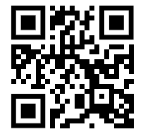
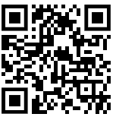

Cindy Hope, Director, Costing & Financial Compliance
COGR Update – NACCA, October 2024
Title
Date
www.cogr.edu
www.linkedin.com/
company/cogr
Notes:
For my remarks today, I will give you some background on COGR who we are, what we do, how we do it, and what we care about.

Slide 2

COGR History at-a-Glance
1948
COGR begins as a standing committee within NACUBO (then “CACUBO)” - “Committee on Governmental Relations”
1960
Offices established in DC near ACE building
1962
COGR appoints first Executive Director
1973
First female Chair appointed by the Board of Directors
1979
COGR moves to include faculty and research administrators on its Board, in addition to business officers
1994
COGR begins operating as a 501 c 3 organization independent from NACUBO
2000
First female ED/President is hired
2015
4th COGR Committee established (now Research Ethics & Compliance)
2020
COGR goes virtual, hosting first webinars and virtual meetings ever in response to COVID-19 pandemic
2023
COGR celebrates its 75th Anniversary
1998
COGR celebrates its 50th anniversary
1973
COGR welcomes its 100th member
2022
COGR welcomes its 200th member & launches the COGR Member Portal
2003
COGR expands member eligibility to include ‘associate’ members
2024
COGR launches Emerging Research Institutions (ERI) Pilot Program (August)
Notes:
COGR was established in May 1948 when the Central Association of College and University Business Officers formed a committee to represent the five regional associations of college and university business officers within NACUBO.
At that time, the United States government was shifting its focus from military procurement to investment in academic research.
Several insightful business officers recommended that universities explore how the independent governance of academic insitutions could be reconciled with increasing federal support.
The new committee was expected to develop effective fiscal principles for university-government contracting, seek acceptance of general principles in university-government relationships, and be a vehicle for innovation and change.
Opened a DC office in 1960. COGR’s activities evolved in subsequent years in response to the increasing influence of governmental regulations, policies, and practices.
As these rules began to reach beyond the fiscal sector into all areas of policy affecting the performance of research universities, COGR expanded its technical expertise and broadened its scope of activities.
During the 1970s, 80s, and early 90’s, COGR continued to be a part of NACUBO but increasingly it operated as a separate element.
COGR incorporated as a separate organization in September 1993 and began operating independently on January 1, 1994.
COGR celebrated its 75th anniversary and in early 2024 we will mark 30 years operating as a 501 c 3 nonprofit organization.

Slide 3
Who We Are
Nonprofit 501 (c) (3) association of leading research-intensive universities and affiliated medical centers and nonprofit research institutes
222 member institutions in 48 states & D.C.
  83 Privates | 139 Publics | 20 Affiliate Academic Hospitals and Research Institutes
  135 Carnegie Research I Institutions
  30+ Hispanic Serving Institutions (HSI)
  1 Historically Black College & University (HBCU)
  $49 Billion+ in combined federal expenditures (2022 NSF HERD Survey)
96% of eligible institutions among top 100 & 84% of eligible institutions among the top 200 institutions as measured in federal research expenditures are COGR members (2022 NSF HERD Survey)
Notes:
COGR is a nonprofit association of 220 public and private U.S. research universities and affiliated academic medical centers and research institutes. (33 new members since March 2020
We focus on the impact of federal regulations, policies, and practices on the performance of research conducted at our member institutions, and we advocate for sound, efficient, and effective regulation that safeguards research and minimizes administrative and cost burdens.
We advocate to the executive branch only and we are non a registered lobbying organization with Congress or under the tax code.
----------
Let me take a minute to discuss who from our member institutions engage with COGR
COGR Member representatives:
Over 3000 individuals in our database
Large institutions like UNC chapel hill has --- 26 officials
University offices represented
VP of Research
Sponsored Research
Research Compliance
Research security
General Counsel
Accounting / Finance / Audit
Government relations
Compliance
Others
Officials' titles range from
VPs
AVPs
GCs
Executive Directors / Directors
Chiefs
Officers
Managers
Analysts
Faculty
These are the people who are responsible for the administration and oversight of an institution’s research enterprise
Background Facts:
States not represented: Alaska and South Dakota
146 R-1 universities (2021)
133 R-2 universities
187 Doctoral/Professional universities
279 R-1 & R-2 combined
466 R-1, R-2, D/PU combined

Slide 4
What We Do
Advocate directly to federal agencies in areas of research administration, financial oversight, compliance, and ethics, intellectual property, and research security
Provide expertise, commentary, and analysis to higher education associations and government officials about pending federal policies, guidance, and legislation
Provide guidance and analysis on topics of interest to COGR members in the form of white papers, readiness guides, webinars, written updates, and more
Promote effective compliance practices
Provide opportunities to engage directly with federal officials, the research university community, and institutional colleagues on key and timely issues
Work closely and coordinate with key partners – AAU, APLU, AAMC, AUTM, EDUCAUSE, FASEB, and other higher education associations – that lobby on pending legislation - COGR does not lobby or directly influence pending legislation
Notes:
First: A major goal of COGR’s advocacy is to make federal research funding and regulatory agencies more aware of academic operations and the need to avoid unnecessary regulatory burdens. COGR represents institutions collectively, not individually.
Second: The positions we take reflect a general consensus of our membership and are believed to be in the best interests of the research community.
Third: [Speak from slide and mention COGR does NOT lobby Congress on legislation, but may inform Congress and partners about + / - of proposed policies.
Fourth: COGR strives to be the leading advocate for policies that support:
the conduct of research at the highest standards, and
sound and informed decision-making on issues critical to the research and higher education community.
Fifth: [OPTIONAL]
COGR serves its membership by:
seeking to balance appropriate accountability with minimizing administrative burden in its advocacy regarding sponsored research regulations, policies, and practices;
promoting policies and practices that fairly balance the legitimate interests and obligations of not only institutions but also federal agencies and other sponsors of research;
conducting objective and timely analysis of research security, costing, compliance, administration, ethical, and intellectual property issues for the benefit of its members, their sponsors, and other higher education associations;
working with governmental agencies and research sponsors to develop a common understanding of the impact that policies, regulations, and practices may have on the research programs of its membership; and
providing opportunities to engage directly with agency representatives and other higher education associations, as well as numerous networking opportunities with institutional colleagues through meetings and webinars.

Slide 5
Current Key Issues
Research Security
  Required Research Security Plans, Assessing Risk, Cybersecurity, and more . . .
Research Misconduct
Intellectual Property Issues
  Bayh-Dole and March-in Rights
Uniform Grant Guidance
Facilities & Administration Costs Reimbursement
Conflicts of Interest and Conflicts of Commitment
Public Access to the Results of Federally Funded Research
Animal Subjects
Human Subjects
The Research Partnership Between the Federal Government and Research Institutions
Notes:
The previous 2 slides provided some indications of the issues with which COGR is most engaged.
This is my final substantive slide and provides a snapshot of the issues the COGR team has been most engaged in the past few months.
I am glad to answer questions or hear your comments about any of them.
But I want to close my presentation on what I believe captures all these issues and a top priority of COGR.
--- Fostering a healthy research partnership between the federal government and research universities.
This partnership is extraordinary and been critical to the health, security, and economic prosperity of the U.S.
It’s under great strain and has been for some time:
Stagnant Federal research investments
Policy challenges to our nation’s ability to attract & retain international talent to universities
Proposals and actual policies that limit reimbursement of F&A costs
Increased regulatory burden – and it just keeps coming (40%+ FDP) and UNFUNDED mandates
COGR’s lane is in helping foster a healthy partnership is in the costs reimbursement and regulatory burden –
We are focused on risk-calibrated regulation that ensures universities are good stewards of federal taxpayer investments in research, that we conduct research safely and ethically, and that policies, guidelines, and regulations are sensible and do not create unneeded burden and put up barriers to conducting research.

Slide 6
FY 2024 Revisions to 2 CFR
COGR Response
COGR raised nine issues with OMB (6/28 letter)
  Implement the Changes to the Equipment and Subaward Thresholds: Request OMB issue guidance to ensure that all institutions are provided a pathway to implement the new thresholds as soon as October 1, 2024.
  Do Not Implement Fixed Amount Awards and Subawards Changes: Partner with the Community to Implement Changes at a Future Date: The language on fixed amount awards and subawards should revert to the 2020 language and include the $50K threshold, which will allow all stakeholders to work towards language that achieves the proper balance between appropriate oversight, achieving performance outcomes, and minimizing administrative burden.
  Reaffirm the Partnership: Streamlining Regulation and Strengthening U.S. Competitiveness in Global Research and Development: The longstanding “Consistency” and “Fair Share” principles should be maintained as part of the OMB Guidance.
  Voluntary Uncommitted Cost Sharing (VUCS): Aligning the Preamble with 200.306(k): Improve VUCS guidance by extending flexibilities to all research entities, not IHEs only. Improve the definition of VUCS as suggested by COGR and eliminate the reference to memorandum OMB M-01-06.

Slide 7
FY 2024 Revisions to 2 CFR
COGR Response
  Sole Source Procurement is Appropriate for Specialized Scientific Items: 200.320(c): Incorporate FAQ #88, which permits sole source procurement of specialized scientific items.
  Implementation of Indirect (F&A) Cost Rates in a Timely Manner: 200.414(c)(2): Memorialize OMB’s role to address delays and related issues with implementing federally negotiated indirect cost rates.
  Retract the New Text Applicable to Unused Leave: 200.431(b)(3)(i): COGR urges OMB to delete the new text proposed by OMB, which is problematic and will inappropriately disallow an accounting methodology applicable to unused leave that is acceptable under GAAP and that is used regularly by many institutions.
  Retract the New Requirement for Agency Approval of a Subaward Condition: 200.332(d): COGR urges OMB to delete the new text requiring a pass-through entity to notify the federal agency if the passthrough entity implements a specific subaward condition, which creates new burden without any corresponding benefit to oversight of federal funds.
  Eliminate the Expectation for the Prime Recipient to Negotiate Indirect Cost Rates with a Subrecipient: 200.414(f): COGR urges OMB to delete the new text that sets an expectation for the prime recipient to accept an indirect cost rate proposal from a subrecipient – and subsequently, negotiate a unique indirect cost rate with the subrecipient as it creates a significant administrative burden which is in direct opposition to the spirit of the new OMB Guidance.

Slide 8
FY 2024 Revisions to 2 CFR
COGR Response
COGR identified 3 as most concerning (in 8/7 meeting with OMB):
  Unused leave payout at end of employment
  Additional requirements for use of Fixed Amount Awards
  Implementation of Changes to the Equipment and Subaward Thresholds
Notes:
I don’t have any information for you that isn’t already available but, I’m hoping that walking through it together will inspire creative solutions.

Slide 9
Unused leave payout at end of employment
2 CFR 200.431 - Compensation—fringe benefits. (APRIL 2024 VERSION)
  (b) Leave. The cost of fringe benefits…allowable if all of the following criteria are met: (paraphrasing below)
    provided under established written leave policies;
    equitably allocated; and
    accounting basis (cash or accrual) selected is consistently followed
      cash basis must be allocated as a general administrative expense
      accrual basis may be only used for those types of leave for which a liability as defined by GAAP exists when the leave is earned… allowable leave costs are the lesser of the amount accrued or funded

Slide 10
Unused leave payout at end of employment
2 CFR 200.431 - Compensation—fringe benefits. (TECHNICAL CORRECTION)
  (b) Leave. The cost of fringe benefits…allowable if all of the following criteria are met: (paraphrasing below)
    provided under established written leave policies;
    equitably allocated; and
    accounting basis (cash or accrual) selected is consistently followed
      cash basis - Payments for unused leave when an employee retires or terminates employment are allowable in the year of payment and should* be allocated as a general administrative expense to all activities or included in the fringe benefit rate.
      accrual basis may be only used for those types of leave for which a liability as defined by GAAP exists when the leave is earned… allowable leave costs are the lesser of the amount accrued or funded
* In the Section-by-Section Discussion, OMB states, “Paragraph (b)(3)(i), as revised, continues to describe the two options that will generally be used for these types of payments under subpart E”
Notes:
And verbally, OMB confirmed “should” was very intentional. Tech Correction – “In addition, OMB further revised paragraph (b)(3)(i) of § 200.431 through this document to replace the word “must” with “should” in the instruction to either allocate these payments for unused leave as a general administrative expense to all activities or include them in fringe benefit rates. This revision is consistent with prior OMB guidance on this topic in the “2 CFR Frequently Asked Questions” (2 CFR FAQ) published on May 3, 2021, which was a source of the text at paragraph (b)(3)(i) of § 200.431. See 2 CFR FAQ, at Q-104. All payments for unused leave must still be allocated in accordance with the cost principles in subpart E. See, e.g., 2 CFR 200.401(a). Paragraph (b)(3)(i), as revised, continues to describe the two options that will generally be used for these types of payments under subpart E. “

Slide 11
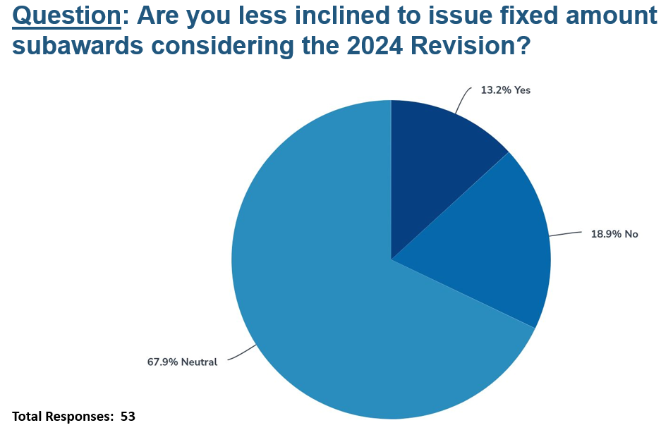
Additional requirements for use of Fixed Amount Awards
2 CFR 200.201 - Use of grants, cooperative agreements, fixed amount awards, and contracts.
  (b) Fixed amount awards.
    (4) At the end of a fixed amount award…must certify in writing…that the project was completed…or identify those activities that were not completed, and that all expenditures were incurred in accordance with § 200.403 (Factors affecting allowability of costs).
Notes:
OMB says previous FAQ will not continue to exist but intends to conduct listening sessions and develop a guidance document. (Dismissive of FAQs in general)
Recent COGR polling indicates a lack of understanding of the change in wording.

Slide 12
Implementation of Changes to the Equipment and Subaward Thresholds
2 CFR 200.110 - Effective date.
  …become effective once implemented by Federal agencies...
  Existing negotiated indirect cost rates will remain in place until they expire. …for indirect cost rates and cost allocation plans, the revisions to this part…become effective in generating proposals and negotiating a new rate (i.e. when the rate is negotiated).
COFFA (Council on Federal Financial Assistance)
  FY 2024 Revisions to 2 CFR: Federal Agency Implementation, August 15, 2024
    …provides additional supplementary information to assist Federal agencies with more consistently implementing the revisions made by the Office of Management and Budget (OMB) to Title 2 of the Code of Federal Regulations (CFR) in April 2024…
Notes:
The COFFA convenes agency Senior Financial Assistance Officials to meet with OMB on all federal financial assistance related matters and is a partnership among all federal financial assistance making agencies to provide a single voice on federal financial assistance policy, management, and technology activities. The COFFA was established by M-23-19 Establishment of the Council on Federal Financial Assistance.

Slide 13
Implementation of Changes to the Equipment and Subaward Thresholds
  Federal agencies must take appropriate steps to ensure the 2024 Revisions are effective for all Federal awards entered into on or after October 1, 2024…
  Encourages agencies to apply to existing awards but, This flexibility to provide written approval reducing burden for past activities does not apply to revisions of indirect cost rates or de minimis rates.
  … Negotiated Indirect Cost Rate Agreements (NICRA) negotiated prior to October 1, 2024 must continue to be honored by both Federal agencies and recipients. However, cognizant agencies for indirect costs may—but are not required to—renegotiate existing NICRAs (i.e., issue revised or amended agreements) to reflect the new MTDC base. OMB encourages cognizant agencies for indirect costs to accommodate requests to renegotiate existing NICRAs that are in effect beyond October 1, 2025.

Slide 14
Implementation of Changes to the Equipment and Subaward Thresholds
Threshold changes are not simple:
  State or multi-campus institutions requiring consistent equipment definitions
  New NICRA date, new award date, new subaward date, project budget...
Even with a new NICRA, the Base definition may look like:
  For all awards beginning 6/30/2025 and earlier –
    Total direct costs excluding capital expenditures…that portion of each subaward in excess of $25,000…
  For all awards beginning 7/1/2025 and later –
    Total direct costs excluding capital expenditures…that portion of each subaward in excess of $50,000…
  Or:
    Equipment means an article of nonexpendable tangible personal property having a useful life of more than one year, and an acquisition cost of $5,000 or more per unit. Effective 7/1/2025, equipment means an article of nonexpendable tangible personal property having a useful life of more than one year, and an acquisition cost of $10,000 or more per unit.

Slide 15

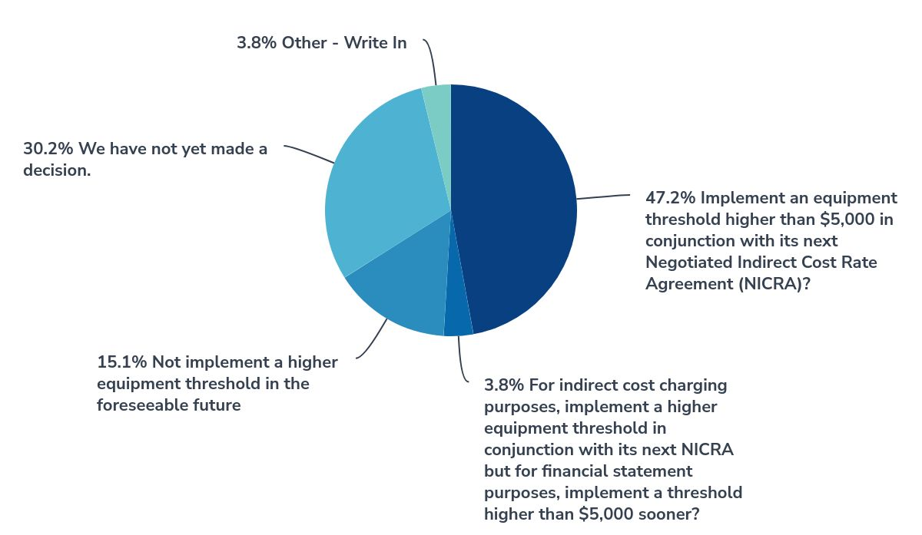


Question: [For equipment threshold] Does your institution plan to:
Other Responses:
∙Already implemented higher equipment threshold for unrestricted funds(1)
∙Limited by state definitions (1)
Total Responses: 53
Notes:
Cindy

Slide 16
Implementation of Changes to the Equipment and Subaward Thresholds
COFFA (Council on Federal Financial Assistance) August 15, 2024
  … through a properly documented case-by-case exception, a Federal agency may allow a recipient to use the new de minimis indirect cost rate for an existing award, which is now available under the 2024 Revisions. This would also include using the new definition of modified total direct cost (MTDC).
  While it may be necessary for recipients to implement certain systematic changes across their organization to implement new awards incorporating the 2024 Revisions, recipients should also keep in mind that not all flexibilities provided by the 2024 Revisions will be available through existing Federal awards issued prior to the effective date of the 2024 Revisions.

Slide 17
Implementation of Changes to the Equipment and Subaward Thresholds
Could we get a safe harbor for system changes?
Previous FAQ:
  .110-13 (Previously Q II-2) Effective Dates and Federal Awards Made Previously
  Will this apply only to awards made after the effective date, or does it apply to awards made earlier?
  We would anticipate that for many of the changes, non-Federal entities with both old and new awards may make changes to their entity-wide policies (for example to payroll or procurement systems). Practically speaking, these changes would impact their existing/older awards. Non-Federal entities wishing to implement entity-wide system changes to comply with the Uniform Guidance after the effective date of December 26, 2014 will not be penalized for doing so.

Slide 18
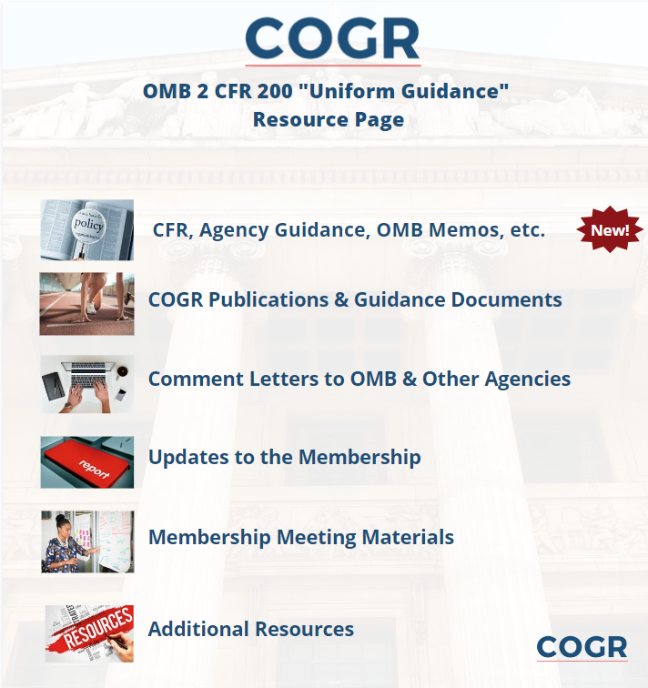
“Look” Series
  “First Look: COGR Preliminary Assessment of Selected Items (April 24, 2024)
  Second Look: Webinar on the Final OMB Guidance for Federal Financial Assistance (May 15, 2024)
  Third Look: COGR Meeting – Final OMB Guidance for Federal Financial Assistance, What’s Next? (June 6, 2024, no slides/recording)
  Fourth Look: COGR Proposes Technical Corrections and Comments for the OMB Guidance (June 28, 2024)
Pollev.com/cogrstaff949 Ask a question from your seat!
Notes:
Krystal
Important to mention the website anything and everything UG (old and new).
Not only COGR resources but info from OMB and agency guidance – include cross walk of old UG and new UG

Slide 19
Readiness Guide
  “Fifth Look” – Posted September 20, 2024
    Also see September 2024 COGR Update regarding subsequent Technical Correction (p 19)
  Includes analysis and guidance based on COGR's understanding of effective dates and significant revisions to 2 CFR 200 such as:
    increases to thresholds for equipment/supplies, subawards, and single audits; de minimis F&A cost rates; and fixed amount award requirements
Pollev.com/cogrstaff949 Ask a question from your seat!
Notes:
Cindy

Slide 20
New Adjustment to F&A Cost Pools for Salary Cap
Language in appropriation:
  Sec. 202. None of the funds appropriated in this title shall be used to pay the salary of an individual, through a grant or other extramural mechanism, at a rate in excess of Executive Level II…
Implemented in HHS Grants Policy Statement effective October 1, 2024
  Salary Rate Limit (SRL) - The HHS SRL applies to… Both direct and indirect costs under applicable HHS awards.
    Effective October 1, 2024, when HHS is the cognizant agency for indirect costs … the HHS component that reviews and negotiates indirect cost rate proposals and cost allocation plans will issue NICRAs that incorporate the HHS SRL, to comply with the HHS Appropriations Act requirement.

Slide 21
New Adjustment to F&A Cost Pools for Salary Cap
IHHS Grants Policy Statement effective October 1, 2024 (cont.)
    Beginning with HHS awards, including continuation and supplemental awards, made on or after October 1, 2024, HHS recipients that do not have an approved indirect cost rate that complies with the HHS SRL requirement must take and document the following actions.:
      Identify any HHS award where HHS funds are used to pay any salary that exceeds the SRL using the HHS award. This includes both direct and indirect costs, both in whole and any portion of a salary that at a full-time equivalent exceeds the SRL.
      Have written policies and procedures that ensure the recipient does not draw down HHS award funds, whether as direct or indirect costs, to pay for salaries above the HHS SRL.
HHS GPS does not apply to NIH but NIH Grants Policy Notice will say that its policy is the same.
Institutions not subject to admin cap of 26% significantly impacted.
  Additional administrative burden for all.
Notes:
They expect us to self-adjust NICRA for this, why not for threshold changes?

Slide 22
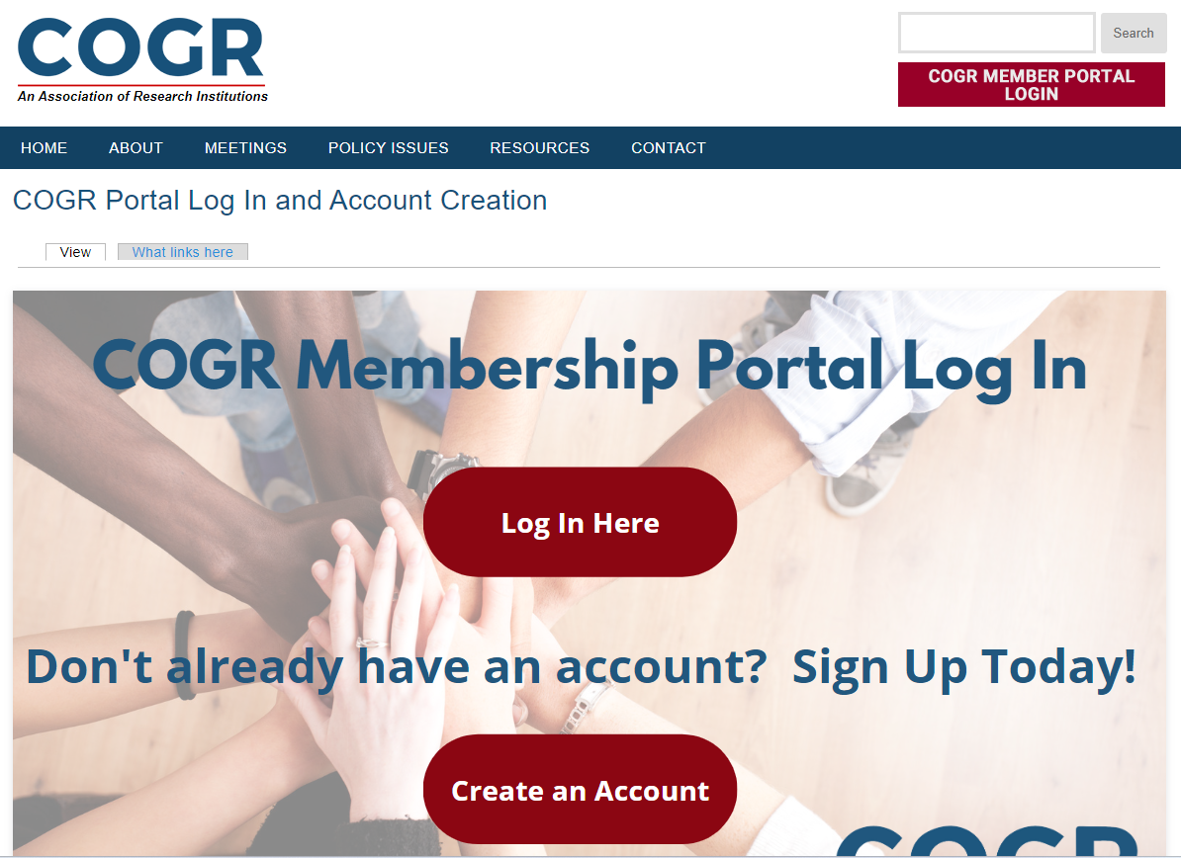
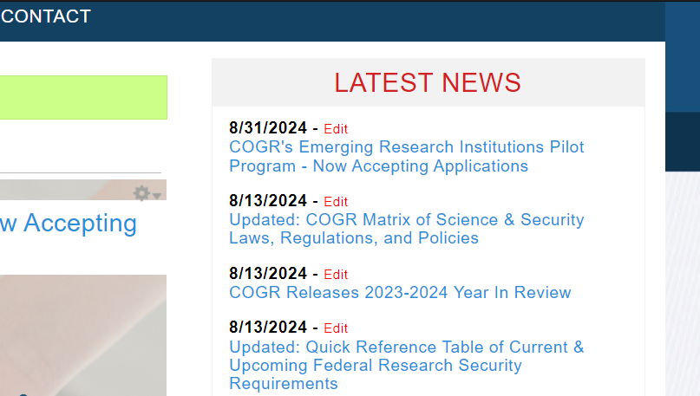
Latest COGR Update & Year in Review: Available Now at www.cogr.edu
Update the below

Slide 23

Get in Touch – Stay Connected
  Email: chope@cogr.edu
  Member Services: Memberservices@cogr.edu
  ERI Pilot Services: ERIservices@cogr.edu
  Phone: (202) 289-6655
  Website: www.cogr.edu
  LinkedIn: www.linkedin.com/company/cogr
Notes:
But I want to close my presentation on what I believe captures all these issues and a top priority of mine
--- Fostering a healthy research partnership between the federal government and research universities.
This partnership is extraordinary and been critical to the health, security, and economic prosperity of the U.S.
It’s under great strain and has been for some time:
Stagnant Federal research investments
Policy challenges to our nation’s ability to attract & retain international talent to universities
Proposals and actual policies that limit reimbursement of F&A costs
Increased regulatory burden – and it just keeps coming (40%+ FDP) and UNFUNDED mandates
COGR’s lane in helping foster a healthy partnership is in the costs reimbursement and regulatory burden – we are focused on risk-calibrated regulation that ensures universities are good stewards of federal taxpayer investments in research, that we conduct research safely and ethically, and that policies, guidelines, and regulations are sensible and do not create unneeded burden and put up barriers to conducting research.

Slide 24


