Slide 1
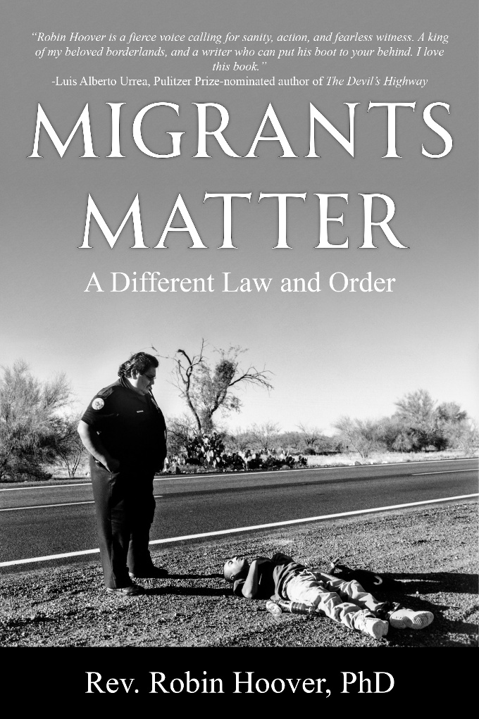
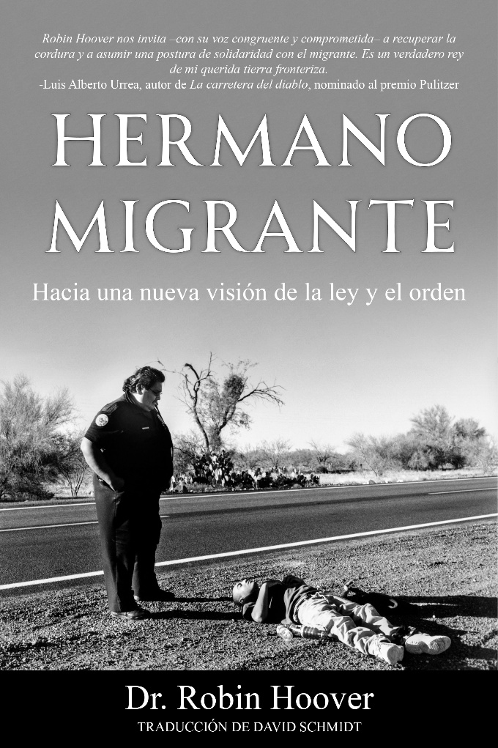
MIGRANTS MATTER: a different law and order
by Rev. Robin Hoover Ph.D.,
Slides can be
Downloaded at
RobinHoover.Com

Slide 2
WHO AM I?
Social Ethicist/Political Scientist/Political Theorist
40+ years working for migrants
Founder/President Emeritus of Humane Borders, Inc.
2006 Mexico’s National Human Rights Award
Former National Scholar in Residence CENADEH, CDMX
Author/Lecturer/Activist/Media Guy…
  Archives: University of Arizona Special Collections
Storyteller and artificial inseminator of honeybees…
I made a three-star DHS general cry one day

Slide 3
“HOOVER PLAN” (I DIDN’T NAME IT)
FOR THE “UNDOCUMENTED”
As a matter of social justice, we start here
No papers? Give ‘em papers!
We’ve done this before
Use some good social science
Start with IRCA ‘86 legalization
NGOs prepare docs
Interviews
As much vetting as needed (current biggest complaint)
New visas from two to twenty-two years

Slide 4
“HOOVER PLAN” FOR “UNDOCUMENTED”
New social contract
Drivers’ licenses and car insurance
Health insurance
Use good social science: factor in self-deportations, marriages, deaths, etc. Keep foreign born below 15%, etc.
Begin naturalization if appropriate
Naturalization can be completed in absentia
Up to 8 million could change status within 10 years faster than Trump’s goals and a tiny fraction of enforcement costs

Slide 5
“HOOVER PLAN” VISA HOLDERS CAN:
  Travel (even international)
  Buy homes, cars
  Start businesses (make eligible for other visas)
  Serve in military (make eligible for other visas)

Slide 6
OTHER THINGS TO DO:
Tweak the INA preferences
Move ALL immigration matters to Title III courts
  Due process deserves nothing less
  Separate is not equal, remember?
  Fix ‘96
Limit all detention sentences, eliminate indefinite detention

Slide 7
The deaths of Pretti and Good were horrible. 10,000 others are
documented. I started the mapping of deaths in fall of 2000.

Slide 8
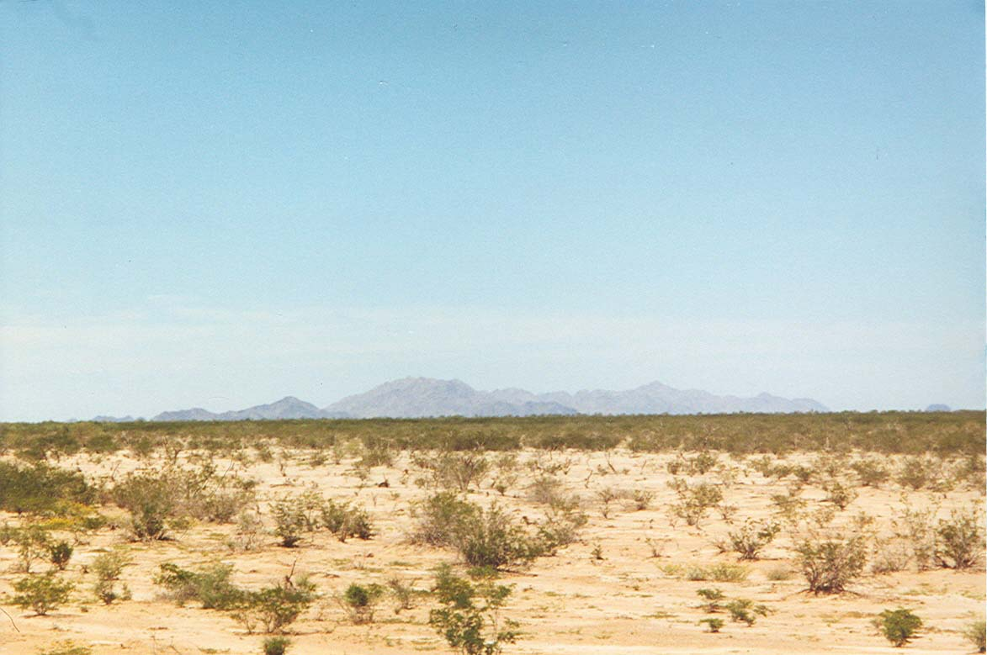
The Death Trap
Fourteen migrants perished from dehydration on May 23, 2001. Their guide walked the wrong way in Cabeza Prieta National Wildlife Refuge. Lack of water was fatal. I’m standing on the border. The mountains are 30 miles away.

Slide 9
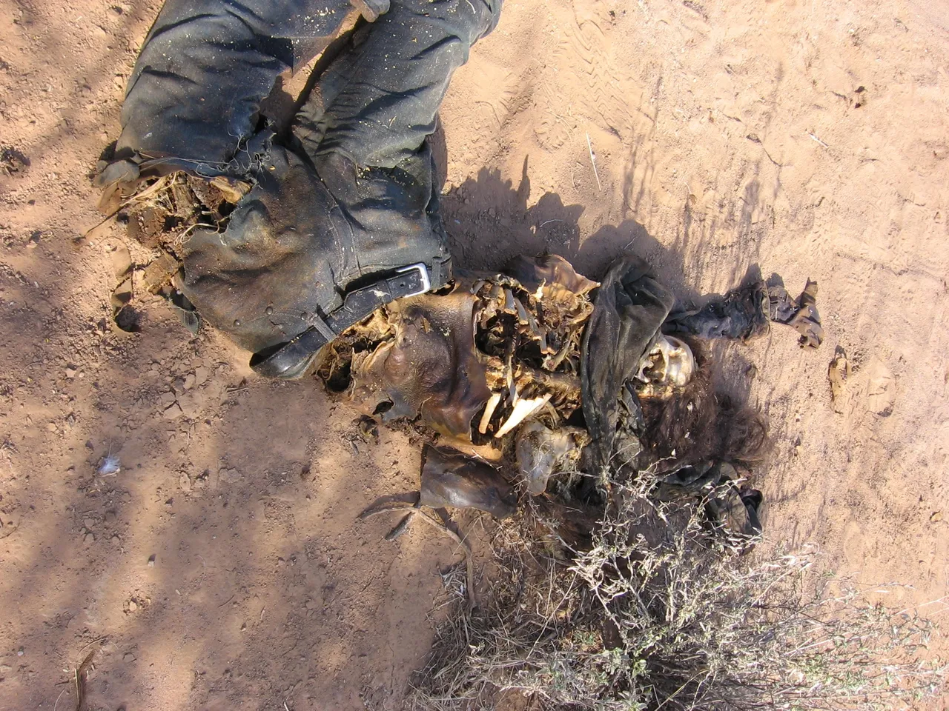
PRUDENCIA MARTIN
GOMEZ—AGE 19
(USED WITH HER PARENTS’ PERMISSION)
First of the dead migrants I have found
One of more than 10,000 human remains discovered since ‘99

Slide 10
DEATH IS A DELIBERATELY CHOSEN POLICY
PRE ‘94 DEATHS OF MIGRANTS WERE IN URBAN AREAS
‘94-ON, DEATHS WERE MOVED TO THE DESERT THROUGH ENFORCEMENT STRATEGIES
TODAY, DEATHS ARE STILL IN THE DESERT, BUT NOW MOVING BACK TO URBAN AREAS AND TO DETENTION

Slide 11
REFORM IS NOT A SALIENT WEDGE ISSUE…YET
In many (certainly not all) jurisdictions, politicians can be for or against reform and still raise $$.
Most people still vote their pocketbooks.
Most candidates can still flounder around on immigration by being for this part and against that part and still get elected.
The political will is not present to get reform over the finish line.
The DHS funding issue is mostly window dressing and proves that DEMOCRATS DO NOT HAVE A PLAN.

Slide 12
“HOOVER PLAN” (I didn’t name it) FOR WORKERS
Exempt Mexico and Central America from quotas
(40K for Brazil is not equal to 40K for Mexico
Establish annual quotas by sectors: AG, service, hospitality, construction, healthcare….
Certify workers in countries of origin
Allow unions, syndicates, trade associations to prep workers in countries of origin
Issue visas directly to migrants to avoid the human rights intrinsic violations of the Bracero Program

Slide 13
“HOOVER PLAN” FOR WORKERS
Open an account in the U.S. with $6K-10K USD deposit
10% of each paycheck is added to grow account
PEW HISPANIC CTR: accounts would grow 2X, 3X, more
VISA EXPIRES:
  Worker presents at Port of Entry
  $$ is transferred home
  Worker leaves U.S.
  This establishes the first-ever economic incentive to comply with the terms of visas

Slide 14
“HOOVER PLAN” FOR WORKERS
  Today, migrants are paying up to 13K to get from Hermosillo to the border to get through Guardia Nacional
  They’re paying approx. 2K just to cross
  They’re paying 2K to 6K to get to a major urban area
  That’s about $20K per head removed from cartels
  Workers would use public transportation, cross border documented, inspected, vaccinated and would pay cartels $0.00. Our policies created the cartels.

Slide 15
VERY LOW EXPECTATIONS
The closest we got to reform was with George W. Bush: Presidente Fox testified to a joint session of Congress in August. My proposals were sitting in the west wing. Bishop Wenske et al., Labor, Civil Society, others were to meet with George 9-12-01. Boom! 9/11!
Since, I (and hundreds of others) briefed Senators, Members of Congress, Governors, Cities and Counties…
I’ve lectured in 100 universities coast to coast, Canada to Honduras…
My cohort have participated in field hearings, testified to Congress, …
I’ve personally appeared in nearly every major media market on earth including the front page of Pravda in Moscow, the Manchurian News, the Pakistani Military News, the Vatican…
After decades we conclude that reform will come only through the public, think tanks, INGOs, Mexican government, and other regional neighbors. VIZ., CATO’s recent work. It could percolate from Indivisibles, Labor, religious denominations, universities, trade associations, sector specific groups, and other stakeholders.
Members of Congress talk, but they don’t act.

Slide 16
BOTH PARTIES ARE GUILTY GOP DEMS
EUGENICS, RACISM, QUOTAS, FAMILY
SEPARATIONS, WALLS, BARRIERS, MORE AGENTS,
MORE SURVEILLANCE, HUMAN RIGHTS ABUSES,
POLICIES OF DEATH, FORCED STERILIZATIONS,
LET’S JUST SAY IT: GENOCIDE
SLAVERY, INTERNMENT, BOUNTIES, DETENTION,
IMPRISONMENT, POLITICAL VISAS
PREFERENCES FOR NORTHERN EUROPEANS
MEDICAL EXPERIMENTATIONS
ALL OF IMMIGRATION IS PURPLE

Slide 17
REFORM REQUIRES EMPATHY
EMPATHY=Diversity, Equity, and Inclusion
“Americans” WERE TAUGHT TO HATE:
Indigenous, Mexicans, Chinese, southern Europeans, eastern Europeans, slaves, blacks, middle easterners…
We were taught to hate Muslims, Jews, sub-continent Indians, those who are “sexually-different” viz: LGBTQIA+2S
We were taught to hate Germans, Japanese, Koreans, Vietnamese.
Now, MAGA political and religious leaders are trying tell us that empathy is wrong and even a sin.

Slide 18
REFORM REQUIRES KNOWLEDGE
Almost all immigration/migration news is government-manufactured.
Politicians know VERY LITTLE about the border or immigration.
Reform is not a problem to be “solved”.
“Immigration” gets redefined/reduced to: drug war, race, culture, terrorism, the welfare state, healthcare, economy…

Slide 19
JUST ONE EXAMPLE: WHERE IS THE BORDER?
International Boundary Commission Line?
The Roosevelt Reservation?
DHS Sec. Chertoff’s suspension of environmental laws?
100 air miles from ports of entry?
State Dept. office in Dubai?
U.S. Southern Command?
Soto Cano Air Base in Honduras?
Washington, D.C.?
U.S. corporation board rooms?
U.S. markets? Trade?

Slide 20
ENFORCEMENT-ONLY POLICIES HAVE FAILED
Walls, surveillance, personnel
Lateral repatriation, interior repatriation, flights
Enforcement made billionaires out of the cartels
Driving up the costs of coyotes did not work

Slide 21
CURRENT STRATEGIES/EFFECTS:
MAKE IT PHYSICALLY DIFFICULT TO ENTER US
DESTROYS ENVIRONMENT/KILLS MIGRANTS
MAKE IT FISCALLY DIFFICULT TO ENTER US
TRANSFERS WEALTH TO MAFIA/KILLS MIGRANTS
PUSH MIGRANTS TO THE EDGES OF DESERTS
SIMPLY KILLS MIGRANTS
SEPARATE FAMILIES
MILITARIZE BORDERS
COST WAY TOO MUCH MONEY
DEPT. OF DEFENSE DOESN’T WANT CHANGES. ARIZONA IS WHERE THEY DO R&D ON LOW-INTENSITY WARFARE

Slide 22
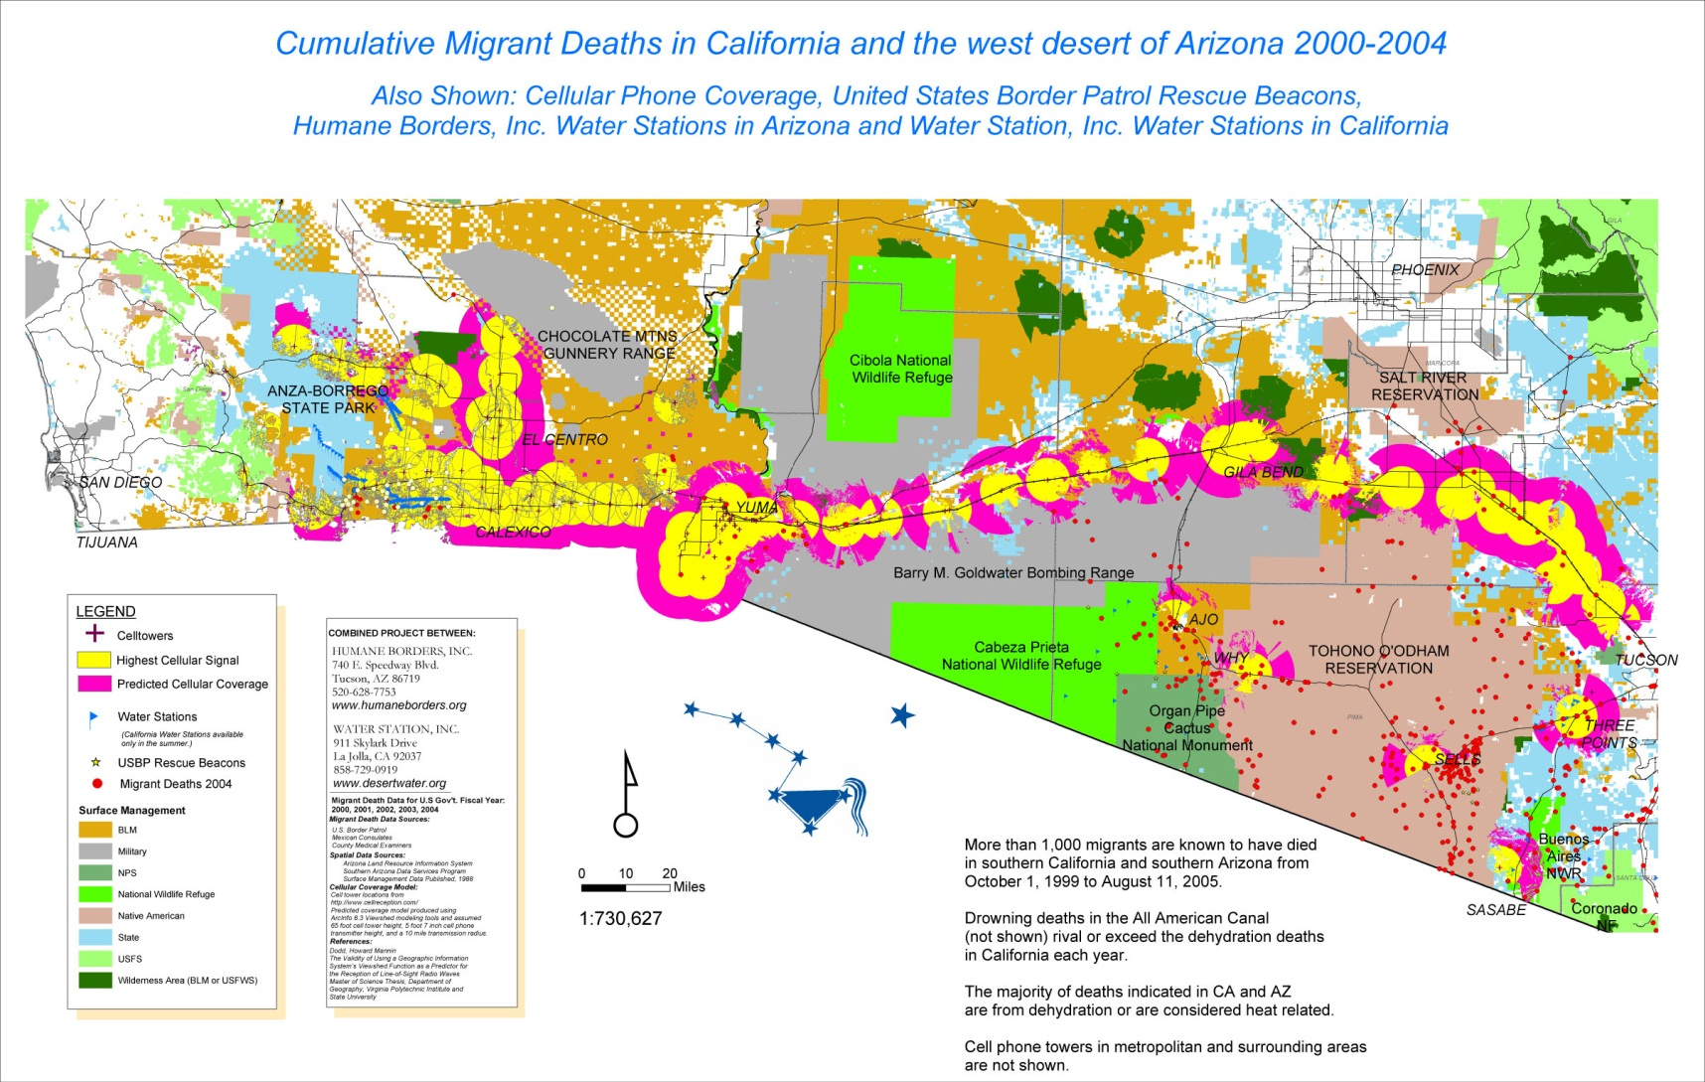
CELL PHONE TOWER PROJECT
A project of:
Dr. Robin Hoover
Dr. John Hunter
Dr. John Chamblee

Slide 23
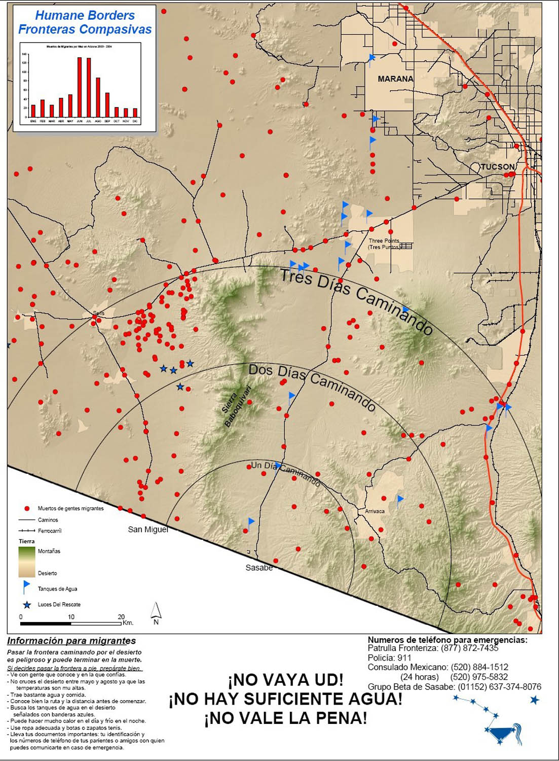
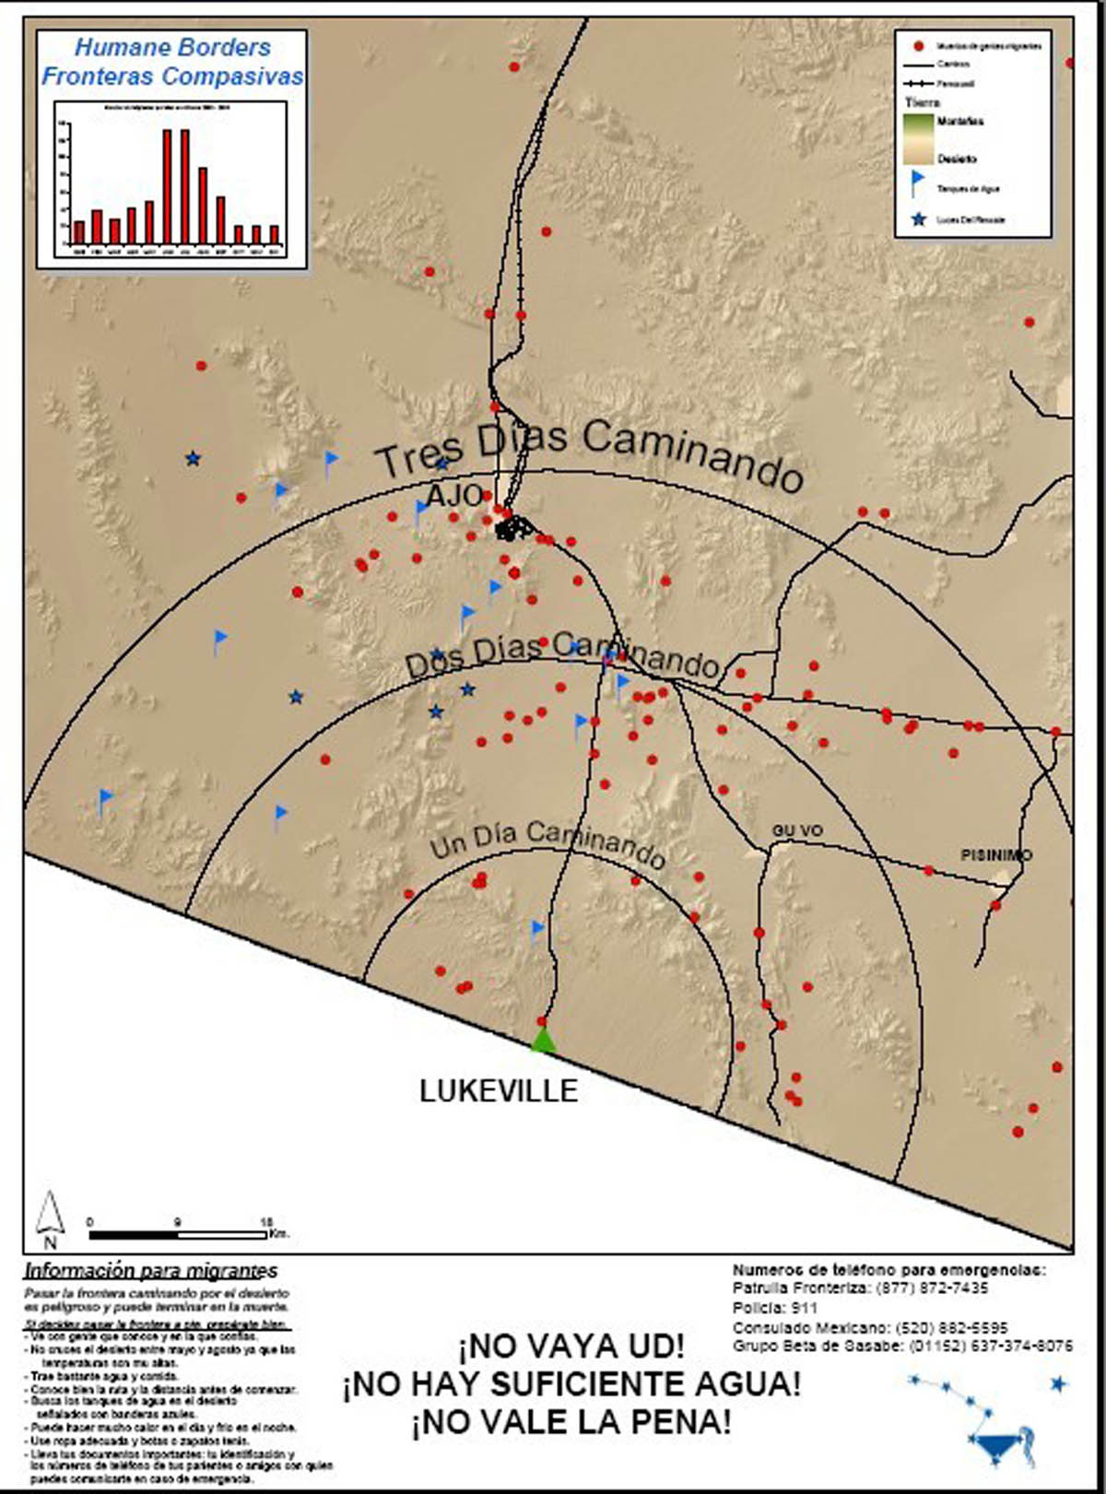
MIGRANTS WARNED OF EXPLICIT DANGER

Slide 24
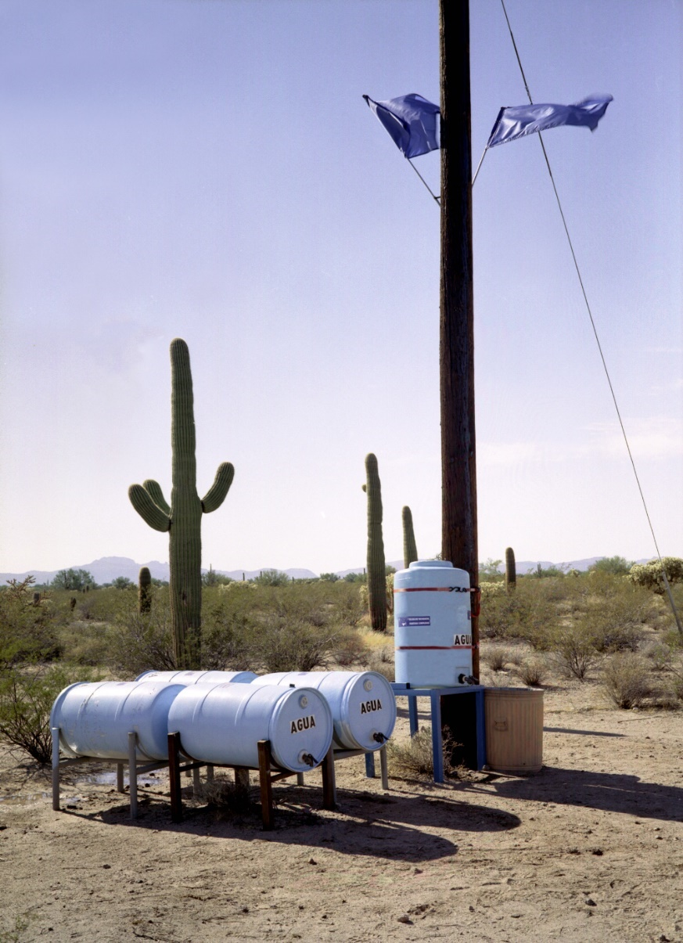
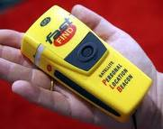
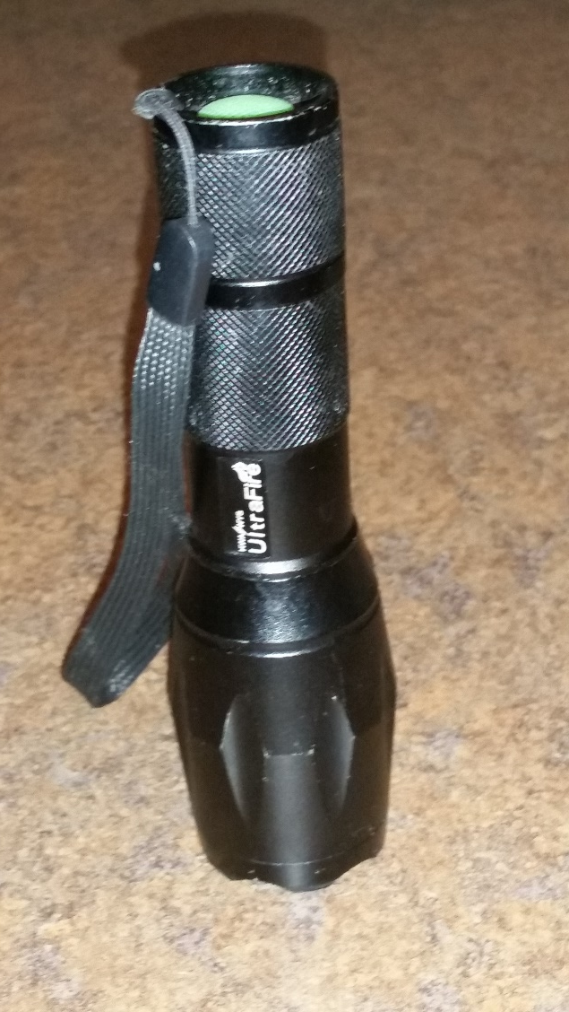
HUMANITARIAN ASSISTANCE

Slide 25
PEOPLE SUPPORT THESE GOALS:
NATIONAL SECURITY
STABLE/EXPANSIVE LABOR
HUMAN RIGHTS/LIBERTY ISSUES
REDUCED “NOISE” ON THE BORDER
REDUCED VIOLENCE IN MEXICO

Slide 26
PEOPLE DO NOT SUPPORT:
WAR IN OUR CITIES
MASKS AND LACK OF IDENTIFICATION
RANDOM INTERIOR RAIDS
HARASSMENT/ARRESTS/MURDERS OF CITIZENS
DYNAMIC ENTRIES OF HOMES
BREAKING VEHICLE WINDOWS

Slide 27
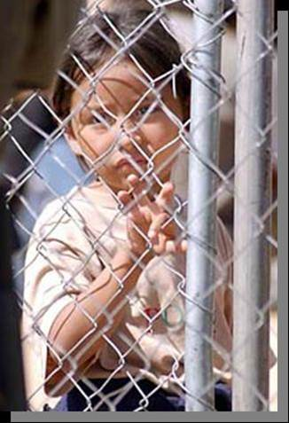
ALL OF THESE THINGS MATTER
TOHONO O’ODHAM NATION OPERATED
DETENTION CENTER
CHILD DETAINED WITH ADULTS IN CAGE WITH BP AGENTS SITTING ON THE OTHER SIDE OF THE WALL IN AIR-CONDITIONED COMFORT

Slide 28
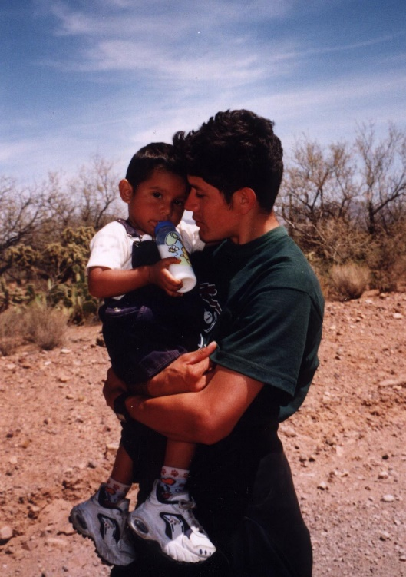
The child’s grandmother, the young man’s mother, had soiled herself and was sitting sobbing, so she is not in the photo. She screamed to me in Spanish, “If I had only known how hard it was going to be, I would never have come. The child is worth the world to me.”

