Slide 1
Report From The Border
Presentation by: Rev. Dr. Robin Hoover
President: Migrant Status, Inc.

Slide 2
THINK CREATIVELY
When Pres. George W. Bush sent National Guard troops to the border in 2006, I was quoted on the front page of the New York Times saying:
“The United States has a stunning lack of imagination of how to deal with immigration.” --Robin Hoover

Slide 3
NAMING, FRAMING, BLAMING
National Security, Terrorism, Labor, Nationalism, Tourism, Trade, Racism, Identity, Culture, Competition, Liberty, Rights, Unions, Institutions, Faith Communities, Corporatism, Population Control, Crime, Health, Welfare, “Us vs. Them”, Enforcement, Rule of Law, Budgets, Education, Electoral Politics, Justice, Benefits, Citizenship, Partisanship, Gross Domestic Product, Entitlements, Human Rights, Pundits, Economics, Women’s Rights, …
EVERY “ISSUE” IN AMERICAN POLITICS IS TOUCHED BY MIGRATION, IMMIGRATION, REFUGEES, ASYLEES, ….

Slide 4
KNOWLEDGE OF ISSUE
Opinion, Factoids, Media, Fake News, Social Science, Electoral Mandates, Law, Policy, Rights, ….
Epistemology:
Deductive
Inductive
Abductive: Pragmaticism, Postmodernism, Whitehead, Charles Sanders Pearce, Suchocki, ….

Slide 5
TOPICAL APPROACH
Fences, Racism, Environment, International Law, Human Rights, Justice, Families, Employment, Migrant Deaths, Enforcement, Migrant Safety, Migrant Education, Services to Migrants….

Slide 6
US ENFORCEMENT STRATEGIES
Make it physically difficult to enter U.S.
Make it expensive to enter U.S.
Make it deadly to enter U.S.
Make it miserable to enter U.S.

Slide 7
ENFORCEMENT CONSEQUENCES
Destroy the environment
Kill Migrants
Give money to the cartels
Kill Migrants
Drive migrants into inhospitable terrain
Kill Migrants
Incarcerate migrants
Destroy families

Slide 8
INTEREST GROUP POLITICS
Law Enforcement, Ranchers, Municipal Governments, State Governments, Federal Government, Faith Communities, Unions, Public Administrators, Rights Groups, Humanitarian Groups,

Slide 9
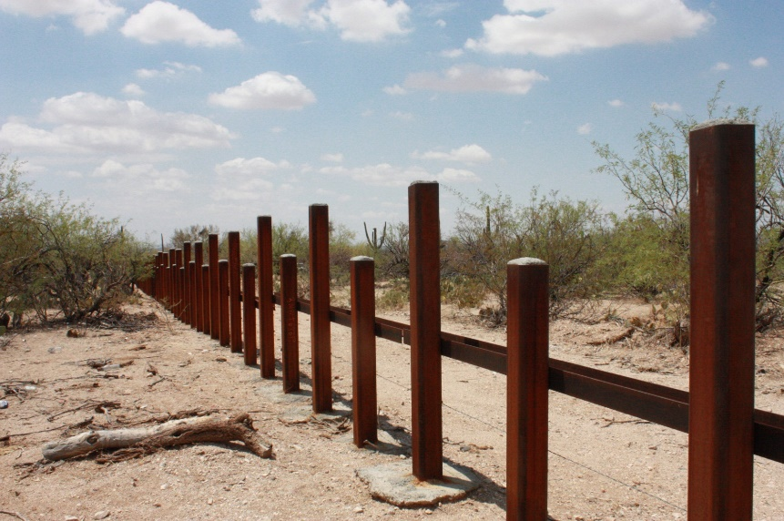
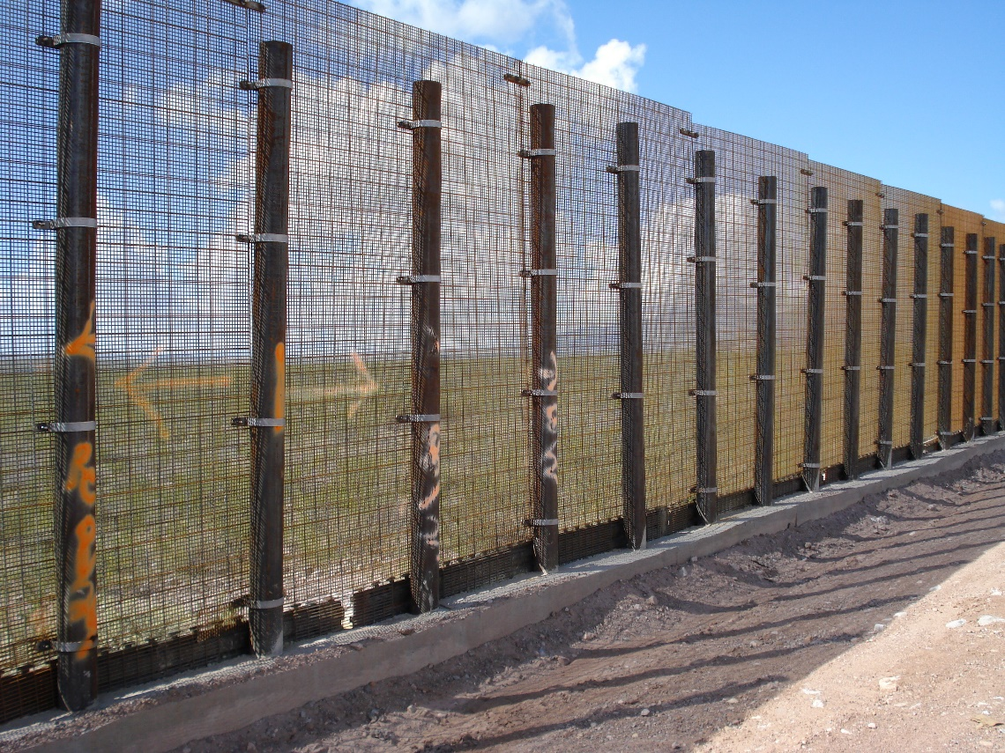
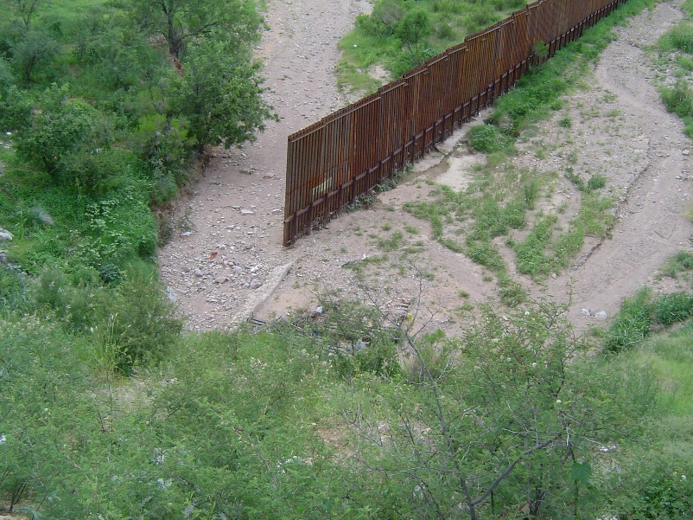
BORDER FENCES ON ABOUT 1/3 OF BORDER

Slide 10
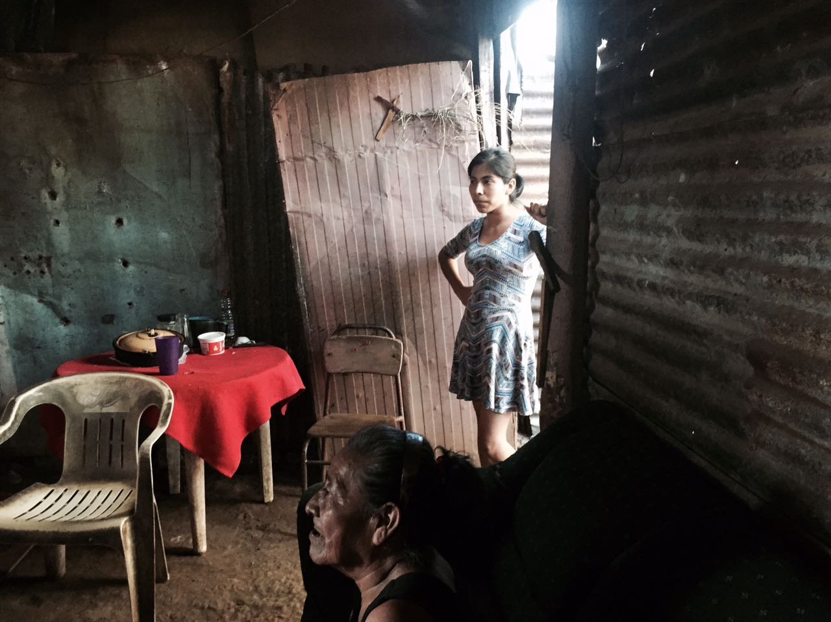
WOMEN IN MIGRATION

Slide 11
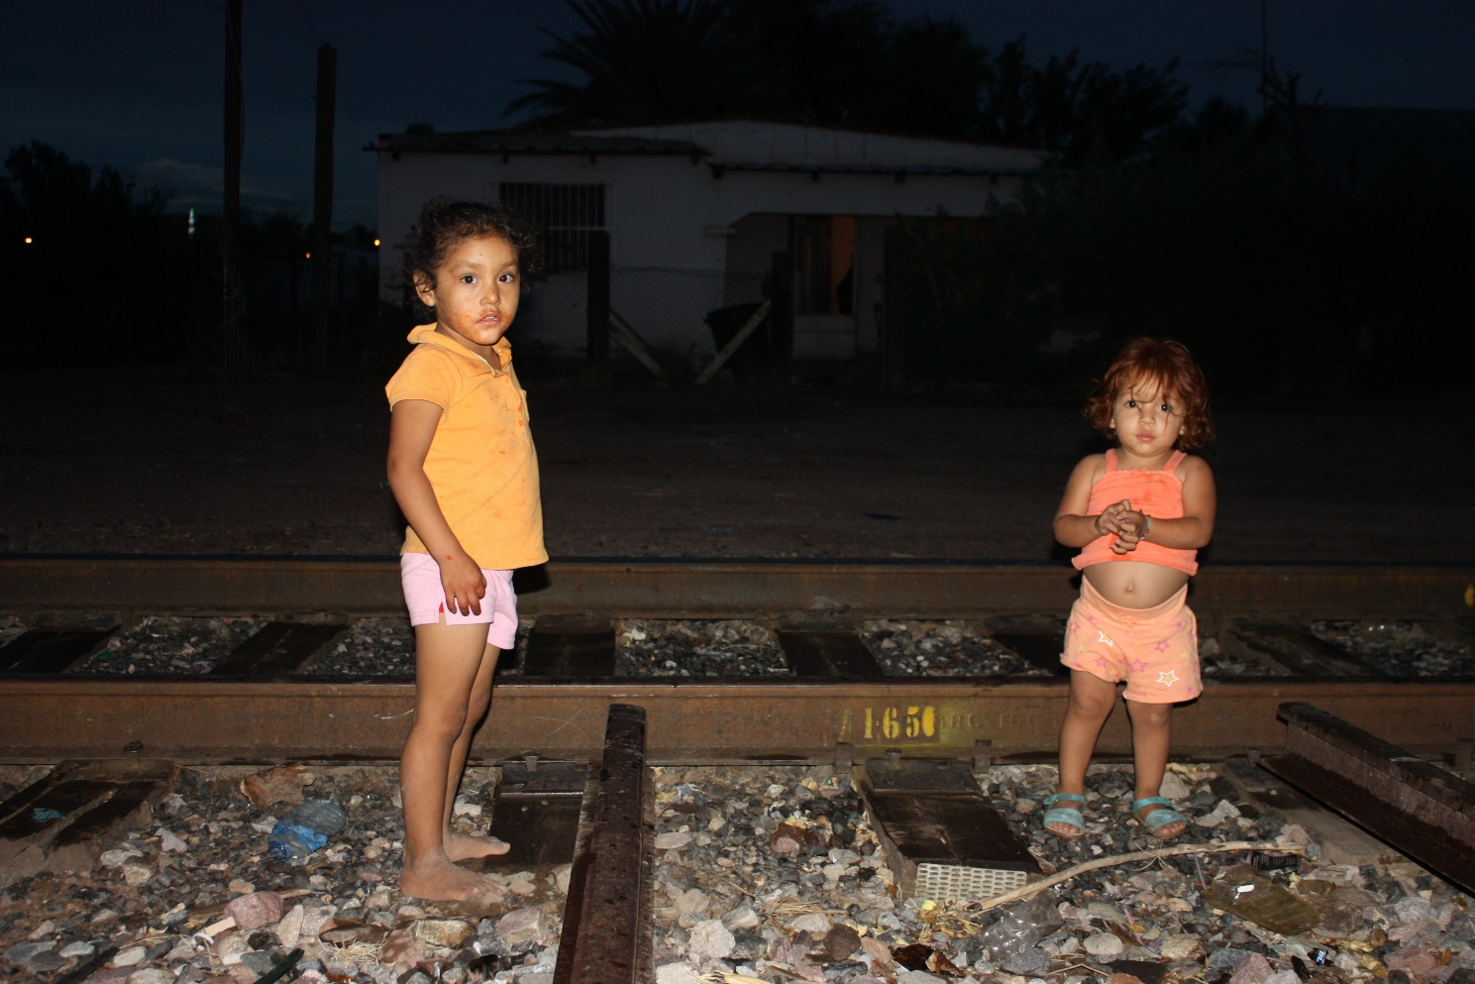
CHILDREN IN MIGRATION

Slide 12
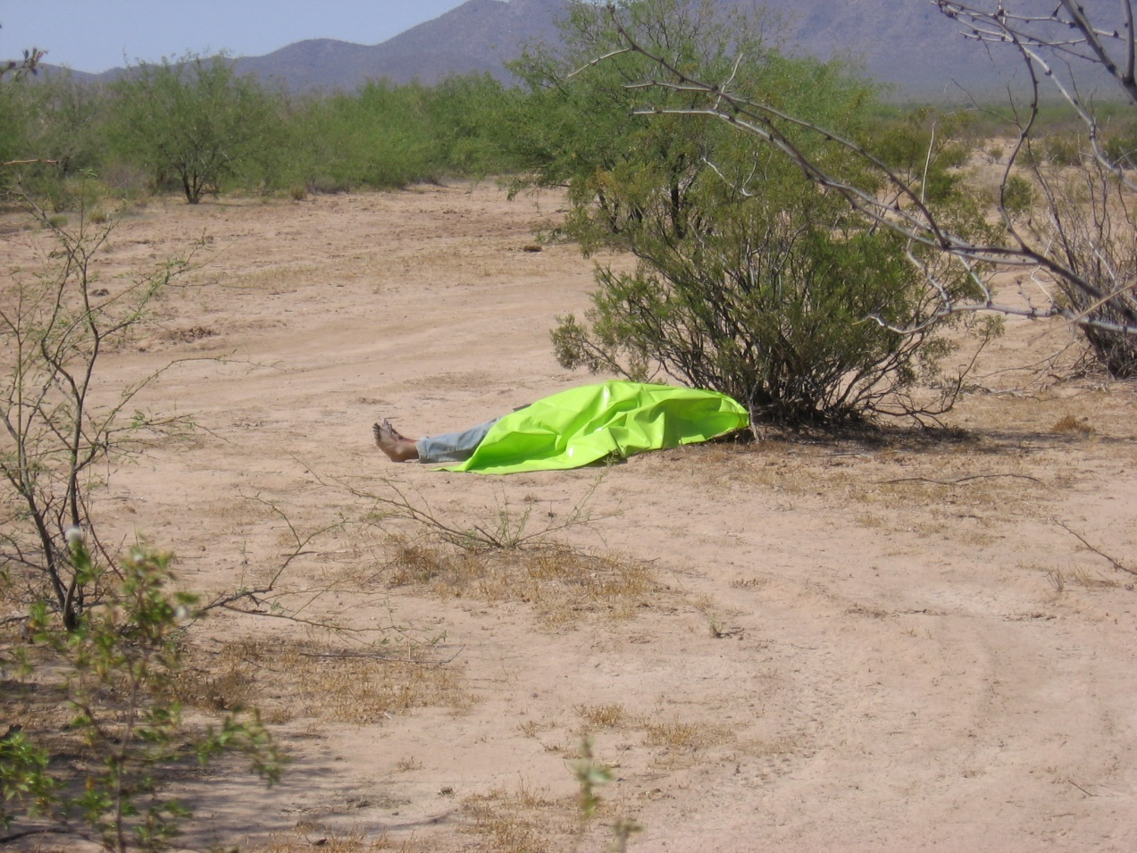
ELDERLY IN MIGRATION

Slide 13
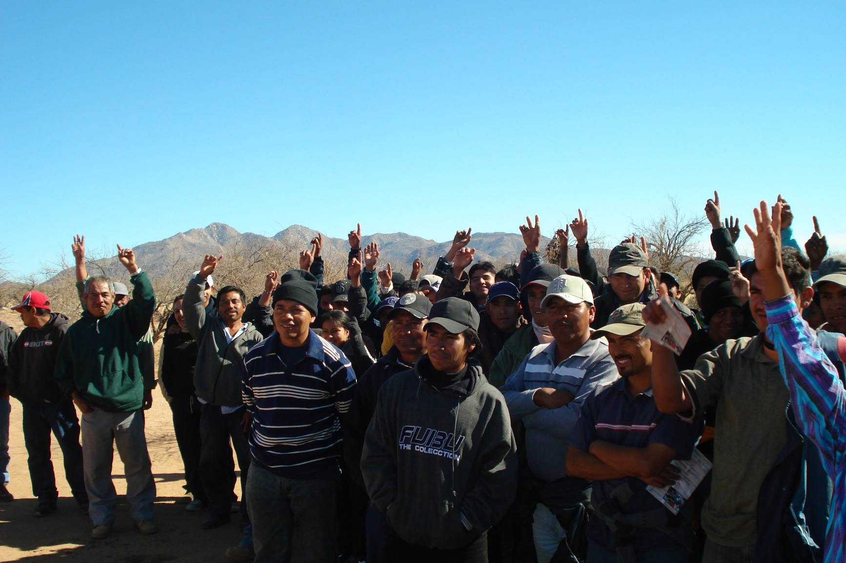
WHO IS COMING?

Slide 14
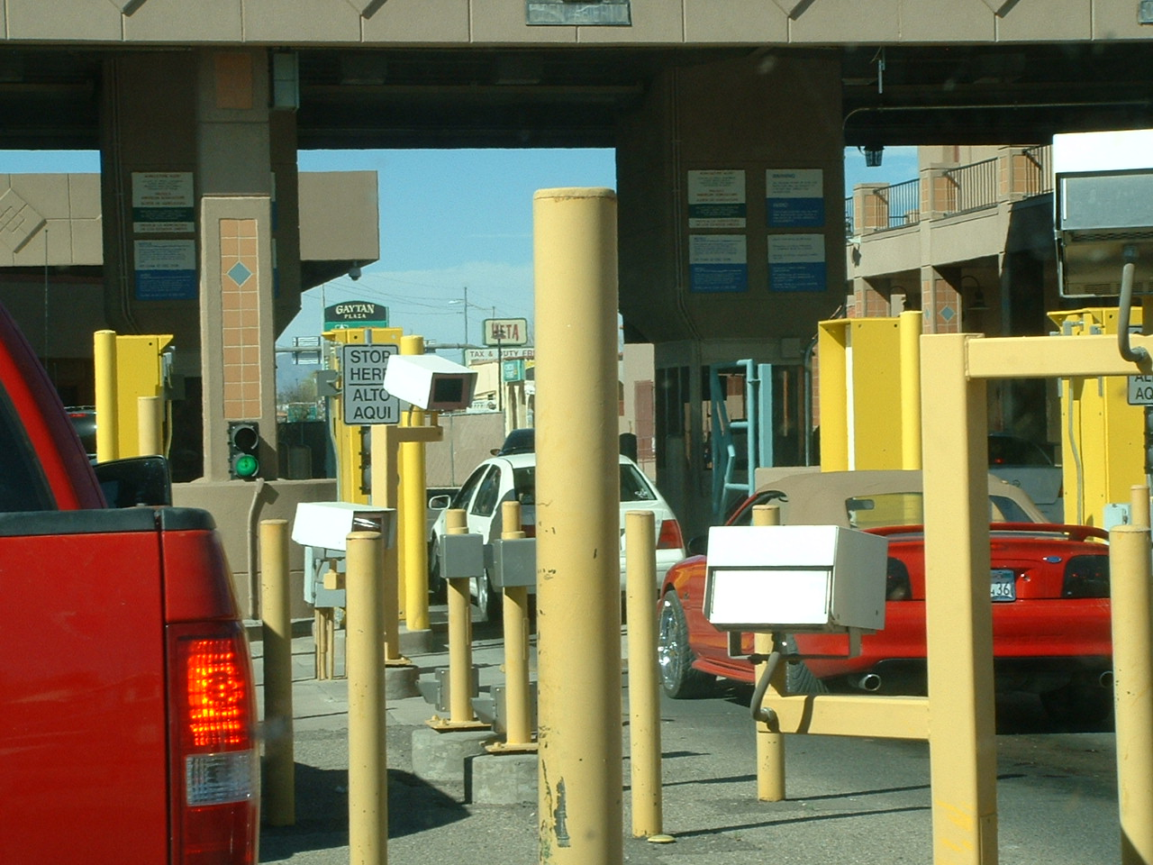
REFUGEES AND ASYLEES

Slide 15
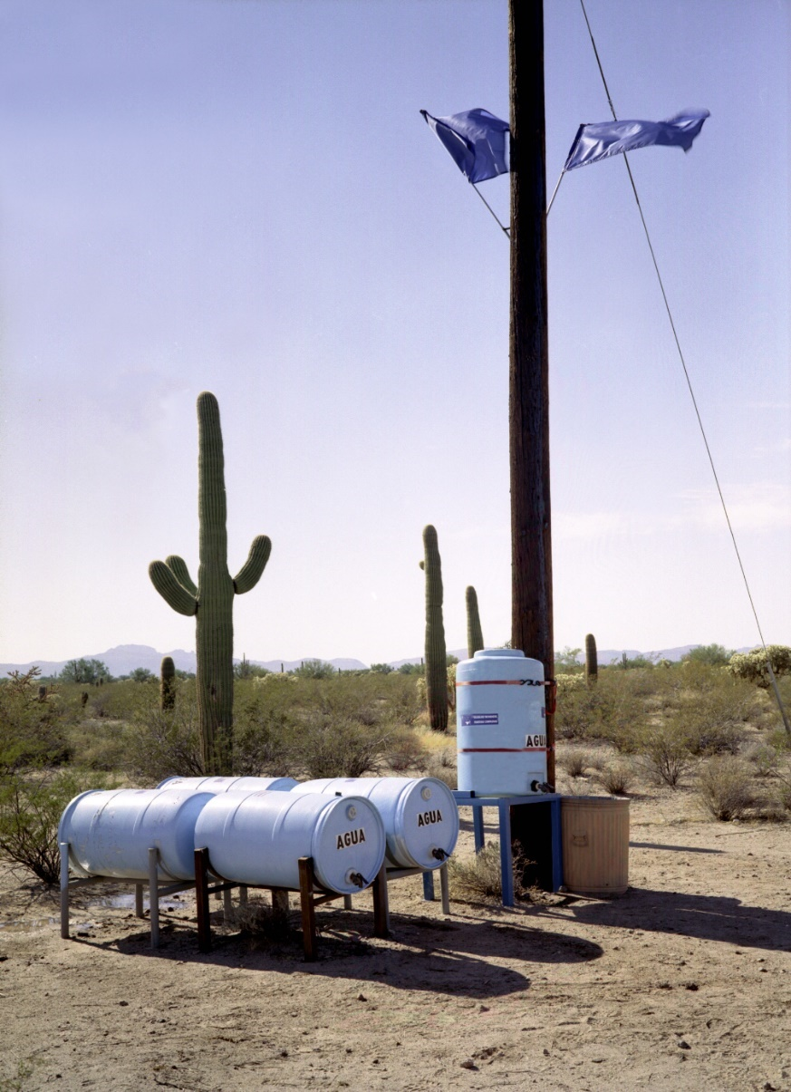
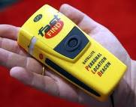
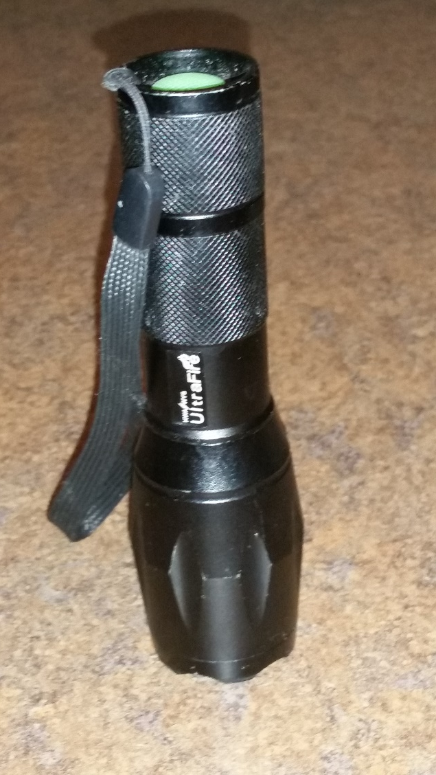
HUMANITARIAN ASSISTANCE

Slide 16
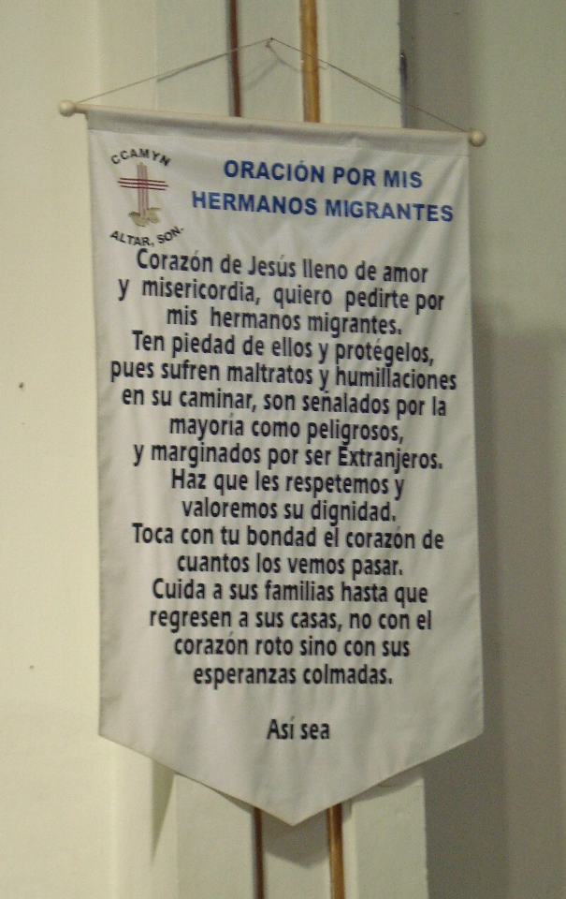
RELIGION IMPORTANT FOR MIGRANTS

Slide 17
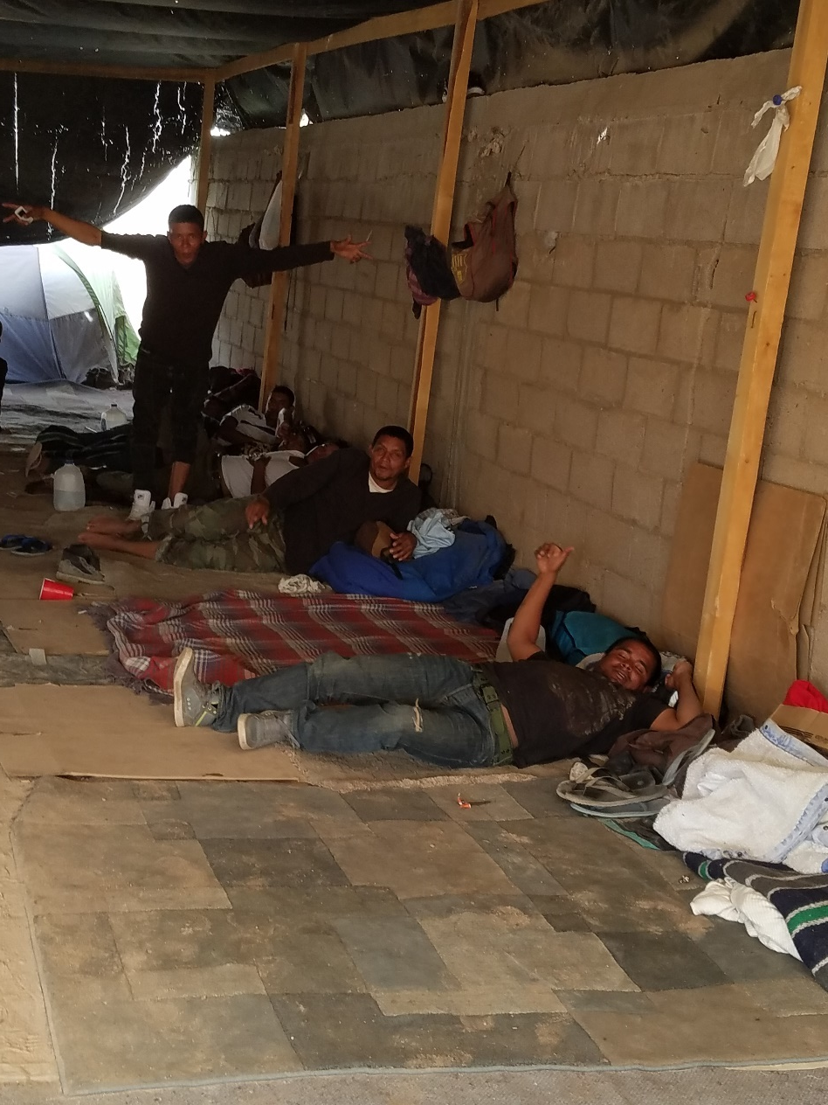
SHELTERS IN MEXICO—NORTH & WEST

Slide 18
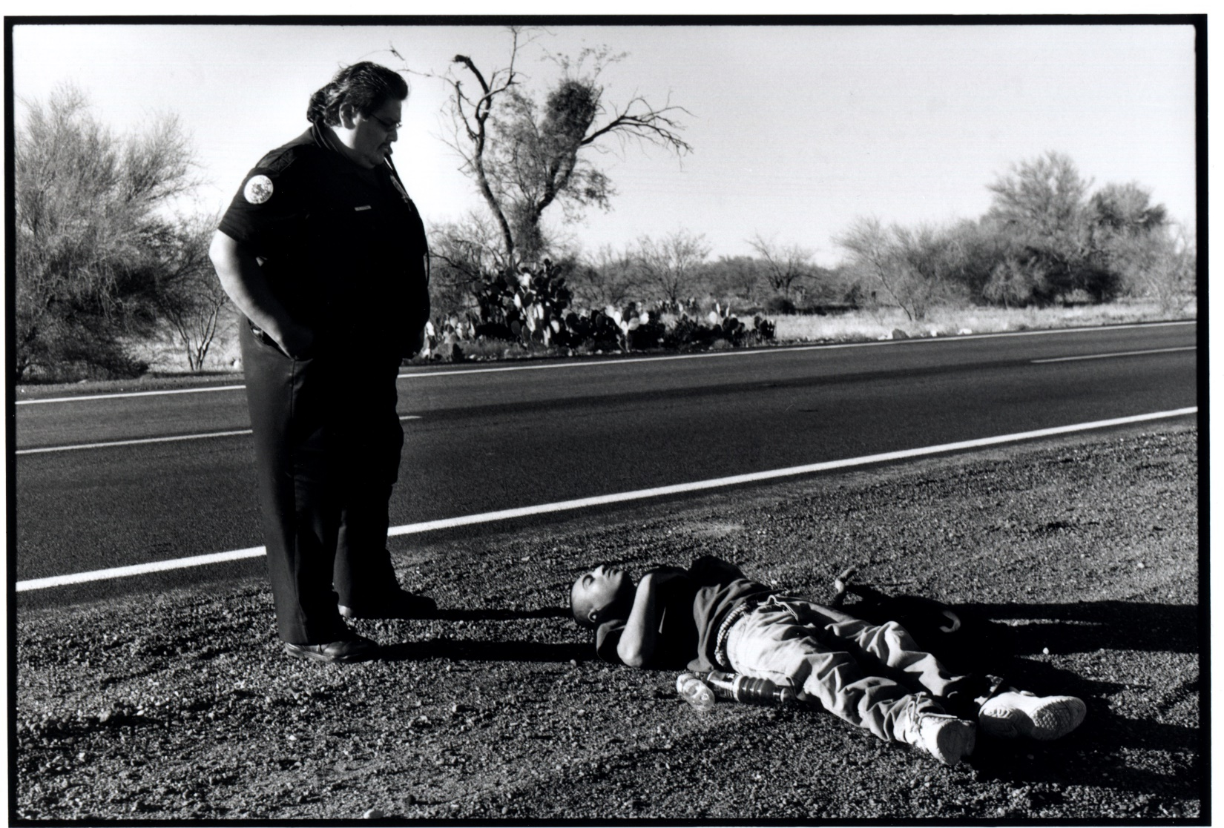
TOHONO O’ODHAM NATION

Slide 19
NIGHTTIME ENFORCEMENT
Border Patrol is increasingly militarized
US only major military that prefers night operations
Perceived tactical advantage
Preferred working conditions for agents
Extremely technology-dependent

Slide 20
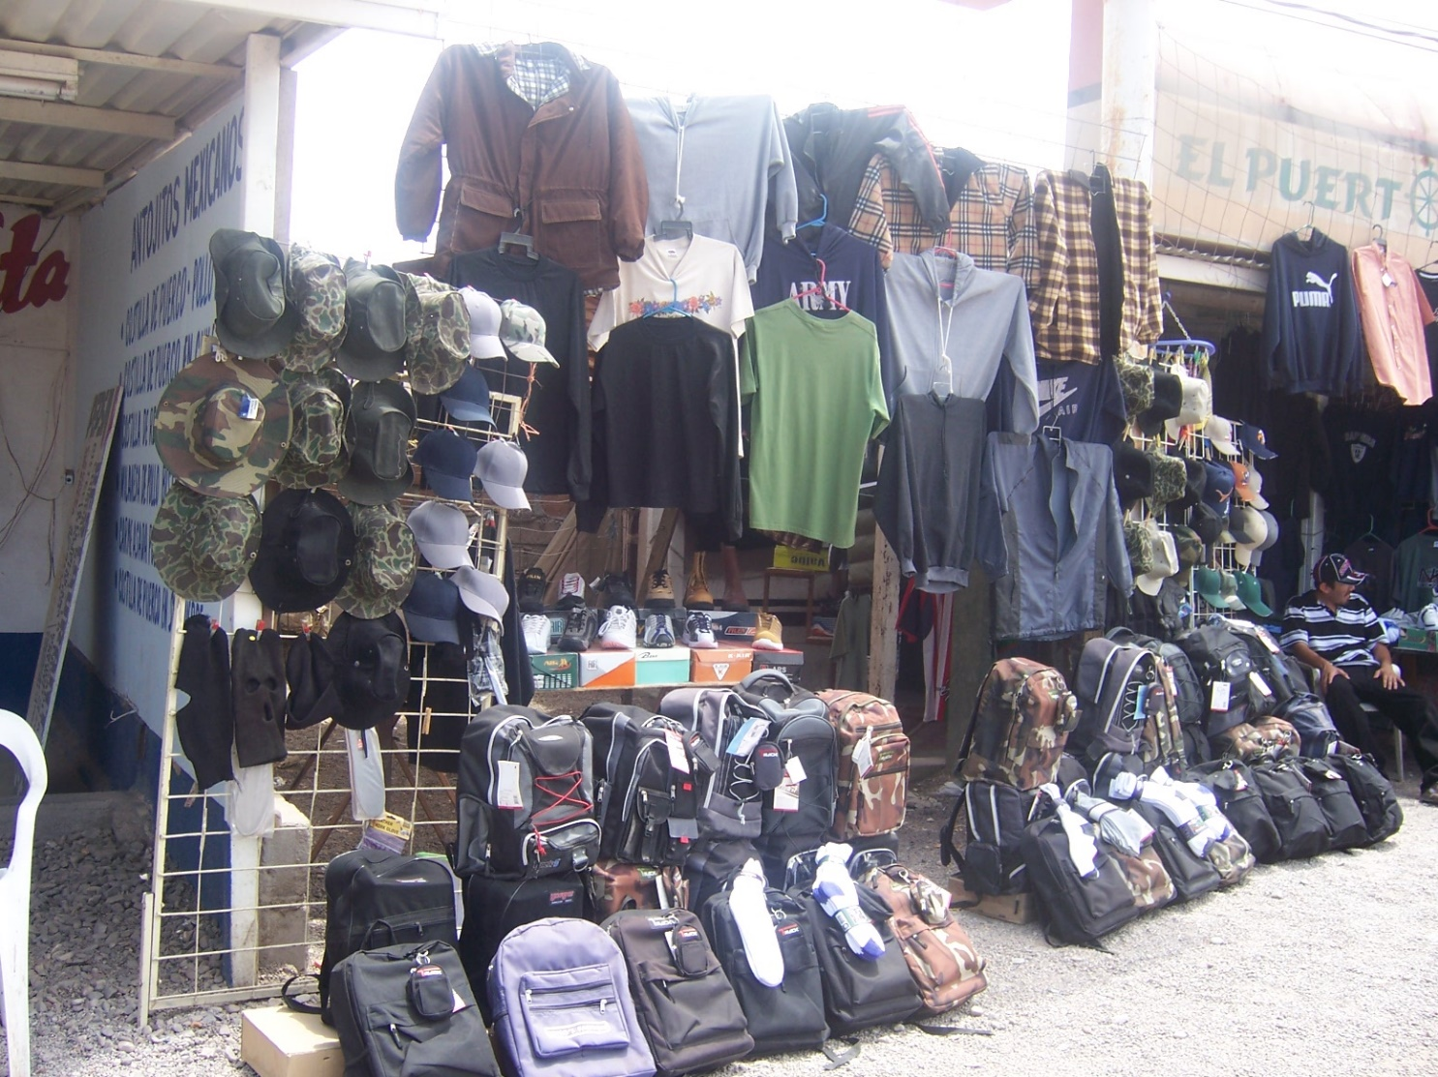
MIGRATION CREATES MARKETS

Slide 21
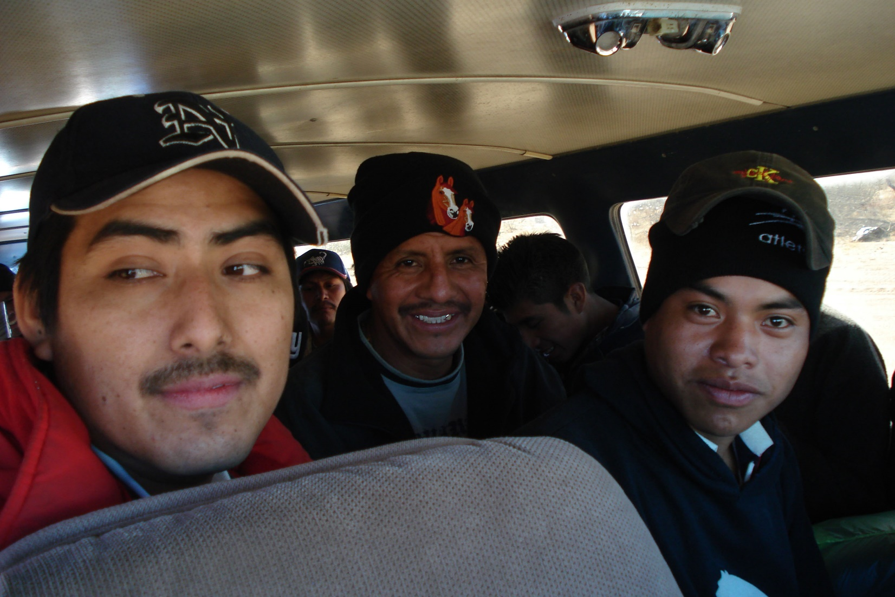
CARTELS NOW CONTROL EVERYTHING

Slide 22
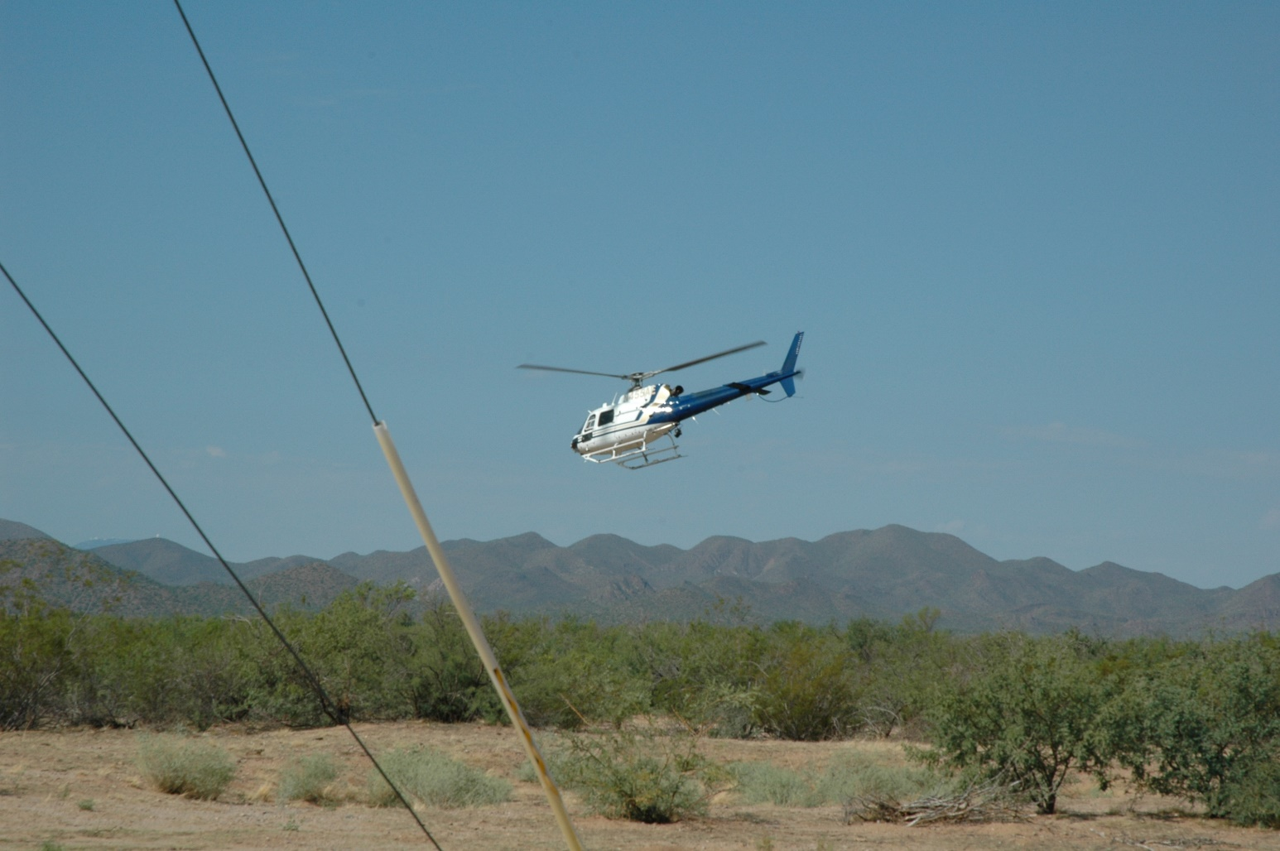
TECHNOLOGY OF LOW-INTENSITY WARFARE

Slide 23
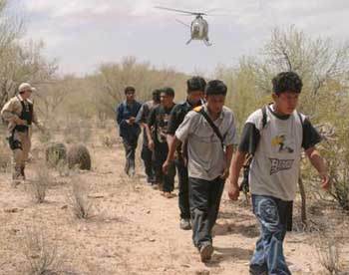
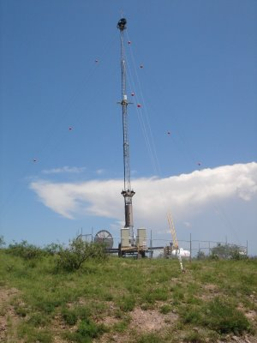
BORDER PATROL AND ENFORCEMENT TECHNOLOGY

Slide 24
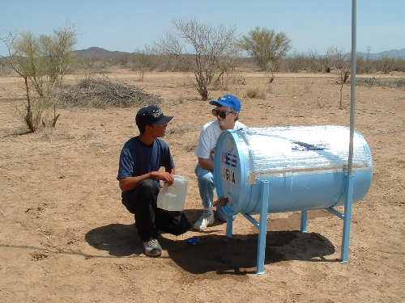
LOW-TECH SAVES LIVES
WATER STATIONS, FLASHLIGHTS, MAPS, PERSONAL LOCATION BEACONS, WARNING POSTERS, SEARCH AND RESCUE, ORIENTATIONS, SHELTER SUPPLIES, MEDICAL ASSISTANCE, ADVOCACY, LEGAL SERVICES….
CURRENT PROJECTS:
WEBSITE-BASED MIGRANT MANUAL AND DIRECTORY
CLOUD-BASED MEDICAL RECORD SYSTEM

Slide 25
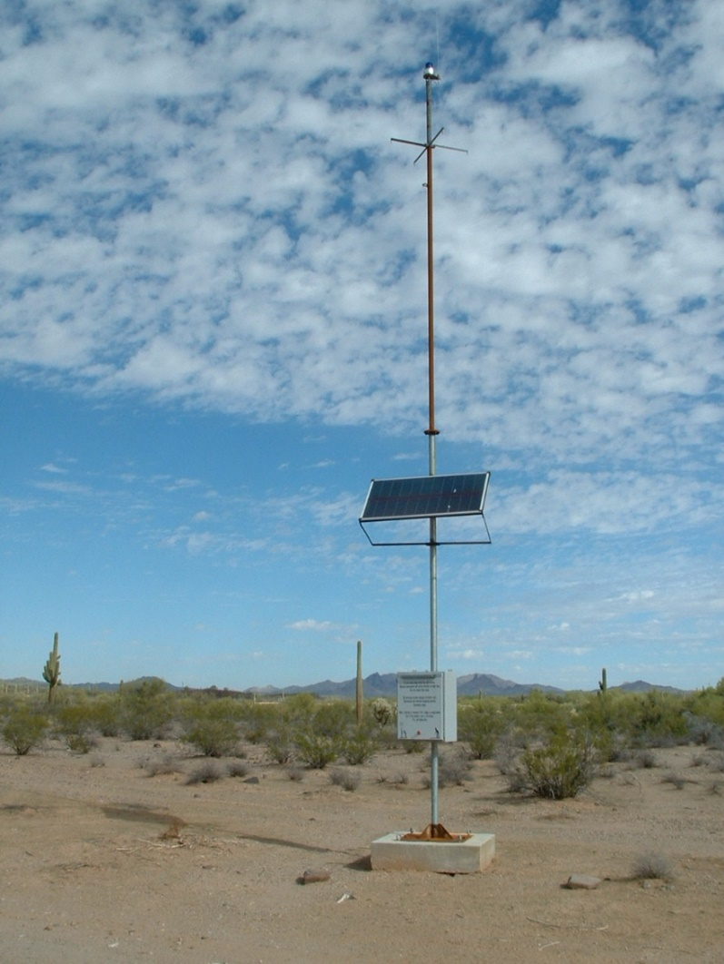
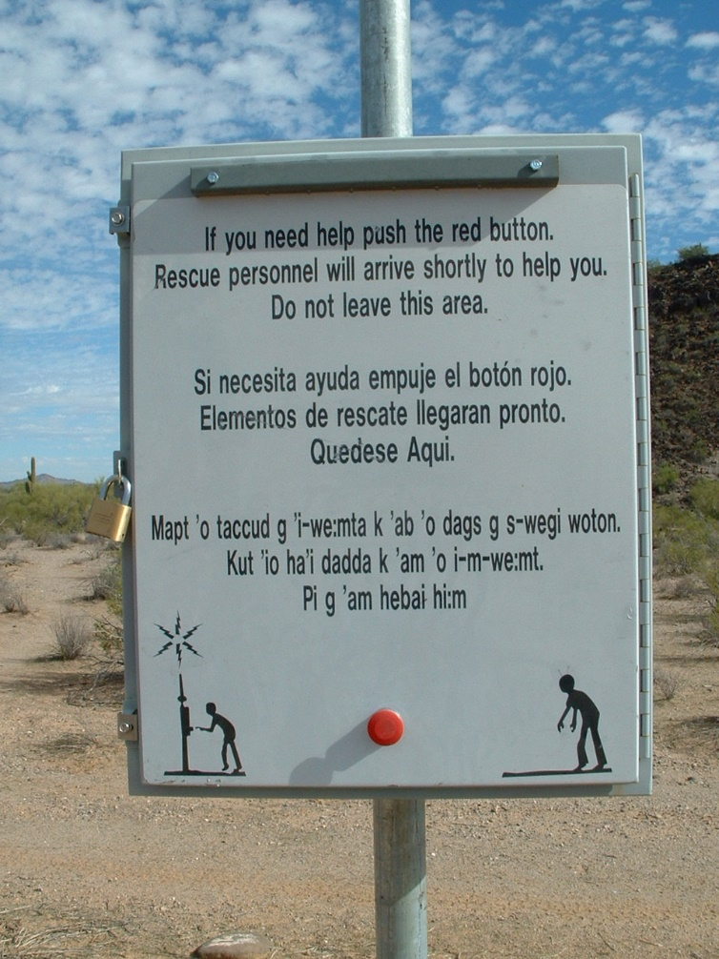
RESCUE TOWERS DESIGNED WHEN 14 DIED IN ONE DAY 2001

Slide 26
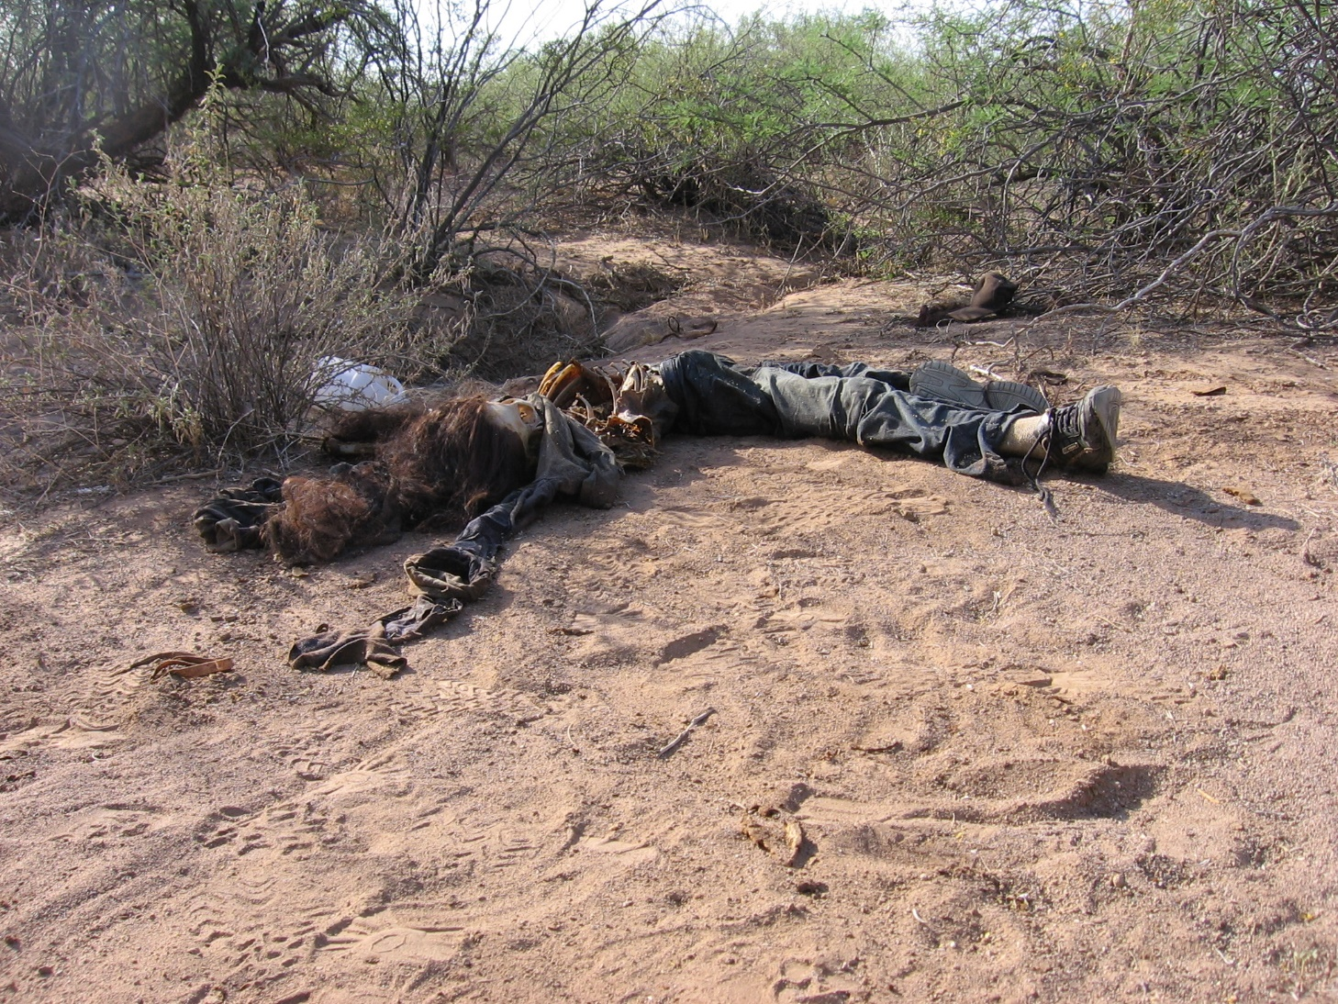
18 YEAR OLD GIRL DEAD IN THE DESERT
PRUDENCIA
MARTIN
GOMEZ
18 YEARS OLD
GUATEMALA

Slide 27
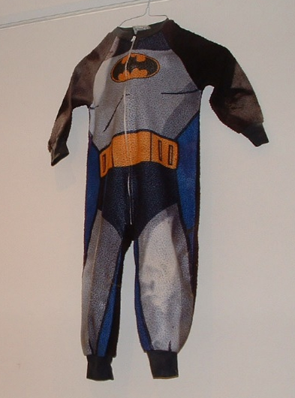
CHILD’S PAJAMAS FOUND IN DESERT

Slide 28
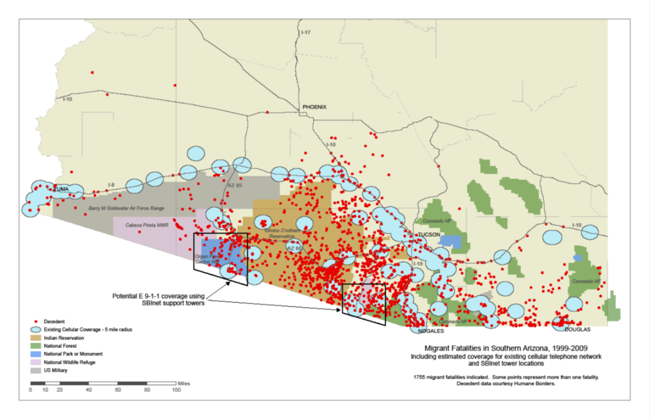
17 YEARS: NEARLY 3000 RECOVERED HUMAN REMAINS IN ARIZONA ALONE. SOUTH TEXAS IS NOW THE DEADLIEST
MORE THAN 1000 UNIDENTIFIED REMAINS IN TUCSON
ARIZONA

Slide 29
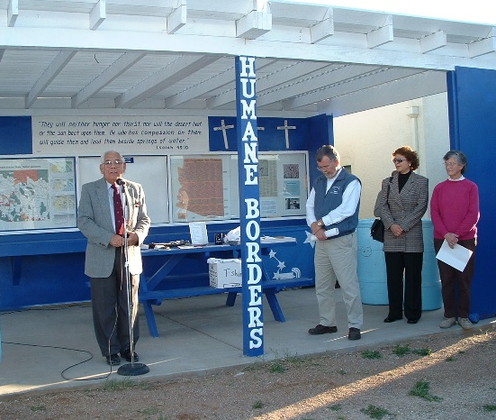
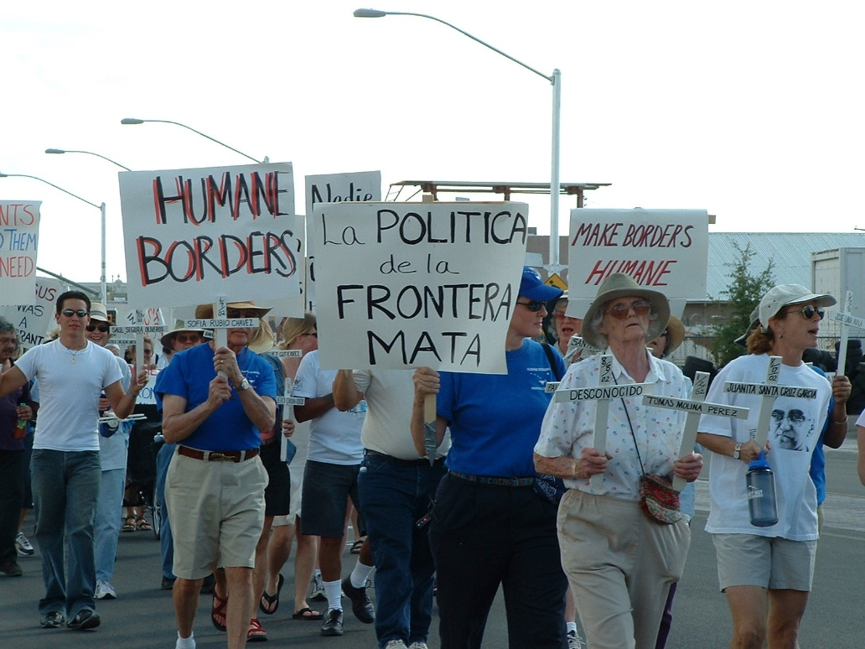
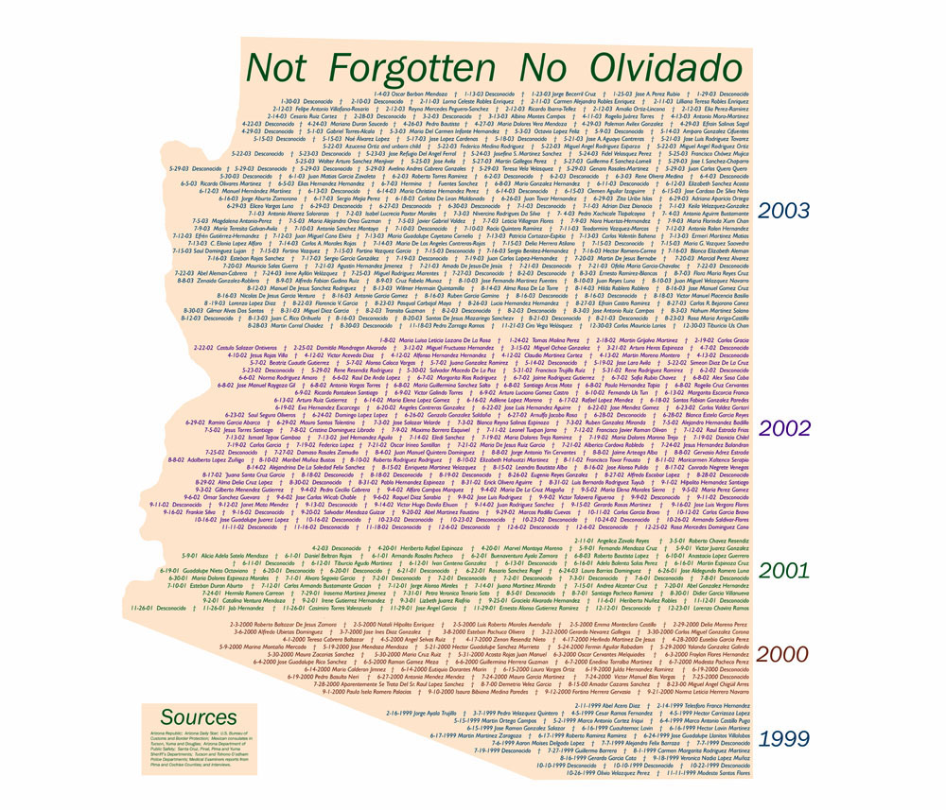
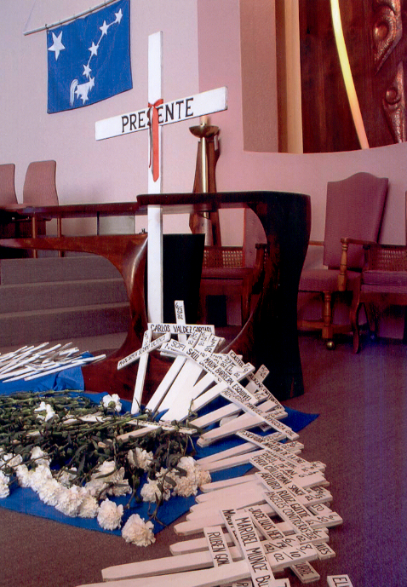
MIGRANTS REMEMBERED AND MEMORIALIZED THROUGH
MARCHES, MEMORIAL SERVICES, SHRINES, GRAPHICS

Slide 30
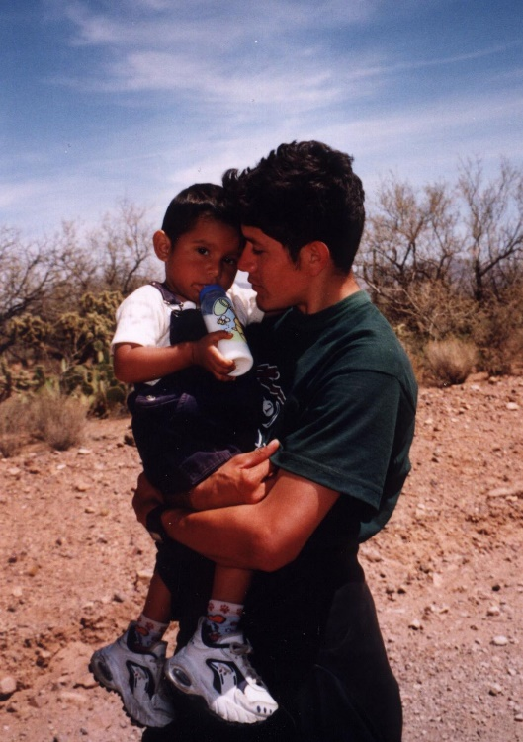
The child’s grandmother, the young man’s mother, had soiled herself and was sitting crying, so she is not in the photo. She screamed to me in Spanish, “If I had only known how hard it was going to be, I would never have come. The child is worth the world to me.”

Slide 31
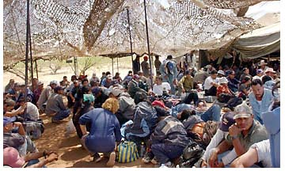
MIGRANTS READY TO BE TRANSPORTED TO STATION

Slide 32
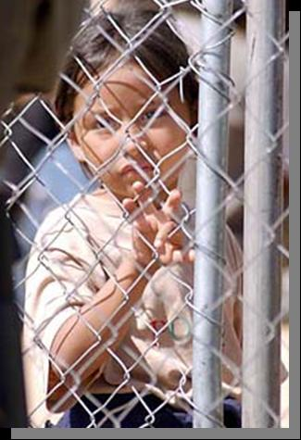
VERY YOUNG GIRL DETAINED WITH ADULTS

Slide 33
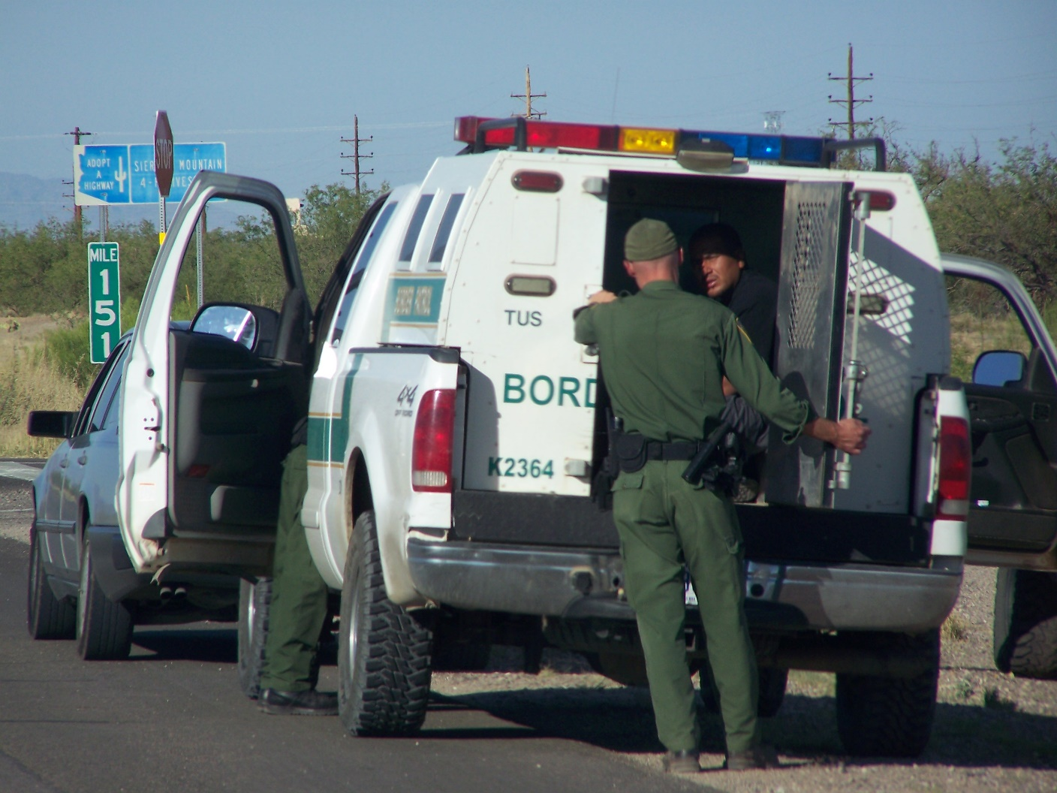
MIGRANTS TRANSPORTED LIKE STRAY PETS

Slide 34
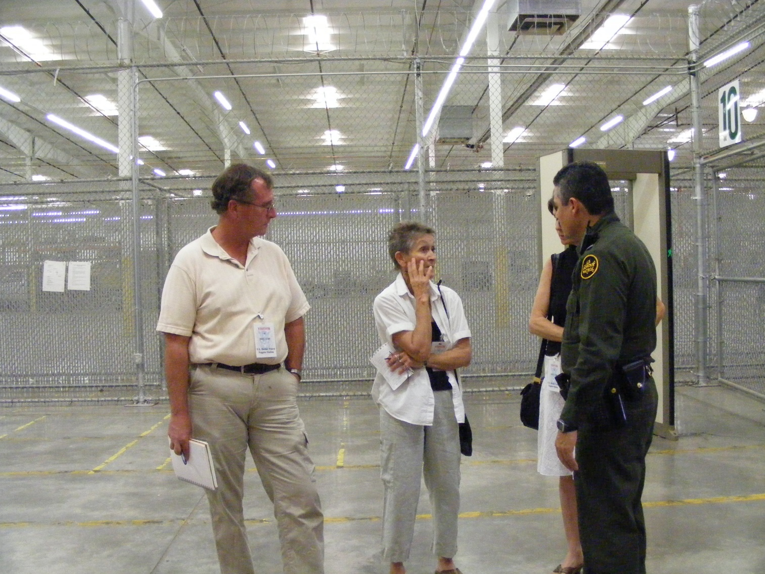
BORDER PATROL PROCESSING CENTER
Minors are supposed to be separated from adults, and they are supposed to be in detention less than 24 hours. This goal is rarely realized.

Slide 35
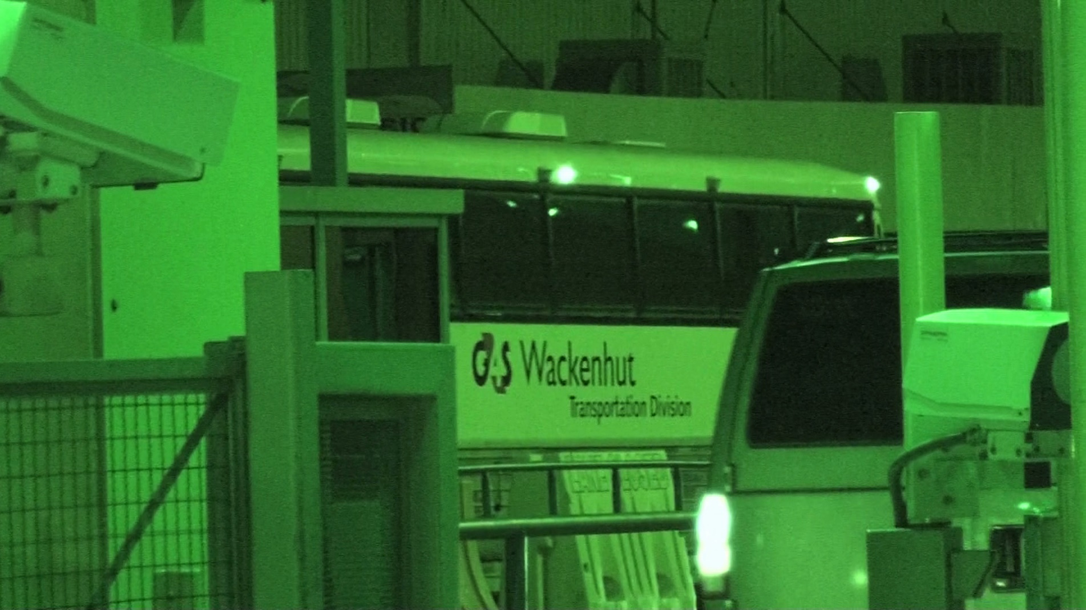
MIGRANTS RETURNED TO MEXICO IN THE DARK
Returning minors and women to Mexican ports of entry after dark is a serious treaty violation.

Slide 36
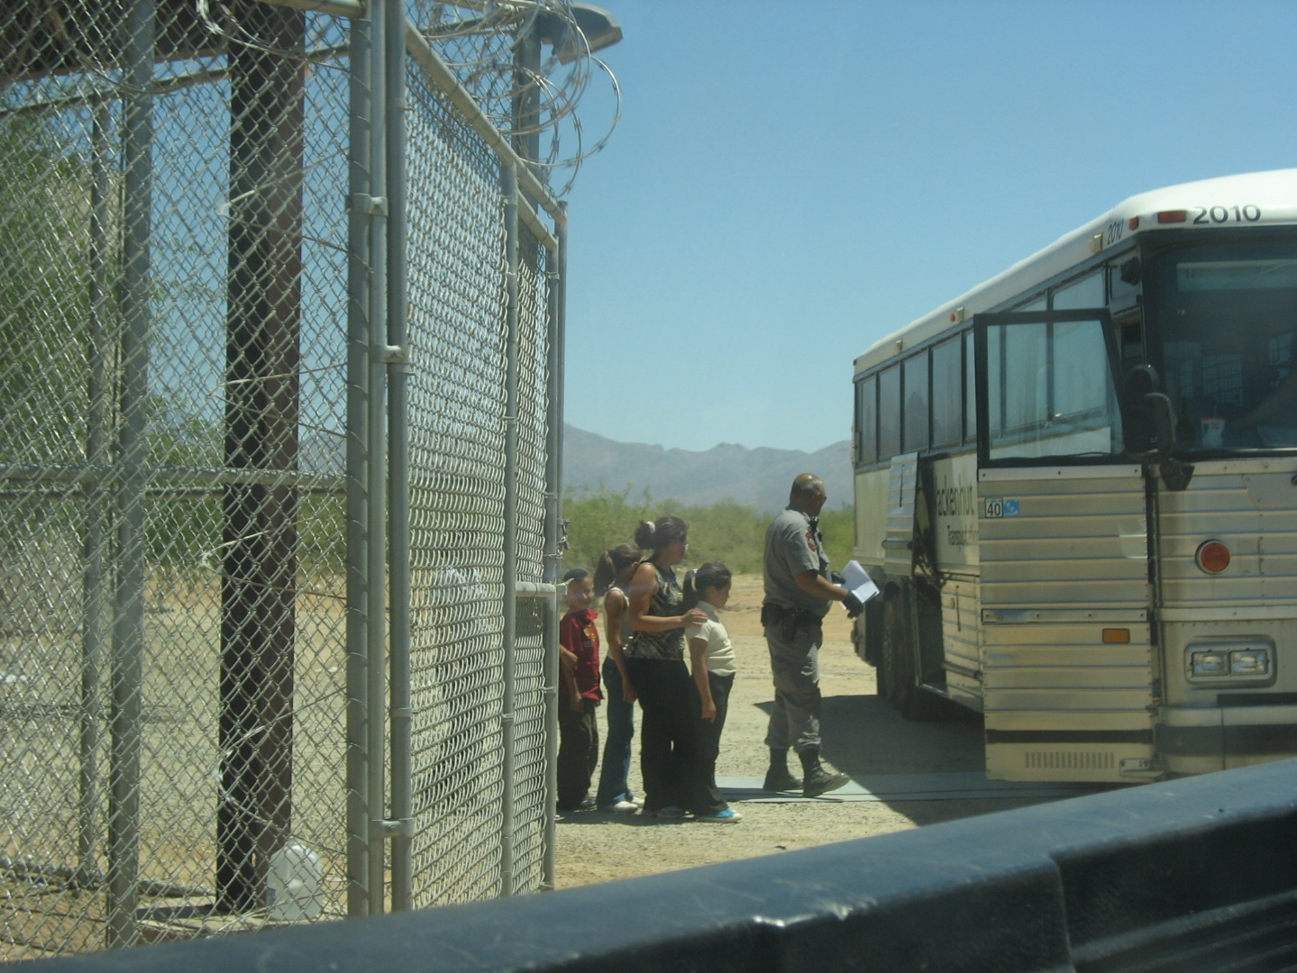
UNACCOMPANIED YOUTHS LOADED ONTO BUS

Slide 37
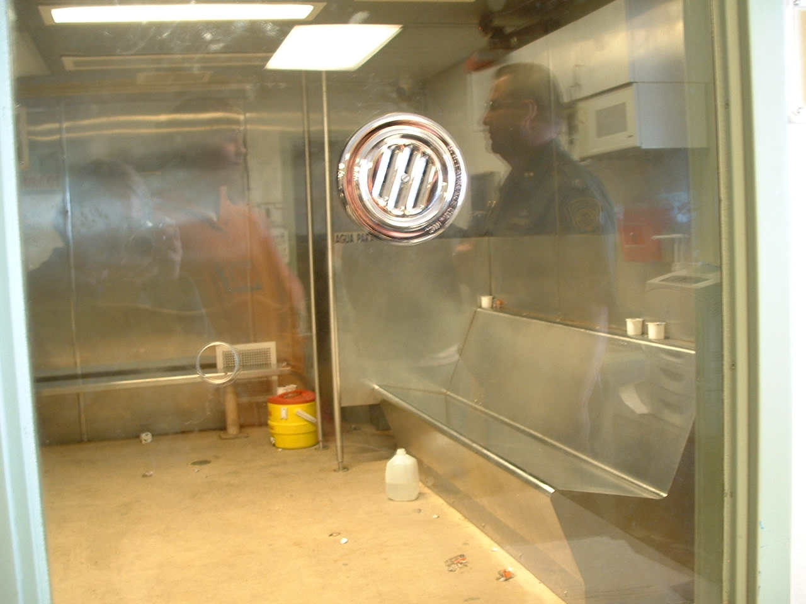
MIGRANTS ARE “PROCESSED” IN HOLDING TANKS
AKA “HIELEROS”

Slide 38
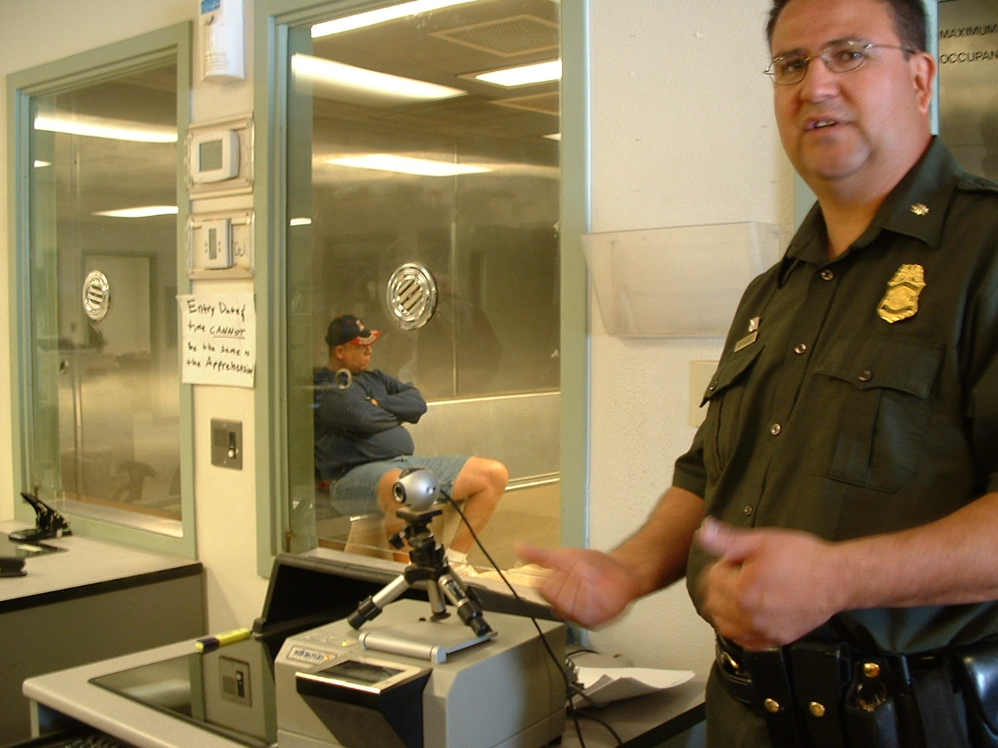
AGENTS TAKE PICTURES AND PRINTS TO CREATE FILES

Slide 39
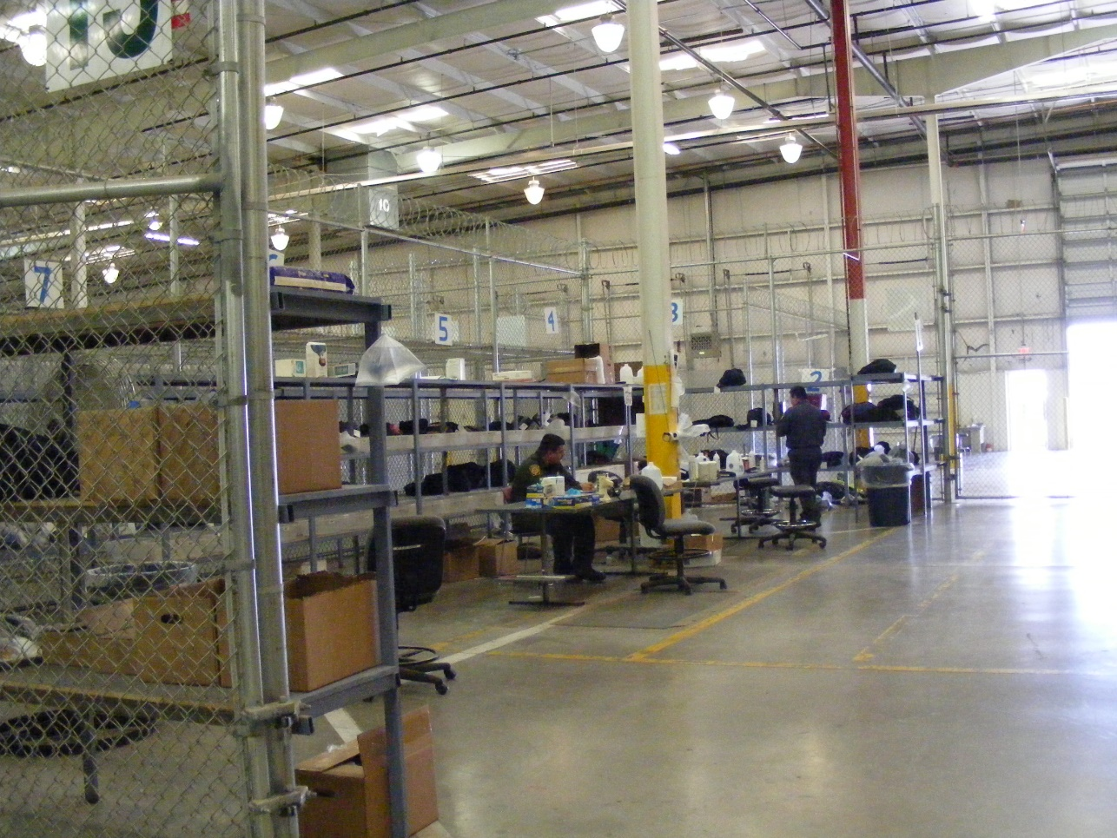
MIGRANTS’ “STUFF” TAKEN AND OFTEN NOT RETURNED

Slide 40
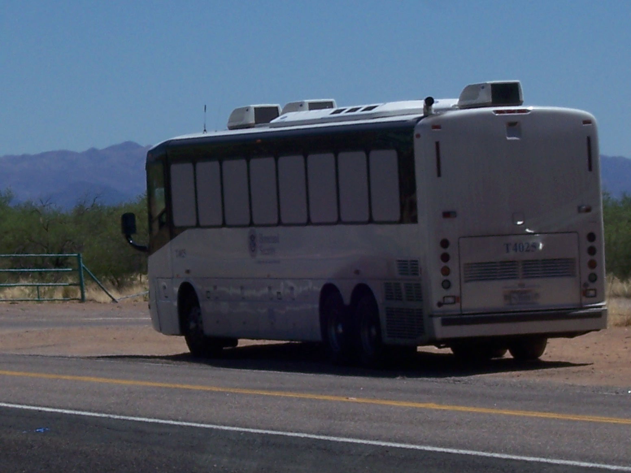
MIGRANTS TRANSPORTED TO MEXICO
Migrants returned to Mexico are often:
Hungry
Tired
Sleepy
Injured
Sick
Without family
Without possessions
Without hope

Slide 41
CHILDREN AND YOUTH HURT BY TRAINS, WALLS, ….
Efren came to Arizona to work in Phoenix with his uncle. Both legs were cut off by the wheels of the train he was on.

Slide 42
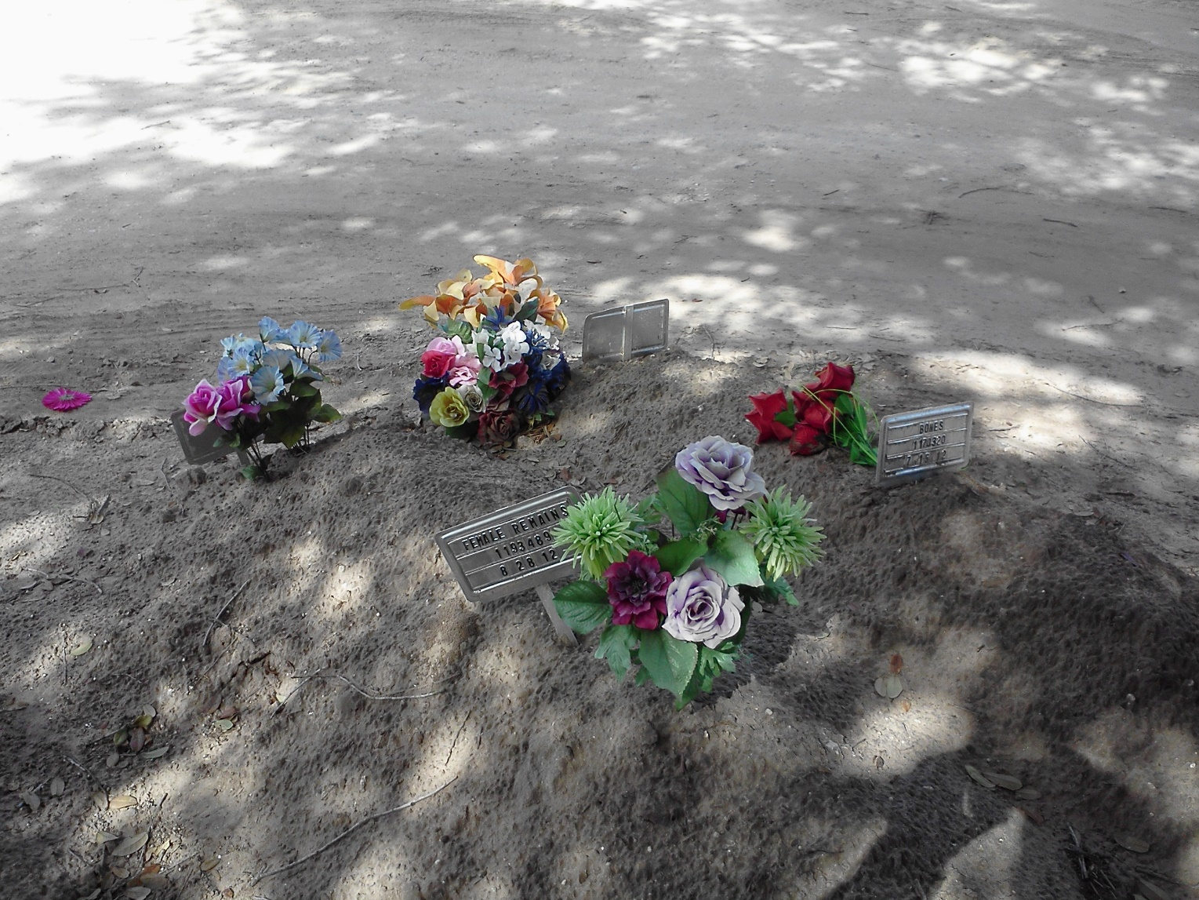
MEN, WOMEN, AND CHILDREN IN MASS GRAVES

Slide 43
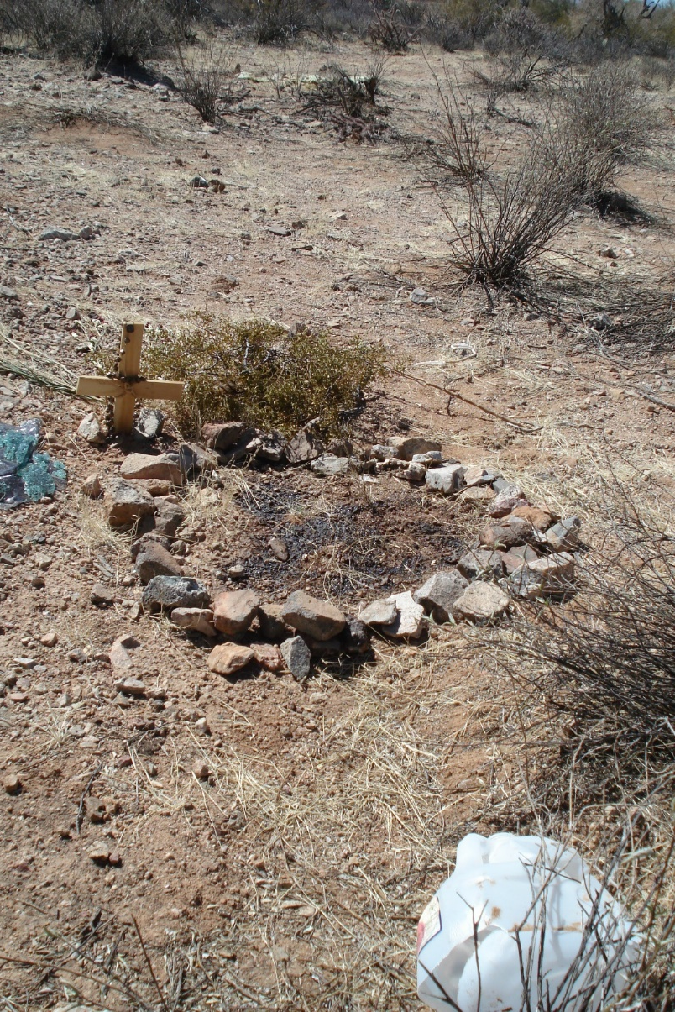
BODY FLUIDS STAIN THE GROUND
Three migrants from Guatemala were killed because they refused to pay coyotes for crossing the Tohono O’Odham Nation Lands.

Slide 44
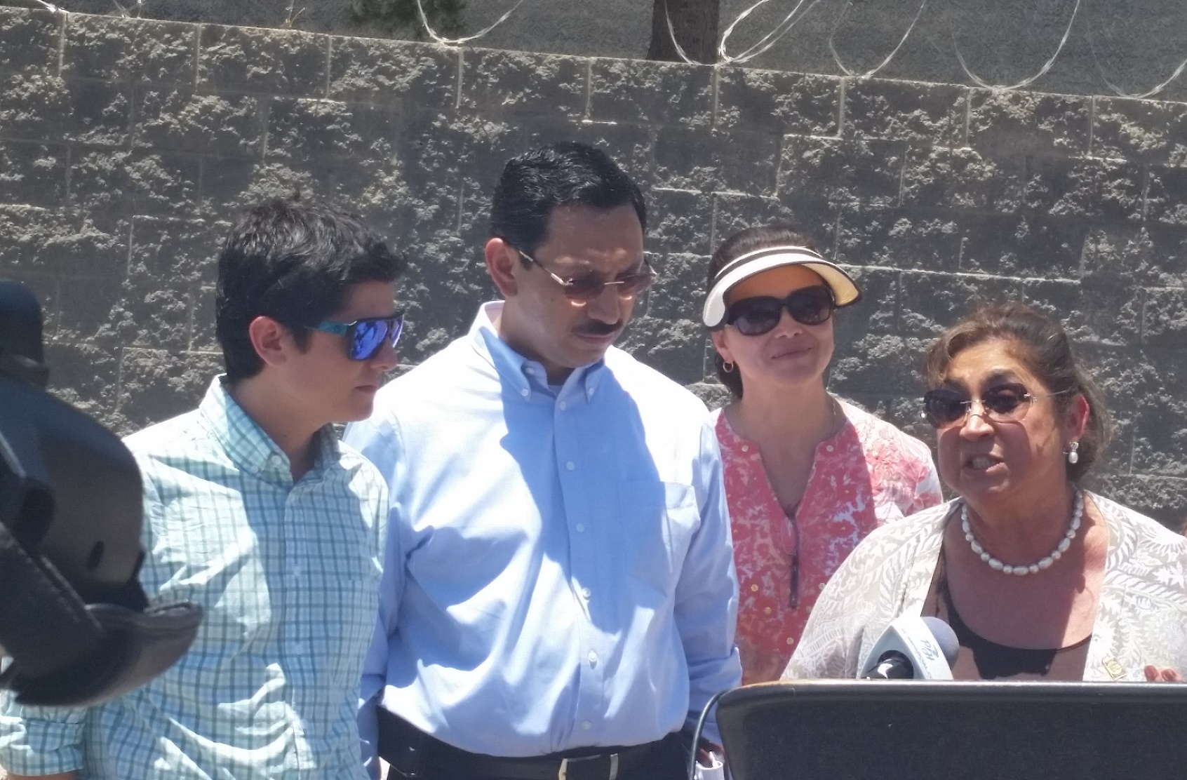
BORDER PATROL WILL RE-NAME THINGS TO COMPLY
Former First Lady of Guatemala visiting child detention facility re-named processing center.

Slide 45
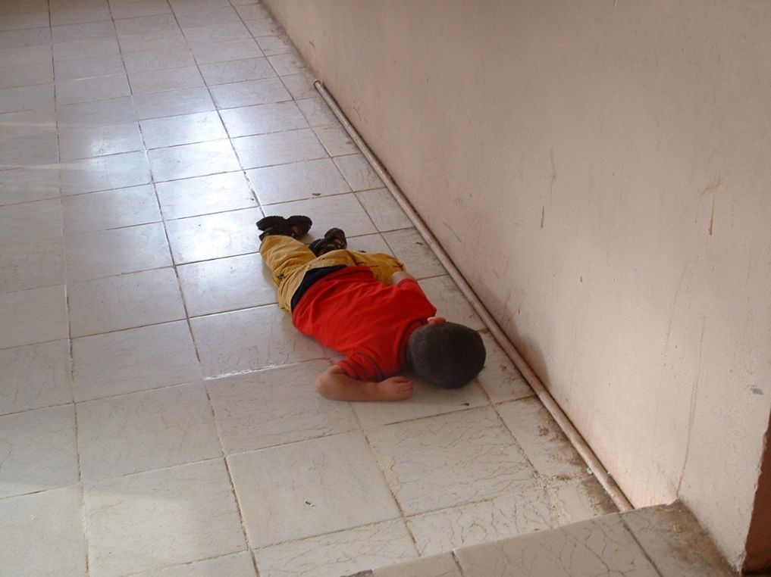
CHILD ASLEEP ON SHELTER FLOOR IN MEXICO 3 MILES AWAY

Slide 46
MANY GROUPS IN THE USA DO TRY TO HELP MIGRANTS:
NON-GOVERNMENTAL ORGANIZATIONS
CIVIL SOCIETY
HUMANITARIAN GROUPS
HUMAN RIGHTS GROUPS
CONGREGATIONS AND DENOMINATIONS
UNIVERSITIES
INDIVIDUAL CITIES AND COUNTIES

Slide 47
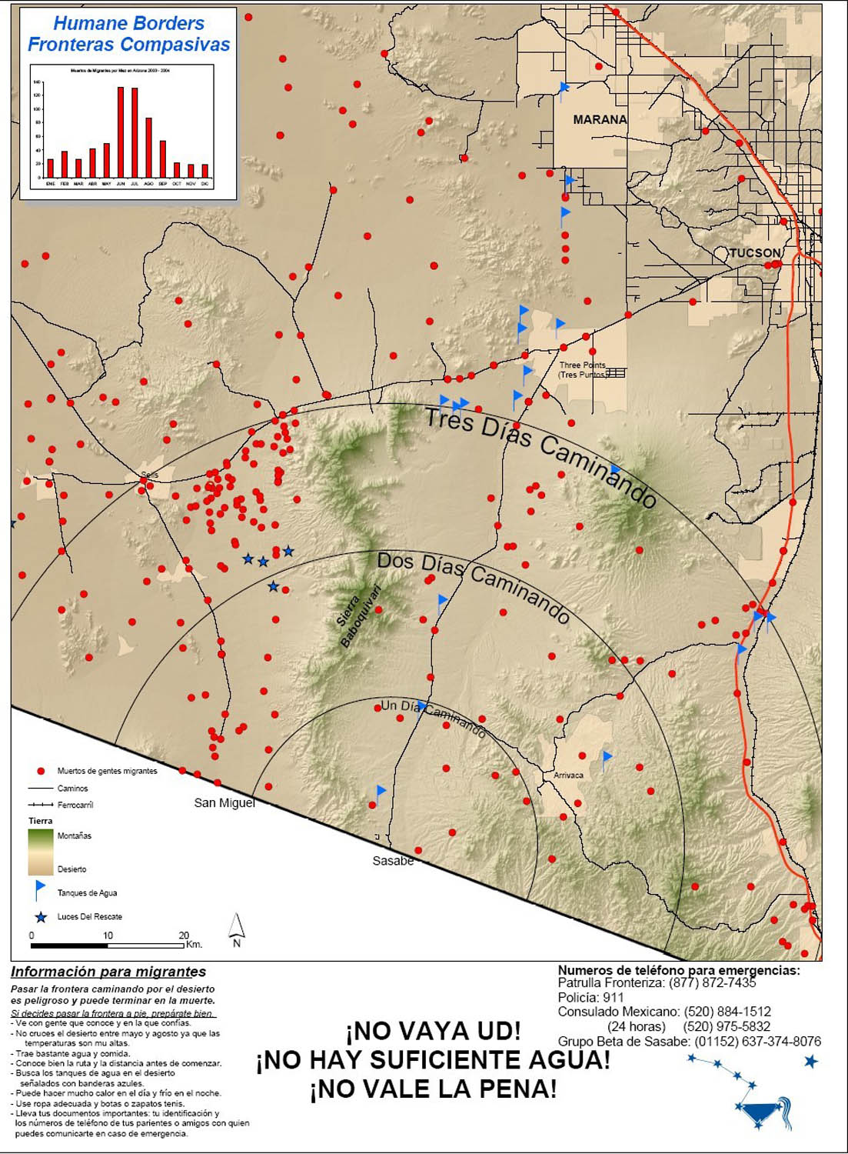
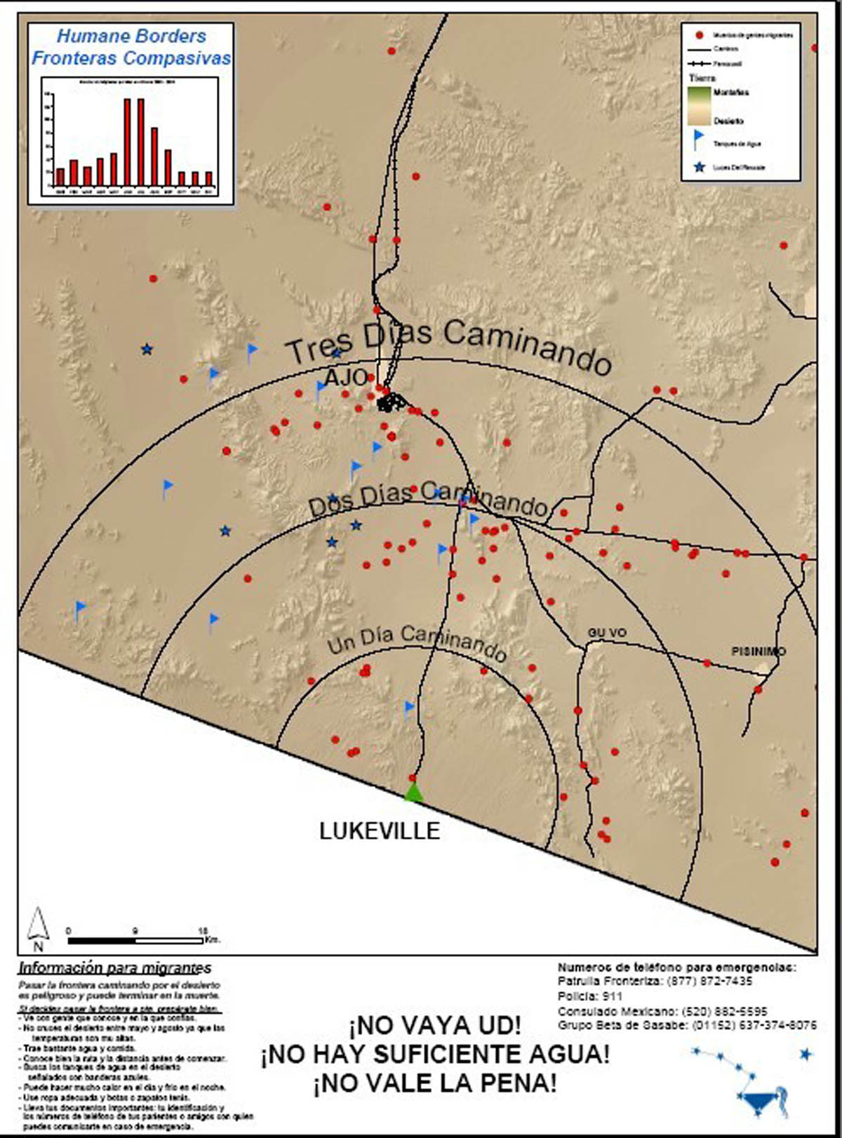
MIGRANTS WARNED OF EXPLICIT DANGER

