Slide 1
HOW TO FIX THE BORDER
Presentation By:
Rev Robin Hoover PhD
MIGRANT STATUS, INC.

Slide 2
THE BORDER IS BROKEN
ONLY THE FEDS CAN FIX IT

Slide 3
SCHOLARLY CONSENSUS
DOZENS OF TOP RESEARCHERS CONFIRM WHAT ACTIVISTS HAVE BEEN SAYING FOR DECADES:
THE SO-CALLED IMMIGRATION DEBATE CONFLATES DOZENS OF ISSUES, ESPECIALLY LABOR, DRUG ENFORCMENT AND NATIONAL SECURITY.

Slide 4
MOST IMPORTANT SCHOLARS:
DOUGLASS MASSEY, JORGE DURAND, KAREN PREN, DANIEL MARTINEZ, JEREMY MARSHALL, JACQUELINE HAGAN, JEFFREY PASSEL, NESTOR RODRIQUEZ….

Slide 5
REVIEW OF LITERATURE
BRACERO PROGRAM: 40s-60s
INA65 INITIATED QUOTA SYSTEM
80s: RISE OF THREAT NARRATIVE
MIGRANTS ARE CRIMINALS
THEY TAKE JOBS
USE SCARCE PUBLIC FUNDS
DON’T PAY TAXES
THEY’RE DEMONS

Slide 6
LARGE-SCALE ENFORCEMENT BEGAN
“…TERRORISTS AND SUBVERSIVES JUST 2 DAYS DRIVING TIME FROM HARLINGEN, TEXAS.”
--President Ronald Reagan
Others: Sheriff Joe Arpaio, Lou Dobbs, CIS, Samuel “Mad Dog” Huntington, Tom Tancredo….

Slide 7
SOME FACTS:
1986-PRESENT
3-12 MILLION UNDOCUMENTED
43 % ARE OVERSTAYS
4-21,000 AGENTS
24X $$ SPENT ON ENFORCEMENT
ENFORCEMENT DOESN’T WORK

Slide 8
ENFORCEMENT DOES SOME THINGS:
It changes where to cross
It changes destinations
It disrupts previous patterns
It makes migrants’ lives miserable

Slide 9
MOST CITIZENS WANT REFORM
TOO MANY INTERESTED ACTORS

Slide 10
HARD STORY TO SELL
“…IT IS DIFFICULT TO GET A MAN TO UNDERSTAND SOMETHING WHEN HIS SALARY DEPENDS ON HIS NOT UNDERSTANDING IT.” --Upton Sinclair

Slide 11
MIGRANTS CROSSING BORDER:
WARS IN CENTRAL AMERICA CREATED AN EXODUS
BABY-BOOM AND BOOMING ECONOMY ATTRACTED MANY MEXICANS
NOW CENTRAL AMERICA IS IMPLODING AGAIN

Slide 12
ENFORCEMENT IS BACKFIRING
SUPPORT NETWORKS HAVE EMERGED
COSTS TO MIGRATE DO NOT DETER MIGRATION
COSTS TO MIGRATE ENCOURAGE LONGER STAYS
CBP ACTIVITY INCREASES CARTEL MARKETS

Slide 13
COYOTE SYSTEM ADAPTING
Apprehensions are a horrible measure
However, every $100 spent by migrant decreases apprehension odds by 1.1% --Massey, et al.
Therefore, $900 more spent decreases apprehension odds by 10%

Slide 14
SCALE OF MIGRATION:
ONE DECADE AGO, MORE MIGRANTS WERE SUCCESSFULLY CROSSING SOUTHERN ARIZONA THAN LIVED IN TUCSON, ARIZONA, SOMETIMES MORE THAN PIMA COUNTY, ARIZONA. THAT’S 650,000-1,000,000!
TODAY, THERE ARE 4,400 AGENTS IN TUCSON SECTOR WITH 500 SUPPORT PERSONNEL PLUS CONTRACTORS.

Slide 15
BORDER DEATHS:
“…WE ESTIMATE THAT IF THE BORDER PATROL HAD REMAINED AT ITS 1986 VALUE THROUGH 2010, THERE WOULD HAVE BEEN 5,119 FEWER DEATHS ALONG THE BORDER.” --Massey, et al.
“It’s the equivalent of two airline crashes each year in southern Arizona alone.” --common quote

Slide 16
POLICY REFORM GOALS:
INCREASED NATIONAL SECURITY
FLEXIBLE EMPLOYMENT CONDITIONS
EXPANDED HUMAN RIGHTS
REDUCTION IN POLITICAL BORDER NOISE
REDUCED VIOLENCE IN MEXICO
REASONABLE LAW ENFORCEMENT
US-MEXICO BORDER IS 1954 MILES LONG

Slide 17
CURRENT MIGRATION CONTROL POLICIES:
MAKE IT DIFFICULT TO ENTER US
MAKE IT EXPENSIVE TO ENTER US
MAKE IT DIFFICULT FOR EMPLOYERS TO NAVIGATE THE SYSTEM
RESULT IN HUMAN RIGHTS ABUSES
RESULT IN FAMILY SEPARATIONS
RESULT IN HUNDREDS OF MIGRANT DEATHS ANNUALLY
THERE ARE 35 COUNTRIES IN AMERICA

Slide 18
CURRENT POLICY OUTCOMES:
BORDER ENVIRONMENT DESTRUCTION
ENORMOUS TAXPAYER COSTS
BILLIONS TRANSFERRED TO CARTELS
RISING MIGRANT DEATH RATES
EMPLOYER FRUSTRATIONS
FAMILIES FACE DIFFICULT DECISIONS
HUMAN RIGHTS ABUSES
POLITICS IS A GAME OF NAMING, FRAMING, AND BLAMING

Slide 19
“THE SYSTEM” COULD BE CHANGED:
ADOPT NEW PROPOSALS FOR THE UNDOCUMENTED LIVING ARE HERE
ADOPT NEW PROPOSALS FOR THOSE WHO WANT TO COME HERE AND WORK LEGALLY
WHY DO WE TREAT HI-TECH WORKERS DIFFERENTLY FROM MIGRANTS?

Slide 20
WHERE DO WE BEGIN?
LEARN LESSONS FROM LEGALIZATION PROGRAMS
USE AVAILABLE SOCIAL SCIENCE
USE MARKET-ORIENTED INCENTIVES
ACHIEVE LARGE RESULTS BY ADJUSTING ONLY A FEW VARIABLES
START WITH THE TWO LARGEST GROUPS: THE UNDOCUMENTED AND THE WILLING WORKERS SEEKING WILLING EMPLOYERS
FEWER MIGRANTS ARE DYING, BUT THE RATE OF DEATH IS RISING RAPIDLY

Slide 21
FOR THE UNDOCUMENTED:
INTERVIEW THE UNDOCUMENTED
ISSUE VISAS FROM TWO TO TWELVE YEARS BASED ON NEED AND US QUOTAS
REQUIRE DRIVER LICENSE/CAR AND HEALTH INSURANCE COMPLIANCE
BEGIN NATURALIZATION IF DESIRED. MAY BE COMPLETED INABSENTIA.
ALLOW VISA HOLDERS TO TRAVEL, BUY CARS, HOMES, START BUSINESSES, ETC.

Slide 22
FOR THOSE WHO WANT TO WORK:
US LABOR DEPARTMENT SETS QUOTAS FOR TWO-YEAR VISAS JUST FOR MEXICO, HONDURAS, GUATEMALA, EL SALVADOR
SENDING COUNTRIES SCREEN APPLICANTS
OPEN A $2,500 SECURITY ACCOUNT WITH INTERNAL REVENUE SERVICE
DEDUCT 10% OF GROSS WAGES AND ADD TO ACCOUNT EACH PAY PERIOD
THE ACCOUNT ACCRUES FOR TWO YEARS

Slide 23
WHEN THE VISA EXPIRES, MIGRANT TRANSFERS FUNDS ELECTRONICALLY AND GOES HOME
IF NO COMPLIANCE, FUNDS ARE FORFEITED TO LAW ENFORCEMENT
THIS CREATES AN ECONOMIC INCENTIVE TO COMPLY WITH THE TERMS OF A VISA
EMPLOYERS WOULD HAVE STABLE, PREDICTABLE SYSTEM
DEPARTMENT OF DHS PERSONNEL WOULD BE FREED UP TO LOOK FOR TERRORISTS
MIGRANTS WANT WORK. WE WANT WORKERS. WHY DO WE MAKE IT SO HARD?

Slide 24
WHAT WOULD WE ACCOMPLISH?
INCREASED NATIONAL SECURITY: WE WOULD KNOW WHO IS HERE
EMPLOYMENT FLEXIBILITY AND SECURITY WOULD BE ESTABLISHED
BASIC RIGHTS WOULD BE EXTENDED SINCE PEOPLE HAVE RIGHT TO BE PRESENT
MIGRANTS WOULD SHARE MORE OF THE COSTS OF PARTICIPATING IN OUR SYSTEM
MEXICAN CARTEL REVENUES WOULD DROP DRAMATICALLY
IT IS NOT IN OUR SHORT OR LONG TERM INTERESTS TO HAVE POOR NEIGHBORS

Slide 25
NEW POLICY RESULTS:
MIGRANTS USE PUBLIC TRANSPORTATION
CARTEL REVENUES WOULD DECLINE
MIGRANT DEATHS WOULD DIMINISH
FAMILIES WOULD BE INTACT
EMPLOYERS COULD NAVIGATE SYSTEM
HUMAN RIGHTS WOULD EXPAND
HUMAN RIGHTS IS NOT A LUXURY. THEY HELP US CONVICT THE BAD GUYS
AND THEY PROTECT THE MOST VULNERABLE AMONG US

Slide 26
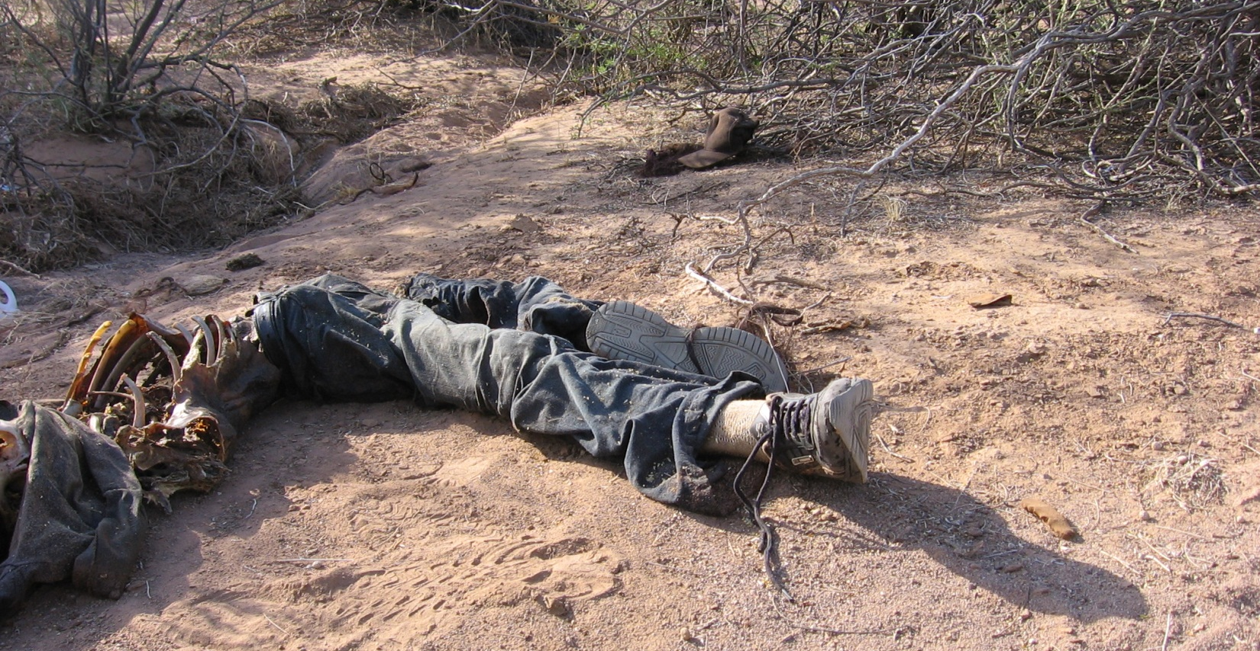
THESE THINGS MATTER:
DEATH HAS BECOME PUBLIC POLICY
PRUDENCIA MARTIN GOMEZ, 18 YEAR OLD GUATEMALAN IN DESERT
“WE MUST REMOVE DEATH FROM THE IMMIGRATION EQUATION”—ROBIN HOOVER

Slide 27
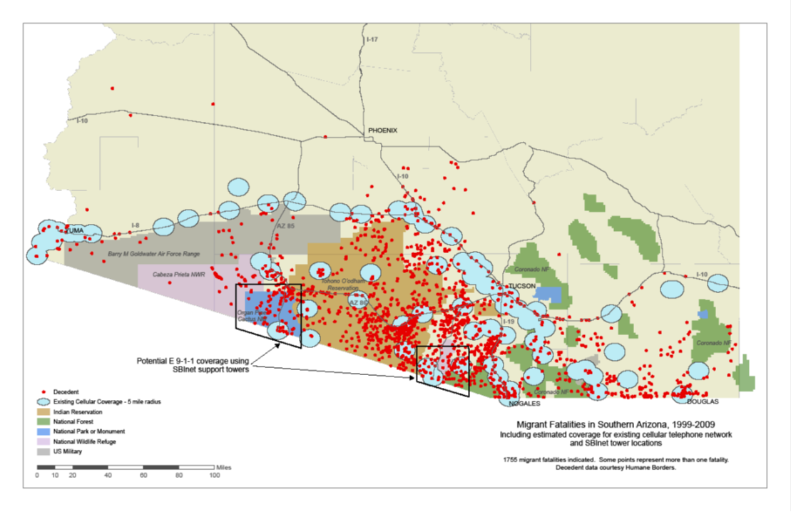
THESE THINGS MATTER:
MORE THAN 2250 DEATHS IN 11 YEARS IN ARIZONA ALONE

Slide 28
THESE THINGS MATTER:
THE “LAW ENFORCEMENT ONLY” APPROACH REVEALS A STUNNING LACK OF IMAGINATION.
ONLY A CRITICALLY-FOCUSED, BI-PARTISAN POLITICAL SOLUTION WILL ADDRESS THE ISSUES.
ONLY AN INSISTENT PUBLIC CAN CREATE POLITICAL WILL.

