Slide 1
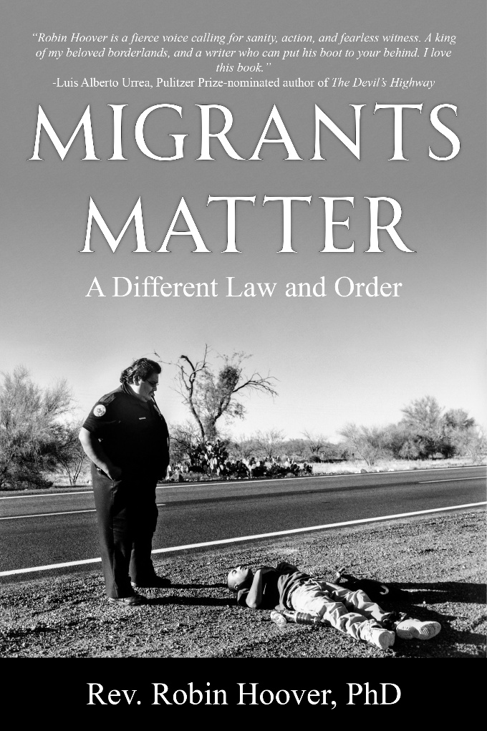
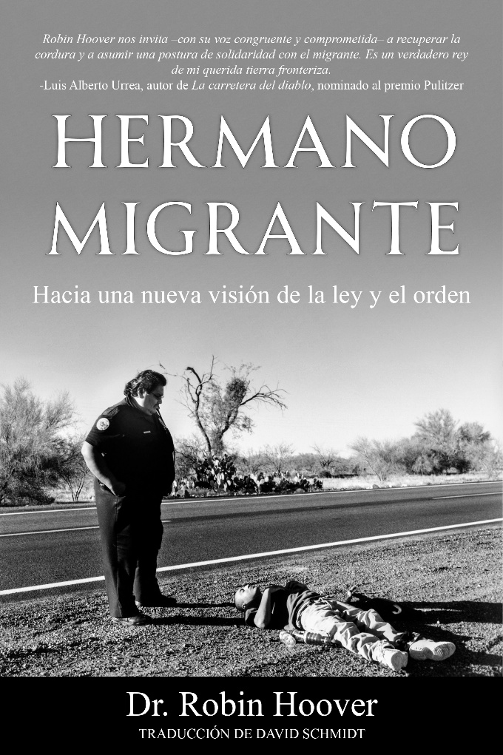
MIGRANTS MATTER: a different law and order
by Rev. Robin Hoover Ph.D., RobinHoover.Com

Slide 2
Why I’m Not Speaking Spanish Today

Slide 3
WHO AM I?
Social Ethicist
Political Scientist/Political Theorist
40+ years working for migrants
Founder/President Emeritus of Humane Borders, Inc.
2006 Mexico’s National Human Rights Award
Former Scholar in Residence CENADEH, Mexico City
Author/Lecturer/Activist/Media Guy…
  Archives: University of Arizona Special Collections
Storyteller and artificial inseminator of honeybees…

Slide 4
REFORM REQUIRES EMPATHY
EMPATHY=Diversity, Equity, and Inclusion
“Americans” WERE TAUGHT TO HATE:
Indigenous, Mexicans, Chinese, southern Europeans, eastern Europeans, slaves, blacks, middle easterners…
We were taught to hate Muslims, Jews, sub-continent Indians, those who are “sexually-different” viz: LGBTQIA+2S
We were taught to hate Germans, Japanese, Koreans, Vietnamese.
Now, political and religious leaders are trying tell us that empathy is wrong and even a sin.

Slide 5
REFORM REQUIRES KNOWLEDGE
Almost all immigration/migration news is government-manufactured.
Politicians don’t know much about the border or immigration.
Reform is not a problem to be “solved”.
“Immigration” gets redefined/reduced to: drug war, race, culture, terrorism, the welfare state, healthcare, economy…

Slide 6
RE: KNOWLEDGE: WHERE IS THE BORDER?
International Boundary Commission Line?
DHS Sec. Chertoff’s suspension of environmental laws?
100 air miles from ports of entry?
State Dept. office in Dubai?
U.S. Southern Command?
Soto Cano Air Base in Honduras?
Washington, D.C.?
U.S. corporation board rooms?
U.S. markets? Trade?

Slide 7
REFORM CONCEPT LITMUS TEST:
  National Security
  Stable Labor
  Political Noise
  Human Rights
  Violence in U.S. & Mexico
  “It’s always the economy, Stupid!”

Slide 8
*REFORM CONCEPTS FOR NON-CITIZENS HERE:
  “undocumented”: no visas
  TPS holders
  Asylum seekers, refugees, DACAs, ….
  Persons with work authorizations, H2-As, H1-Bs….
  *REFORM CONCEPTS FOR FUTURE WORKERS:

Slide 9
ENFORCEMENT-ONLY POLICIES HAVE FAILED
Walls, surveillance, personnel
Lateral repatriation, interior repatriation, flights
Enforcement made billionaires out of the cartels
Driving up the costs of coyotes did not work

Slide 10
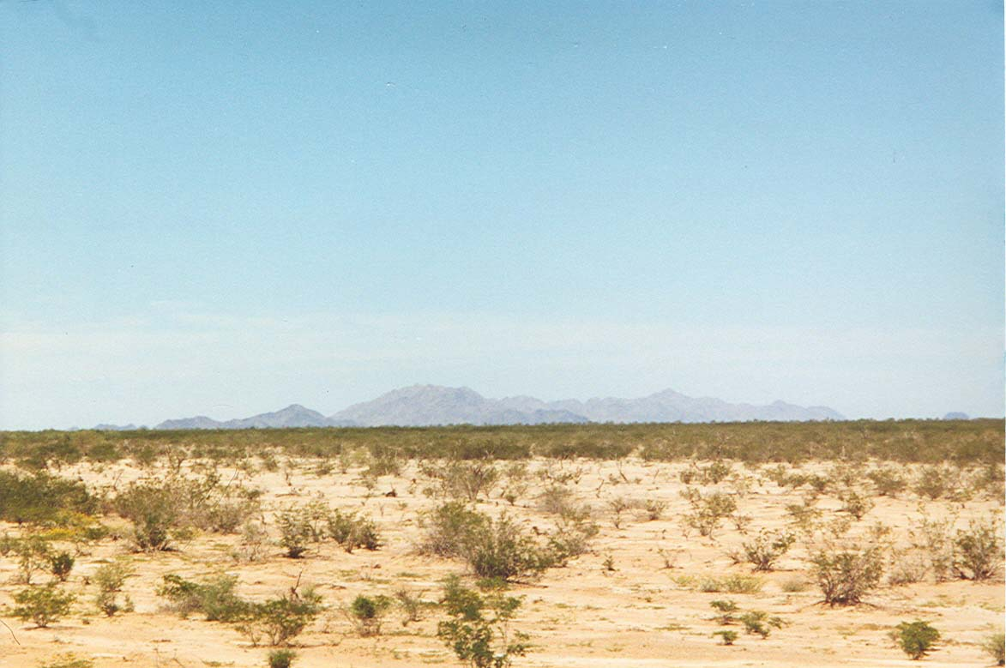
The Death Trap
Fourteen migrants perished from dehydration on May 23, 2001. Their guide walked the wrong way in Cabeza Prieta National Wildlife Refuge. Lack of water was fatal.

Slide 11
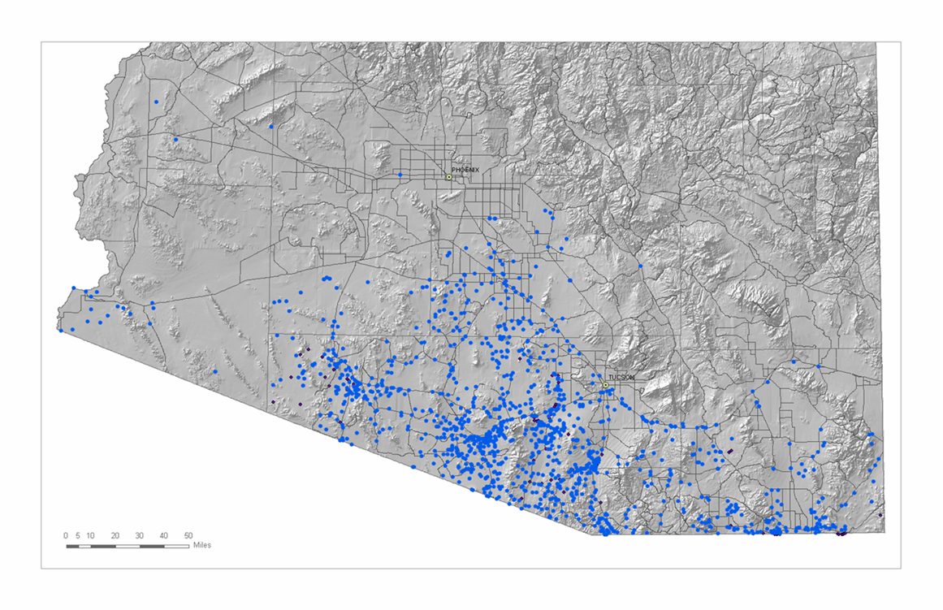
MAPPING MIGRANT DEATHS

Slide 12
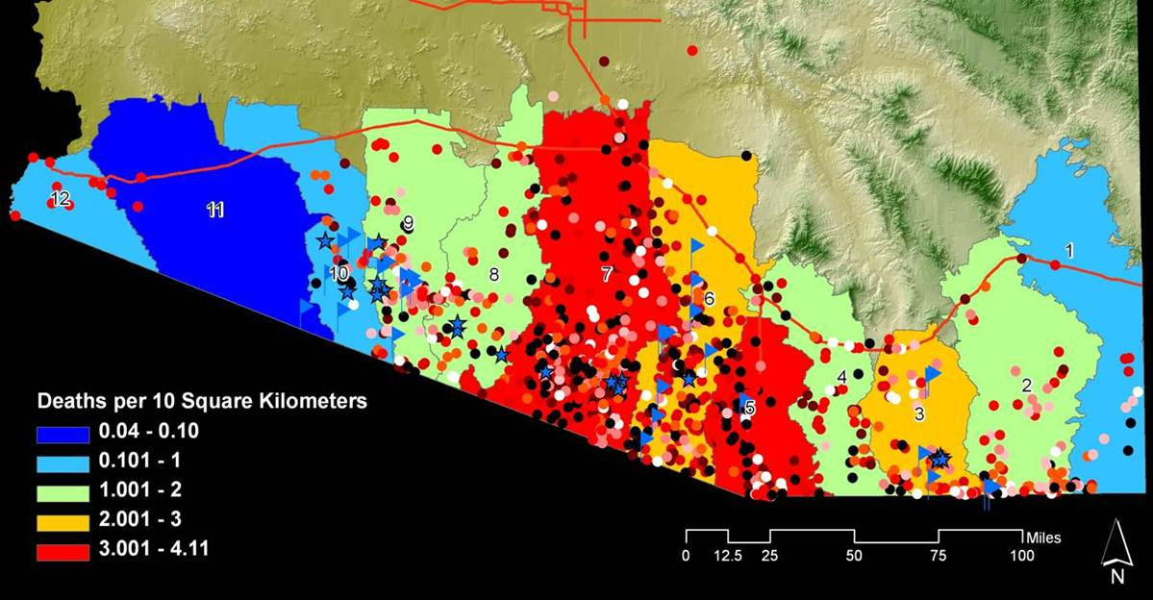
MIGRANT DEATHS BY WATERSHED—CORRIDOR
Graphic by:
Dr. John Chamblee

Slide 13
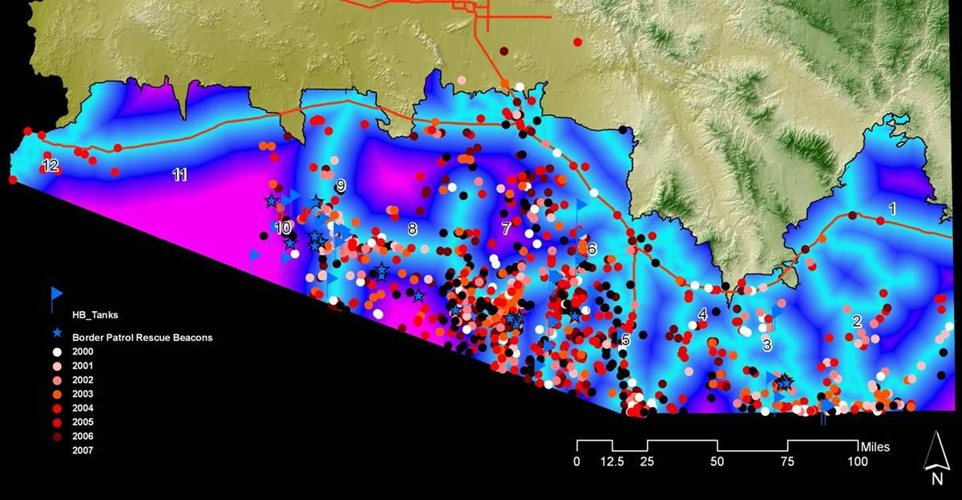
MIGRANT DEATHS BY DISTANCE FROM ROADS
Graphic by:
Dr. John Chamblee

Slide 14
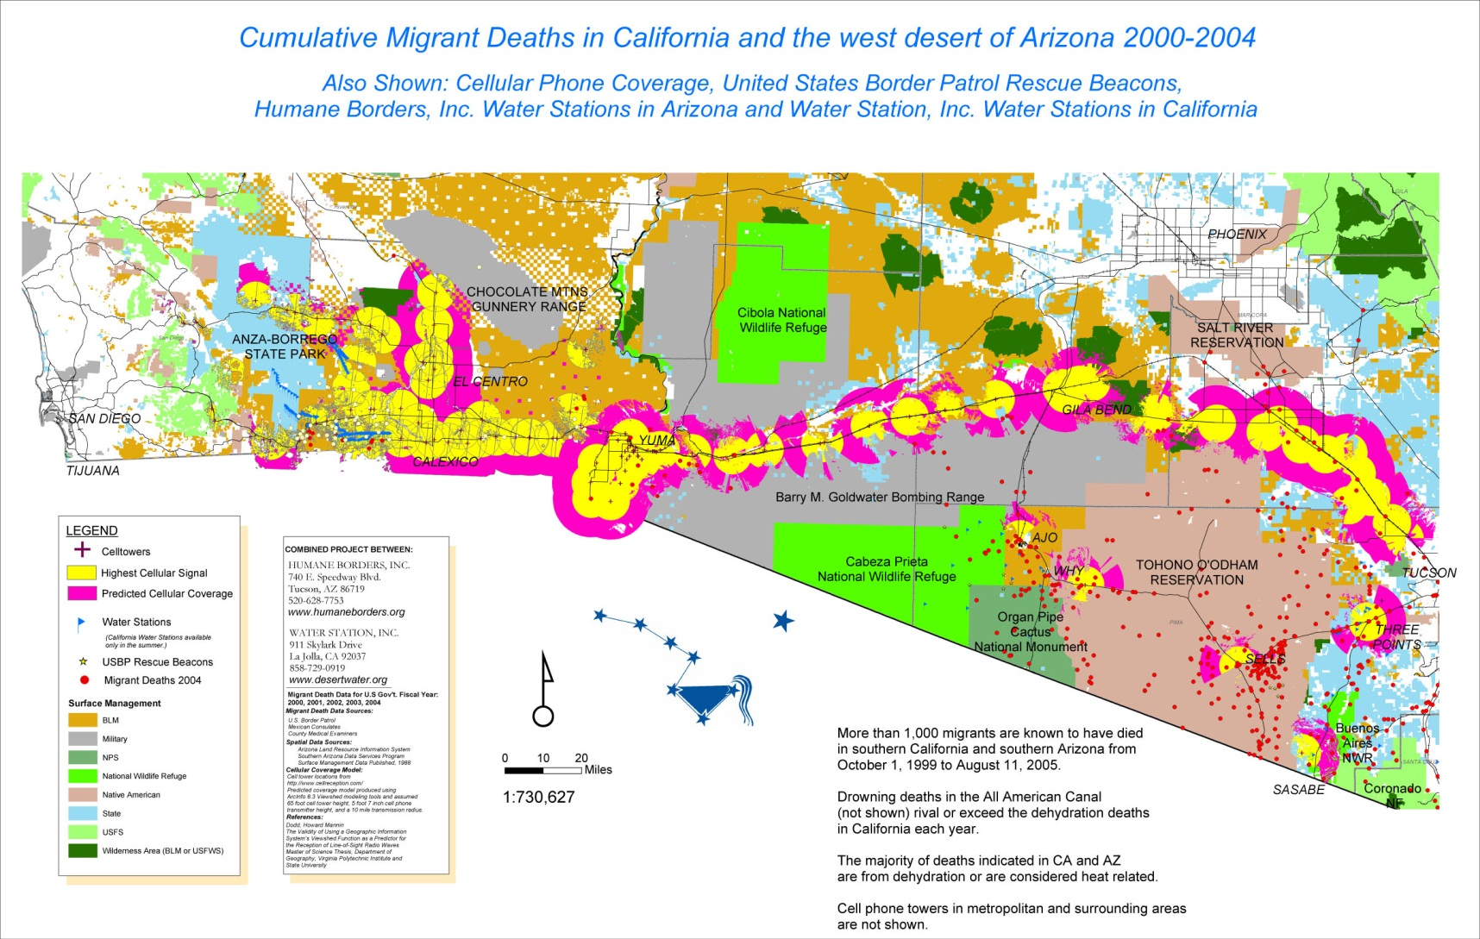
CELL PHONE TOWER PROJECT
A project of:
Dr. Robin Hoover
Dr. John Hunter
Dr. John Chamblee

Slide 15
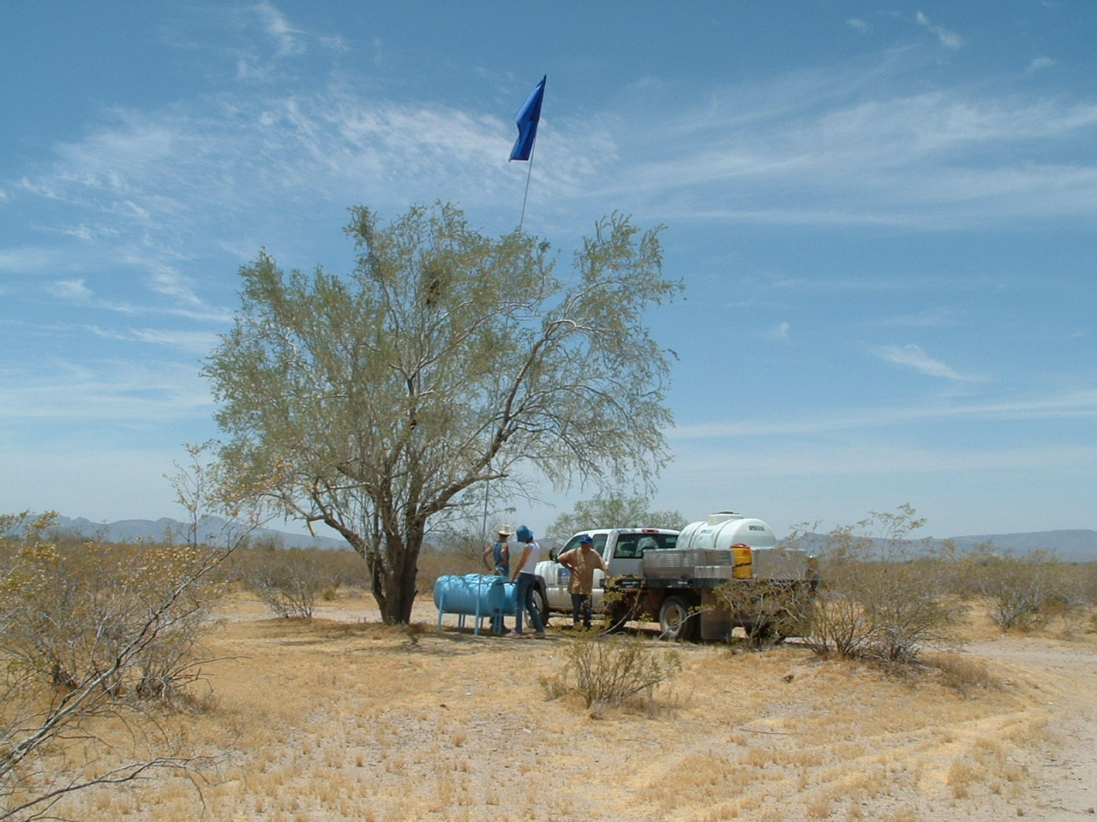
WATER STATIONS IN REMOTE DESERT AREAS

Slide 16
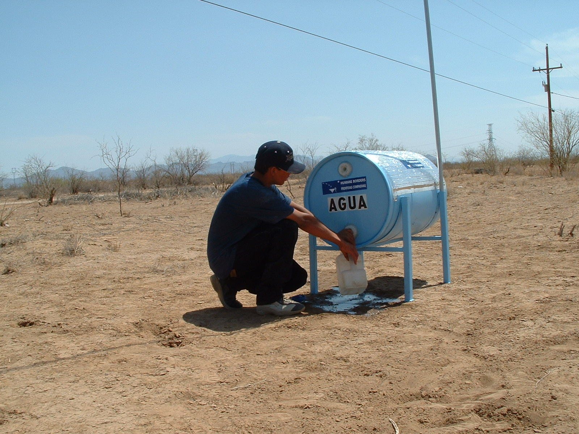
YOUNG MIGRANT FINDS WATER STATION
This water station was recognized by the Cooper-Hewitt Museum (part of the Smithsonian) for its design.

Slide 17
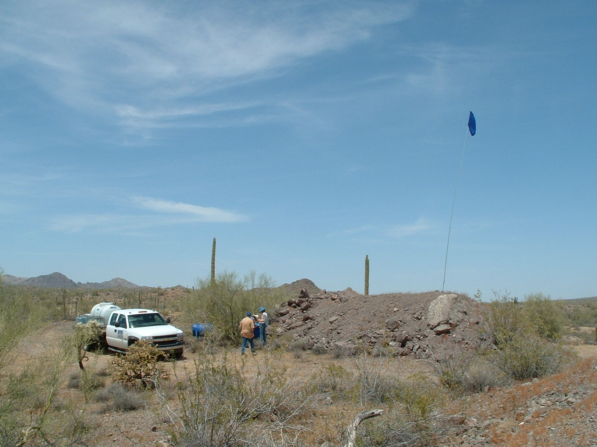
BLUE ROCK STATION IN AJO BLOCK OF
THE BUREAU OF LAND MANAGEMENT
Public Administration Nightmare:
Permits
Insurance
Equipment designs
Politics
Expense
Volunteers
Donors
Media

Slide 18
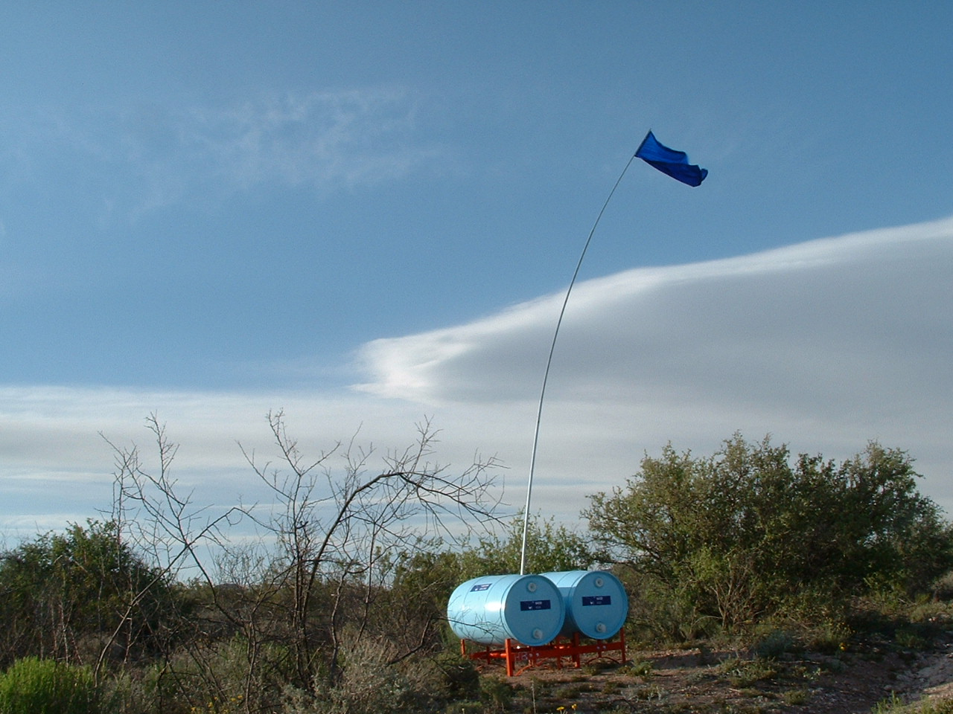
TYPICAL STATIONS: 100 GALLONS OF H20

Slide 19
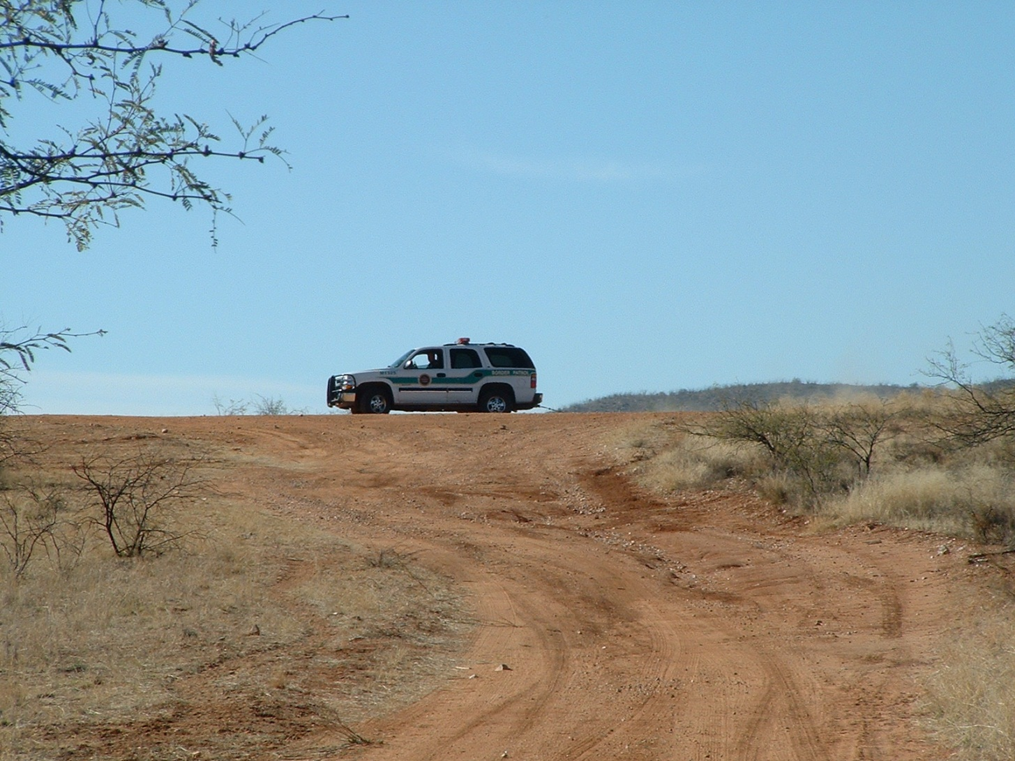
AGENTS WATCHED US IN THE DESERT
USED SURVEILLANCE IN TOWN

Slide 20
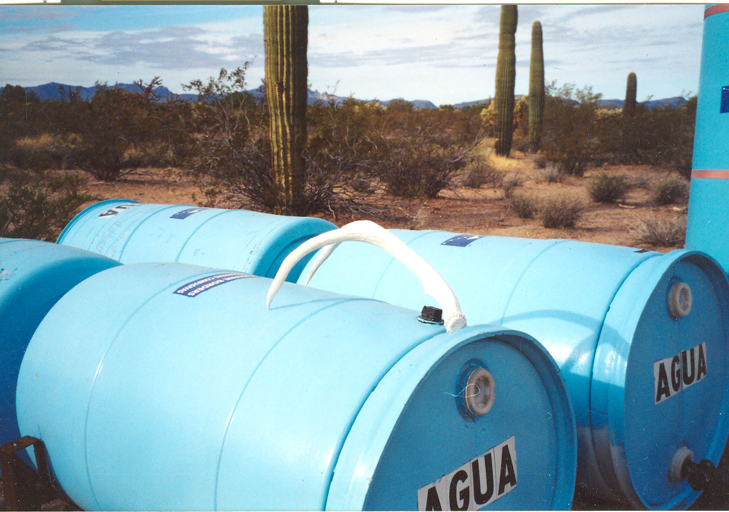
A GIFT FROM PASQUA YAQUI MIGRANT

Slide 21
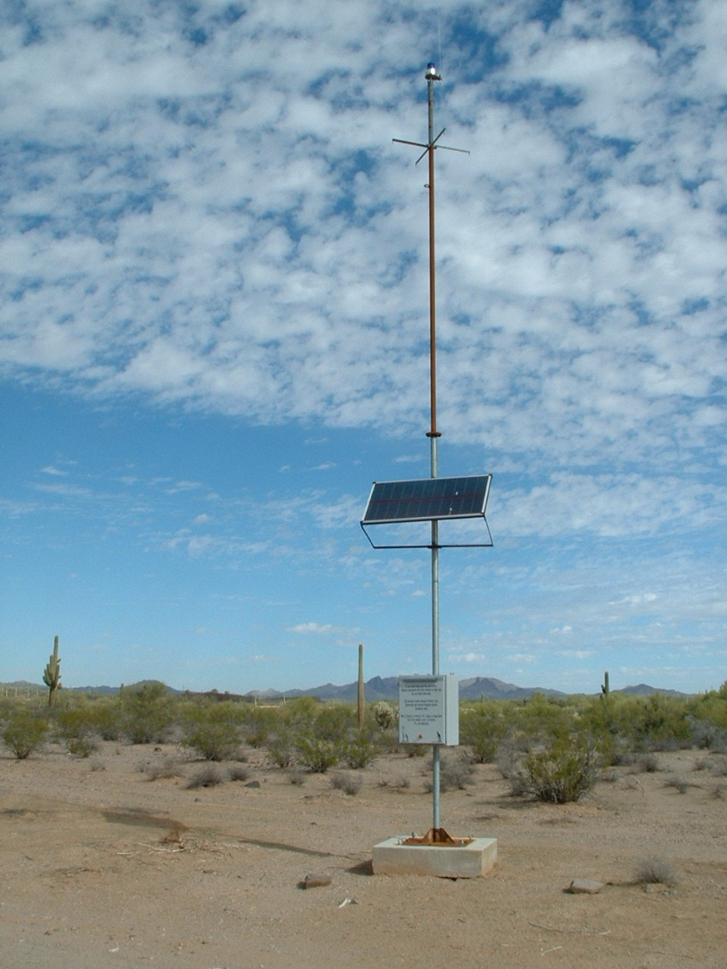
BORDER PATROL RESCUE BEACON

Slide 22
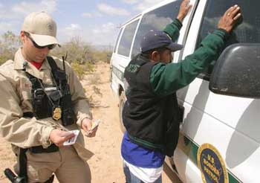
BORSTAR AGENTS WEAR TAN OVER RED

Slide 23
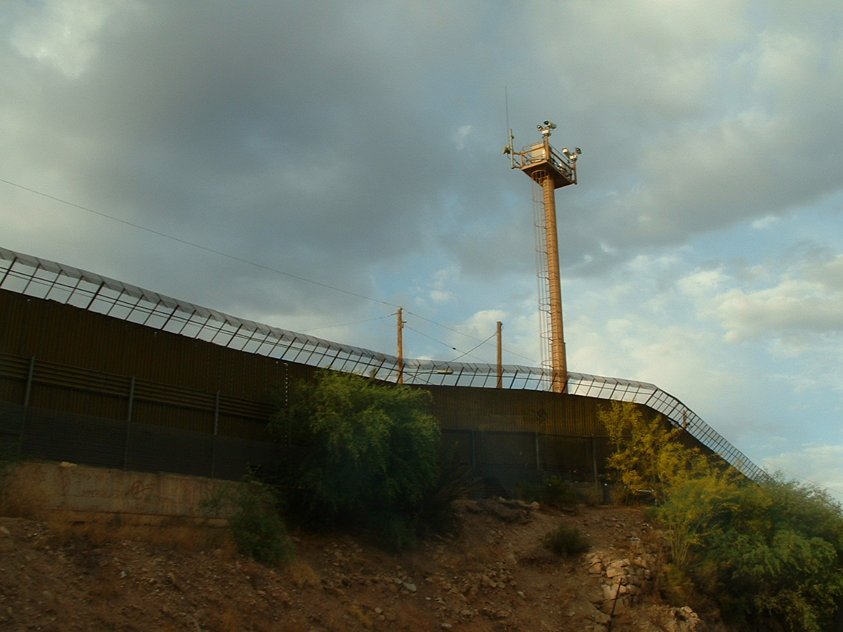
SURVEILLANCE CAMERAS AT BORDER FENCE
SEEN FROM NOGALES, SONORA SIDE

Slide 24
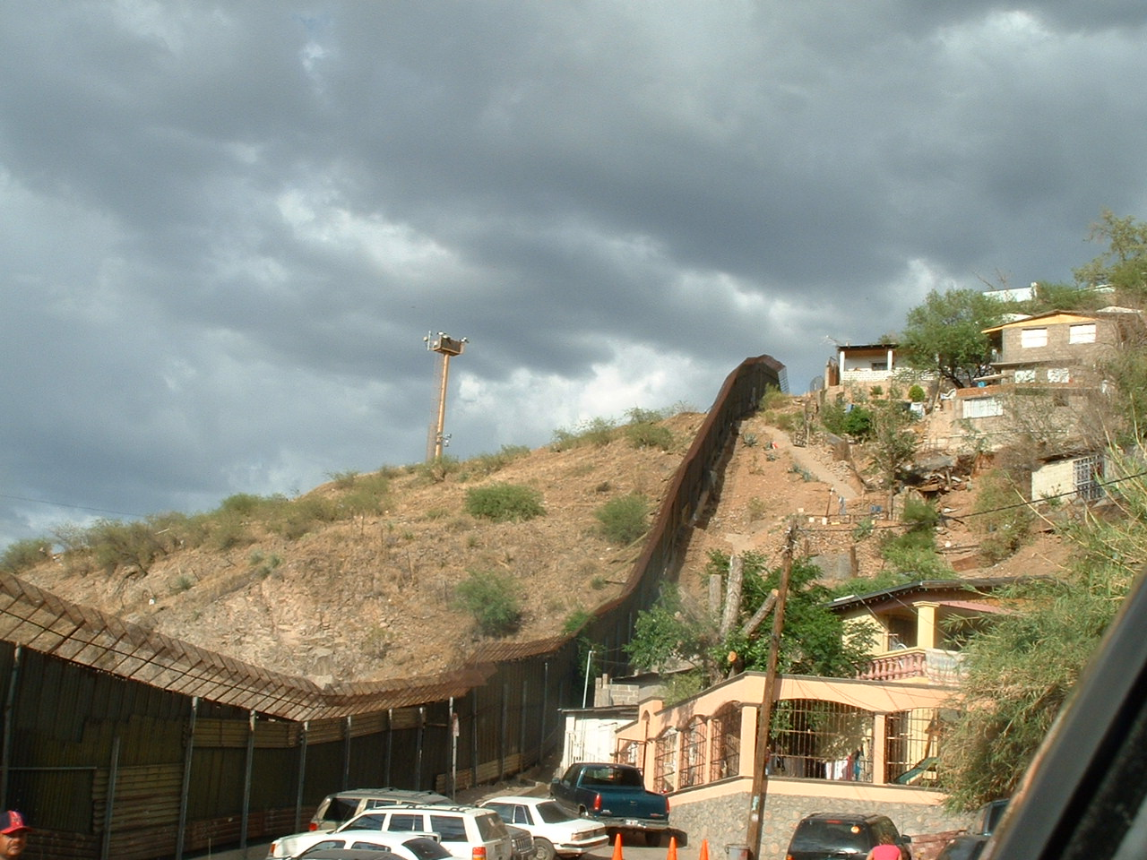
EAST SIDE OF NOGALES PORT OF ENTRY
LOOKING TO US

Slide 25
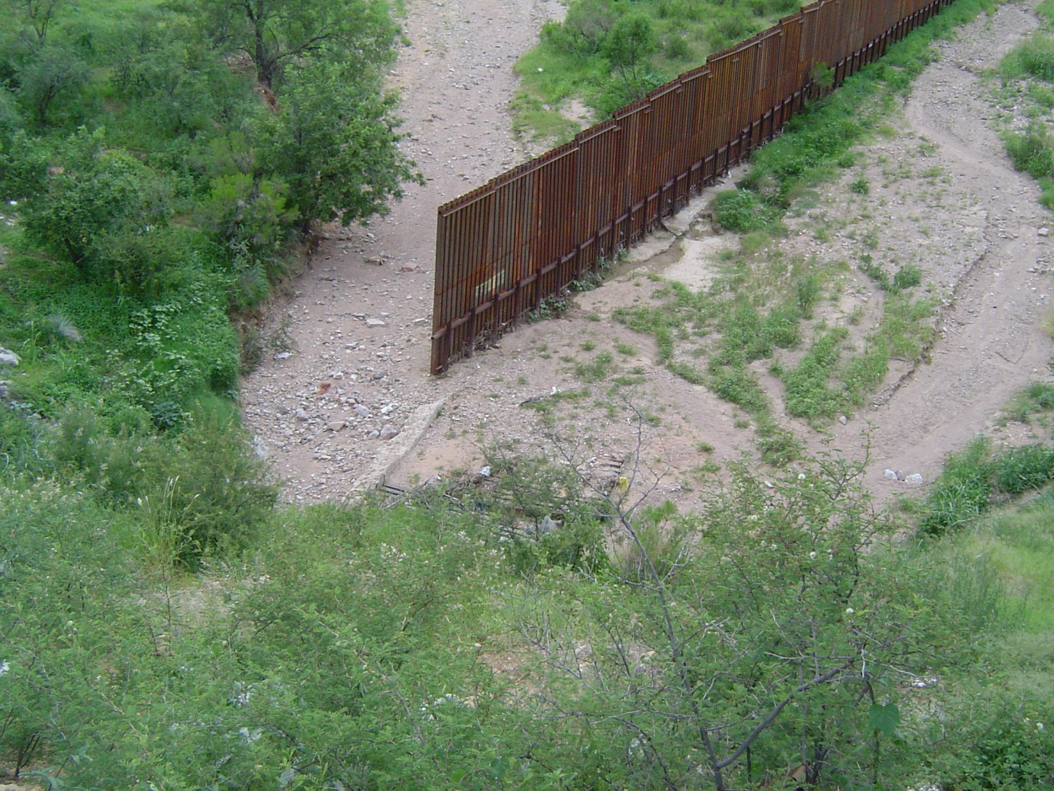
WALLS PUSH MIGRANTS TO OPEN AREAS

Slide 26
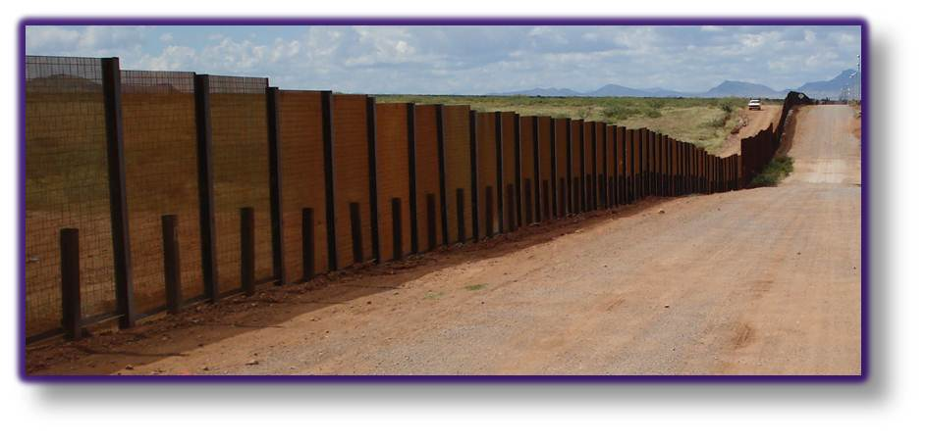
WALLS DESTROY THE ENVIRONMENT
BIGGEST ENVIRONMENTAL WAIVER IN US HISTORY

Slide 27
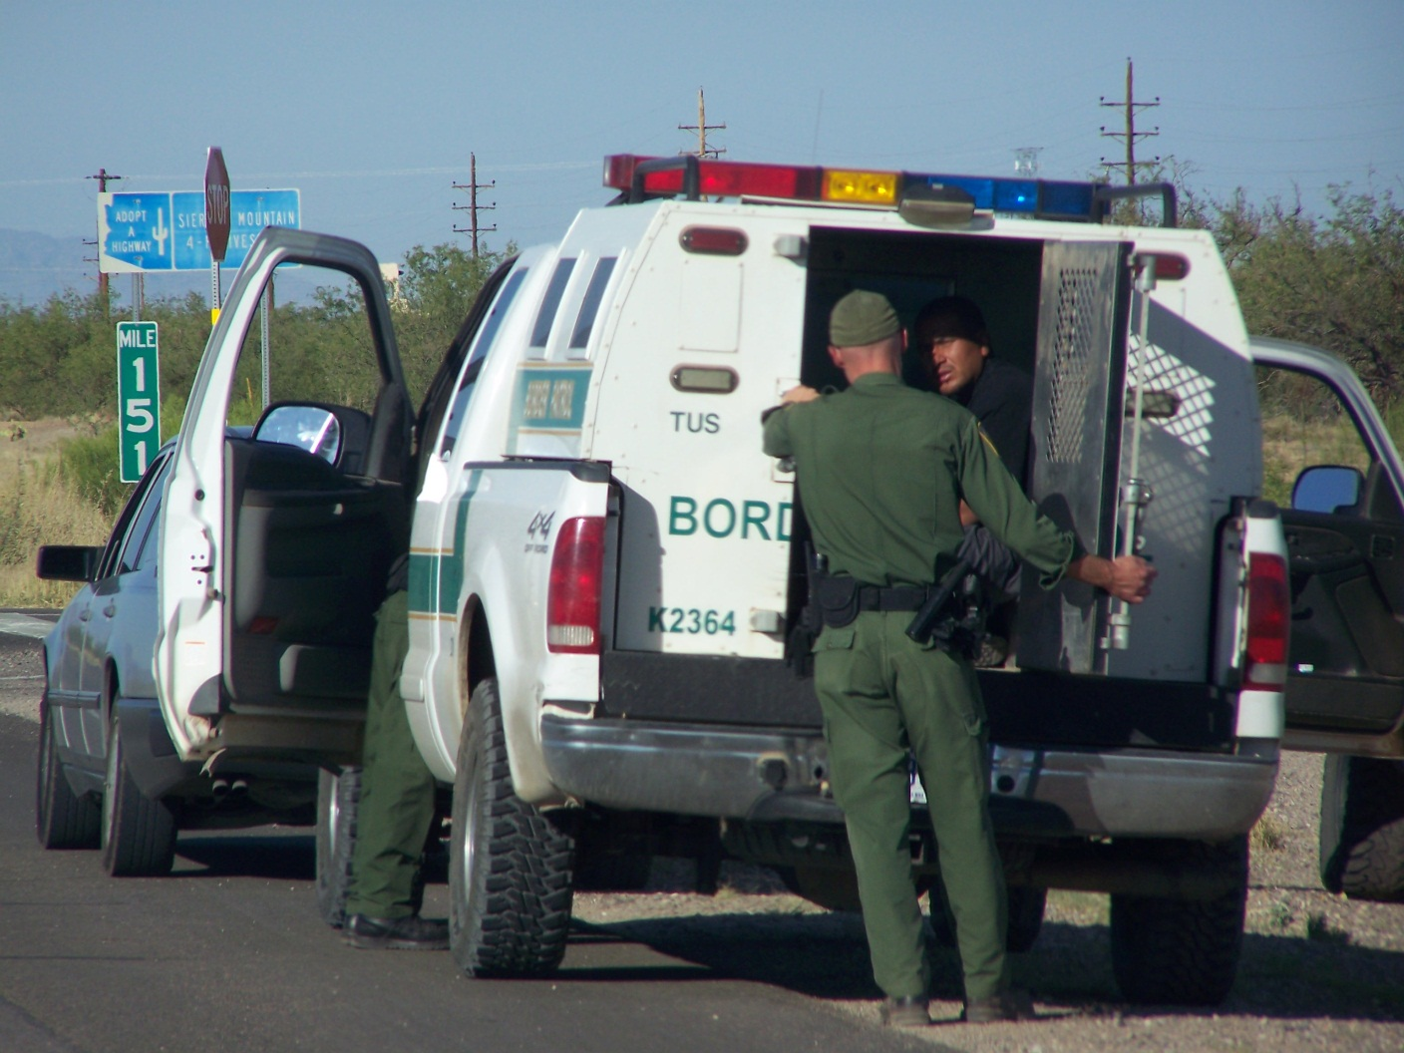
AGENTS TRANSPORT MIGRANTS

Slide 28
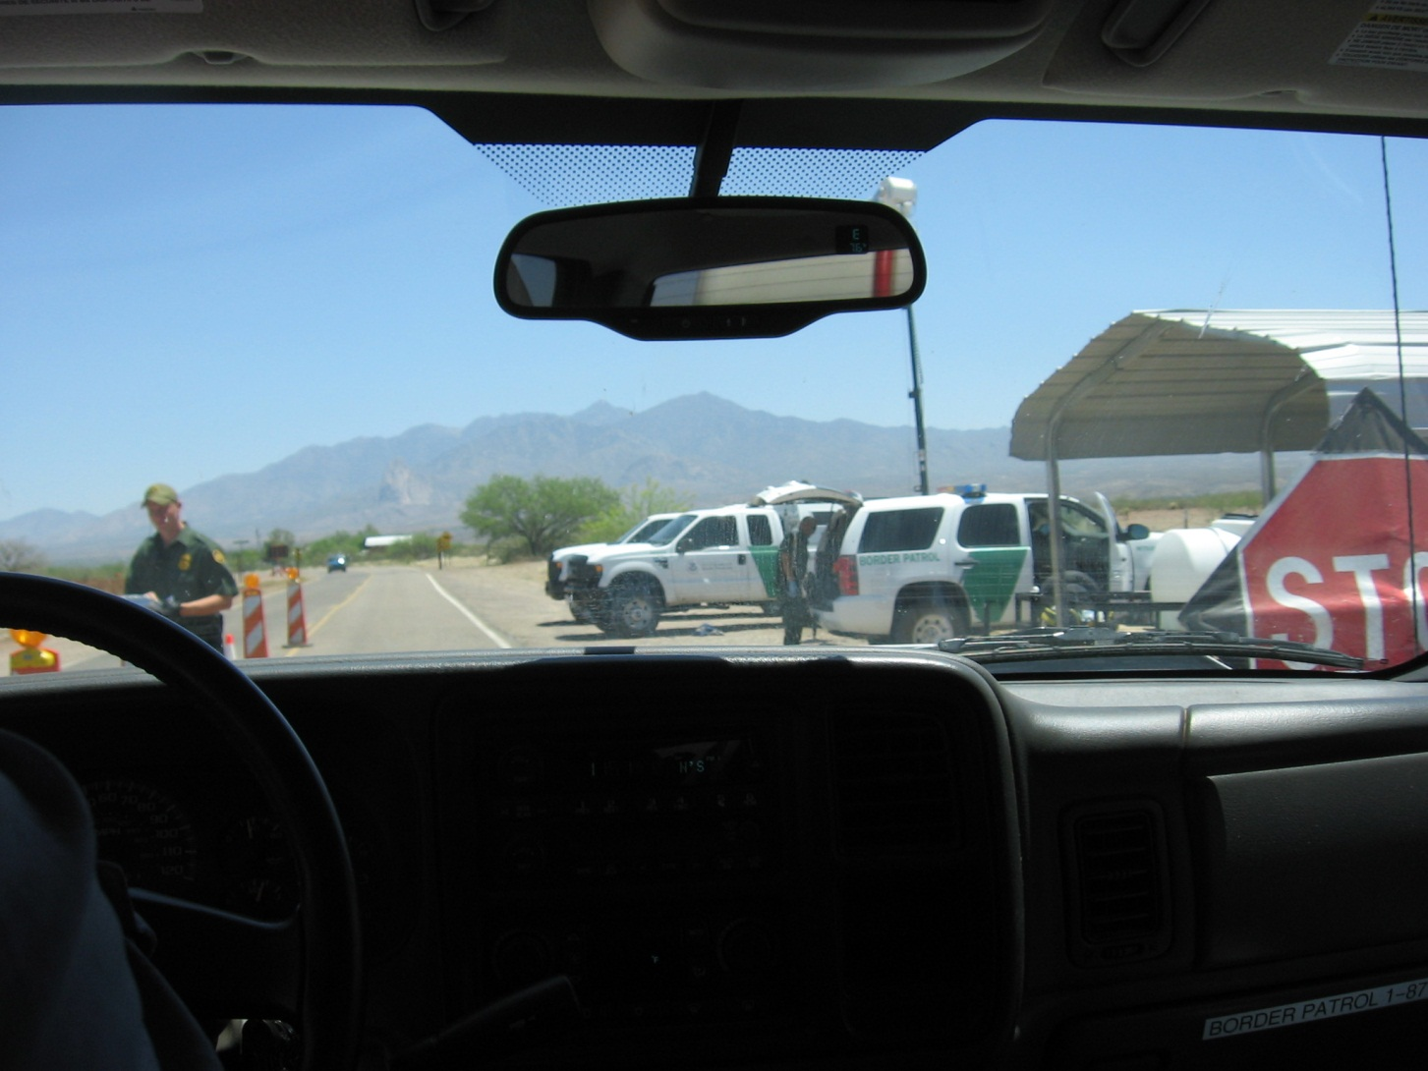
CONTROVERSIAL INTERIOR CHECK POINTS
Agents can ask anything they want at checkpoints. The ONLY thing a citizen has to do, though, is attest to citizenship. No citizen is required by law to provide documents. Dogs wrongfully “alert” more than 50% of the time.

Slide 29
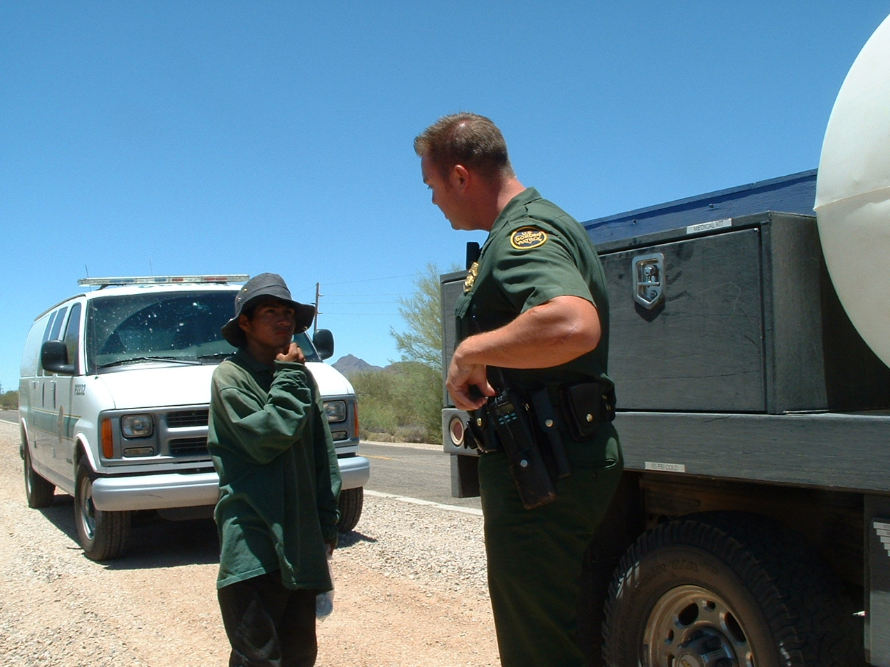
SATELLITE PHONE CALL FOR AGENT TO MEET US
Agents act differently when being filmed. Still, some yell at us for photographing. They are advised that they have -0- expectation of privacy on public properties.

Slide 30
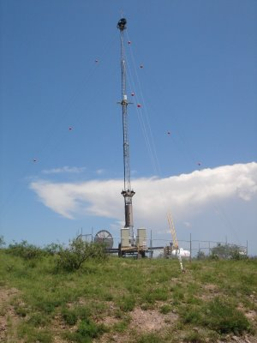
ONE OF MANY VIRTUAL FENCE TOWERS
The border is used as a Research and Development location for the Department of Defense to develop technologies for low-intensity conflict and low-intensity warfare around the world. Technologies include all sizes of drones; infrared, laser, seismic, audio sensors; disrupt groups; high altitude optics.

Slide 31
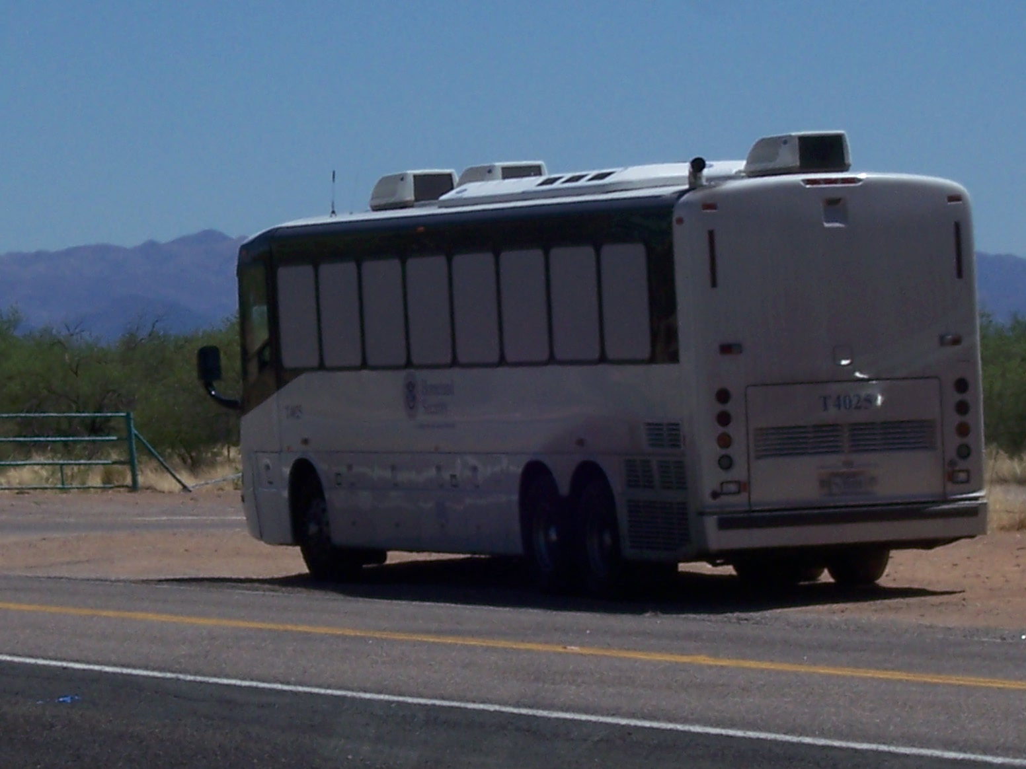
MIGRANTS TRANSPORTED BY PRIVATE CONTRACTORS

Slide 32
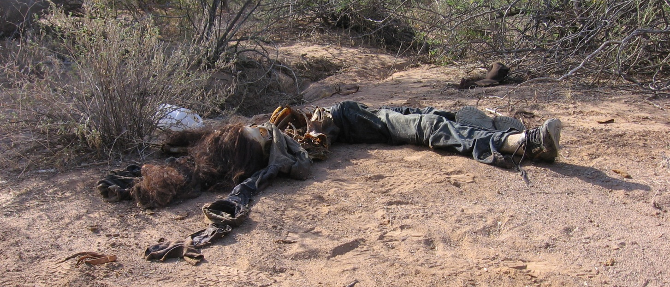
GUATEMALAN NATIONAL
PRUDENCIAL MARTIN GOMEZ, 18 YEARS OLD

Slide 33
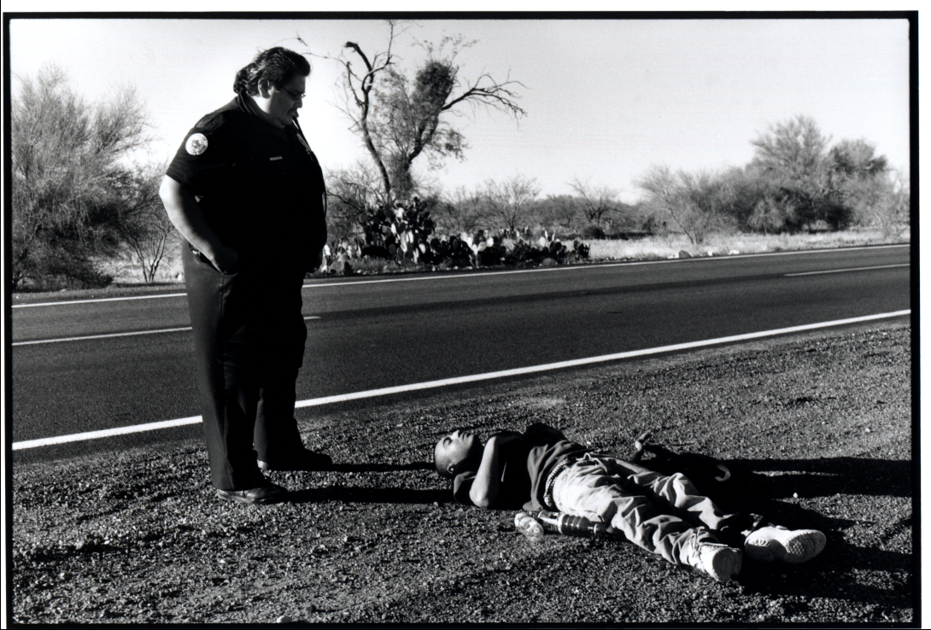
TOHONO O’ODHAM POLICE WITH MIGRANT

Slide 34
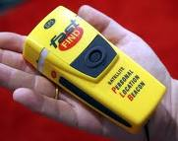
PROYECTO RESCATAME!

Slide 35
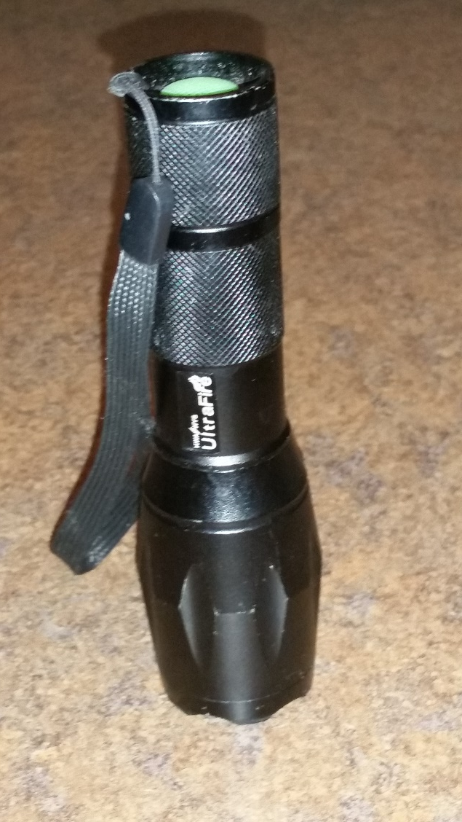
EXTREMELY HIGH INTENSITY FLASHLIGHTS

Slide 36
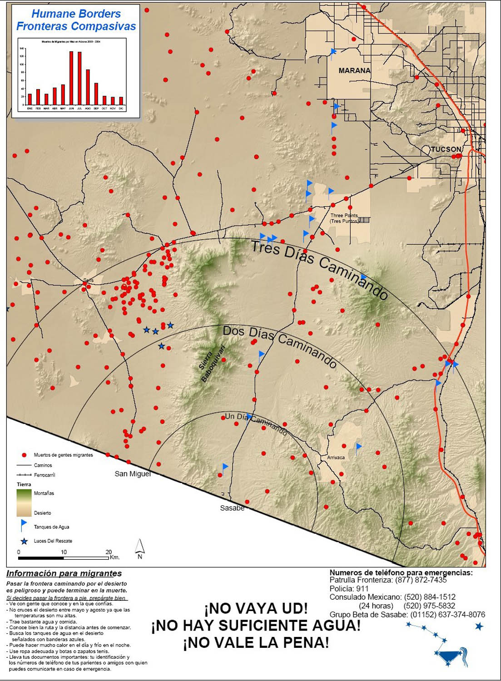
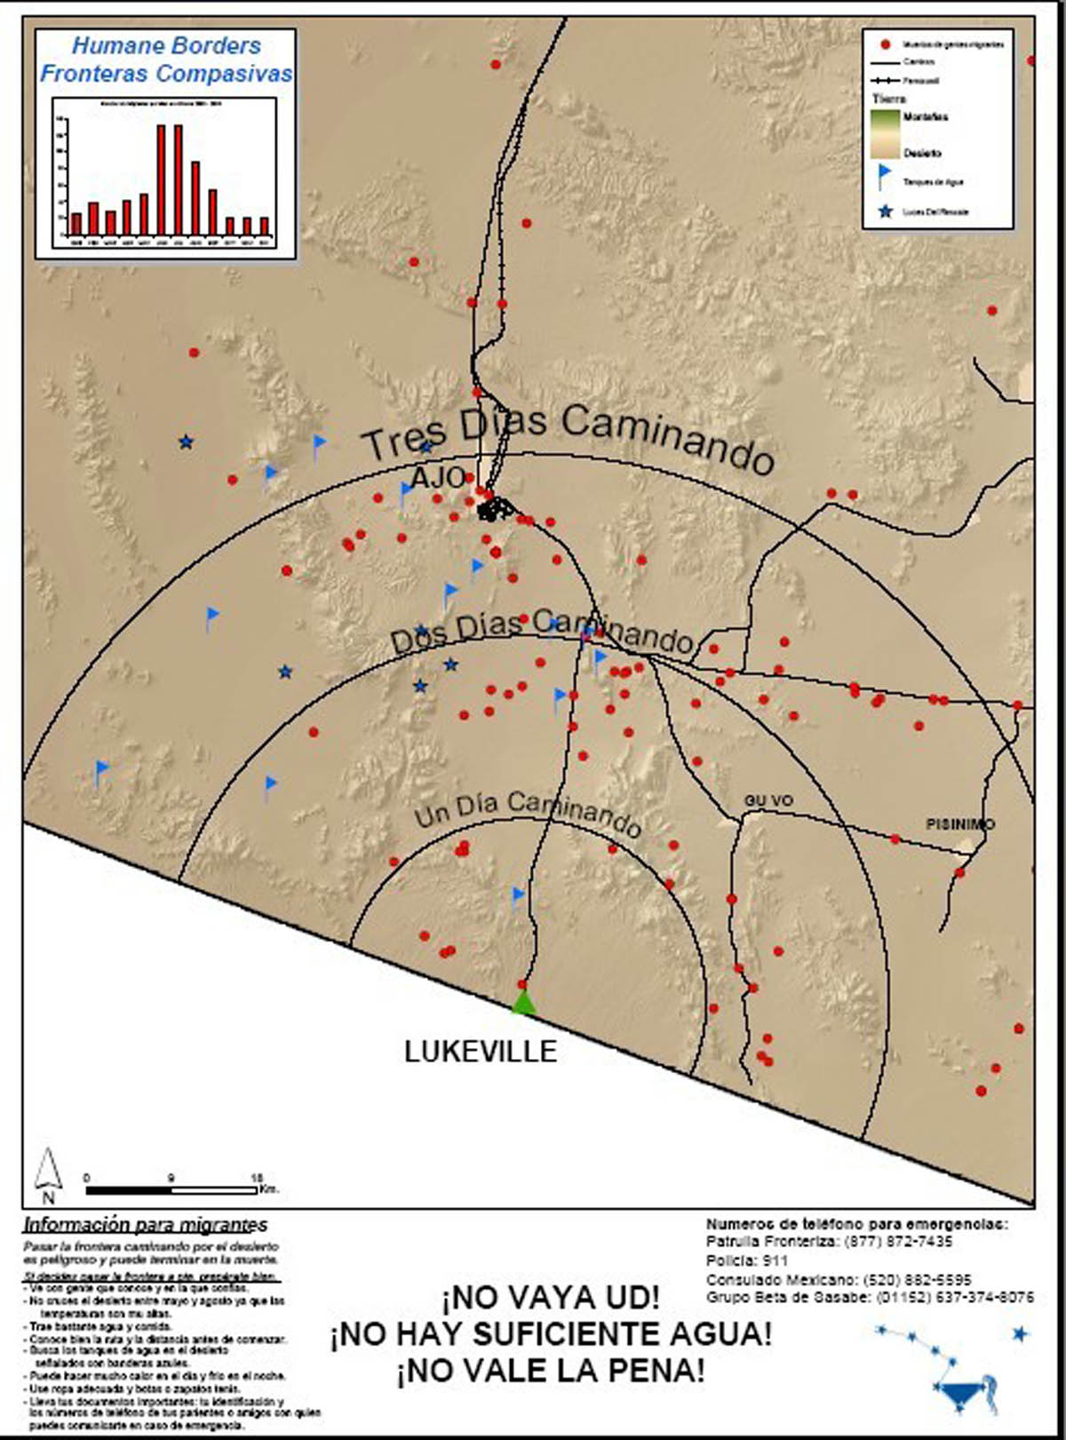
MIGRANTS WARNED OF EXPLICIT DANGER

Slide 37
PEOPLE SUPPORT THESE GOALS:
NATIONAL SECURITY
STABLE/EXPANSIVE LABOR
HUMAN RIGHTS/LIBERTY ISSUES
REDUCED “NOISE” ON THE BORDER
REDUCED VIOLENCE IN MEXICO

Slide 38
PEOPLE DO NOT SUPPORT:
WAR IN OUR CITIES
MASKS AND LACK OF IDENTIFICATION
RANDOM INTERIOR RAIDS
HARASSMENT/ARRESTS/MURDERS OF CITIZENS
DYNAMIC ENTRIES OF HOMES
BREAKING VEHICLE WINDOWS

Slide 39
CURRENT STRATEGIES/EFFECTS:
MAKE IT PHYSICALLY DIFFICULT TO ENTER US
DESTROYS ENVIRONMENT/KILLS MIGRANTS
MAKE IT FISCALLY DIFFICULT TO ENTER US
TRANSFERS WEALTH TO MAFIA/KILLS MIGRANTS
PUSH MIGRANTS TO THE EDGES OF DESERTS
SIMPLY KILLS MIGRANTS
SEPARATE FAMILIES
MILITARIZE BORDERS
COST WAY TOO MUCH MONEY

Slide 40
TACTICS CORRELATED WITH DEATHS:
Fences and Barricades
Surveillance
# Agents
# National Guard Personnel
Drones
Aircraft (especially those with FLIR)
Denouncing Public Efforts to Reduce Deaths

Slide 41
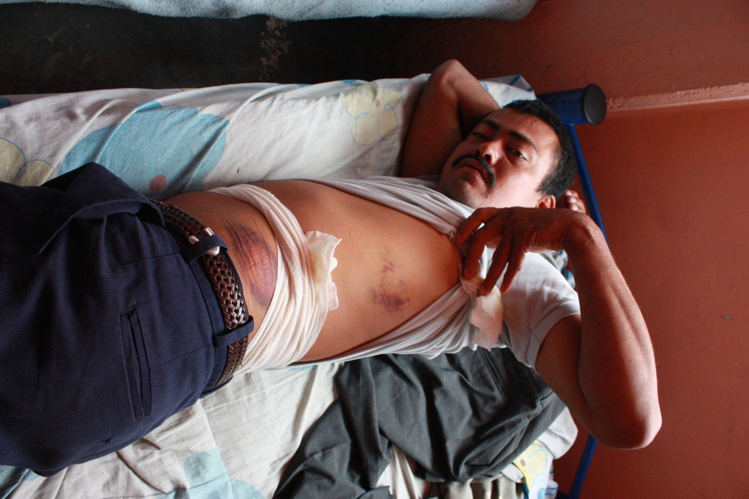
ALL OF THESE THINGS MATTER

Slide 42
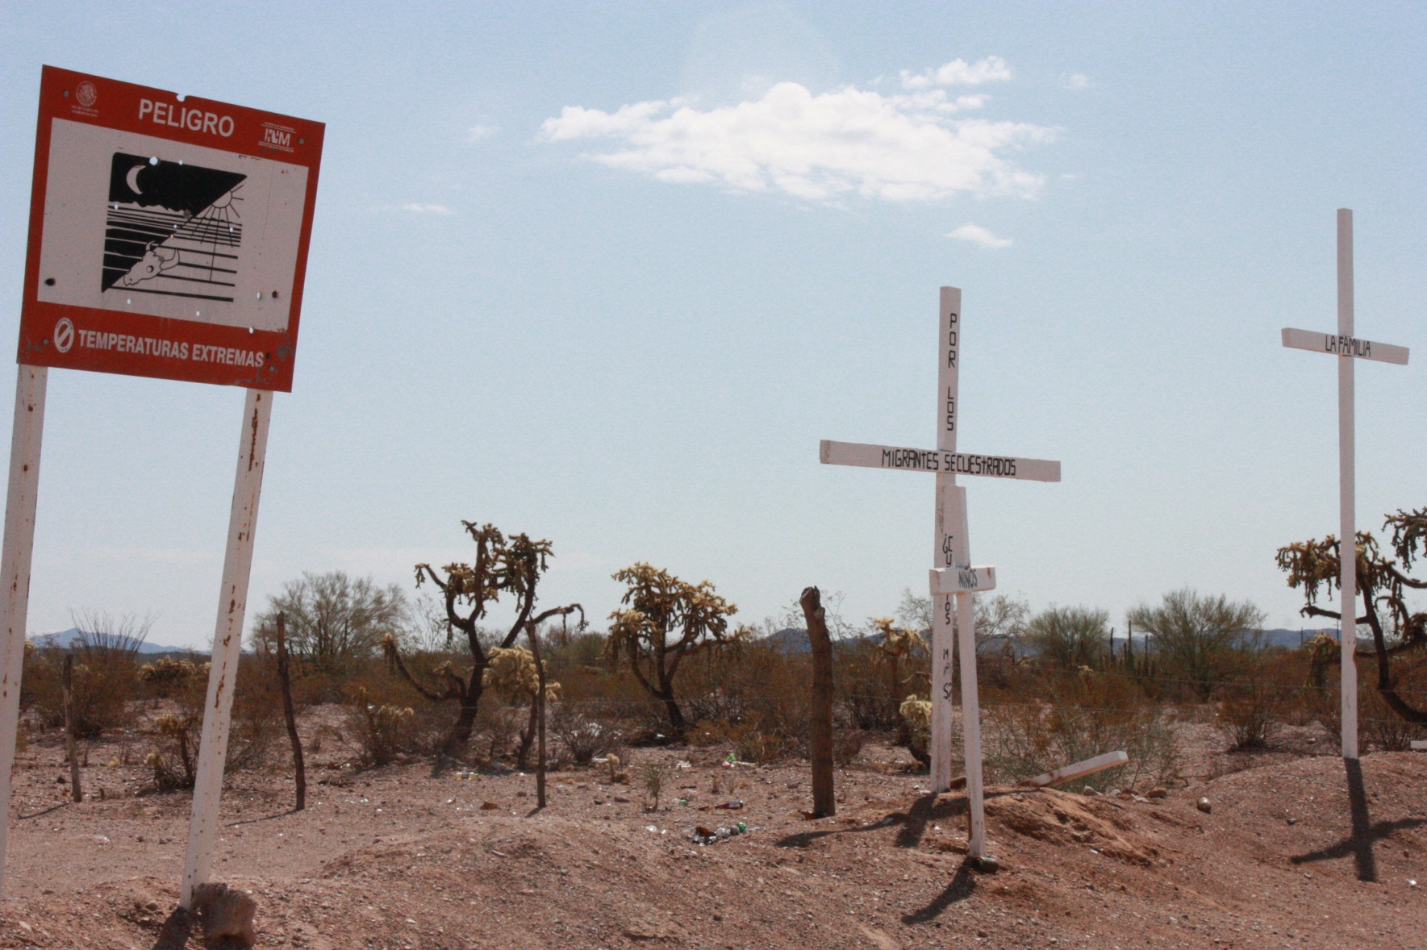
ALL OF THESE THINGS MATTER

Slide 43
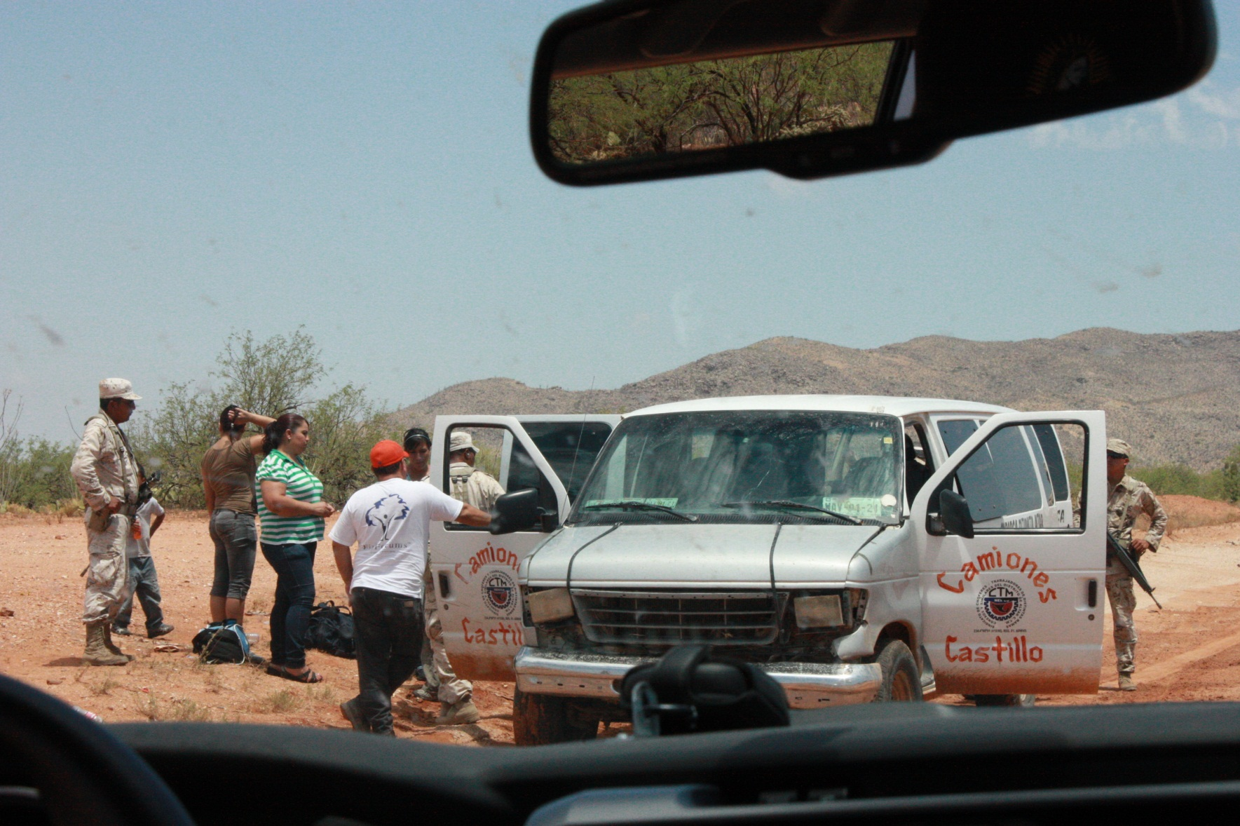
ALL OF THESE THINGS MATTER

Slide 44
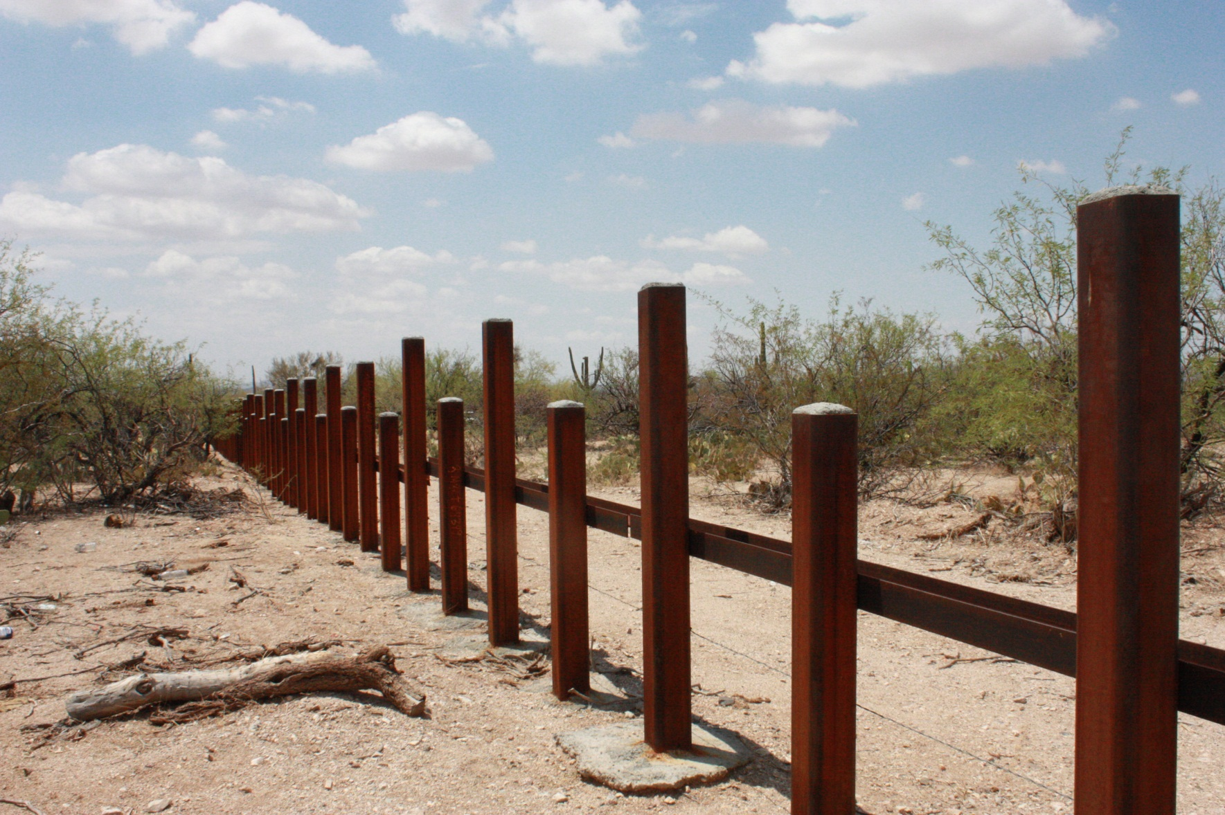
ALL OF THESE THINGS MATTER

Slide 45
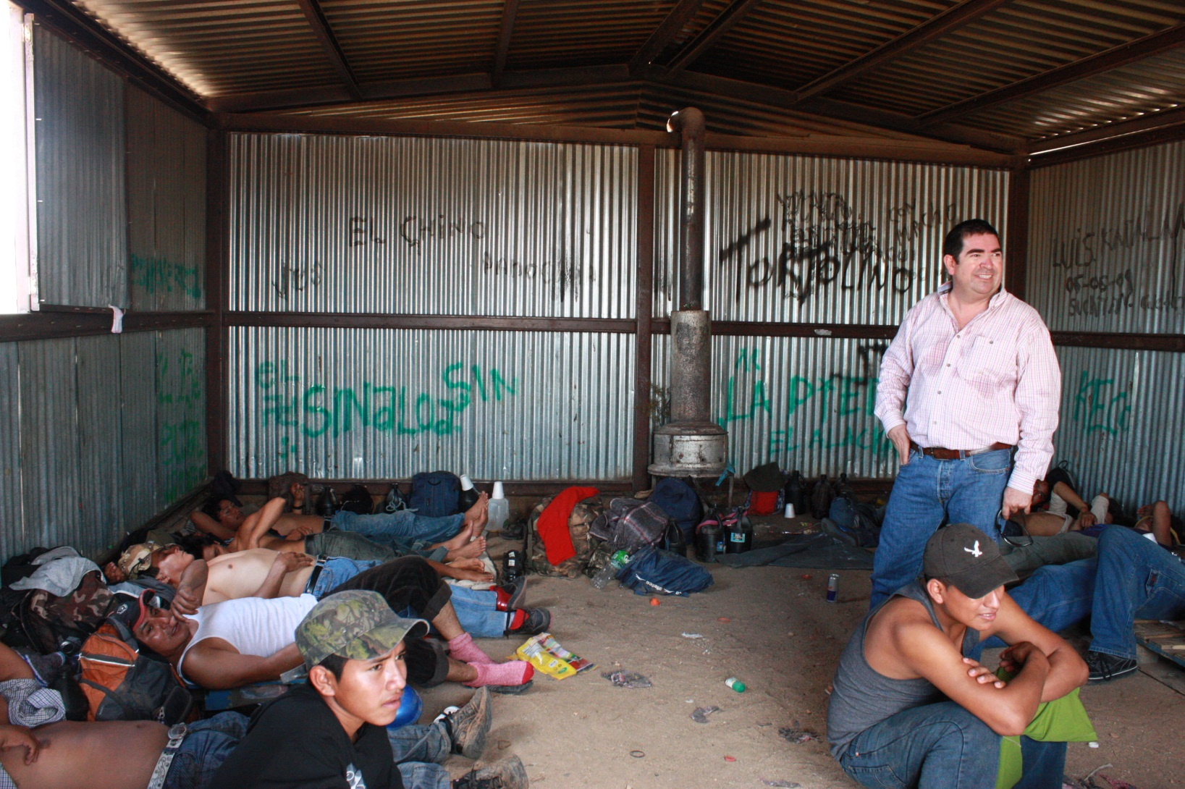
ALL OF THESE THINGS MATTER

Slide 46
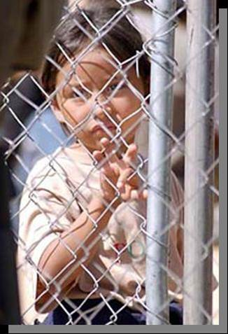
ALL OF THESE THINGS MATTER
TOHONO O’ODHAM NATION OPERATED
DETENTION CENTER
CHILD DETAINED WITH ADULTS IN CAGE WITH BP AGENTS SITTING ON THE OTHER SIDE OF THE WALL IN AIR-CONDITIONED COMFORT

Slide 47
FAITH COMMUNITIES HAVE A WORD TO SPEAK:
My hero is Oded, the original “Good” Samaritan
(2 Chronicles 28)
Jesus and the Parable of the Samaritan
Jesus in Matthew 25:
Food, Water, Clothes, Welcome, Tend to the sick, visit the
imprisoned.
These are also agenda for reform and they go to the kind of people we want to be/become.

Slide 48
GLOBAL THINGS TO DO:
Contribute to groups and agencies
Work on hope: “Hope is the search for the transformation of fear.”
Help take death out of the immigration equation.
Don’t fund wars, economic exploitation, or police state behaviors that influence migration.
Insist we change migration policies here in the US.

Slide 49
“HOOVER PLAN” FOR THOSE ALREADY HERE:
Interview the undocumented
Issue visas for two to twenty years based on case
Change the quota system
Clean up the citizenship line and make it fair
Open the banks and let the migrants stimulate economy
Let the undocumented travel
Let them bring families
Require them to have insurance (auto, health, etc.)
Require them to have all licenses (drivers’)
Require them to pay all taxes

Slide 50
“HOOVER PLAN” FOR WILLING WORKERS:
Sending countries are exempted from worldwide quotas.
Sending countries certify worker eligibility per country quota.
Migrants hold visas, not employers.
Migrants open account with initial $5,000 to $10,000 deposit.
10% of each paycheck is added to the account.
When visa expires, migrant transfers money and goes home.
If not, money is forfeited to law enforcement and become a self-adjudicated felon.

Slide 51
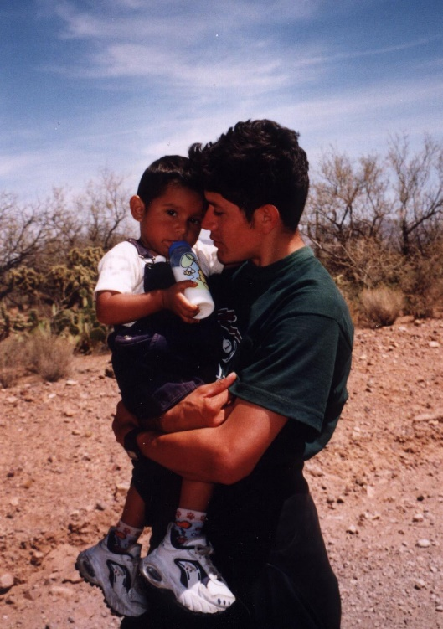
The child’s grandmother, the young man’s mother, had soiled herself and was sitting sobbing, so she is not in the photo. She screamed to me in Spanish, “If I had only known how hard it was going to be, I would never have come. The child is worth the world to me.”

Slide 52
KEEP YOUR POLITICS AND ETHICS SIMPLE
…for I was hungry and you gave me food, I was thirsty and you gave me something to drink, I was a stranger and you welcomed me, I was naked and you gave me clothing, I was sick and you took care of me, I was in prison and you visited me.’
--Matthew 25
"Give me your tired, your poor,
Your huddled masses yearning to breathe free,
The wretched refuse of your teeming shore.
Send these, the homeless, tempest-tost to me,
I lift my lamp beside the golden door!"
--Statue of Liberty

Slide 53
ENFORCEMENT DOES DO SOME THINGS:
It changes where to cross
It changes destinations
It disrupts previous patterns
It makes migrant lives miserable

Slide 54
ENFORCEMENT DOES DO SOME THINGS:
Makes is physically difficult to enter U.S.
Makes it expensive to enter U.S.
Makes it difficult for employers to navigate system
Systematically (purposefully) violates human rights
Results in family separations
Results in hundreds of migrant deaths each year

Slide 55
CURRENT POLICY OUTCOMES
Destruction of border environment
Costs taxpayers huge amounts of money
Transfers billions of dollars to cartels
Raises migrant death rates
Frustrates employers
Requires difficult family decisions
Systematic human rights abuses

Slide 56
“THE SYSTEM” COULD EASILY BE CHANGED:
Adopt new proposals for those living here
Adopt new proposals for those who want to work here
Treat migrants more like Hi-tech workers

Slide 57
WHERE TO BEGIN:
Learn lessons from previous legalization programs
Use existing social science
Use market-oriented incentives
Expect large results by adjusting only a few variables
Focus on the undocumented and the willing workers

Slide 58
FOR THE UNDOCUMENTED:
VET “interview” the undocumented
Issue new visas from two-twenty years based on interviews
Require a new social contract:
  Driver license
  Car and health insurance
Begin naturalization if desired. May be completed in absentia
Allow visa holders to travel, buy cars, homes, start businesses

Slide 59
FOR FUTURE WORKERS:
U.S. Labor Department sets quotas based on economy sectors
Sending countries screen applicants
Open $5,000-$10,000 security accounts
Deduct 10% of wages and add to account each pay period
Account accrues. It belongs to migrant worker.
End of visa: money and migrant go home together
If no compliance: $$ forfeited to law enforcement
Creates first ever economic incentive to comply with visas
Employers would have stable system
DHS can look for bad actors elsewhere

Slide 60
FOR FUTURE WORKERS:
U.S. Labor Department sets quotas based on economy sectors
Sending countries screen applicants
Open $5,000-$10,000 security accounts
Deduct 10% of wages and add to account each pay period
Account accrues. It belongs to migrant worker.
End of visa: money and migrant go home together
If no compliance: $$ forfeited to law enforcement
Creates first ever economic incentive to comply with visas
Employers would have stable system
DHS can look for bad actors elsewhere

Slide 61
WE ACCOMPLISH OUR PRIMARY GOALS
National security
Employment stability
Human rights would be expanded
Costs for enforcement would plummet
Cartel revenues would drop dramatically

Slide 62
SOME RESULTS:
Migrants use public transportation
Migrants and agents don’t tear up the desert
Cartel revenue down
Migrant deaths down
Hospital costs down
Families remain intact
Employers know what to expect
Human rights expand

