Slide 1
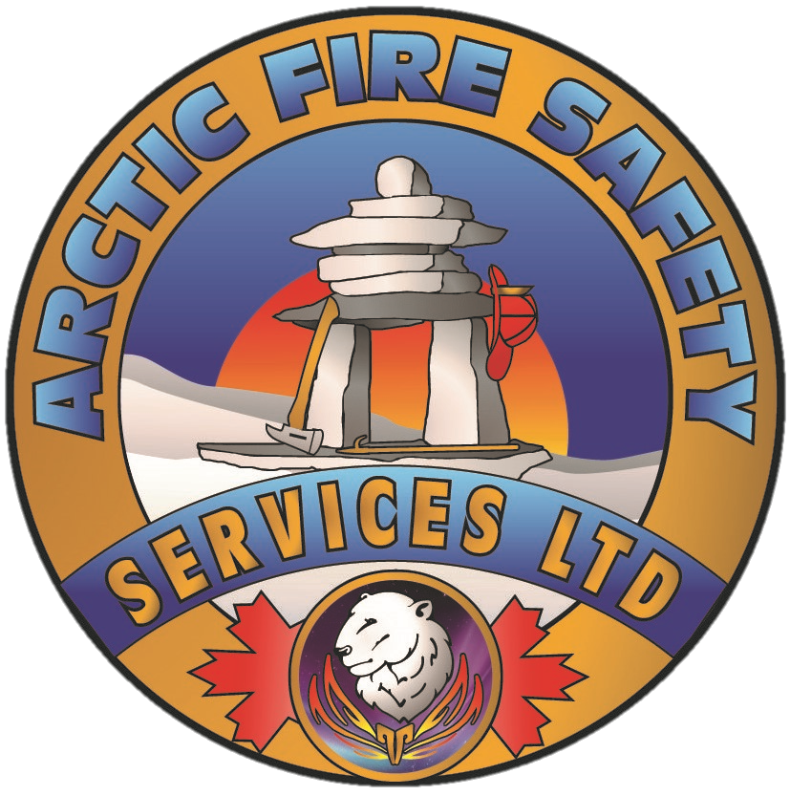
Wildfires
The Threat You Thought You Knew

Slide 2
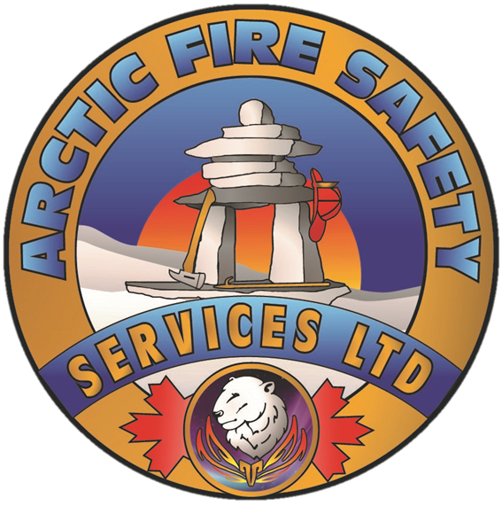
Introductions
Kris Liivam, Arctic Fire Safety Services
Canadian Registered Safety Professional
18 year industrial safety professional
3 Years operating wildfire suppression company

Slide 3
Objectives
Overview of Wildfire Risk
Overview of Alberta Wildfire Legislation
Overview of Fire Smart
Basic Prevention and Response

Slide 4
Radiant Heat vs. Fire Brands

Slide 5
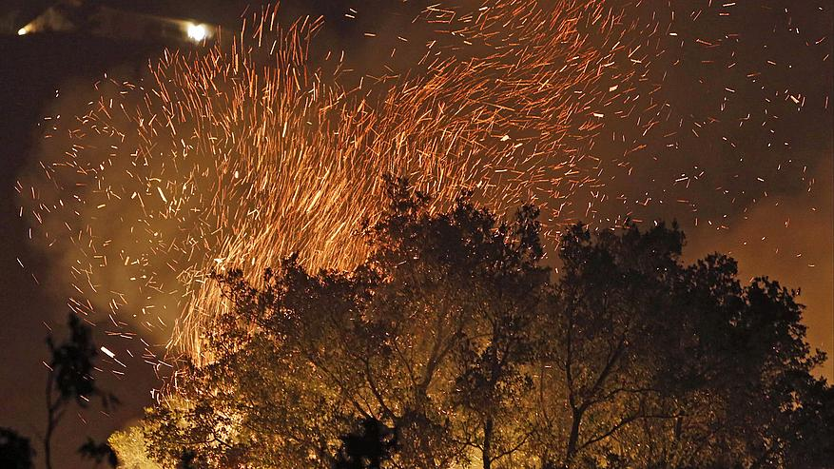
FIRE BRANDS
Can carry enough energy to cause spot fires 6 km ahead of the fire
Caused 85% of home losses in Fort McMurray

Slide 6
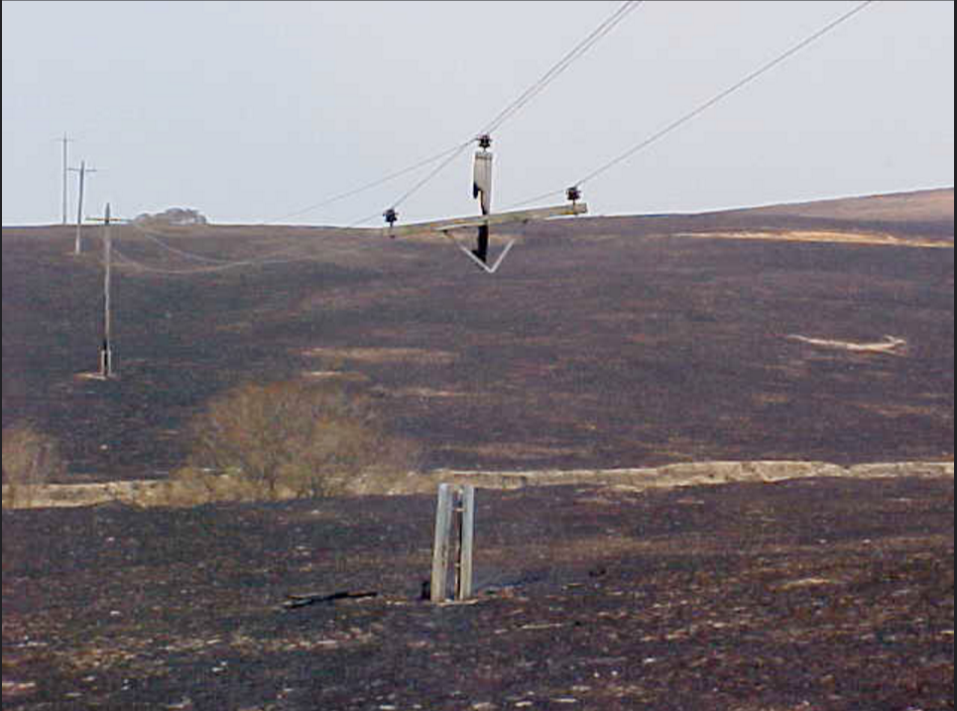
Wildfire Risk
2015-2017 have been devastating wildfire years for Western Canada
Large Scale Evacuations
Largest $ natural disaster in Canada was due to wildfire

Slide 7
Wildfire Risk
Recent large scale evacuations
Fort McMurray
Williams Lake and interior of BC
LaRonge
Waterton

Slide 8
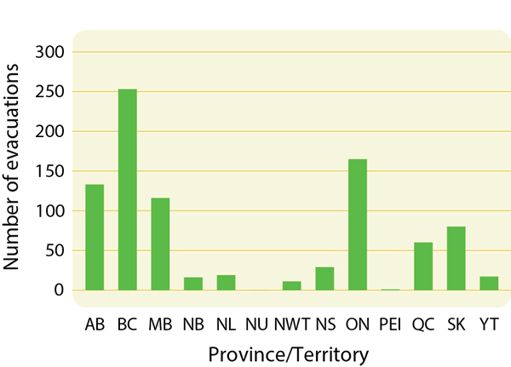
Wildfire Risk
1980-2014 Source: Natural Resources Canada

Slide 9
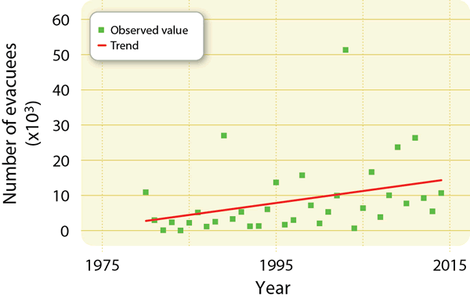
Wildfire Risk
Annual number of evacuees (in thousands) as a result of wildland fires in Canada for the period 1980–2014
Source: Natural Resources Canada
80000
60000

Slide 10
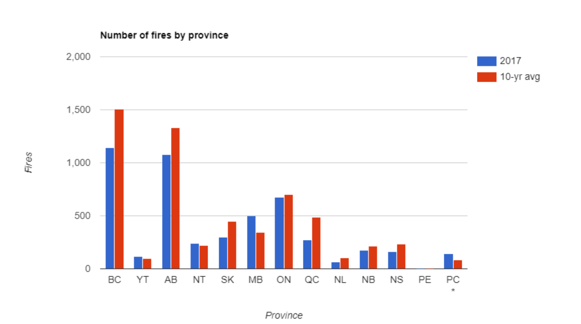
Wildfire Risk

Slide 11
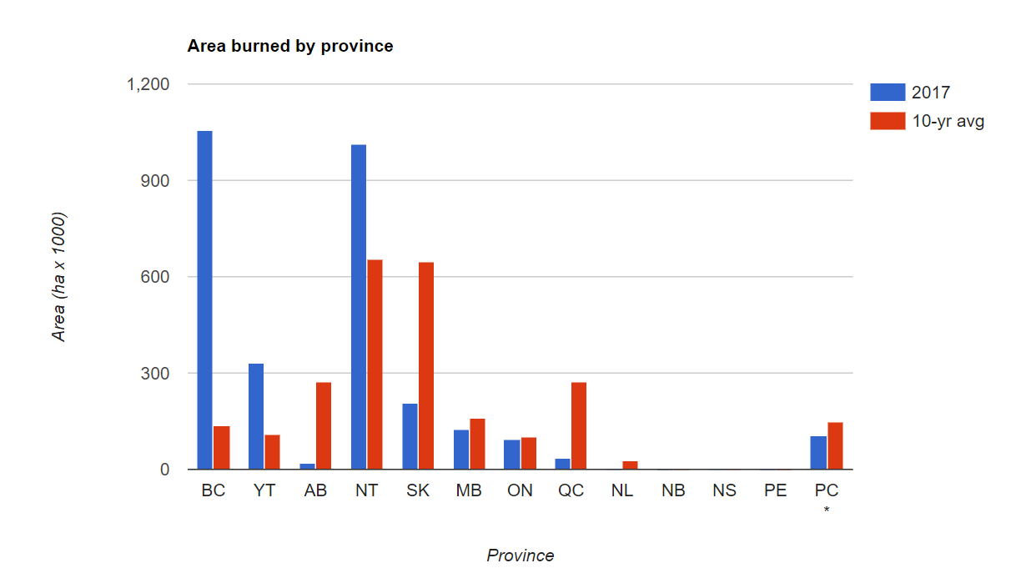
Wildfire Risk

Slide 12
Wildfire Risk
However;
Alberta Wildfire does not record municipal/ county wildfires in its statistics.

Slide 13
Wildfire Laws
Alberta Forest and Prairie Protection Act and Regulations
BC Wildfire Act and Regulations
Sask Wildfire Act and Regulations

Slide 14
Alberta Forest and Prairie Protection Act
In effect from March 1 to Oct 31, unless extended by Minister of AG
Compels all work in Forest Protection Zones to have wildfire measures in place

Slide 15
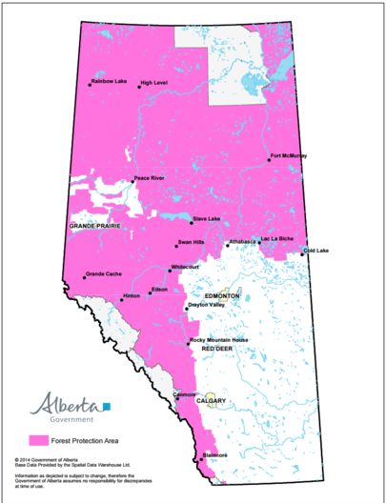

Slide 16
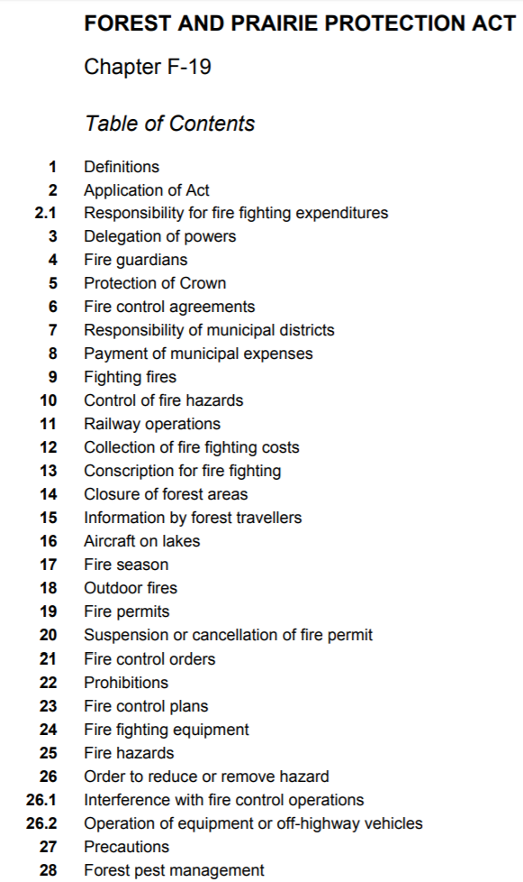
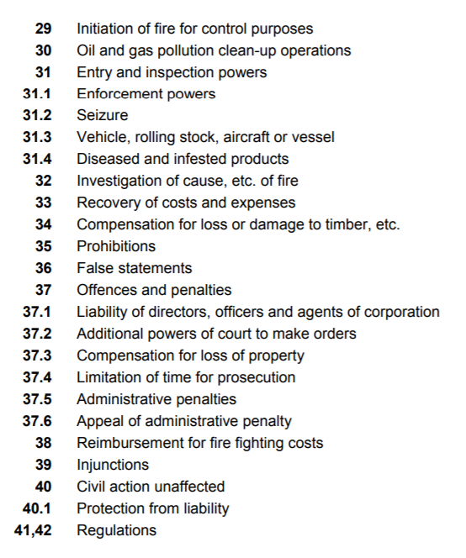

Slide 17
Fines and Liabilities
Up to $100 000 and 2 years incarceration for an individual
Up to $1 000 000 for a corporation
Plus:
Cost of Fire Fighting
Loss of Burnt Timber
Property Damages

Slide 18
Fire Fighting Equipment
Section 24
"A person carrying on or having charge of an industrial or commercial operation in or within one kilometre of any public land shall have on hand fire fighting equipment in accordance with the regulations capable of controlling and suppressing any fire that may occur directly or indirectly as a result of the operation."

Slide 19
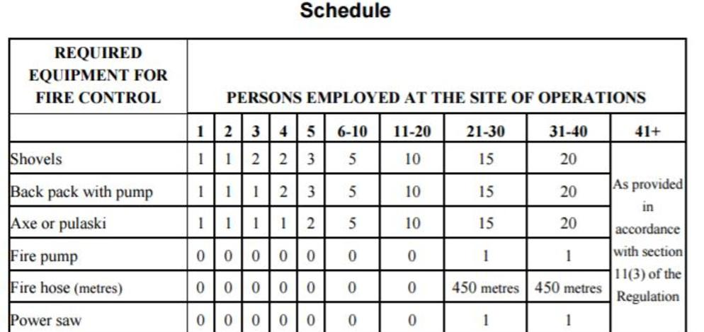
Fire Fighting Equipment
Plus adequate water supplies

Slide 20
Fire Fighting Equipment
Dozers and water trucks can be used to reduce fire fighting equipment on site IF given approval by Forest Officer.
All industrial commercial vehicles working in or within 1 KM Forest Protection Zone must be equipped with a shovel, an axe and a container able to hold at least 5 litres of water.

Slide 21
Fire Fighting
OHS Code Part 7 Emergency Response:
117(2) An employer must ensure that designated rescue and emergency workers are trained in emergency response appropriate to the work site and the potential emergencies identified in the emergency response plan.
(NFPA 1051, Firetak, S-100)
118(1) An employer must provide workers designated under section 117 with personal protective clothing and equipment appropriate to the work site and the potential emergencies identified in the emergency response plan.

Slide 22
Conscription for fire fighting
13(1) A forest officer or a fire guardian may require any able-bodied adult person not exempted by regulations to assist in fighting a fire.
(2) A forest officer or fire guardian may commandeer and authorize payment for the possession or use of any equipment for the purpose of fighting a fire.

Slide 23
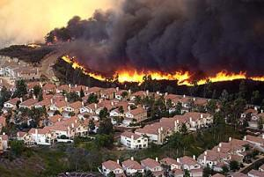
Wildland Urban Interface
Transition from vegetative to other fuel sources

Slide 24
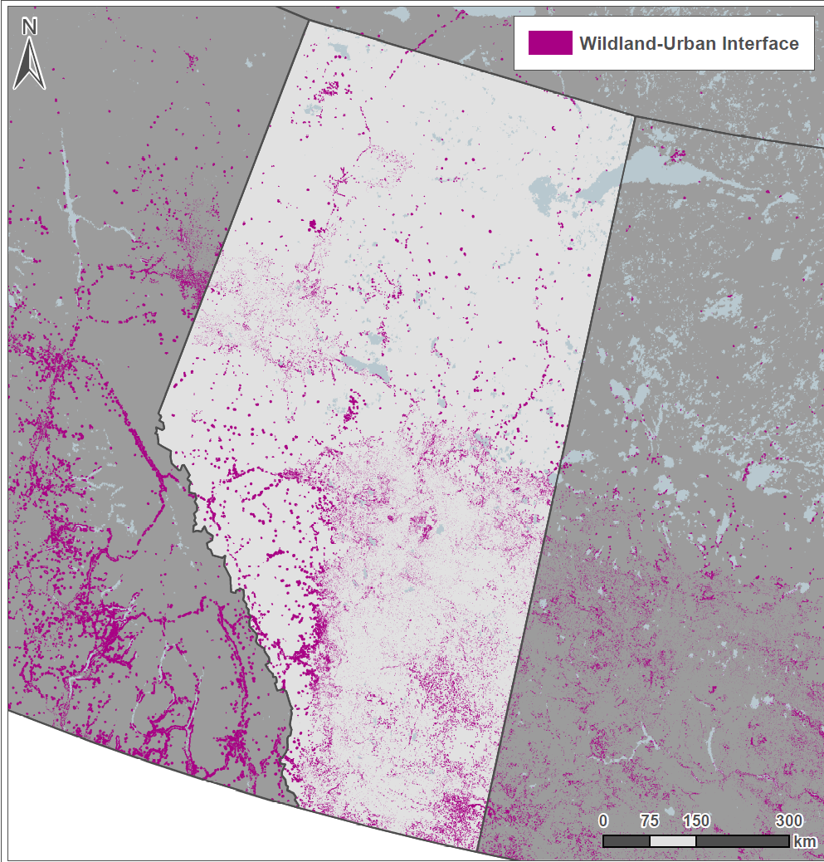
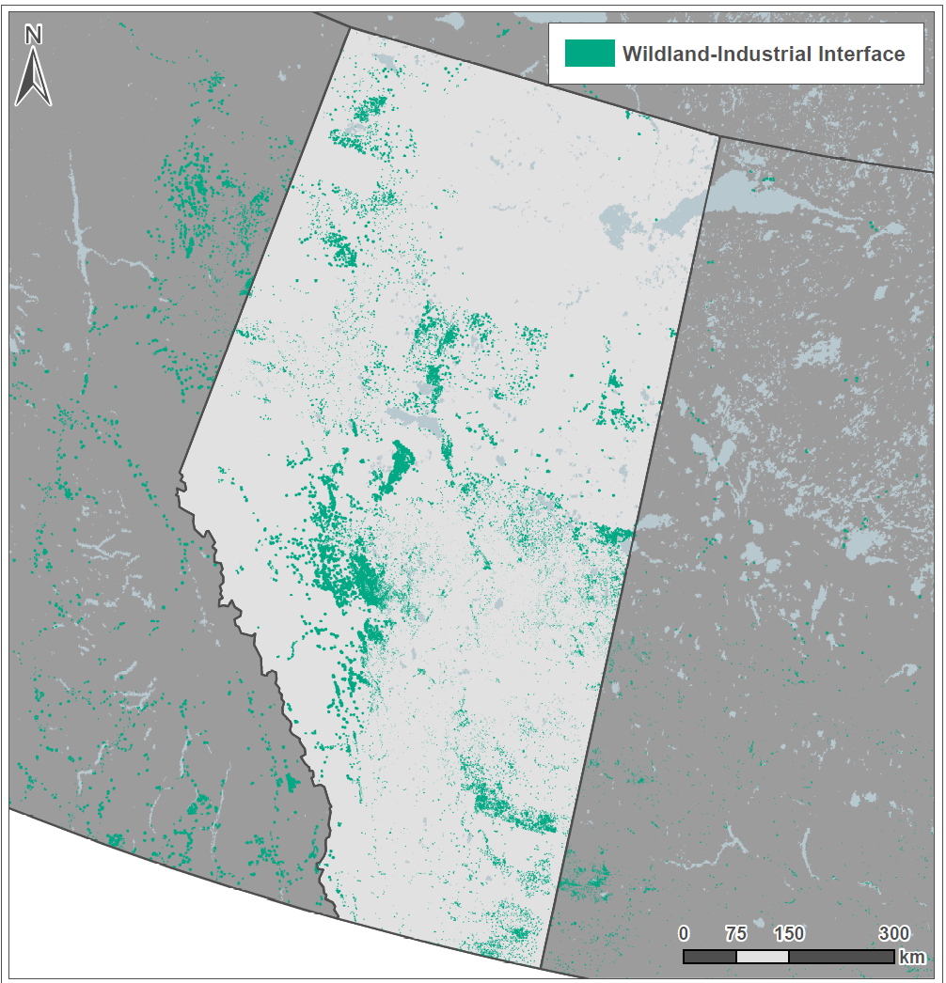
Wildfire Risk

Slide 25
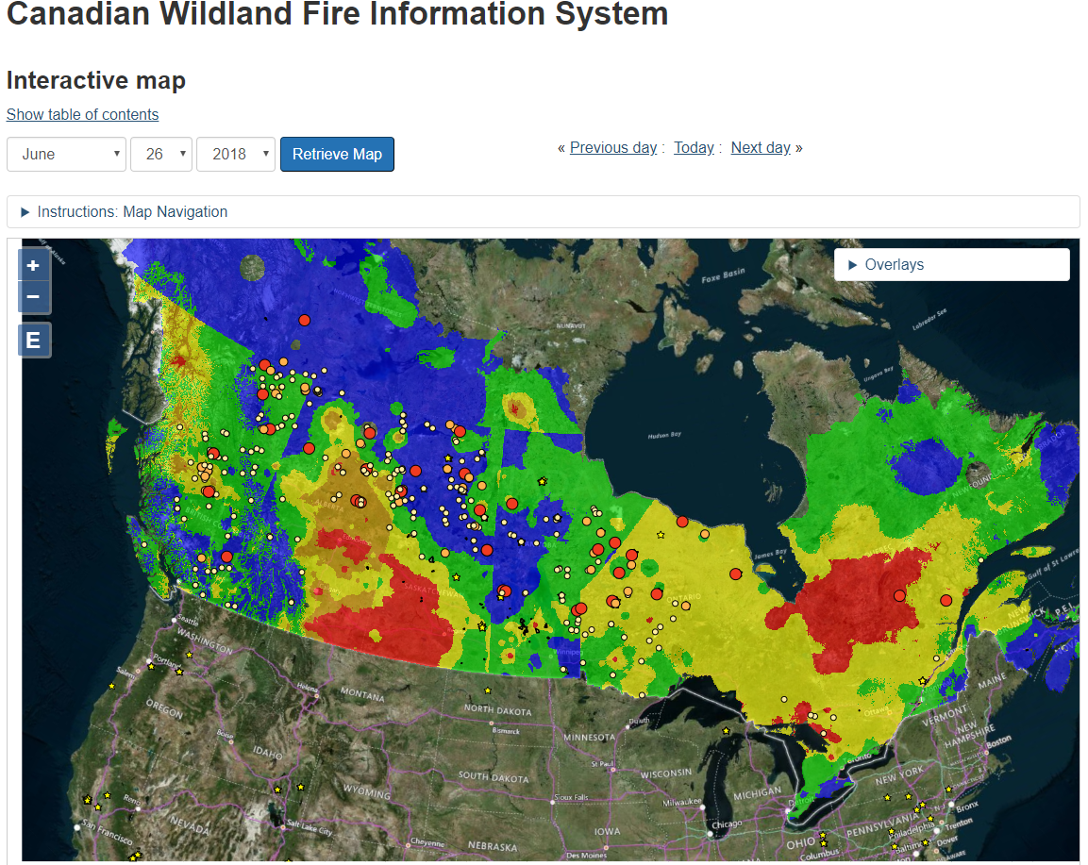
Wildfire Risk
http://cwfis.cfs.nrcan.gc.ca/interactive-map

Slide 26
Wildfire Risk
http://wildfire.alberta.ca/files/firehaz.gif

Slide 27
Wildfire Hazard Identification Tool (WHIT)
Intended to help employers determine if a wildland fire hazard exists near a current or planned worksite that could compromise the health and safety of employees working there if a wildland fire were to affect the area.
https://maps.alberta.ca/WHIT/?TermsOfUseRequired=true&Viewer=WHIT

Slide 28
WHIT

Slide 29
WHIT

Slide 30
FireSmart
What is Fire Smart?
FireSmart is living with and managing for wildfire on our landscape.
Preparing for the threat of wildfire is a shared responsibility. From home owners, to industry and government we all have responsibility to lessen the effects of wildfire.
FireSmart Canada helps you understand the potential of wildfire affecting your home and your community.

Slide 31
FireSmart

Slide 32
Components of the Wildland Urban Interface
Education
Vegetation management
Legislation and planning
Development considerations
Interagency cooperation
Emergency planning
Cross training

Slide 33
Likely Causes of Industrial Wildfires
Smokers
Flare Stacks
Hot Work (welding, cutting, etc.)
Winter burns not fully extinguished
Brush piles not properly monitored

Slide 34
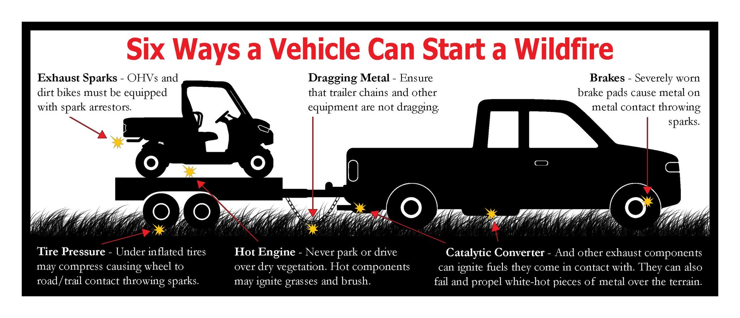
Likely Causes of Industrial Wildfires

Slide 35
Industrial operations in or near forest protection area
(11) An owner or operator of an industrial operation or industrial camp located in or within one kilometre of a forest protection area shall, unless otherwise authorized by a forest officer,
(a) keep the area in which the industrial operation or industrial camp is located clear of all timber, vegetation and combustible material,
(b) maintain a cleared distance of not less than 30 metres between the industrial operation or industrial camp and the closest standing timber, and
(c) maintain a clear, bare mineral soil surface extending at least 8 metres around any burner, pit or other source of fire.
Forest and Prairie Protection Regulation

Slide 36
Flare Pits and Tanks
13 No person shall burn any material or substance produced from an oil or gas well in a flare pit or flare tank unless
(a) an area extending at least 30 metres around the flare pit or flare tank is clear of all debris and combustible material, unless otherwise specified by a forest officer,
(b) there is a clear, bare mineral soil surface extending at least 8 metres around the flare pit or flare tank,
14 No person shall flare gas at the end of a vertical pipe unless the base of the vertical pipe is located at least 30 metres, or such other distance as may be specified by a forest officer, from any timber, vegetation or combustible material.

Slide 37
Pipelines
15(2) The licensee of a pipeline or an installation that is endangered by a fire shall, as soon as the licensee knows or ought to know of the fire, unless otherwise approved by the Minister
immediately shut off every well supplying the pipeline,
(b) immediately depressurize every pipeline located within one kilometre of the fire, and
(c) notify the Minister in writing when the licensee has complied with the requirements of clauses (a) and (b).
(3) A licensee who is required to comply with subsection (2) shall not repressurize the pipeline until the licensee is notified in writing by the Minister that the licensee may do so.

Slide 38
Industrial Wildfire Control Plan
Mandatory requirement under the Forest and Prairie Protection Act.
IWCPs are required from all companies operating within 1 km of public land from March 1 to November 30.
Intent is to provide information to Agriculture and Forestry as to where your employees are working full time and emergency equipment caches.

Slide 39
Response
Know your fire risk hazards
Have necessary response equipment available
Have adequate size of trained responders

Slide 40
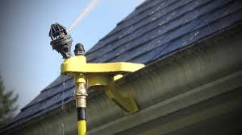
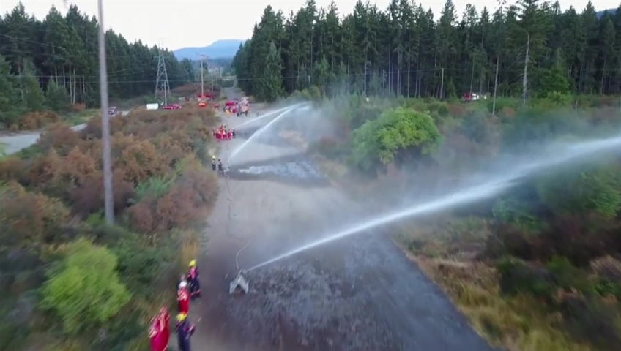
Tactics
Sprinklers

Slide 41
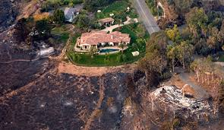
Tactics
Gels and Retardants

Slide 42
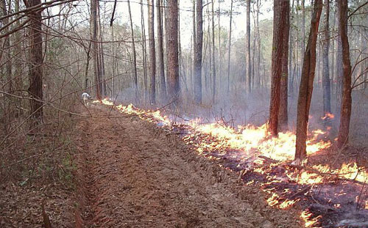
Fire Breaks

Slide 43
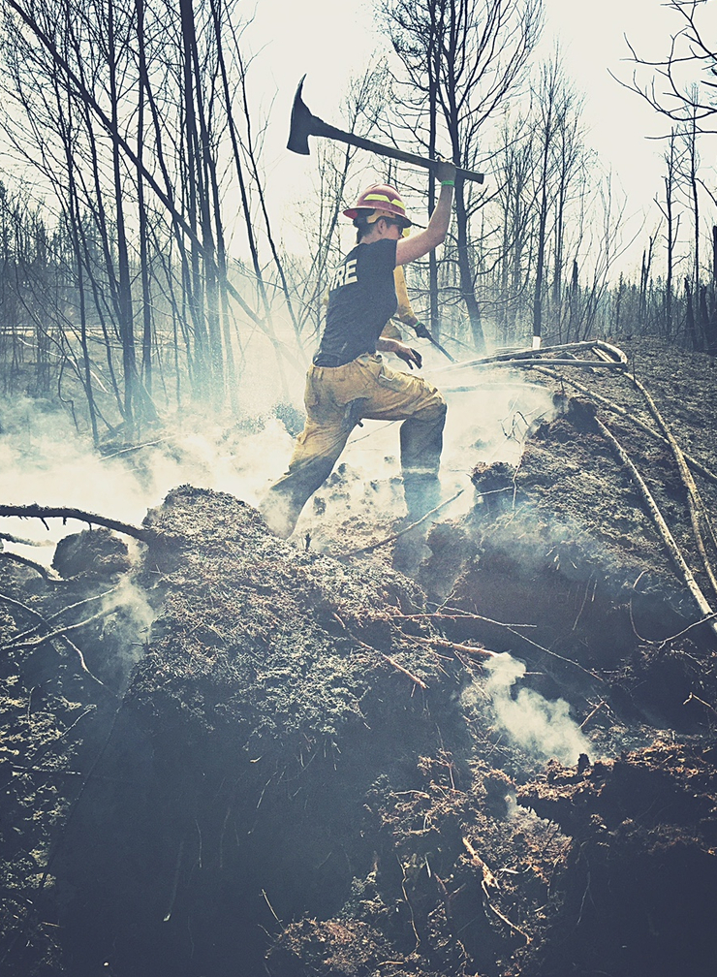
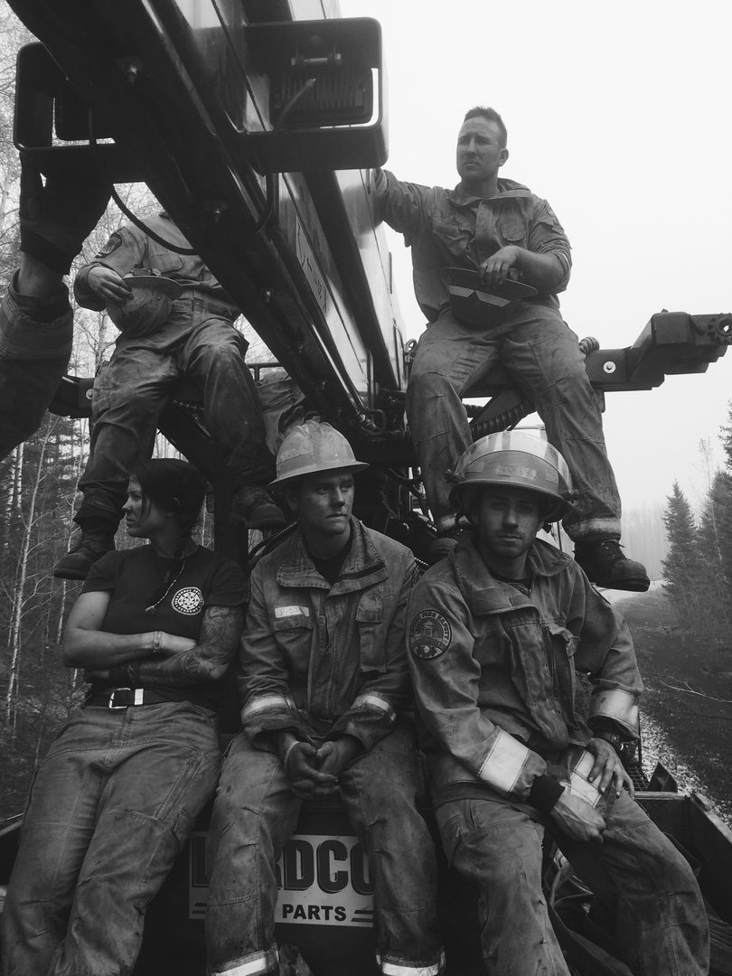
Response
Fire Fighting Contractors

Slide 44
Safeguard Water Curtain
https://www.facebook.com/697474123761081/videos/831214423720383/

Slide 45
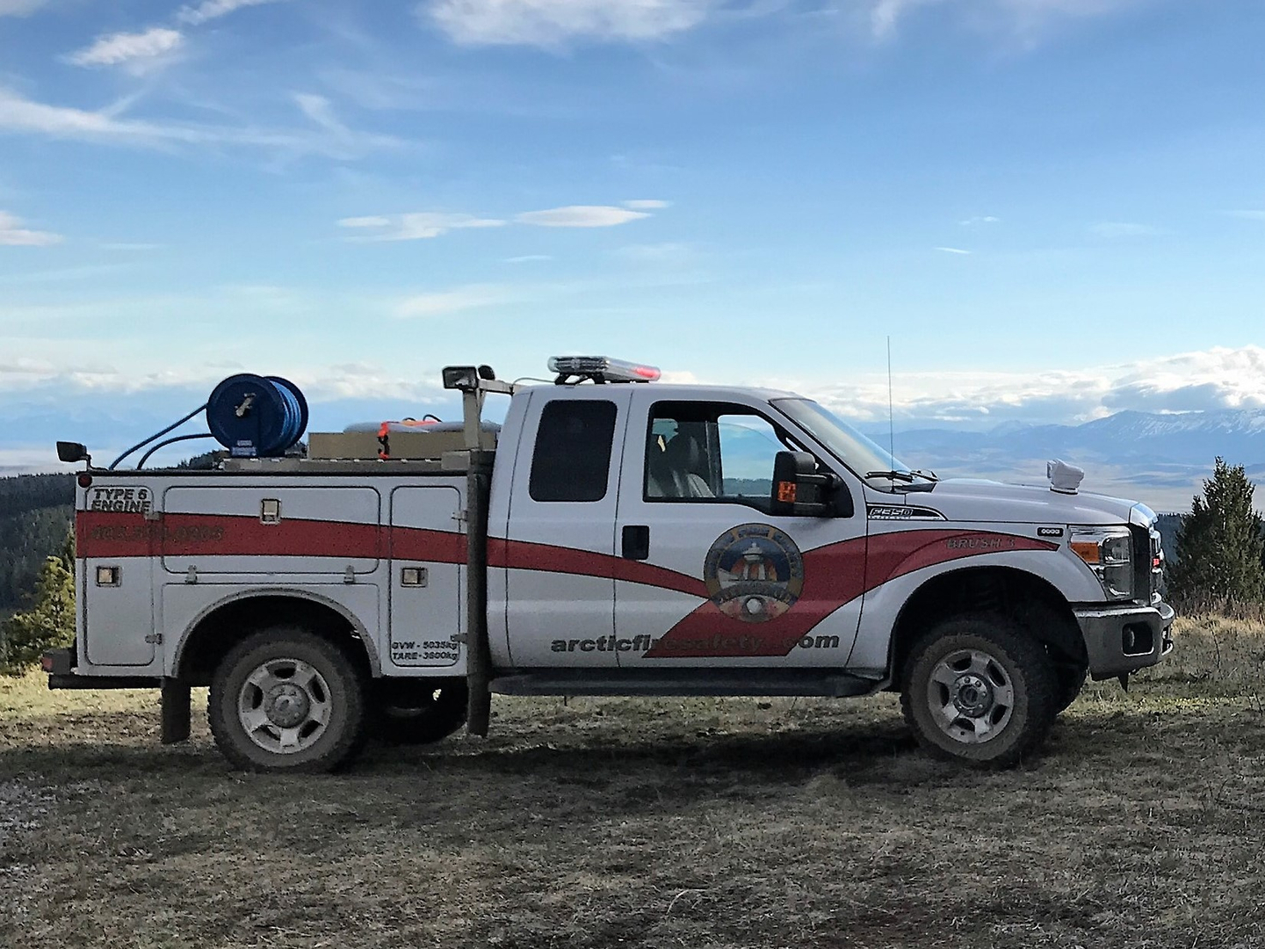
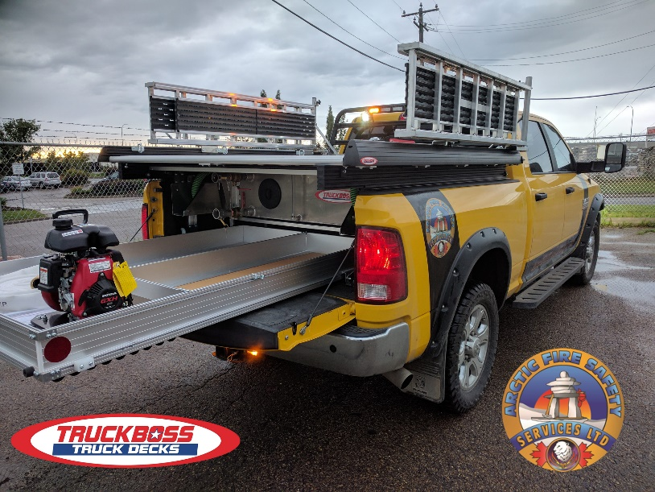
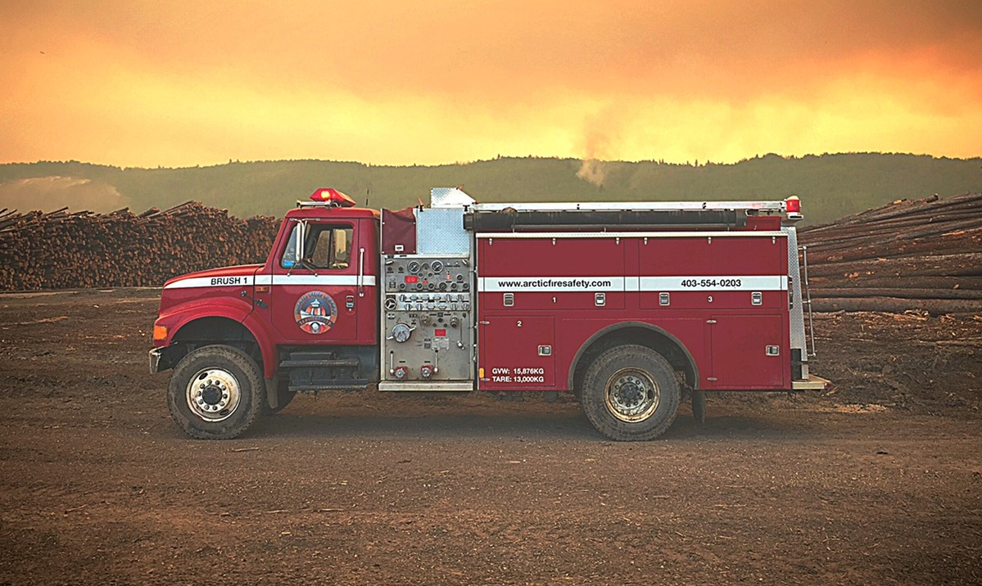
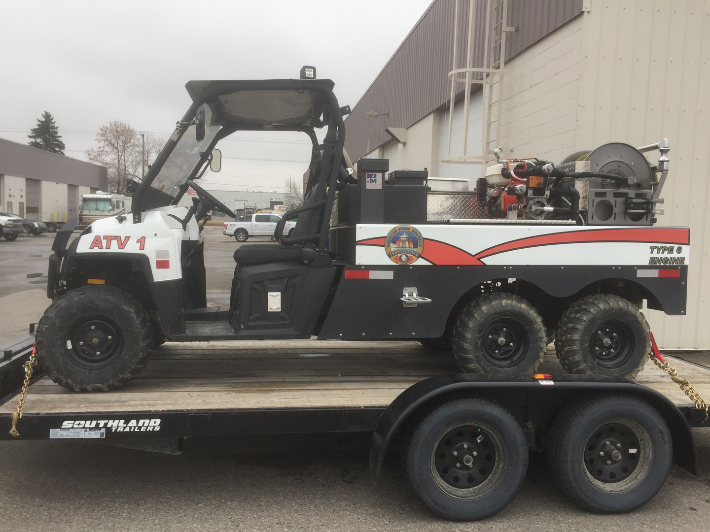
Arctic Fire Safety “why wait for 911?”

