Slide 1

AVIS RESEARCH & CONSULTANCY LLP
(ARC)

Slide 2

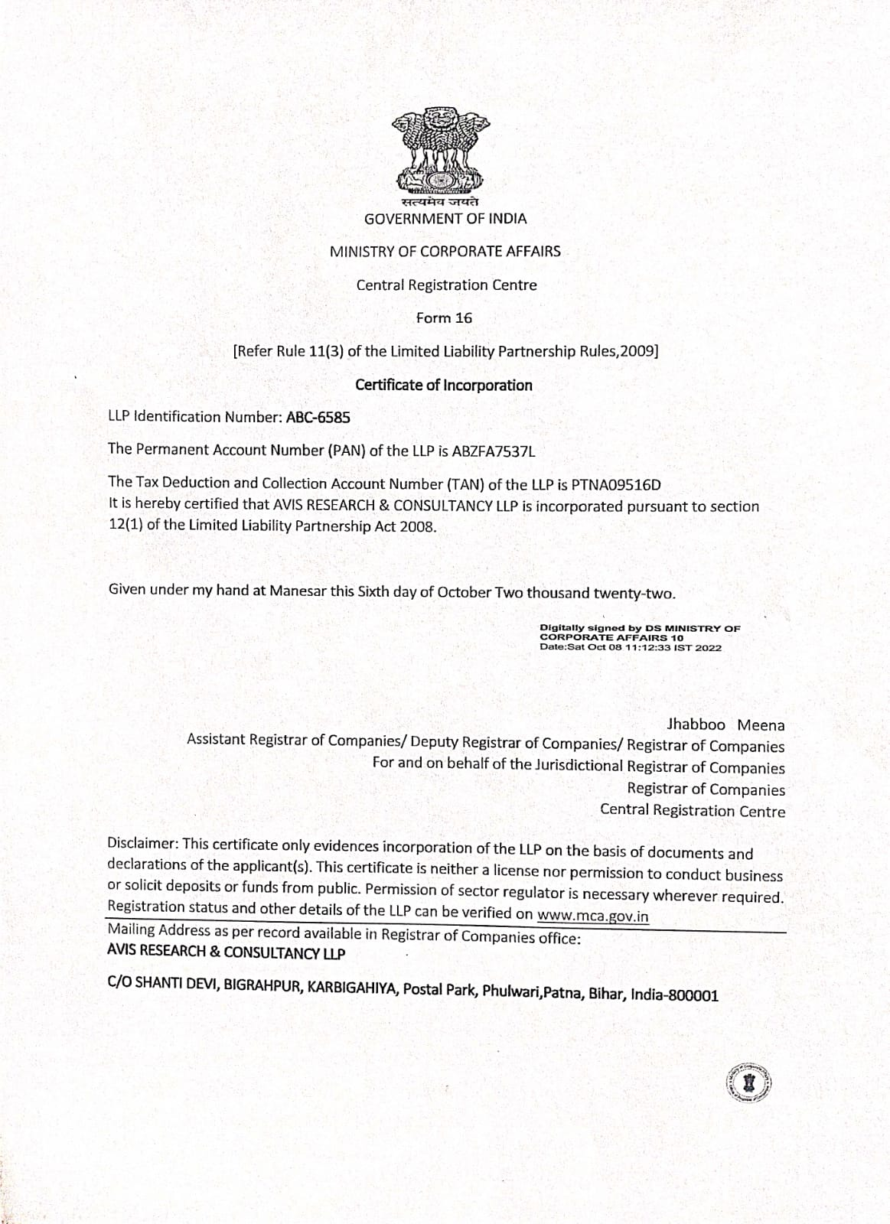
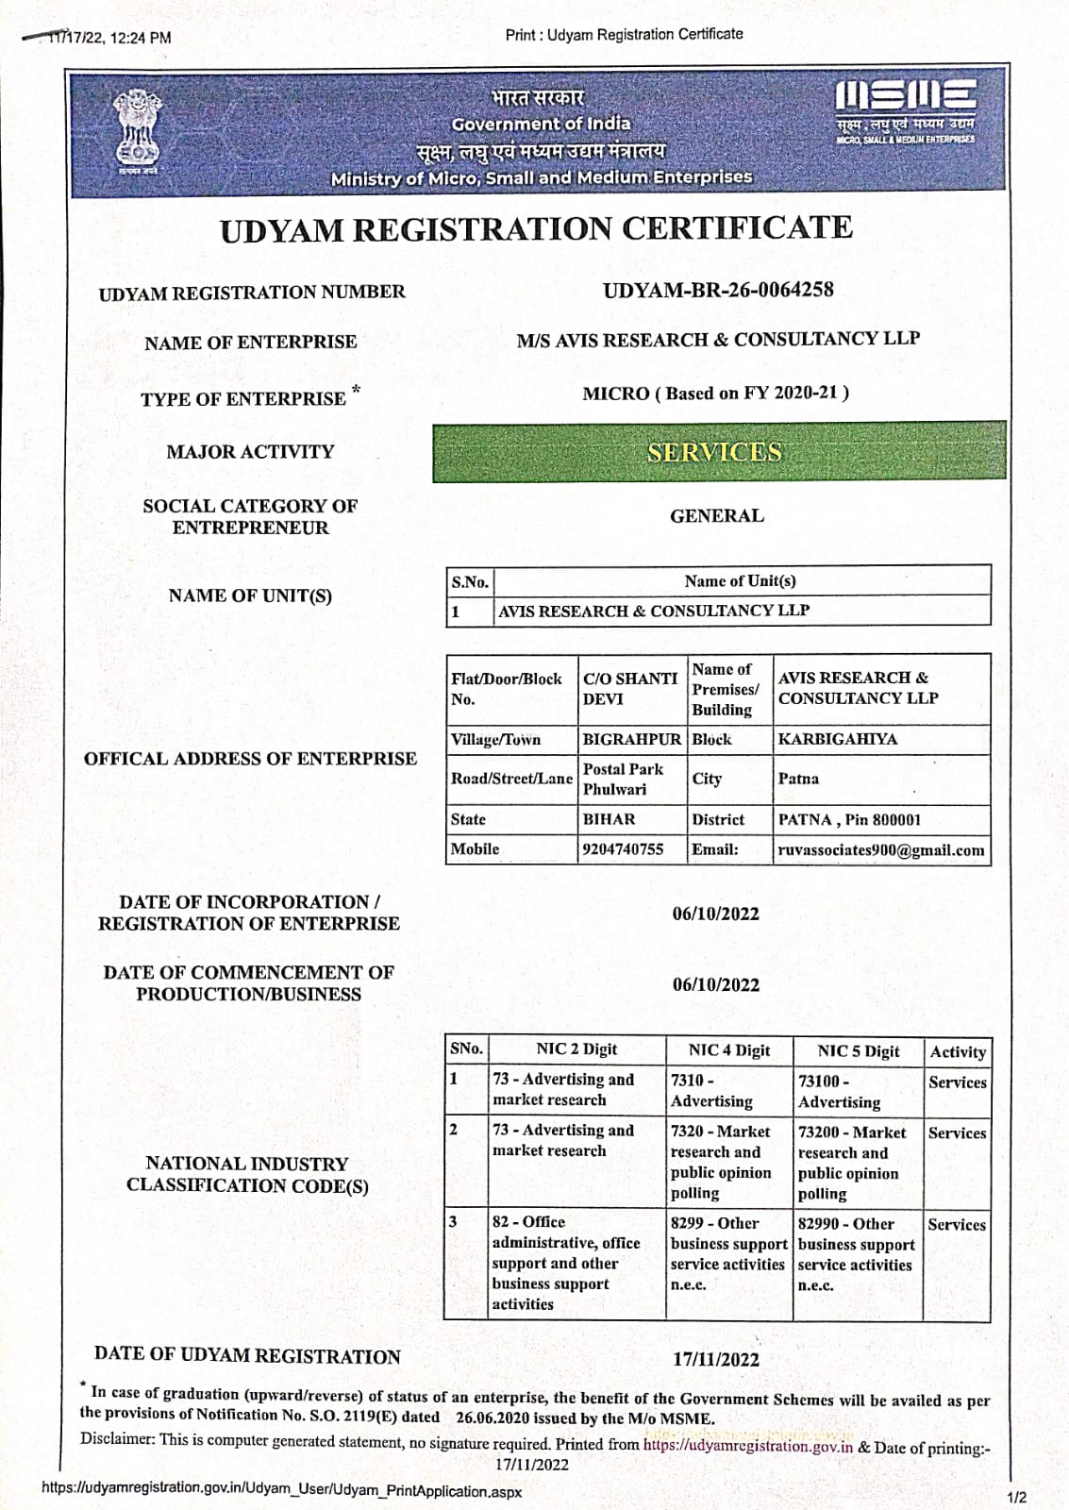
Certificate of Company

Slide 3
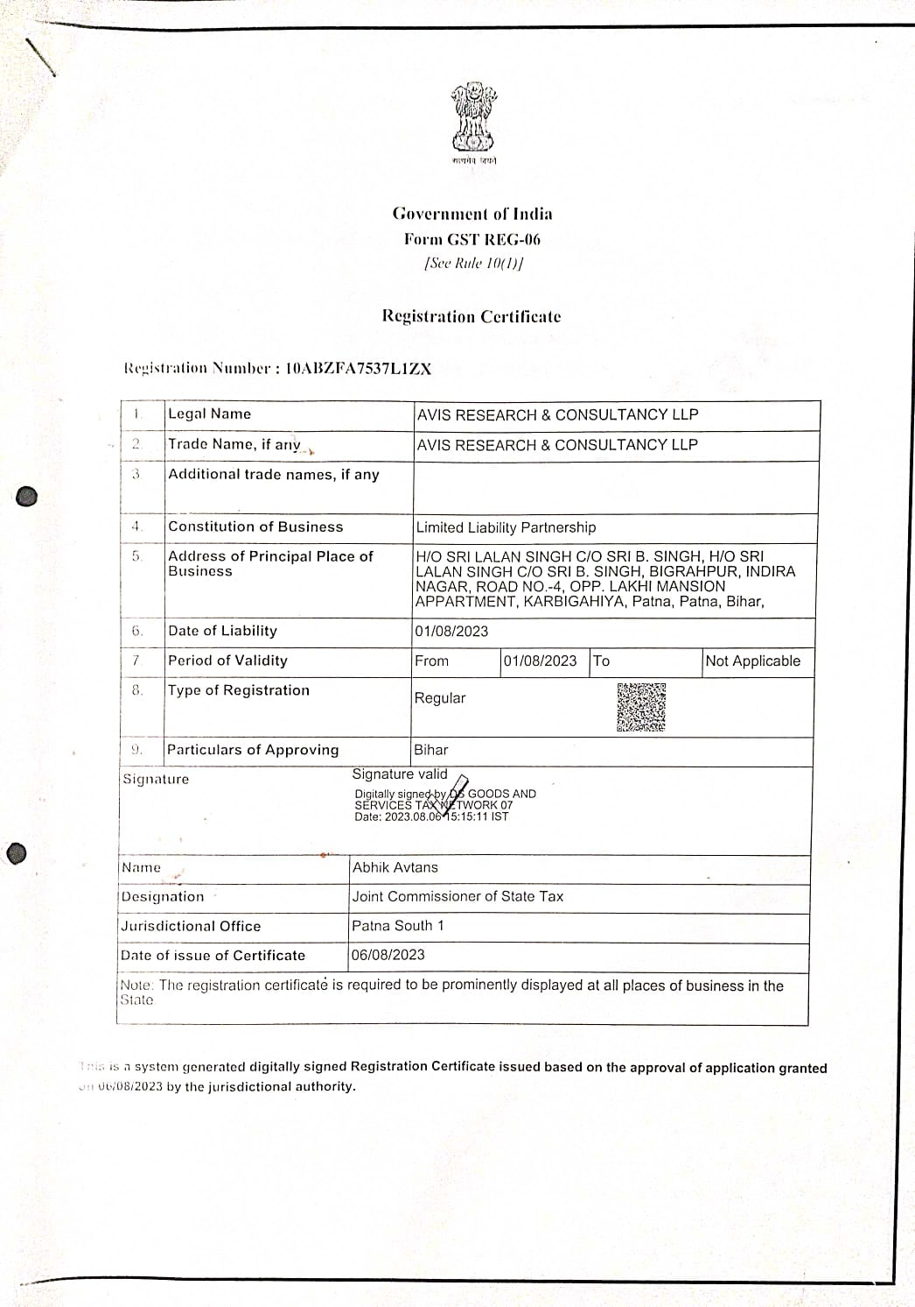
GST Certificate of Company

Slide 4

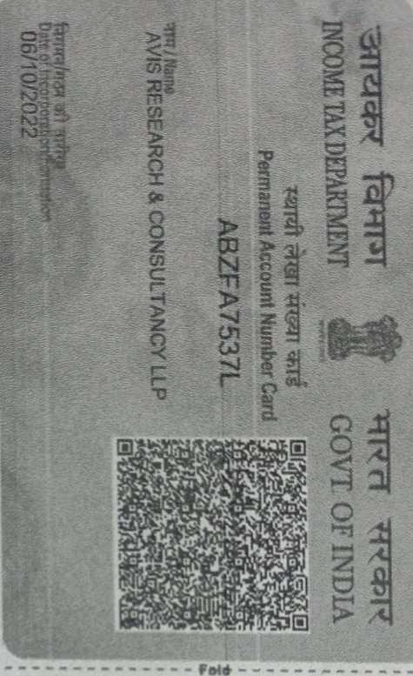
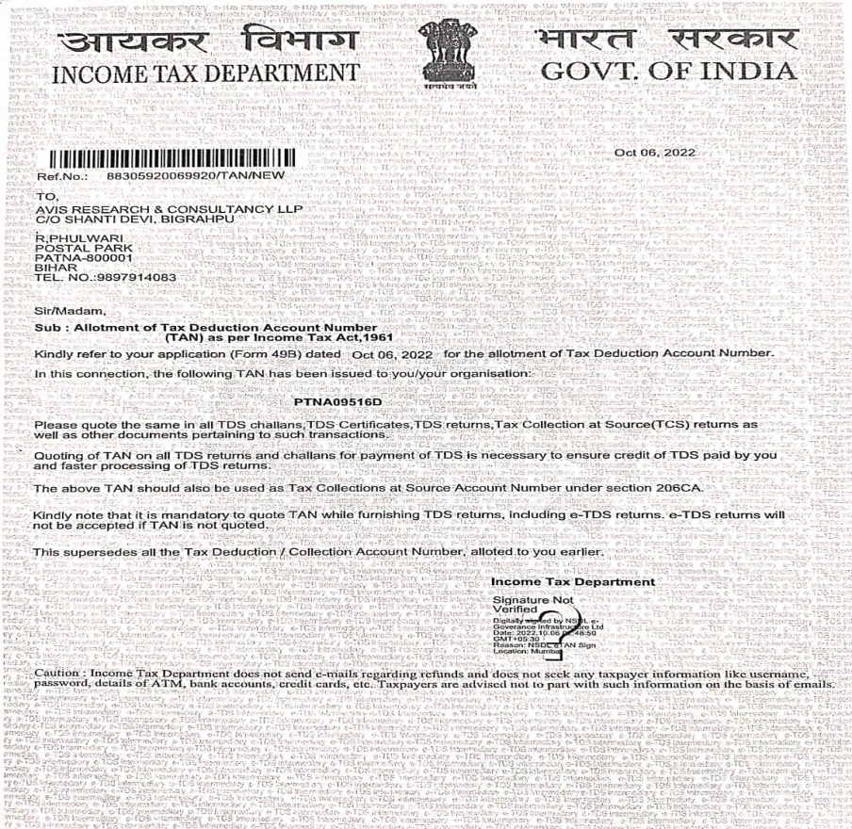
PAN & TAN Certificate of Company

Slide 5

Introduction: Our Ideology
    ARC strongly believes in innovating new ideas leading to a new operational process and services. We believe that innovation can generate new values and also can bring significant better changes in the society.
    At ARC we have a highly experienced team, who are dedicated to driving success through innovation strategy in the field of market research. We thoroughly examine each of the research project to identify the best suitable innovative strategies and techniques for data acquisition, data analysis and report to demonstrate a true commercial advantage.
    ARC believes in promises. Promise of delivering faster and authentic data for each project execution. Enabling our clients with superior business insights within tight timelines of today’s highly dynamic market.

Slide 6

ARC Advantage
ARC quality philosophy focuses on continuous improvement despite practicing the rigorous quality process at each stage of field execution so as to provide the best results.
    ARC firmly believes that hiring the best talent and robust people practices are the key to creating client delight and providing best in class services.
    ARC offers its expert services for undertaking fieldwork and use scientific methods and tools for data collection – personal / face to face interviews, in-depth interviews, focus group discussion, central location test, participatory method, product test, pack test, trade survey, industrial research, corporate image studies, and covering all type of products and services.
    ARC maintains a panel of well trained and experienced interviewers and team leaders with excellent achievement record in field investigation, data collection and have conducted interviews / promotional activities in any type of acceptable situation.
    Pan-India field presence with industry specific executives experienced and competent of initiating projects in absolutely all industrial verticals including automotive, retail, health, media, education, IT, agriculture, electronics
    We know the value of data and every efforts have been made to collect the quality data

Slide 7

Our Mission
Our mission though, to provide clients with the right information at the right time from the right place and at the right price. No matter that how big or small project we offer the highest possible quality of services to the best of our efforts to ensure an output that is conducive to client growth.
We not only want to be recognized only for providing highest quality data, but also want to work alongside with you as a business partner. Our aim is to always provide you with fair pricing consistent quality all the way.
Our double digit growth over the past years is the result of satisfying the needs of a very demanding client base & high rate of repeat business.
Our singular focus has always been to ensure that our clients keep up the belief in market research investment, and the fact that it will ultimately pay off, in terms of sales and long term brand health.

Slide 8

Data collection
Information Type
Primary
Quantitative
Qualitative
Secondary
Web based Data
Face to Face PAPI
Face to Face CAPI
CATI
Focus Group Discussion
In-depth Interview
Published Data
Journal and Publications
The quality of data collection has a direct impact on the quality of analysis & hypothesis which ultimately impacts the decision making for clients
Bad data lead to more complex, less powerful and invalid analysis
Therefore we at ARC pay much attention to the data acquisition process in training of data acquisition team
We check at the end of t he training whether all the interviewers and supervisors are on common understanding for each of the question of the research tool or not
Debriefing session is organized and those who have not attained a good understanding are excluded from the data acquisition
Disciplined and targeted approach of data acquisition for each of the project:
Step 1- Types of data to be gathered for the study
Step 2- To evaluate the problem to be encountered in data acquisition
Step 3- Plan data acquisition as per the project objectives
Step 4- Quality assurance, progress report frequencies
Step 5- Cleaning and analysis of collected data (Parallel activity)
Some projects involve combination of qualitative and quantitative methodologies

Slide 9
Our Capabilities
Quantitative Research
PAPI/CATI/TAPI / Online / Offline
Face 2 Face
Telephonic
Exit Interviews
Outlet Visits
Mystery Audit
Data Cleaning, etc.
Qualitative Research
FGD/ MGD / Online / Offline
IDI
CLT
Moderation
Transcription
Case Study, etc.
Social Research
Face 2 Face
IDI /FGD/MGD
@ We are able to all types of projects for commercial and social..

Slide 10

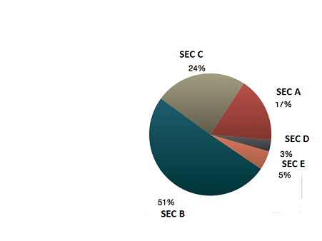
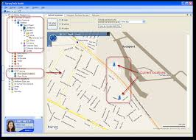
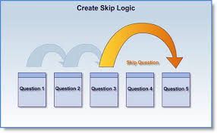
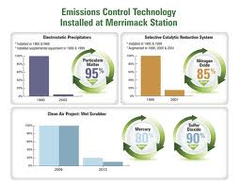
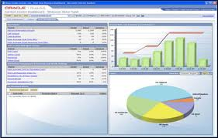
Technology- CAPI Capabilities
Tracking interviewer movement
Online quota management
Monitoring the logic flow
Monitoring progress report online and access to client too
Dash board if client needs

Slide 11


Flow Chart – Scripting till data delivery
Scripting done for all scenarios. Script linked to data / quota monitoring formats
Detailed activity calendar worked out. All quotas / scenarios built into the electronic calendar
This calendar, along with the script, is then loaded on server, to be used for data capture
Audio listening and back check after interview done followed by data delivery
GPS and quota monitoring
Activity begins. The online calendar allows tight control on quota and data on a daily basis.
Selected Interviewer profile is briefed and trained.

Slide 12

FUNDAMENTAL QC POLICY
Accompany
Personal Back Check
Telephonic Checks
Audio Check
Field Supervisor – With all interviewer at least- 10%
Field Coordinator – With all interviewer at least-05%
Field Executive – With all Interviewer.
Field Supervisor – With all interviewer at least-20%
Field Coordinator – With all interviewer at least-10%
Field Executive – With all Interviewer-05%
Field Supervisor – With all interviewer at least -20%
Field Coordinator – With all interviewer at least-10%
Field Executive – With all Interviewer-05%
Field Supervisor – With all interviewer at least-15%
Field Coordinator – With all interviewer at least-20%
Field Executive – With all Interviewer-10%
@ Field manager – 5 % of SS.
@ If Required any additional QC - Can be provide.
@ Scrutiny done by sup/cord, & Team then Checked 5 % and unchecked 5 % questionnaire done by FE.

Slide 13

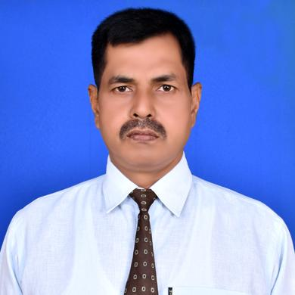
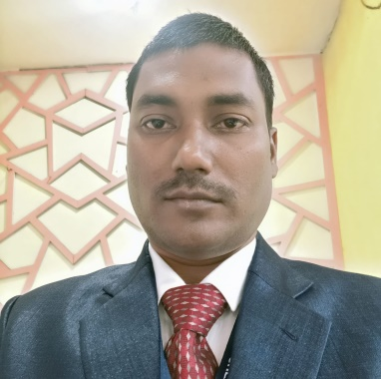
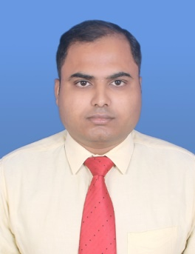
Core Team
Rakesh Kumar - Director
Over 18 years of industry experience with Operations and Project Management, Ability to handle various multi-location and huge sample size projects, Good experience with former company GFK-MODE & Kadence International.
Ashok Kumar – Head of Operations
With over 16 years experience in MR industry with operations and management, I believe it is one of the best industry in the world as one can learn in every field, great experience with former company IMRB and Kadence International.
@ Age should be less but experience should be more, I believe that the only way to gain experience is to work with experienced people.
@ There is no competition in the market if you do better work.
My Thoughts:
Vikas Kumar - Field Operations
Over 14 years of industry experience with Operations with IMRB, & KADENCE INTERNATIONAL,
Ability to handle various multi-location and huge sample size projects.

Slide 14















Our Clients

Slide 15

Our Presence
In INDIA
NORTH | EAST | WEST | SOUTH
New Delhi | Bihar (Patna –HQ ) | Maharashtra | Karnataka
Lucknow | Jharkhand | Nagpur | Bangalore
Varanasi | West Bengal | Madhya Pradesh | Telangana ( Hyderabad)
Kanpur | Odisha | Indore | Telangana ( Warangal)
 | Assam | Ahmadabad | Telangana ( All Districts)
 | Chhattisgarh | Jaipur | AP (Visakhapatnam)
 | Nagaland |  | AP (Vijayawada)
 |  |  | AP (All Districts)
 |  |  | Tamil Nadu
In NEPAL
Kathmandu | Pokhara | Biratnagar | Bharatpur

Slide 16

We would be happy to assist you in any way we can!
Regd. office
Patna, Bihar
Address: Bigrahpur, Main road, Indira Nagar road no -4,Patna-800001
Mob: +9204740755, 7654186872, PH: 06123592804
Mail us: info@avisresearch.in, rakesh@avisresearch.in, ashok@avisresearch.in

