Slide 1

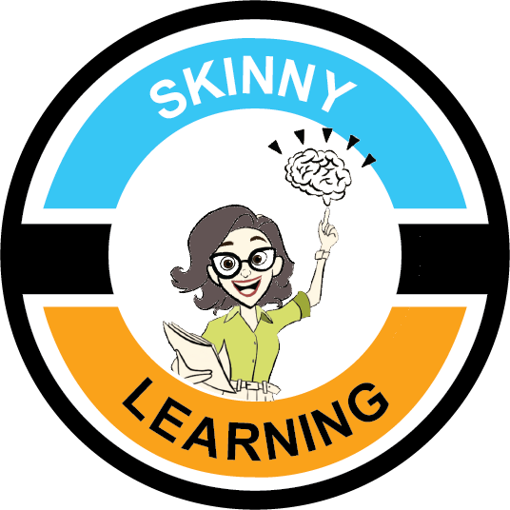
Notes:
Adding parenting image here
Dave

Slide 2
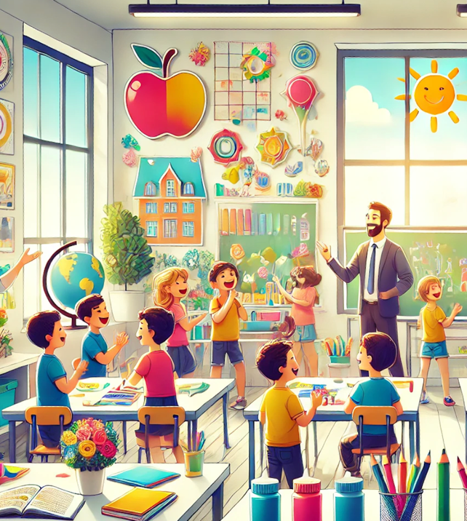

  Our mission is …
  Provide strategies to teachers & parents that boost JOY in teaching, parenting & learning.
Notes:
Teaching and home environment pictures
Dave
John will have the center line blurred.

Slide 3
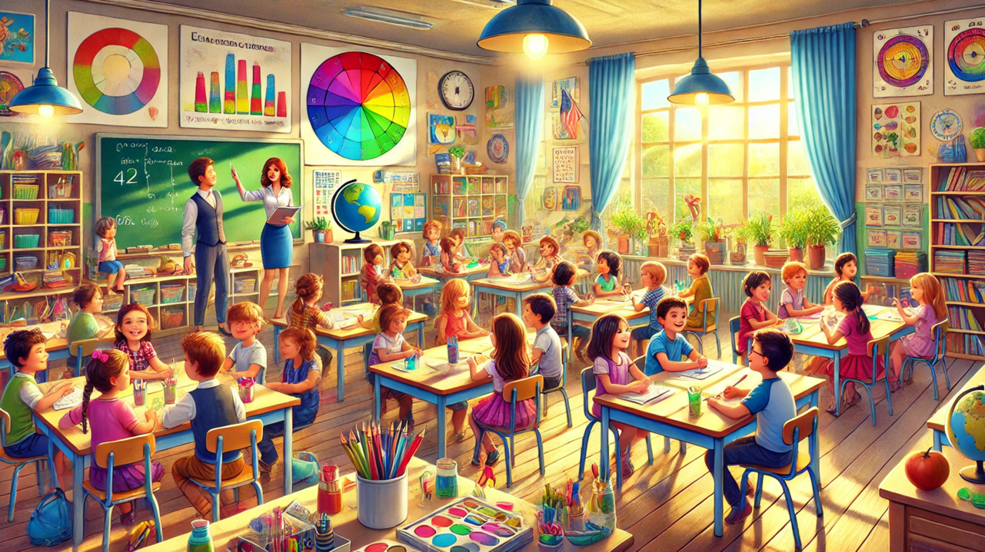
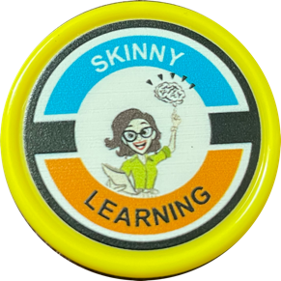
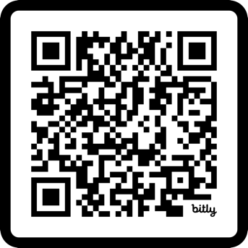
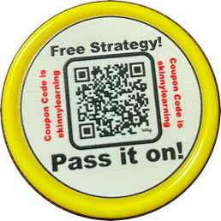
Booth # here
Notes:
Stop by our booth …
John

Slide 4

Notes:
John

Slide 5
Notes:
John

Slide 6
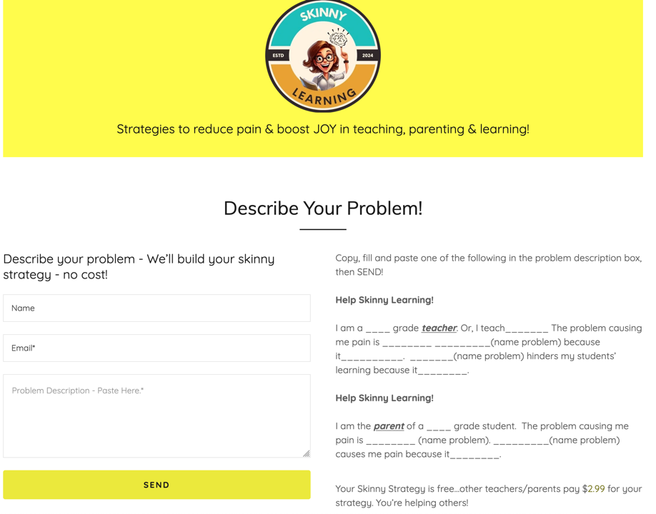
Notes:
Add $2.99 with firework as animation
John

Slide 7

Notes:
Hey Teachers! John and Dave from Skinny Learning.
Our mission at Skinny is to provide strategies to teachers and parents that boost JOY in teaching, parenting and learning.
Check Skinny Learning out at the URL and stop by booth #?. We’d love to talk with you and give you a token for a free strategy.
Now, two strategies that can help you skinny down your teaching inputs to your desired student learning outputs, while increasing your joy in teaching!
Here’s Strategy 1 - We call it “Scrape Off the Barnacles.”
When I was a kid, I spent a summer in Oregon, and watched the large barges and ships go up the Columbia River (photo needed).

Slide 8

Notes:
I wondered, where are they going and why? Later I learned, some of them were going to dry dock, and get the barnacles scraped off the bottom of their hulls (picture here). They had amassed so much tonnage of barnacles that they could no longer carry the freight they were designed to carry, nor carve through the water efficiently.

Slide 9

Notes:
In classrooms, on our learning ship, we can also collect barnacles over time…the objects in the classroom may increase, but our practices may also increase. These increases, increase your effort, and may impair student learning. For your sake and for students sake, we invite you to scrape off your classroom barnacles. Take your classroom into dry dock (picture of cluttered classroom and perhaps through the sides of a ship - AI) and remove the barnacles (picture of teacher feverishly cleaning out and throwing out) weighing you and your students down. But how? Here’s how!

Slide 10
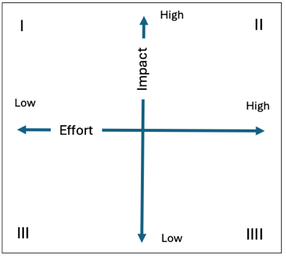
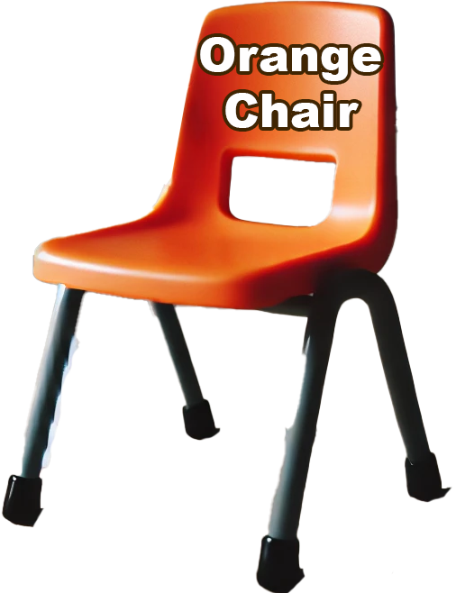
Classroom Items | Classroom Practices
1. Orange Chair | 11. Self-start
2. Desks | 12. Restroom use
3. Bookshelves | 13. Pencil sharpening
4. Kidney table | 14. Getting drink
5. Pencil sharpener | 15. Getting tissue
6. Wall charts | 16. Syllabus
7. White board | 17. Asking question
8. Pencil sharpener | 18. Commenting
9. Television | 19. Class discussion
10. iPad | 20.Turn and talk
Continue as needed… | Continue as needed…
?
Low Effort High Impact | High Effort High Impact
Low Effort Low Impact | High Effort Low Impact
X
X
Notes:
In the first column, using a blue pen, list all classroom objects and materials by number. (Build table and populate it…list a classroom couch first)
Next, using the “effort x impact quadrant” tool, think deeply about each object, and ask “what physical and emotional effort does this take to keep in my classroom? What impact does it have on what I am trying to accomplish as a teacher? Does it impair or obstruct me from achieving what I want?”
Now, take the number for that classroom item and place it in the appropriate quadrant using the blue pen. For example, with the orange chair, you may say, “It's easy to keep, but it's a bit of an emotional drain for me because it's stained beyond repair. That bugs me. Therefore, the effort to keep it is moderate, and the impact it has on what I’m trying to accomplish is minimal. (animate placement of number)

Slide 11
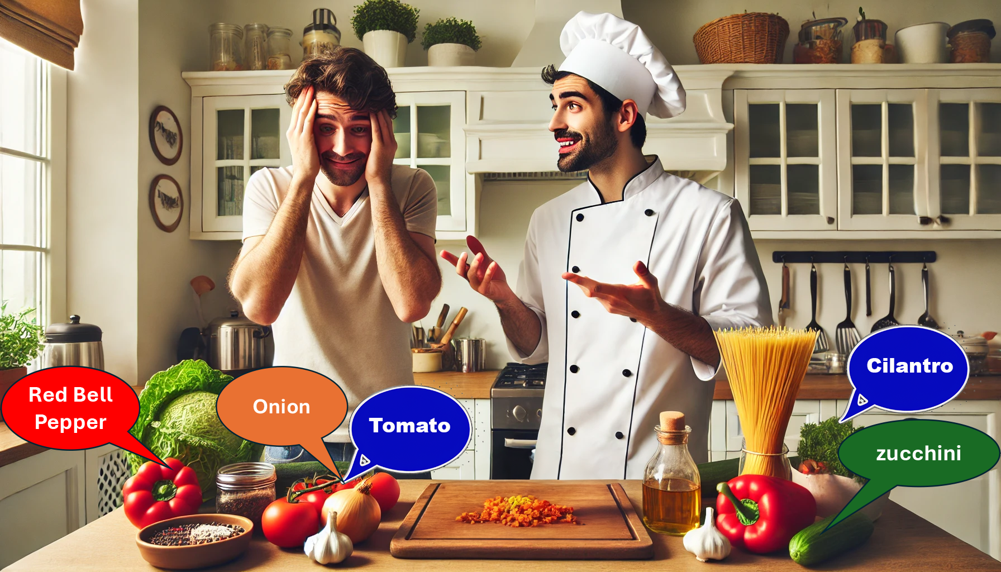
Low Effort High Impact | High Effort High Impact
Low Effort Low Impact | High Effort Low Impact
?
X
X
Notes:
I am going to teach you how to develop a strategy that are LE HI and HE HI.

Slide 12
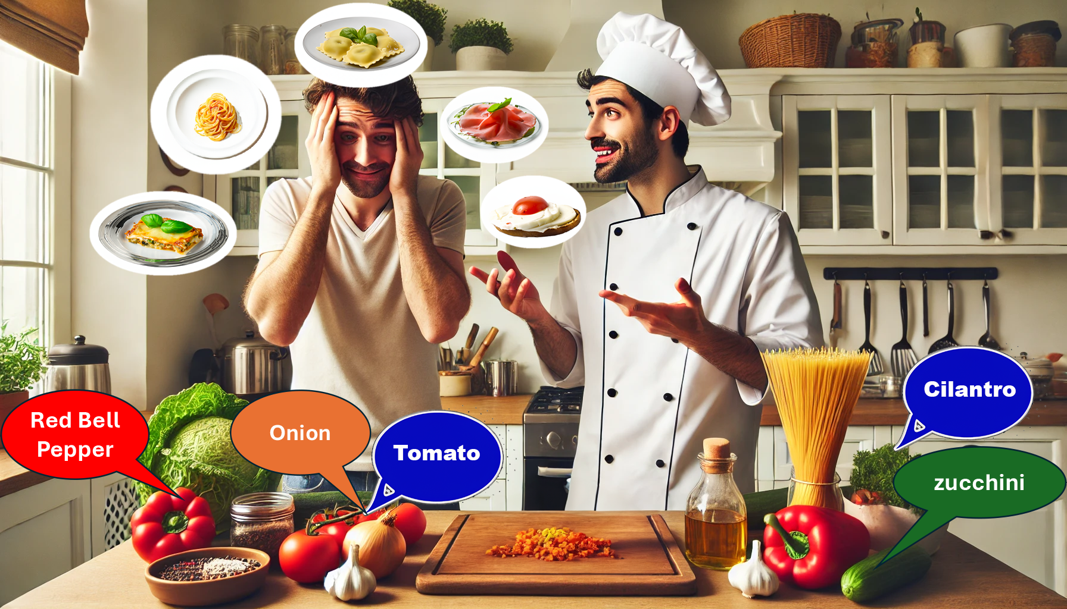

Slide 13


Slide 14

Learning Objective | Remember (Terms & Definitions) | Concept (Compare / Contrast) | Rules (Arrange Concepts) | Learning Activity
Students will read and write a word with a consonant blend. | Define consonant letters. | Contrast a single-letter consonant and a two-letter consonant. | Distinguish the sounds of single-letter and two-letter consonants. | Teach consonants and vowels. Demonstrate how to combine alphabet blocks together to create single-letter and two-letter consonant sounds and have a small group of students follow your demonstration. Each student in the small group combines a single-letter and a two-letter consonant and sounds them out to the group. Now, individual students take turns.
 | Define vowel letters.
 | Sound out consonant and vowel letters. | Sound out a single-letter consonant and a two-letter consonant.
Notes:
Rule: Use the sounds of single-letter and two-letter consonants when writing them.

Slide 15
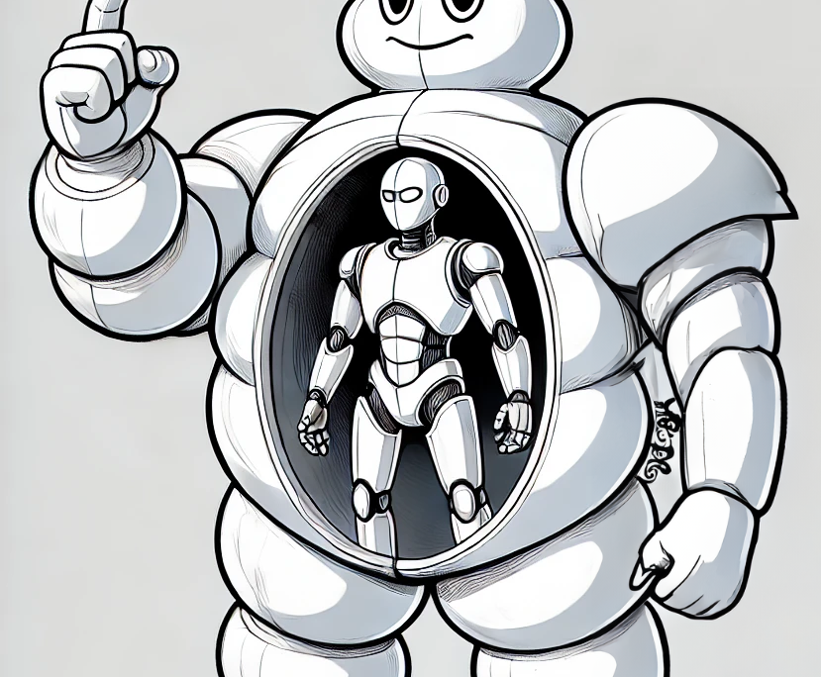

“Inside every bloated, oversized learning strategy is a skinny strategy screaming to get out!”

Slide 16
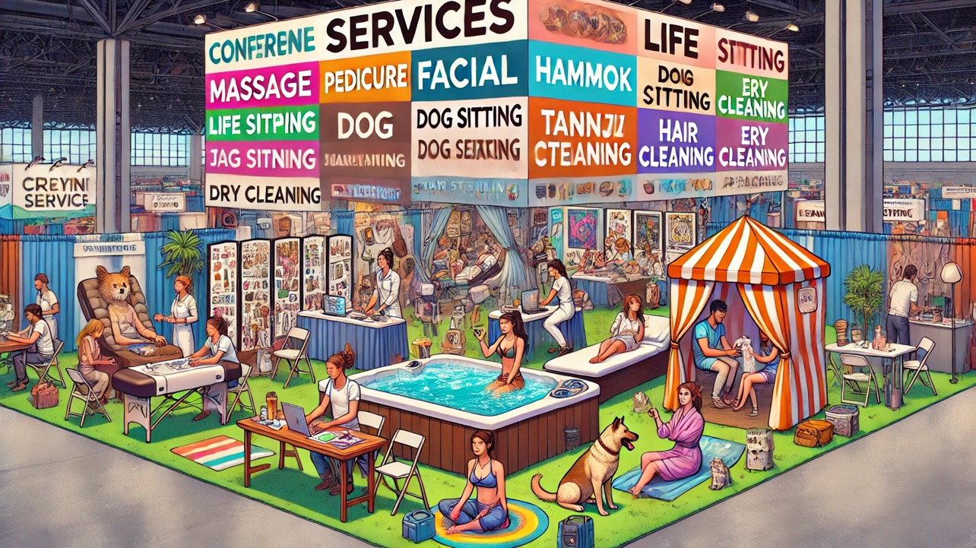
Booth
#

Slide 17
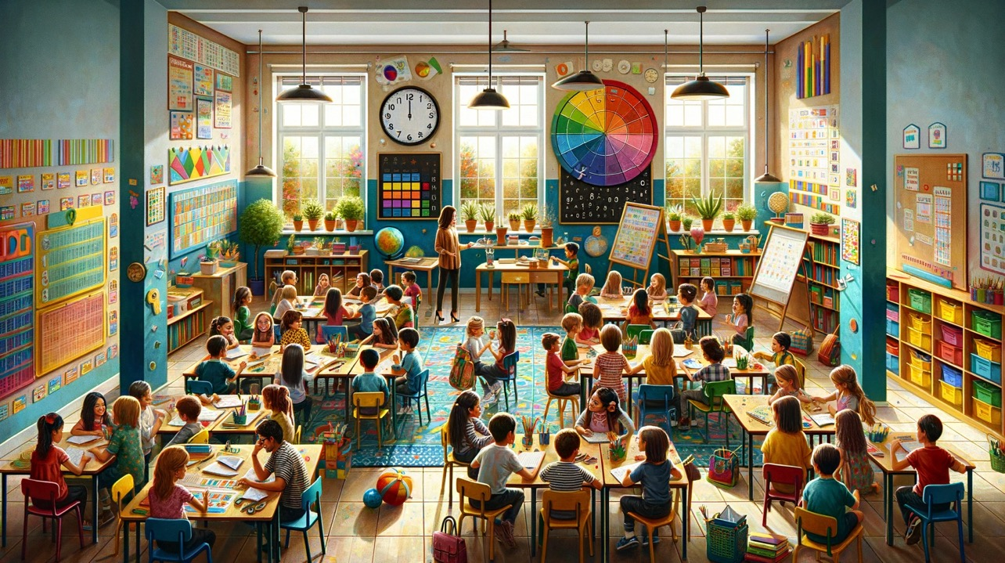
Objects/Materials | Q | Practices
High Effort High Impact | Low Effort High Impact
High Effort Low Impact | Low Effort Low Impact
High Effort High Impact | Low Effort High Impact
High Effort Low Impact | Low Effort Low Impact

Slide 18
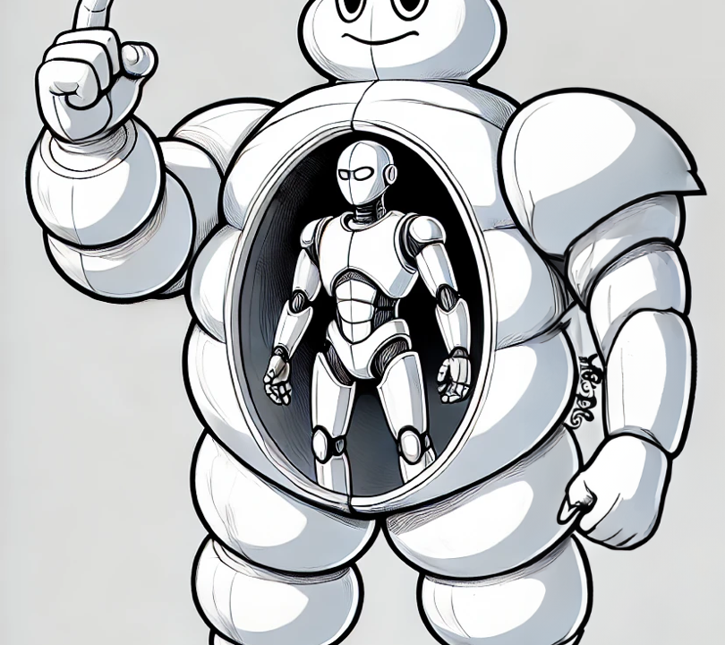
“Inside every bloated, oversized learning strategy is a skinny strategy screaming to get out!”
Notes:
“Inside every bloated, oversized learning strategy is a skinny strategy screaming to get out!”
Image of fat thing with skinny inside

