Slide 1


College Viability
2024 TOP / bottom
Private College Reports:
AZ, CO, OR, WA,
^{TOP} & _{bottom} Comparisons
IPEDS reports on: FTE enrollment,Tuition and Fee Revenue (2015-2022), Endowment, 4-year graduation rate (undergrads), & retention rates
Data source: National Center for Education Statistics, IPEDS data base
2015-2022
Dr. Gary Stocker

Slide 2
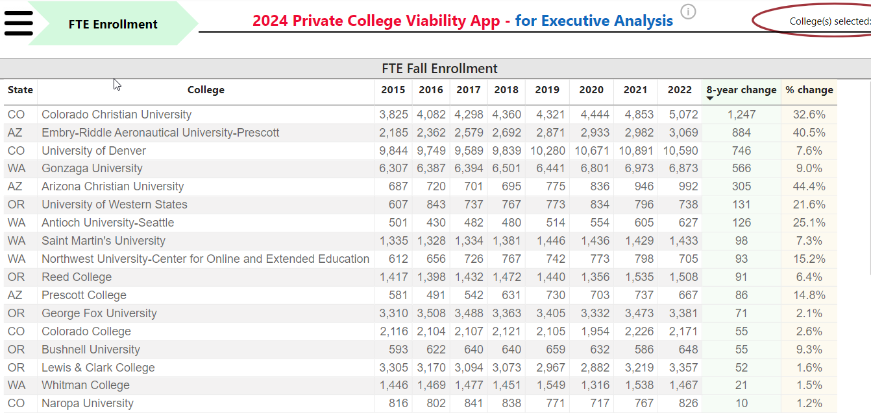
AZ, CO, OR, WA, Private College Top / bottom Reports
Top
Top

Slide 3
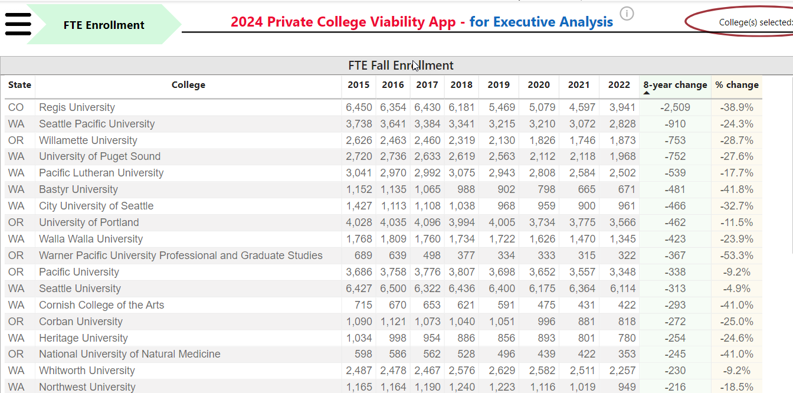
AZ, CO, OR, WA, Private College Top / bottom Reports
Bottom
Bottom

Slide 4
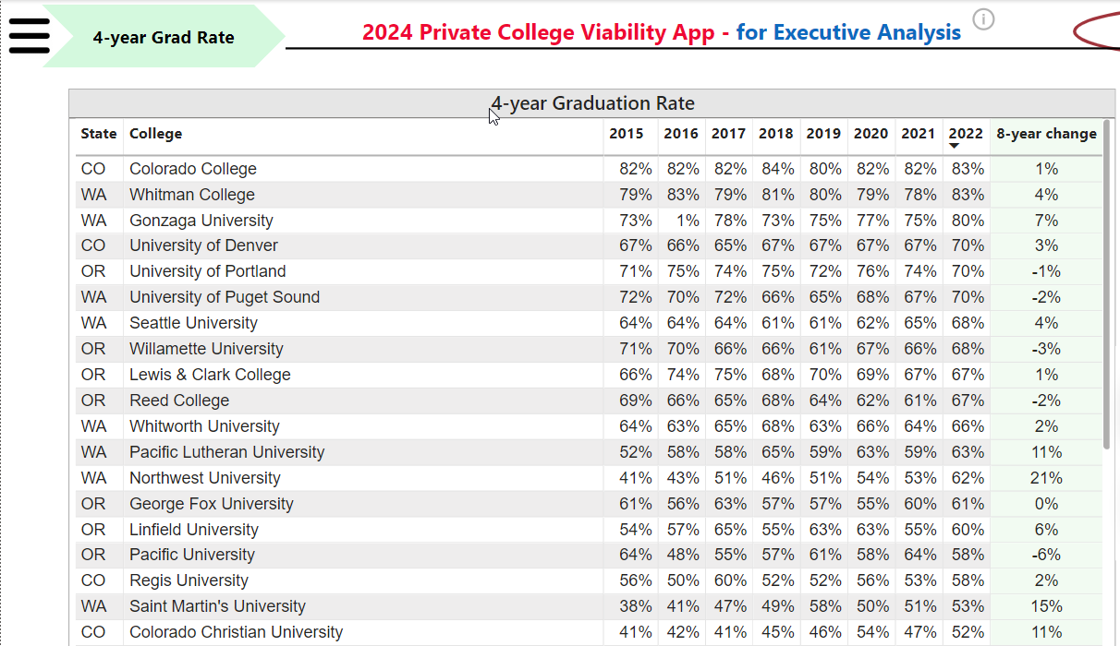
AZ, CO, OR, WA, Private College Top / bottom Reports
Top
Top

Slide 5
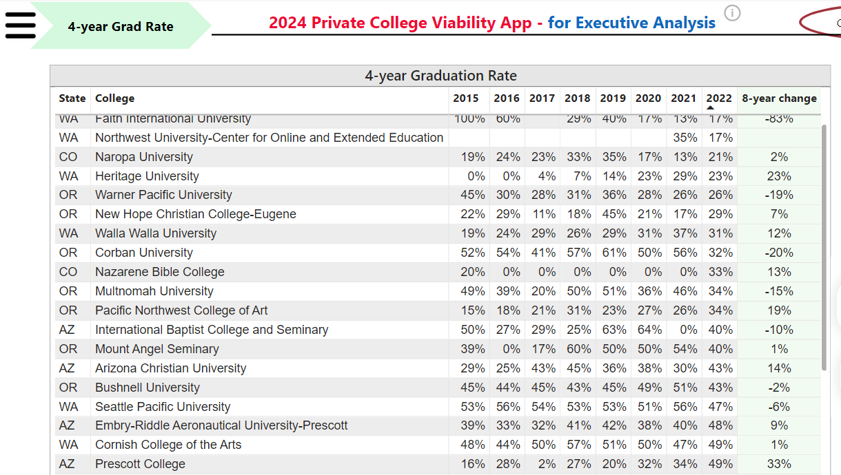

AZ, CO, OR, WA, Private College Top / bottom Reports
Bottom
Bottom

Slide 6
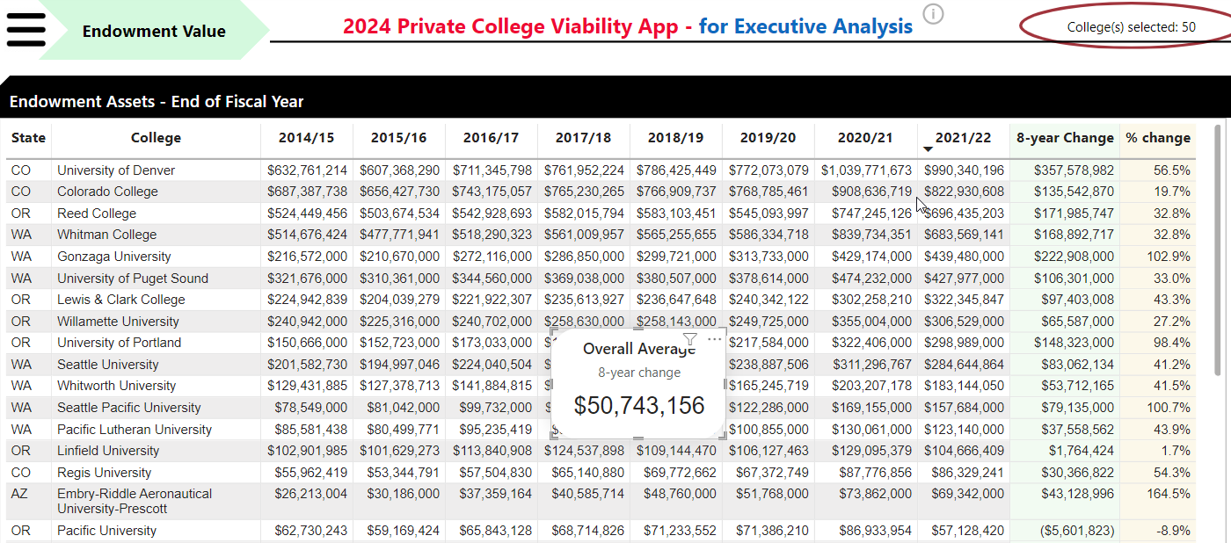
AZ, CO, OR, WA, Private College Top / bottom Reports
Top
Top

Slide 7
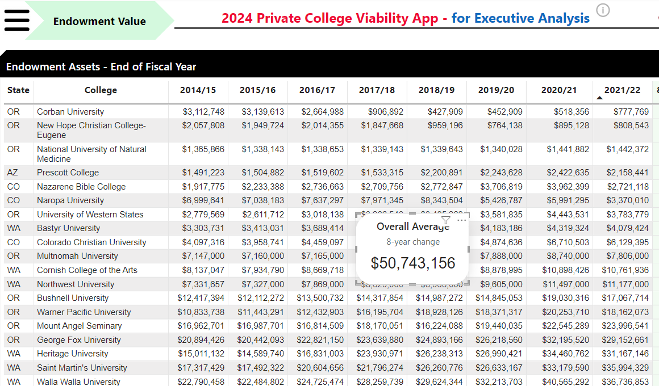
AZ, CO, OR, WA, Private College Top / bottom Reports
Bottom
Bottom

Slide 8
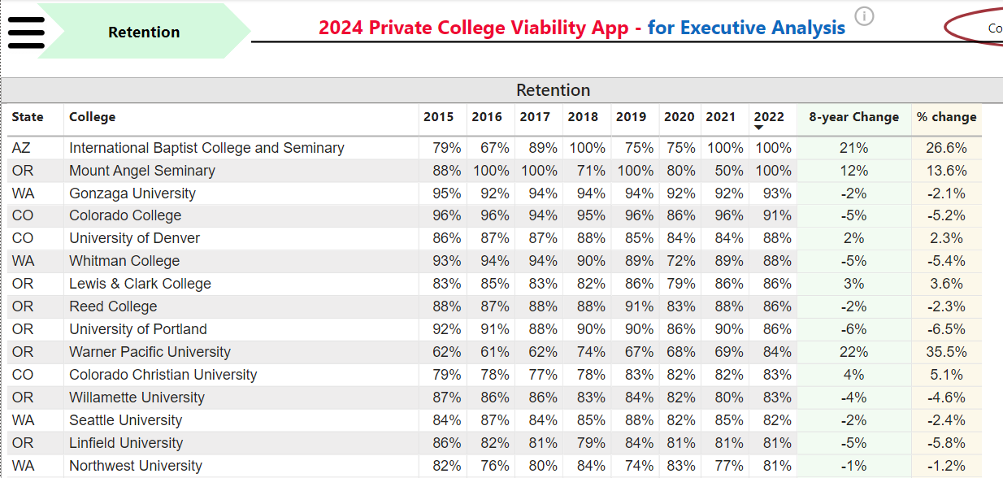
AZ, CO, OR, WA, Private College Top / bottom Reports
Top
Top

Slide 9
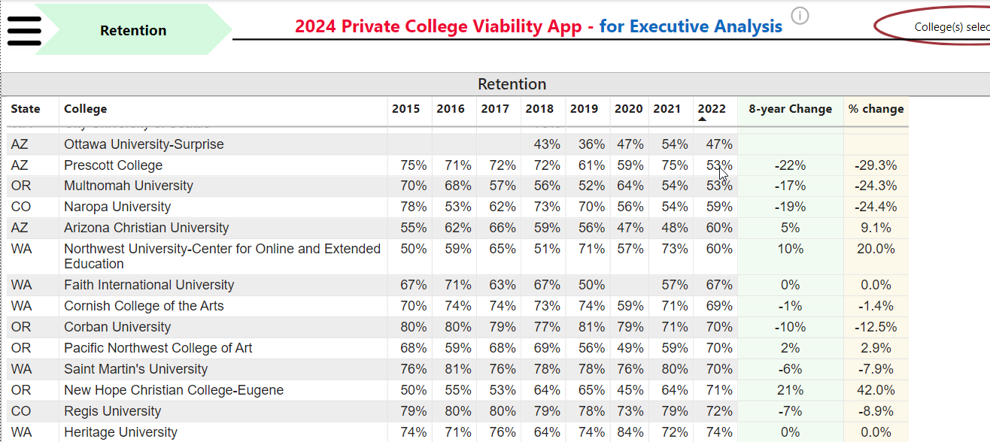
AZ, CO, OR, WA, Private College Top / bottom Reports
Bottom
Bottom

Slide 10
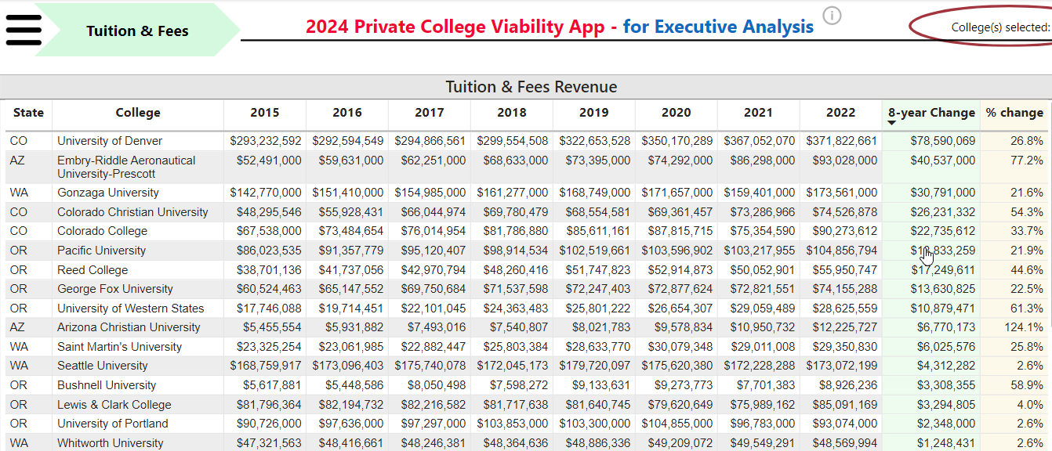
AZ, CO, OR, WA, Private College Top / bottom Reports
Top
Top

Slide 11
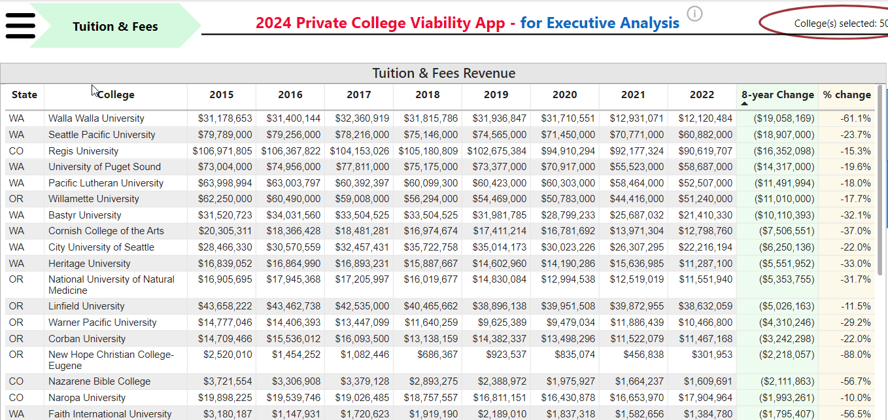
AZ, CO, OR, WA, Private College Top / bottom Reports
Bottom
Bottom

Slide 12
2024 College Viability Apps
Private College Versions
  Public College Versions (2 & 4 year)
Colleges Reported: 1,297
Executive Analysis version
  32 reports
Faculty and Staff version
  8 reports
Student & Family version
  5 reports
Colleges Reported: 1,579
Executive Analysis version
  35 reports
Faculty and Staff version
  10 reports
Student & Family version
  6 reports

Slide 13
What can you do with these data comparisons?
There are 50 private 4-year colleges in AZ, CO, OR, and WA. I posted Top & bottom across3 comparison reports. The 2024 Private College Viability App – Executive Analysis version of the will let you compare more than 30 reports.
As a student or parent, focus on these stronger private colleges. Those colleges that are consistently in the bottom list should be considered only with aggressive questioning. ‘Let the buyer beware’ in those situations. Bad history = Bad future.
gary@collegeviability.com
3 versions of the 2024 Private College Viability apps
  Executive Analysis version
  Faculty & Staff version
  Student & Families version
Notes:
Why did the enrollment decrease so much? Why is your endowment so low? What have you done to improve your graduation rates?

Slide 14
Ohio 4-Year Public Colleges
Bottom
Bottom

