Slide 1
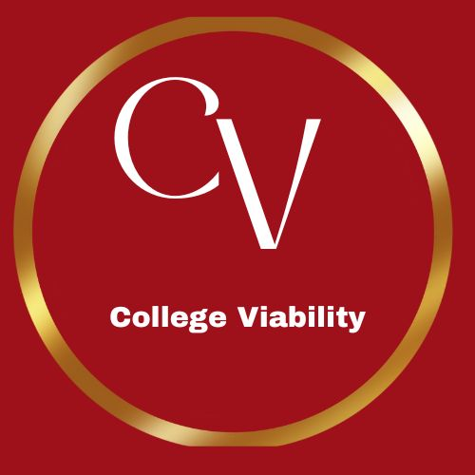
College Viability 2024 TOP / bottom Private College Reports: North Carolina & South Carolina
^{TOP} & _{bottom} Comparisons
IPEDS reports on: FTE enrollment,Tuition and Fee Revenue (2015-2022), Endowment, 4-year graduation rate (undergrads), & retention rates
Data source: National Center for Education Statistics, IPEDS data base
2015-2022
Dr. Gary Stocker

Slide 2
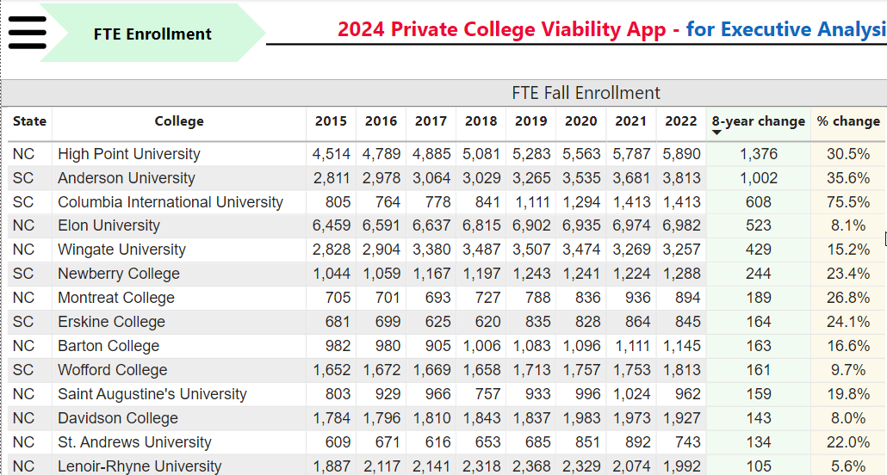
North Carolina and South Carolina Private College Top / bottom Reports
Top
Top

Slide 3
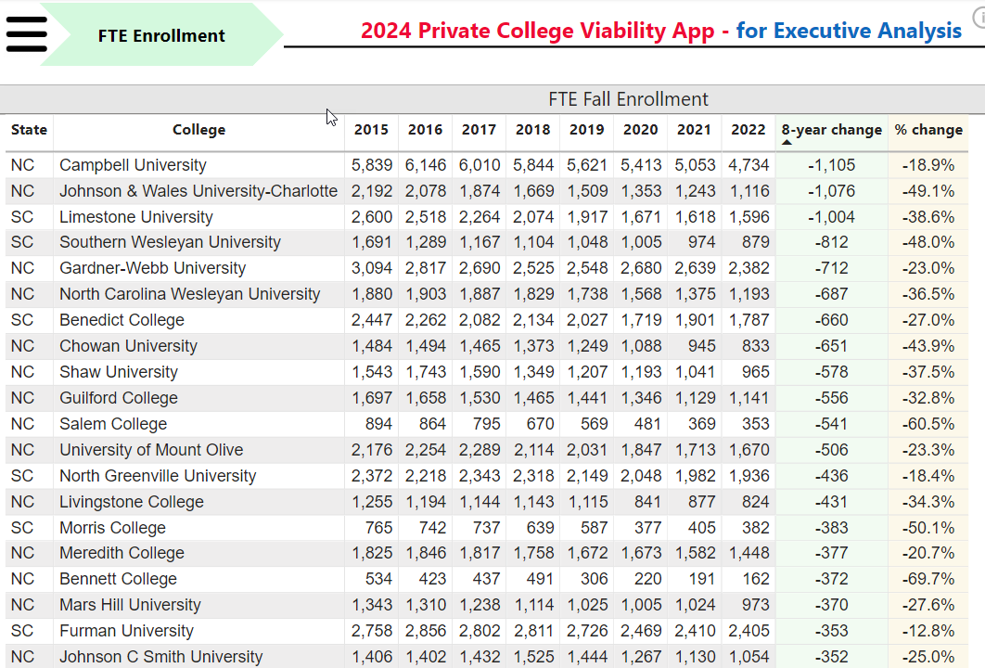
North Carolina and South Carolina Private College Top / bottom Reports
Bottom
Bottom

Slide 4
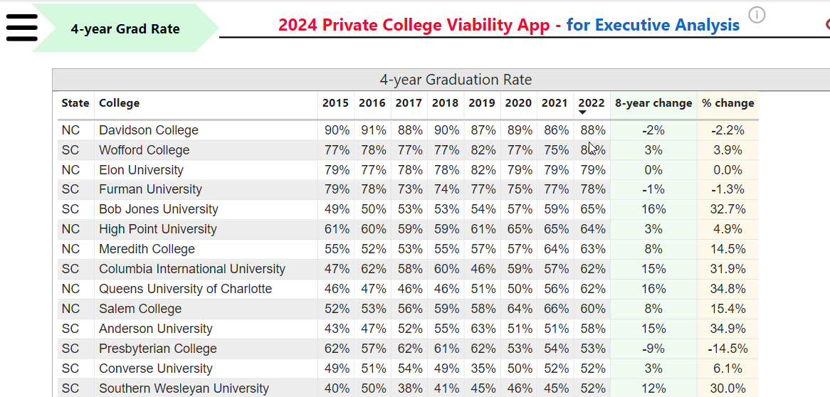
North Carolina and South Carolina Private College Top / bottom Reports
Top
Top

Slide 5
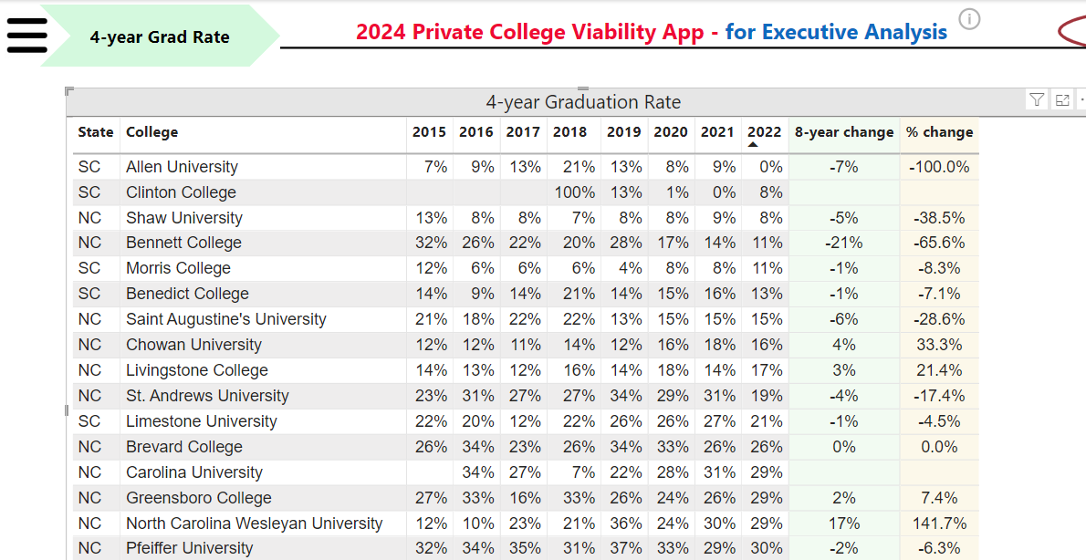
North Carolina and South Carolina Private College Top / bottom Reports
Bottom
Bottom

Slide 6
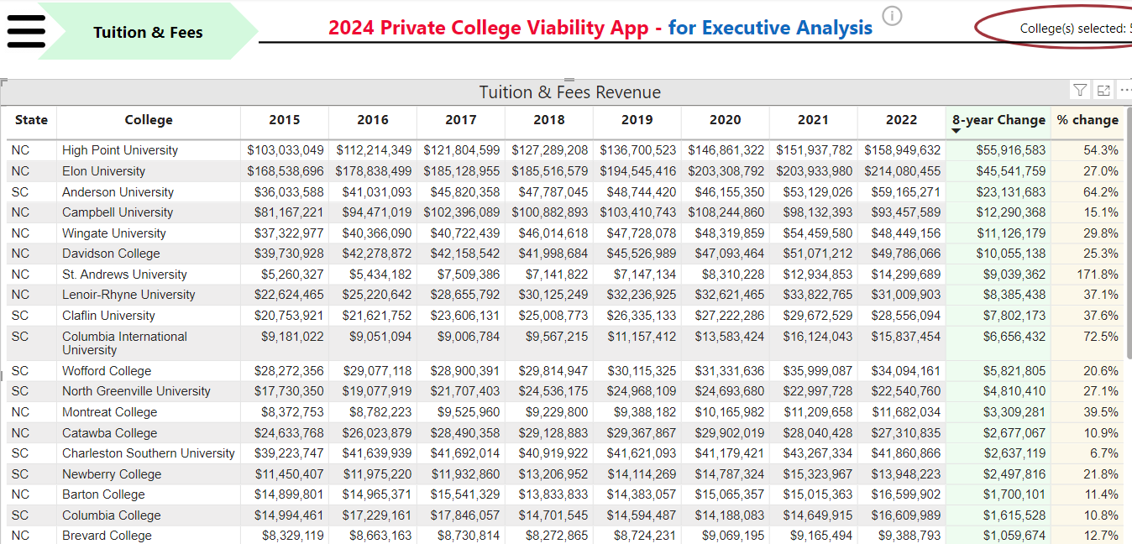
North Carolina and South Carolina Private College Top / bottom Reports
Top
Top

Slide 7
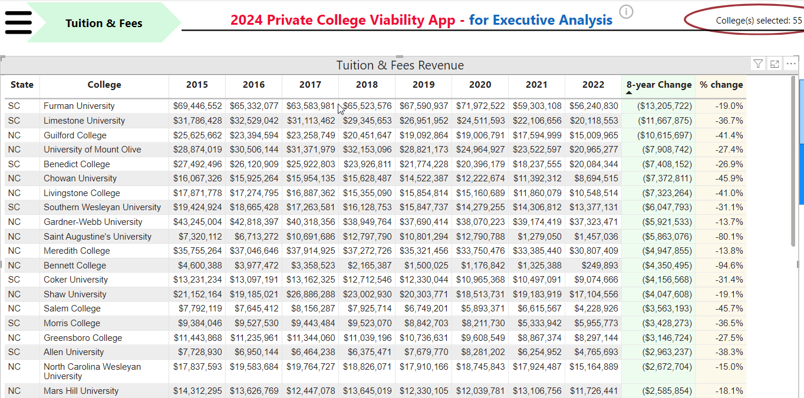
North Carolina and South Carolina Private College Top / bottom Reports
Bottom
Bottom

Slide 8
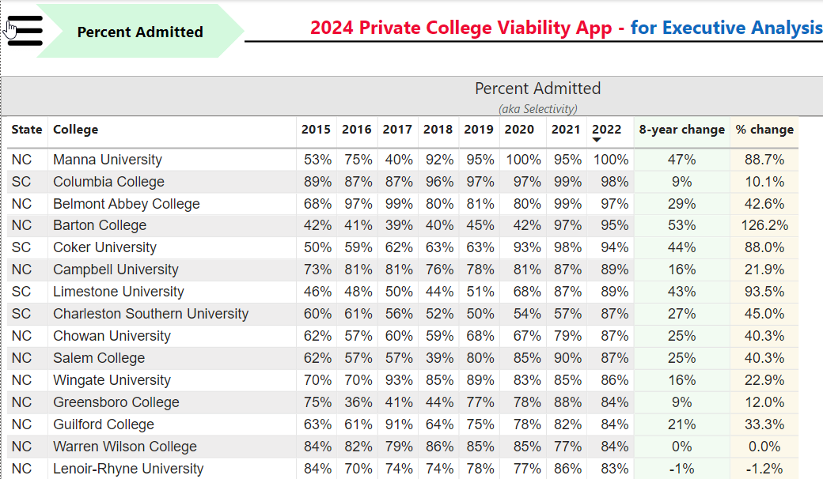
North Carolina and South Carolina Private College Top / bottom Reports
Top
Top

Slide 9
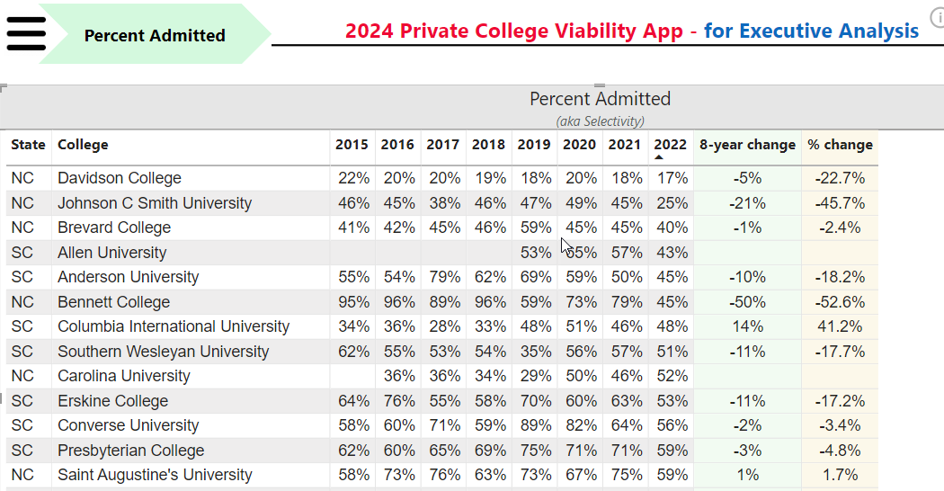
North Carolina and South Carolina Private College Top / bottom Reports
Bottom
Bottom

Slide 10
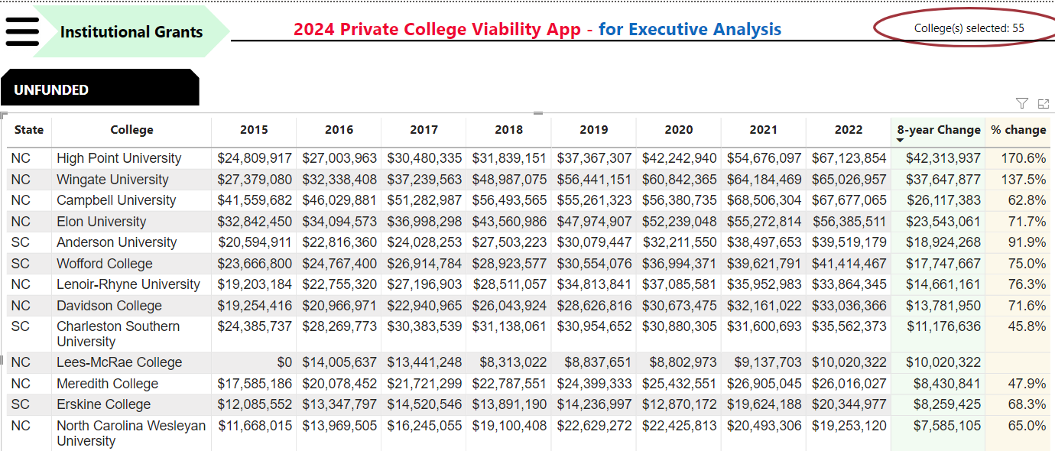
North Carolina and South Carolina Private College Top / bottom Reports
Top
Top

Slide 11
North Carolina and South Carolina Private College Top / bottom Reports
Bottom
Bottom

Slide 12
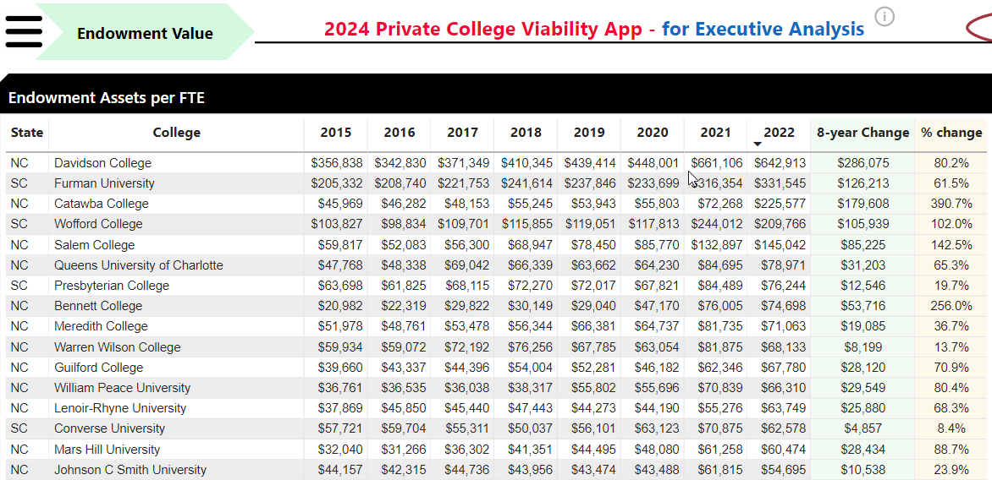
North Carolina and South Carolina Private College Top / bottom Reports
Top
Top

Slide 13
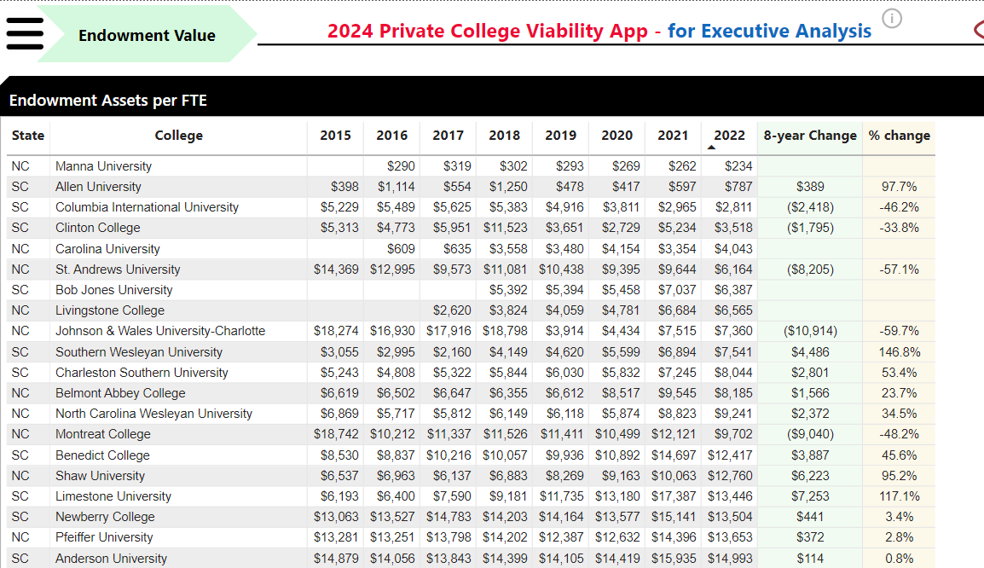
North Carolina and South Carolina Private College Top / bottom Reports
Bottom
Bottom

Slide 14
2024 College Viability Apps
Private College Versions
Public College Versions (2 & 4 year)
Colleges Reported: 1,297
Executive Analysis version
32 reports
Faculty and Staff version
8 reports
Student & Family version
5 reports
Colleges Reported: 1,579
Executive Analysis version
35 reports
Faculty and Staff version
10 reports
Student & Family version
6 reports

Slide 15
What can you do with these data comparisons?
There are 55 private, regional 4-year colleges in North Carolina and South Carolina. I posted Top & bottom across3 comparison reports. The 2024 Private College Viability App – Executive Analysis version of the will let you compare more than 30 reports.
As a student or parent, focus on these stronger private colleges. Those colleges that are consistently in the bottom list should be considered only with aggressive questioning. ‘Let the buyer beware’ in those situations. Bad history = Bad future.
gary@collegeviability.com
3 versions of the 2024 Private College Viability apps
Executive Analysis version
Faculty & Staff version
Student & Families version
Notes:
Why did the enrollment decrease so much? Why is your endowment so low? What have you done to improve your graduation rates?

