Slide 1
College Viability 2024 TOP / bottom Private College Reports: MI, MN, WI
^{TOP} & _{bottom}
Program Completion Comparisons
IPEDS reports on: bachelor and masters program completions from 2020-2022
Data source: National Center for Education Statistics, IPEDS data base
Dr. Gary Stocker

Slide 2
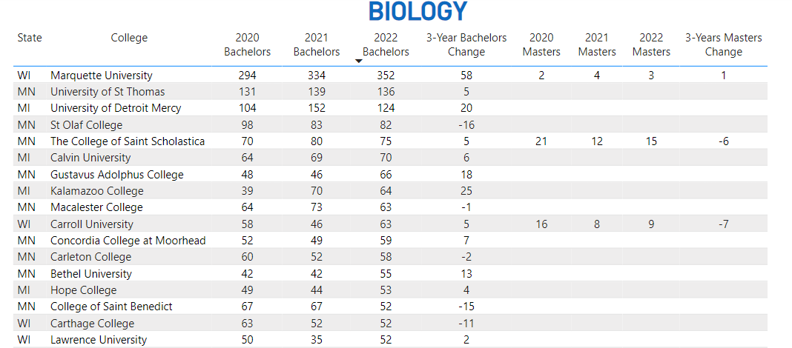
MI, MN, WI Private College Program Completion Top / bottom Reports
Top
Top

Slide 3
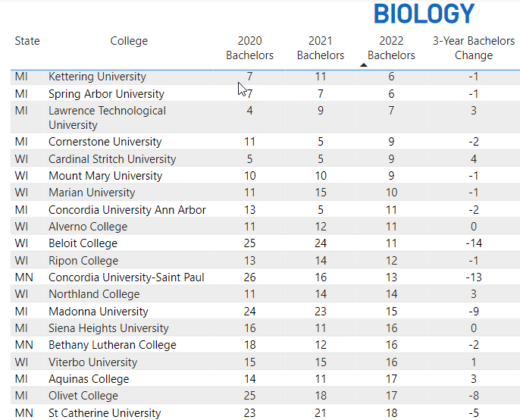
MI, MN, WI Private College Program Completion Top / bottom Reports
Bottom
Bottom

Slide 4
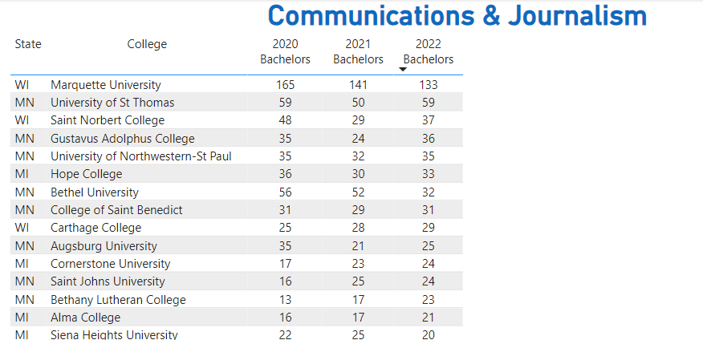
MI, MN, WI Private College Program Completion Top / bottom Reports
Top
Top

Slide 5
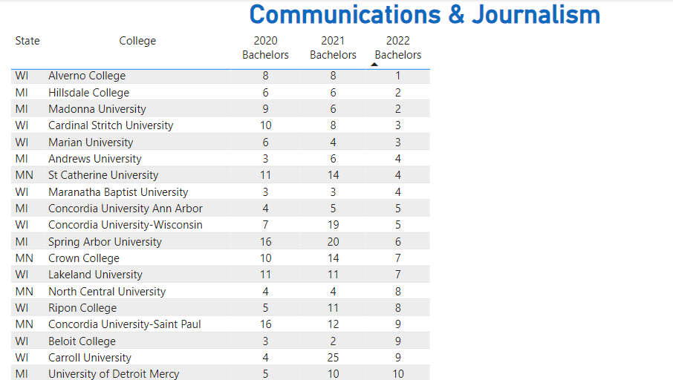
MI, MN, WI Private College Program Completion Top / bottom Reports
Bottom
Bottom

Slide 6
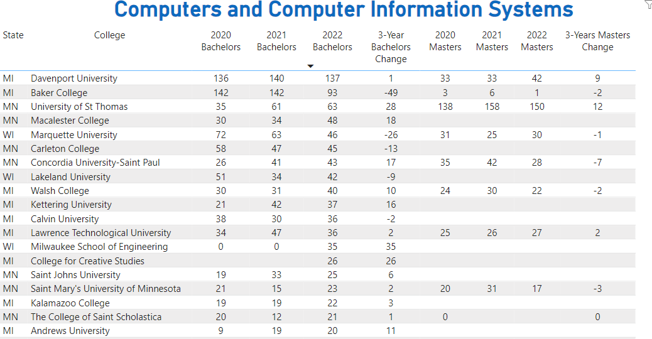
MI, MN, WI Private College Program Completion Top / bottom Reports
Top
Top

Slide 7
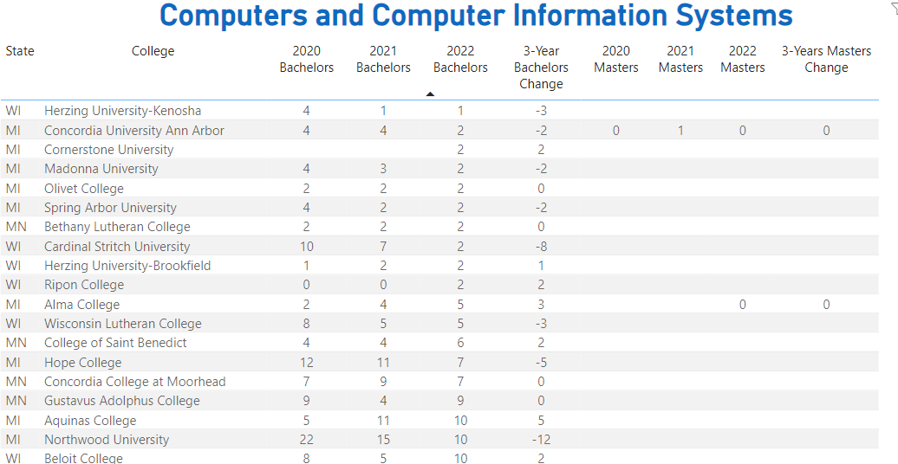
MI, MN, WI Private College Program Completion Top / bottom Reports
Bottom
Bottom

Slide 8
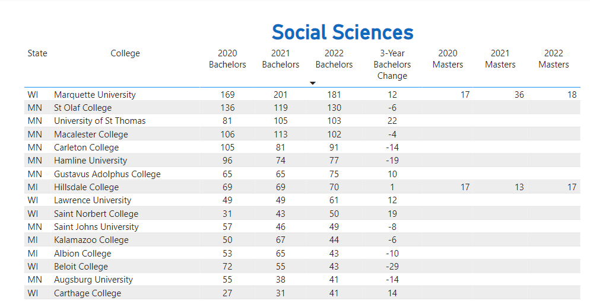
MI, MN, WI Private College Program Completion Top / bottom Reports
Top
Top

Slide 9
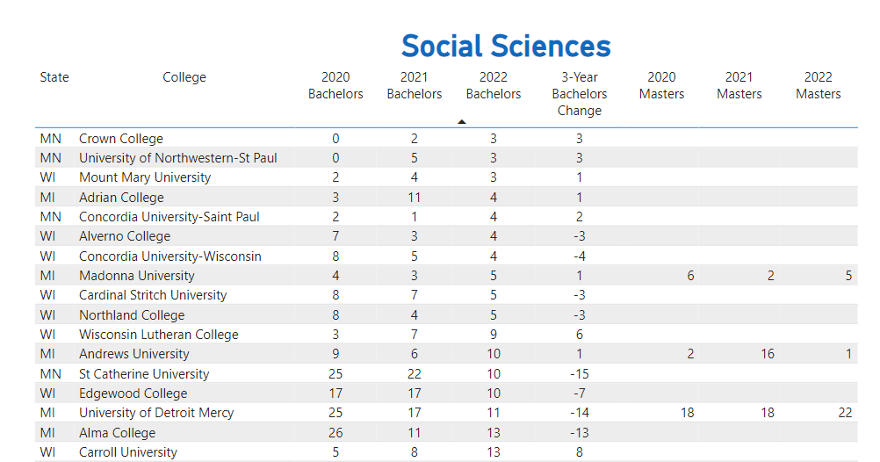
MI, MN, WI Private College Program Completion Top / bottom Reports
Bottom
Bottom

Slide 10
2024 College Viability Apps
Private College Versions
Public College Versions (2 & 4 year)
Colleges Reported: 1,297
Executive Analysis version
32 reports
Faculty and Staff version
8 reports
Student & Family version
5 reports
Colleges Reported: 1,579
Executive Analysis version
35 reports
Faculty and Staff version
10 reports
Student & Family version
6 reports

Slide 11
What can you do with these data comparisons?
As a student or parent, focus on these stronger private colleges. Those colleges that are consistently in the bottom list should be considered only with aggressive questioning. ‘Let the buyer beware’ in those situations. Bad history = Bad future.
gary@collegeviability.com
3 versions of the 2024 Private College Viability apps
Executive Analysis version
Faculty & Staff version
Student & Families version
Notes:
Why did the enrollment decrease so much? Why is your endowment so low? What have you done to improve your graduation rates?

